Slide 1
CS 61C: Great Ideas in Computer Architecture
Special Topics:
Biological Computing
Instructor: Justin Hsia

Slide 2
BONUS
MATERIAL
You are NOT responsible for the material contained in this lecture.
This is just a bonus lecture trying to relate some of the topics covered in this class with the emerging research fields at the intersection of computer science and engineering and biology.
ENJOY!

Slide 3
Disclaimer
I am not a biologist
The information presented here is by no means entirely accurate or up-to-date
There is much I haven’t researched myself
Vast bodies of literature available
I am brushing a lot of details under the rug to make these topics easily accessible and relatable to the topics of basic computer architecture

Slide 4
Agenda
Motivation
Basics of Genetics
Biological Components
Challenges

Slide 5
Biology: What is it good for?
“Biology is a natural science concerned with the study of life and living organisms, including their structure, function, growth, origin, evolution, distribution, and taxonomy.”
Biology is a massive field
Much of it is still so poorly understood
Covers stuff as large as planetary ecosystems to stuff as small as parts of a cell/microbe

Slide 6
Biology: What is it good for?
Interesting biological phenomena:
Robustness to errors
Evolution/adaptation
“Renewability” (reproduction)
Massive amount of pre-existing machinery
There’s no reason we can’t figure out a way to use it!
Maybe other currently unknown benefits
“Won’t know until you try” mindset

Slide 7
Terminology
Computational Biology
Synthetic Biology
Genetic Engineering
Biological Computing

Slide 8
Computational Biology
“Computational biology involves the development and application of data-analytical and theoretical methods, mathematical modeling and computational simulation techniques to the study of biological, behavioral, and social systems.”
Modeling of systems (e.g. predator-prey, genetic circuits)
Processing of data (e.g. genome sequencing)
The Human Genome Project

Slide 9
Synthetic Biology
“The [genetic] engineering of biology: the synthesis of complex, biologically-based systems, which display functions that do not exist in nature.”
Rational, systematic design (e.g. parts library, modeling and simulation, predictable behaviors)
Test hypotheses (e.g. synthetic oscillators to understand circadian rhythm)
Generate useful behaviors (e.g. biofuels, oil-eating bacteria, protein tagging)

Slide 10
Biological Computing
“A form of computing which uses DNA, biochemistry and molecular biology, instead of the traditional silicon-based computer technologies”
Can compute certain specialized problems
Solution to Hamiltonian path problem [Adelman, 1994]
Evaluating Boolean circuits [Ogihara, 1999]
Strassen’s matrix multiplication algorithm [Nayebi, 2009]
http://en.wikipedia.org/wiki/DNA_computing

Slide 11
Agenda
Motivation
Basics of Genetics
Biological Components
Challenges

Slide 12
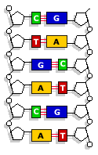
Genes: Building Blocks of Life
Genetic information stored in DNA
Normally in double-stranded helix
4 nucleotides (bases): A, C, G, T
Bind in pairs (A-T, C-G)
U replaces T in mRNA
Genes → Organisms
3 nucleotides code one amino acid (21 in humans)
A chain of amino acids (~100-1000) form a protein
Proteins interact in complicated ways to form cells, tissues, organs, etc.

Slide 13
Protein Biosynthesis
This is the focus of DNA computing
Multistep process:
RNA polymerase transcribes DNA into RNA
Starts at “start codon” (usually AUG)
Ribosomes translate mRNA
Put together as an amino acid sequence by tRNA
Stops at “stop codon” (UAA/UAG/UGA)
Protein folds before proper function begins
Proteins can affect translation and transcription (feedback!)

Slide 14
Protein Design
Protein behavior is extremely difficult to predict
Complex interactions involving potential energies, hydrophobicity, folding, etc.
How many possible “proteins” are 100 amino acids in length?
A ton of research is dedicated to this
Not our area – let’s just use known proteins others have discovered/characterized

Slide 15
Biology and Gaming
Foldit
Protein design and structure prediction
EteRNA
Design RNAs, actually gets synthesized

Slide 16
Agenda
Motivation
Basics of Genetics
Biological Components
Challenges

Slide 17
Basic Components
What are the basic elements of computers?
Transistors (switches)
Clock (oscillator)
Wires
Are there biological equivalents?

Slide 18
Schematic Basics
An arrow ( ) means A “activates” or “promotes” production of B
A line ( ) means A “represses” or “inhibits” production of B
Molecules generally shown as circles
Both mRNA and protein
A promoter indicated with bent arrow
A gene is indicated with a box

Slide 19
Promoters
Schematic:
Proteins bind to operator sites, can activate or inhibit production
Generates mRNA, which later gets translated into protein (sometimes mRNA not shown)
operator sites
terminator
promoter

Slide 20
Toggle Switches
From [Gardner, 2000]:
Two different genes that repress each other generate two possible states (one gene “wins”)
Property called bistability
Addition of inducers allows switching of states

Slide 21
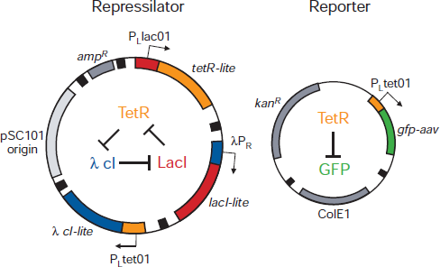
Oscillators (1/2)
Ring oscillator from [Elowitz, 2000]:
Called the “repressilator” – an odd # of repressors in a ring

Slide 22
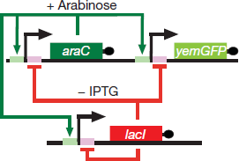
Oscillators (2/2)
Relaxation oscillator from [Stricker, 2008]:
Works based on “time delay” of negative feedback loop
Has been shown to be more robust and faster than repressilator

Slide 23
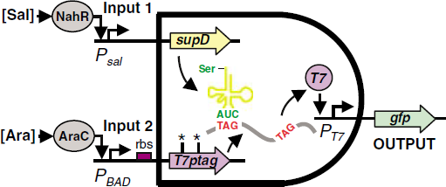
Logic Gates
Try it! Construct theoretical logic gates using promoter schematics
AND, OR, XOR?
Real implementations involve more complex biological components (from [Anderson, 2007]):

Slide 24
Biological Computers
Great, so we have all of the components we need to build a computer, right?
A really long list of issues/problems prevent us from building complex biological circuits currently
We’ll briefly mention a few of them here

Slide 25
Agenda
Motivation
Basics of Genetics
Biological Components
Challenges

Slide 26
Wires?
No exact equivalent!
Molecules are either in the cytoplasm (inside a cell) or in the extracellular space
There are limited forms of “active transport,” but not commonly used… yet?
Molecules generally move around in random fashion
Most systems contained within a single cell, so can potentially interact with anything within that cell

Slide 27
Wires?
Need orthogonal communication “channels”
Use a bunch of different molecules that don’t interact
Find ways to connect completely different mechanisms
Other clever ideas:
Fix locations of cells, use space as “wires” [citation needed]

Slide 28
Parameter Values
So far we’ve just assumed that all the schematics shown magically work
Usually very small portion of parameter space “works”
Lots of parameters in a biological system
Un/binding rates, degradation rates, translation/transcription rates, leakage rates, etc.
Parameter values usually very “fuzzy” and difficult to manipulate

Slide 29
Stochasticity
A measure of randomness at pretty much every step of the process
“Random walk” for diffusion
“Bursting” in molecule production & binding
Even in debugging
DNA sequencing
Protein fluorescence measurements

Slide 30
More Complicated Circuits
Pattern formation:
Turing patterning [Hsia, 2012]
Lateral inhibition [Collier, 1996]
Bio-electronic interfacing
Cyborg beetles
Potential differences to generate electrical signals
Any of the biological computing circuits mentioned before

Slide 31
References (1/2)
Adleman, LM (1994). "Molecular computation of solutions to combinatorial problems". Science 266 (5187): 1021–1024.
Collier, JR et. al. (1996). “Pattern Formation by Lateral Inhibition with Feedback: a Mathematical Model of Delta-Notch Intercellular Signalling.” J. theor. Biol. 183, 429-446.
Elowitz, MB & Leibler, S (2000). “A synthetic oscillatory network of transcriptional regulators.” Nature 403, 335-338.
Gardner, TS, Cantor, CR, & Collins, JJ (2000). "Construction of a genetic toggle switch in Escherichia coli." Nature 403, 339-342.
Hsia, J et. al. (2012). “A Feedback Quenched Oscillator Produces Turing Patterning with One Diffuser.” PLoS Comput Biol 8(1): e1002331. doi:10.1371/journal.pcbi.1002331
Lewin, DI (2002), "DNA computing." Computing in Science & Engineering , vol.4, no.3, pp.5-8.
Ogihara, M & Ray, A "Simulating Boolean circuits on a DNA computer.” Algorithmica, 25:239–250, 1999.

Slide 32
References (2/2)
Nayebi, A (2009). "Fast matrix multiplication techniques based on the Adleman-Lipton model".
Stricker, J, et. al. (2008). “A fast, robust and tunable synthetic genetic oscillator.” Nature 456, 516-519.

Slide 33
Get To Know Your Instructor

