Slide 1
CS 61C: Great Ideas in Computer Architecture
Amdahl’s Law,
Thread Level Parallelism
Instructor: Justin Hsia

Slide 2
1st Half in Review
Write bigger, talk slower
Students afraid/too lost to respond
Don’t be afraid/ashamed of being lost/wrong
Peer instruction grading
Answers will be added to slides after lecture
2nd half material is “clean slate”
Found copied code! Will be dealt with at end.
Don’t dig yourself into a deeper hole…

Slide 3
Review of Last Lecture
Flynn Taxonomy of Parallel Architectures
SIMD: Single Instruction Multiple Data
MIMD: Multiple Instruction Multiple Data
Intel SSE SIMD Instructions
One instruction fetch that operates on multiple operands simultaneously
128/64 bit XMM registers
Embed the SSE machine instructions directly into C programs through use of intrinsics
Loop Unrolling: Access more of array in each iteration of a loop

Slide 4
Agenda
Amdahl’s Law
Administrivia
Multiprocessor Systems
Multiprocessor Cache Coherence
Synchronization - A Crash Course

Slide 5
Amdahl’s (Heartbreaking) Law
Speedup due to enhancement E:
Example: Suppose that enhancement E accelerates a fraction F (F<1) of the task by a factor S (S>1) and the remainder of the task is unaffected
Exec time w/E =
Speedup w/E =
F
Exec Time w/o E × [ (1-F) + F/S]
1 / [ (1-F) + F/S ]

Slide 6
Amdahl’s Law
Speedup = 1
Example: the execution time of half of the program can be accelerated by a factor of 2. What is the program speed-up overall?
(1 - F) + F
Non-speed-up part
S
Speed-up part
1
1
=
=
1.33
0.5 + 0.5
0.5 + 0.25
2

Slide 7
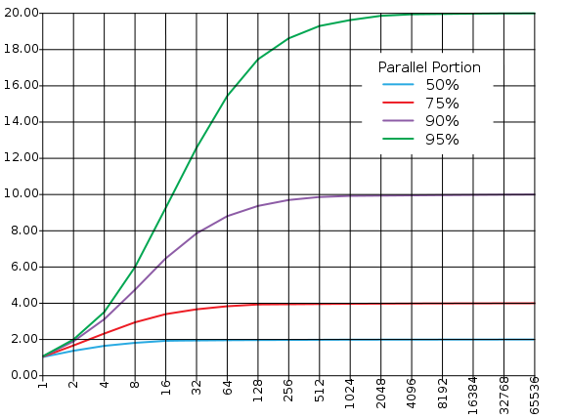
Consequence of Amdahl’s Law
The amount of speedup that can be achieved through parallelism is limited by the non-parallel portion of your program!
Time
Speedup
Parallel
portion
Serial
portion
1
2
3
4
5
Number of Processors
Number of Processors

Slide 8
Parallel Speed-up Examples (1/3)
Speedup w/ E = 1 / [ (1-F) + F/S ]
Consider an enhancement which runs 20 times faster but which is only usable 15% of the time
Speedup = 1/(.85 + .15/20) = 1.166
What if it’s usable 25% of the time?
Speedup = 1/(.75 + .25/20) = 1.311
Amdahl’s Law tells us that to achieve linear speedup with more processors, none of the original computation can be scalar (non-parallelizable)
To get a speedup of 90 from 100 processors, the percentage of the original program that could be scalar would have to be 0.1% or less
Speedup = 1/(.001 + .999/100) = 90.99
Nowhere near
20x speedup!
Notes:
For last part, can solve for max percentage:
1/(x + (1-x)/100) = 90
1/90 = x + (1-x)/100
10/9 – 1 = 99x
x = 1/891 = 0.112233%!!! ← so small!

Slide 9
Parallel Speed-up Examples (2/3)
Z₁ + Z₂ + … + Z₁₀
X_{1,1}
X_{1,10}
Y_{1,1}
Y_{1,10}
Partition 10 ways and perform on 10 parallel processing units
.
.
.
+
.
.
.
X_{10,1}
X_{10,10}
Y_{10,1}
Y_{10,10}
Non-parallel part
Parallel part
10 “scalar” operations (non-parallelizable)
100 parallelizable operations
Say, element-wise addition of two 10x10 matrices.
110 operations
100/110 = .909 Parallelizable, 10/110 = 0.091 Scalar

Slide 10
Parallel Speed-up Examples (3/3)
Speedup w/ E = 1 / [ (1-F) + F/S ]
Consider summing 10 scalar variables and two 10 by 10 matrices (matrix sum) on 10 processors
Speedup = 1/(.091 + .909/10) = 1/0.1819 = 5.5
What if there are 100 processors ?
Speedup = 1/(.091 + .909/100) = 1/0.10009 = 10.0
What if the matrices are 100 by 100 (or 10,010 adds in total) on 10 processors?
Speedup = 1/(.001 + .999/10) = 1/0.1009 = 9.9
What if there are 100 processors ?
Speedup = 1/(.001 + .999/100) = 1/0.01099 = 91

Slide 11
Strong and Weak Scaling
To get good speedup on a multiprocessor while keeping the problem size fixed is harder than getting good speedup by increasing the size of the problem
Strong scaling: When speedup is achieved on a parallel processor without increasing the size of the problem
Weak scaling: When speedup is achieved on a parallel processor by increasing the size of the problem proportionally to the increase in the number of processors
Load balancing is another important factor: every processor doing same amount of work
Just 1 unit with twice the load of others cuts speedup almost in half (bottleneck!)
Notes:
Add load balancing example here – page 638

Slide 12
Question: Suppose a program spends 80% of its time in a square root routine. How much must you speed up square root to make the program run 5 times faster?
Speedup w/ E = 1 / [ (1-F) + F/S ]
(A)
10
(B)
20
(C)
100
(D)
None of the above

Slide 13
Agenda
Amdahl’s Law
Administrivia
Multiprocessor Systems
Multiprocessor Cache Coherence
Synchronization - A Crash Course

Slide 14
Administrivia (1/2)
Midterm Re-grade Policy
Rubric posted
Any questions? Ask in discussion section
Written appeal process
Explain rationale for re-grade request
Attach rationale to exam & submit to your TA by the end of Thursday’s lab
ENTIRE test will be re-graded (is possible to end up with a lower grade)

Slide 15
Administrivia (2/2)
Project 2: Matrix Multiply Performance Improvement
Work in groups of two!
Part 1: Due July 28 (this Sunday)
Part 2: Due August 4 (posted by Thu)
HW 5 also due July 31 (posted Thu)
Closely packed due dates, try to get ahead of schedule for the project

Slide 16
Agenda
Amdahl’s Law
Administrivia
Multiprocessor Systems
Multiprocessor Cache Coherence
Synchronization - A Crash Course

Slide 17
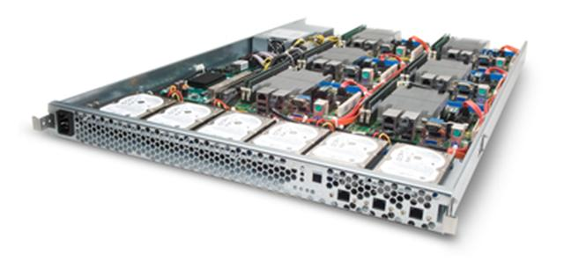
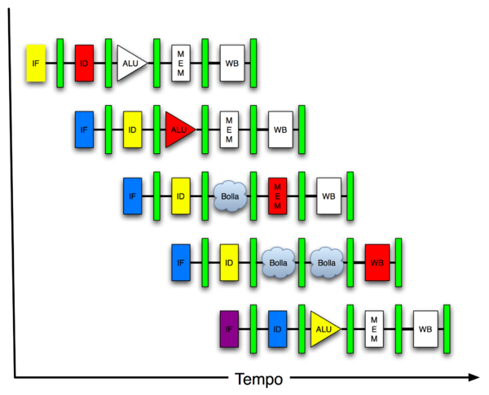
Great Idea #4: Parallelism
Software Hardware
Parallel Requests
Assigned to computer
e.g. search “Garcia”
Parallel Threads
Assigned to core
e.g. lookup, ads
Parallel Instructions
> 1 instruction @ one time
e.g. 5 pipelined instructions
Parallel Data
> 1 data item @ one time
e.g. add of 4 pairs of words
Hardware descriptions
All gates functioning in parallel at same time
Warehouse Scale Computer
Smart Phone
Leverage Parallelism &
Achieve High Performance
Computer
Core
…
Core
Memory
Input/Output
Core
Instruction Unit(s)
Functional
Unit(s)
A₀+B₀
A₁+B₁
A₂+B₂
A₃+B₃
Cache Memory
Logic Gates

Slide 18
Parallel Processing: Multiprocessor Systems (MIMD)
Multiprocessor (MIMD): a computer system with at least 2 processors
Use term core for processor (“multicore”)
Deliver high throughput for independent jobs via request-level or task-level parallelism
Processor
Processor
Processor
Cache
Cache
Cache
Interconnection Network
Memory
I/O
Notes:
Power has become the overriding issue for both data centers and microprocessors. Power efficiency has joined scalable performance making the case for multiprocessors. Multiprocessors also improve availability.

Slide 19
Parallel Processing: Multiprocessor Systems (MIMD)
Multiprocessor (MIMD): a computer system with at least 2 processors
Use term core for processor (“multicore”)
Improve the run time of a single program that has been specially crafted to run on a multiprocessor - a parallel processing program
Processor
Processor
Processor
Cache
Cache
Cache
Interconnection Network
Memory
I/O
Notes:
Power has become the overriding issue for both data centers and microprocessors. Power efficiency has joined scalable performance making the case for multiprocessors. Multiprocessors also improve availability.

Slide 20
Shared Memory Multiprocessor (SMP)
Single address space shared by all processors
Processors coordinate/communicate through shared variables in memory (via loads and stores)
Use of shared data must be coordinated via synchronization primitives (locks) that allow access to data to only one processor at a time
All multicore computers today are SMP

Slide 21
Memory Model for Multi-threading
Can be specified in a language with MIMD support – such as OpenMP

Slide 22
Example: Sum Reduction (1/2)
Sum 100,000 numbers on 100 processor SMP
Each processor has ID: 0 ≤ Pn ≤ 99
Partition 1000 numbers per processor
Step 1: Initial summation on each processor
sum[Pn] = 0;
for (i=1000*Pn; i<1000*(Pn+1); i++) sum[Pn] = sum[Pn] + A[i];
Step 2: Now need to add these partial sums
Reduction: divide and conquer approach to sum
Half the processors add pairs, then quarter, …
Need to synchronize between reduction steps

Slide 23
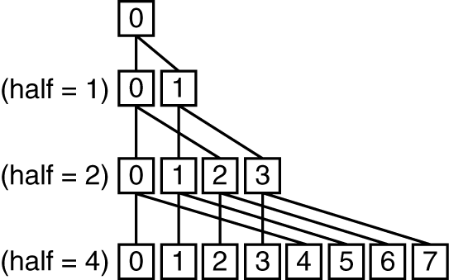
Example: Sum Reduction (2/2)
This is Step 2, after all “local” sums computed.
This code runs simultaneously on all processors.
half = 100;
repeat
synch();
if (half%2 != 0 && Pn == 0)
sum[0] = sum[0] + sum[half-1];
/* When half is odd, P0 gets extra element */
half = half/2; /* dividing line on who sums */
if (Pn < half) sum[Pn] = sum[Pn] + sum[Pn+half];
until (half == 1);
Notes:
“barrier synchronization” – wait until everyone reaches that point.
% is modulus operator in C
Round 1 in repeat loop: 8/2 → 4, p0 = p0 + p4, p1 = p1 + p5; p2 = p2 + p6; p3 = p3 + p7;
Round 2 in repeat loop: 4/2 → 2, p0 = p0 + p2: p1 = p1 + p3;
Round 3 in repeat loop: 2/2 → 1, p0 = p0 + p1;

Slide 24
Sum Reduction with 10 Processors
sum[P0]
sum[P1]
sum[P2]
sum[P3]
sum[P4]
sum[P5]
sum[P6]
sum[P7]
sum[P8]
sum[P9]
P0
P1
P2
P3
P4
P5
P6
P7
P8
P9
half = 10
P0
P1
P2
P3
P4
half = 5
P0
P1
half = 2
P0
half = 1
Notes:
For lecture
So load balancing issue at second reduction (when half = 2)

Slide 25
Question: Given the Sum Reduction code, are the given variables Shared data or Private data?
half = 100;
repeat
synch();
... /* handle odd elements */
half = half/2; /* dividing line */
if (Pn < half)
sum[Pn] = sum[Pn] + sum[Pn+half];
until (half == 1);
half sum Pn
(A)
Shared Shared Shared
(B)
Shared Shared Private
(C)
Private Shared Private
(D)
Private Private Shared
Notes:
Reason we need half to be private is because EVERY processor is running the “half = half/2” instruction. If Shared, would hit < 1 in one pass!

Slide 26
Agenda
Amdahl’s Law
Administrivia
Multiprocessor Systems
Multiprocessor Cache Coherence
Synchronization - A Crash Course

Slide 27
Shared Memory and Caches
How many processors can be supported?
Key bottleneck in an SMP is the memory system
Caches can effectively increase memory bandwidth/open the bottleneck
But what happens to the memory being actively shared among the processors through the caches?

Slide 28
Shared Memory and Caches (1/2)
What if?
Processors 1 and 2 read Memory[1000] (value 20)
0
1
2
Processor
Processor
1000
Processor
1000
Cache
1000
1000
Cache
Cache
Interconnection Network
20
Memory
20
I/O

Slide 29
Shared Memory and Caches (2/2)
What if?
Processors 1 and 2 read Memory[1000]
Processor 0 writes Memory[1000] with 40
0
Processor 0
Write
Invalidates
Other Copies
Processor
1
2
1000
Processor
Processor
1000 40
1000 20
1000 20
Cache
Cache
Cache
Interconnection Network
1000 40
Memory
I/O

Slide 30
Cache Coherence (1/2)
Cache Coherence: When multiple caches access the same memory, ensure data is consistent in each local cache
Main goal is to ensure no cache incorrectly uses an outdated value of memory
Many different implementations
We will focus on snooping, where every cache monitors a bus (the interconnection network) that is used to broadcast activity among the caches

Slide 31
Cache Coherence (2/2)
Snooping Idea: When any processor has a cache miss or writes to memory, notify the other processors via the bus
If reading, multiple processors are allowed to have the most up-to-date copy
If a processor writes, invalidate all other copies (those copies are now old)
What if many processors use the same block?
Block can “ping-pong” between caches

Slide 32
Implementing Cache Coherence
Cache write policies still apply
For coherence between cache and memory
Write-through/write-back
Write allocate/no-write allocate
What does each cache need?
Valid bit? Definitely!
Dirty bit? Depends…
New: Assign each block of a cache a state, indicating its status relative to the other caches

Slide 33
Cache Coherence States (1/3)
The following state should be familiar to you:
Invalid: Data is not in cache
Valid bit is set to 0
Could still be empty or invalidated by another cache; data is not up-to-date
This is the only state that indicates that data is NOT up-to-date

Slide 34
Cache Coherence States (2/3)
The following states indicate sole ownership
No other cache has a copy of the data
Modified: Data is dirty (mem is out-of-date)
Can write to block without updating memory
Exclusive: Cache and memory both have up-to-date copy
Notes:
Modified indicates a write-back policy

Slide 35
Cache Coherence States (3/3)
The following states indicate that multiple caches have a copy of the data
Shared: One of multiple copies in caches
Not necessarily consistent with memory
Does not have to write to memory if block replaced (other copies in other caches)
Owned: “Main” copy of multiple in caches
Same as Shared, but can supply data on a read instead of going to memory (can only be 1 owner)

Slide 36
Cache Coherence Protocols
Common protocols called by the subset of caches states that they use:
Modified
Owned
Exclusive
Shared
Invalid
e.g. MOESI, MESI, MSI, MOSI, etc.
Snooping/Snoopy Protocols
e.g. the Berkeley Ownership Protocol
See http://en.wikipedia.org/wiki/Cache_coherence

Slide 37
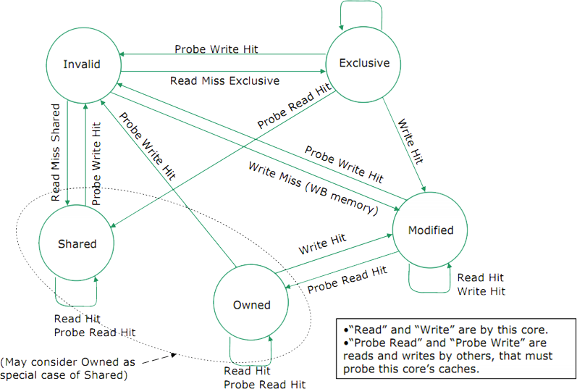
Example: MOESI Transitions
You’ll see more in discussion

Slide 38
False Sharing
One block contains both variables x and y
What happens if Processor 0 reads and writes to x and Processor 1 reads and writes to y?
Cache invalidations even though not using the same data!
This effect is known as false sharing
How can you prevent it?
e.g. different block size, ordering of variables in memory, processor access patterns

Slide 39
Get To Know Your Staff
Category: Television

Slide 40
Agenda
Amdahl’s Law
Administrivia
Multiprocessor Systems
Multiprocessor Cache Consistency
Synchronization - A Crash Course

Slide 41
Threads
Thread of execution: Smallest unit of processing scheduled by operating system
On uniprocessor, multithreading occurs by time-division multiplexing
Processor switches between different threads
Context switching happens frequently enough user perceives threads as running at the same time
On a multiprocessor, threads run at the same time, with each processor running a thread

Slide 42
Multithreading vs. Multicore (1/2)
Basic idea: Processor resources are expensive and should not be left idle
Long memory latency to memory on cache miss?
Hardware switches threads to bring in other useful work while waiting for cache miss
Cost of thread context switch must be much less than cache miss latency
Put in redundant hardware so don’t have to save context on every thread switch:
PC, Registers, L1 caches?

Slide 43
Multithreading vs. Multicore (2/2)
Multithreading => Better Utilization
≈1% more hardware, 1.10X better performance?
Share integer adders, floating point adders, caches (L1 I $, L1 D$, L2 cache, L3 cache), Memory Controller
Multicore => Duplicate Processors
≈50% more hardware, ≈2X better performance?
Share lower caches (L2 cache, L3 cache), Memory Controller

Slide 44
Data Races and Synchronization
Two memory accesses form a data race if different threads access the same location, and at least one is a write, and they occur one after another
Means that the result of a program can vary depending on chance (which thread ran first?)
Avoid data races by synchronizing writing and reading to get deterministic behavior
Synchronization done by user-level routines that rely on hardware synchronization instructions

Slide 45
Analogy: Buying Milk
Your fridge has no milk. You and your roommate will return from classes at some point and check the fridge
Whoever gets home first will check the fridge, go and buy milk, and return
What if the other person gets back while the first person is buying milk?
You’ve just bought twice as much milk as you need!
It would’ve helped to have left a note…

Slide 46
Lock Synchronization (1/2)
Use a “Lock” to grant access to a region (critical section) so that only one thread can operate at a time
Need all processors to be able to access the lock, so use a location in shared memory as the lock
Processors read lock and either wait (if locked) or set lock and go into critical section
0 means lock is free / open / unlocked / lock off
1 means lock is set / closed / locked / lock on

Slide 47
Lock Synchronization (2/2)
Pseudocode:
Check lock
Set the lock
Critical section
(e.g. change shared variables)
Unset the lock
Can loop/idle here if locked

Slide 48
Possible Lock Implementation
Lock (a.k.a. busy wait)
Get_lock: # $s0 -> address of lock
addiu $t1,$zero,1 # t1 = Locked value
Loop: lw $t0,0($s0) # load lock
bne $t0,$zero,Loop # loop if locked
Lock: sw $t1,0($s0) # Unlocked, so lock
Unlock
Unlock:
sw $zero,0($s0)
Any problems with this?

Slide 49
Possible Lock Problem
Thread 1
addiu $t1,$zero,1
Loop: lw $t0,0($s0)
bne $t0,$zero,Loop
Lock: sw $t1,0($s0)
Thread 2
addiu $t1,$zero,1
Loop: lw $t0,0($s0)
bne $t0,$zero,Loop
Lock: sw $t1,0($s0)
Time
Both threads think they have set the lock!
Exclusive access not guaranteed!

Slide 50
Hardware Synchronization
Hardware support required to prevent an interloper (another thread) from changing the value
Atomic read/write memory operation
No other access to the location allowed between the read and write
How best to implement?
Single instr? Atomic swap of register ↔ memory
Pair of instr? One for read, one for write
Notes:
Interloper thread can be from same core or another core.

Slide 51
Synchronization in MIPS
Load linked: ll rt,off(rs)
Store conditional: sc rt,off(rs)
Returns 1 (success) if location has not changed since the ll
Returns 0 (failure) if location has changed
Note that sc clobbers the register value being stored (rt)!
Need to have a copy elsewhere if you plan on repeating on failure or using value later
Notes:
Here using the Green Sheet convention of rs and rt for source register and target register.

Slide 52
Synchronization in MIPS Example
Atomic swap (to test/set lock variable)
Exchange contents of register and memory: $s4 ↔ Mem($s1)
try: add $t0,$zero,$s4 #copy value
ll $t1,0($s1) #load linked
sc $t0,0($s1) #store conditional
beq $t0,$zero,try #loop if sc fails
add $s4,$zero,$t1 #load value in $s4
sc would fail if another threads executes sc here

Slide 53
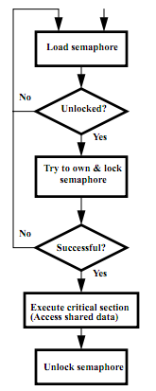
Test-and-Set
In a single atomic operation:
Test to see if a memory location is set (contains a 1)
Set it (to 1) if it isn’t (it contained a zero when tested)
Otherwise indicate that the Set failed, so the program can try again
While accessing, no other instruction can modify the memory location, including other Test-and-Set instructions
Useful for implementing lock operations

Slide 54
Test-and-Set in MIPS
Example: MIPS sequence for implementing a T&S at ($s1)
Try: addiu $t0,$zero,1
ll $t1,0($s1)
bne $t1,$zero,Try
sc $t0,0($s1)
beq $t0,$zero,try
Locked:
# critical section
Unlock:
sw $zero,0($s1)

Slide 55
Summary
Amdahl’s Law limits benefits of parallelization
Multiprocessor systems uses shared memory (single address space)
Cache coherence implements shared memory even with multiple copies in multiple caches
Track state of blocks relative to other caches (e.g. MOESI protocol)
False sharing a concern
Synchronization via hardware primitives:
MIPS does it with Load Linked + Store Conditional

