Slide 1
CS 61C: Great Ideas in Computer Architecture Lecture 10: Finite State Machines, Functional Units
Instructor: Sagar Karandikar
sagark@eecs.berkeley.edu
http://inst.eecs.berkeley.edu/~cs61c

Slide 2
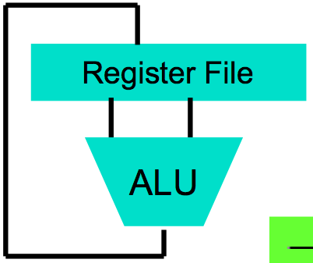
Levels of Representation/Interpretation
High Level Language Program (e.g., C)
temp = v[k];
v[k] = v[k+1];
v[k+1] = temp;
Compiler
Anything can be represented as a number, i.e., data or instructions
lw $t0, 0($2)
lw $t1, 4($2)
sw $t1, 0($2)
sw $t0, 4($2)
Assembly Language Program (e.g., MIPS)
Assembler
0000 1001 1100 0110 1010 1111 0101 1000
1010 1111 0101 1000 0000 1001 1100 0110
1100 0110 1010 1111 0101 1000 0000 1001
0101 1000 0000 1001 1100 0110 1010 1111
Machine Language Program (MIPS)
Machine Interpretation
Hardware Architecture Description (e.g., block diagrams)
Architecture Implementation
Logic Circuit Description (Circuit Schematic Diagrams)

Slide 3
Type of Circuits
Synchronous Digital Systems consist of two basic types of circuits:
Combinational Logic (CL) circuits
Output is a function of the inputs only, not the history of its execution
E.g., circuits to add A, B (ALUs)
Sequential Logic (SL)
Circuits that “remember” or store information
aka “State Elements”
E.g., memories and registers (Registers)

Slide 4
Uses for State Elements
Place to store values for later re-use:
Register files (like $1-$31 in MIPS)
Memory (caches and main memory)
Help control flow of information between combinational logic blocks
State elements hold up the movement of information at input to combinational logic blocks to allow for orderly passage

Slide 5
Accumulator Example
Why do we need to control the flow of information?
SUM
X_{i}
S
Want: S=0;
for (i=0;i<n;i++)
S = S + X_{i}
Assume:
Each X value is applied in succession, one per cycle
After n cycles the sum is present on S

Slide 6
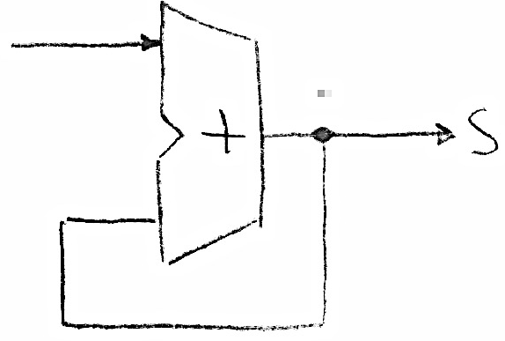
First Try: Does this work?
Feedback
No!
Reason #1: How to control the next iteration of the ‘for’ loop?
Reason #2: How do we say: ‘S=0’?
We’ll go through a working version in more detail today
Notes:
Like if you write y = y + 1 as a math formula (NOT an assignment in C)

Slide 7
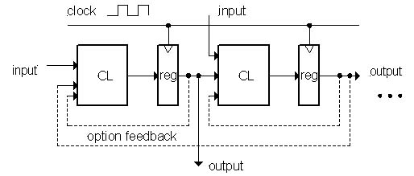
Model for Synchronous Systems
Collection of Combinational Logic blocks separated by registers
Feedback is optional
Clock signal(s) connects only to clock input of registers
Clock (CLK): steady square wave that synchronizes the system
Register: several bits of state that samples on rising edge of CLK (positive edge-triggered) or falling edge (negative edge-triggered)

Slide 8
Register Internals
n instances of a “Flip-Flop”
Flip-flop name because the output flips and flops between 0 and 1
D is “data input”, Q is “data output”
Also called “D-type Flip-Flop”

Slide 9
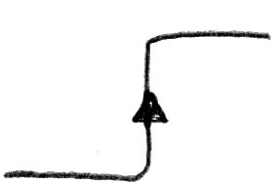
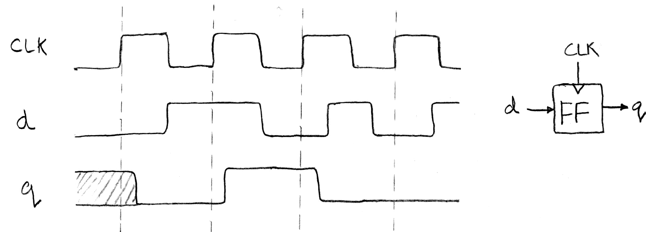
Flip-Flop Operation
Edge-triggered d-type flip-flop
This one is “positive edge-triggered”
“On the rising edge of the clock, the input d is sampled and transferred to the output. At all other times, the input d is ignored.”
Example waveforms:

Slide 10
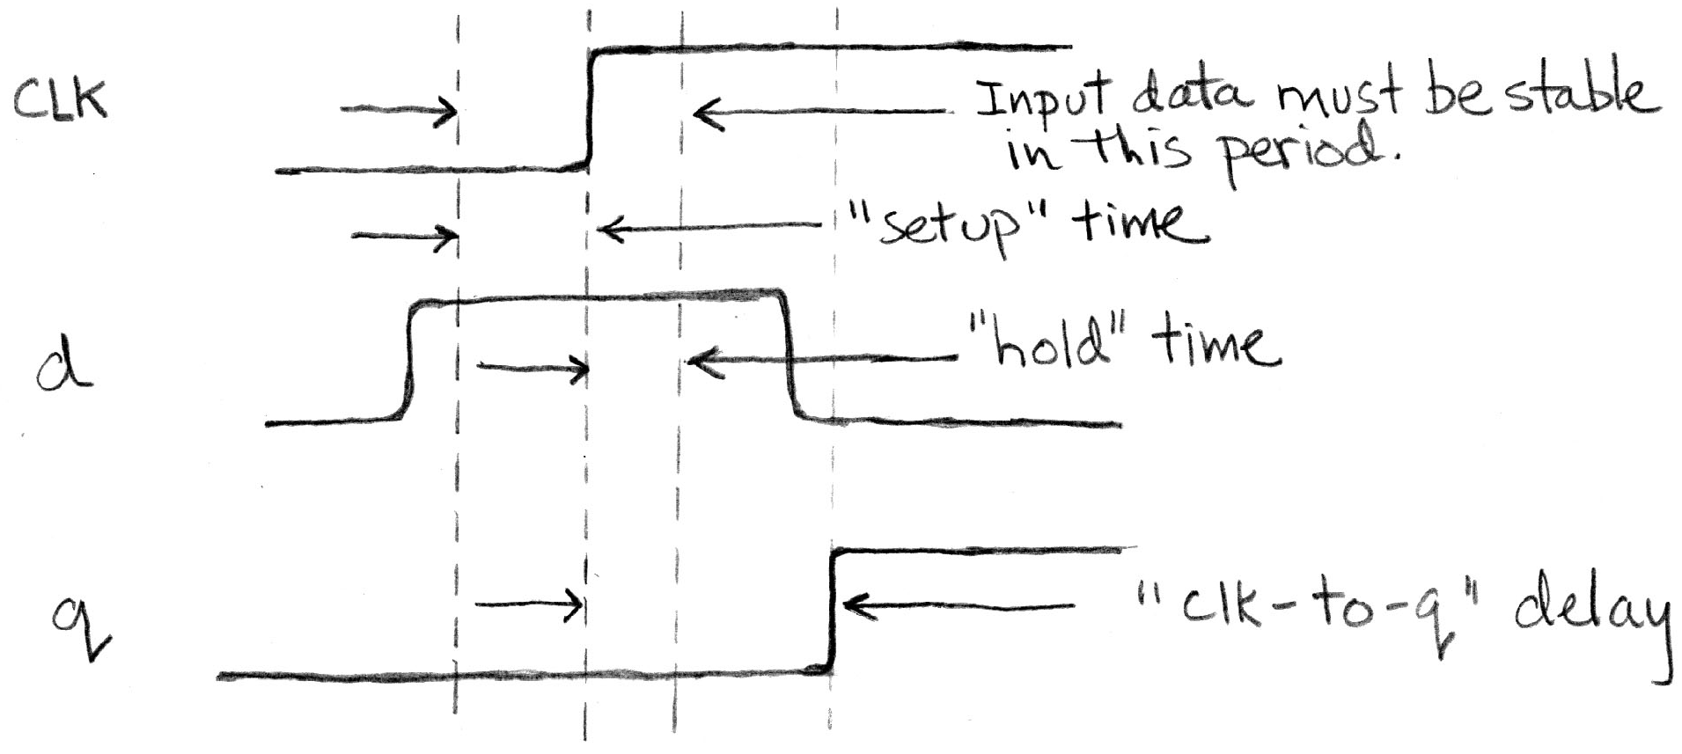
Flip-Flop Timing
Edge-triggered d-type flip-flop
This one is “positive edge-triggered”
“On the rising edge of the clock, the input d is sampled and transferred to the output. At all other times, the input d is ignored.”
Example waveforms (more detail):

Slide 11
Camera Analogy Timing Terms
Want to take a portrait – timing right before and after taking picture
Set up time – don’t move since about to take picture (open camera shutter)
Hold time – need to hold still after shutter opens until camera shutter closes
Time click to data – time from open shutter until can see image on output (viewscreen)

Slide 12
Hardware Timing Terms
Setup Time: when the input must be stable before the edge of the CLK
Hold Time: when the input must be stable after the edge of the CLK
“CLK-to-Q” Delay: how long it takes the output to change, measured from the edge of the CLK

Slide 13
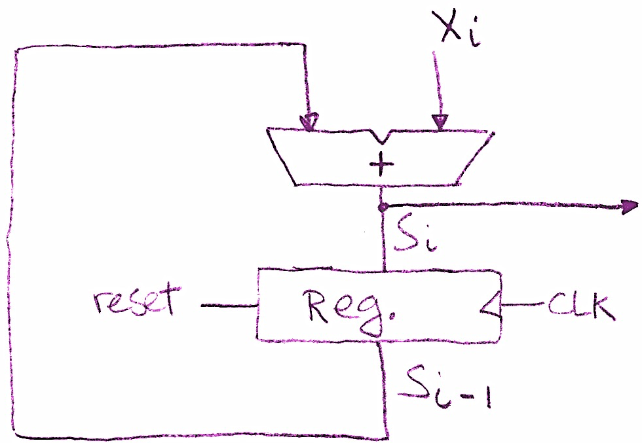
Accumulator Timing 1/2
Reset input to register is used to force it to all zeros (takes priority over D input).
S_{i-1} holds the result of the i^{th}-1 iteration.
Analyze circuit timing starting at the output of the register.

Slide 14
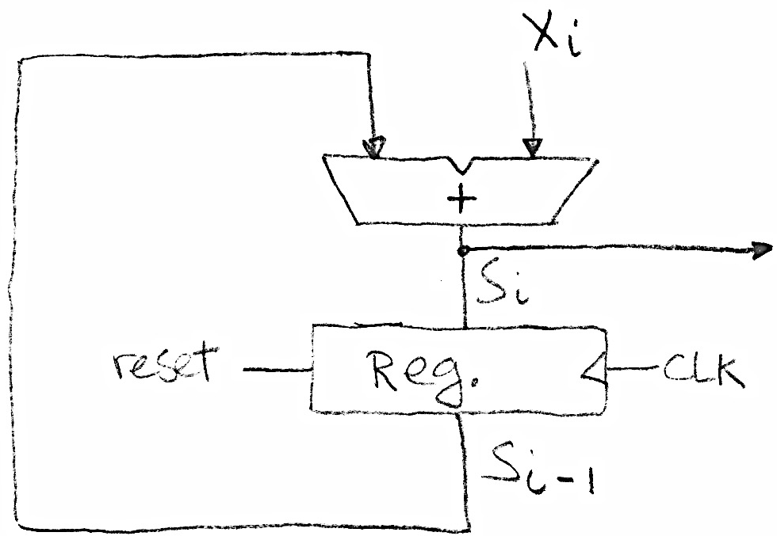
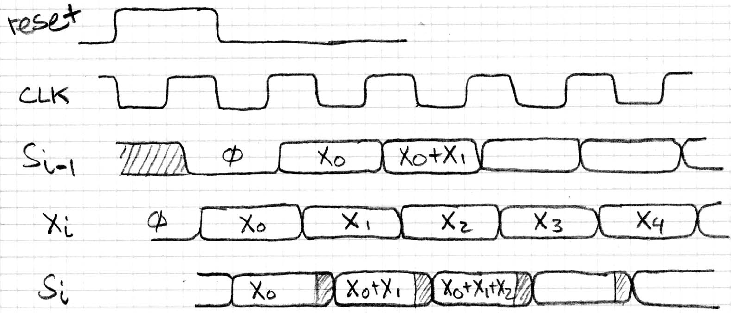
Accumulator Timing 2/2
Reset signal shown
Also, in practice X might not arrive to the adder at the same time as S_{i-1}
S_{i} temporarily is wrong, but register always captures correct value.
In good circuits, instability never happens around rising edge of clk.

Slide 15
Accumulator Logisim Demo

Slide 16
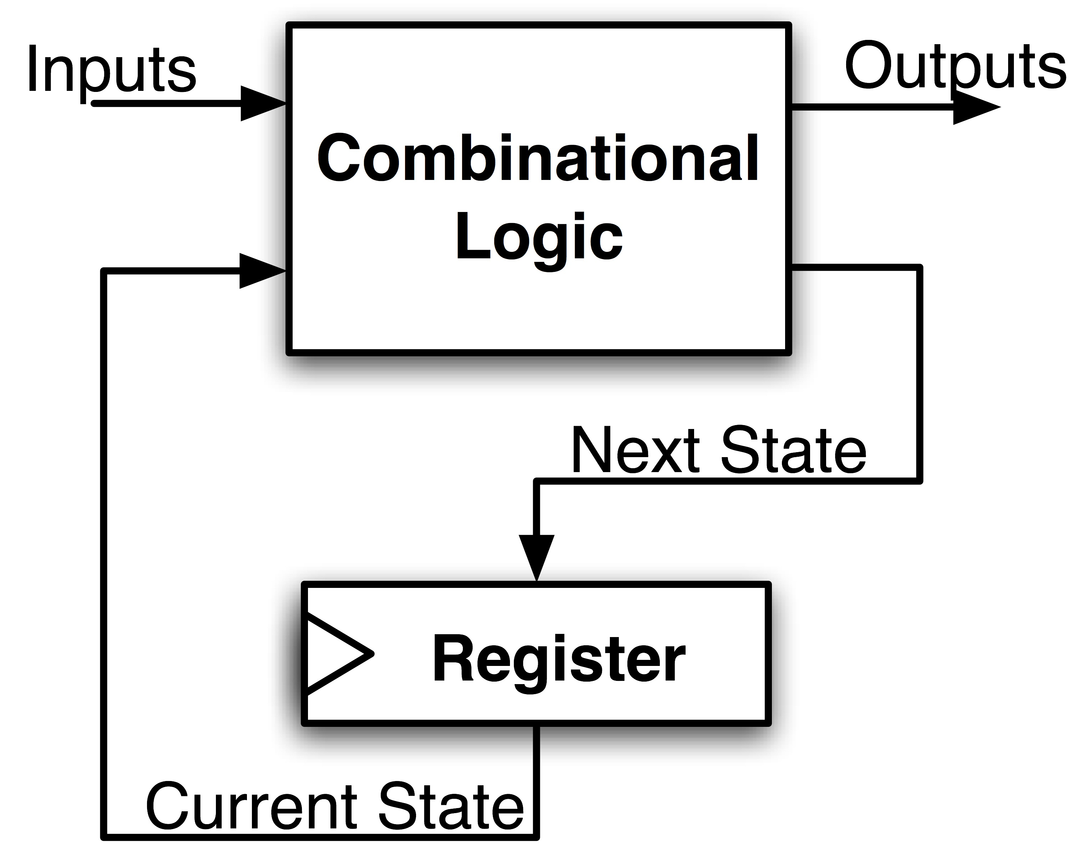
Maximum Clock Frequency
What is the maximum frequency of this circuit?
Hint:
Frequency = 1/Period
Max Delay = CLK-to-Q Delay + CL Delay + Setup Time

Slide 17
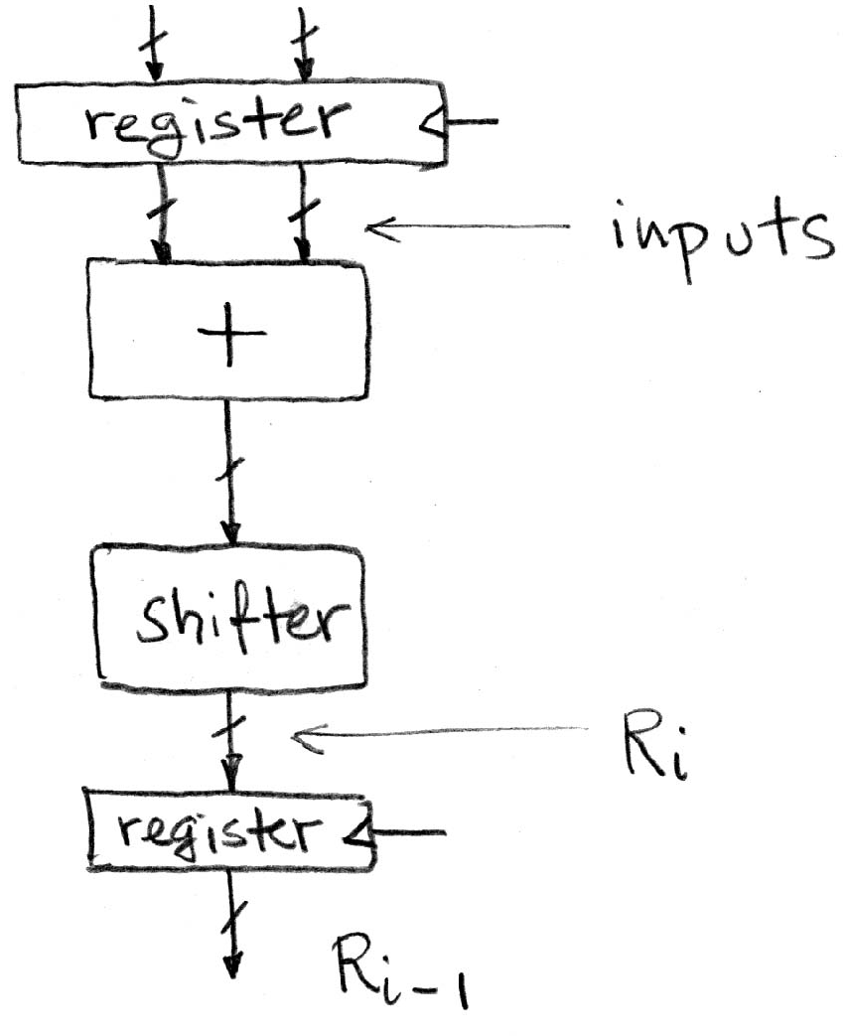
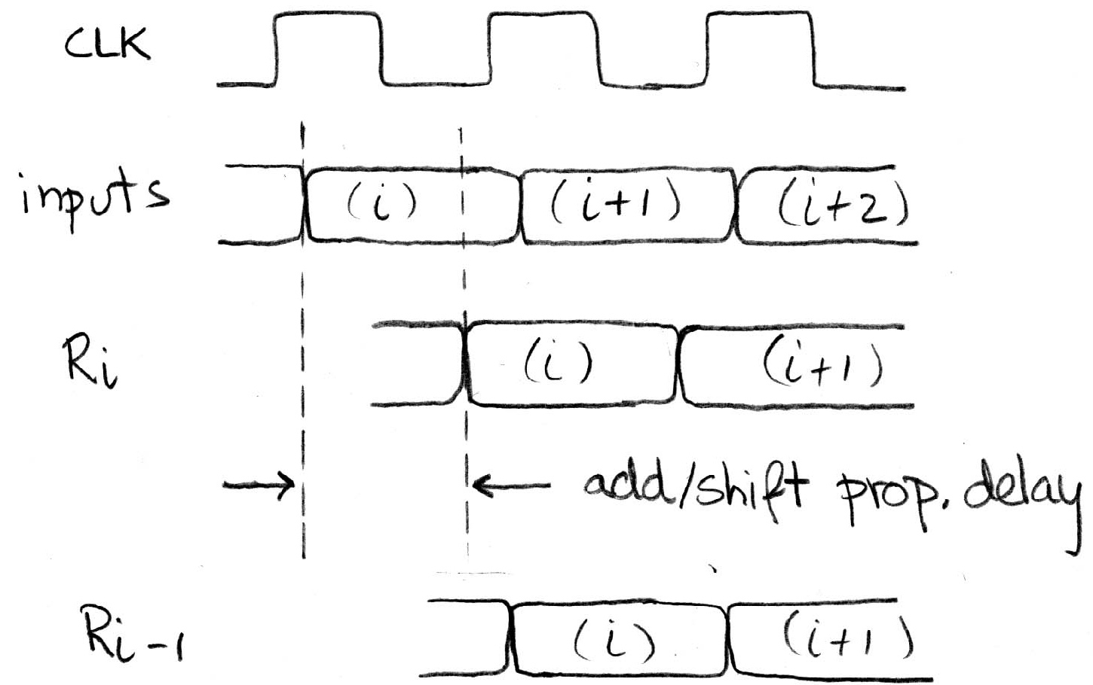
Critical Paths
Timing…
Note: delay of 1 clock cycle from input to output.
Clock period limited by propagation delay of adder/shifter.

Slide 18
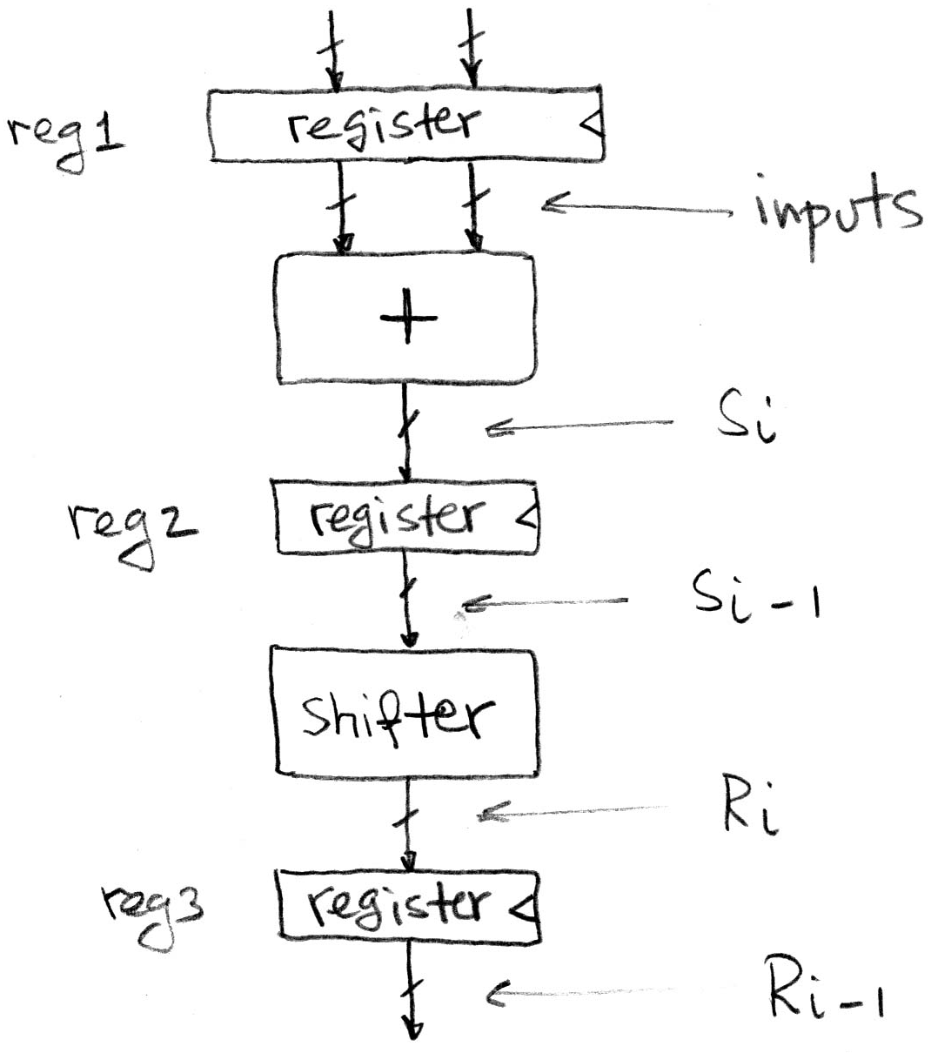
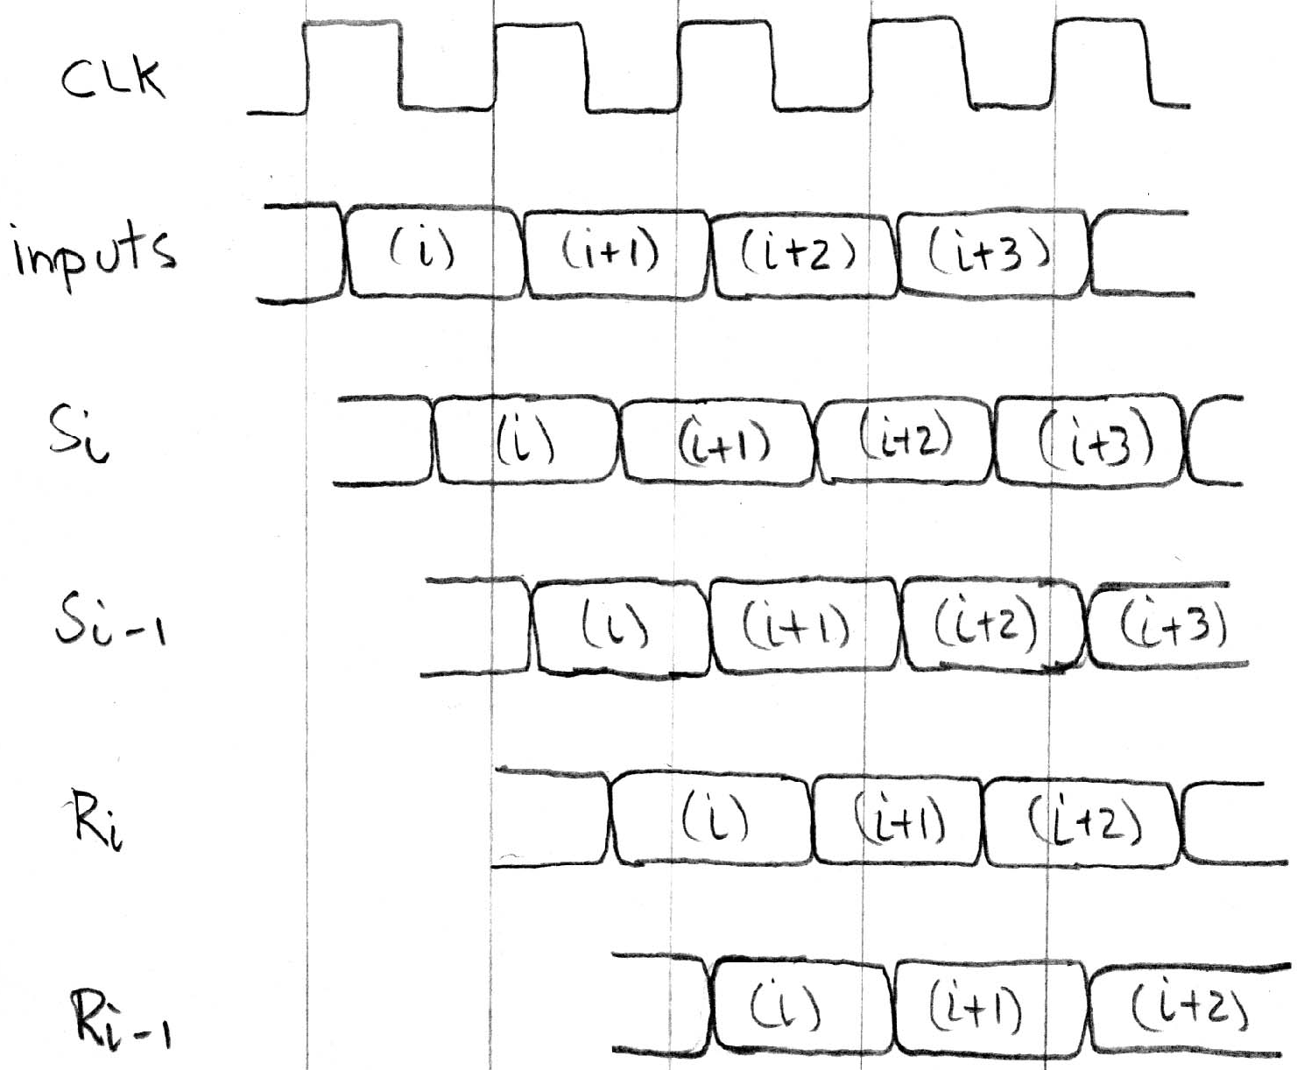
Pipelining to improve performance
Timing…
Insertion of register allows higher clock frequency.
More outputs per second (higher bandwidth)
But each individual result takes longer (greater latency)

Slide 19
Recap of Timing Terms
Clock (CLK) - steady square wave that synchronizes system
Setup Time - when the input must be stable before the rising edge of the CLK
Hold Time - when the input must be stable after the rising edge of the CLK
“CLK-to-Q” Delay - how long it takes the output to change, measured from the rising edge of the CLK
Flip-flop - one bit of state that samples every rising edge of the CLK (positive edge-triggered)
Register - several bits of state that samples on rising edge of CLK or on LOAD (positive edge-triggered)

Slide 20
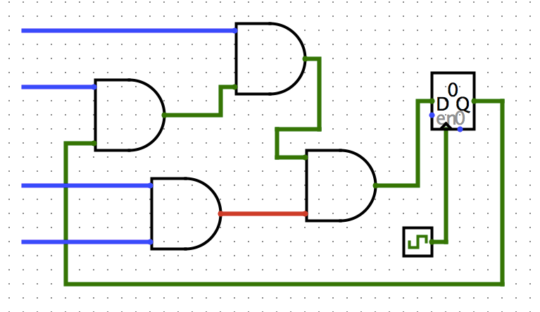
Clickers/Peer Instruction
Clock->Q 1ns
Setup 1ns
Hold 1ns
AND delay 1ns
What is maximum clock frequency? (assume all unconnected inputs come from some register)
A: 5 GHz
B: 200 MHz
C: 500 MHz
D: 1/7 GHz
E: 1/6 GHz

Slide 21
Administrivia
HW2 out
We recommend doing this before the midterm
Proj 2-1 out
Make sure you test your code on hive machines, that’s where we’ll grade them
Team registration problems? Email Jay

Slide 22
Administrivia
Midterm this Thursday
In this room, at this time
One 8.5”x11” handwritten cheatsheet
We’ll provide a MIPS green sheet
No electronics
Covers up to and including the 07/02 lecture
Review session slides posted on Piazza

Slide 23
Break

Slide 24
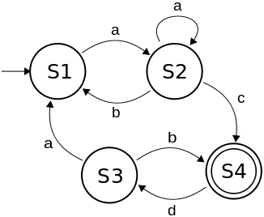
Finite State Machines (FSM) Intro
A convenient way to conceptualize computation over time
We start at a state and given an input, we follow some edge to another (or the same) state
The function can be represented with a “state transition diagram”.
With combinational logic and registers, any FSM can be implemented in hardware.

Slide 25
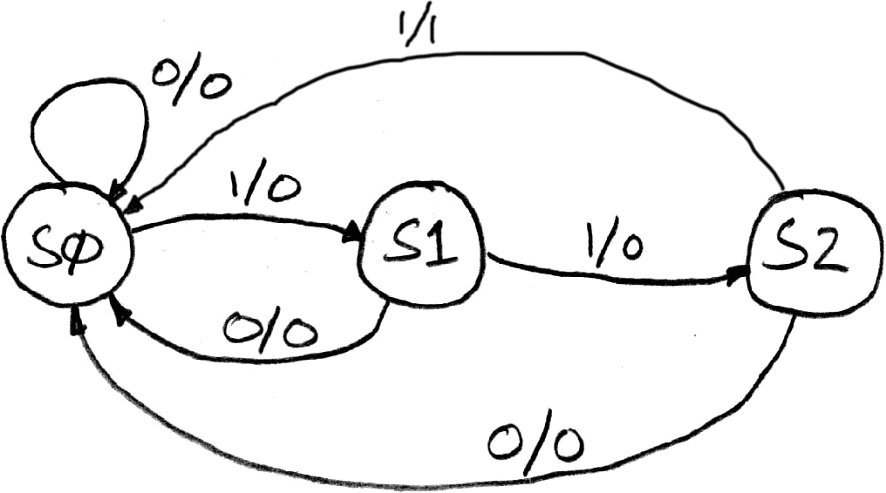
FSM Example: 3 ones…
FSM to detect the occurrence of 3 consecutive 1’s in the input.
Draw the FSM…
Assume state transitions are controlled by the clock:
on each clock cycle the machine checks the inputs and moves to a new state and produces a new output…

Slide 26
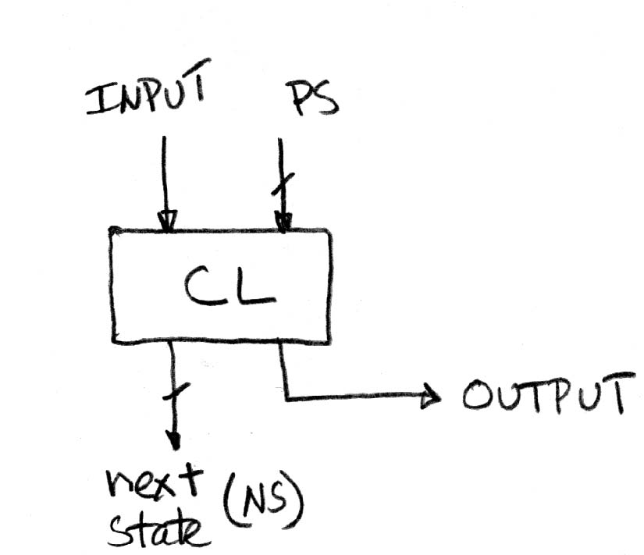
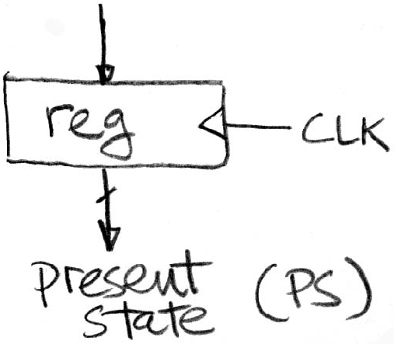
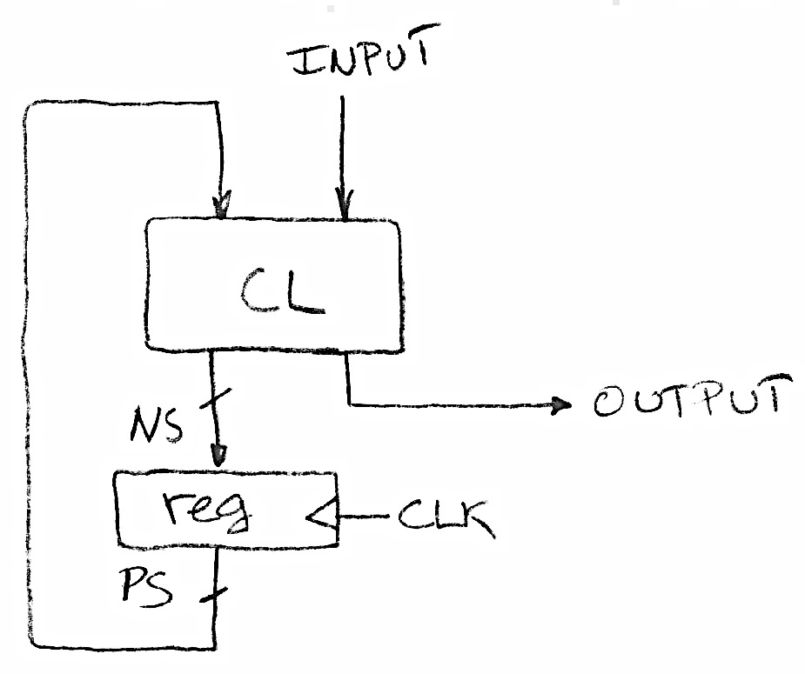
Hardware Implementation of FSM
… Therefore a register is needed to hold the a representation of which state the machine is in. Use a unique bit pattern for each state.
+
=
?
Combinational logic circuit is used to implement a function maps from present state and input to next state and output.

Slide 27
FSM Combinational Logic
Specify CL using a truth table.
Truth table…
PS
Input
NS
Output
00
0
00
0
00
1
01
0
01
0
00
0
01
1
10
0
10
0
00
0
10
1
00
1

Slide 28
Moving between Representations
Use this table and techniques we learned last time (and later in discussion) to transform between alternative views of same logic function
Truth Table
Enumerate Inputs
Enumerate Inputs
Sum of Products,
Product of Sums Methods
Boolean Expression
Use Equivalency between boolean operators and gates
Gate Diagram

Slide 29
Building Standard Functional Units
Data multiplexers
Arithmetic and Logic Unit
Adder/Subtractor

Slide 30
Data Multiplexer (“Mux”) (here 2-to-1, n-bit-wide)
Notes:
draw the truth table

Slide 31
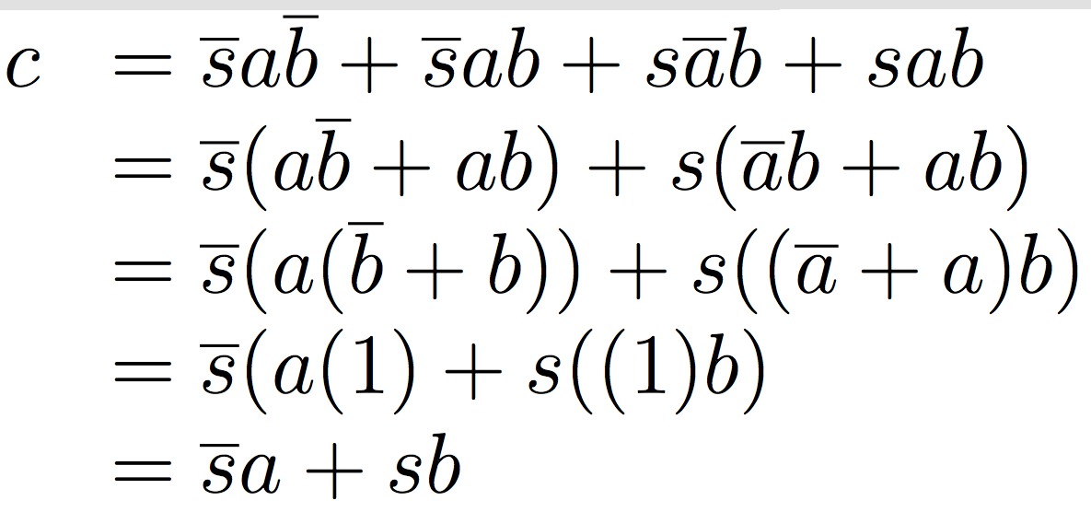
N instances of 1-bit-wide mux
How many rows in TT?

Slide 32
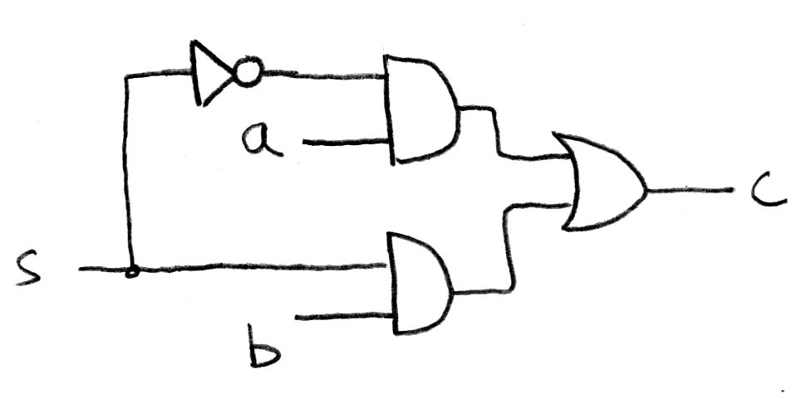
How do we build a 1-bit-wide mux?

Slide 33
4-to-1 multiplexer?
How many rows in TT?

Slide 34
Another way to build 4-1 mux?
Hint: NCAA tourney!
Ans: Hierarchically!

Slide 35
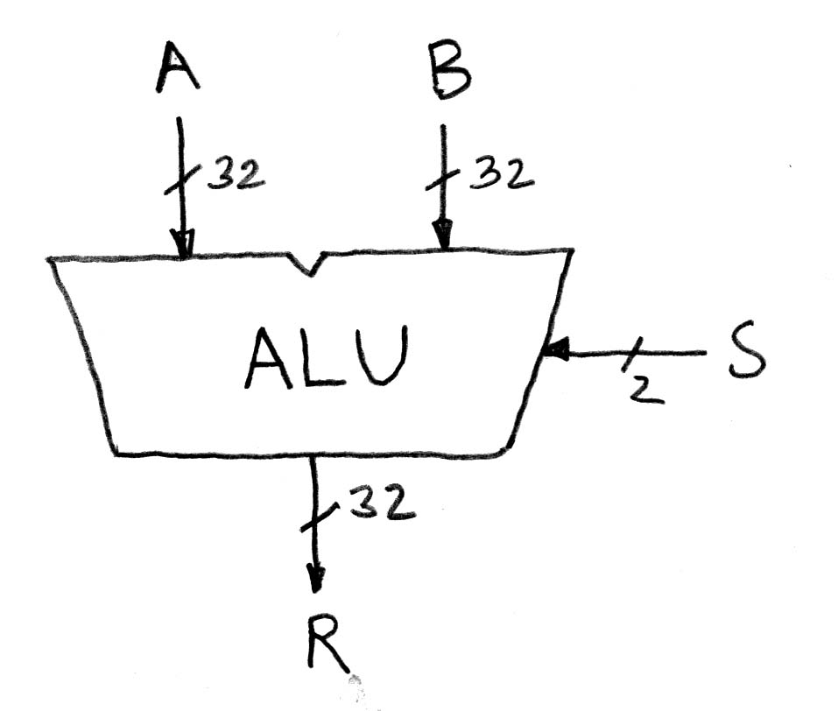
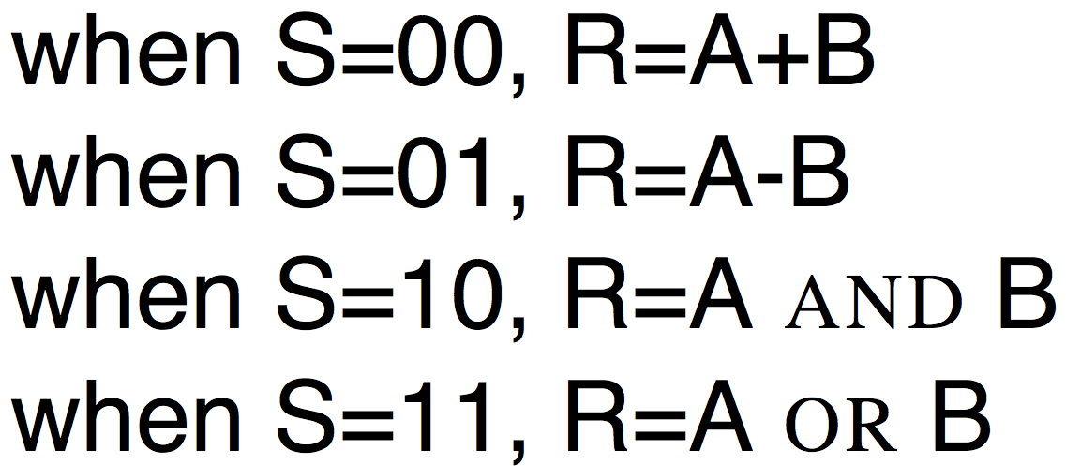
Arithmetic and Logic Unit
Most processors contain a special logic block called the “Arithmetic and Logic Unit” (ALU)
We’ll show you an easy one that does ADD, SUB, bitwise AND, bitwise OR

Slide 36
Our simple ALU

Slide 37
Clicker Question
Convert the truth table to a boolean expression using sum of products (no need to simplify):
A: F = xy + x(~y)
B: F = xy + (~x)y + (~x)(~y)
C: F = xy + (~x)y
D: F = (~x)y + x(~y)
x | y | F(x,y)
0 | 0 | 0
0 | 1 | 1
1 | 0 | 0
1 | 1 | 1

Slide 38
In the News: Microsoft, Google beat Humans at Image Recognition (EE Times)
On ImageNet benchmark image database, systems from Microsoft and Google performed better than humans at recognizing images
Both companies used deep artificial neural networks to train on image database
NVIDIA is a sponsor of the annual ImageNet Challenge, and supplies access to arrays of its graphic processing units (GPUs) to all contestants. Microsoft did use Nvidia GPUs, but bought and configured their own supercomputer using them to simulate parametric rectified linear neural units to become the "1st to beat a human" at image classification.

Slide 39
Break

Slide 40
How to design Adder/Subtractor?
Truth-table, then determine canonical form, then minimize and implement as we’ve seen before
Look at breaking the problem down into smaller pieces that we can cascade or hierarchically layer

Slide 41
Adder/Subtractor – One-bit adder LSB…

Slide 42
Adder/Subtractor – One-bit adder (1/2)…

Slide 43
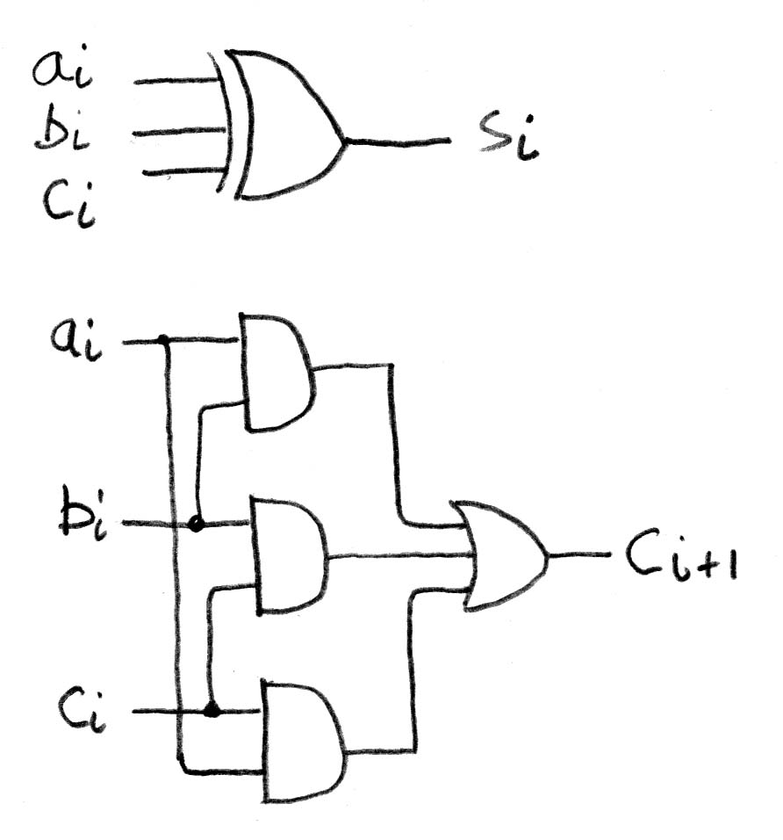
Adder/Subtractor – One-bit adder (2/2)

Slide 44
N 1-bit adders ⇒ 1 N-bit adder
b₀
+
+
+
What about overflow?
Overflow = c_{n}?

Slide 45
Extremely Clever Subtractor
+
+
+
x | y | XOR(x,y)
0 | 0 | 0
0 | 1 | 1
1 | 0 | 1
1 | 1 | 0
XOR serves as conditional inverter!

Slide 46
Clicker Question pt. 2
Convert the truth table to a boolean expression using product of sums (no need to simplify):
A: F = (x+y)(~x+y)
B: F = (x+y)(~x+~y)
C: F = (~x+y)(x+y)(~x+~y)
D: F = (~x+~y)(~x+y)(x+~y)(x+y)
x | y | F(x,y)
0 | 0 | 0
0 | 1 | 1
1 | 0 | 0
1 | 1 | 1

Slide 47
In Conclusion
Finite State Machines have clocked state elements plus combinational logic to describe transition between states
Standard combinational functional unit blocks built hierarchically from subcomponents
Tomorrow: We’ll build a CPU

