Slide 1

CS 61C: Great Ideas in Computer Architecture
Lecture 21: Warehouse-Scale Computing, MapReduce, and Spark
Instructor: Sagar Karandikar
sagark@eecs.berkeley.edu
http://inst.eecs.berkeley.edu/~cs61c

Slide 2
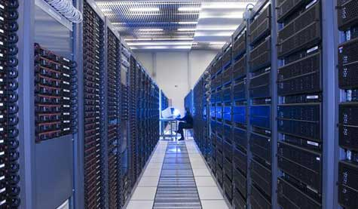




New-School Machine Structures
(It’s a bit more complicated!)
Software Hardware
Parallel Requests
  Assigned to computer
  e.g., Search “Asanovic”
Parallel Threads
  Assigned to core
  e.g., Lookup, Ads
Parallel Instructions
  >1 instruction @ one time
  e.g., 5 pipelined instructions
Parallel Data
  >1 data item @ one time
  e.g., Deep Learning for
  image classification
Hardware descriptions
  All gates @ one time
Programming Languages
Warehouse Scale Computer
Smart
Phone
Harness
Parallelism &
Achieve High
Performance
Computer
Core
…
Core
Memory (Cache)
Input/Output
Core
Labs 11/13
Instruction Unit(s)
Functional
Unit(s)
A₀+B₀
A₁+B₁
A₂+B₂
A₃+B₃
Cache Memory
Logic Gates

Slide 3
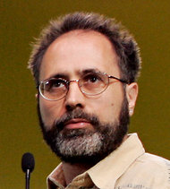
In the news
Google disclosed that it continuously uses enough electricity to power 200,000 homes, but it says that in doing so, it also makes the planet greener.
Search cost per day (per person) same as running a 60-watt bulb for 3 hours
Urs Hoelzle, Google SVP
Co-author of today’s reading
http://www.nytimes.com/2011/09/09/technology/google-details-and-defends-its-use-of-electricity.html

Slide 4
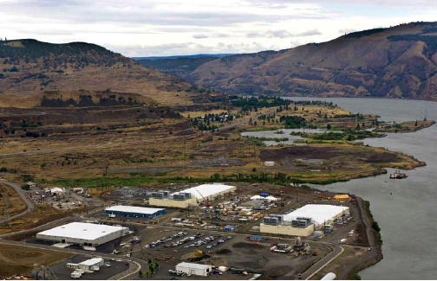
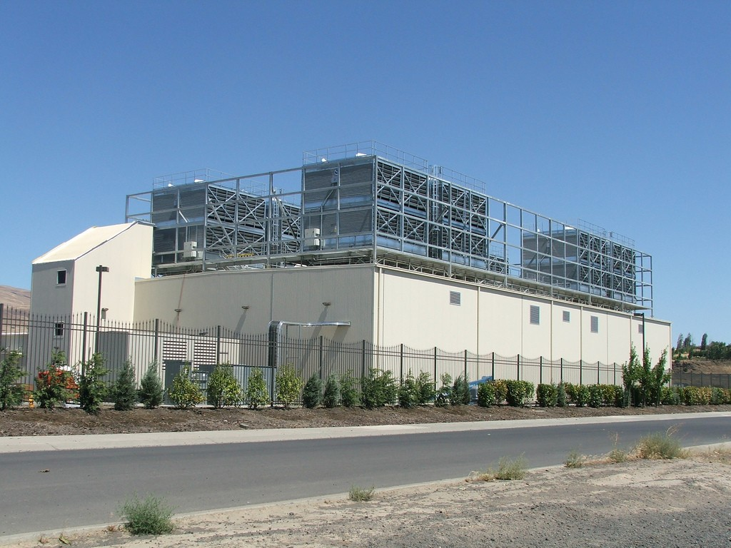
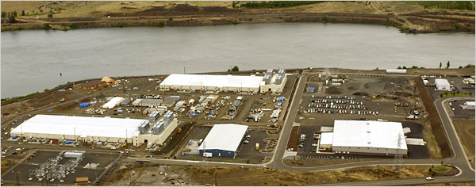
E.g., Google’s Oregon WSC

Slide 5
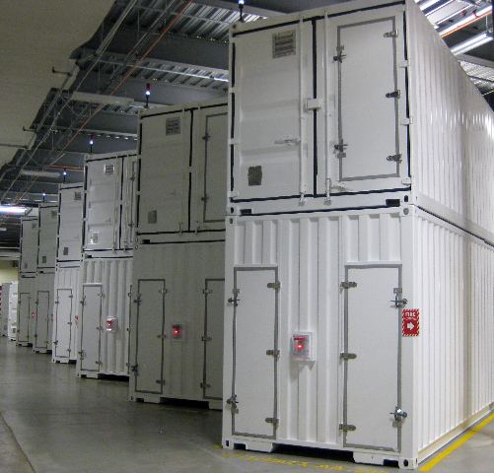
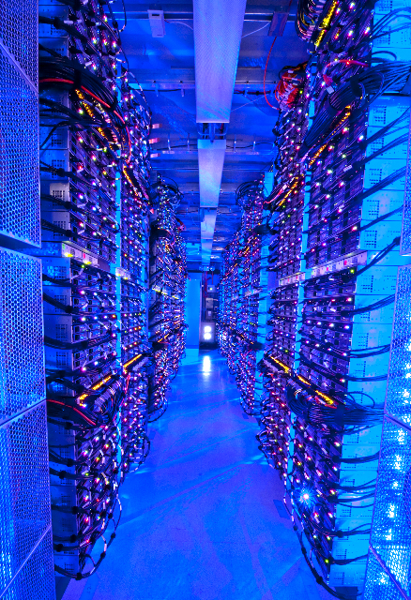
Containers in WSCs
Inside WSC
Inside Container

Slide 6
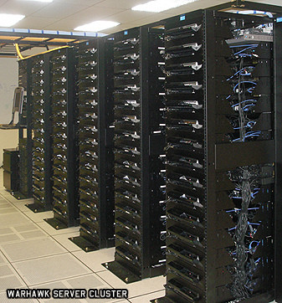
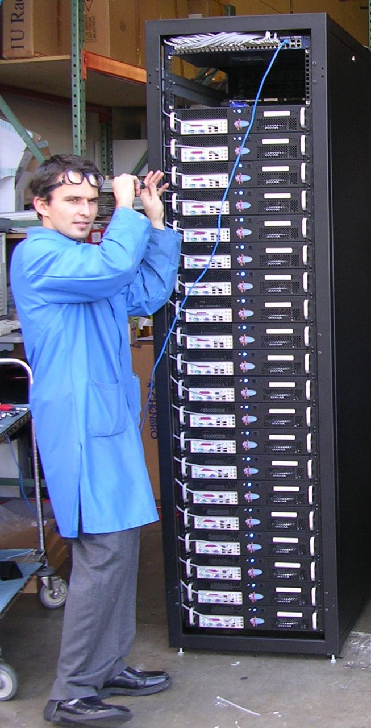
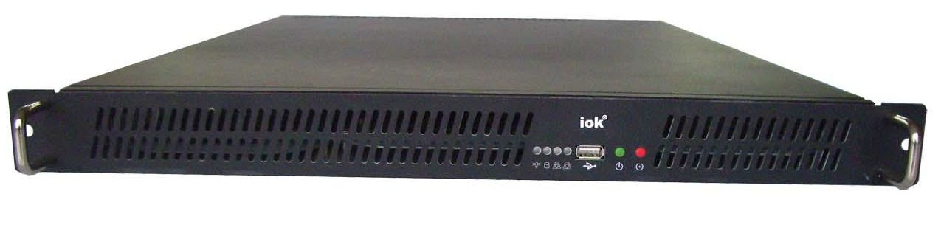
Server, Rack, Array

Slide 7
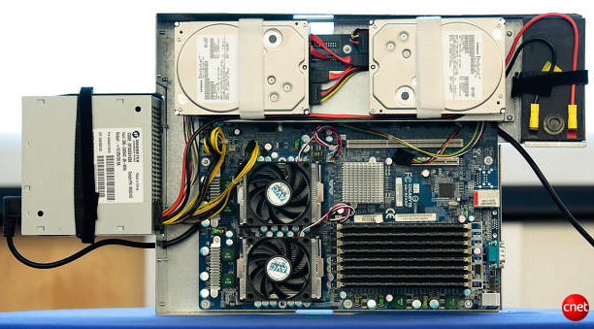
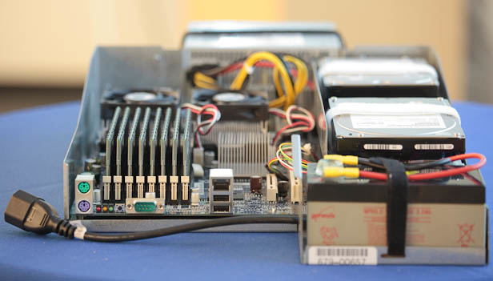
Google Server Internals
Google Server
Notes:
Most companies buy servers from the likes of Dell, Hewlett-Packard, IBM, or Sun Microsystems. But Google, which has hundreds of thousands of servers and considers running them part of its core expertise, designs and builds its own. Ben Jai, who designed many of Google's servers, unveiled a modern Google server before the hungry eyes of a technically sophisticated audience.
Google's big surprise: each server has its own 12-volt battery to supply power if there's a problem with the main source of electricity. The company also revealed for the first time that since 2005, its data centers have been composed of standard shipping containers--each with 1,160 servers and a power consumption that can reach 250 kilowatts.
It may sound geeky, but a number of attendees--the kind of folks who run data centers packed with thousands of servers for a living--were surprised not only by Google's built-in battery approach, but by the fact that the company has kept it secret for years. Jai said in an interview that Google has been using the design since 2005 and now is in its sixth or seventh generation of design.
Read more: http://news.cnet.com/8301-1001_3-10209580-92.html#ixzz0yo8bhTOH

Slide 8
Warehouse-Scale Computers
Datacenter
  Collection of 10,000 to 100,000 severs
  Networks connecting them together
Single gigantic machine
Very large applications(Internet service):
search, email, video sharing, social networking
Very high availability
“…WSCs are no less worthy of the expertise of computer systems architects than any other class of machines”
Barroso and Hoelzle 2009

Slide 9
Unique to WSCs
Ample Parallelism
  Request-level Parallelism: ex) Web search
  Data-level Parallelism: ex) Image classifier training
Scale and its Opportunities/Problems
  Scale of economy: low per-unit cost
  Cloud computing: rent computing power with low costs
  High # of failures
    ex) 4 disks/server, annual failure rate: 4%
    → WSC of 50,000 servers: 1 disk fail/hour
Operation Cost Count
  Longer life time(>10 years)
  Cost of equipment purchases << cost of ownership

Slide 10
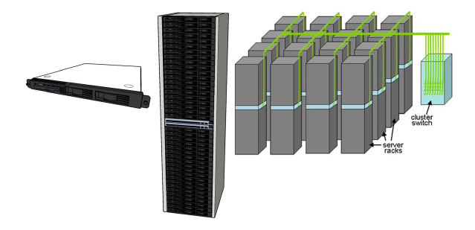
WSC Architecture
1U Server:
8 cores,
16 GB DRAM,
4x1 TB disk
Array(aka cluster):
16-32 racks
Expensive switch
(10X bandwidth → 100x cost)
Rack:
40-80 severs,
Local Ethernet(1-10Gbps) switch
(30$/1Gbps/server)

Slide 11
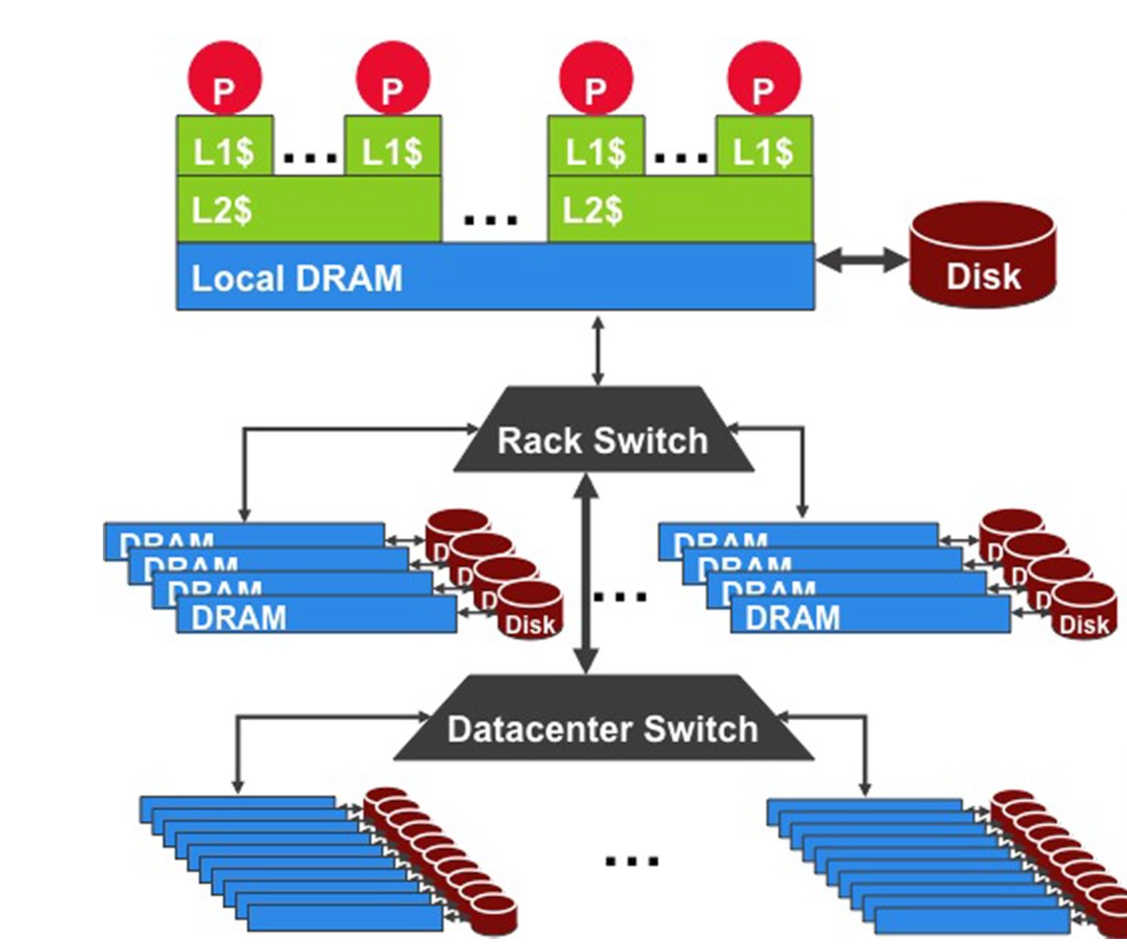
WSC Storage Hierarchy
Lower latency to DRAM in another server than local disk
Higher bandwidth to local disk than to DRAM in another server
1U Server:
DRAM: 16GB, 100ns, 20GB/s
Disk: 2TB, 10ms, 200MB/s
Rack(80 severs):
DRAM: 1TB, 300us, 100MB/s
Disk: 160TB, 11ms, 100MB/s
Array(30 racks):
DRAM: 30TB, 500us, 10MB/s
Disk: 4.80PB, 12ms, 10MB/s

Slide 12
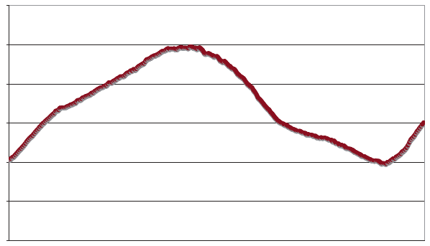
Workload Variation
Workload
2X
Midnight
Noon
Midnight
Online service: Peak usage 2X off-peak

Slide 13
Impact on WSC software
Latency, bandwidth → Performance
  Independent data set within an array
  Locality of access within sever or rack
High failure rate → Reliability, Availability
  Preventing failures is expensive
  Cope with failures gracefully
Varying workloads → Availability
  Scale up and down gracefully
More challenging than software for single computers!

Slide 14
Power Usage Effectiveness
Energy efficiency
  Primary concern in the design of WSC
  Important component of the total cost of ownership
Power Usage Effectiveness (PUE):
  A power efficiency measure for WSC
  Not considering efficiency of servers, networking gears
  Perfection = 1.0
  Google WSC’s PUE = 1.2
Total Building Power
IT equipment Power

Slide 15
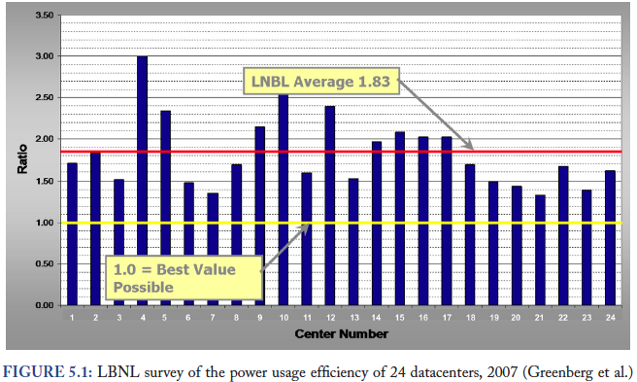
PUE in the Wild (2007)

Slide 16
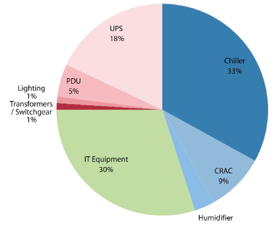
High PUE: Where Does Power Go?
Uninterruptable
Power Supply
(battery)
Cooling warm
water from
Air Conditioner
Power
Distribution
Unit
Severs +
Networking
Computer Room
Air Conditioner

Slide 17
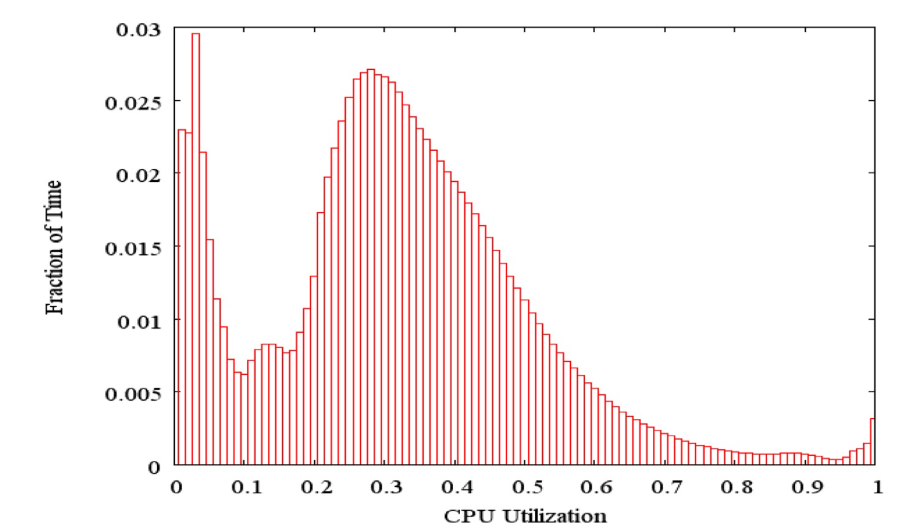
Load Profile of WSCs
Average CPU utilization of 5,000 Google severs
Most servers in WSC idle or utilized 20% to 60%

Slide 18
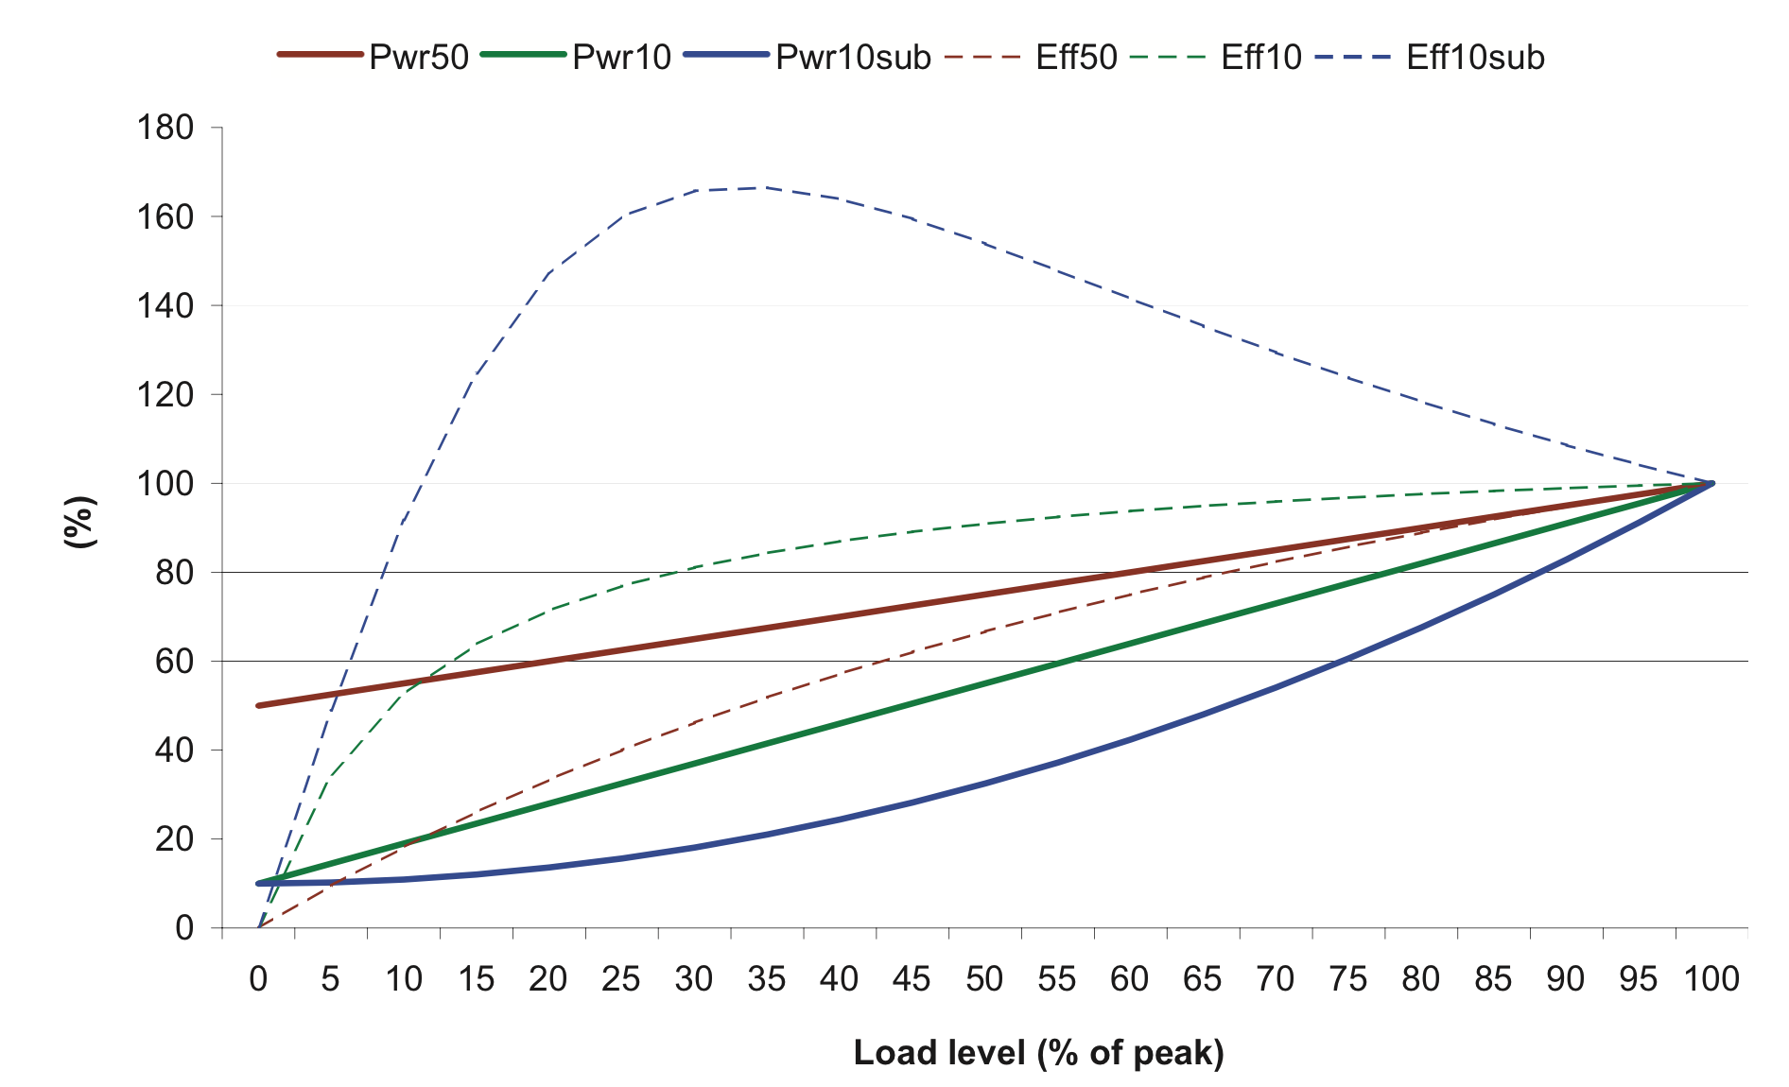
Energy-Proportional Computing
:Design Goal of WSC
Energy = Power x Time, Efficiency = Computation / Energy
→ Efficiency α 1 / Power, 1 / Time
Consumes almost no power when idle
Gradually consume more power as the activity level increases

Slide 19
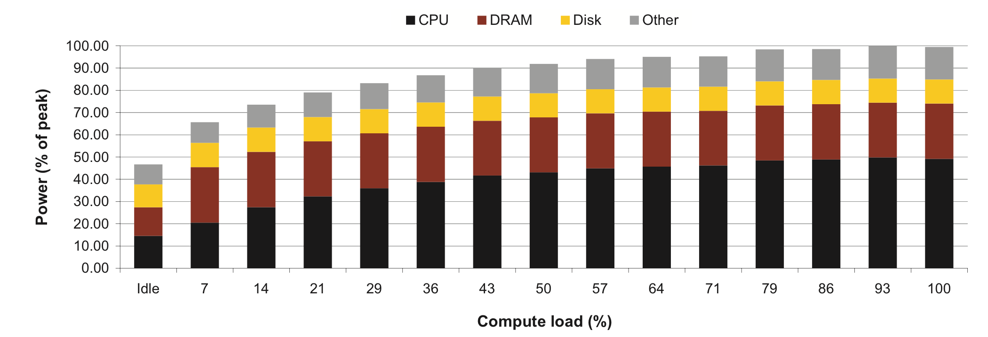
Cause of Poor Energy Proportionality
CPU: 50% at peek, 30% at idle
DRAM, disks, networking: 70% at idle!
Need to improve the energy efficiency of peripherals

Slide 20
Cloud Computing: Scale of Economy
Instance | Per Hour | Ratio to small | Compute Units | Virtual Cores | Compute Unit / Core | Memory (GiB) | Disk (GiB) | Address
Standard Small | $0.065 | 1.0 | 1.0 | 1 | 1.00 | 1.7 | 160 | 32bit
Standard Large | $0.260 | 4.0 | 4.0 | 2 | 2.00 | 7.5 | 850 | 64bit
Standard Extra Large | $0.520 | 8.0 | 8.0 | 4 | 2.00 | 15.0 | 1680 | 64bit
High-Memory Extra Large | $0.460 | 5.9 | 6.5 | 2 | 3.25 | 17.1 | 420 | 64bit
High-Memory Double Extra Large | $0.920 | 11.8 | 13.0 | 4 | 3.25 | 34.2 | 850 | 64bit
High-Memory Quadruple Extra Large | $1.840 | 23.5 | 26.0 | 8 | 3.25 | 68.4 | 1680 | 64bit
High-CPU Medium | $0.165 | 2.0 | 5.0 | 2 | 2.50 | 1.7 | 350 | 32bit
High-CPU Extra Large | $0.660 | 8.0 | 20.0 | 8 | 2.50 | 7.0 | 1680 | 64bit
March 2014 AWS Instances & Prices
Closest computer in WSC example is Standard Extra
At these low rates, Amazon EC2 can make money!
  even if used only 50% of time
Virtual Machine(VM) plays an important role

Slide 21
Agenda
Warehouse Scale Computing
Request-level Parallelism
  e.g. Web search
Administrivia & Clickers/Peer Instructions
Data-level Parallelism
  Hadoop, Spark
  MapReduce

Slide 22
Request-Level Parallelism (RLP)
Hundreds of thousands of requests per sec
  Not your laptop or cell-phone, but popular Internet services like web search, social networking, …
  Such requests are largely independent
    Often involve read-mostly databases
    Rarely involve read-write sharing or synchronization across requests
Computation easily partitioned across different requests and even within a request

Slide 23
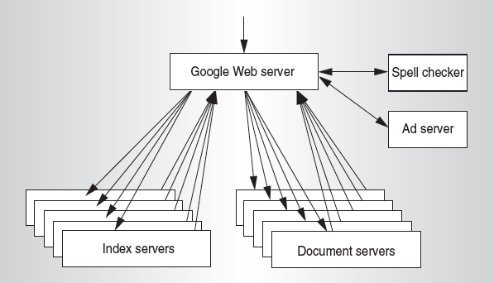
Google Query-Serving Architecture

Slide 24
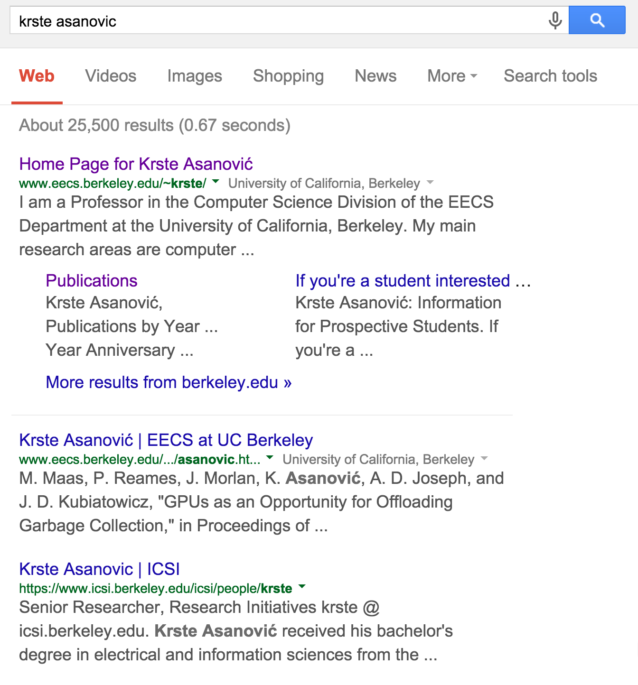
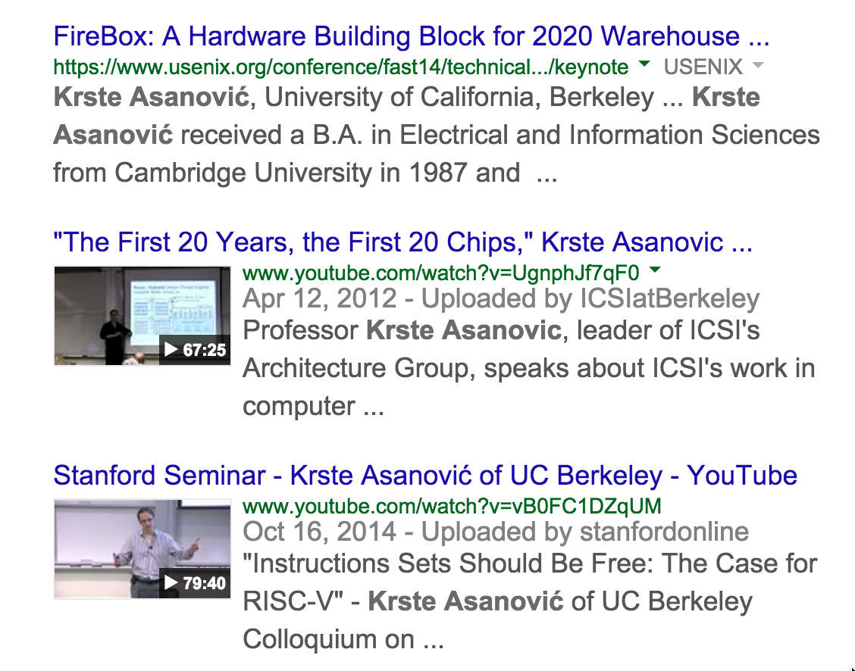
Anatomy of a Web Search
Google “Krste Asanovic”

Slide 25
Anatomy of a Web Search (1/3)
Google “Krste Asanovic”
  Direct request to “closest” Google WSC
  Front-end load balancer directs request to one of many arrays (cluster of severs) within WSC
  Within array, select one of many Goggle Web Servers(GWS) to handle the request and compose the response pages
  GWS communicates with Index Servers to find documents that contains the search words, “Krste”, “Asanovic”
  Return document list with associated relevance score

Slide 26
Anatomy of a Web Search (2/3)
In parallel,
  Ad system: run ad auction for bidders on search terms
  Get videos of Krste Asanovic’s talks
Use docids (Document IDs) to access indexed documents
Compose the page
  Result document extracts (with keyword in context) ordered by relevance score
  Sponsored links (along the top) and advertisements (along the sides)

Slide 27
Anatomy of a Web Search (3/3)
Implementation strategy
  Randomly distribute the entries
  Make many copies of data(a.k.a. “replicas”)
  Load balance requests across replicas
Redundant copies of indices and documents
  Breaks up search hot spots, e.g. “Taylor Swift”
  Increases opportunities for request-level parallelism
  Makes the system more tolerant of failures

Slide 28
Agenda
Warehouse Scale Computing
Request-level Parallelism
  e.g. Web search
Administrivia & Clickers/Peer Instruction
Data-level Parallelism
  Hadoop, Spark
  MapReduce

Slide 29
Administrivia
Project 3-2 Out
HW5 Out – Performance Programming
Guerrilla Section on Performance Programming on Thursday, 5-7pm, Woz

Slide 30
Clicker/Peer Instruction:
Which Statement is True
A: Idle servers consume almost no power
B: Disks will fail once in 20 years, so failure is not a problem of WSC
C: The search requests of the same keyword from different users are dependent
D: WSCs are not good at batch processing
E: WSCs contain many copies of data

Slide 31
Break

Slide 32
Agenda
Warehouse Scale Computing
Administrivia & Clickers/Peer Instructions
Request-level Parallelism
  e.g. Web search
Data-level Parallelism
  MapReduce
  Hadoop, Spark

Slide 33
Data-Level Parallelism(DLP)
SIMD
  Supports data-level parallelism in a single machine
  Additional instructions & hardware
  e.g. Matrix multiplication in memory
DLP on WSC
  Supports data-level parallelism across multiple machines
  MapReduce & scalable file systems
  e.g. Training CNNs with images across multiple disks

Slide 34
What is MapReduce?
Simple data-parallel programming model and implementation for processing large dataset
Users specify the computation in terms of
  a map function, and
  a reduce function
Underlying runtime system
  Automatically parallelize the computation across large scale clusters of machines.
  Handles machine failure
  Schedule inter-machine communication to make efficient use of the networks
Jeffrey Dean and Sanjay Ghemawat, “MapReduce: Simplified Data Processing on Large Clusters,” 6th USENIX Symposium on Operating Systems Design and Implementation, 2004. (optional reading, linked on course homepage – a digestible CS paper at the 61C level)
Notes:
Scalable to large volumes of data
Be cost-efficient: run on large clusters of commodity hardware

Slide 35
What is MapReduce used for?
At Google:
  Index construction for Google Search
  Article clustering for Google News
  Statistical machine translation
  For computing multi-layers street maps
At Yahoo!:
  “Web map” powering Yahoo! Search
  Spam detection for Yahoo! Mail
At Facebook:
  Data mining
  Ad optimization
  Spam detection

Slide 36
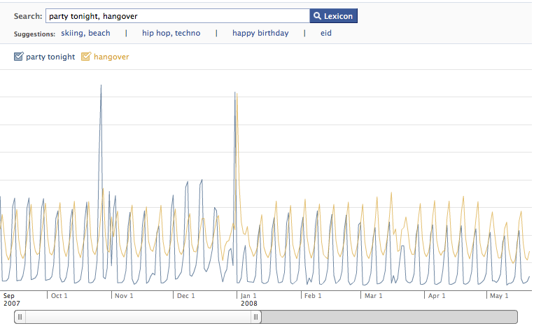
Example: Facebook Lexicon
www.facebook.com/lexicon
(no longer available)

Slide 37
Map & Reduce Functions in Python
1
2
3
4
Calculate :
l = [1, 2, 3, 4]
def square(x):
return x * x
def sum(x, y):
return x + y
reduce(sum,
map(square, l))
1
4
9
16
5
25
30

Slide 38
MapReduce Programming Model
Map: (in_key, in_value) → list(interm_key, interm_val)
  map(in_key, in_val):
  // DO WORK HERE
  emit(interm_key,interm_val)
  Slice data into “shards” or “splits” and distribute to workers
  Compute set of intermediate key/value pairs
Reduce: (interm_key, list(interm_value)) → list(out_value)
  reduce(interm_key, list(interm_val)):
  // DO WORK HERE
  emit(out_key, out_val)
  Combines all intermediate values for a particular key
  Produces a set of merged output values (usually just one)

Slide 39
MapReduce Word Count Example
Map phase: (doc name, doc contents) → list(word, count)
  // “I do I learn”” → [(“I”,1),(“do”,1),(“I”,1),(“learn”,1)]
  map(key, value):
  for each word w in value:
  emit(w, 1)
Reduce phase: (word, list(count)) → (word, count_sum)
  // (“I”, [1,1]) → (“I”,2)
  reduce(key, values):
  result = 0
  for each v in values:
  result += v
  emit(key, result)

Slide 40
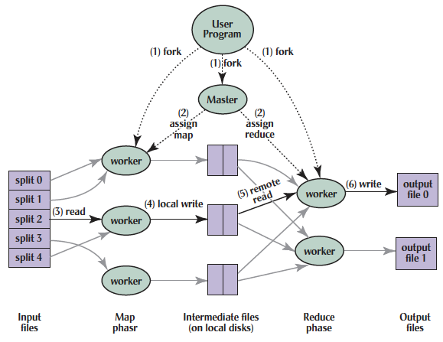
MapReduce Implementation

Slide 41
MapReduce Execution
(1) Split inputs,
start up programs on a cluster of machines

Slide 42
MapReduce Execution
(2) Assign map & reduce tasks to
idle workers

Slide 43
MapReduce Execution
(3) Perform a map task, generate intermediate key/value pairs
(4) Write to the buffers

Slide 44
MapReduce Execution
(5) Read intermediate key/value pairs,
sort them by its key.

Slide 45
MapReduce Execution
(6) Perform a reduce task for each intermediate key,
write the result to the output files

Slide 46
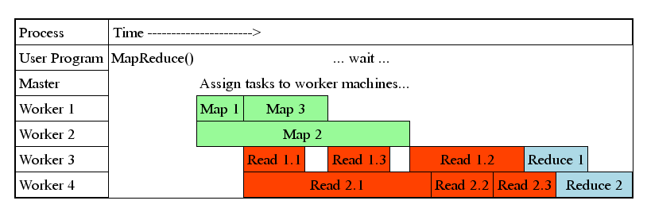
MapReduce Processing Time Line
Master assigns map + reduce tasks to “worker” servers
As soon as a map task finishes, worker server can be assigned a new map or reduce task
Data shuffle begins as soon as a given Map finishes
Reduce task begins as soon as all data shuffles finish
To tolerate faults, reassign task if a worker server “dies”

Slide 47

Big Data Framework: Hadoop & Spark
Apache Hadoop
  Open-source MapReduce Framework
  Hadoop Distributed File System (HDFS)
  MapReduce Java APIs
Apache Spark
  Fast and general engine for large-scale
  data processing.
  Originally developed in the AMP lab at UC Berkeley
  Running on HDFS
  Provides Java, Scala, Python APIs for
    Database
    Machine learning
    Graph algorithm

Slide 48
WordCount in Hadoop’s Java API

Slide 49
Word Count in Spark’s Python API
// RDD: primary abstraction of a distributed collection of items
file = sc.textFile(“hdfs://…”)
// Two kinds of operations:
// Actions: RDD → Value
// Transformations: RDD → RDD
// e.g. flatMap, Map, reduceByKey
file.flatMap(lambda line: line.split())
.map(lambda word: (word, 1))
.reduceByKey(lambda a, b: a + b)

Slide 50
Summary
Warehouse Scale Computers
  New class of computers
  Scalability, energy efficiency, high failure rate
Request-level parallelism
  e.g. Web Search
Data-level parallelism on a large dataset
  MapReduce
  Hadoop, Spark

