Slide 1
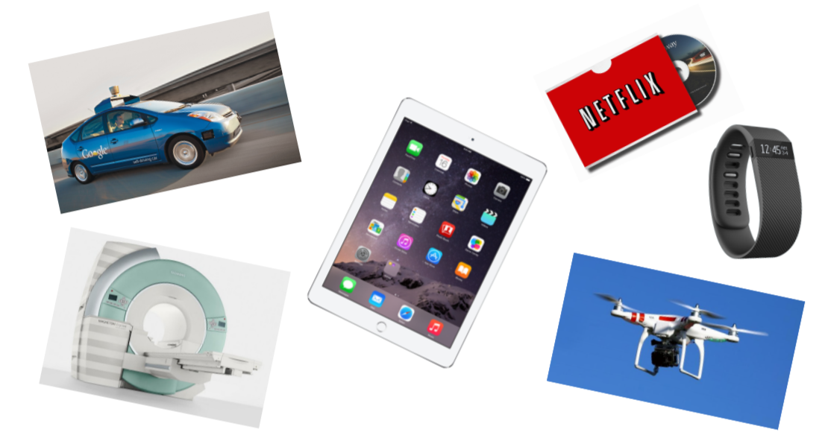
EE16A
Designing Information Devices and Systems I
We ask for 100% of your focus. Please turn off all technology.

Slide 2
All of these extract information from the real world and interact with it; we will be learning how to design and understand these devices & systems

Slide 3
First Lecture Plan
Introductions
Administrative Details (discussions, homework, etc.)
Overview of 16A’s material and how it fits into EECS
Start with module 1

Slide 4
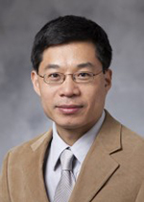
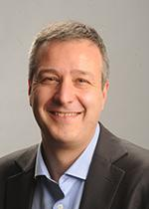
Instructors
Prof. Chunlei Liu
chunlei.liu@eecs.berkeley.edu
505 Cory
Prof. Vladimir Stojanovic
vlada@berkeley.edu
513 Cory

Slide 5
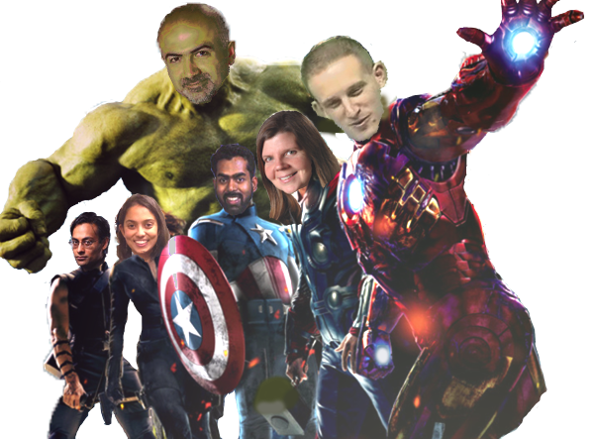

Other contributors to 16: Elad Alon, Anant Sahai, Laura Waller, Ali Niknejad, Claire Tomlin, Michel Maharbiz, Miki Lustig, Vivek Subramanian, Thomas Courtade, Babak Ayazifar
Credit: Akshay Madhani

Slide 6
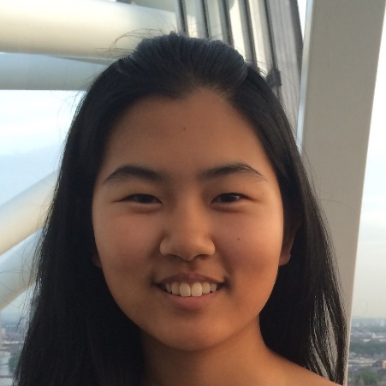


GSIs and uGSIs
Head GSIs:
ee16a.staff@gmail.com
Email with:
Questions not for Piazza
All conflicts
Any emergencies
Administrative questions
Grace Zhang
Rohan Lageweg
Sam Weismann

Slide 7
Lots of you, but lots of us too!
Many many Academic Student Employees…
  Former 16A students just like you …
The path to being on 16A staff
  Do great in 16A
  Become an Academic Student Employee
    Grade homeworks, assist in labs, tutor and help out in OH, work on improving the notes …
    Become a uGSI
    Become faculty!

Slide 8
Some logistics
EECS 16A
http://inst.eecs.berkeley.edu/~ee16a/sp19/
Piazza
http://piazza.com/

Slide 9


Course policies
Syllabus is on course website
  Please read and follow all course policies listed. You are responsible for this.
Grading is absolute (no curve)
  You are not competing against one another
No technology (usage) during lecture!
  Sleeping is OK
Notes:
Be respectful of staff time

Slide 10
Course audience
Freshmen and incoming junior-transfers (like 61A)
Sophomores who for some reason were unable
to take the class their first year
We assume no prior background in linear algebra or physics

Slide 11
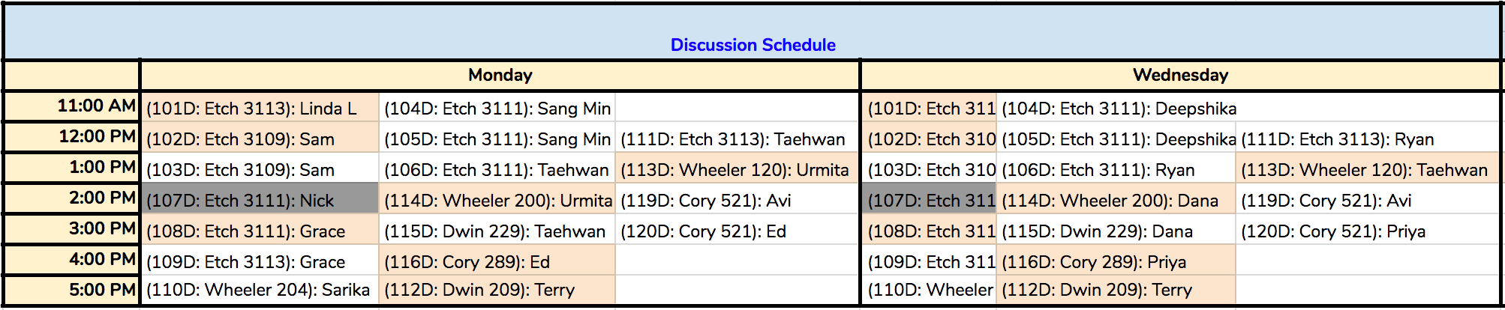
Discussions
Transfer section
Freshman section
Notes:
CS Scholars

Slide 12
Homeworks
Due Friday at midnight
  Except HW 0, due Monday, Jan 28 at midnight
HW Party: Wed 9-11 am and Thu 2-4 pm
OH: See website
HW solutions released on Saturday at noon
Self-grades due Tuesdays at midnight
Resubmissions due along with self-grades

Slide 13
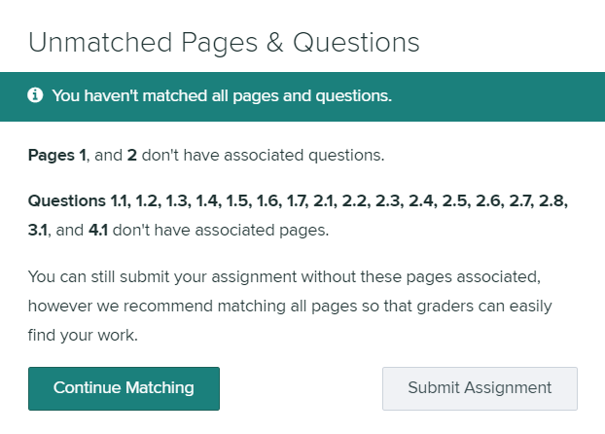
Homework Submission
Homework submitted on Gradescope (enroll ASAP if you haven’t been automatically: code 9Z3R5J)
  You must select pages
  You must submit printout of iPython code (see syllabus)

Slide 14
How to succeed in this 16A
Marathon, not a sprint
Focus on understanding, get enough sleep, and keep up!
Attend lecture (especially freshmen and junior transfers)
Actively read notes, mark what is challenging
Attend discussion
Try HW on your own, early on
            Discuss problems with study group and/or at HW Party
Ask/Lurk and help others on Piazza
Write up HW on your own
Reflect on solutions while self-grading
Study with others as well as alone.
Seek and offer help.
We are here to help you and to have you succeed!

Slide 15
You are here to learn!
Our staff wants to help you learn
  In-lecture Q&A, Professor and TA OH, HW parties, Lab
Cheating directly detracts from learning
  Any cheating will be immediately sent to the Office of Student Conduct
  Report bad behavior
Be kind and compassionate to each other and to your GSIs
  Everyone here is smart, everyone comes from different backgrounds
  Helping others is good for both of you
  Professors can make mistakes – feedback helps
  Ask for help! If you are confused about something, most likely others are too!
Notes:
Empower you

Slide 16
EE16A Playlist
We’d like to play you some music before the class
but it has to be non copyrighted
Send us a link to non copyrighted playlists
and we’ll give it a shot

Slide 17
Extra credit
Good citizen credit
  Award each other tokens for being helpful!
  Each student can award up to two tokens to other students each week
  Can award tokens to the same student at most twice
  These tokens can count as extra credit
Content creation extra credit
  Extra-credit for creating demos, videos, good explanations etc.

Slide 18
16AB: “How to think like an engineer”
Model, design and build systems
  (driven by linear algebra, circuits, information systems, signals, and learning)
Complementary perspective to 61AB
  Computational thinking on the mathematical and hardware side
“Thinking tools” that are relevant to all careers
  Show you the different parts of EECS

Slide 19
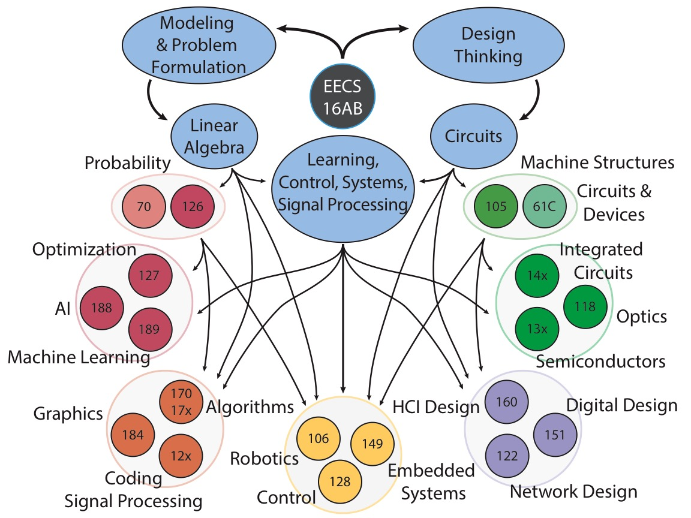
Thanks: Sahaana Suri
Notes:
EE127 is core material related to 189 and many people don’t realize that

Slide 20
Topics
Imaging/Tomography and Google PageRank (5 weeks)
  Topics: Linear algebraic thinking and graphs
  Lab: Single-pixel imager
Touchscreens (5 weeks)
  Topics: Linear circuits and design
  Lab: Home-made R and C touchscreens
Locationing and Least-Squares (4 weeks)
  Topics: Linear-algebraic optimization
  Lab: Acoustic localization “GPS”

Slide 21
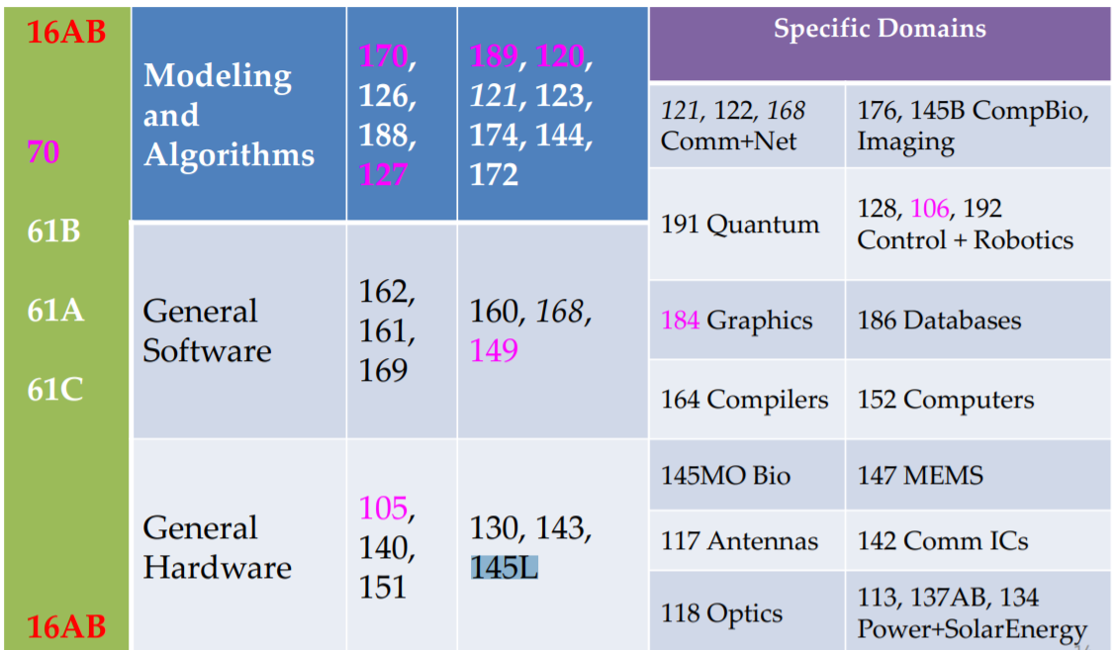
Related courses
Notes:
What are the color codes here?

Slide 22


Slide 23
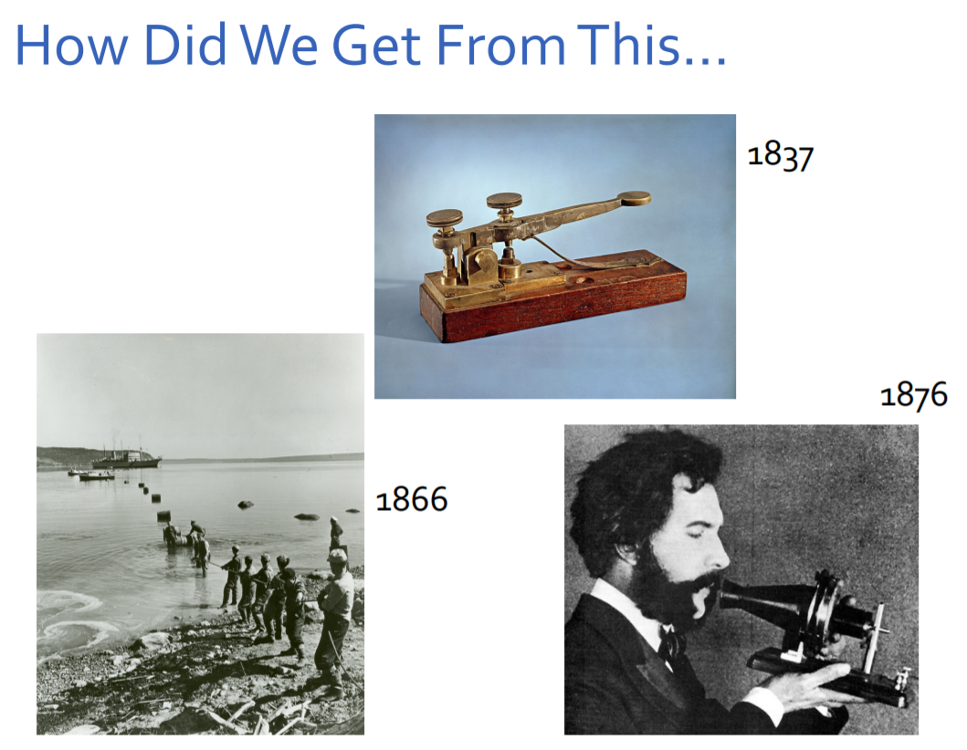
Notes:
Communications examples that required a LOT of engineering
Top: telegraph, attributed to Morse (of Morse code fame), press the lever and it sends messages in binary (long or short pulse). I’m so old that I know my name in Morse code: Dit-dah-dit-dit (L) dit-dah (A), dit-dit-dah (U), dit-dah-dit (R ), dit-dah (A)
Bottom Left: trans-Atlantic cable, didn’t work first time because engineers didn’t correctly model how the power travels through (and decays) through the wire. An example of not understanding what problem to solve in the first place, and the importance of modeling
Bottom right: telephone (Alex graham-bell)

Slide 24
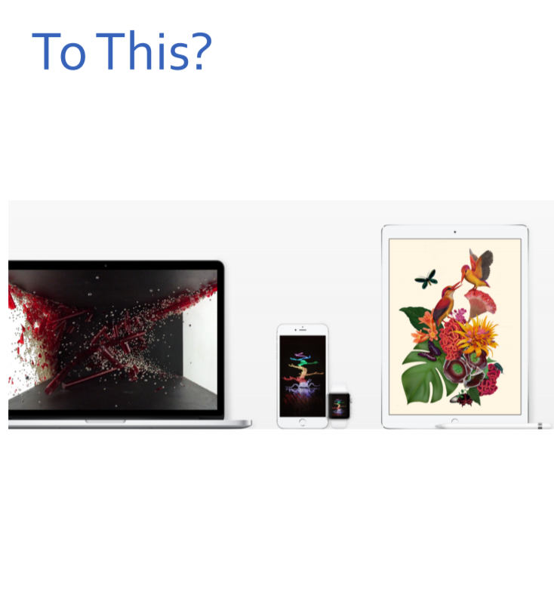
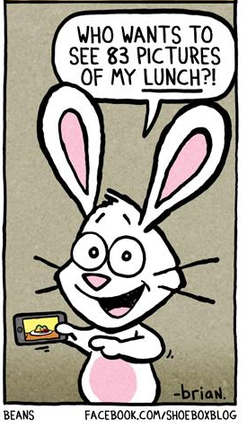

Slide 25
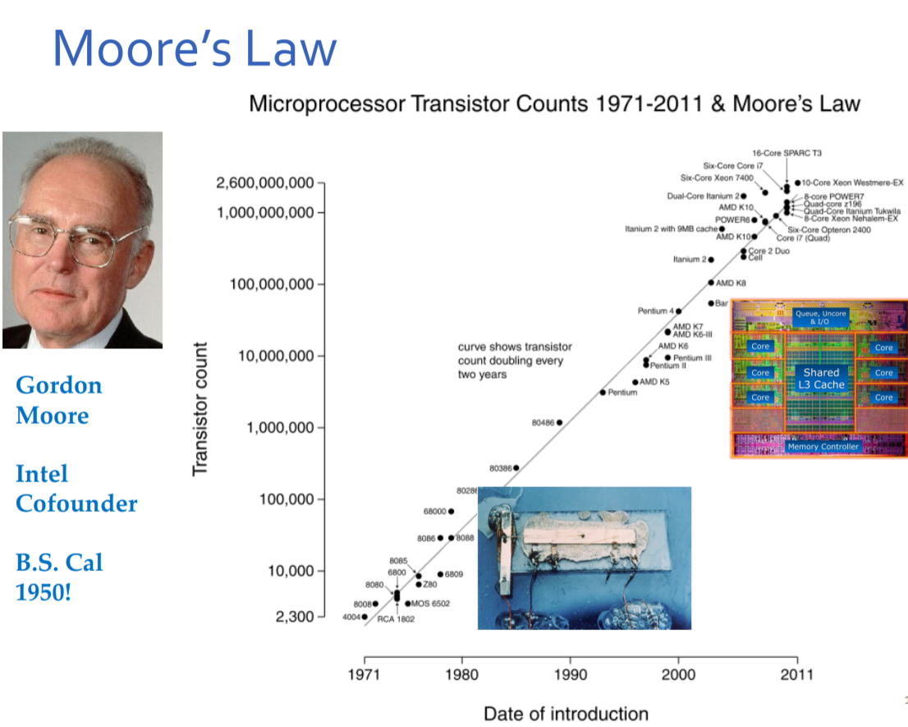
What is a transistor?
Notes:
Moore’s Law: the number of transistors you can put on a silicon chip roughly doubles every 2-3 years or so
Moore was Berkeley grad, cofounded Intel
What’s a transistor? (discuss one min) How would you explain so my mother can understand?
An electronic switch.
All electronics is based on being able to make very small fast and cheap switches (like the telegraph).
Over last 40 years, we’ve gotten 6 orders of mag increase in the switches we can build, so massive transition over short time! Can build super complicated systems
e.g. 2.6 Billion transistors on a chip now, can’t worry about how each electron flows, need to apply abstraction and multi-step thinking → KEY in this class

Slide 26
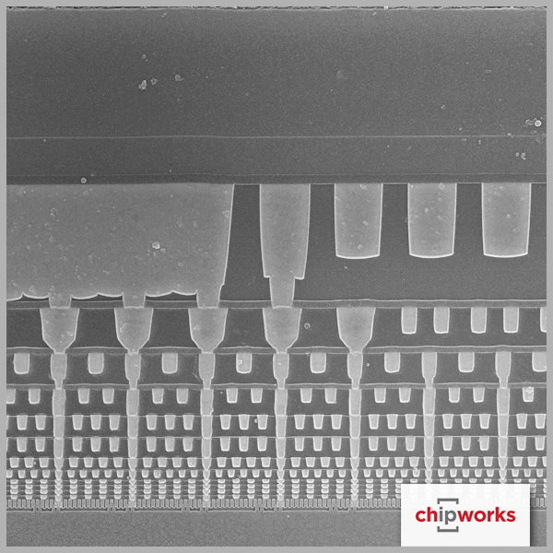
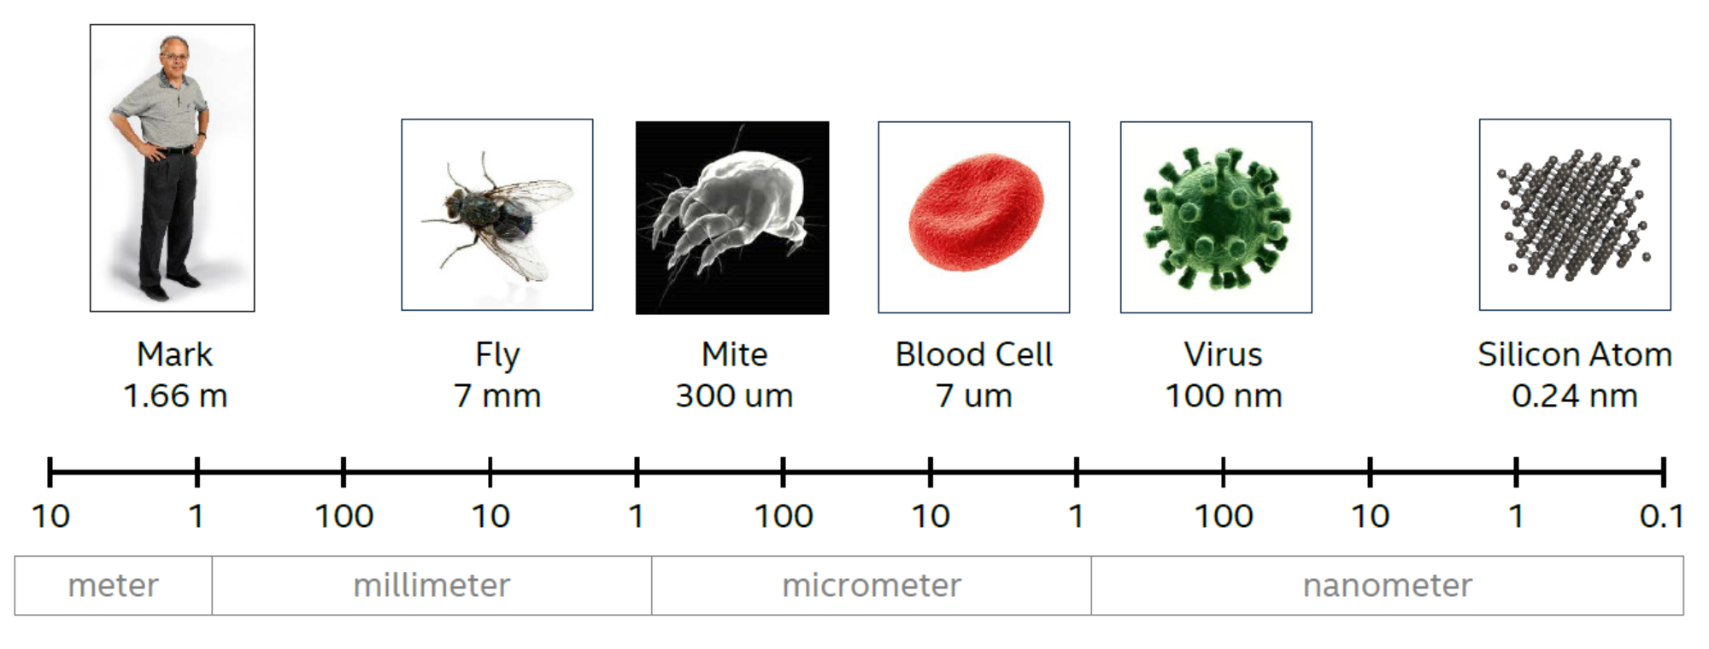
Sense of Scale
Side view of wiring layers
Source: Mark Bohr, IDF14

Slide 27
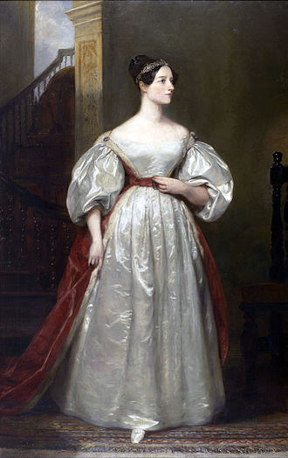
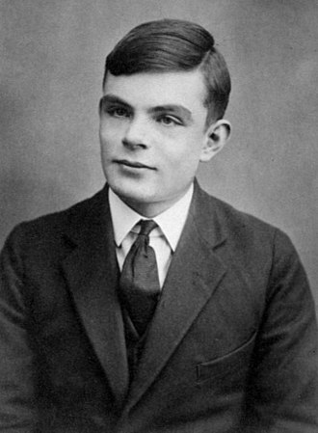
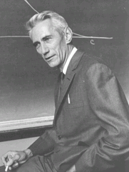
Completing the puzzle …
Ada Lovelace - wrote the first computer program
Turing – invented the Turing machine – how to build a computer to execute programs – what is actually computable?
Claude Shannon – info theory, + how to implement logic out of EM switches
Notes:
Turing was first gay man in computers (also first man) (also first person). Helped win the war by cracking the code for Enigma machine to spy on Germans – some say this saved 14M lives.
Died early at 41 (1952) of cyanide poisoning, likely suicide after being prosecuted for homosexual acts.
Considered the father of CS and AI, he could have otherwise lived to see his work transform the world.
These folks figured out fundamental limits on what’s possible so we can build up to the high tech we have today.

Slide 28
Design of Information Devices and Systems
16a
Real World
Sense
Process
Actuate
16b
Best when hardware and software work together
  Best algorithms and best code written by understanding the sensing and compute mechanisms
  Best devices designed understanding the physical limitations

Slide 29
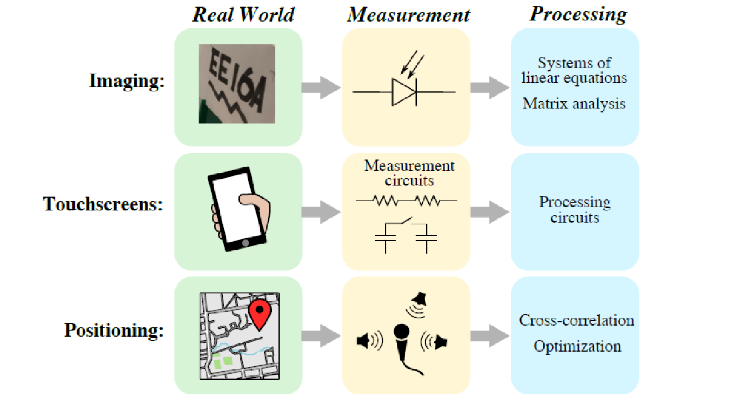
16a Examples

Slide 30
Module 1: Imaging

Slide 31
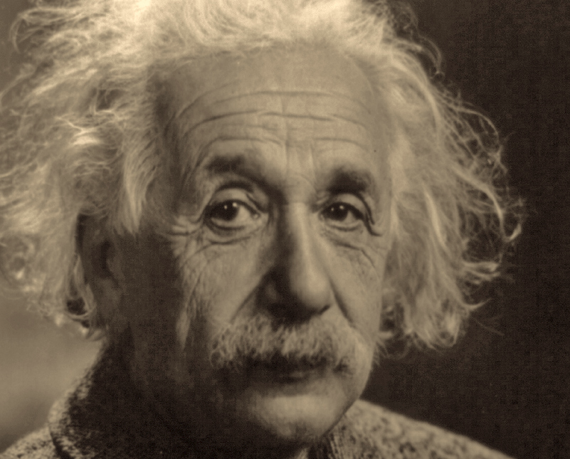
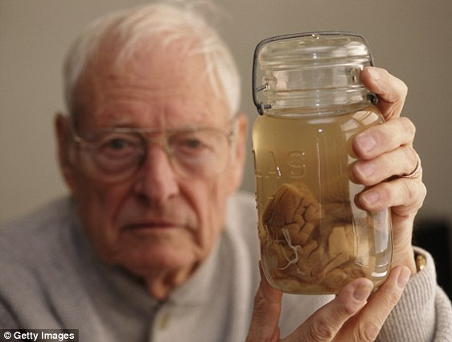
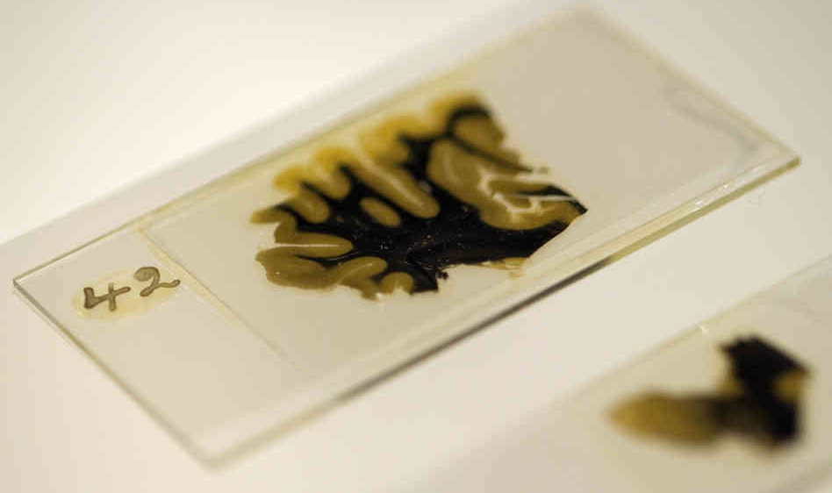
The Case of Einstein’s Brain

Slide 32
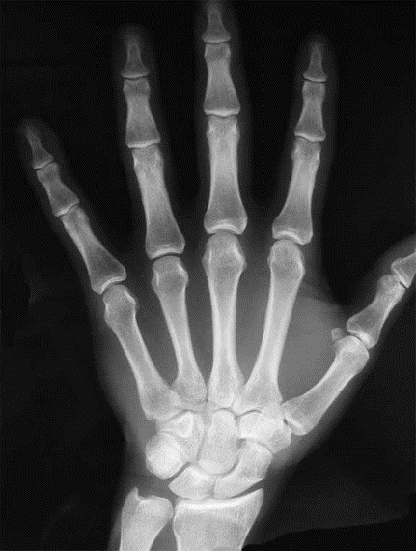
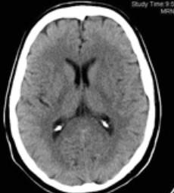
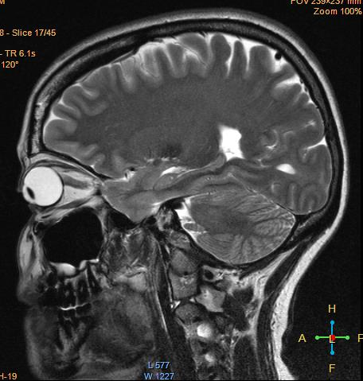
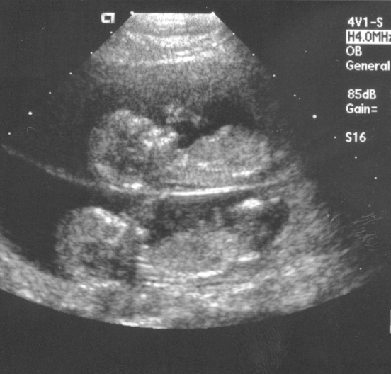
Seeing inside bodies: sans surgery…
MRI
X-Ray
CT
All of these benefitted from the math/hardware design techniques you will learn in this class!
Ultrasound
Notes:
Do you recognize this fine specimen of brain in the MRI? It’s me (Laura Waller)
What does CT stand for? “Computed Tomography”

Slide 33
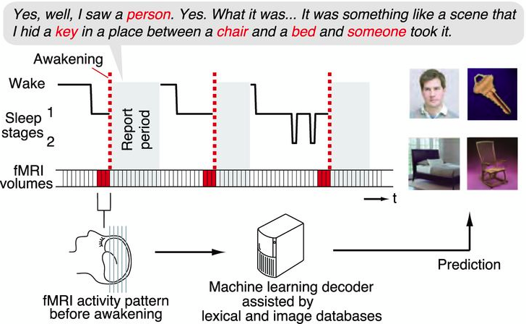
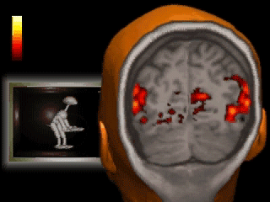
“Decode Dreams”: Visual Imagery During Sleep
~ 70% accuracy
Horikawa, Tomoyasu, et al. Science 340.6132 (2013): 639-642.
Notes:
fMRI data were acquired from sleeping participants simultaneously with polysomnography. Participants were awakened during sleep stage 1 or 2 (red dashed line) and verbally reported their visual experience during sleep. fMRI data immediately before awakening [an average of three volumes (= 9 s)] were used as the input for main decoding analyses (sliding time windows were used for time course analyses). Words describing visual objects or scenes (red letters) were extracted. The visual contents were predicted using machine-learning decoders trained on fMRI responses to natural images. (B) The numbers of awakenings with and without visual contents are shown for each participant (with numbers of experiments in parentheses).
(A) Words describing visual objects or scenes (red) were mapped onto synsets of the WordNet tree. Synsets were grouped into base synsets (blue frames) located higher in the tree. (B) Visual reports (participant 2) are represented by visual content vectors, in which the presence or absence of the base synsets in the report at each awakening is indicated by white or black, respectively. Examples of images used for decoder training are shown for some of the base synsets.

Slide 34
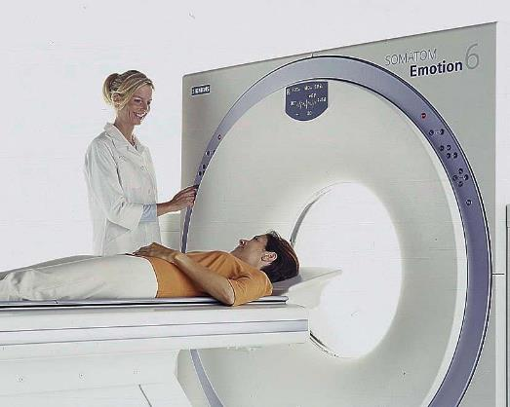
Tomography
Siemens
‘tomo’ – slice
‘graphy’ – to write
Assume it is not desirable to slice open my brain. How does tomography ‘see’ inside?
Notes:
When you don’t understand something, simplify.

Slide 35
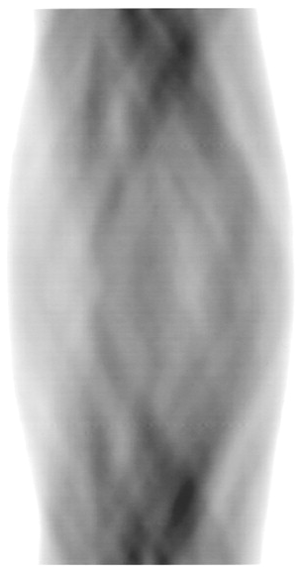
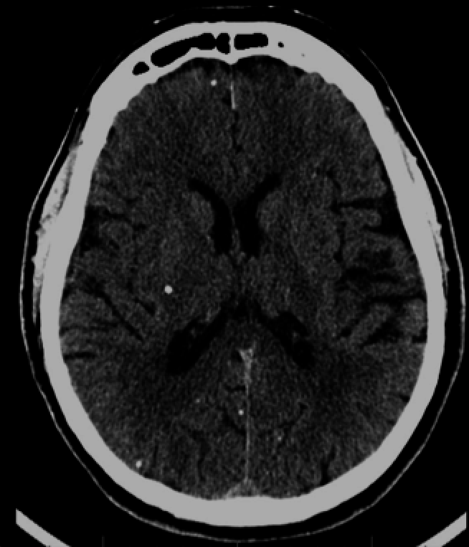
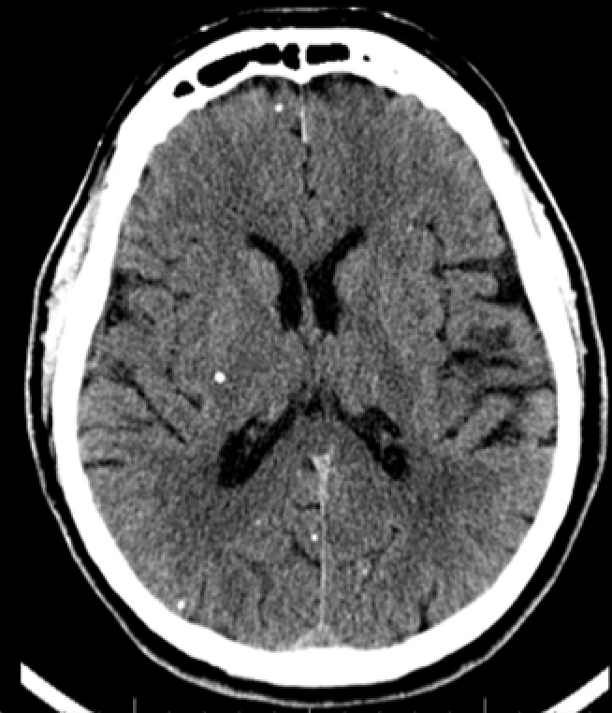
Tomography
Physical Imaging System
Measurements
Reconstruction
Image
many projections
?
Projection Angles
What is a projection?
Sum of values along a line.
1D projections of a 2D object → 2D recovery
2D projections of a 3D object → 3D recovery
Notes:
What does each pixel in the image represent?

Slide 36
What Is A “Digital Image”?
A numeric representation of an image, most commonly by a “matrix”.
A matrix is an array of numbers, can be of 2D, 3D or higher dimensions.
How many pixels is needed to fully represent an image?
  Sampling theory: convert analog to digital
  Information theory
Can you think of a physical quantity that has to be represented by a matrix?

Slide 37
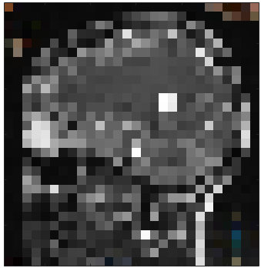
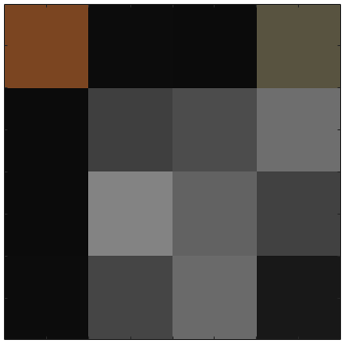


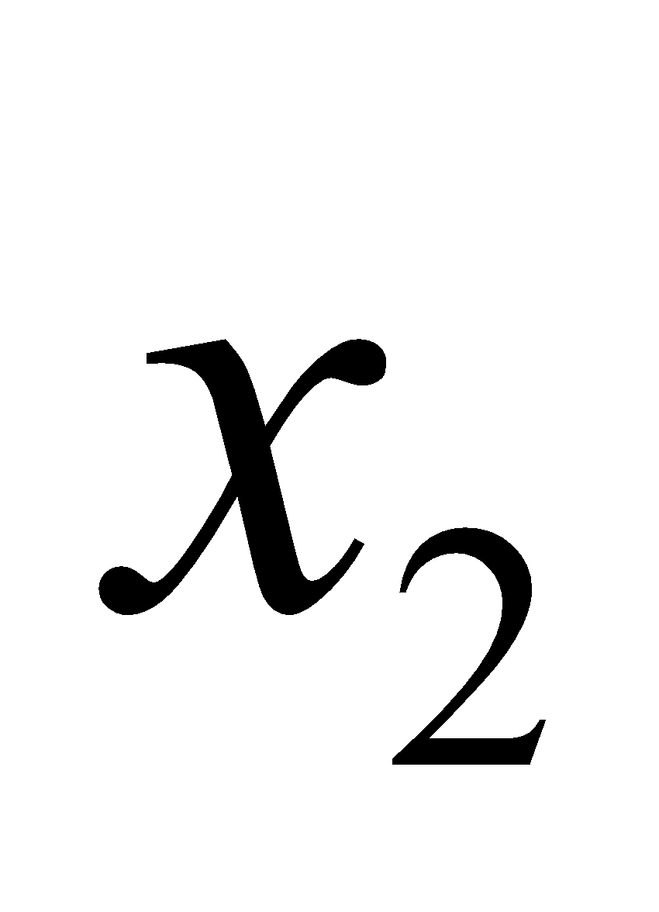
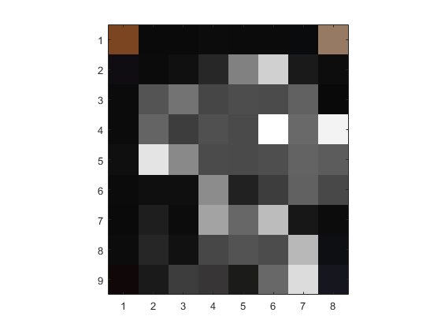
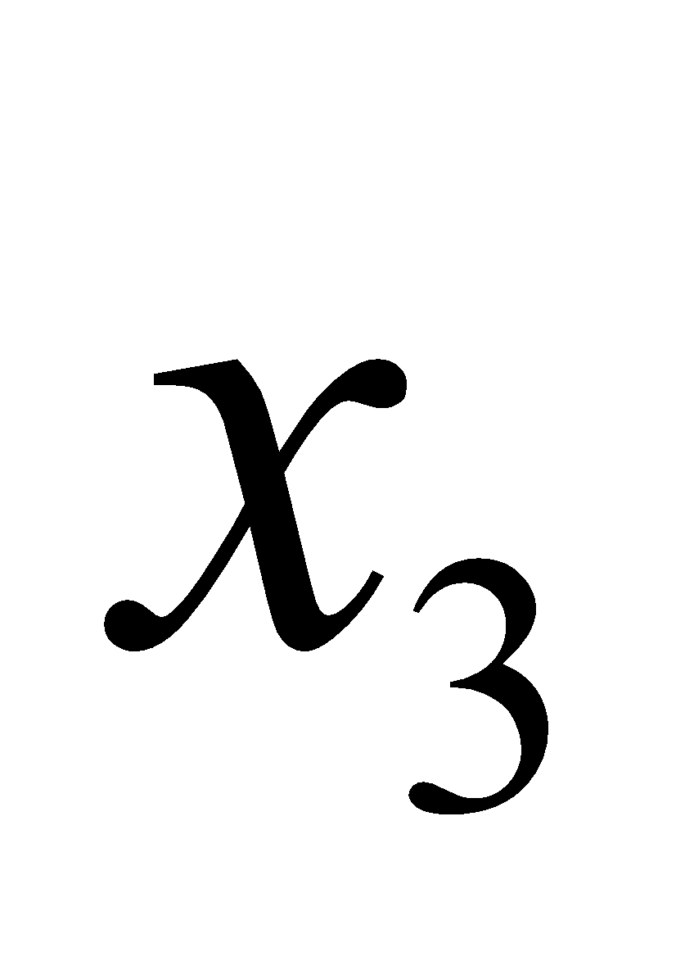
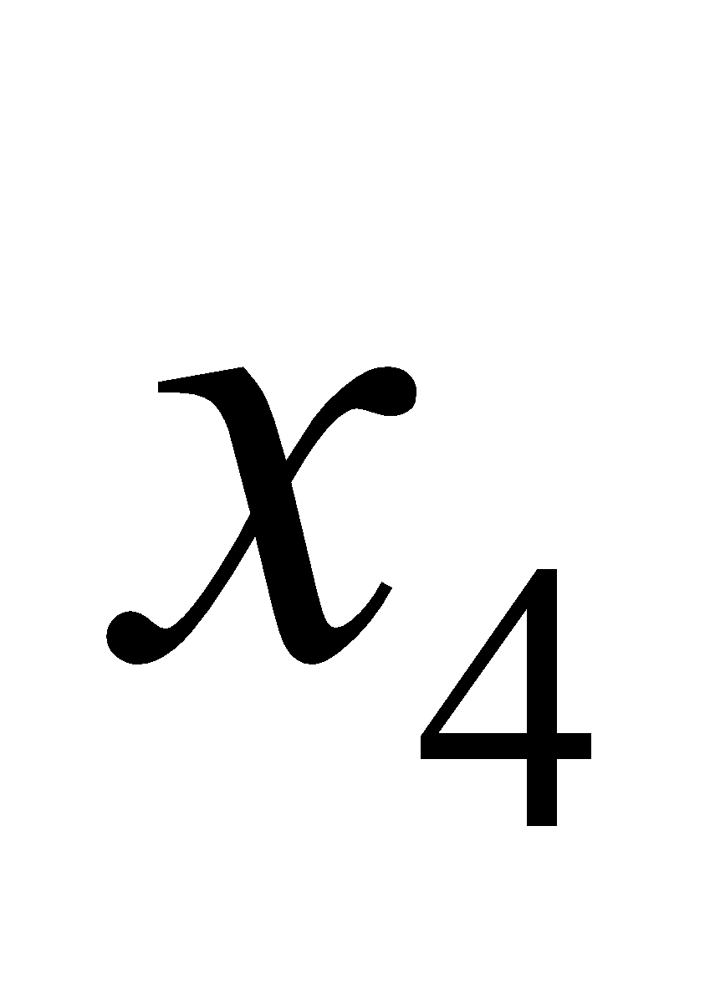
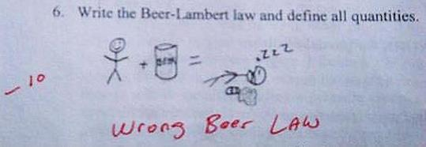
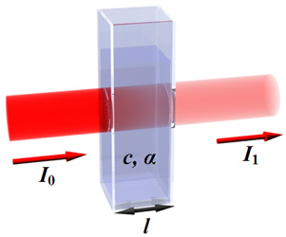
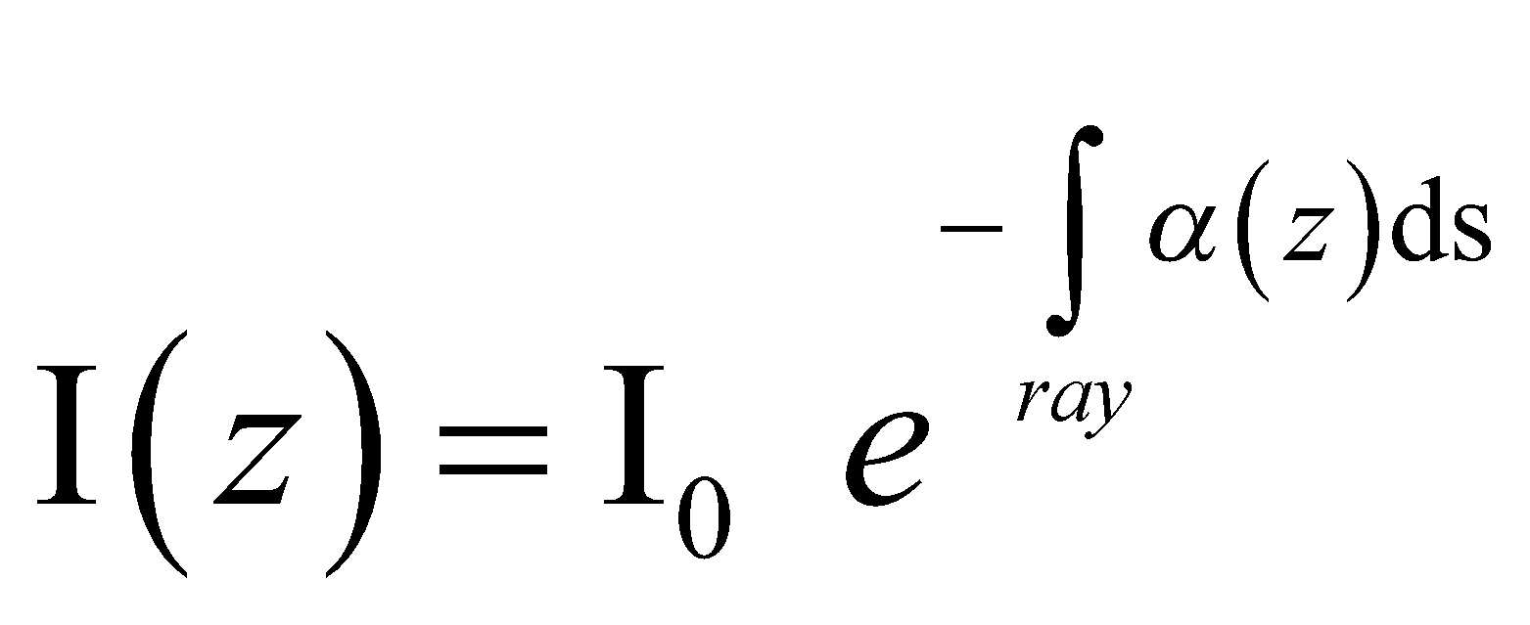

Example: Tomography
What do pixel values represent?
e.g. density, absorption, etc.
Can we solve for the pixel values from projections?
Yes, with tomography.
projection intensity
attenuation coefficient
Notes:
First, let’s simplify by reducing the resolution…. A LOT. Now it’s just a 4 pixel image.

Slide 38


Example: Tomography
a
$$ax_{1}+ax_{2} =b_{1}$$
a
$$ax_{3}+ax_{4}=b_{2}$$
projection intensity
attenuation coefficient

Slide 39
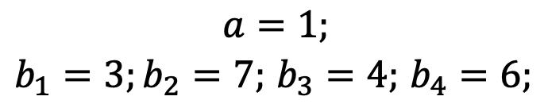


Example: Tomography
a
a
a
$$ax_{1}+ax_{2} =b_{1}$$
EQ1
a
$$ax_{3}+ax_{4}=b_{2}$$
EQ2
$$ax_{1} +ax_{3} =b_{3}$$
EQ3
$$a=1;$$
$b_{1}=3;b_{2}=7;$ $b_{3}=4;$ $b_{4}=6;$
$$ax_{2} +ax_{4} =b_{4}$$
EQ4
EQ1 + EQ2 = EQ3 + EQ4: linearly dependent
projection intensity
attenuation coefficient

Slide 40
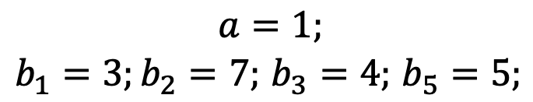

Example: Tomography
a
a
a
a
$$ax_{1}+ax_{2} =b_{1}$$
EQ1
$$ax_{3}+ax_{4}=b_{2}$$
EQ2
$$ax_{1} +ax_{3} =b_{3}$$
EQ3
$$a=1;$$
$b_{1}=3;b_{2}=7;$ $b_{3}=4;$ $b_{5}=5;$
$$ax_{1} +ax_{4} =b_{5}$$
EQ5
Is it really true?
projection intensity
attenuation coefficient

Slide 41
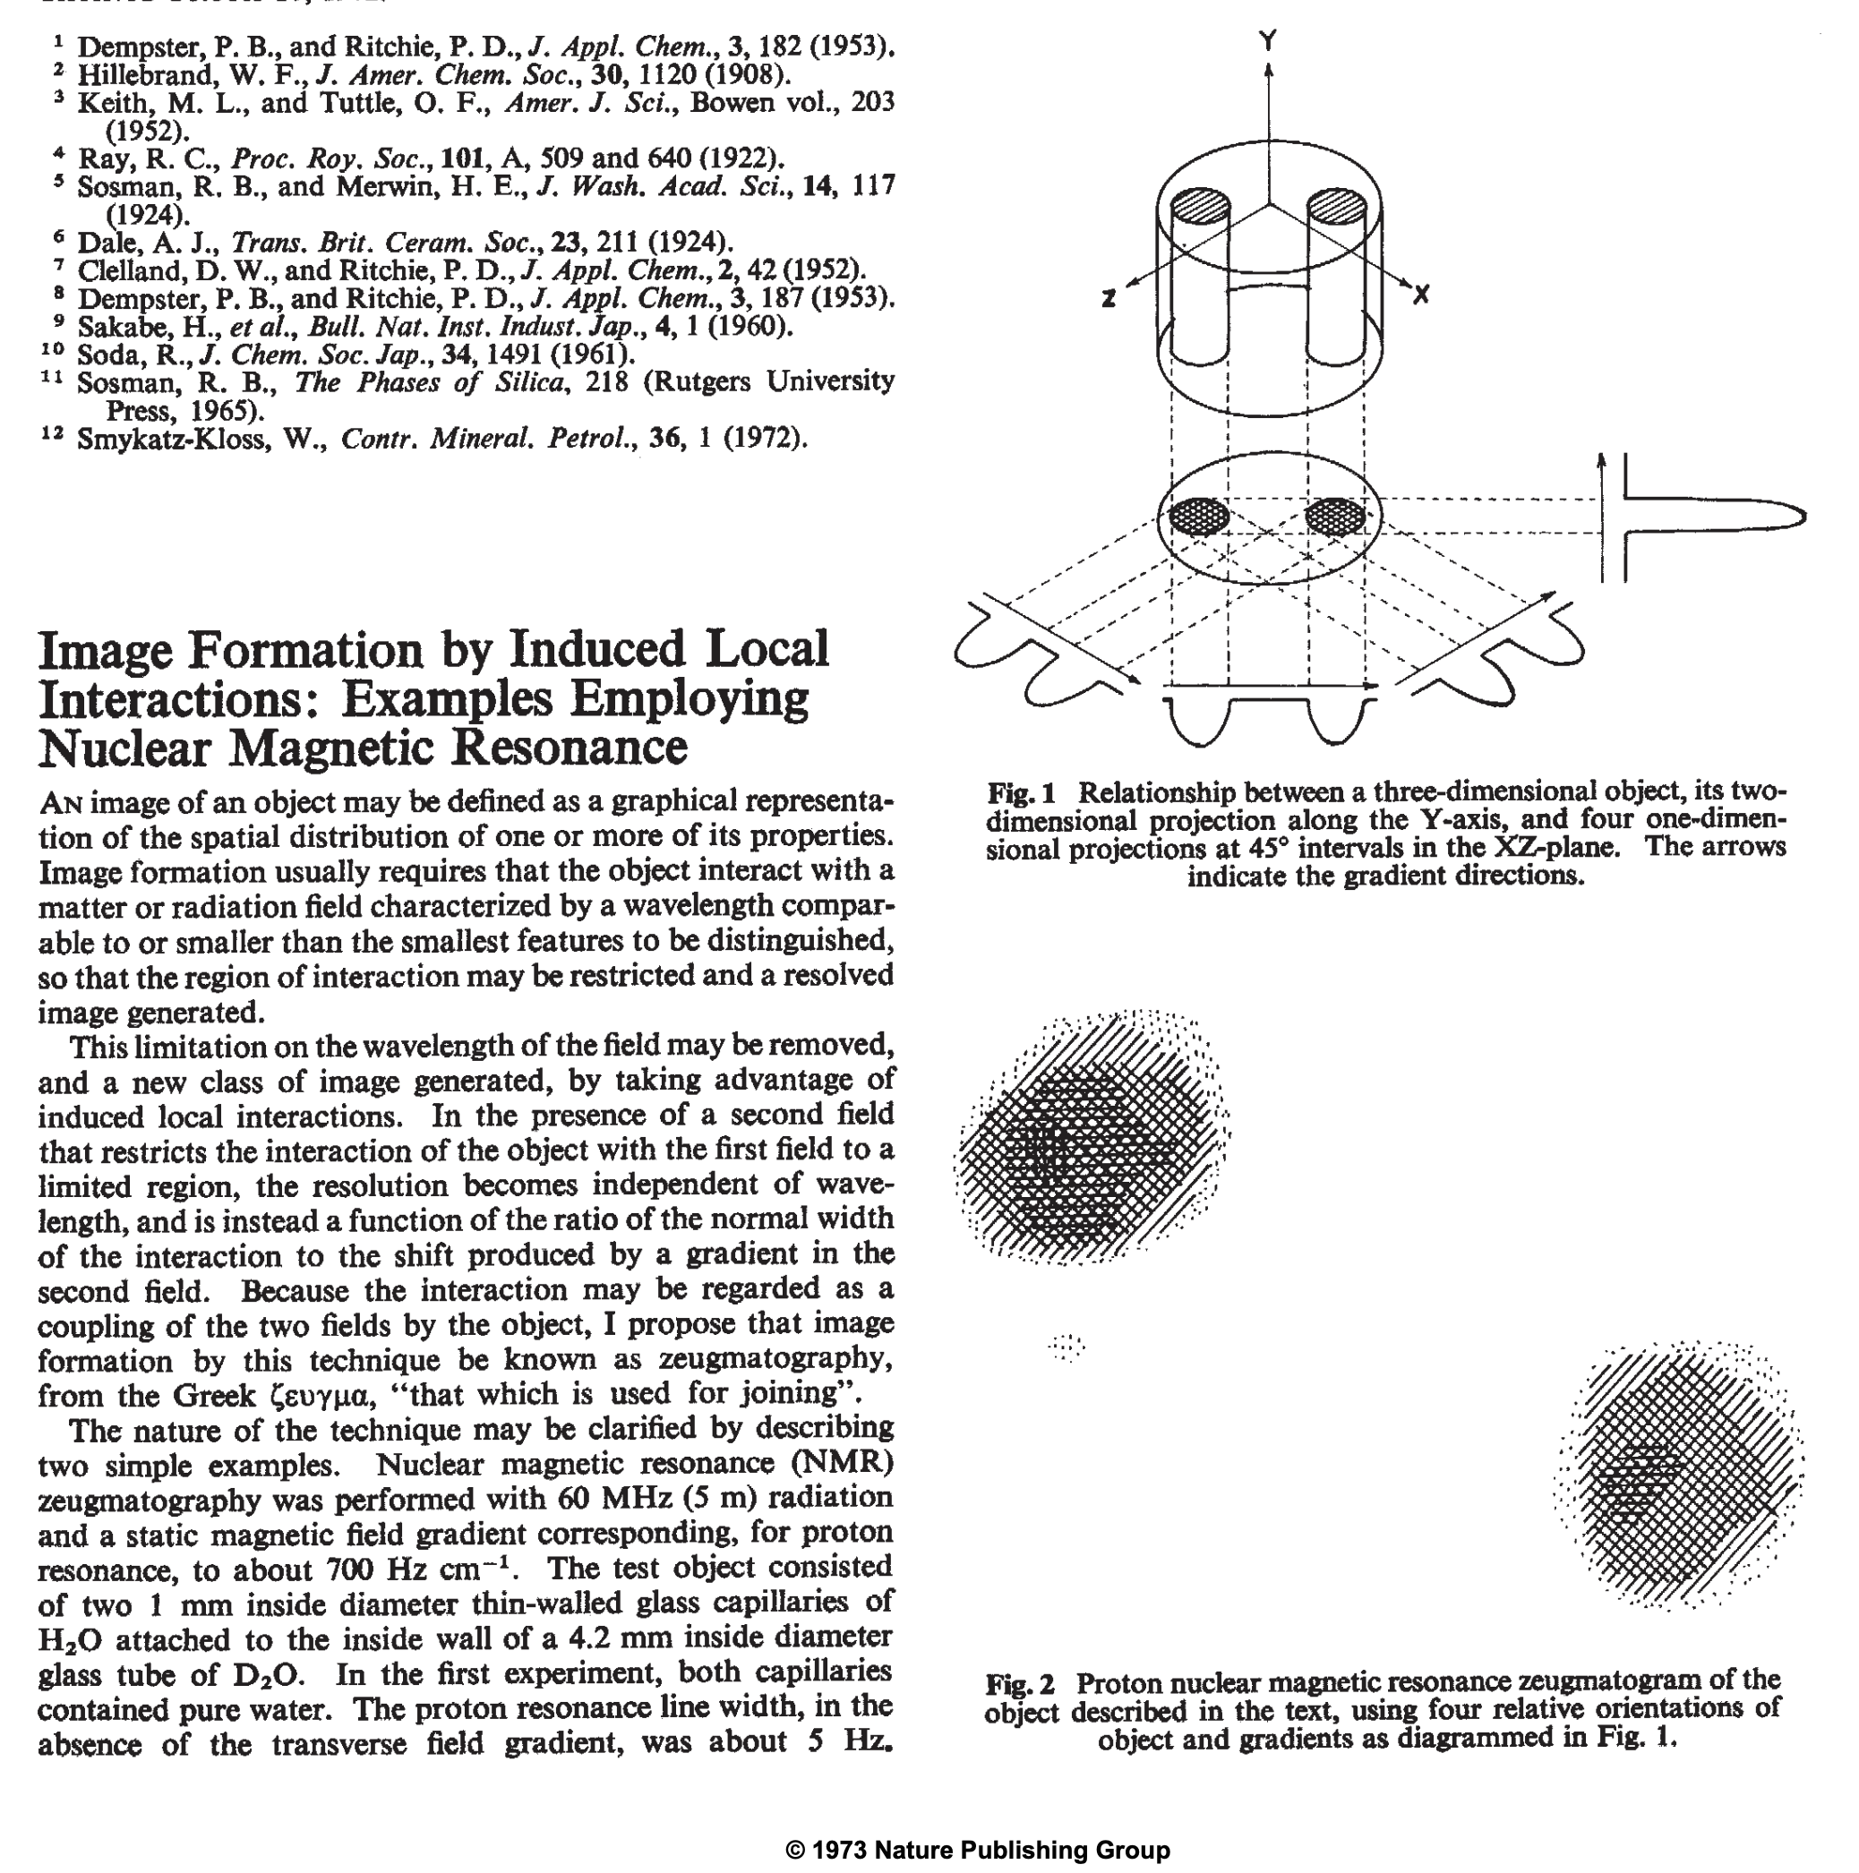
First MRI Image
P. C. LAUTERBUR
Nature volume 242, pages 190–191 (16 March 1973)

Slide 42
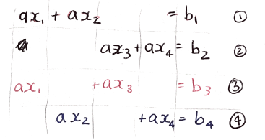
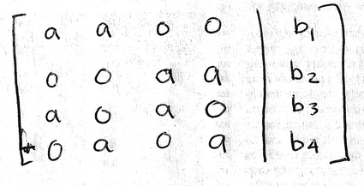
All our measurements are linear
What does that mean?
Each variable (x) is multiplied by a scalar (a) to contribute to the measurement
This is called a
system of linear equations
Linear Algebra is what we need to solve it!
Can also be represented like this:

Slide 43


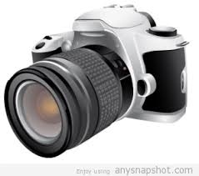

Imaging in general
Energy source
Energy detection
Subject
Imaging System
(electronics, control, computing, algorithms, visualization…)

Slide 44
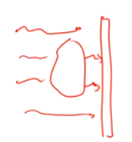
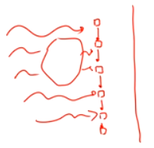
What is the absolute smallest number of components you need to make an imaging system?
Example: flat illumination, one photosensor scans through pixels
OR scan the illumination, use only one big pixel
Notes:
Need source, light sensor,
Show diffusercam here, highlight Grace as a GSI

Slide 45
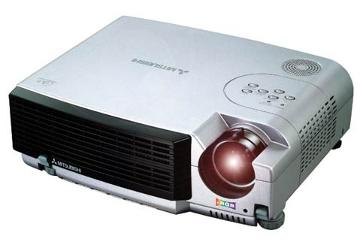

Single-pixel camera
Patterned illumination
Subject
Single-pixel detector
Reconstructed
(2% of data)
Original image
Can I create an image if I have just one detector?
Barniauk et al., Rice University.

Slide 46
Single-pixel camera
Patterned illumination
Subject
Single-pixel detector
Reconstructed
(2% of data)
Original image
Barniauk et al., Rice University.

Slide 47

Imaging Lab #1 Setup
TI Launchpad
Notes:
After all, today’s cameras have millions of pixels…
Great teaching vehicle: you can actually get a lot out of surprisingly simple designs – Once you know the right techniques!
In some systems the sources and/or detectors might actually be expensive – Take this opportunity to learn a little more about how detectors usually work – And how we get them to “talk” to our electronic systems

Slide 48

Imaging Lab #1

Slide 49
Single-pixel camera
Patterned illumination
Subject
Single-pixel detector
Reconstructed
(2% of data)
Original image
What if I can’t light up just one pixel at a time?
Can we recover the frog?
How many measurements do I need?
How should I choose illumination patterns?
Barniauk et al., Rice University.
Notes:
Signal will be a LINEAR COMBINATION of signals from each “pixel”
Can we recover the original image? – In many cases, yes! – Will start to see how next…

