Slide 1
How I Made A Radio…Controller
And Other Digital Things
By Sahar Mesri

Slide 2

Who Am I?
Engineer at Qualcomm (6 mos)
  PMIC Digital Team
    LDO controller
    Interrupt controller
Former 5th Year MS Student at UC Berkeley (Aug 2015 – May 2016)
  Helped design SCuM v2
  Wrote the longest and most boring MS report in EECS history

Slide 3

What Am I Talking About?
Good practices for digital design
Single Chip Micro Mote v2 Architecture
How I made a radio controller
Bluetooth 5.0 LE

Slide 4
Verilog DO’s and DON’T’s
This is for your own good!

Slide 5

Digital Design DO’s and DON’T’s
DO make sure you have a well-defined spec before you write ANY code
Avoids wasted time
Avoids re-doing work
Makes your design easier to implement
A well-planned design reduces
unnecessary churn

Slide 6
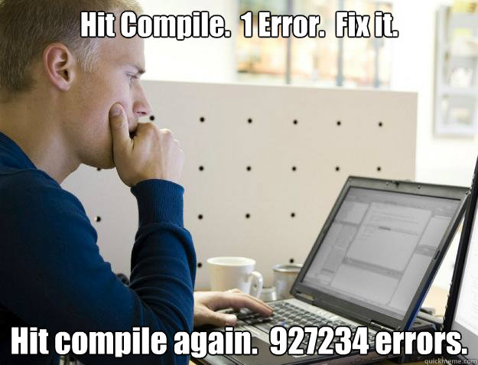
Digital Design DO’s and DON’T’s
DO compile and synthesize your RTL early and often
Compile = starting your simulator
Synthesize = run design compiler
Both will help you find small bugs
like forgetting to connect a port
It’s harder to deal with all the errors
at the end since they accumulate
throughout the design process
May run into situations that require
big design changes

Slide 7

Digital Design DO’s and DON’T’s
DO make sure you speak the same language as the analog/RF designer
I’m not talking about English
Define terminology
“Explain like I’m five”
Don’t continue designing until
you are all on the same page

Slide 8

Digital Design DO’s and DON’T’s
DO learn some scripting languages
Shell scripting
Perl
Python
tcl
Helps automate tedious,
repetitive processes

Slide 9

Digital Design DO’s and DON’T’s
DON’T use tasks or functions in RTL you want to synthesize
More like programming
than like hardware
Typically unsynthesizable
Should only be used in
testbenches
The only exception:
a function to calculate
log2

Slide 10

Digital Design DO’s and DON’T’s
DON’T wait until the end to make testbenches
Do I even have to explain?
Make tests for each level of
hierarchy
After design changes, re-run
testbenches to make sure
nothing broke
Update testbenches alongside
the design

Slide 11

Digital Design DO’s and DON’T’s
DON’T wait until the end to document your design
Your spec is just the beginning
Add helpful comments while
you are writing your code
DOCUMENT ALL ASSUMPTIONS
IN THE SPEC AND IN THE CODE
COMMENTS

Slide 12
Single Chip Micro Mote v2
Architecture Overview

Slide 13
Block Diagram

Slide 14
ARM Cortex-M0 DesignStart Processor
This microprocessor is actually an educational version of the ARM Cortex-M0 with a slightly reduced feature set
It has 16 interrupts (the real product is configurable to have 1 to 32)
NO JTAG or debug options
No power management
No system timer
No fast multiplier
Comes with some basic peripherals for demonstration purposes (like UART)

Slide 15
Memories
A basic embedded system will have instruction memory (to hold the code) and data memory (to store data generated when running the code)
SCuM v2 has two separate SRAM blocks for instructions and data
There’s also some basic code stored in ROM that is used when the chip is first powered on
  This code referred to as a bootloader, and its purpose is to start some basic software that then tries to get the rest of the code from the outside world and copied into the instruction SRAM
  The rest of the code could come over the radio, over UART, or in the case of SCuM v2, over a special bus that can write directly into the instruction SRAM
  Once the bootloader is done, the Cortex is rebooted, and it starts executing code from the instruction SRAM

Slide 16
Bus Architecture
The ARM Cortex-M0 has only one bus, which is shared with instruction memory, data memory, and all peripherals
This bus uses a protocol called AHBlite. It supports 32-bit addresses and 32-bit data
The AHB supports only one master (in this case, the Cortex), all other devices on the bus are slaves
Only bus masters can initiate a read or a write, the slaves respond to the masters according to the protocol
To support multiple masters, and arbiter is required to provide control of the bus to one master at a time (all others are stalled)

Slide 17
Bus Architecture (cont.)
Off of the main AHB bus is
another AHB bus. This is done to
allow for two masters (the Cortex
and DMA) to control the data
memory and RF controller
Off the main AHB bus is another
bus called the APB
The APB supports 16-bit data (instead
of 32-bits in the AHB), and therefore
saves area when use with small
or simple peripherals
There is some latency when using
the APB, and should only be used
for peripherals that do not need
to be accessed quickly or often

Slide 18
AHB and APB Protocols
A spec for these protocols can be found online (there are also references to them in my MS report)
They both have an address bus, read data bus, write data bus, write enable bit, and a ready bit from both the master to the slave, and from the slaves back to the master
Both have an address phase, where the master specifies the address for the read/write, and a data phase, where either the master provides the write data or the slave provides the read data
The AHB allows for overlapping address/data phases between two subsequent accesses, the APB does not

Slide 19
Address Space
The ARM Cortex-M0 has a 32-bit address space, that is split up into sections for different purposes
Instruction memory can use 0x00000000-0x1FFFFFFF
Data Memory can use 0x20000000-0x3FFFFFFF
Peripherals can use
0x40000000-0x5FFFFFFF

Slide 20
Address Space (cont.)
If you try to use a particular address incorrectly (like try to execute code from an address set aside for peripherals) it will cause an exception in the CPU
Each address corresponds to one byte, but reads and writes must be word-aligned, where each word is 4 bytes
  So you can read or write to addresses 0x20000000, 0x20000004, but not 0x20000001
When you put your memories and peripherals onto the AHB, you assign it a set of addresses
  So if you assign the data memory to addresses 0x20000000-0x3FFFFFFF, then any transfer on the bus that has an address in that range will be ‘routed’ to the data memory block, and no other peripheral will see anything happening

Slide 21
Peripheral Address Space 0x40000000-0x5FFFFFFF
Addresses are split up amongst the peripherals using the first 8 bits of the address. This means each peripheral has 2^24 addresses
  The radio controller ‘owns’ all addresses in the range of 0x40000000-0x40FFFFFF
  The DMA ‘owns’ all addresses in the range of 0x41000000-0x41FFFFFF
  The RFTIMER ‘owns’ all addresses in the range of 0x42000000-0x42FFFFFF
  The ADC ‘owns’ all addresses in the range of 0x50000000-0x50FFFFFF
  The UART ‘owns’ all addresses in the range of 0x51000000-0x51FFFFFF
  The analog config bits ‘owns’ all addresses in the range of 0x52000000-0x52FFFFFF
  The GPIO ‘owns’ all addresses in the range of 0x53000000-0x53FFFFFF
For logic simplification, all peripherals on the AHB have the first 4 bits of their addresses set to 0x4. All peripherals on the APB have the first 4 bits of their addresses set to 0x50
Since the APB is a 16-bit bus, it only uses the upper 16-bits of the address, it ignores the lower 16-bits of the address. This also means it really only has 2^12 useful addresses

Slide 22
What does it mean to ‘own’ and address?
Any bus transfers (reads or writes) to a particular address are routed to a particular peripheral
The peripheral can choose to respond to a transfer in many ways
  A write to address 0x40123454 might be writing to a physical register. Reading from that address might mean reading the value stored in the register
  A write to address 0x50000008 might mean triggering an FSM to read data from the ADC. Reading from that address might show the current state in the FSM
  Some addresses may respond only to a write, and just return some constant for a read
  Some addresses may only return a value to a read, and do nothing on a write
BOTTOM LINE: JUST BECAUSE A PERIPHERAL HAS 2^24 ADDRESSES ASSIGNED TO IT DOESN’T MEAN THAT THERE ARE 2^24 BYTES OF PHYSICAL MEMORY IN THE PERIPHERAL

Slide 23
Controlling Peripherals in Software
Peripherals are controlled using bus transfers (reads and writes)
In C code, it looks like you are writing or reading certain registers
But the spec will define what those writes and reads are supposed to do
Peripherals can also have interrupts to the Cortex
  This is just a one-bit signal that triggers the software to jump execution to the interrupt handler
  Each interrupt has a different handler, and that handler usually has to read some status registers from the peripheral to determine what caused the interrupt
  For example, the RF controller has one interrupt that triggers whenever it is done sending or receiving a packet. The interrupt handler needs to read a status register to determine if it was Tx or Rx that triggered the interrupt and also check to see if there were any errors
  Once the interrupt handler is done, execution will return to the last place it was before the interrupt

Slide 24
Sub-blocks: Overview
IMEM/BOOTLOADER: Contains the instruction memory and special code to load the instruction memory from the outside world
DMEM: Data memory
RFCONTROLLER: Controls the RF transceiver to send/receive packets (compliant with the 802.15.4 standard)
DMA: Used to transfer packet data between the data memory and the RFCONTROLLER
RFTIMER: Special timer used to trigger sending/receiving packets and recording when the packets were sent/received
AHB2APB: Connects the AHB to the APB
ADC: Controller for a SAR-ADC designed by David Burnett
UART: Serial communication
ANALOG_CFG: Configuration registers used for the analog/RF circuits on SCuM v2
GPIO: General-purpose input/output bits

Slide 25
Radio System Overview
This system includes everything needed to send data to the RF circuit and an interface for the software to control when and what to send/receive
This system doesn’t include the hardware needed to tune and change channels on the radio
Composed of:
  RF controller
  DMA
  RFTIMER

Slide 26
RF Controller
For transmitting: Converts the packet data stored in memory into a bitstream compliant with the 15.4 standard that goes to the radio
For receiving: Scans a bitstream from the radio for the beginning of a packet, and then converts that packet into data than can be read from the software, and stores that data in memory

Slide 27
DMA
Direct Memory Access (DMA) is a special hardware block that allows other peripherals to access the data memory without using the CPU
The DMA in SCuM v2 is used to copy Tx packet data from the memory to the RF controller, and copy Rx packet data from the RF controller to the memory
For this to work, the DMA needs to act as a bus master to the data memory and the RF controller
The RF controller has signals going directly to the DMA to indicate when it needs more data for Tx, or when it has more data for Rx

Slide 28
RFTIMER
SCuM v2 was designed to be used with a higher-level standard called OpenWSN
This standard defines how IoT devices form networks and talk with one another (in this case using 802.15.4 radios)
This standard uses time-synchronized channel hopping (TCSH), which requires that devices synchronize their clocks to one another, and talk to one another during assigned time slots on assigned frequencies
SCuM v2 has a special RFTIMER block, which contains timers (counters) that can directly control the radio, allowing for more precise control over when packets are sent and received

Slide 29
Radio System Architecture
This bus provides access the data memory and the RF controller
This arbiter is used to allow the Cortex-M0 and the DMA to both be the master of the bus
The RF controller has special connections directly to the DMA to request a data transfer
The RF controller has special connections directly to the RFTIMER for triggering and capturing events

Slide 30
How I Made a Radio Controller
And what you can do better!

Slide 31
Simple Tx: Fetching Packet Data
The first main requirement of this controller is that the software can provide a pointer to a place in memory with contiguous packet data (along with the length of the data), and that data should be automatically copied and stored into some kind of buffer
That way, the software can “preload” the packet data, and then at a precise time later, choose to send the packet
This can be done using a FIFO designed to store Tx data
Note that the packet data comes in units of bytes, but the DMA will fetch 32-bits (4 bytes) at a time. Therefore, not all the data fetched may need to go into the FIFO

Slide 32
Simple Tx: Fetching Packet Data
!start
!dma_done
reset
TX_SLEEP
start
TX_INIT
TX_INIT_WAIT
dma_done
TX_LOAD_BYTE0
bytes_left!=0
bytes_left==0
TX_LOAD_BYTE1
bytes_left==0
bytes_left!=0
TX_LOAD_DONE
TX_LOAD_BYTE2
bytes_left==0
bytes_left!=0
bytes_left==0
TX_LOAD_BYTE3
bytes_left!=0
TX_DMA_WAIT
!dma_done
dma_done

Slide 33
Simple Rx: Storing Packet Data
Another requirement for this controller is that software can provide a pointer to a place in memory with space allocated for received packet data, and the controller will automatically store the data there
This requires the DMA to copy data as it comes in from the radio
However, the rate at which the data comes in fro the radio may be different from the rate at which the DMA can store the data
Therefore, a FIFO (large enough to hold one packet) can be used to continuously store the incoming data, and the DMA can copy the data at its own rate

Slide 34
Simple Rx: Storing Packet Data
!packet_detected
reset
RX_SLEEP
packet_detected
RX_INIT
RX_GET_BYTE0
bytes_left==0
bytes_left!=0
RX_GET_BYTE1
bytes_left==0
RX_DONE
bytes_left!=0
bytes_left!=0
RX_GET_BYTE2
bytes_left==0
dma_done
bytes_left!=0
RX_GET_BYTE3
RX_DMA_WAIT2
bytes_left==0
RX_DATA_STORE
dma_done
RX_DMA_WAIT
!dma_done
!dma_done

Slide 35
Simple Tx: Packet Composition
Sending a packet involves more than just the data
The 802.15.4 standard defines other fields that are required for the packet
  Preamble: 4 bytes of 0’s
  Start Symbol: 1 byte that is the same in every packet
  Length: 1 byte (7 bits are the length, 1 bit is reserved)
  Packet Data: Up-to 127 bytes
  CRC: 2 bytes, calculated over the packet data
In SCuM v2, the preamble, start symbol, length, and CRC are also put into the FIFO with the packet data (in the order in which they are sent)
Used by the receiver to detect an incoming packet
Used by the receiver to know how much data to expect
Used by the receiver for error detection

Slide 36
Simple Tx: Sending FIFO Data
In the initial tests for the RF controller, it was assumed that our ‘radio’ was just two wires sending clock and data (serially) to the other ‘radio’
Each byte of data is sent in the order in which it was put into the FIFO, and when serialized, the LSB is sent first
These two ‘radios’ run at a different clock frequency than the main system
Therefore, the FIFO needs to be:
  Asynchronous (different clock domains for read/write)
  Asymmetric (8 bits going in, 1 bit going out)
A simple FSM is required on the other side of the FIFO to read out each bit one at a time, and then indicate to the main Tx FSM when transmission is finished

Slide 37
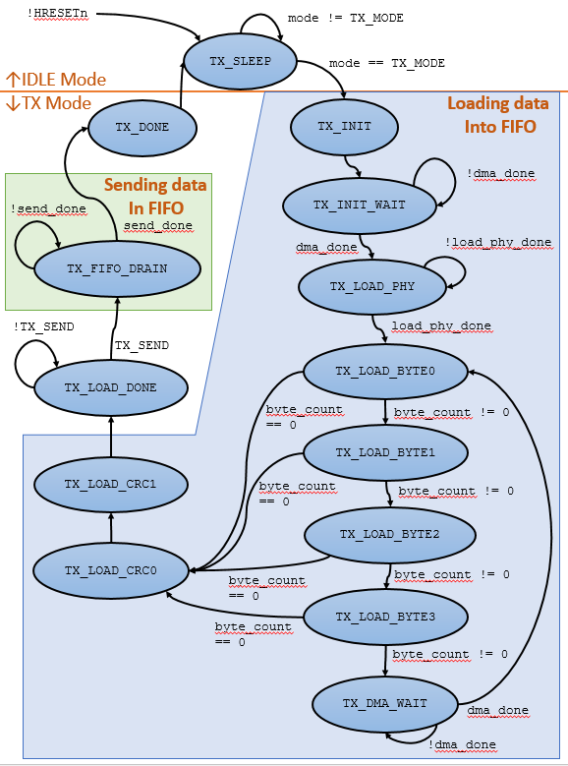
Simple Tx:
Final FSM

Slide 38
Simple Rx: Packet Detection
The data received by this ‘radio’ is a serial stream of bits, where the LSB of the first byte is received first
Packets are detected by looking for part of the preamble (a long string of 0’s) followed by the start symbol
In real life, it would be very unlikely that a random noisy signal would happen to be a long string of 0’s followed by the start symbol, which means false positives are unlikely
Finding the start symbol also indicates the ‘alignment’ of the data (where is the LSB and where is the MSB of each byte)

Slide 39
Simple Rx: Packet Decomposition
Another state machine is required to detect the preamble and start symbol
  From there it will need to capture the packet length and send that to the main Rx FSM
  It will also need to load each bit into the FIFO (which is emptied by the Rx FSM)
The ‘radio’, and thus this new FSM, run at a different clock frequency than the main system
Therefore, the FIFO needs to be:
  Asynchronous (different clock domains for read/write)
  Asymmetric (1 bit going in, 8 bit going out)

Slide 40
Simple Rx: Packet Detection FSM
last_8_bits==0 &&
last_16_bits != 0
last_8_bits==0 ||
partial_match
!start
last_8_bits!=0
reset
last_8_bits==0
PREAMBLE_MATCH1
STARTSYMBOL_MATCH
IDLE
PREAMBLE_MATCH0
last_16_bits==0
start
last_8_bits!=0
last_8_bits!=0 &&
!partial_match
DONE
full_match
bits_left==0 && bytes_left==0
PAYLOAD_CAPTURE
bits_left==0
LEN_CAPTURE
bits_left!=0 || bytes_left!=0
bits_left!=0

Slide 41
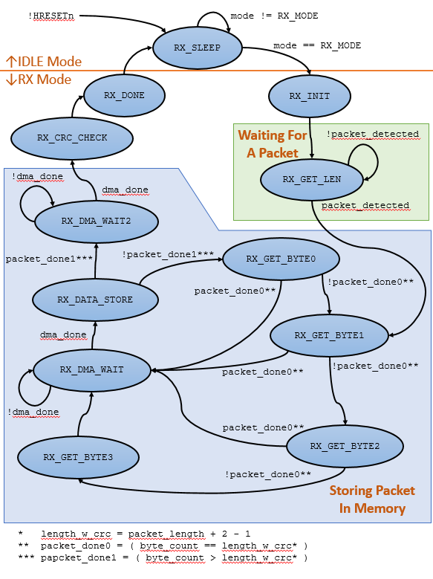
Simple Rx:
Final FSM

Slide 42
Putting It Together: Simple Tx/Rx
System Clock Domain Radio Clock Domain
Tx_clk
Tx_data
TX FSM
TX FIFO
Send Bits FSM
Transmitting Radio
Receiving Radio
Rx_data
Rx_clk
RX FSM
RX FIFO
Packet Detection FSM
Our model for the radio is a clock and data line connecting the two digital systems. In real life, the TX data is sent to the transmitter which goes through the amplification and modulation needed to send the packet over the air. When receiving the packet, the receiver circuit demodulates the signal and provides “clock and data recovery”. This process supplies the digital the actual bitstream, along with a clock aligned to the data

Slide 43
15.4 Spreading
The 802.15.4 standard has an additional requirement to provide robustness against error
Every 4 bits in the packet (this includes the preamble, start symbol, length, data, and CRC) are ‘spread’ or mapped to a particular 32-bit code, where each of those 32 bits are called chips
The chips are transmitted, not the original bits
When transmitting, that simple FSM that reads data from the FIFO now has to convert that data (4 bits at a time) to a 32-bit code, and then send the chips serially
This means that the FIFO needs to be 8-bits-in and 4-bits-out

Slide 44
15.4 Correlation
The receiver looks at the last set of 32 chips, and sees if they match one of the 16 possible codes. This process is called correlation
Note that if there are any errors in the signal, then the chips will not exactly match one of the codes
  However, there is a way to find the closest possible match, called the Hamming Distance
  A threshold can be used, in which a true match must have a Hamming distance within that threshold

Slide 45
15.4 Packet Detection and Despreading
The actual packet detection FSM in SCuM v2 goes through the following steps
  Check during each cycle to see if the last 32 chips match code 0
  If there’s a match, wait for the next 32 chips, and make sure they match code 0. If true, then the input is probably the preamble of a packet
  If that’s true, then keep checking the next 32 chips. If they continue to match 0, then that means this could be the packet preamble. If they then match the first half of the start symbol, wait for the next 32 chips. If those match the second half of the start symbol, then the packet is considered detected
Once a packet is detected, the state machine continues to wait every 32 cycles for a new set of chips. These chips are then converted to their closest matching code, and that code is put into the FIFO. This process is called despreading
This means that the FIFO needs to be 4-bits-in and 8-bits-out

Slide 46
Putting It All Together: 15.4 Tx/Rx
System Clock Domain Radio Clock Domain
TX FSM
TX FIFO
Spreading FSM
Tx_data
Transmitter
Transmitting Radio
Receiving Radio
Rx_data
Rx_clk
Receiver
RX FSM
RX FIFO
Correlation Packet Detection FSM
Clock
Data
Recovery

Slide 47
Bluetooth 5.0 LE
From the perspective of a digital designer

Slide 48
Reading Standards
Standards contain everything you would ever need to know to implement something and ensure it is compliant
They usually don’t tell you how to actually implement your design, but they have suggestions and a recommended architecture
They can be thousands of pages long
You don’t need to read all of it
  This standard specifies everything form the physical properties of the RF signal to the applications that send data over Bluetooth
  It’s important to pick out the parts related to your level of abstraction
  Understanding the levels above and below also help guide your design

Slide 49
Vol 1: Architecture and Terminology Overview
Don’t need to worry about BR/EDR (Basic Rate/Enhanced Data Rate)
Focus on the sections about LE (Low Energy)
Focus on the sections about the physical layer and try to understand the logical layer
High-level software
(applications)
Lower-level software
(drivers, OS)
Hardware (both RF and digital)

Slide 50
Vol 1: Architecture and Terminology Overview

Slide 51
Vol 1: Architecture and Terminology Overview
Standard defines two main variations on the physical layer: LE 1M PHY and LE 2M PHY, where LE 1M PHY has 2 optional error coding schemes
In this class you are implementing the basic LE 1M PHY so ignore the rest
LE also uses frequency division multiple access (FDMA) and time division multiple access (TDMA)
This means that each device can only send messages during certain time slots, and on certain frequencies. Master-slave pairs also hop between channels
TDMA, FDMA, and channel hopping are handled more at the logical layer, but you still should add special hardware to assist with that!

Slide 52
Vol 6: Core System Package [Low Energy Controller]
This volume contains the real details on what you want to implement
“Part A: Physical Layer Specification” has everything the RF engineer would need
“Part B: Link Layer Specification” has everything the digital designer and low-level software developer would need
  Parts of the link layer are better implemented in software, some are better in hardware, and where to draw that line can get rather blurry and differs between designs

Slide 53
Link Layer Specification: HW/SW Line
The first part of the Link Layer Specification is the link layer state machine
  State machines sound like
  something in hardware
  But this state machine is not
  used to control the RF circuit,
  it’s to manage the connections
  between devices
  High-level control usually goes
  in software since it’s more
  flexible

Slide 54
Link Layer Specification: HW/SW Line
The next few sections talk about bit ordering (during transmission), address generation, address resolution
This should be addressed in hardware (or assisted by hardware)
After that is the packet format. Some parts of the packet should be automatically added in HW, the rest from SW

Slide 55
Packet Format
The preamble is used in the receiver to perform frequency synchronization, symbol timing estimation, and Automatic Gain Control training. This should be automatically appended to the beginning of the packet by the HW
The access address is unique to each link layer connection, and is generated randomly (but subject to certain rules). The SW needs to keep track of each connection and its address, and provide the appropriate address to the HW when sending a packet. A HW accelerator can be used to assist in generating the addresses
The PDU (protocol data unit) is the data that is being sent. The PDU itself has its own header and data (which is different for advertising vs. data channels)
The CRC (cyclic redundancy check) is a special function that is run on the data in the PDU. The output of this function is appended to the end of the packet and it is used by the receiver to make sure the data wasn’t corrupted during transmission. This should be automatically calculated and appended to the end of the packet by HW

Slide 56
PDU Formats
Both the advertising PDU and data PDU have their own headers and payloads, and even those payloads vary based on PDU “subtype”
This level of detail should probably be handled in SW and not in HW, due to the many different types of packets that can be sent

Slide 57
CRC Generation
CRC is basically a special function calculated over the PDU, and the result (appended to the end of the packet) is used by the receiver for error detection
CRC is a recursive function where its output is a function of its input (part of the packet data) and its last output
The final CRC value depends on the initial preset
  So if you are calculating an 8-bit CRC, then the output will be different depending on if the preset value is 00000000 or 00000001
Typical examples calculate the CRC serially (one bit each cycle), but in SCuM v2 the 16-bit CRC is calculated using 8 bits each cycle

Slide 58
CRC Generation: Example
Calculating the CRC serially just means using a linear feedback shift register (LFSR) that matches the CRC polynomial
The LSB is on the left, and the input to the CRC is the LSB of the PDU
The preset value is just the initial/reset value of the flip-flops
A new bit is shifted in each cycle. The CRC value is the final value of the flip-flops after the last bit of the PDU has been shifted in

Slide 59
Data Whitening
This is an extra step performed on the PDU+CRC that isn’t shown in the packet format
Data whitening ‘transforms’ the data in such a way that it avoids long sequences of 0’s or 1’s (why is this bad? Ask your RF engineer!)
The standard defines this step using a 7-bit LFSR
The preset value of this LFSR depends on the channel index (so your radio controller needs to know which channel it’s using)

Slide 60
Packet Format Bottom Line
HW generates preamble automatically
SW gives HW the address, HW appends to packet automatically
SW provides PDU, HW doesn’t care
HW automatically calculates CRC and appends to the end of packet
HW automatically applies data whitening to the PDU+CRC

Slide 61
Bitstream Processing
In SCuM v2, whitening/dewhitening was spreading/de-spreading
The encryption/decryption is for the PDU only, and this can be done in SW or with a HW accelerator

Slide 62
Timing
The SW can handle the actual scheduling for TDMA and FDMA
It is up to the HW to ensure it can send packets at the appropriate rate
  It should be able to meet the requirement for the minimum time between packets. This is mostly up to the digital designer
  It should provide timers that are accurate enough (in terms of resolution, drift, and uncertainty) to meet the requirements for the standard. This is mostly a collaboration between the analog designer and the digital designer
SCuM v2 has timers tied-in directly to the radio controller, to provide more temporal precision

Slide 63
Anything else?
The SCuM v2 radio controller does not have any hardware used to tune and change the channels on the RF transceiver
This is also not covered by any standards because this spec is between the digital designer and the RF engineer
Just as the SCuM v2 has a timer tied-in and specifically designed for the radio controller, it might be necessary to create a special timer just for the frequency tuning hardware, to assist with TDMA/FDMA

