Slide 1
Structure Computation

Slide 2
Structure Computation
How to compute the position of a point in 3-space given its image in two views and the camera matrices of those two views
Use image correspondence to compute F; then find a pair of consistent camera matrices.
Assume these matrices are known exactly or with great accuracy as compared to the matching points in the two images.

Slide 3
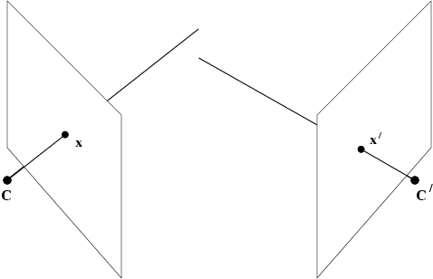
Point reconstruction
Error in measured points, x and x’:
Rays back-projected from the points are skew
There is no point X which exactly satisfies:
x = P X x’ = P’X
The image points do not satisfy the epipolar constraint
x’^{T} F x = 0
(a)
(b)

Slide 4
Invariance Under Transformation
Desirable triangulation: invariant under transformations for reconstruction:
If camera matrices known only up to affine (projective) transformation, use a affine (projective) invariant triangulation method to find 3D space points
What is an invariant triangulation method?
Τ= triangulation method

Slide 5
Projective Reconstruction
Inappropriate to minimize error in the 3D projective space P³
Bad idea: find midpoint of the common perpendicular to the two rays in space:
Distance and perpendicularity not valid in projective geometry
Gives different results depending on which projective reconstruction is considered
Not projective invariant
Need to design a projective invariant approach
Better idea: minimize the re-projection error
Find 3D point X so that the sum squared distance between the projection of X and measured image points x, and x’ is minimized

Slide 6
Linear Triangulation
Eliminate the homogeneous scale factor by a cross product to give three equations for each image point of which two are linearly independent
➔
➔
p^{iT} rows of P Soln up to scale ➔ redundant Eqn
Two approaches: homogeneous and inhomogeneous
Homogeneous: unit singular vector corresp. To smallest sing. value of A
Not projective invariant
Inhomogeneous: Set X = ( X,Y,Z,1) ➔ get four inhomogeneous equations in
three unknowns ➔ Least squares solution
Not projective invariant
Implicitly assumes the solution X is not at infinity by assuming 4th coordinate to be 1 ➔ problematic if 4th coordinate is close to zero ➔ numerical instabilities
For affine transformation, homogeneous solution is not affine invariant, inhomogeneous solution is affine invariant

Slide 7
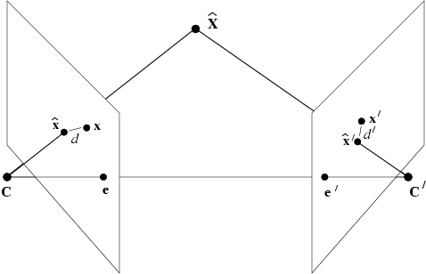
Geometric Error
Noisy point correspondence (x,x’) dies not satisfy epipolar constraint, but points near x and x’ do, i.e. (x^ , x^’ ).
Minimize over x^ and x^’:
If error in x and x’ is Gaussian, x^ and x^’ are maximum likelihood estimates for x and x’
First find x^ and x^’ , then find X by any triangulation method: x^ and x^’ rays meet in space
Use Levenberg Marquardt numerical minimization to find x^ and x^’
Minimum can also be found non-iteratively by a solution of a 6th degree polynomial

Slide 8
Non-Iterative, Optimal Solution
Observation: x^ and x^’ lying on the “true” epipolar lines, are obtained by dropping a perpendicular line from x to l and x’ to l’;
Minimize d² + d’²

Slide 9
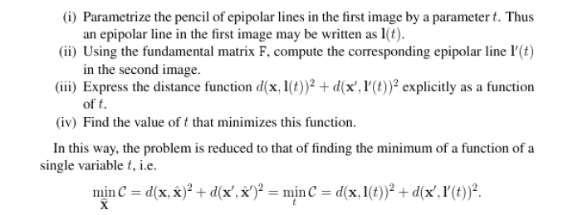
Details of non-iterative solution
g (t) is the derivative of the cost function
Roots of g(t) are minimum of cost function
g (t) is 6th order polynomial ➔ as many as 3 minima
some local, one global; maybe at ∞
Iterative algorithms can get stock in local minima

Slide 10
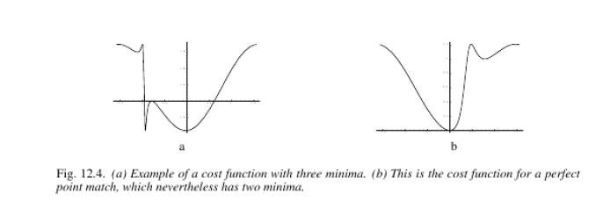

Slide 11
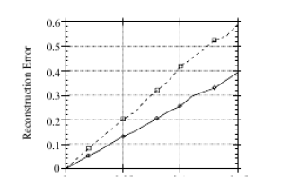
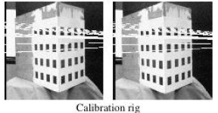
Evaluation on Real images
Results shown for the cube of Figure 11.2 ➔ epipole distant from image
Improvement of non-iterative method over iterative is more pronounced when
epipole is closer to image

Slide 12
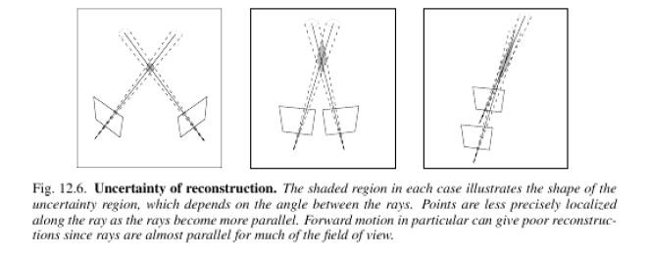
Reconstruction Uncertainty

Slide 13
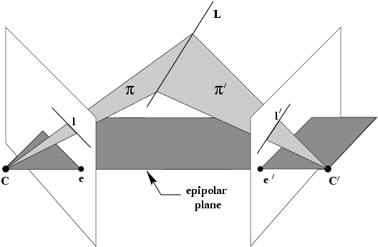
Line reconstruction
For correspoinding points, the pre-image ,i.e. the point in 3 space that projects to the impage points is over determined, since there are 4 measurements on 3 degrees of freedom of the 3 space point
For lines , preimage is exactly determined because a line in 3 space has four
degrees of freedom, and the image line provides two measurements in each view

Slide 14
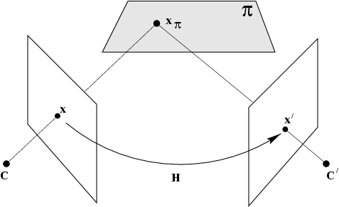
Scene planes and homographies
plane induces homography between two views

Slide 15
Homography given the Plane
Example: Calibrated stereo rig with the world origin at the first camera

Slide 16
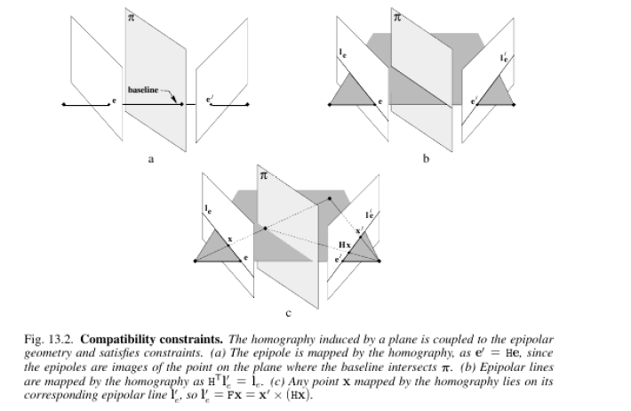
Epipolar Geometry and Homography

Slide 17
Homographies and Epipolar Geometry

Slide 18
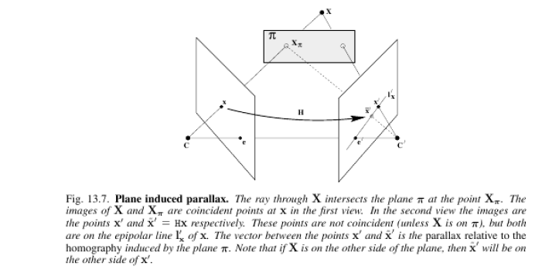
Plane Induced Parallax
Can compute F once H is known

Slide 19
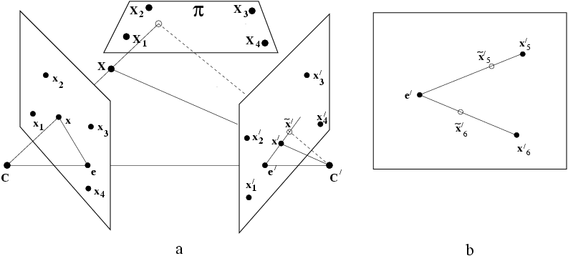
Plane induced parallax
x₁,x₂,x₃,x₄ in plane, x₅,x₆ out of plane
Compute H from x₁,x₂,x₃,x₄

Slide 20
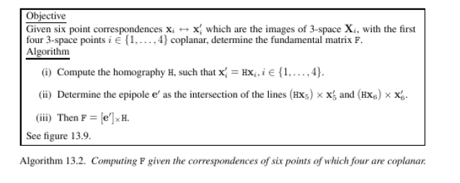
Plane induced Homography
Images of four co-planar points define homography
Two points off the plane provide constraints to determine the epipole

Slide 21
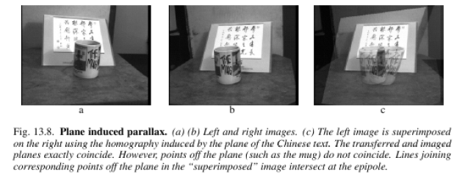
Example of Plane Induced Parallax

