Slide 1
Camera Calibration

Slide 2
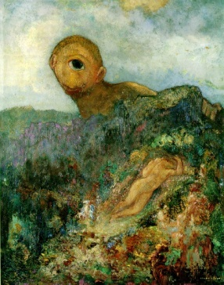
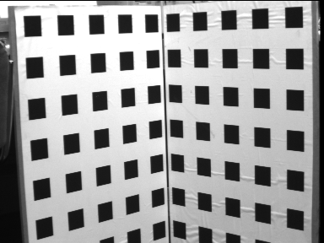
Camera calibration

Slide 3
Resectioning

Slide 4
Basic equations

Slide 5
Basic equations
minimal solution
P has 11 dof, 2 independent eq./points
5½ correspondences needed (say 6)
Over-determined solution
n ≥ 6 points
minimize subject to constraint

Slide 6
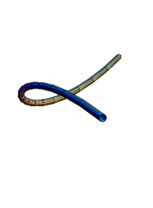
Degenerate configurations
More complicate than 2D case (see Ch.21)
Camera and points on a twisted cubic
Points lie on plane and single line passing
through projection center
No unique solution; camera solution moves arbitrarily along the twisted
Cube or straight line.

Slide 7
Data normalization
Less obvious
(i) Simple, as before
RMS distance from origin
is √ 3 so that “average” point has coordinate mag of (1,1,1,1)^{T}. Works when
variation in depth of the
points is relatively small, i.e.
compact distribution of points
(ii) Anisotropic scaling
some points are close to camera, some at infinity;
simple normalization doesn’t work.

Slide 8
Line correspondences
Extend DLT to lines
(back-project line l_{i} to plane )
For each 3D to 2D line correspondence:
(2 independent eq.)
X₁
X₂
X₁ and X₂
are points

Slide 9
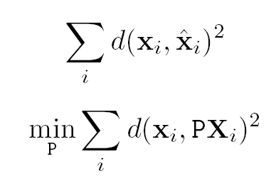
Geometric error
P X_{i} =
Assumes no error in 3D point X_{i} e.g. accurately
Machined calibration object;
x_{i} is measured point and has error

Slide 10
Gold Standard algorithm
Objective
Given n≥6 3D to 2D point correspondences {X_{i}↔x_{i}’}, determine the Maximum Likelyhood Estimation of P
Algorithm
Linear solution:
Normalization:
DLT: form 2n x 12 matrix A by stacking correspondence Ap = 0 subj.
to ||p|| = 1 ➔ unit singular vector of A corresponding to smallest
singular value
Minimization of geometric error: using the linear estimate as a starting point minimize the geometric error:
Denormalization:
~
~
~
use Levenson Marquardt

Slide 11
Calibration example
Canny edge detection
Straight line fitting to the detected edges
Intersecting the lines to obtain the images corners
typically precision of x_{i} <1/10 pixel
(HZ rule of thumb: 5n constraints for n unknowns ➔ 28 points = 56 constraints
for 11 unknowns
DLT
Gold standard

Slide 12
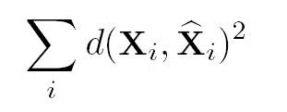
Errors in the world
is closest point in space to X_{i} that maps exactly to x_{i}
Errors in the image and in the world
Must augment set of parameters by including
Mhanobolis distance w.r.t. known error covariance matrices for
Each measurement x_{i} and X_{i}

Slide 13
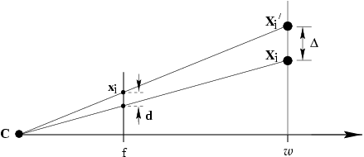
Geometric interpretation
of algebraic error
note invariance to 2D and 3D similarities
given proper normalization

Slide 14
Estimation of affine camera
note that in this case algebraic error = geometric error

Slide 15
Gold Standard algorithm
Objective
Given n≥4 3D to 2D point correspondences {X_{i}↔x_{i}’}, determine the Maximum Likelyhood Estimation of P
(remember P^{3T}=(0,0,0,1))
Algorithm
Normalization:
For each correspondence
solution is
Denormalization:

Slide 16
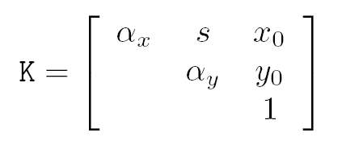
Restricted camera estimation
Find best fit that satisfies
skew s is zero
pixels are square
principal point is known
complete camera matrix K is known
Minimize geometric error
Impose constraint through parametrization
Assume square pixels and zero skew ➔ 9 parameters
Apply Levinson-Marquardt
Minimizing image only error f: ⁹ → ^{2n},
But minimizing 3D and 2D error, f: ^{3n+9} → ^{5n}
3D points must be included among the measurements
Minimization also includes estimation of the true position of 3D points

Slide 17
Minimizing Alg. Error.
assume map from parameters q → P=K[R|-RC], i.e. p=g(q)
Parameters are principal point, size of square pixels and 6 for rotation and translation
minimize ||Ag(q)||
A is 2n x 12; reduce A to a square 12x12 matrix independent of n such that
for any vector p
Mapping is from R⁹ → R¹²

Slide 18
Restricted camera estimation
Initialization
Use general DLT to get an initial camera matrix
Clamp values to desired values, e.g. s=0, α_{x}= α_{y}
Use the remaining values as initial condition for iteration
Hopefully DLT answer close to “known” parameters and clamping doesn’t move things too much; Not always the case ➔ in practice clamping leads to large error and lack of convergence.
Alternative initialization
Use general DLT for all parameters
Impose soft constraints
Start with low values of weights and then gradually increase them as iterations go on.

Slide 19
Exterior orientation
Calibrated camera, position and orientation unkown
→ Pose estimation
6 dof ⇒ 3 points minimal
Can be shown that the resulting non linear equations have
Four solutions in general

Slide 20
Restricted camera parameters; algebraic R⁹ ➔ R¹² super fast
Geometric: R⁹ ➔ R^{2n} 2n = 396 in this case; super slow
Same problem with no restriction on camera matrix
Note: solutions are different!

Slide 21
Covariance estimation
ML residual error
Example: n=197, =0.365, =0.37

Slide 22
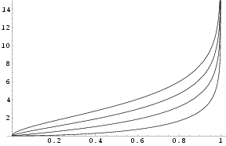
Covariance for estimated camera
Compute Jacobian at ML solution, then
(variance per parameter can be found on diagonal)
cumulative⁻¹
(chi-square distribution
=distribution of sum of squares)

Slide 23
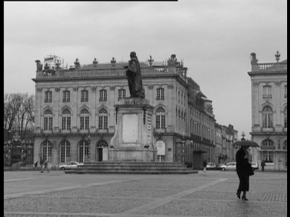
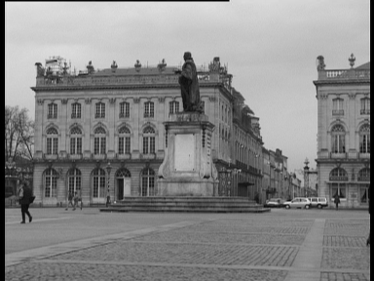
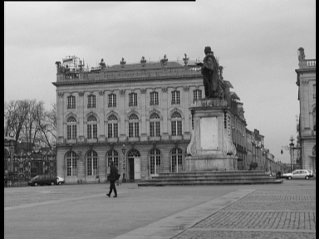
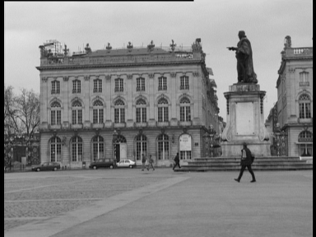
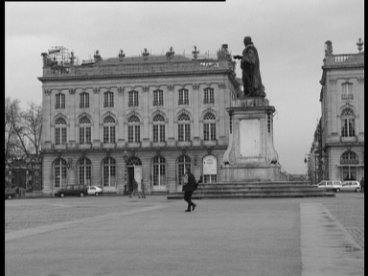
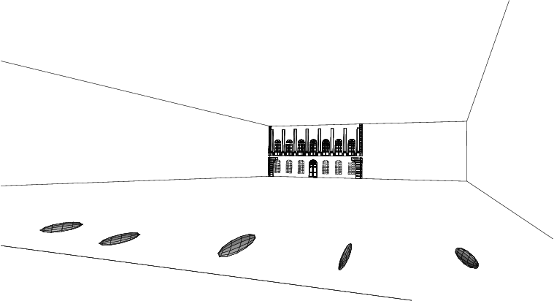

Slide 24
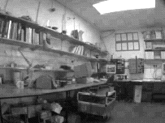
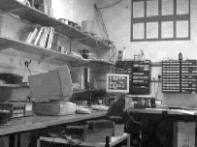
Radial distortion
short focal length long focal length;
Distortion worse for short focal length

Slide 25
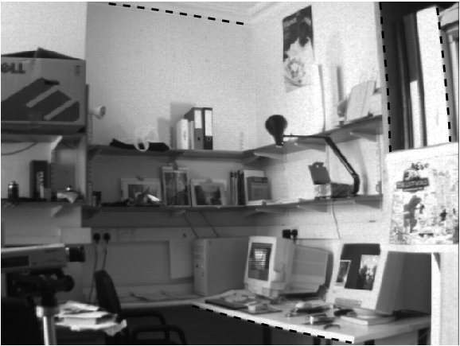
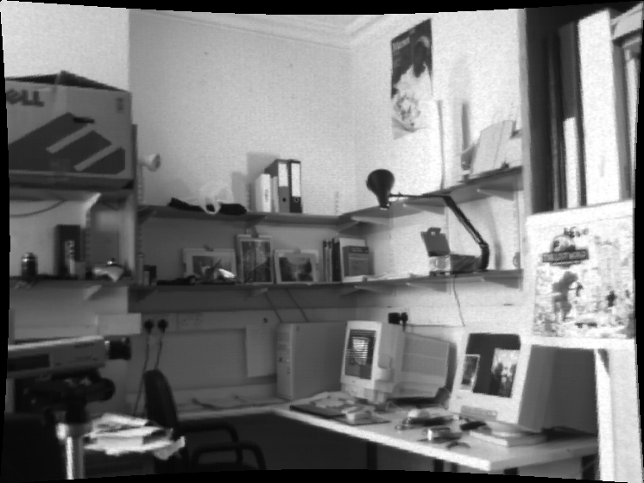

Slide 27
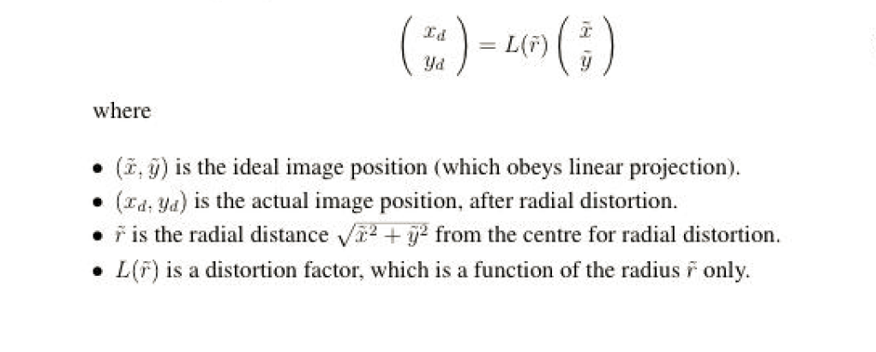

Slide 28
Correction of distortion
x and y are the measured coordinates;
Choice of the distortion function and center: x_{c} and y_{c}
Computing the parameters of the distortion function
Minimize with additional unknowns: i.e. estimate kappa, center and P
simultaneously
Straighten lines: determine L (r) so that images of straight scene lines
should be straight; then solve for P

Slide 29
K1 = 0.103689; k2 = .00487908; k3 = .0016894; k4 = .00841614
X_{c} = 321.87; y_{c} = 241.18 ; original image: 640 x 480; periphery of image
Moved by 30 pixels

Slide 30
