Slide 1
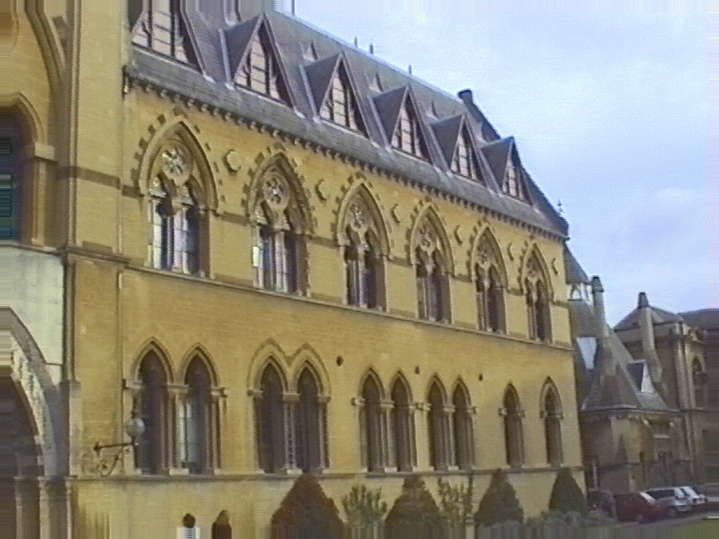
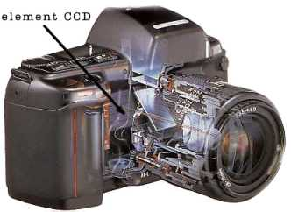
Camera model
Relation between pixels and rays in space
?

Slide 2
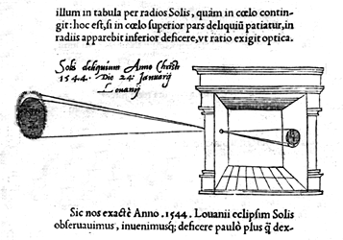
Pinhole camera

Slide 3
Pinhole camera model
Camera is a mapping between 3D world (object space) and 2D image;
Camera model: matrix representing camera mapping; interested in central projection
P = Intersection of principle axis
With image plane
Plane through camera
Center C, parallel to image
Plane is called principle
Plane of the camera
Line from camera
Center perp. To image
plane
Focal plane
Z=f
linear projection in homogeneous coordinates!

Slide 4
Pinhole camera model

Slide 5
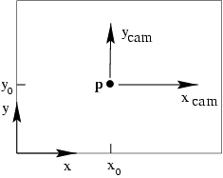
Principal point offset
So far, assumed the origin of the coordinate in the image
plane is the Same as the principal point
principal point

Slide 6
Principal point offset
calibration matrix

Slide 7
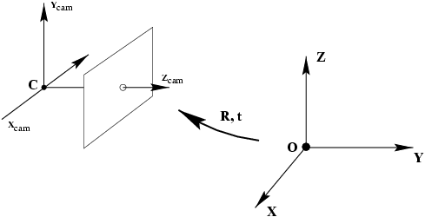
Camera rotation and translation
Points in space are usually expressed in terms of world coordinate frame, i.e. Euclidean
Inhomogeneous vector in world coordinate
Coordinates of camera center in world coord
Inhomogeneous 3 vector in camera coord.
~
General mapping for pinhole camera
9 deg of freedom: f, px,py,3 rot, 3 trans

Slide 8
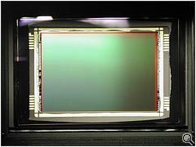
CCD camera
Pinhole camera model assumes image coordinates are Euclidean coordinates with equal scales in both axial directions; CCD cameras does not have square pixels
m_{x} is the number of pixels per unit distance in image coordinates in the x direction
m_{y} is the number of pixels per unit distance in image coordinates in the y direction
α_{x} = f m_{x} and α_{y} = f m_{y} : focal length of the camera in terms of the pixel dimensions in x and y directions
10 degrees of freedom for CCD camera

Slide 9
When is skew non-zero?
arctan(1/s)
1
γ
for CCD/CMOS, always s=0
Example of skew: negative enlarging

Slide 10
General projective camera
11 dof (5+3+3)
non-singular
intrinsic camera parameters
extrinsic camera parameters

Slide 11
Camera parameters
A camera is described by several parameters
Translation T of the optical center from the origin of world coords
Rotation R of the image plane
focal length f, principle point (x’_{c}, y’_{c}), pixel size (s_{x}, s_{y})
blue parameters are called “extrinsics,” red are “intrinsics”
Projection equation
The projection matrix models the cumulative effect of all parameters
Useful to decompose into a series of operations
identity matrix
intrinsics
projection
rotation
translation
The definitions of these parameters are not completely standardized
especially intrinsics—varies from one book to another

Slide 12
Projection matrices for Orhographic and scaled orthographic projections
Orthographic projection
(5dof)
Scaled orthographic projection
(6dof)

Slide 13
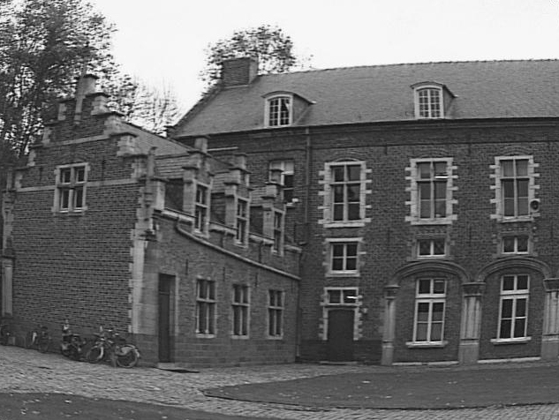
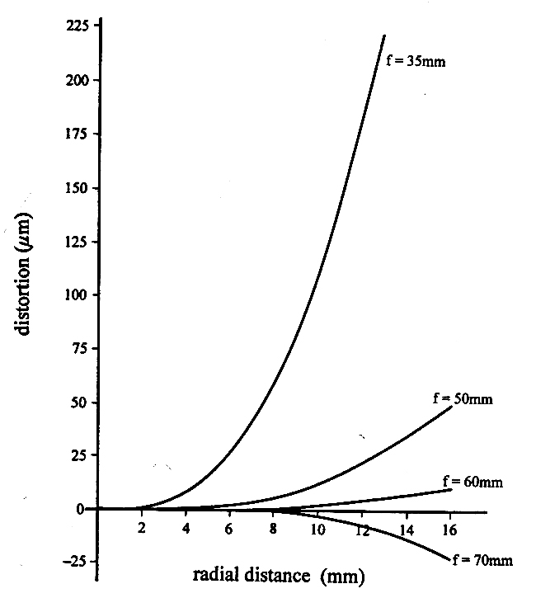
Radial distortion
Due to spherical lenses (cheap)
Model:
R
R
straight lines are not straight anymore
http://foto.hut.fi/opetus/260/luennot/11/atkinson_6-11_radial_distortion_zoom_lenses.jpg

Slide 14
Camera model
Relation between pixels and rays in space
?

Slide 15
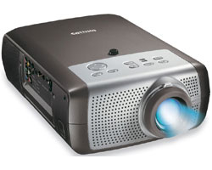
Projector model
Relation between pixels and rays in space
(dual of camera)
?

Slide 16
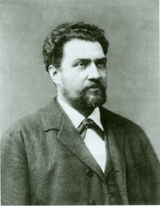
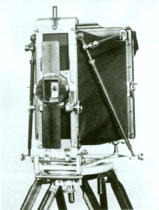
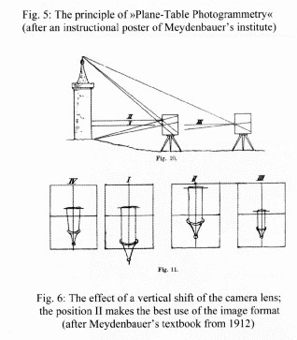
Meydenbauer camera
vertical lens shift
to allow direct
ortho-photographs

Slide 17
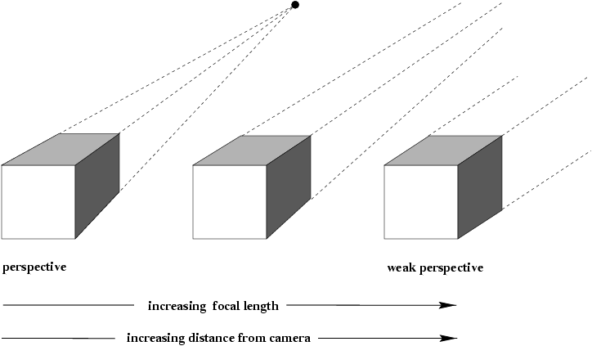
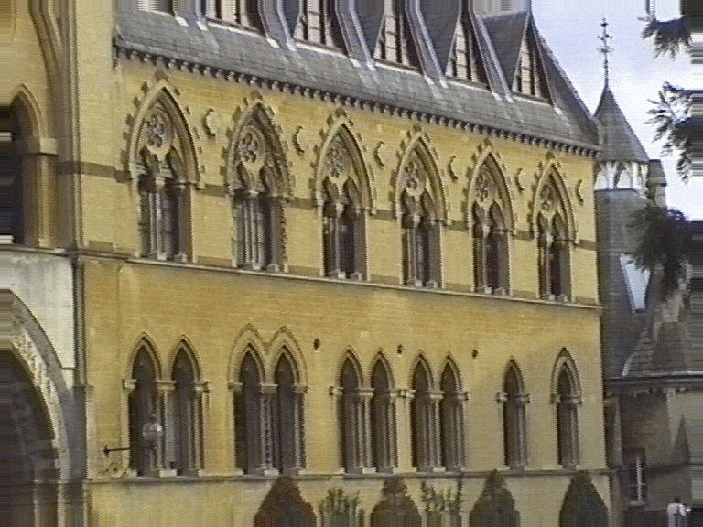
Affine cameras
Track back while zooming in
Keep object of interest same size

Slide 18
Action of projective camera on points and lines
projection of point
forward projection of line
back-projection of line

Slide 19
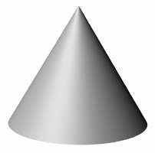
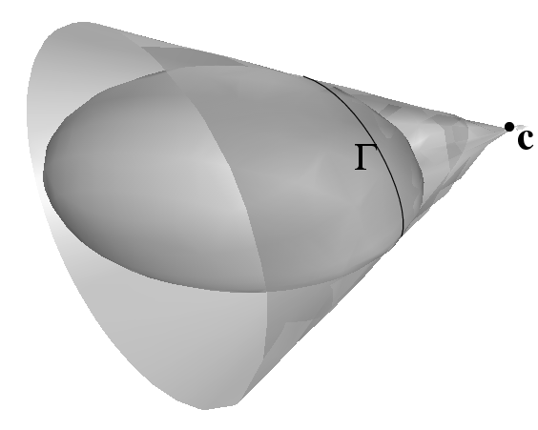
Action of projective camera on conics and quadrics
back-projection to cone
projection of quadric

Slide 20
Image of absolute conic

Slide 21
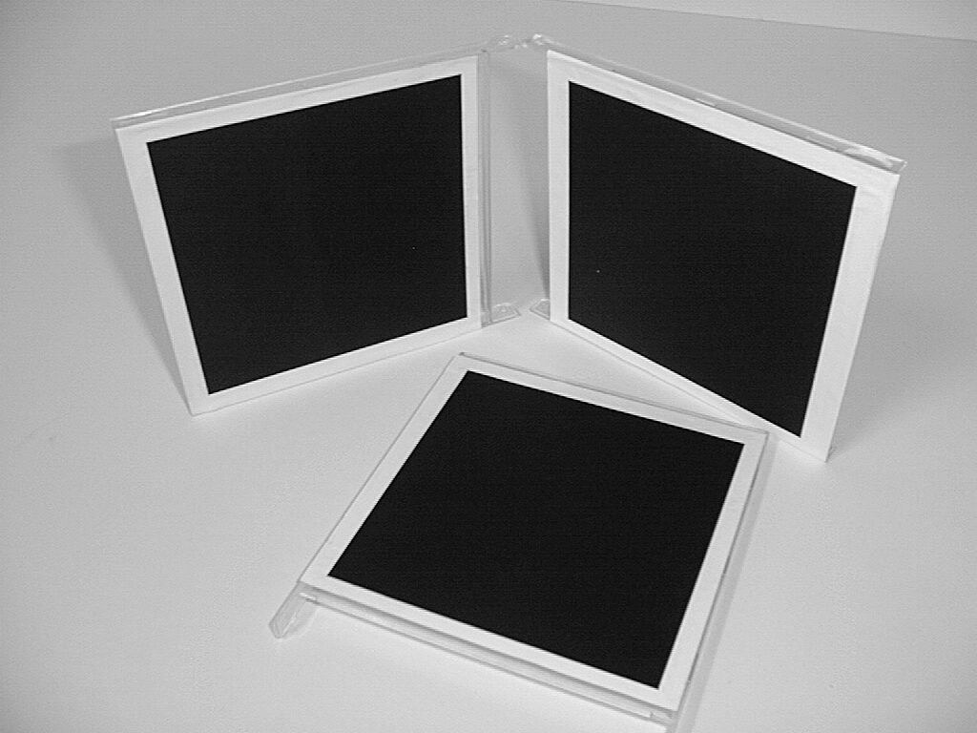
A simple calibration device
compute H for each square
(corners @ (0,0),(1,0),(0,1),(1,1))
compute the imaged circular points H(1,±i,0)^{T}
fit a conic to 6 circular points
compute K from ω through cholesky factorization
(≈ Zhang’s calibration method)

