Slide 1
Introduction to Microelectronic Circuits EE40 Lecture 1 Josh Hug
6/21/2010

Slide 2
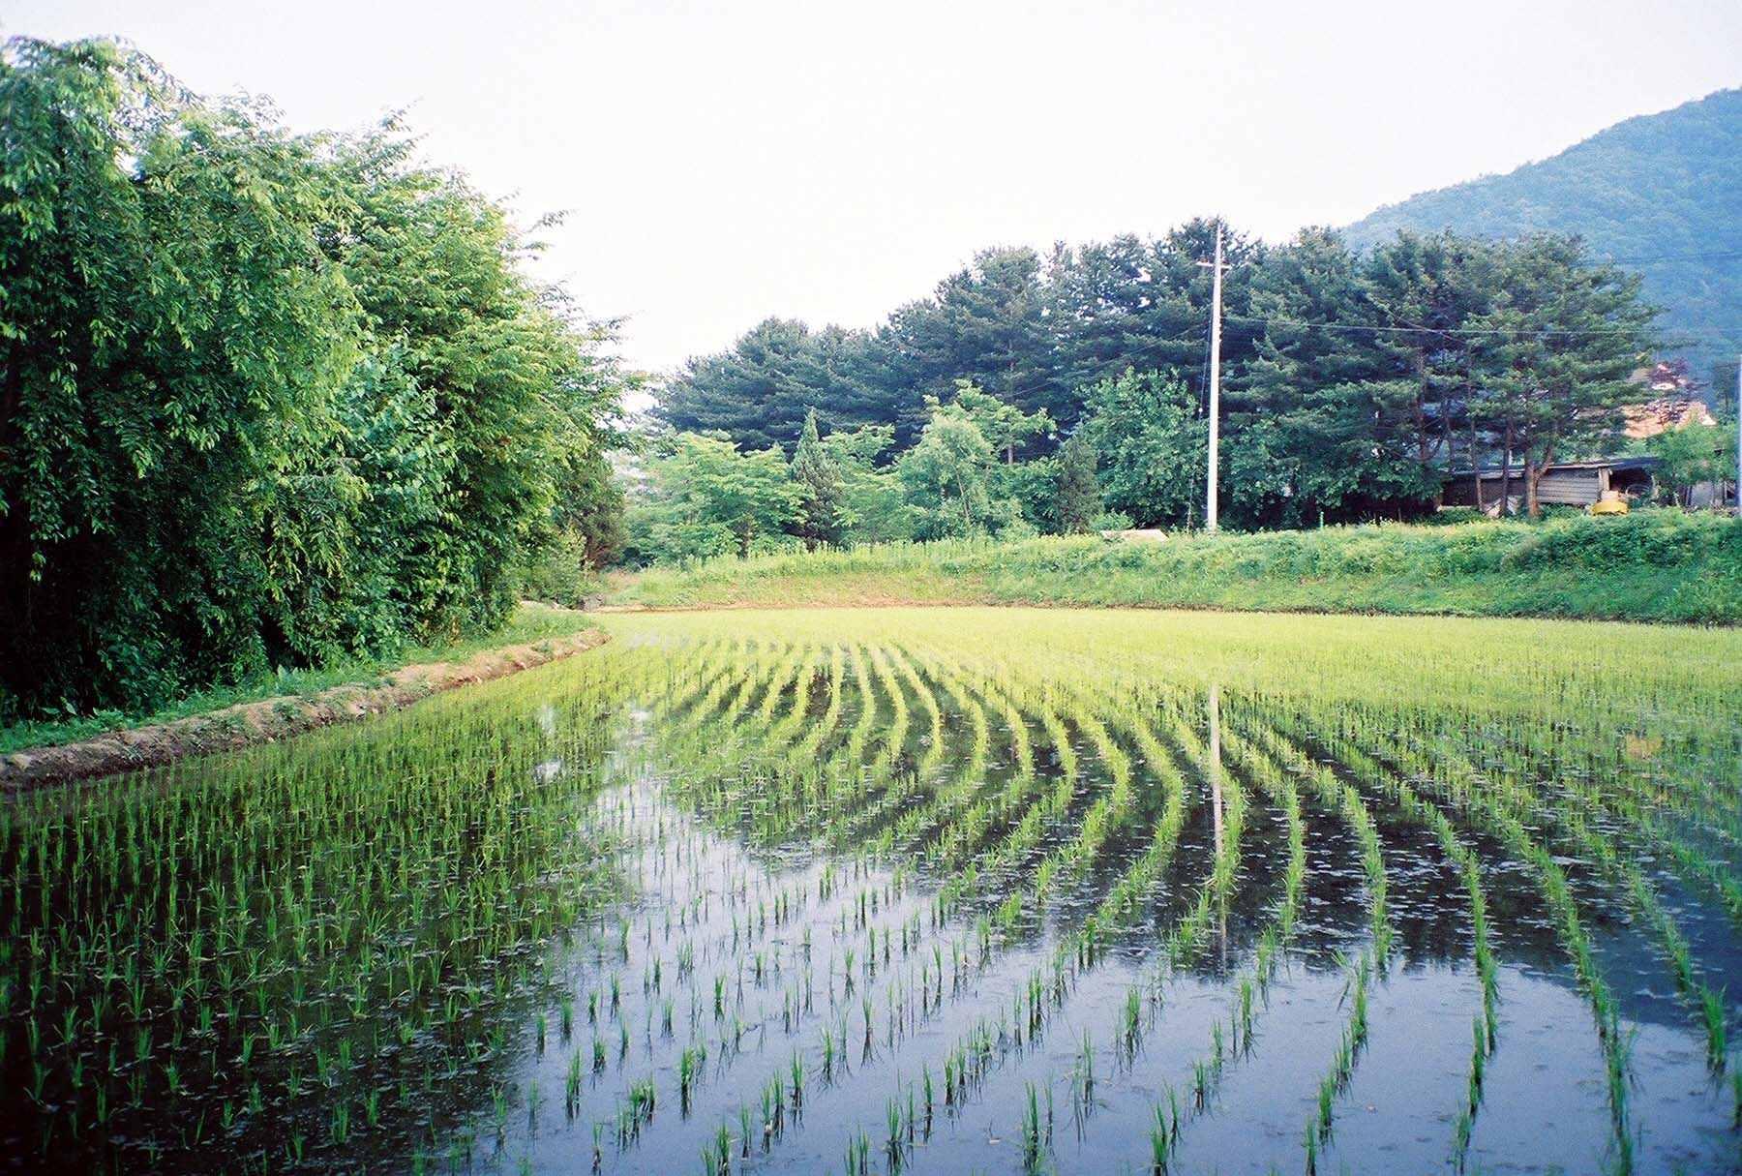
A Story

Slide 3
Integrated Circuit (Core i7 processor)
Courtesy of Intel

Slide 4
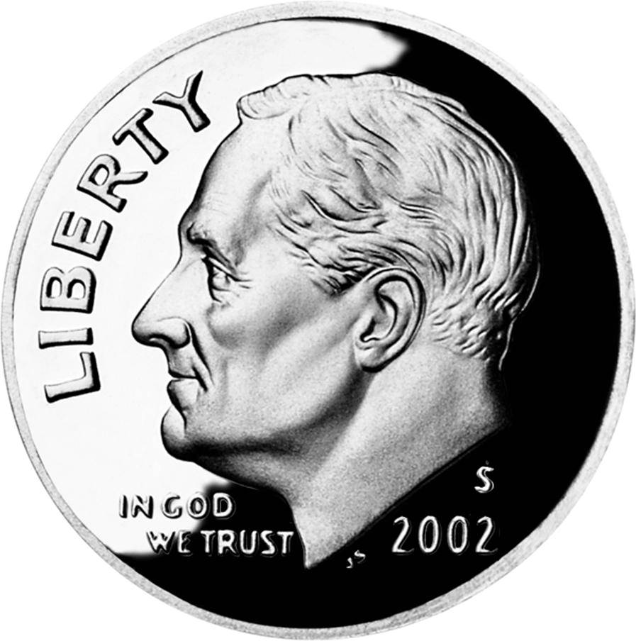
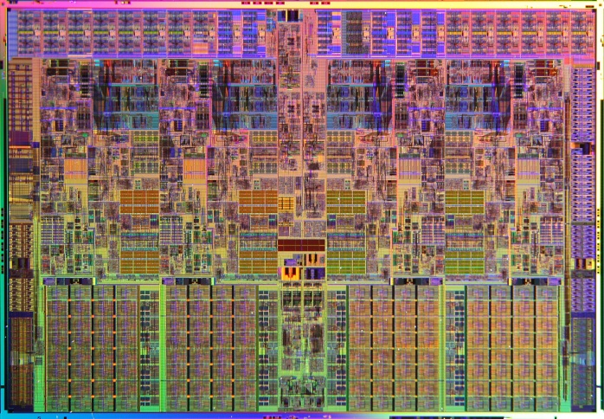
Integrated Circuits (Core i7 processor)
Almost 1,000,000,000 transistors
Features as small as a nanometer

Slide 5
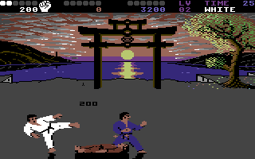
Then (C64, 1983) and Now (iPhone, 2010)
5000 nanometer process
1.023 MHz (CPU)
10,000s of transistors
160 x 200 x 16 color display
$1300 dollars at release (adjusted for inflation)
45 nanometer process
1,000 MHz
100,000,000 transistors
320 x 480 x 262,144 color display
$600 dollars at release

Slide 6
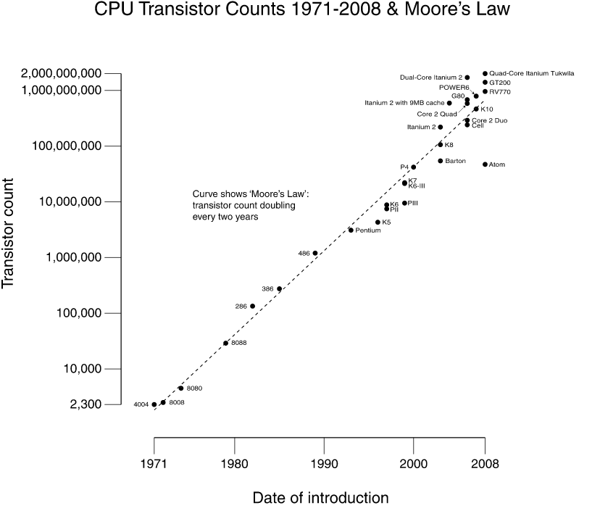
Moore’s Law
Notes:
1965

Slide 7
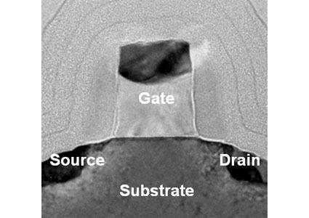
Electron Microscope view of MOS Transistor
Insulating Layer (gate oxide) now just 1.2 nm thick
For reference:
Human hair: 100,000 nm
Silicon atom: 0.1 nm
35 nm wide
In 10 years, we will hit a wall.
Courtesy: Tom’s Hardware, June 11 2006 (65 nm process)

Slide 8
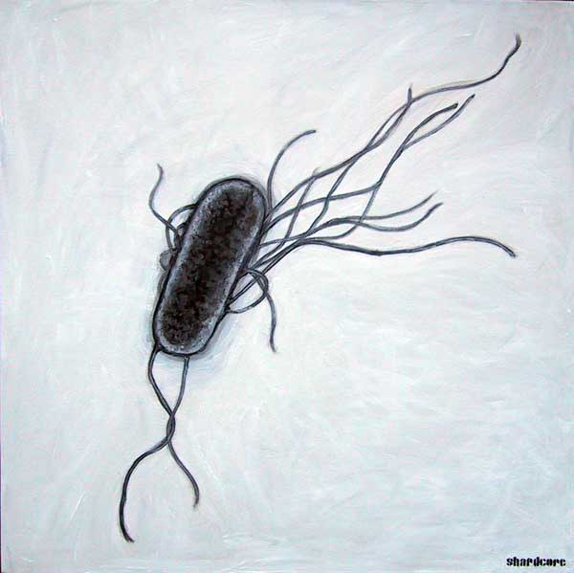
There’s (still) Plenty of Room at the Bottom
“There’s more than one way to build a nanoscale information processing unit” – Folklore
E coli is a 2000 nm by 500 nm device by area (in 3D, 500 nm tall)
Self-replicating, self-powered system
1 million interconnected subdevices of 4000 types
Stores 1 megabyte of genomic data
Humans are capable of building only a 10 bit SRAM in the same area
Painting of E. Coli courtesy of shardcore.org

Slide 9
Even if we switch from MOS transistors…
Integrated Circuits will be an important technology for a long time
Designing and building these circuits requires knowledge in many fields
Circuit analysis
Semiconductor physics
Chemistry
Computer microarchitecture
Signal processing
And many many more…

Slide 10
EE 40 Course Overview
EECS 40:
One of five EECS core courses (with 20, 61A, 61B, and 61C)
introduces “hardware” side of EECS
prerequisite for EE105, EE130, EE141, EE150
Prerequisites: Math 1B, Physics 7B
Course content:
Electronic circuits
Some very basic semiconductor physics
Integrated-circuit devices and technology

Slide 11
EE40
Circuit Input/Output Response
EE40
Circuit Modeling
EE105, EE130
Silicon
Device Modeling
Device Response
Copper
Other Materials

Slide 12
Core EECS Courses (Computer Centric View)
Computer Programs
61A/B
CS61C
EE40
Computers
Integrated Circuits
Circuit models
EE40
Combinational and Sequential Logic
State machines
CS61C
Transistors and other devices
CS61C
EE20
Buildable
Artifacts
Silicon and other materials
Network Models

Slide 13
Course Logistics

Slide 14
Important Dates
Two or three in-class midterms
July 9th (18 days from now)
July 28th
August 11th (if you guys vote to do this)
One comprehensive final
August 13th
July 2 – must be registered for course
June 25th – last day to drop for a refund
July 30th – last day to drop for no refund

Slide 15
Grades
Reading Assignments (5%)
HW (20%)
Lowest HW dropped
One late homework allowed
Midterm and Final (20%, 20%, 20%)
If we do 3 midterms, lowest dropped
Labs (15%)
Six labs
Two lab projects
2nd project is open ended, get started early if you want to do something crazy

Slide 16
Reading Assignments
Reading assignments due before class
Easy problems to make sure you got at least something out of the reading
Credit/No Credit grading
No late submissions allowed
Lowest two dropped
Submit on bspace (bspace.berkeley.edu)

Slide 17
Homeworks
Homeworks due on either Tuesdays or Fridays
Must be in the HW box, 240 Cory by 5 PM
Problems graded on a 0,1,2,3 basis
You do not get 1 point for writing the problem down
Will be returned in lecture
Also available during my office hours
On the top page, right top corner, write your name (in the form: Last Name, First Name)
Fine to discuss problems with others but ALL WORK SHOULD BE YOUR OWN

Slide 18
Homework Philosophy
Homework is where the real learning happens, similar to practicing a musical instrument
My homeworks are for a grade so that if you perform poorly on midterms, it is evidence of what you’ve accomplished outside of a testing environment
Copying homework answers is tempting, but:
It is an unfair representation of your accomplishments
You will be unprepared for midterms

Slide 19
Labs
Labs start NEXT week
2 labs per week, 3 hours each
Labs
50% on Prelab and 50% on Report
Do prelabs BEFORE the lab
You must complete the prelab section before going to the lab. The prelabs are checked by the GSIs at the beginning of each session. If prelabs are completed during the lab sessions, it is considered late and 50% will be deducted
Lab reports are due exactly one week after your lab is completed
Some make up labs will be scheduled

Slide 20
Discussion Sections and Office Hours
Note that discussion section times have changed, now only one hour:
Tuesday: 1-2 PM
Friday: 2-3 PM
Held in 293 Cory
Office Hours will be posted later today

Slide 21
Textbook and i>Clicker
Our textbook is “Foundations of Analog and Digital Electronic Circuits”, 1st edition by Anant Agarwal and Jeffrey Lang
Also required is an i>Clicker
For submitting answers in class
Available at ASUC bookstore or online
ASUC will buy them for $30 (as of last semester)
Will register them by serial # to your name online (details on website soon)

Slide 22
Lectures
We have a 2 hour lecture
Nobody on this earth is that entertaining
End of each hour – peer instruction
Work on small problem in groups
Submit answer via i>Clicker
Go over problem
Take a break
Attendance isn’t required, but reading assignments for lecture ARE required
Lectures will be posted online

Slide 23
i>Clicker Test
Let’s test those i>Clickers
Question: Does your i>Clicker work?
A. Yes
B. No

Slide 24
Course Website
Course website is at http://www-inst.eecs.berkeley.edu/~ee40/su10/
Homeworks, midterm solutions, labs, and anything else we want you to know will be posted there
Bspace will be used for
Submitting reading assignments
Discussion board

Slide 25
HW0
Mini-biography assignment
Due Wednesday
May submit either:
Online on bSpace (due at midnight)
In class (at beginning of class)
Our HW0 is available on the web under our pictures

Slide 26
Study Groups
Learning or working in a team works better than alone
Reduces chance that you get stuck on something minor
Helping someone else requires very deep well organized knowledge of a topic
You learn best by teaching
Provides a chance to learn how to solve problems more efficiently and with higher accuracy
Gives immediate feedback on how you stand on coursework comprehension

Slide 27
Study Groups
In my obscenely difficult Graduate Probability and Statistics Class, we’d:
Start the homework early (like the day it came out), and attempt all of the problems alone.
Meet a day or two before it was due
Go over every homework problem
Discuss our approach to each
Different person led on each problem
This is fine, but ALL WORK MUST BE YOUR OWN. Do not copy.

Slide 28
Extra Credit: EPA!
Effort
Attending office hours, completing all assignments, turning in HW0
Participation
Attending lecture and voting using i>Clickers
Asking great questions in discussion, lab, and lecture and making things generally more interactive
Altruism
Helping others in lab or on the discussion board
EPA! extra credit points have the potential to bump students up to the next grade level! (but actual EPA! scores are internal)

Slide 29
Course Problems…Cheating
What is cheating?
Studying together in groups is encouraged.
Turned-in work must be completely your own.
Common examples of cheating: running out of time on a assignment and then copying an answer from a friend, taking homework from box and copying, asking to borrow a solution “just to take a look”, copying an exam question, …
Both “giver” and “receiver” are equally culpable
Cheating points: 0 EPA, negative points for that assignment / lab / exam (e.g., if it’s worth 10 pts, you get -10) In most cases, F in the course.
Every offense will be referred to the Office of Student Judicial Affairs.
www.eecs.berkeley.edu/Policies/acad.dis.shtml

Slide 30
About Me (Josh Hug)
6th year graduate student
Research on Biological Systems
How Bacillus subtilis makes decisions
Math is the same as we’ll use in this class
One day, maybe a Teaching Professor
My HW0 is available online!

Slide 31
My Goal as an Instructor
To make your time in EE40 as fun and informative as I can
Make lectures interesting and timely
Bring out the beauty and make clear the usefulness of the material
Give secrets to getting good grades
To get a 7.0 with HKN
This is my first class, be gentle
I’ll need your feedback as much as possible

Slide 32
Friday Lunch
Every Friday after class
Email me at least a day in advance so that I am not overbooked

Slide 33
Teaching Staff
GSI/TAs:
Onur Ergen
Cooper Levy
Readers/Lab Assistants:
Jonathan Lin
Tony Dear

Slide 34
Topic 1
Fundamentals of Electronic Circuits

Slide 35
Topic 1
Outline
Electrical quantities
Charge, Current, Voltage, Power
The ideal basic circuit element
Circuit schematics
Sign conventions
Mostly a review of Physics 7B

Slide 36
Etymology
The word electric is derived from the Greek elektron (Latin electrum) denoting amber.
It was discovered in ancient times that when amber is rubbed it attracts feathers, dried leaves, etc.
This is due to the amber becoming charged (discovered much later).
These are the roots of our subject.

Slide 37
Common Sense
If we take a AA battery and a paperclip and connect the two terminals, it heats up
If we stick the same paperclip into the wall outlet and get it to actually stay there, it will heat up much more (and then melt)
This heat is due to the flow of electrical current driven by the voltage provided by the source
As electrons bump into neighboring electrons, they get jostled around. This is exactly what heat is

Slide 38
Intuition Test and a break
We decide to stick a piece of wire in a nearby electrical outlet to heat our room.
We have a choice of many different thicknesses of wire to use. Assume that resistance scales inversely with diameter of the wire, i.e. R_{wire}=constant/diameter
Assuming our wire won’t melt, if we wish to maximize the amount of heat generated, which wire should we choose:
A. The thinnest wire
B. The thickest wire
C. Some medium wire

Slide 39
The Universe
Electric charges exert forces on other electric charges, according to Coulomb’s Law:
The part of the universe we care about is made up of atoms composed of these charges
Negative charges (electrons) orbiting a positively charged nucleus in discrete (i.e. quantum) orbits

Slide 40
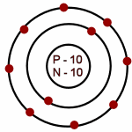
Atomic Structure
Electrons are organized into orbitals, basically a nested set of shells
If you rememeber high school chemistry:
Neon’s electronic subshells: 1s²2s²2p⁶
The existence of these shells plays a key role in conductivity. It is hard to give an electron to someone with no room to hold it.
http://www.iq.poquoson.org/6sci/atoms/neonA.gif

Slide 41
Matter
Atoms agglomerate into solids, liquids, and gases
Typically, most objects in the world are neutrally charged
Exceptions: clouds in a thunderstorm, people on carpets in dry weather, rubbed amber, plates of a charged capacitor, etc.
When there is an imbalance of charge, there are forces (Coulomb’s Law)
Static cling
Current through a wire

Slide 42
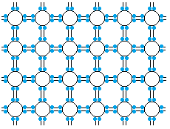
Classification of Materials: Insulators
Solids in which all electrons are tightly bound to atoms are insulators.
e.g. Neon: applying an electric field will tend to do little, because it is hard for an electron to move in to your neighbors valence shell.

Slide 43
CoM : Metals and Semiconductors
Solids in which the outermost atomic electrons are free to move around are metals
Metals typically have ~1 “free electron” per atom
~5 ×10²² free electrons per cubic cm
Electrons in semiconductors are not tightly bound, nor are they free, but can be easily “promoted” to a free state
insulators
semiconductors
metals
Quartz, SiO₂
Si, GaAs
Al, Cu
poor conductors
excellent conductors

Slide 44
Abstraction
Though a detailed quantum mechanical formulation would be the most accurate choice, it would be hard to use
Thinking of 10²³⁺ atoms composed of charged subatomic particles each with their own individual state is too much
We’ll instead lump large objects like a battery into more abstract pieces
Likewise, we will treat current as a bulk flow of charges

Slide 45
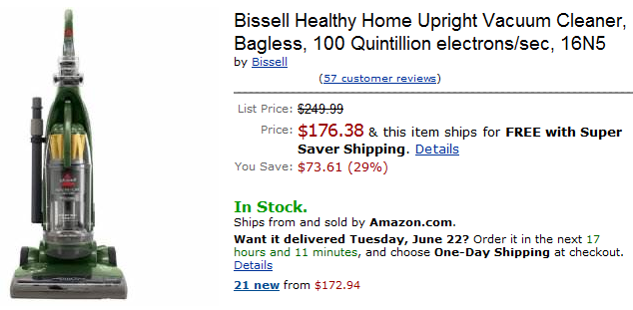
Current
Electrical Current is simply a measure of the net amount of positive charge that passes a plane in space per second in a reference direction
For convenience, the base unit is 1 Ampere, which is 1.6x10¹⁹ charges/sec or 1 Coulomb/sec

Slide 46
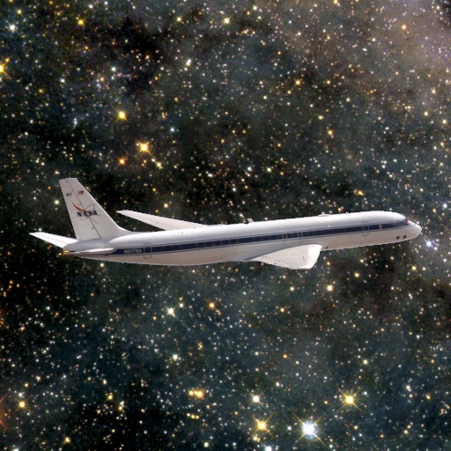
A Plane in Space?
Net amount of positive charge passing a plane in space in a reference direction
Analogous to measuring river flow
Don’t care how much total water is moving throughout the entire length of a river
Do care about how much water is passing a given point on the shore per second
Current = speed of water * cross section of river
Cross section is the “plane in space”
We care about the plane perpendicular to flow
?

Slide 47
Electric Current Examples
10⁵ positively charged hydrogen ions (each with charge 1.6×10⁻¹⁹ C) pass the perpendicular plane in space to the right (+x direction) every nanosecond. What is the current to the right?
10⁵ electrons (each with charge -1.6×10⁻¹⁹ C) pass the perpendicular plane in space to the right (+x direction) every nanosecond. What is the current to the right?
Current is net positive charges to the right, so…

Slide 48
Electric Current Summary
Definition: Rate of positive charge flow in a reference direction
Symbol: I
Units: Ampere (A) = 1 Coulomb/second
Simply the net amount of charge/second passing through a plane perpendicular to the direction of flow

Slide 49
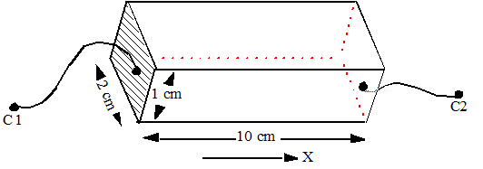
Current Density
Definition: rate of positive charge flow per unit area
Symbol: J
Units: A / cm²
Example 1:
Wire attached
to end
Suppose we force a electron current of 1 A to flow from C1 to C2, what is the current density:
Electron flow is in -x direction through 2cm² cross section:
-0.5 A/cm²

Slide 50
Voltage
The voltage between two points in space is simply the amount of energy (in Joules) that it would take to move 1 Coulomb of charge between those two points
Example: There is a uniform electric field pulling electrons to the left at 9.8 Newtons/Coulomb. How much energy would it take to move this charge 2 meters to the right?
Energy=Force*Distance

Slide 51
Analogy to Gravity
Example: There is a uniform gravitational field pulling some matter downwards at 9.8 Newtons/kg. How much energy/kg would it take to move this matter 2 meters upwards?

Slide 52
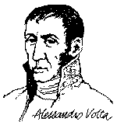
Electric Potential (Voltage)
Definition: energy per unit charge
Symbol: v
Units: Joules/Coulomb ≡ Volts (V)
v = dw/dq
where w = energy (in Joules), q = charge (in Coulombs)
Note: Potential is always referenced to some point.
Alessandro Volta (1745–1827)
a
Subscript convention:
v_{ab} means the potential at a minus the potential at b.
b
v_{ab} ≡ v_{a} - v_{b}
Notes:
The discovery of the battery was an important discovery and also gave rise to a famous debate between Volta and Luigi Galvani 1737-1798. Galvani while dissecting a frog discovered that when a knife was in contact with the frog’s nerve center and at the same time a spark was produced by nearby electrical machine, the muscles of the frog’s legs contracted violently as if in a convulsion.
Galvani proceeded to investigate further and could reproduce this effect by other means: when a copper or brass hook was pressed into the frog’s flesh and then hung from an iron trellis which touched the frog, the muscle again twitched. Galvani believed the contractions were due to electricity – and the source of the electric charge was in the frog muscle or nerve itself, the wire merely transmitted the charge to the probe points. He published a paper called animal electricity. Many, including Galvani, wondered if he had discovered the long-sought “life force”.
Volta rushed to confirm the experiments and soon came to a different conclusion: put two dissimilar metals in contact on one end and their other ends are placed on the opposite side of the tongue – tongue feels a tingling sensation.

Slide 53
Electric Power
Definition: transfer of energy per unit time
Symbol: p
Units: Joules per second ≡ Watts (W)
p = dw/dt = (dw/dq)(dq/dt) = vi
Concept:
As a positive charge q moves through a
drop in voltage v, it loses potential energy
Voltage is Joules/Coulomb
Current is Coulombs/second
Power is the product of these

Slide 54
Summary
So far:
Current: Number of positive charges per second passing a plane in a particular direction
Current density: Current per unit area
Voltage: Amount of energy per Coulomb to move a charge between two points
Power: Amount of energy per second
Where do these quantities arise?
When we build networks of electrical components

Slide 55
Power Sources
We want to get charges moving in a controlled fashion
Generate heat
Turn motors
Perform computation
Store entire corpus of written human work in easily transmittable format
It is easier to build a source which provides an almost constant voltage as opposed to an almost constant current (more on this later)

Slide 56
Voltage Sources
One of the fundamental devices in electrical engineering is the voltage source
Batteries
Generators
Provide a consistent voltage difference between two points in space
If a charge is at the “top” of the voltage, a force will try to move it towards the “bottom”

Slide 57
Voltage Sources
Positive and negative charges will move in opposite directions given the same voltage
“Positive” terminal of a voltage source
High potential for a positive charge
Low potential for a negative charge

Slide 58
Our First Circuit
Imagine that we have an ideal voltage source connected to a piece of metal. What happens?
Electrons at the negative terminal travel towards the positive terminal
These electrons will encounter some resistance as they travel generating heat
The current of the electrons will be a function of this resistance and the original voltage

Slide 59
Ohm’s Law
Ohm* discovered in 1825 that for many materials, voltage and current are related by a simple linear relationship: V=IR
Here the “resistance” is a bulk property of the object connecting the two terminals of a voltage source and is empirically derived
Measured in Ohms
Any material which obeys Ohm’s Law is called a “resistor”
*: Cavendish was first in 1781, but didn’t publish. Take note.

Slide 60
Ohm’s Law
Ohm’s law doesn’t always work
Consider your wall outlet with terminals connected by a gaseous mixture of mostly nitrogen and oxygen
There is no current flow
With a high enough voltage, called the breakdown voltage, current will eventually flow (via a spark, a.k.a. lightning)
Such phenomena are beyond the scope of this course

Slide 61
Circuit Schematics
Ohm’s law paved the way for simple circuit schematics
We can model circuits as a series of interconnected discrete components or ideal basic circuit elements
For now, each component can be characterized with a single physical parameter

Slide 62
The Ideal Basic Circuit Element
i
+
v
_
Polarity reference for voltage can be
indicated by plus and minus signs
Reference direction for the current
is indicated by an arrow
Attributes:
Two terminals (points of connection)
Device model gives us current/voltage relationship (I-V Characteristic)
Cannot be subdivided into other elements

Slide 63
Example Circuit Element: Resistor
Resistor: Circuit element where the voltage across the element is linearly proportional to the amount of current flowing through the device
i
+
v
_
v
i
The slope must be positive and the characteristic must go through the origin.

Slide 64
Example Circuit Element: Voltage Source
Voltage Source: Circuit element that maintains a prescribed voltage across its terminals, regardless of the current flowing in those terminals
Voltage is known, but current is determined by the circuit to which the source is connected
A battery can be approximated by a voltage source

Slide 65
I-V Characteristic of Ideal Voltage Source
i
a
i
+
V_{ab}
_
+
v_{s}
_
i=0
b
v
V_{s}>0
Voltage is known, but current is determined by the circuit to which the source is connected

Slide 66
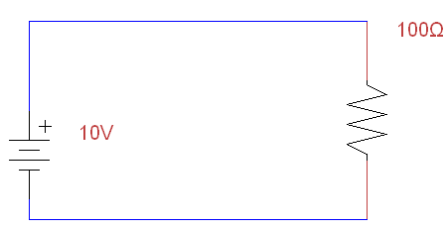
Circuit Schematics
Combinations of ideal basic circuit elements
A (high resistance) paperclip connecting the terminals of a 10 volt battery can be schematically represented as shown below

Slide 67
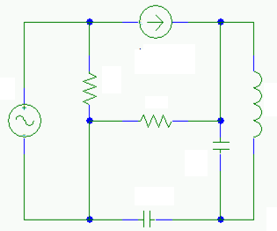
Larger Circuit Schematics
We can compose these components into an arbitrary network
For much of the semester we will discuss how to convert these networks into a system of algebraic (and later differential) equations
The solution will give us the current and voltage between any two terminals in an arbitrary network

Slide 68
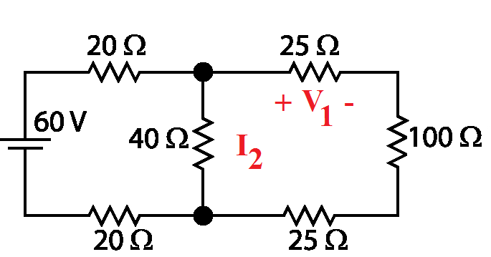
Example Problem Structure
Find the voltage V₁ and current I₂
Note that the problem statement assumes a certain reference direction for currents and voltages
If you find that the reference direction is wrong, just note your answer as negative

Slide 69
Reference Example
Find the current I₁
Magnitude of the current is obviously 10V/100Ω or 0.1 Amps.
Current flows from positive to negative, so “reference” current is wrong. Answer is -0.1 Amps
I₁

Slide 70
Reference Directions and Sign Conventions
The minus sign is just shorthand for “it’s going the other way than the one you asked for”
Like asking “how fast is your plane moving in the direction of New York?” when you’re flying away from New York
Could say “500 mph, but the other direction”
Or just “minus 500 mph”
If you get confused on sign conventions at any point in the course, just step back and think about what is reasonable

Slide 71
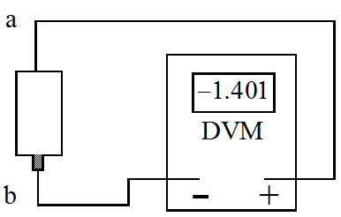
Sign Convention Example
Suppose you have an unlabelled battery and you measure its voltage with a digital voltmeter (DVM). It will tell you the magnitude and sign of the voltage.
With this circuit, you are measuring v_{ab}.
The DVM indicates −1.401, so v_{a} is lower than v_{b} by 1.401 V.
Which is the positive battery terminal?
+

Slide 72
Sign Convention for Power
If P > 0 for a circuit element
Consuming power (as heat, light, motion, etc)
If P < 0 for a circuit element
Providing power
Resistors always consume power
Voltage sources may consume or provide power

Slide 73
Sign Convention for Power
Remember earlier that we said P=VI
This can be problematic depending on the chosen reference directions
+
V
I₁
1
–
Resistor providing power??
P=VI=10 V * (-0.1 Amps) = -1 Watt

Slide 74
Sign Convention for Power
We’ll have to revise P=VI to take into account this reference direction problem
+
V
I₁
1
–

Slide 75
Sign Convention for Power
Passive sign convention
p = vi
p = -vi
i
i
i
i
_
v
+
_
v
+
+
v
_
+
v
_
Current from + to –
Current from – to +
If p > 0, power is being delivered to the box.
If p < 0, power is being extracted from the box.

Slide 76
Sign Convention for Power
For this circuit, since reference current is in the opposite direction of reference voltage in the resistor, then P=-VI
+
V
I₁
1
–
P=VI=-10 V * (-0.1 Amps) = 1 Watt
All is well

Slide 77
Summary
Current = rate of charge flow
Voltage = energy per unit charge created by charge separation
Power = energy per unit time
Ideal Basic Circuit Element
2-terminal component that cannot be sub-divided
Described mathematically in terms of its terminal voltage and current
Circuit Schematics
Networks of ideal basic circuit elements
Equivalent to a set of algebraic equations
Solution provides voltage and current through all elements of the circuit

Slide 78
iClickers Once More
We decide to stick a piece of wire in a nearby electrical outlet to heat our room.
We have a choice of many different thicknesses of wire to use. Assume that resistance scales inversely with diameter of the wire, i.e. R_{wire}=constant/diameter
Assuming our wire won’t melt, if we wish to maximize the amount of heat generated, which wire should we choose:
A. The thinnest wire
B. The thickest wire
C. Some medium wire

Slide 79
Acknowledgements
Dan Garcia, Babak Ayazifar, Mike Clancy for help in CS302 (a course in course design)
Slides and Course Organization:
Tsu Jae King
Connie Chang-Hasnain
Octavian Florescu
Brian Gawalt
Bernhard Boser
Labs
Bernhard Boser
Electronics Lab Staff

Slide 80
Extra Slides
Extra slides you’re responsible for knowing about, but which I won’t talk about in class for lack of time

Slide 81
EE40 Content (Detailed Version)
Fundamental Circuit Concepts and Analysis Techniques
Networks of power sources and resistors
Op-amps
Signal amplification
Conversion of circuit schematics into algebraic equations
Circuits with Energy Storage Elements
Capacitors
Inductors
Filtering
Conversion of circuit schematics into differential equations
Semiconductors and Integrated Circuits
Basic semiconductor devices
Diodes
Transistors
Logic gates
Textbook
Foundation of Analog and Digital Electronic Circuits, Anant Agarwal and Jeffrey Lang, Morgan Kaufman, 1st Edition

Slide 82
Final Grade Distribution – subject to change before first midterm
Grading: 800 pts total
120pts = 15% Labs
160pts = 20% Homework
320pts = 40% Two midterms (each 20%)
160 pts= 20% Final
40 pts = 5% Reading Assignments
+ Extra credit for EPA. What’s EPA?
Grade distributions
Pseudo-Absolute Scale
Perfect score is 1000 points. 25-60-25 for A+, A, A-
Similar for Bs and Cs (110 pts per letter-grade)
C+, C, C-, D, F (No D+ or D- distinction)
Exception: No F will be given if all but one hw and labs are completed and all exams taken
We’ll “ooch” grades up but never down
May change before 1st midterm!

Slide 83
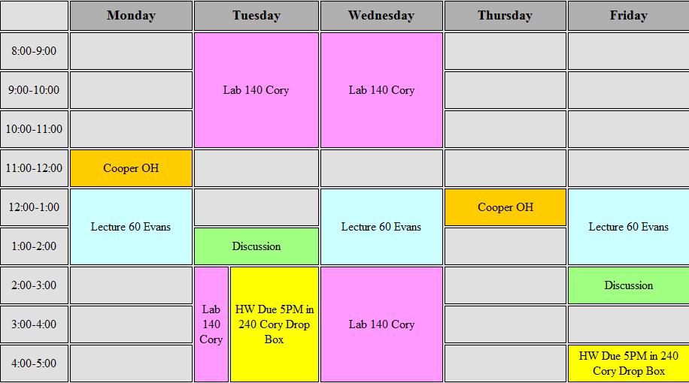
Weekly Calendar

Slide 84
Core EE Courses
Input Signals
Output Signals
Systems Modeling
System Architecture
EE20
EE40
Circuit Input/Output Response
Circuit Modeling
Silicon
Device Modeling
Device Response
Copper
Other Materials

