Slide 1
CS162
Operating Systems and
Systems Programming
Lecture 3
Processes (con’t), Fork,
Introduction to I/O
January 28th, 2015
Prof. John Kubiatowicz
http://cs162.eecs.Berkeley.edu

Slide 2
Recall: Four fundamental OS concepts
Thread
  Single unique execution context
  Program Counter, Registers, Execution Flags, Stack
Address Space w/ Translation
  Programs execute in an address space that is distinct from the memory space of the physical machine
Process
  An instance of an executing program is a process consisting of an address space and one or more threads of control
Dual Mode operation/Protection
  Only the “system” has the ability to access certain resources
  The OS and the hardware are protected from user programs and user programs are isolated from one another by controlling the translation from program virtual addresses to machine physical addresses

Slide 3
Recall: Process
Process: execution environment with Restricted Rights
  Address Space with One or More Threads
  Owns memory (address space)
  Owns file descriptors, file system context, …
  Encapsulate one or more threads sharing process resources
Why processes?
  Protected from each other!
  OS Protected from them
  Navigate fundamental tradeoff between protection and efficiency
  Processes provides memory protection
  Threads more efficient than processes (later)
Application instance consists of one or more processes

Slide 4

Single and Multithreaded Processes
Threads encapsulate concurrency: “Active” component
Address spaces encapsulate protection: “Passive” part
  Keeps buggy program from trashing the system
Why have multiple threads per address space?
Notes:
Sometimes need parallelism for a single job, and processes are very expensive – to start, switch between, and to communicate between

Slide 5
Recall: give the illusion of multiple processors?
vCPU1
vCPU2
vCPU3
vCPU1
vCPU2
vCPU3
vCPU1
vCPU2
Shared Memory
Time
Assume a single processor. How do we provide the illusion of multiple processors?
  Multiplex in time!
Each virtual “CPU” needs a structure to hold:
  Program Counter (PC), Stack Pointer (SP)
  Registers (Integer, Floating point, others…?)
How switch from one virtual CPU to the next?
  Save PC, SP, and registers in current state block
  Load PC, SP, and registers from new state block
What triggers switch?
  Timer, voluntary yield, I/O, other things

Slide 6
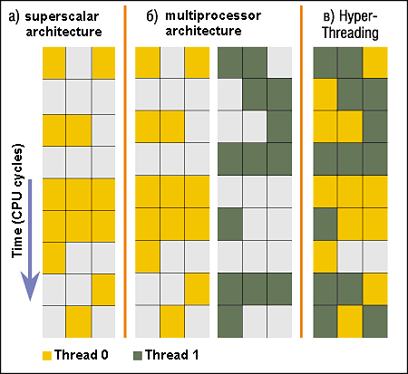
Simultaneous MultiThreading/Hyperthreading
Hardware technique
  Superscalar processors can
  execute multiple instructions
  that are independent.
  Hyperthreading duplicates
  register state to make a
  second “thread,” allowing
  more instructions to run.
Can schedule each thread
as if were separate CPU
  But, sub-linear speedup!
Original technique called “Simultaneous Multithreading”
  http://www.cs.washington.edu/research/smt/index.html
  SPARC, Pentium 4/Xeon (“Hyperthreading”), Power 5
Colored blocks show
instructions executed
Notes:
Intel seems to be discarding SMT in Silvermont because of power problems

Slide 7
Recall: User/Kernal(Priviledged) Mode
User Mode
interrupt
exception
syscall
rtn
rfi
Kernel Mode
exit
exec
Limited HW access
Full HW access

Slide 8
Recall: A simple address translation (B&B)
0000…
0000…
code
code
Static Data
Static Data
heap
heap
stack
Base Address
stack
1000…
1000…
code
Program
address
Static Data
heap
Bound
<
stack
1100…
0100…
Can the program touch OS?
Can it touch other programs?
FFFF…

Slide 9
Recall: Address Mapping
Code
Data
Heap
Stack
Data 2
Code
Data
Heap
Stack
Stack 1
Heap 1
Code 1
Stack 2
Prog 1
Virtual
Address
Space 1
Data 1
Prog 2
Virtual
Address
Space 2
Heap 2
Code 2
OS code
Translation Map 1
OS data
Translation Map 2
OS heap &
Stacks
Physical Address Space

Slide 10
Putting it together: web server
syscall
syscall
RTU
RTU
wait
wait
interrupt
interrupt

Slide 11
Running Many Programs
We have the basic mechanism to
  switch between user processes and the kernel,
  the kernel can switch among user processes,
  Protect OS from user processes and processes from each other
Questions ???
  How do we represent user processes in the OS?
  How do we decide which user process to run?
  How do we pack up the process and set it aside?
  How do we get a stack and heap for the kernel?
  Aren’t we wasting are lot of memory?
  …

Slide 12
Process Control Block
Kernel represents each process as a process control block (PCB)
  Status (running, ready, blocked, …)
  Register state (when not ready)
  Process ID (PID), User, Executable, Priority, …
  Execution time, …
  Memory space, translation, …
Kernel Scheduler maintains a data structure containing the PCBs
Scheduling algorithm selects the next one to run

Slide 13
Scheduler
if ( readyProcesses(PCBs) ) {
nextPCB = selectProcess(PCBs);
run( nextPCB );
} else {
run_idle_process();
}
Scheduling: Mechanism for deciding which processes/threads receive the CPU
Lots of different scheduling policies provide …
  Fairness or
  Realtime guarantees or
  Latency optimization or ..

Slide 14
Implementing Safe Kernel Mode Transfers
Important aspects:
  Separate kernel stack
  Controlled transfer into kernel (e.g. syscall table)
Carefully constructed kernel code packs up the user process state an sets it aside.
  Details depend on the machine architecture
Should be impossible for buggy or malicious user program to cause the kernel to corrupt itself.

Slide 15
Need for Separate Kernel Stacks
Kernel needs space to work
Cannot put anything on the user stack (Why?)
Two-stack model
  OS thread has interrupt stack (located in kernel memory) plus User stack (located in user memory)
  Syscall handler copies user args to kernel space before invoking specific function (e.g., open)
  Interrupts (???)

Slide 16
Before

Slide 17
During

Slide 18
Kernel System Call Handler
Vector through well-defined syscall entry points!
  Table mapping system call number to handler
Locate arguments
  In registers or on user(!) stack
Copy arguments
  From user memory into kernel memory
  Protect kernel from malicious code evading checks
Validate arguments
  Protect kernel from errors in user code
Copy results back
  into user memory

Slide 19
Hardware support: Interrupt Control
Interrupt processing not be visible to the user process:
  Occurs between instructions, restarted transparently
  No change to process state
  What can be observed even with perfect interrupt processing?
Interrupt Handler invoked with interrupts ‘disabled’
  Re-enabled upon completion
  Non-blocking (run to completion, no waits)
  Pack up in a queue and pass off to an OS thread for hard work
    wake up an existing OS thread
OS kernel may enable/disable interrupts
  On x86: CLI (disable interrupts), STI (enable)
  Atomic section when select next process/thread to run
  Atomic return from interrupt or syscall
HW may have multiple levels of interrupt
  Mask off (disable) certain interrupts, eg., lower priority
  Certain non-maskable-interrupts (nmi)
    e.g., kernel segmentation fault

Slide 20
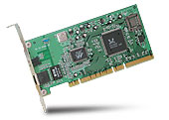
Interrupt Controller
Interrupt Mask
Priority Encoder
IntID
CPU
Interrupt
Int Disable
Timer
Software
Interrupt
Control
NMI
Network
Interrupts invoked with interrupt lines from devices
Interrupt controller chooses interrupt request to honor
  Mask enables/disables interrupts
  Priority encoder picks highest enabled interrupt
  Software Interrupt Set/Cleared by Software
  Interrupt identity specified with ID line
CPU can disable all interrupts with internal flag
Non-maskable interrupt line (NMI) can’t be disabled

Slide 21
How do we take interrupts safely?
Interrupt vector
  Limited number of entry points into kernel
Kernel interrupt stack
  Handler works regardless of state of user code
Interrupt masking
  Handler is non-blocking
Atomic transfer of control
  “Single instruction”-like to change:
    Program counter
    Stack pointer
    Memory protection
    Kernel/user mode
Transparent restartable execution
  User program does not know interrupt occurred

Slide 22
Administrivia: Getting started
Kubiatowicz Office Hours:
  1pm-2pm, Monday/Wednesday
Homework 0 immediately ⇒ Due on Monday!
  Get familiar with all the cs162 tools
  Submit to autograder via git
Should be going to section already!
Participation: Get to know your TA!
Friday is Drop Deadline!
Group sign up form out next week (after drop deadine)
  Get finding groups ASAP
  4 people in a group!
Finals conflicts: Tell us now
  Must give us a good reason for providing an alternative
  No alternate time if the conflict is because of an overlapping class (e.g. EE122)!

Slide 23
Question
Process is an instance of a program executing.
  The fundamental OS responsibility
Processes do their work by processing and calling file system operations
Are their any operations on processes themselves?
exit ?

Slide 24
pid.c
#include <stdlib.h>
#include <stdio.h>
#include <string.h>
#include <unistd.h>
#include <sys/types.h>
#define BUFSIZE 1024
int main(int argc, char *argv[])
{
int c;
pid_t pid = getpid(); /* get current processes PID */
printf("My pid: %d\n", pid);
c = fgetc(stdin);
exit(0);
}
ps anyone?

Slide 25
Can a process create a process ?
Yes
Fork creates a copy of process
Return value from Fork: integer
  When > 0:
    Running in (original) Parent process
    return value is pid of new child
  When = 0:
    Running in new Child process
  When < 0:
    Error! Must handle somehow
    Running in original process
All of the state of original process duplicated in both Parent and Child!
  Memory, File Descriptors (next topic), etc…

Slide 26
fork1.c
#include <stdlib.h>
#include <stdio.h>
#include <string.h>
#include <unistd.h>
#include <sys/types.h>
#define BUFSIZE 1024
int main(int argc, char *argv[])
{
char buf[BUFSIZE];
size_t readlen, writelen, slen;
pid_t cpid, mypid;
pid_t pid = getpid(); /* get current processes PID */
printf("Parent pid: %d\n", pid);
cpid = fork();
if (cpid > 0) { /* Parent Process */
mypid = getpid();
printf("[%d] parent of [%d]\n", mypid, cpid);
} else if (cpid == 0) { /* Child Process */
mypid = getpid();
printf("[%d] child\n", mypid);
} else {
perror("Fork failed");
exit(1);
}
exit(0);
}

Slide 27
UNIX Process Management
UNIX fork – system call to create a copy of the current process, and start it running
  No arguments!
UNIX exec – system call to change the program being run by the current process
UNIX wait – system call to wait for a process to finish
UNIX signal – system call to send a notification to another process
Notes:
UNIX splits creating a process into two steps, each of them a lot simpler.

Slide 28
fork2.c
…
cpid = fork();
if (cpid > 0) { /* Parent Process */
mypid = getpid();
printf("[%d] parent of [%d]\n", mypid, cpid);
tcpid = wait(&status);
printf("[%d] bye %d\n", mypid, tcpid);
} else if (cpid == 0) { /* Child Process */
mypid = getpid();
printf("[%d] child\n", mypid);
}
…

Slide 29
UNIX Process Management
Notes:
How is this used – typically, fork a process, child and parent are now both running the same program. One sets up the child program, and runs exec – becoming the new program
The parent, usually, waits for the child to finish

Slide 30
Shell
A shell is a job control system
  Allows programmer to create and manage a set of programs to do some task
  Windows, MacOS, Linux all have shells
Example: to compile a C program
  cc –c sourcefile1.c
  cc –c sourcefile2.c
  ln –o program sourcefile1.o sourcefile2.o
  ./program
HW1

Slide 31
Signals – infloop.c
#include <stdlib.h>
#include <stdio.h>
#include <sys/types.h>
#include <unistd.h>
#include <signal.h>
void signal_callback_handler(int signum)
{
printf("Caught signal %d - phew!\n",signum);
exit(1);
}
int main() {
signal(SIGINT, signal_callback_handler);
while (1) {}
}
Got top?

Slide 32
Process races: fork.c
if (cpid > 0) {
mypid = getpid();
printf("[%d] parent of [%d]\n", mypid, cpid);
for (i=0; i<100; i++) {
printf("[%d] parent: %d\n", mypid, i);
// sleep(1);
}
} else if (cpid == 0) {
mypid = getpid();
printf("[%d] child\n", mypid);
for (i=0; i>-100; i--) {
printf("[%d] child: %d\n", mypid, i);
// sleep(1);
}
}
Question: What does this program print?
Does it change if you add in one of the sleep() statements?

Slide 33
Break

Slide 34
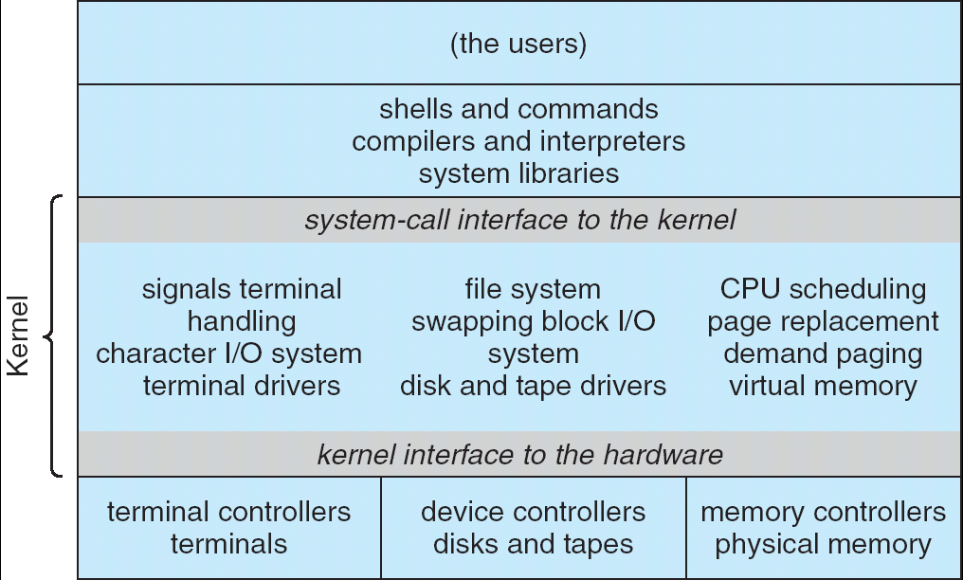
Recall: UNIX System Structure
Applications
User Mode
Standard Libs
Kernel Mode
Hardware

Slide 35
How does the kernel provide services?
You said that applications request services from the operating system via syscall, but …
I’ve been writing all sort of useful applications and I never ever saw a “syscall” !!!
That’s right.
It was buried in the programming language runtime library (e.g., libc.a)
… Layering

Slide 36
OS run-time library
Proc 1
Proc 2
Proc n
…
OS
Appln
login
Window Manager
…
OS library
OS library
OS library
OS

Slide 37
A Kind of Narrow Waist
Word Processing
Compilers
Web Browsers
Email
Databases
Web Servers
Application / Service
Portable OS Library
OS
User
System Call
Interface
System
Portable OS Kernel
Software
Platform support, Device Drivers
Hardware
x86
PowerPC
ARM
PCI
Ethernet (10/100/1000)
802.11 a/b/g/n
SCSI
IDE
Graphics

Slide 38
Key Unix I/O Design Concepts
Uniformity
  file operations, device I/O, and interprocess communication through open, read/write, close
  Allows simple composition of programs
    find | grep | wc …
Open before use
  Provides opportunity for access control and arbitration
  Sets up the underlying machinery, i.e., data structures
Byte-oriented
  Even if blocks are transferred, addressing is in bytes
Kernel buffered reads
  Streaming and block devices looks the same
  read blocks process, yielding processor to other task
Kernel buffered writes
  Completion of out-going transfer decoupled from the application, allowing it to continue
Explicit close

Slide 39
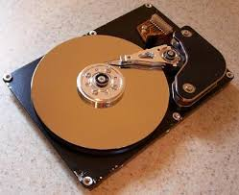
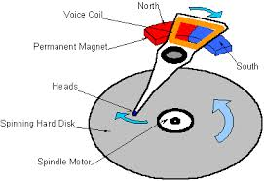
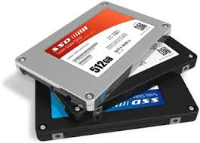

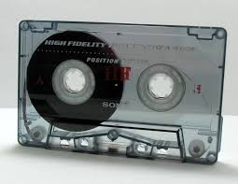
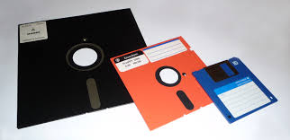
I/O & Storage Layers
Application / Service
streams
High Level I/O
Low Level I/O
handles
Syscall
registers
File System
descriptors
I/O Driver
Commands and Data Transfers
Disks, Flash, Controllers, DMA

Slide 40
The file system abstraction
File
  Named collection of data in a file system
  File data
    Text, binary, linearized objects
  File Metadata: information about the file
    Size, Modification Time, Owner, Security info
    Basis for access control
Directory
  “Folder” containing files & Directories
  Hierachical (graphical) naming
    Path through the directory graph
    Uniquely identifies a file or directory
      /home/ff/cs162/public_html/fa14/index.html
  Links and Volumes (later)

Slide 41
C high level File API – streams (review)
Operate on “streams” - sequence of bytes, whether text or data, with a position
#include <stdio.h>
FILE *fopen( const char *filename, const char *mode );
int fclose( FILE *fp );
Mode Text | Binary | Descriptions
r | rb | Open existing file for reading
w | wb | Open for writing; created if does not exist
a | ab | Open for appending; created if does not exist
r+ | rb+ | Open existing file for reading & writing.
w+ | wb+ | Open for reading & writing; truncated to zero if exists, create otherwise
a+ | ab+ | Open for reading & writing. Created if does not exist. Read from beginning, write as append
Don’t forget to flush

Slide 42
Connecting Processes, Filesystem, and Users
Process has a ‘current working directory’
Absolute Paths
  /home/ff/cs152
Relative paths
  index.html, ./index.html - current WD
  ../index.html - parent of current WD
  ~, ~cs152 - home directory

Slide 43
C API Standard Streams
Three predefined streams are opened implicitly when the program is executed.
  FILE *stdin – normal source of input, can be redirected
  FILE *stdout – normal source of output, can too
  FILE *stderr – diagnostics and errors
STDIN / STDOUT enable composition in Unix
  Recall: Use of pipe symbols connects STDOUT and STDIN
    find | grep | wc …

Slide 44
C high level File API – stream ops
#include <stdio.h>
// character oriented
int fputc( int c, FILE *fp ); // rtn c or EOF on err
int fputs( const char *s, FILE *fp ); // rtn >0 or EOF
int fgetc( FILE * fp );
char *fgets( char *buf, int n, FILE *fp );
// block oriented
size_t fread(void *ptr, size_t size_of_elements,
size_t number_of_elements, FILE *a_file);
size_t fwrite(const void *ptr, size_t size_of_elements,
size_t number_of_elements, FILE *a_file);
// formatted
int fprintf(FILE *restrict stream, const char *restrict format, ...);
int fscanf(FILE *restrict stream, const char *restrict format, ... );

Slide 45
C Stream API positioning
int fseek(FILE *stream, long int offset, int whence);
long int ftell (FILE *stream)
void rewind (FILE *stream)
Preserves high level abstraction of a uniform stream of objects
Adds buffering for performance

Slide 46
What’s below the surface ??
Application / Service
streams
High Level I/O
Low Level I/O
handles
Syscall
registers
File System
descriptors
I/O Driver
Commands and Data Transfers
Disks, Flash, Controllers, DMA

Slide 47
C Low level I/O
Operations on File Descriptors – as OS object representing the state of a file
  User has a “handle” on the descriptor
#include <fcntl.h>
#include <unistd.h>
#include <sys/types.h>
int open (const char *filename, int flags [, mode_t mode])
int creat (const char *filename, mode_t mode)
int close (int filedes)
Bit vector of:
Access modes (Rd, Wr, …)
Open Flags (Create, …)
Operating modes (Appends, …)
Bit vector of Permission Bits:
User|Group|Other X R|W|X
http://www.gnu.org/software/libc/manual/html_node/Opening-and-Closing-Files.html

Slide 48
C Low Level: standard descriptors
#include <unistd.h>
STDIN_FILENO - macro has value 0
STDOUT_FILENO - macro has value 1
STDERR_FILENO - macro has value 2
int fileno (FILE *stream)
FILE * fdopen (int filedes, const char *opentype)
Crossing levels: File descriptors vs. streams
Don’t mix them!

Slide 49
C Low Level Operations
ssize_t read (int filedes, void *buffer, size_t maxsize)
- returns bytes read, 0 => EOF, -1 => error
ssize_t write (int filedes, const void *buffer, size_t size)
- returns bytes written
off_t lseek (int filedes, off_t offset, int whence)
int fsync (int fildes) – wait for i/o to finish
void sync (void) – wait for ALL to finish
When write returns, data is on its way to disk and can be read, but it may not actually be permanent!

Slide 50
And lots more !
TTYs versus files
Memory mapped files
File Locking
Asynchronous I/O
Generic I/O Control Operations
Duplicating descriptors
int dup2 (int old, int new)
int dup (int old)

Slide 51
What’s below the surface ??
Application / Service
streams
High Level I/O
Low Level I/O
handles
Syscall
registers
File System
descriptors
I/O Driver
Commands and Data Transfers
Disks, Flash, Controllers, DMA

Slide 52
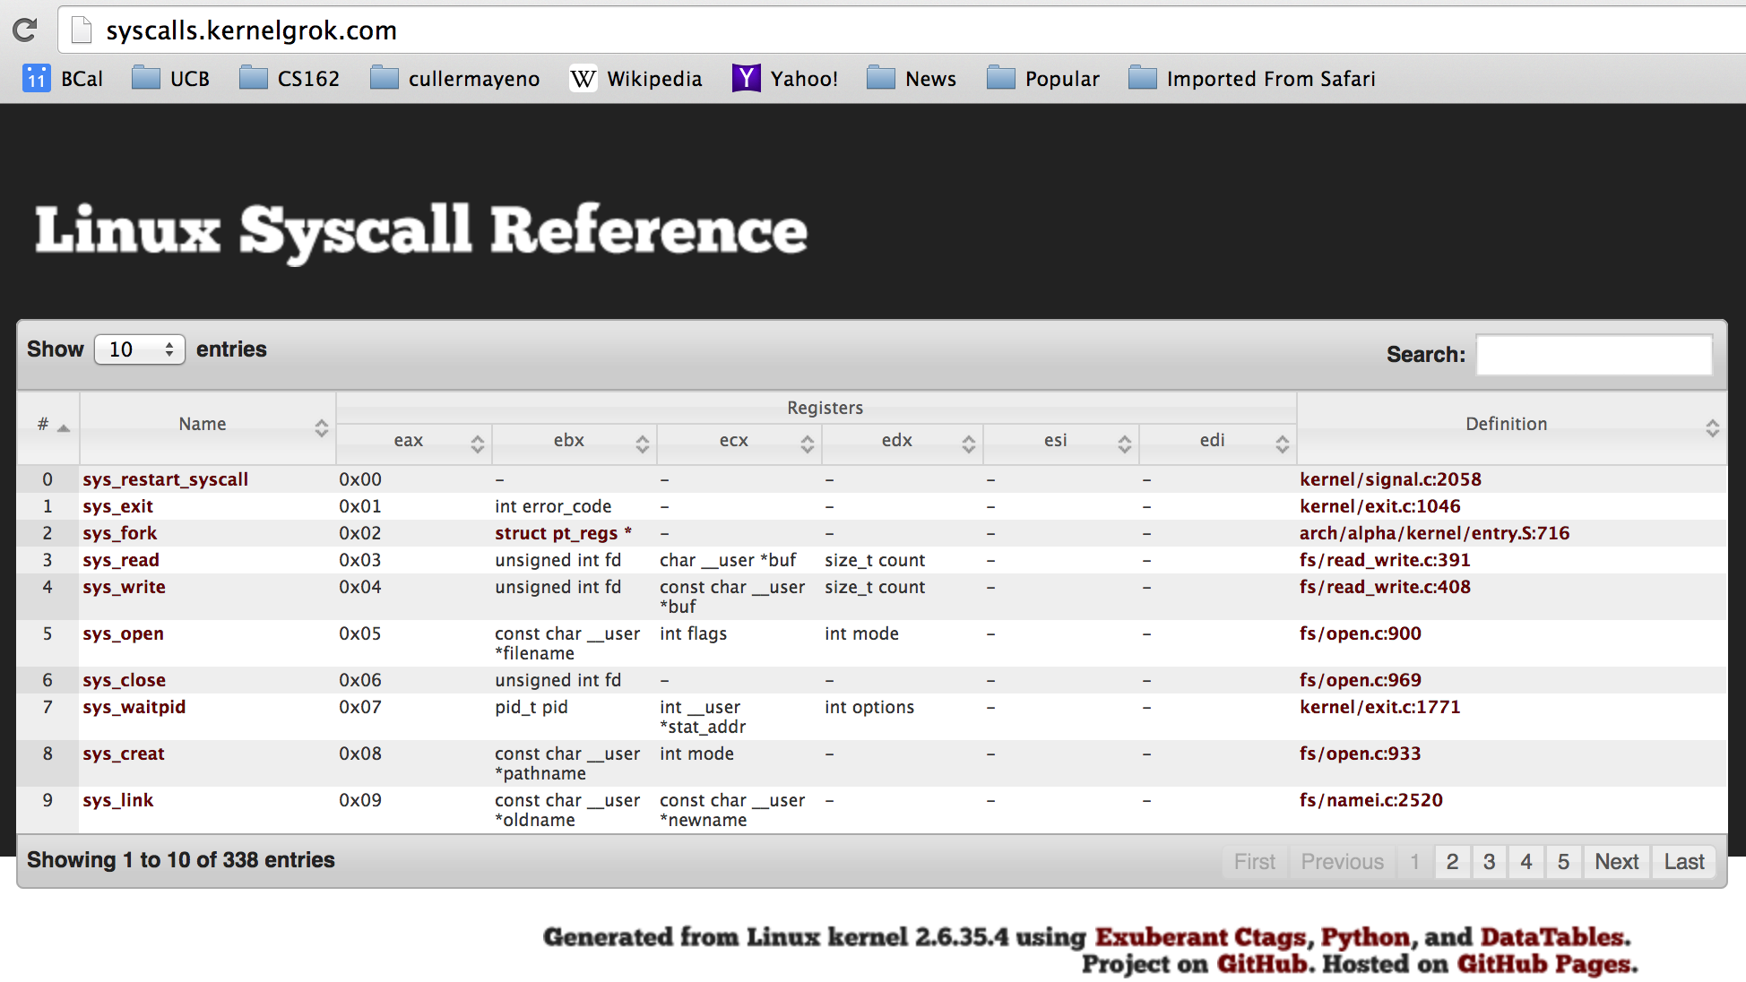
SYSCALL
Low level lib parameters are set up in registers and syscall instruction is issued
  A type of synchronous exception that enters well-defined entry points into kernel

Slide 53
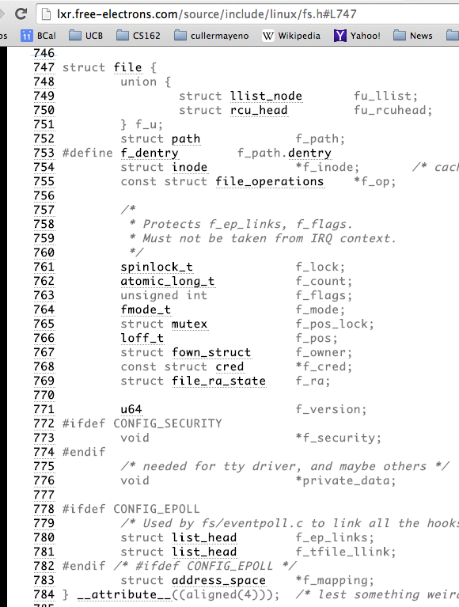
Internal OS File Descriptor
Internal Data Structure describing everything about the file
  Where it resides
  Its status
  How to access it

Slide 54
Device Drivers
Device Driver: Device-specific code in the kernel that interacts directly with the device hardware
  Supports a standard, internal interface
  Same kernel I/O system can interact easily with different device drivers
  Special device-specific configuration supported with the ioctl() system call
Device Drivers typically divided into two pieces:
  Top half: accessed in call path from system calls
    implements a set of standard, cross-device calls like open(), close(), read(), write(), ioctl(), strategy()
    This is the kernel’s interface to the device driver
    Top half will start I/O to device, may put thread to sleep until finished
  Bottom half: run as interrupt routine
    Gets input or transfers next block of output
    May wake sleeping threads if I/O now complete

Slide 55
File System: from syscall to driver
In fs/read_write.c
ssize_t vfs_read(struct file *file, char __user *buf, size_t count, loff_t *pos)
{
ssize_t ret;
if (!(file->f_mode & FMODE_READ)) return -EBADF;
if (!file->f_op || (!file->f_op->read && !file->f_op->aio_read))
return -EINVAL;
if (unlikely(!access_ok(VERIFY_WRITE, buf, count))) return -EFAULT;
ret = rw_verify_area(READ, file, pos, count);
if (ret >= 0) {
count = ret;
if (file->f_op->read)
ret = file->f_op->read(file, buf, count, pos);
else
ret = do_sync_read(file, buf, count, pos);
if (ret > 0) {
fsnotify_access(file->f_path.dentry);
add_rchar(current, ret);
}
inc_syscr(current);
}
return ret;
}

Slide 56
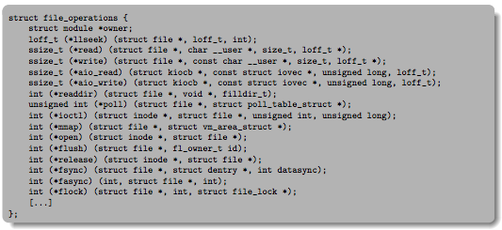
Low Level Driver
Associated with particular hardware device
Registers / Unregisters itself with the kernel
Handler functions for each of the file operations

Slide 57
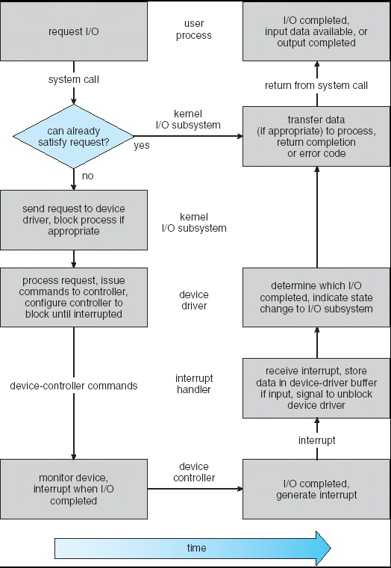
Life Cycle of An I/O Request
User
Program
Kernel I/O
Subsystem
Device Driver
Top Half
Device Driver
Bottom Half
Device
Hardware

Slide 58
So what happens when you fgetc?
Application / Service
streams
High Level I/O
handles
Low Level I/O
registers
Syscall
File System
descriptors
I/O Driver
Commands and Data Transfers
Disks, Flash, Controllers, DMA

Slide 59
Summary
Process: execution environment with Restricted Rights
  Address Space with One or More Threads
  Owns memory (address space)
  Owns file descriptors, file system context, …
  Encapsulate one or more threads sharing process resources
Interrupts
  Hardware mechanism for regaining control from user
  Notification that events have occurred
  User-level equivalent: Signals
Native control of Process
  Fork, Exec, Wait, Signal
Basic Support for I/O
  Standard interface: open, read, write, seek
  Device drivers: customized interface to hardware

