Slide 1
Midterm Review
CS 168, Fall 2014
Sylvia Ratnasamy
http://inst.eecs.berkeley.edu/~cs168/

Slide 2
Logistics
Test is in this classroom starting at 4:10pm
Closed book, closed notes, etc.
Single two-sided “cheat sheet”, handwritten
No calculators, electronic devices, etc.
  Test does not require any complicated calculation
I will have extra office hours
  Friday, Oct 17 1-2pm in 413 Soda Hall
  Monday, Oct 20 10-11am in 413 Soda Hall

Slide 3
General Guidelines (1)
Test only assumes material covered in lecture & sections
  Text: only to clarify details and context for the above
The test doesn’t require you to do complicated calculations
  Use this as a hint to whether you are on the right track
You don’t need to memorize packet headers
  We’ll provide the IP header for your reference on the exam sheet
You do need to understand how things work
  not for the sake of knowing gory details but to understand pros/cons, when a solution is applicable/useful/useless, etc.

Slide 4
General Guidelines (2)
Be prepared to:
  Weigh design options outside of the context we studied them in
  e.g., I had a TCP connection, then BGP went nuts…”
  Contemplate new designs we haven’t talked about
    e.g., I introduce a new IP address format; how does this affect..”
    e.g., I start with UDP, but want weak reliability of the form...”
    Don’t let this daunt you. Reason from what you know about the
    pros/cons of solutions we did study
      e.g., TCP is inefficient when…

Slide 5
General Guidelines (3)
Exam format (tentative!)
  Q1) 20 multiple-choice questions
    ordered (roughly) from easiest to hardest
  Q2) Design questions: A set of “here’s a scenario, tell me if the following is true/false”-style questions
    ordered (roughly) from easiest to hardest within each scenario
  Q3+ more traditional questions
    (we think) 3 < 4 < 5 < … (< implies easier than)
    sub-questions within each question ordered easiest to hardest
Pace yourself accordingly!

Slide 6
This Review
Walk through what we expect you to know: key topics, important aspects of each
Just because I didn’t cover it in review doesn’t mean you don’t need to know it
  But if I covered it today, you should know it
My plan: summarize, not explain
  Stop me when you want to discuss something further!

Slide 7
Topics
Basic concepts (lectures 2, 3)
Architecture and principles (lecture 4)
Network layer (lecs. 4-9)
  Concepts: valid routing state, convergence, least-cost paths
  Overall context (inter- and intra-domain routing)
  Computing least-cost routes (DV, LS)
  IP addressing
  Inter-domain
  Router architecture
Transport (lecs. 9 -12)
  Role of the transport layer
  UDP vs. TCP
  TCP details: reliability and flow control
  TCP congestion control: general concepts only

Slide 8
Basic concepts
You should know:
  statistical multiplexing
  packet vs. circuit switching
  link characteristics
  packet delays

Slide 9
How are network resources shared?
Two approachces
Reservations
On demand

Slide 10
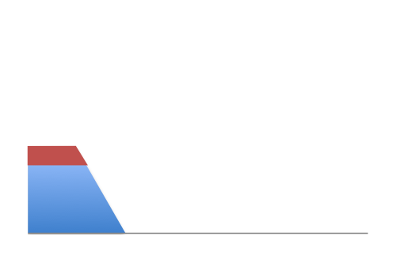
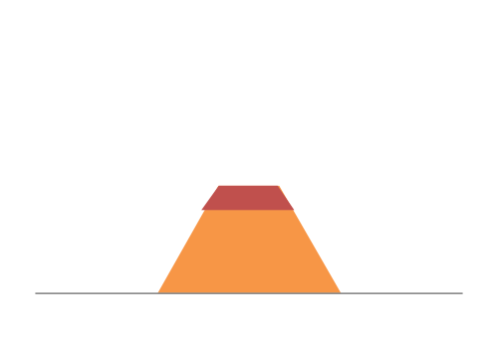
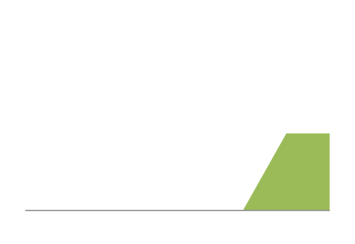
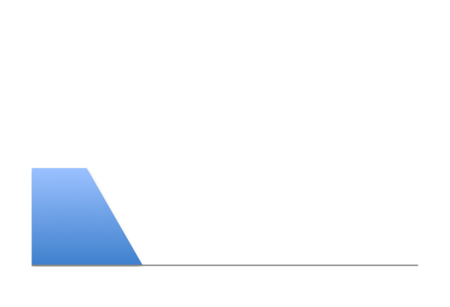
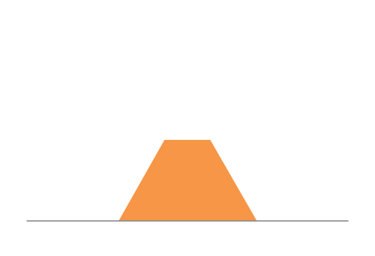
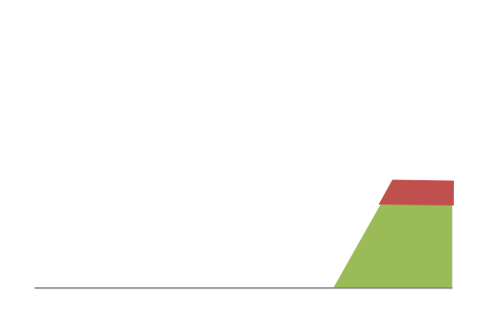
Intuition: reservations
Frequent overloading
12Mbps
Link capacity = 30Mbps
11Mbps
Each source gets 10Mbps
13Mbps
Time

Slide 11
Intuition: on demand
No overloading
Link capacity = 30Mbps
Time

Slide 12
Two approaches to sharing
Reservations → circuit switching
On demand → packet switching

Slide 13
Two approaches to sharing
Packet switching
  network resources consumed on demand per-packet
  “admission control”: per packet
Circuit switching
  network resources reserved a priori at “connection” initiation
  "admission control": per connection

Slide 14
Packet switching exploits statistical multiplexing better than circuit switching
Sharing using the statistics of demand
Good for bursty traffic (average << peak demand)
Similar to insurance, with the same failure mode

Slide 15
Circuit Switching
10Mb/s?
dst
src
✔
10Mb/s?
✔
10Mb/s?
✔
src sends a reservation request to dst
(2) Switches “establish a circuit”
(3) src starts sending data
(4) src sends a “teardown circuit” message
Notes:
multiple conversations in parallel
resources are shared

Slide 16
Packet Switching
Data is sent as chunks of formatted bits (Packets)
Packets consist of a “header” and “payload”
Switches “forward” packets based on their headers
Each packet travels independently
No link resources are reserved in advance

Slide 17
Circuit Switching
Pros
  predictable performance
  simple/fast switching (once circuit established)
Cons
  inefficient when traffic is bursty
  complexity of circuit setup/teardown
  circuit setup adds delay
  switch fails → its circuit(s) fails

Slide 18
Packet Switching
Pros
  efficient use of network resources
  simpler to implement
  robust: can “route around trouble”
Cons
  requires buffer management and congestion control
  unpredictable performance

Slide 19
Performance Metrics
Delay
Loss
Throughput

Slide 20
A network link
bandwidth
delay x bandwidth
Propagation delay
Link bandwidth
  number of bits sent/received per unit time (bits/sec or bps)
Propagation delay
  time for one bit to move through the link (seconds)
Bandwidth-Delay Product (BDP)
  number of bits “in flight” at any time
  BDP = bandwidth × propagation delay

Slide 21
Delay
Consists of four components
  transmission delay
  propagation delay
  queuing delay
  processing delay
due to link properties
due to traffic mix and
switch internals

Slide 22
End-to-end delay
transmission
propagation
queuing
processing
transmission
propagation
queuing
processing
transmission
propagation

Slide 23

Packet Delay
Sending 100B packets from A to B?
A
B
1Mbps, 1ms
100Byte packet
time=0
Time to transmit
one bit = 1/10⁶s
Time when that
bit reaches B
= 1/10⁶+1/10³s
Time to transmit
800 bits=800x1/10⁶s
The last bit
reaches B at
(800x1/10⁶)+1/10³s
= 1.8ms
Time

Slide 24
Little’s Law (1961)
L = A x W
A: Average rate at which packets arrive at a queue
W: Average time packets wait at the queue
L: Avg. number of packets waiting in queue (q length)
Easy to compute L, harder to compute W
Notes:
Row vs column

Slide 25
Topics
Basic concepts (lectures 2,3)
Architecture and principles (lecture 4)
Network layer (lecs. 4-9)
  Concepts: valid routing state, convergence, least-cost paths
  Overall context (inter- and intra-domain routing)
  Computing least-cost routes (DV, LS)
  IP addressing
  Inter-domain
  Router architecture
Transport (lecs. 9 -12)
  Role of the transport layer
  UDP vs. TCP
  TCP details: reliability and flow control
  TCP congestion control: general concepts only

Slide 26
Architecture
You should know
  Layering: what/where/why
  Protocols: what/where/why
  Principles: layering, end-to-end argument, “narrow waist”
  Benefits and weaknesses/consequences of principles/choices
    E.g., layering is good because… but has hurt…

Slide 27
Layering
Layering is a particular form of modularization
System is broken into a vertical hierarchy of logically distinct entities (layers)
Service provided by one layer is based solely on the service provided by layer below

Slide 28
Internet Layers
Applications
…built on…
Reliable (or unreliable) transport
…built on…
L7
Application
Best-effort global packet delivery
L4
Transport
…built on…
L3
Network
Best-effort local packet delivery
L2
Data link
L1
Physical
…built on…
Physical transfer of bits

Slide 29
What gets implemented where?
Lower three layers implemented everywhere
Top two layers implemented only at hosts
Application
Application
Transport
Transport
Network
Network
Network
Datalink
Datalink
Datalink
Physical
Physical
Physical
End system
Switch
End system
Notes:
Why go up? Why not stay down in the lower levels?

Slide 30
Logical Communication
Layers interacts with peer’s corresponding layer
Application
Application
Transport
Transport
Network
Network
Network
Datalink
Datalink
Datalink
Physical
Physical
Physical
Host A
Router
Host B

Slide 31
Physical Communication
Communication goes down to physical network
Then up to relevant layer
Application
Application
Transport
Transport
Network
Network
Network
Datalink
Datalink
Datalink
Physical
Physical
Physical
Host A
Router
Host B

Slide 32
Protocols and Layers
L7
Application
Application
L7
L4
Transport
Transport
L4
L3
Network
Network
L3
L2
Data link
Data link
L2
L1
Physical
Physical
L1
Communication between peer layers on
different systems is defined by protocols

Slide 33
Protocols at different layers
L7
Application
SMTP
HTTP
DNS
NTP
L4
Transport
TCP
UDP
L3
Network
IP
L2
Data link
Ethernet
FDDI
PPP
L1
Physical
optical
radio
copper
PSTN
There is just one network-layer protocol!

Slide 34
Layer Encapsulation
App
msg
msg
Transport
H_{t}
msg
H_{t}
msg
Network
H_{n}
H_{t}
msg
H_{n}
H_{t}
msg
H_{n}
H_{t}
msg
Link
H_{l}
H_{n}
H_{t}
msg
H_{l}
H_{l}
H_{n}
H_{n}
H_{t}
H_{t}
msg
msg
H_{l}
H_{n}
H_{t}
msg
Physical
Alice
Router
Bob

Slide 35
Layers: pros and cons
Why layer?
Reduce complexity
Improve flexibility/innovation
  (Each layer can evolve independently)
Why not layer?
sub-optimal performance
cross-layer information often useful

Slide 36
End-to-end argument: Intuition
Some application requirements can only be correctly implemented end-to-end
  reliability, security, etc.
End-systems
  Can satisfy the requirement without network’s help
  Will/must do so, since they can’t rely on the network
Notes:
Contrary to wisdom of the day!
Talmud

Slide 37
Implications of the E2E argument
In layered design, the E2E principle provides guidance on which layers are implemented where
Key argument for why IP offers only “best effort” delivery (leading to “dumb network / smart ends”)
  Reliability implemented at the end host (TCP)
  Often credited as key to the Internet’s success

Slide 38
Architectural Wisdom
Layering
  reduce complexity, increase flexibility
IP as the “narrow waist”
  eases interoperability
“smart ends, dumb network” (E2E argument)
  No application knowledge in network → more general
  Minimal state in the network → more robust to failure

Slide 39
Topics
Basic concepts (lectures 2,3)
Architecture and principles (lecture 4)
Network layer (lecs. 4-9)
  Concepts: valid routing state, convergence, least-cost paths
  Overall context (inter- and intra-domain routing)
  Routing algorithms that compute least-cost routes (DV, LS)
  IP addressing
  Inter-domain
  Router architecture
Transport (lecs. 9 -12)
  Role of the transport layer
  UDP vs. TCP
  TCP details: reliability and flow control
  TCP congestion control: general concepts only

Slide 40
Forwarding vs. Routing
Forwarding: “data plane”
  Directing one data packet
  Each router using local forwarding table
Routing: “control plane”
  Computing the forwarding tables that guide packets
  Jointly computed by routers using a distributed algorithm

Slide 41
Routing: basic concepts
Valid routing state
Convergence
Least-cost paths

Slide 42
“Valid” Routing State
Global forwarding state is “valid” if it produces forwarding decisions that always deliver packets to their destinations
Global routing state is valid if and only if:
    There are no dead ends (other than destination)
    There are no loops
Notes:
What could go wrong?

Slide 43
Convergence Delay
Time to achieve convergence
  E.g., all nodes have the same link-state database
Sources of convergence delay?
  time to detect failure
  time to flood link-state information
  time to re-compute forwarding tables
Performance during convergence period?
  lost packets due to blackholes
  looping packets
  out-of-order packets reaching the destination

Slide 44
Least-cost path routing
Given: router graph & link costs
Goal: find least-cost path
from each source router
to each destination router
Distance-Vector and Link-State are examples

Slide 45
“Least Cost” Routes
“Least cost” routes an easy way to avoid loops
  No sensible cost metric is minimized by traversing a loop
Least cost routes are destination-based
  i.e., do not depend on the source
Least-cost paths form a spanning tree

Slide 46
Topics
Basic concepts (lectures 2,3)
Architecture and principles (lecture 4)
Network layer (lecs. 4-9)
  Concepts: valid routing state, convergence, least-cost paths
  Overall context (inter- and intra-domain routing)
  Routing algorithms that compute least-cost routes (DV, LS)
  IP addressing
  Inter-domain
  Router architecture
Transport (lecs. 9 -12)
  Role of the transport layer
  UDP vs. TCP
  TCP details: reliability and flow control
  TCP congestion control: general concepts only

Slide 47
“Autonomous System (AS)” or “Domain”
Region of a network under a single administrative entity
“Border Routers”
An “end-to-end” route
“Interior Routers”

Slide 48
Internet Routing
Internet Routing works at two levels
Each AS runs an intra-domain routing protocol that
establishes routes within its domain
  Intra-domain routes are “least cost”
  e.g., Link State (OSPF) and Distance Vector (RIP)
ASes participate in an inter-domain routing protocol
that establishes routes between domains
  Inter-domain routes determined by policy (need not be least-cost)
  e.g., Path Vector (BGP)

Slide 49
Link State Routing
Every router knows its local “link state”
A router floods its link state to all other routers
Every router learns the entire network graph
Every router locally runs Dijkstra’s to compute its forwarding table
Will not test your ability to solve Dijkstra’s under pressure
But you should know the high level properties of LS
  every node maintains complete topology
  link updates flooded everywhere
  may have loops while nodes have inconsistent topology information

Slide 50
Distance-vector routing
Distributed algorithm (Bellman-Ford)
All routers run it “together”
  each router runs its own instance
  neighbors exchange and react to each
  other’s messages
Notes:
A distance-vector routing algorithm is a click distributed algorithm,
in the sense that click all routers run it together:
- they exchange messages
- and they keep reacting to each other’s messages.

Slide 51
Distance Vector Routing
Each router knows the links to its neighbors
  Each router has provisional “least cost” estimate to
  every other router -- its distance vector (DV)
    E.g.: Router A: “A can get to B with cost 11”
Routers exchange this DV with their neighbors
Routers look over the set of options offered by their neighbors and select the best one
Iterative process converges to set of shortest paths

Slide 52
y
2
x
7
u
z
1
w
dx(z) =
minn{
cost(x,n) + dn(z)
}
for all neighbors n
Bellman-Ford equation
Notes:
... which is called the Bellman-Ford equation.

Slide 53
DV: You should understand
How DV works
  what’s in a DV; how nodes process and update DVs
The counting to infinity problem
  why it occurs
Poison Reverse
  when it does/doesn’t fix counting-to-infinity

Slide 54
Counting-to-Infinity
Cause
  z routes through y, y routes through x (to reach dst)
  y loses connectivity to x
  y decides to route through z (to reach dst)
Can take a very long time to resolve

Slide 55
Poisoned Reverse
How:
  If z routes to dst through y, z advertises to y that its cost to dst is infinite
  y never decides to route to dst through z
Often avoids the count-to-infinity problem

Slide 56
Topics
Basic concepts (lectures 2,3)
Architecture and principles (lecture 4)
Network layer (lecs. 4-9)
  Concepts: valid routing state, convergence, least-cost paths
  Overall context (inter- and intra-domain routing)
  Routing algorithms that compute least-cost routes (DV, LS)
  IP addressing
  Inter-domain
  Router architecture
Transport (lecs. 9 -12)
  Role of the transport layer
  UDP vs. TCP
  TCP details: reliability and flow control
  TCP congestion control: general concepts only

Slide 57
Addressing Goal: Scalable Routing
State: Small forwarding tables at routers
Churn: Limited rate of change in routing tables
Ability to aggregate addresses is crucial for both
(one entry to summarize many addresses)

Slide 58
Hierarchy in IP Addressing
32 bits are partitioned into a prefix and suffix components
Prefix is the network component; suffix is host component
Interdomain routing operates on the network prefix
“slash” notation: 12.34.158.0/23 → network with a 23 bit
prefix and 2⁹ host addresses
12
34
158
5
00001100
00100010
10011110
00000101
Network (23 bits)
Host (9 bits)

Slide 59
IP addressing → scalable routing?
Hierarchical address allocation helps routing scalability if allocation matches topological hierarchy
Problem: may not be able to aggregate addresses for “multi-homed” networks

Slide 60
UCB is “multi-homed” to AT&T and ESNet
  Multi-homed domain → domain has 2 (or more) providers
AT&T
a.0.0.0/8
ESNet
LBL
a.b.0.0/16
UCB
a.c.0.0/16
ESNet must maintain routing entries for both a.*.*.* and a.c.*.*

Slide 61
IP addressing → scalable routing?
Hierarchical address allocation helps routing scalability if allocation matches topological hierarchy
Problem: may not be able to aggregate addresses for “multi-homed” networks
Two competing forces in scalable routing
  aggregation reduces number of routing entries
  multi-homing increases number of entries

Slide 62
BGP and Inter-Domain Routing
Destinations are IP prefixes (12.0.0.0/8)
Nodes are Autonomous Systems (ASes)
Links represent both physical connections and business relationships
  customer-provider or peer-to-peer
BGP is the protocol for inter-domain routing

Slide 63
Topology and policy is shaped by the business relationships between ASes
Three basic kinds of relationships between ASes
  AS A can be AS B’s customer
  AS A can be AS B’s provider
  AS A can be AS B’s peer
Business implications
  Customer pays provider
  Peers don’t pay each other
Notes:
Ehy???

Slide 64
BGP extends DV
With some important differences
  routes selected based on policy, not just shortest path
  path vector (useful to avoid loops)
  Selective route advertisement
  may aggregate routes (aggregating prefixes)

Slide 65
Policy imposed in how routes are selected and exported
Route export
Route selection
P
A
B
Can reach 128.3/16
blah blah
Q
C
Selection: Which path to use?
  controls whether/how traffic leaves the network
Export: Which path to advertise?
  controls whether/how traffic enters the network
Notes:
Arrows: routing messages!

Slide 66
Typical Export Policy
Destination prefix advertised by… | Export route to…
Customer | Everyone (providers, peers, other customers)
Peer | Customers
Provider | Customers
We’ll refer to these as the “Gao-Rexford” rules
(capture common -- but not required! -- practice!)
You must know this!

Slide 67
Typical Selection Policy
In decreasing order of priority
  make/save money (send to customer > peer > provider)
  maximize performance (smallest AS path length)
  minimize use of my network bandwidth (“hot potato”)
  …
BGP uses route attributes to implement the above
  ASPATH, LOCAL_PREF, MED, …
You should know the general idea/goal for each attribute;
we won’t quiz you on the detailed implementation

Slide 68

Policy Dictates Route Selection
Pr
Cu
Q
Peer
Peer
A
B
C
D
E
F
traffic allowed
traffic not allowed

Slide 69
Topics
Basic concepts (lectures 2,3)
Architecture and principles (lecture 4)
Network layer (lecs. 4-9)
  Concepts: valid routing state, convergence, least-cost paths
  Overall context (inter- and intra-domain routing)
  Routing algorithms that compute least-cost routes (DV, LS)
  IP addressing
  Inter-domain
  Router architecture
Transport (lecs. 9 -12)
  Role of the transport layer
  UDP vs. TCP
  TCP details: reliability and flow control
  TCP congestion control: general concepts only

Slide 70
IP Packet Structure
We’ll give you the header format but you should
know what each field is and its use/misuse
4-bit
Version
4-bit
Header
Length
8-bit
Type of Service
16-bit Total Length (Bytes)
16-bit Identification
3-bit
Flags
13-bit Fragment Offset
8-bit Time to
Live (TTL)
8-bit Protocol
16-bit Header Checksum
32-bit Source IP Address
32-bit Destination IP Address
Options (if any)
Payload

Slide 71
IPv4 and IPv6 Header Comparison
IPv4
IPv6
Version | IHL | Type of Service | Total Length
Identification |  |  | Flags | Fragment Offset
Time to Live |  | Protocol | Header Checksum
Source Address
Destination Address
Options |  |  |  |  | Padding
Version | Traffic Class | Flow Label
Payload Length |  |  | Next Header | Hop Limit
Source Address
Destination Address
Field name kept from IPv4 to IPv6
Fields not kept in IPv6
Name & position changed in IPv6
New field in IPv6

Slide 72
What’s inside a router?
Input and Output for
the same port are on one
physical linecard
Processes packets
on their way in
Route/Control
Processor
Processes packets
before they leave
Linecards (input)
Linecards (output)
1
1
2
2
Interconnect
(Switching)
Fabric
Transfers packets
from input to
output ports
N
N

Slide 73
What’s inside a router?
(1) Implement IGP
and BGP protocols;
compute routing tables
(2) Push forwarding
tables to the line cards
Route/Control
Processor
Linecards (input)
Linecards (output)
1
1
2
2
Interconnect
(Switching)
Fabric
N
N

Slide 74
What’s inside a router?
Constitutes the
control plane
Route/Control
Processor
Constitutes the
data plane
Linecards (input)
Linecards (output)
1
1
2
2
Interconnect
Fabric
N
N
Notes:
Control plane: software. Makes decisions over long time horizons.
Data plane: mostly hardware. A decision for each packet.

Slide 75
Challenges in Router Design
@ Line cards: destination lookups at high speed
  e.g., find the longest prefix match (LPM) in the table that matches the packet destination address
@ Switch fabric: head-of-line blocking, scheduling the switch fabric at high speed
@ Route processor: complexity/correctness more a problem than performance
You should understand why these challenges arise but we don’t expect you to know how to fix them
  e.g., specifics of scheduling algorithms or LPM lookups

Slide 76
Topics
Basic concepts (lectures 2,3)
Architecture and principles (lecture 4)
Network layer (lecs. 4-9)
  Concepts: valid routing state, convergence, least-cost paths
  Overall context (inter- and intra-domain routing)
  Routing algorithms that compute least-cost routes (DV, LS)
  IP addressing
  Inter-domain
  Router architecture
Transport (lecs. 9 -12)
  Role of the transport layer
  UDP vs. TCP
  TCP details: reliability and flow control
  TCP congestion control: general concepts only

Slide 77
Role of the Transport Layer
(1) Communication between application processes
  Mux and demux from/to application processes
  Implemented using ports
(2) Provide common end-to-end services for app layer
  Reliable, in-order data delivery
  Well-paced data delivery

Slide 78
UDP vs. TCP
  Both UDP and TCP provide mux/demux-ing via ports
 | UDP | TCP
Data abstraction | Packets (datagrams) | Stream of bytes of arbitrary length
Service | Best-effort (same as IP) | Reliability In-order delivery Congestion control Flow control
Applications | Video, audio streaming | File transfer, chat

Slide 79
Reliable Transport:
General Concepts
Checksums (for error detection)
Timers (for loss detection)
Acknowledgments (feedback from receiver)
  cumulative: “received everything up to X”
  selective: “received X”
Sequence numbers (detect duplicates, accounting)
Sliding Windows (for efficiency)
You should know:
what these concepts are
why they exist
how TCP uses them

Slide 80
Things to know about TCP
How TCP achieves reliability
RTT estimation
Connection establishment/teardown
Flow Control
Congestion Control (concepts only)
For each, know how the functionality is implemented and why it is needed

Slide 81
E.g., RTT Estimation
Why? TCP uses timeouts to retransmit packets
But RTT may vary (significantly!) for different reasons and on different timescales
  due to temporary congestion
  due to long-lived congestion
  due to a change in routing paths
An incorrect RTT estimate might introduce spurious retransmissions or overly long delays
RTT estimators should react to change but not too quickly
  proposed solutions use EWMA, incorporate deviations

Slide 82
E.g., Reliability
Why? IP is best-effort but many apps. need reliable delivery
  Having TCP take care of it simplifies application development
How
  checksums and timers (for error and loss detection)
  fast retransmit (for faster-than-timeout loss detection)
  cumulative ACKs (feedback from receiver -- what’s lost/what’s not)
  sliding windows (for efficiency)
  buffers at sender (to hold packets while waiting for ACKs)
  buffers at receiver (to reorder packets before delivery to app.)

Slide 83
E.g., Connection Establishment
Why?
  TCP is a stateful protocol (CWND, buffer space, ISN, etc.)
  Need to initialize connection state at both ends
  Exchange initial sequence numbers
How? Three-way handshake
  Host A sends a SYN to host B
  Host B returns a SYN acknowledgment (SYN ACK)
  Host A sends an ACK (+ data) to acknowledge the SYN ACK
  Hosts exchange proposed Initial Sequence Numbers at each step

Slide 84
E.g., Flow Control
Why?
  TCP offers a reliable in-order byte stream abstraction
  Hence, TCP at the receiver must buffer a packet until all packets before it (in byte-order) have arrived and the receiving application has consumed available bytes
  Hence receiver advances its window when the receiving application consumes data
  But sender advances its window when new data ACK’d
  Hence, risk the sender might overrun the receiver’s buffers
How? “Advertised Window” field in TCP header
  Receiver advertises the “right hand edge” of its window to sender
  Sender agrees not to exceed this amount

Slide 85
E.g., Congestion Control
Why?
  Because a sender shouldn’t overload the network itself
  But yet, should make efficient use of available network capacity
  While sharing available capacity fairly with other flows
  And adapting to changes in available capacity
How?
  Dynamically adapts the size of the sending window
  (don’t worry about the exact algorithms used to do the adaptation)

Slide 86
Final Questions?
Good luck!

