Slide 1
Project 3a is out!
Goal: implement a basic network firewall
We give you the VM & framework.
You implement the firewall logic.
Due: Nov 17 @ noon
Notes:
The project 3a is out! (Ouch)
The goal of this project is to implement a basic network firewall. You will implement the firewall logic in the framework we give you.

Slide 2
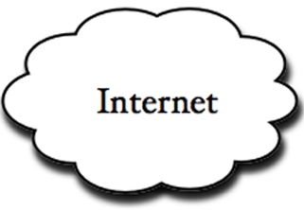
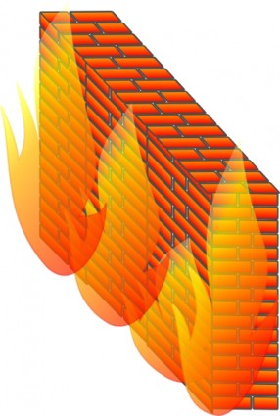
What Is Firewall?
Blocks malicious traffic
Blocks unauthorized traffic
Notes:
A network firewall is the barrier between Internet and your computer. (n)
It blocks malicious inbound traffic, (n)
and unauthorized outbound traffic.

Slide 3
VM
Linux TCP/IP network stack
ext
firewall
int
Notes:
Here is a diagram of the VM framework.
We will provide you a VM. It has physical external interface ext, and a virtual internal interface int. (n)
The firewall program connects these two interfaces, and filters the traffic. You should implement the firewall logics here.

Slide 4
VM
Linux TCP/IP network stack
ext
firewall
int
Decode the packet
Check the firewall rules
Pass or drop the packet
Notes:
So here are the logic:
You parse the packet; Check the firewall rules and determine if the packet is matched; and then pass or drop the packet
We will go through these steps briefly.

Slide 5
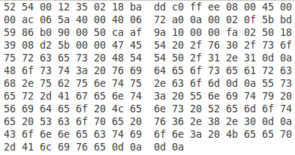
Packets on wire look like this…
and your firewall should decode this.
Notes:
Packets on wire are in binary form, so the first step is to decode them.

Slide 6
Firewall rules
Type 1: a combination of
Protocol (TCP/UDP/ICMP)
IP address or country (e.g., Canada)
Port number
Type 2: domain names
E.g., block DNS queries for *.facebook.com
Notes:
The firewall is very basic, so we only need to implement two type of rules.
Rules can be a combination of protocol, ip address, and port number, or it can also be domain names for DNS queries.

Slide 7
NO CHEATING
WE RUN COPY CHECKER
Notes:
The final reminder: please do not copy codes from others, we will run copy checker for every submission.

Slide 8
Questions?
General questions
Ask your favorite GSI
Project-specific questions
Chang Lan (main)
Shoumik Palkar
Sangjin Han
Start Early!
Notes:
The project spec and code should be online by the end of today.
This project is led by Shoumik, Sangjin, and me.
If you have general questions such as protocols, packet formats, etc., feel free to ask your favorite GSI.
But if you have more specific questions, please ask one of us.

Slide 9
Today
Router-assisted Congestion Control (wrap up)
Application layer: DNS

Slide 10
Router-Assisted Congestion Control
Recall: Three tasks for CC:
Fairness
Rate adjustment
Detecting congestion

Slide 11
Router-Assisted Congestion Control
Recall: Three tasks for CC:
Fairness → e.g., Fair Queuing
Rate adjustment → e.g., Rate Control Protocol
Detecting congestion → e.g., ECN

Slide 12
Fairness: General Approach
Routers classify packets into “flows”
Assume for now flows ~ TCP connections
Each flow has its own FIFO queue in router
Router services flows in a fair fashion

Slide 13
Max-Min Fairness
Given set of bandwidth demands r_{i} and total bandwidth C, max-min bandwidth allocations are:
a_{i} = min(f, r_{i})
where f is the unique value such that Sum(a_{i}) = C
This is what round-robin service gives if all packets are the same size
r₁
?
r₂
C bits/s
?
r₃
?

Slide 14
Fair Queuing is how we deal with packets of different sizes
Mental model: Bit-by-bit round robin
For each packet, compute its “deadline”
deadline → the time at which the last bit of a packet would have left the router if flows are served bit-by-bit
Transmit packets in increasing order of deadlines

Slide 15
Example
Flow 1
(arrival traffic)
1
2
3
4
5
6
time
Flow 2
(arrival traffic)
1
2
3
4
5
time
Bit-wise round-robin
1
2
1
2
3
4
5
6
3
4
5
time
FQ
1
2
1
3
2
3
4
4
5
5
6
time

Slide 16
Exercise
Flow A
(arrival traffic)
A1
A2
A3
A4
time
Flow B
(arrival traffic)
B1
B2
time
Flow C
(arrival traffic)
C1
C2
time
What’s the packet order at the output for four scheduling disciplines?
FIFO
Round-Robin
Fair Queuing
Priority
Assume Flow A > B > C in priority and for breaking ties

Slide 17
Router-Assisted Congestion Control
Recall: Three tasks for CC:
Fairness → e.g., Fair Queuing
Rate adjustment → e.g., Rate Control Protocol
Detecting congestion → e.g., ECN

Slide 18
Idea: Let routers tell endhosts what rate they should use
Packets carry “rate field”
Routers insert “fair share” f in packet header
End-hosts set sending rate (or window size) to f
Note: still assumes end-hosts play by the rules
This is the basic idea behind the “Rate Control Protocol” (RCP) from Dukkipati&McKeown in 2007

Slide 19
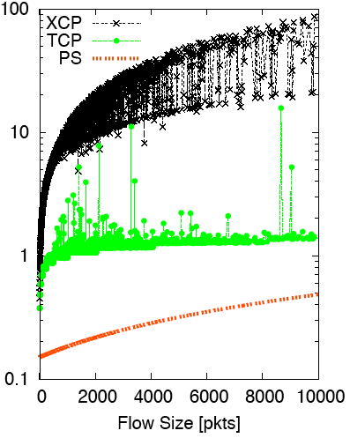
Flow Completion Time: TCP vs. RCP (Ignore XCP)
Flow Duration (secs) vs. Flow Size
RCP

Slide 20
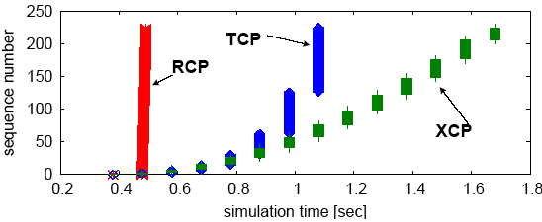
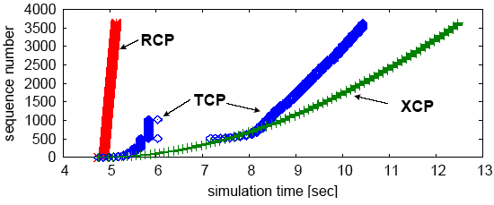
Why the improvement?

Slide 21
Why is RCP important?
Congestion control had long focused on safety (primary) and fairness (secondary)
TCP does a good enough job at both
RCP highlighted CC’s impact on performance
performance matters a lot in today’s environment
RCP shows we can do better but is still fairly complex and not incrementally deployable

Slide 22
RC3 – Mittal et al., 2014
RC3: Recursively Cautious Congestion Control
Senders transmit at max rate from the get-go
But packets are marked with priorities
CWND packets are sent at priority#1
The remaining at low priority
Routers implement priority scheduling (exists today)
If no congestion, all packets get through (high performance)
else, low priority packets dropped (safety and fairness)

Slide 23
Router-Assisted Congestion Control
Recall: Three tasks for CC:
Fairness → e.g., Fair Queuing
Rate adjustment → e.g., Rate Control Protocol
Detecting congestion → e.g., ECN

Slide 24
Explicit Congestion Notification (ECN)
Single bit in packet header; set by congested routers
Many options for when routers set the bit
Tradeoff between (link) utilization and (packet) delay
Receiver relays ECN bit in its ACK to the sender
Congestion semantics can be exactly like that of drop
e.g., endhost reacts as though it saw a drop
Advantages:
Don’t confuse corruption with congestion
Serves as an early indicator of congestion to avoid delays
Easy (easier) to incrementally deploy
Today: defined in RFC 3168 using ToS/DSCP bits in the IP header

Slide 25
A final proposal: Charge people for congestion!
Use ECN as congestion markers
Whenever I get an ECN bit set, I have to pay $$
Now, there’s no debate over what a flow is, or what fair is…
Idea started by Frank Kelly at Cambridge
“optimal” solution, backed by much math
Great idea: simple, elegant, effective
Unclear that it will impact practice

Slide 26
Recap!
TCP
allows apps to assume reliable bytestream delivery
with (mostly) fair and safe sharing of network resources
Congestion control
avoid overloading the network to the point of collapse
while sharing resources fairly
and maximizing performance
TCP does a good enough job at the first two but the last is more iffy

Slide 27
Taking Stock
Course so far
Concepts (links, delays, switches)
Overall architecture (layers, protocols, principles)
Network layer (how we interconnect hosts and networks)
Transport layer (how we make best-effort usable to apps)
What’s left?
Application layer (DNS, HTTP) ← this week
Lower layers (Ethernet, Wireless) ← next
Advanced topics (datacenters, SDN, IPv6) ←last ~2 weeks

Slide 28
Some very special guest lectures
Nov 10: Yahel Ben-David (Wireless)
Nov 19: Stephen Strowes (IPv6)
Nov 24: Scott Shenker (SDN)
Dec 1: Panel: Careers in networking (tentative)

Slide 29
Application Layer
Domain Name System (DNS)
What’s behind (e.g.) instr.eecs.berkeley.edu?
HTTP and the Web
What happens when you click on a link?

Slide 30
Host Names & Addresses
Host addresses: e.g., 169.229.131.109
a number used by protocols
conforms to network structure (the “where”)
Host names: e.g., instr.eecs.berkeley.edu
mnemonic name usable by humans
conforms to organizational structure (the “who”)
The Domain Name System (DNS) is how we map from one to the other
a directory service for hosts on the Internet

Slide 31
Why bother?
Convenience
Easier to remember www.google.com than 74.125.239.49
Provides a level of indirection!
Decoupled names from addresses
Many uses beyond just naming a specific host

Slide 32
DNS: Early days
Mappings stored in a hosts.txt file (in /etc/hosts)
maintained by the Stanford Research Institute (SRI)
new versions periodically copied from SRI (via FTP)
As the Internet grew this system broke down
SRI couldn’t handle the load
conflicts in selecting names
hosts had inaccurate copies of hosts.txt
The Domain Name System (DNS) was invented to fix this
First name server implementation done by 4 UCB students!

Slide 33
Goals?
Scalable
many names
many updates
many users creating names
many users looking up names
Highly available
Correct
no naming conflicts (uniqueness)
consistency
Lookups are fast

Slide 34
How?
Partition the namespace
Distribute administration of each partition
Autonomy to update my own (machines’) names
Don’t have to track everybody’s updates
Distribute name resolution for each partition
How should we partition things?

Slide 35
Key idea: hierarchical distribution
Three intertwined hierarchies
Hierarchical namespace
As opposed to original flat namespace
Hierarchically administered
As opposed to centralized administrator
Hierarchy of servers
As opposed to centralized storage

Slide 36
Hierarchical Namespace
root
edu
com
gov
mil
org
net
uk
fr
…
berkeley
ucla
“Top Level Domains” are at the top
Domains are subtrees
E.g: .edu, berkeley.edu, eecs.berkeley.edu
Name is leaf-to-root path
instr.eecs.berkeley.edu
Name collisions trivially avoided!
each domain’s responsibility
eecs
sims
instr
Notes:
gTLDs and ccTLDs

Slide 37
Hierarchical Administration
ICANN/IANA
root
root
edu
edu
gov
gov
mil
mil
net
net
uk
uk
fr
com
fr
com
org
org
berkeley
ucla
berkeley
eecs
eecs
sims
sims
A zone corresponds to an administrative authority responsible for a contiguous portion of the hierarchy
E.g.: UCB controls *.berkeley.edu and *.sims.berkeley.edu while EECS controls *.eecs.berkeley.edu
instr

Slide 38
Server Hierarchy
Top of hierarchy: Root servers
Location hardwired into other servers
Next Level: Top-level domain (TLD) servers
.com, .edu, etc.
Managed professionally
Bottom Level: Authoritative DNS servers
Actually store the name-to-address mapping
Maintained by the corresponding administrative authority

Slide 39
Server Hierarchy
Every server knows the address of the root name server
Root servers know the address of all TLD servers
…
An authoritative DNS server stores name-to-address mappings (“resource records”) for all DNS names in the domain that it has authority for
→ Each server stores a subset of the total DNS database
→ Each server can discover the server(s) responsible for any portion of the hierarchy

Slide 40
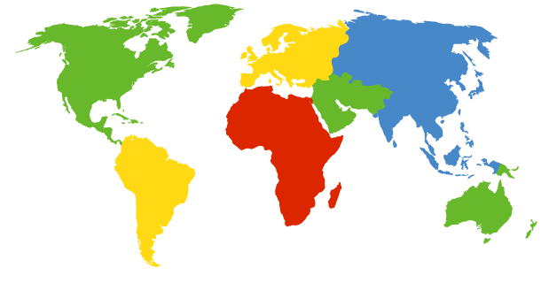
DNS Root
Located in Virginia, USA
Verisign, Dulles, VA

Slide 41
DNS Root Servers
13 root servers (labeled A-M; see http://www.root-servers.org/)
A Verisign, Dulles, VA
C Cogent, Herndon, VA
D U Maryland College Park, MD
G US DoD Vienna, VA
H ARL Aberdeen, MD
J Verisign
K RIPE London
I Autonomica, Stockholm
E NASA Mt View, CA
F Internet Software
Consortium
Palo Alto, CA
M WIDE Tokyo
B USC-ISI Marina del Rey, CA
L ICANN Los Angeles, CA

Slide 42
DNS Root Servers
13 root servers (labeled A-M; see http://www.root-servers.org/)
Replicated via any-casting
A Verisign, Dulles, VA
C Cogent, Herndon, VA (also Los Angeles, NY, Chicago)
D U Maryland College Park, MD
G US DoD Vienna, VA
H ARL Aberdeen, MD
J Verisign (21 locations)
K RIPE London (plus 16 other locations)
I Autonomica, Stockholm (plus 29 other locations)
E NASA Mt View, CA
F Internet Software
Consortium,
Palo Alto, CA
(and 37 other locations)
M WIDE Tokyo
plus Seoul, Paris, San Francisco
B USC-ISI Marina del Rey, CA
L ICANN Los Angeles, CA

Slide 43
Anycast in a nutshell
Routing finds shortest paths to destination
What happens if multiple machines advertise the same address?
The network will deliver the packet to the closest machine with that address
This is called “anycast”
Very robust
Requires no modification to routing algorithms

Slide 44
DNS Records
DNS servers store resource records (RRs)
RR is (name, value, type, TTL)
Type = A: (→ Address)
name = hostname
value = IP address
Type = NS: (→ Name Server)
name = domain
value = name of dns server for domain

Slide 45
DNS Records (cont’d)
Type = MX: (→ Mail eXchanger)
name = domain in email address
value = name(s) of mail server(s)

Slide 46
Inserting Resource Records into DNS
Example: you just created company “FooBar”
You get a block of IP addresses from your ISP
say 212.44.9.128/25
Register foobar.com at registrar (e.g., Go Daddy)
Provide registrar with names and IP addresses of your authoritative name server(s)
Registrar inserts RR pairs into the .com TLD server:
(foobar.com, dns1.foobar.com, NS)
(dns1.foobar.com, 212.44.9.129, A)
Store resource records in your server dns1.foobar.com
e.g., type A record for www.foobar.com
e.g., type MX record for foobar.com

Slide 47
Using DNS (Client/App View)
Two components
Local DNS servers
Resolver software on hosts
Local DNS server (“default name server”)
Clients configured with the default server’s address or learn it via a host configuration protocol (e.g., DHCP – future lecture)
Client application
Obtain DNS name (e.g., from URL)
Triggers DNS request to its local DNS server

Slide 48
root servers
local
DNS server
(mydns.berkeley.edu)
.edu servers
nyu.edu servers
DNS client (me.cs.berkeley.edu)

Slide 49
root servers
local
DNS server
(mydns.berkeley.edu)
.edu servers
nyu.edu servers
www.nyu.edu?
DNS client (me.cs.berkeley.edu)

Slide 50
root
DNS server
DNS server
(mydns.berkeley.edu)
.edu servers
nyu.edu servers
www.nyu.edu?
DNS client (me.cs.berkeley.edu)

Slide 51
root
DNS server
DNS server
(mydns.berkeley.edu)
.edu servers
nyu.edu servers
www.nyu.edu?
DNS client (me.cs.berkeley.edu)

Slide 52
recursive DNS query
root
DNS server
DNS server
(mydns.berkeley.edu)
.edu servers
www.nyu.edu?
nyu.edu servers
DNS client (me.cs.berkeley.edu)

Slide 53
root
DNS server
DNS server
(mydns.berkeley.edu)
.edu servers
nyu.edu servers
DNS client (me.cs.berkeley.edu)

Slide 54
iterative DNS query
root
DNS server
DNS server
(mydns.berkeley.edu)
.edu servers
nyu.edu servers
DNS client (me.cs.berkeley.edu)

Slide 55
DNS Protocol
Query and Reply messages; both with the same message format
see text/section for details
Client-Server interaction on UDP Port 53
Spec supports TCP too, but not always implemented

Slide 56
Goals – how are we doing?
Scalable
many names
many updates
many users creating names
many users looking up names
Highly available

Slide 57
Per-domain availability
DNS servers are replicated
Primary and secondary name servers required
Name service available if at least one replica is up
Queries can be load-balanced between replicas
Try alternate servers on timeout
Exponential backoff when retrying same server

Slide 58
Goals – how are we doing?
Scalable
many names
many updates
many users creating names
many users looking up names
Highly available
Correct
no naming conflicts (uniqueness)
consistency
Lookups are fast

Slide 59
root
DNS server
.edu TLD
DNS server
local
DNS server
nyu.edu
DNS server
DNS client
Notes:
How can we improve performance?

Slide 60
Caching
Caching of DNS responses at all levels
Reduces load at all levels
Reduces delay experienced by DNS client

Slide 61
DNS Caching
How DNS caching works
DNS servers cache responses to queries
Responses include a “time to live” (TTL) field
Server deletes cached entry after TTL expires
Why caching is effective
The top-level servers very rarely change
Popular sites visited often → local DNS server often has the information cached

Slide 62
Negative Caching
Remember things that don’t work
Misspellings like www.cnn.comm and www.cnnn.com
These can take a long time to fail the first time
Good to remember that they don’t work
… so the failure takes less time the next time around
Negative caching is optional

Slide 63
How can one attack DNS?

Slide 64
root
DNS server
.edu TLD
DNS server
local
DNS server
Persa (the impersonator)
1.1.1.1
www.epfl.ch?
nyu.edu
DNS server
DNS client

Slide 65
How can one attack DNS?
Impersonate the local DNS server
give the wrong IP address to the DNS client

Slide 66
root
DNS server
.edu TLD
DNS server
local
DNS server
Denis (the denial-of-service attacker)
epfl.ch
DNS server
DNS client

Slide 67
How can one attack DNS?
Impersonate the local DNS server
give the wrong IP address to the DNS client
Denial-of-service the root or TLD servers
make them unavailable to the rest of the world

Slide 68
root
DNS server
.edu TLD
DNS server
local
DNS server
Casha
nyu.edu
DNS server
DNS client

Slide 69
How can one attack DNS?
Impersonate the local DNS server
give the wrong IP address to the DNS client
Denial-of-service the root or TLD servers
make them unavailable to the rest of the world
Poison the cache of a DNS server
increase the delay experienced by DNS clients

Slide 70
Important Properties of DNS
Administrative delegation and hierarchy results in:
Easy unique naming
“Fate sharing” for network failures
Reasonable trust model
Caching lends scalability, performance

Slide 71
DNS provides Indirection
Addresses can change underneath
Move www.cnn.com to a new IP address
Humans/apps are unaffected
Name could map to multiple IP addresses
Enables load-balancing
Multiple names for the same address
E.g., many services (mail, www, ftp) on same machine
Allowing “host” names to evolve into “service” names

Slide 72
Next Lecture (Scott Shenker lecturing)
HTTP and the Web
(Broadcast) Ethernet

