Slide 1
The Web
+
Random Access
CS168, Fall 2014
Sylvia Ratnasamy
http://inst.eecs.berkeley.edu/~cs168/
Material thanks to Ion Stoica, Scott Shenker, Jennifer Rexford, Nick McKeown, and many other colleagues

Slide 2
Quick Poll
CS168 is getting too popular. We need advice.
Two identical versions: Fall and Spring
One regular 168 (Fall) and one “honors” (Spring)
How many of you would have taken CS168H?
How many of you have taken CS 162?
How many of you would take an “advanced and applied networking” course (not 268, but a 194)?
How many of you are planning to vote?

Slide 3
The Web

Slide 4

The Web – Precursor
1967, Ted Nelson, Xanadu:
  A world-wide publishing network that would allow information to be stored not as separate files but as connected literature
  Owners of documents would be automatically paid via electronic means for the virtual copying of their documents
Coined the term “Hypertext”
Ted Nelson

Slide 5

The Web – History
World Wide Web (WWW): a distributed database of “pages” linked through Hypertext Transport Protocol (HTTP)
  First HTTP implementation - 1990
    Tim Berners-Lee at CERN
  HTTP/0.9 – 1991
    Simple GET command for the Web
  HTTP/1.0 –1992
    Client/Server information, simple caching
  HTTP/1.1 - 1996
Tim Berners-Lee

Slide 6
On inventing a “killer app”
HTML is precisely what we were trying to PREVENT— ever-breaking links, links going outward only, quotes you can't follow to their origins, no version management, no rights management.
– Ted Nelson

Slide 7
Web Components
Infrastructure:
  Clients
  Servers
Content:
  URL: naming content
  HTML: formatting content
Protocol for exchanging information: HTTP

Slide 8
Uniform Record Locator (URL)
protocol://host-name[:port]/directory-path/resource
Extend the idea of hierarchical hostnames to include anything in a file system
  http://www.cs.berkeley.edu/~sylvia/cs268/lecture1.ppt
Extend to program executions as well…
  http://us.f413.mail.yahoo.com/ym/ShowLetter?box=%40B%40Bulk&MsgId=2604_1744106_29699_1123_1261_0_28917_3552_1289957100&Search=&Nhead=f&YY=31454&order=down&sort=date&pos=0&view=a&head=b
  Server side processing can be incorporated in the name

Slide 9
Uniform Record Locator (URL)
protocol://host-name[:port]/directory-path/resource
protocol: http, ftp, https, smtp, rtsp, etc.
hostname: DNS name, IP address
port: defaults to protocol’s standard port; e.g. http: 80 https: 443
directory path: hierarchical, reflecting file system
resource: Identifies the desired resource

Slide 10
Web and DNS
URLs use hostnames
Thus, content names are tied to specific hosts
Why is this a problem?
Makes persistence of names problematic…

Slide 11
Why not name content directly?
How do you know where to send the request?
How do you scale?
How do you trust the response?
  Requesting host
  Network
How would you design it?

Slide 12
Hyper Text Transfer Protocol (HTTP)
Client-server architecture
  server is “always on” and “well known”
  clients initiate contact to server
Synchronous request/reply protocol
  Runs over TCP, Port 80
Stateless
ASCII format

Slide 13
Steps in HTTP Request/Response
Client
Server
TCP Syn
Establish
connection
TCP syn + ack
Client
request
TCP ack + HTTP GET
.
.
Request
response
.
Close connection

Slide 14
Client-to-Server Communication
HTTP Request Message
  Request line: method, resource, and protocol version
  Request headers: provide information or modify request
  Body: optional data (e.g., to “POST” data to the server)
request line
GET /somedir/page.html HTTP/1.1
Host: www.someschool.edu
User-agent: Mozilla/4.0
Connection: close
Accept-language: fr
(blank line)
header
lines
carriage return line feed
indicates end of message

Slide 15
Server-to-Client Communication
HTTP Response Message
  Status line: protocol version, status code, status phrase
  Response headers: provide information
  Body: optional data
status line
(protocol, status code, status phrase)
HTTP/1.1 200 OK
Connection close
Date: Thu, 06 Aug 2006 12:00:15 GMT
Server: Apache/1.3.0 (Unix)
Last-Modified: Mon, 22 Jun 2006 ...
Content-Length: 6821
Content-Type: text/html
(blank line)
data data data data data ...
header lines
data
e.g., requested HTML file

Slide 16
HTTP is Stateless
Each request-response treated independently
  Servers not required to retain state
Good: Improves scalability on the server-side
  Failure handling is easier
  Can handle higher rate of requests
  Order of requests doesn’t matter
Bad: Some applications need persistent state
  Need to uniquely identify user or store temporary info
  e.g., Shopping cart, user profiles, usage tracking, …
Notes:
Fate sharing

Slide 17
Question
How does a stateless protocol keep state?

Slide 18
State in a Stateless Protocol:
Cookies
Client-side state maintenance
  Client stores small state on behalf of server
  Client sends state in future requests to the server
Can provide authentication
Request
Response
Set-Cookie: XYZ
Request
Cookie: XYZ
Notes:
Creates a notion of a “SESSION” for the user
Customize the user experience
Statefulness comes from the client side

Slide 19
HTTP Performance Issues

Slide 20
Performance Goals
User
  fast downloads (not identical to low-latency commn.!)
  high availability
Content provider
  happy users (hence, above)
  cost-effective infrastructure
Network (secondary)
  avoid overload

Slide 21
Solutions?
Improve HTTP to
compensate for
TCP’s weak spots
User
  fast downloads (not identical to low-latency commn.!)
  high availability
Content provider
  happy users (hence, above)
  cost-effective infrastructure
Network (secondary)
  avoid overload

Slide 22
Solutions?
Improve HTTP to
compensate for
TCP’s weak spots
User
  fast downloads (not identical to low-latency commn.!)
  high availability
Content provider
  happy users (hence, above)
  cost-effective delivery infrastructure
Network (secondary)
  avoid overload
Caching and Replication

Slide 23
Solutions?
Improve HTTP to
compensate for
TCP’s weak spots
User
  fast downloads (not identical to low-latency commn.!)
  high availability
Content provider
  happy users (hence, above)
  cost-effective delivery infrastructure
Network (secondary)
  avoid overload
Caching and Replication
Exploit economies of scale
(Webhosting, CDNs, datacenters)

Slide 24
HTTP Performance
Most Web pages have multiple objects
  e.g., HTML file and a bunch of embedded images
How do you retrieve those objects (naively)?
  One item at a time
New TCP connection per (small) object!

Slide 25

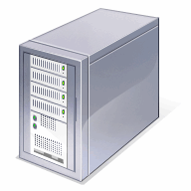
Improving HTTP Performance:
Concurrent Requests & Responses
Use multiple connections in parallel
Does not necessarily maintain order of responses
R2
R3
R1
T2
T3
T1
Client = ☺
Content provider = ☺
Network = ☹ Why?

Slide 26
Improving HTTP Performance:
Persistent Connections
Maintain TCP connection across multiple requests
  Including transfers subsequent to current page
  Client or server can tear down connection
Performance advantages:
  Avoid overhead of connection set-up and tear-down
  Allow TCP to learn more accurate RTT estimate
  Allow TCP congestion window to increase
  i.e., leverage previously discovered bandwidth
Default in HTTP/1.1

Slide 27
Improving HTTP Performance:
Pipelined Requests & Responses
Batch requests and responses to reduce the number of packets
Multiple requests can be contained in one TCP segment
Client
Server
Request 1
Request 2
Request 3
Transfer 1
Transfer 2
Transfer 3
Notes:
HTTP/1.1 allows multiple HTTP requests to be written out to a socket together without waiting for the corresponding responses. The requestor then waits for the responses to arrive in the order in which they were requested. The act of pipelining the requests can result in a dramatic improvement in page loading times, especially over high latency connections.

Slide 28
Scorecard: Getting n Small Objects
Time dominated by latency
One-at-a-time: ~2n RTT
M concurrent: ~2[n/m] RTT
Persistent: ~ (n+1)RTT
Pipelined: ~2 RTT
Pipelined/Persistent: ~2 RTT first time, RTT later

Slide 29
Scorecard: Getting n Large Objects
Time dominated by bandwidth
One-at-a-time: ~ nF/B
M concurrent: ~ [n/m] F/B
  assuming shared with large population of users
  and each TCP connection gets the same bandwidth
Pipelined and/or persistent: ~ nF/B
  The only thing that helps is getting more bandwidth..

Slide 30
Improving HTTP Performance:
Caching
Why does caching work?
  Exploits locality of reference
How well does caching work?
  Very well, up to a limit
  Large overlap in content
  But many unique requests
    A universal story!
    Effectiveness of caching grows logarithmically with size

Slide 31
Improving HTTP Performance:
Caching: How
Modifier to GET requests:
  If-modified-since – returns “not modified” if resource not modified since specified time
Client specifies “if-modified-since” time in request
Server compares this against “last modified” time of resource
Server returns “Not Modified” if resource has not changed
…. or a “OK” with the latest version otherwise
GET /~ee122/fa13/ HTTP/1.1
Host: inst.eecs.berkeley.edu
User-Agent: Mozilla/4.03
If-modified-since: Sun, 27 Oct 2013 22:25:50 GMT
<CRLF>

Slide 32
Improving HTTP Performance:
Caching: How
Modifier to GET requests:
  If-modified-since – returns “not modified” if resource not modified since specified time
Response header:
  Expires – how long it’s safe to cache the resource
  No-cache – ignore all caches; always get resource directly from server

Slide 33
Improving HTTP Performance:
Caching: Where?
Options
  Client
  Forward proxies
  Reverse proxies
  Content Distribution Network

Slide 34
Improving HTTP Performance:
Caching: Where?
Baseline: Many clients transfer same information
  Generate unnecessary server and network load
  Clients experience unnecessary latency
Server
Tier-1 ISP
ISP-1
ISP-2
Clients

Slide 35
Improving HTTP Performance:
Caching with Reverse Proxies
Cache documents close to server
→ decrease server load
Typically done by content provider
Server
Reverse proxies
Backbone ISP
ISP-1
ISP-2
Clients

Slide 36
Improving HTTP Performance:
Caching with Forward Proxies
Cache documents close to clients
→ reduce network traffic and decrease latency
Typically done by ISPs or enterprises
Server
Reverse proxies
Backbone ISP
ISP-1
ISP-2
Forward proxies
Clients

Slide 37
Improving HTTP Performance:
Replication
Replicate popular Web site across many machines
  Spreads load on servers
  Places content closer to clients
  Helps when content isn’t cacheable
Problem: Want to direct client to particular replica
  Balance load across server replicas
  Pair clients with nearby servers
Common solution:
  DNS returns different addresses based on client’s geo
  location, server load, etc.

Slide 38
Improving HTTP Performance:
Content Distribution Networks
Caching and replication as a service
Large-scale distributed storage infrastructure (usually) administered by one entity
  e.g., Akamai has servers in 20,000+ locations
Combination of (pull) caching and (push) replication
  Pull: Direct result of clients’ requests
  Push: Expectation of high access rate
Also do some processing
  Handle dynamic web pages
  Transcoding
Notes:
Transcoding = change compression rate per user’s bandwidth

Slide 39
Improving HTTP Performance:
CDN Example – Akamai
Akamai creates new domain names for each client
  e.g., a128.g.akamai.net for cnn.com
The CDN’s DNS servers are authoritative for the new domains
The client content provider modifies its content so that embedded URLs reference the new domains.
  “Akamaize” content
  e.g.: http://www.cnn.com/image-of-the-day.gif becomes http://a128.g.akamai.net/image-of-the-day.gif
Requests now sent to CDN’s infrastructure…

Slide 40
Cost-Effective Content Delivery
General theme: multiple sites hosted on shared physical infrastructure
  efficiency of statistical multiplexing
  economies of scale (volume pricing, etc.)
  amortization of human operator costs
Examples:
  Web hosting companies
  CDNs
  Cloud infrastructure

Slide 41
Data Link Layer

Slide 42
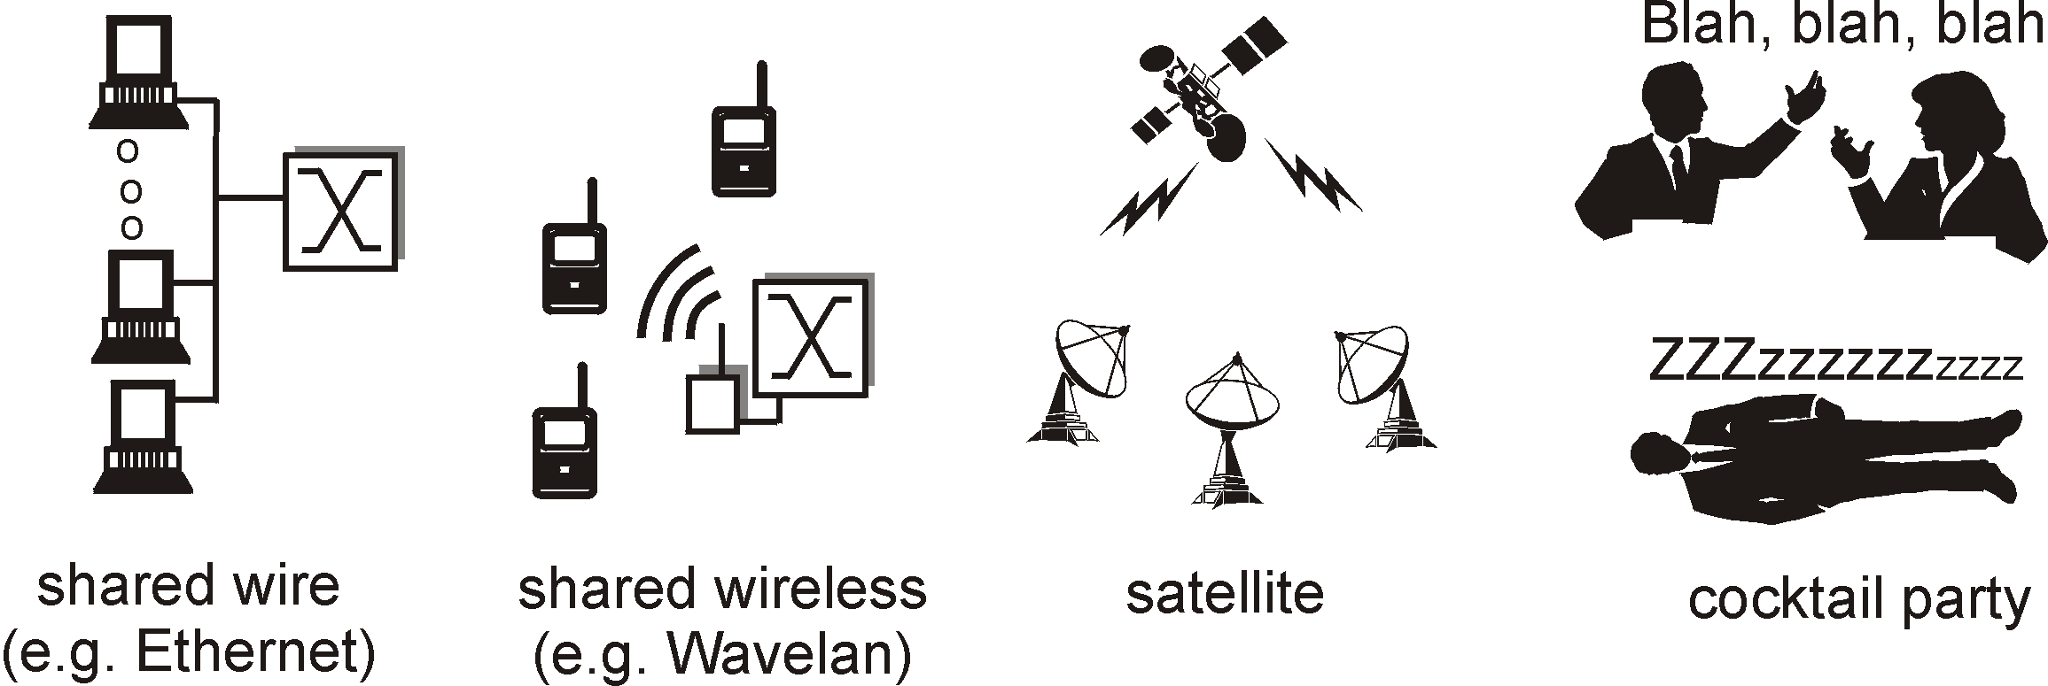

Point-to-Point vs. Broadcast Media
Point-to-point: dedicated pairwise communication
  E.g., long-distance fiber link
  E.g., Point-to-point link between Ethernet switch and host
Broadcast: shared wire or medium
  Traditional Ethernet (pre ~2000)
  802.11 wireless LAN

Slide 43
Multiple Access Algorithm
Context: a shared broadcast channel
  Must avoid having multiple nodes speaking at once
  Otherwise, collisions lead to garbled data
  Need distributed algorithm for sharing the channel
  Algorithm determines which node can transmit
Three classes of techniques
  Channel partitioning: divide channel into pieces
  Taking turns: scheme for trading off who gets to transmit
  Random access: allow collisions, and then recover
    More in the Internet style!

Slide 44
Random Access MAC Protocols
When node has packet to send
  Transmit at full channel data rate
  No a priori coordination among nodes
Two or more transmitting nodes ⇒ collision
  Data lost
Random access MAC protocol specifies:
  How to detect collisions
  How to recover from collisions
Examples
  ALOHA and Slotted ALOHA
  CSMA, CSMA/CD, CSMA/CA (wireless, covered later)

Slide 45

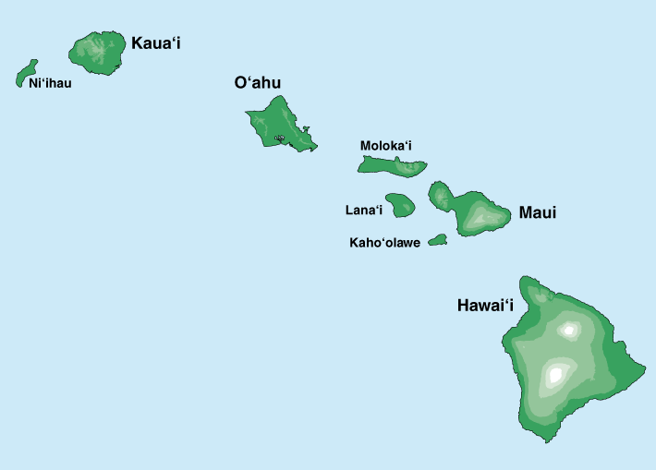
Where it all Started: AlohaNet
Norm Abramson left Stanford in 1970 (so he could surf!)
Set up first data communication system for Hawaiian islands
Central hub at U. Hawaii, Oahu
Notes:
Who is he, and why is he my hero?

Slide 46
Aloha Signaling
Two channels: random access, broadcast
Sites send packets to hub (random-access channel)
  If not received (due to collision), site resends
Hub sends packets to all sites (broadcast channel)
  Sites can receive even if they are also sending

Slide 47
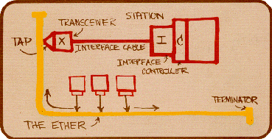
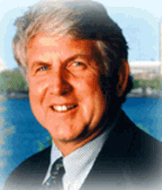
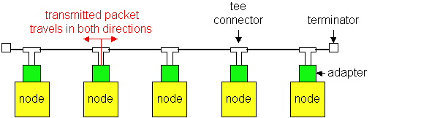
Ethernet:
Bob Metcalfe, Xerox PARC, visits Hawaii and gets an idea!
Shared wired medium
  coax cable

Slide 48
Evolution
Ethernet was invented as a broadcast technology
  Hosts share channel
  Each packet received by all attached hosts
  CSMA/CD for media access control
Current Ethernets are “switched” (next lecture)
  Point-to-point links between switches; between a host and switch
  No sharing, no CSMA/CD
  Uses “self learning” and “spanning tree” algorithms for routing

Slide 49
CSMA (Carrier Sense Multiple Access)
CSMA: listen before transmit
  If channel sensed idle: transmit entire frame
  If channel sensed busy, defer transmission
Human analogy: don’t interrupt others!
Does this eliminate all collisions?
  No, because of nonzero propagation delay

Slide 50
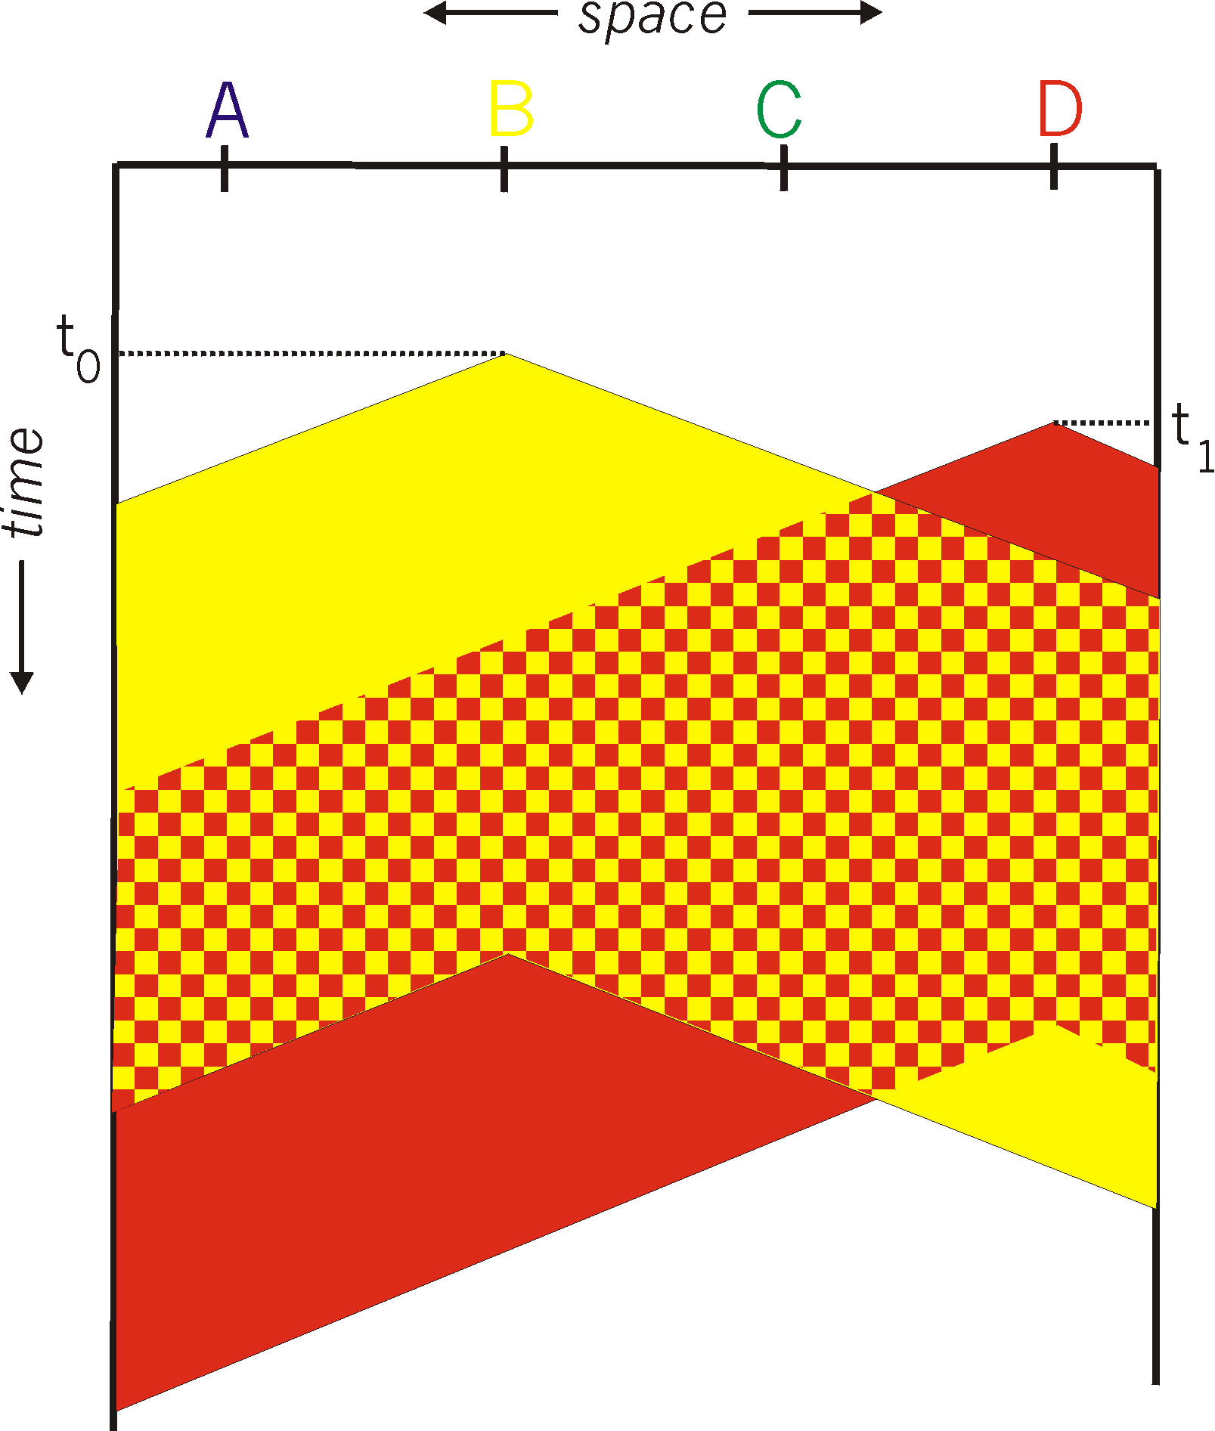
CSMA Collisions
Propagation delay: two nodes may not hear each other’s before sending.
CSMA reduces but does not eliminate collisions
Biggest remaining problem?
Collisions still take the full
transmission slot!
Notes:
Ask: who knows? (from knowing ethernet)?
Someone who doesn’t, how to do this?
Listen before sending to detect possible collision
Why not listen to detect current collision!

Slide 51
CSMA/CD (Collision Detection)
CSMA/CD: carrier sensing, deferral as in CSMA
  Collisions detected within short time
  Colliding transmissions aborted, reducing wastage
Collision detection easy in wired (broadcast) LANs
  Compare transmitted, received signals
Collision detection difficult in wireless LANs
  Lecture on wireless
Notes:
wireless: because reception while tx is difficult . broadcast isn’t perfect so collisions local

Slide 52
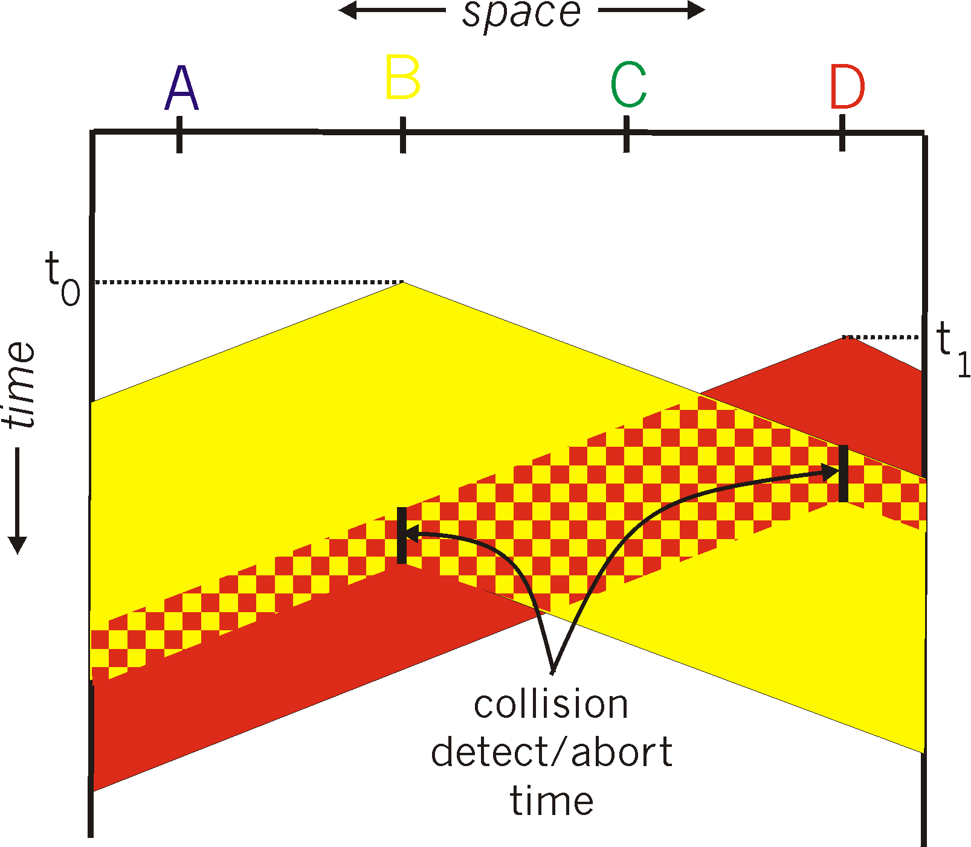
CSMA/CD Collision Detection
B and D can tell that collision occurred.
Note: for this to work, need restrictions on minimum frame size and maximum distance.
Why?
Notes:
Draw failed collision detection….

Slide 53
Limits on CSMA/CD Network Length
A
B
latency d
Latency depends on physical length of link
  Time to propagate a packet from one end to the other
Suppose A sends a packet at time t
  And B sees an idle line at a time just before t+d
  … so B happily starts transmitting a packet
B detects a collision, and sends jamming signal
  But A can’t see collision until t+2d

Slide 54
Limits on CSMA/CD Network Length
A
B
latency d
A needs to wait for time 2d to detect collision
  So, A should keep transmitting during this period
  … and keep an eye out for a possible collision
Imposes restrictions. E.g., for 10 Mbps Ethernet:
  Maximum length of the wire: 2,500 meters
  Minimum length of a frame: 512 bits (64 bytes)
    512 bits = 51.2 μsec (at 10 Mbit/sec)
    For light in vacuum, 51.2 μsec ≈ 15,000 meters
    vs. 5,000 meters “round trip” to wait for collision
  What about 10Gbps Ethernet?
Notes:
10Gbps is switched, doesn’t have this problem!!!

Slide 55
Key Ideas of Random Access
Carrier sense
  Listen before speaking, and don’t interrupt
  Checking if someone else is already sending data
  … and waiting till the other node is done
Collision detection
  If someone else starts talking at the same time, stop
    But make sure everyone knows there was a collision!
  Realizing when two nodes are transmitting at once
  …by detecting that the data on the wire is garbled
Randomness
  Don’t start talking again right away
  Waiting for a random time before trying again

Slide 56
How long should you wait?
After collision, when should you resend?
Should it be immediate?
Should it be a random number with a fixed distribution?

Slide 57
Ethernet: CSMA/CD Protocol
Carrier sense: wait for link to be idle
Collision detection: listen while transmitting
  No collision: transmission is complete
  Collision: abort transmission & send jam signal
Random access: binary exponential back-off
  After collision, wait a random time before trying again
  After m^{th} collision, choose K randomly from {0, …, 2^{m}-1}
  … and wait for K*512 bit times before trying again
    If transmission occurring when ready to send, wait until end of transmission (CSMA)

Slide 58

Performance of CSMA/CD
Time wasted in collisions
  Proportional to distance d
Time spend transmitting a packet
  Packet length p divided by bandwidth b
Rough estimate for efficiency (K some constant)
Note:
  For large packets, small distances, E ~ 1
  As bandwidth increases, E decreases
  That is why high-speed LANs are all switched
Notes:
K represents number of collisions per transmission….

