Slide 1
Basic Concepts
CS168, Fall 2014 Sylvia Ratnasamy http://inst.eecs.berkeley.edu/~cs168/fa14/

Slide 2
Administrivia
Discussion sections start Wednesday, Sep 10
Homework#1 out this week
we will be using PandaGrader for submissions; stay tuned for details
Final exam scheduling conflicts

Slide 3
Today
What is a network made of?
How is it shared?
How do we evaluate a network?

Slide 4
Today
What is a network made of?
How is it shared?
How do we evaluate a network?

Slide 5
link
end-system
switch
Internet Service Provider

Slide 6
phone company

Slide 7
phone company

Slide 8
home PC
switch

Slide 9
central office
DSL modem
DSLAM
phone line
...
home PC
switch
telephone network
telephone

Slide 10
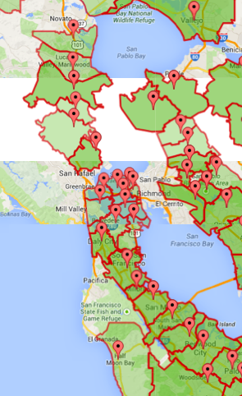
AT&T Central Offices in the Bay Area

Slide 11
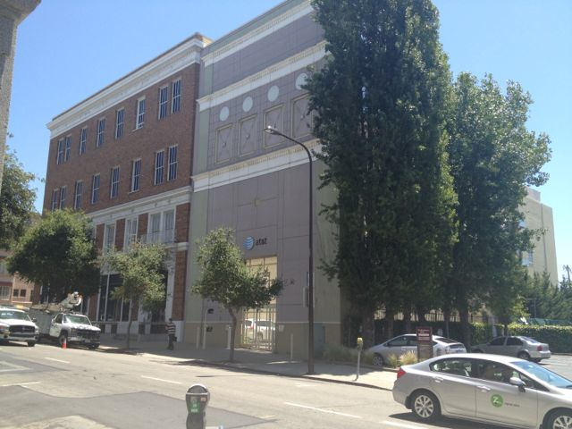
AT&T Central Office in Berkeley

Slide 12
Digital Subscriber Line (DSL)
Twisted pair copper
3 separate channels
downstream data channel
upstream data channel
2-way phone channel
up to 25 Mbps downstream
up to 2.5 Mbps upstream

Slide 13
Why phone lines?

Slide 14
cable company

Slide 15
cable company

Slide 16
home PC
switch

Slide 17
cable modem
cable head end
CMTS
copper
fiber
...
home PC
switch

Slide 18
cable head end
CMTS
fiber
switch

Slide 19
Cable
Coaxial copper & fiber
up to 42.8 Mbps downstream
up to 30.7 Mbps upstream
shared broadcast medium

Slide 20
university net

Slide 21
university net

Slide 22
Ethernet cable
...
workstation
“local” switch
“aggregate” switch

Slide 23
Ethernet
Twisted pair copper
100 Mbps, 1 Gbps, 10 Gbps (each direction)

Slide 24
& more
Cellular (smart phones)
Satellite (remote areas)
Fiber to the Home (home)
Optical carrier (Internet backbone)

Slide 25
WiFi
phone company
university net
cable company
WiFi
WiFi

Slide 26
What physical infrastructure is already available?

Slide 27
Today
What is a network made of?
How is it shared?
How do we evaluate a network?

Slide 28
shared link and switch resources

Slide 29
How do we scale a network to many end-systems?
O(n²) links
per-node capacity scales as 1/n

Slide 30
How do we scale a network to many end-systems?
Switched networks enable efficient scaling!

Slide 31
Two approaches to sharing
Reservations
On demand

Slide 32
Intuition: Three sources of “bursty” traffic
12Mbps
Link capacity = 30Mbps
11Mbps
13Mbps
Time

Slide 33
Intuition: reservations
Frequent overloading
12Mbps
Link capacity = 30Mbps
11Mbps
Each source gets 10Mbps
13Mbps
Time

Slide 34
Intuition: on demand
No overloading
Link capacity = 30Mbps
Time

Slide 35
Switching on-demand exploits statistical multiplexing better than reservations
Sharing using the statistics of demand
Good for bursty traffic (average << peak demand)
Similar to insurance, with the same failure mode

Slide 36
Intuition: on demand
Link capacity = 30Mbps
Time
What do we do under overload?

Slide 37
Statistical multiplexing is a recurrent theme in computer science
Phone network rather than dedicated lines
ancient history
Packet switching rather than circuits
today’s lecture
Cloud computing
shared vs. dedicated machines

Slide 38
Two approaches to sharing
Reservations
On demand
How are these implemented?

Slide 39
Two approaches to sharing
Reservations → circuit switching
On demand → packet switching
How are these implemented?

Slide 40
Two approaches to sharing
Packet switching
packets treated on demand
admission control: per packet
Circuit switching
resources reserved per active "connection"
admission control: per connection
A hybrid: virtual circuits
emulating circuit switching with packets (see text)

Slide 41
Circuit Switching
10Mb/s?
dst
src
✔
10Mb/s?
✔
10Mb/s?
✔
src sends a reservation request to dst
(2) Switches “establish a circuit”
(3) src starts sending data
(4) src sends a “teardown circuit” message

Slide 42
Circuit Switching
switch
src
dst
Reservation establishes a “circuit” within a switch

Slide 43
Many kinds of “circuits”
Time division multiplexing
divide time in time slots
separate time slot per circuit
Frequency division multiplexing
divide frequency spectrum in frequency bands
separate frequency band per circuit
time
frequency
time

Slide 44
Timing in Circuit Switching
time

Slide 45
Timing in Circuit Switching
time

Slide 46
Timing in Circuit Switching
time

Slide 47
Timing in Circuit Switching
time

Slide 48
Timing in Circuit Switching
Circuit establishment
time

Slide 49
Timing in Circuit Switching
Data
Circuit establishment
Data transfer
time

Slide 50
Timing in Circuit Switching
Data
Circuit establishment
Data transfer
time
Circuit teardown
Notes:
Why the delays in the first pass of the establishment, but not in subsequent passes (or in teardown)?

Slide 51
Timing in Circuit Switching
Circuit establishment
Data transfer
time
Circuit teardown
Notes:
Why the delays in the first pass of the establishment, but not in subsequent passes (or in teardown)?

Slide 52
Timing in Circuit Switching
Data
time
Notes:
Why the delays in the first pass of the establishment, but not in subsequent passes (or in teardown)?

Slide 53
Timing in Circuit Switching
Information
time
Notes:
Why the delays in the first pass of the establishment, but not in subsequent passes (or in teardown)?

Slide 54
Circuit Switching
A
B
Circuit switching doesn’t “route around trouble”

Slide 55
Circuit Switching
Pros
predictable performance
simple/fast switching (once circuit established)
Cons
complexity of circuit setup/teardown
inefficient when traffic is bursty
circuit setup adds delay
switch fails → its circuit(s) fails

Slide 56
Packet switching
switch
dst
Each packet contains destination (dst)
Each packet treated independently

Slide 57
Packet switching
switch
dst
Each packet contains destination (dst)
Each packet treated independently
With buffers to absorb transient overloads

Slide 58
Packet Switching
Pros
efficient use of network resources
simpler to implement
robust: can “route around trouble”
Cons
unpredictable performance
requires buffer management and congestion control

Slide 59
On-demand or reserve?

Slide 60
Today
What is a network made of?
How is it shared?
will assume packet switching from here on
How do we evaluate a network?

Slide 61
Today
What is a network made of?
How is it shared?
How do we evaluate a network?

Slide 62
Performance Metrics
Delay
Loss
Throughput

Slide 63
Delay
How long does it take to send a packet from its source to destination?

Slide 64
Loss
What fraction of the packets sent to a destination are dropped?

Slide 65
Throughput
At what rate is the destination receiving data from the source

Slide 66
Delay
Consists of four components
transmission delay
propagation delay
queuing delay
processing delay
due to link properties
due to traffic mix and
switch internals

Slide 67
A network link
bandwidth
delay x bandwidth
Propagation delay
Link bandwidth
number of bits sent/received per unit time (bits/sec or bps)
Propagation delay
time for one bit to move through the link (seconds)
Bandwidth-Delay Product (BDP)
number of bits “in flight” at any time
BDP = bandwidth × propagation delay

Slide 68
Examples
Same city over a slow link:
bandwidth: ~100Mbps
propagation delay: ~0.1msec
BDP: 10,000bits (1.25KBytes)
Cross-country over fast link:
bandwidth: ~10Gbps
propagation delay: ~10msec
BDP: 10⁸bits (12.5MBytes)

Slide 69
1. Transmission delay
How long does it take to push all the bits of a packet into a link?
Packet size / Transmission rate of the link
e.g. 1000 bits / 100 Mbits per sec = 10 ⁻⁵ sec

Slide 70
2. Propagation delay
How long does it take to move one bit from one end of a link to the other?
Link length / Propagation speed of link
E.g. 30 kilometers / 3 10⁸ meters per sec = 10⁻⁴ sec

Slide 71
Packet Delay Sending 100B packets from A to B?
A
B
1Mbps, 1ms
100Byte packet
time=0
Time to transmit one bit = 1/10⁶s
Time when that bit reaches B = 1/10⁶+1/10³s
Time to transmit 800 bits=800x1/10⁶s
The last bit reaches B at
(800x1/10⁶)+1/10³s
= 1.8ms
Time

Slide 72
Packet Delay Sending 100B packets from A to B?
1GB file in 100B packets
1Gbps, 1ms?
A
B
1Mbps, 1ms
100Byte packet
10⁷ x 100B packets
The last bit in the file reaches B at
(10⁷x800x1/10⁹)+1/10³s
= 8001ms
The last bit reaches B at
(800x1/10⁹)+1/10³s
= 1.0008ms
The last bit reaches B at
(800x1/10⁶)+1/10³s
= 1.8ms
Time

Slide 73
Packet Delay: The “pipe” view Sending 100B packets from A to B?
A
B
100Byte packet
1Mbps, 10ms
pkt tx time
100Byte packet
100Byte packet
BW →
time →
Time

Slide 74
Packet Delay: The “pipe” view Sending 100B packets from A to B?
1Mbps, 10ms (BDP=10,000)
BW →
time →
1Mbps, 5ms (BDP=5,000)
10Mbps, 1ms (BDP=10,000)
BW →
BW →
time →
time →

Slide 75
Packet Delay: The “pipe” view Sending 100B packets from A to B?
200B?
1Mbps, 10ms (BDP=10,000)
BW →
time →
1Mbps, 10ms (BDP=10,000)
BW →
time →

Slide 76
3. Queuing delay
How long does a packet have to sit in a buffer before it is processed?

Slide 77
Queuing delay: “pipe” view

Slide 78
Queuing delay: “pipe” view
No overload!

Slide 79
Queuing delay: “pipe” view
Queue
Transient Overload
Not a rare event!

Slide 80
Queuing delay: “pipe” view
Queue
Transient Overload
Not a rare event!

Slide 81
Queuing delay: “pipe” view
Queue
Transient Overload
Not a rare event!

Slide 82
Queuing delay: “pipe” view
Queue
Transient Overload
Not a rare event!

Slide 83
Queuing delay: “pipe” view
Queue
Transient Overload
Not a rare event!

Slide 84
Queuing delay: “pipe” view
Queue
Transient Overload
Queues absorb transient bursts but introduce queuing delay
Not a rare event!

Slide 85
Queuing delay: “pipe” view
What about persistent overload?
Will eventually drop packets (“loss”)

Slide 86
Queuing Delay
How long does a packet have to sit in a buffer before it is processed?
Depends on traffic pattern
arrival rate at the queue
nature of arriving traffic (bursty or not?)
transmission rate of outgoing link

Slide 87
Queuing Delay
How long does a packet have to sit in a buffer before it is processed?
Characterized with statistical measures
average queuing delay
variance of queuing delay
probability delay exceeds a threshold value

Slide 88
Basic Queuing Theory Terminology
Arrival process: how packets arrive
Average rate A
Peak rate P
W: average time packets wait in the queue
W for “waiting time”
L: average number of packets waiting in the queue
L for “length of queue”

Slide 89
Little’s Law (1961)
L = A x W
Compute L: count packets in queue every second
How often does a single packet get counted? W times
Why do you care?
Easy to compute L, harder to compute W
Notes:
Row vs column

Slide 90
4. Processing Delay
How long does the switch take to process a packet?
typically assume this is negligible

Slide 91
Recap
What is a network made of?
What physical infrastructure exists?
How is it shared?
On-demand or reserve?
How do we evaluate a network?
Where is my delay coming from?
To be contd…

