Slide 1
Datacenters
CS 168, Fall 2014
Sylvia Ratnasamy
http://inst.eecs.berkeley.edu/~cs168/

Slide 2
What you need to know
Characteristics of a datacenter environment
  goals, constraints, workloads, etc.
How and why DC networks are different (vs. WAN)
  e.g., latency, geo, autonomy, …
How traditional solutions fare in this environment
  e.g., IP, Ethernet, TCP, ARP, DHCP
Specific design approaches we cover in class
  next lecture

Slide 3
Disclaimer
Material is emerging (not established) wisdom
Material is incomplete
  many details on how and why datacenter networks
  operate aren’t public

Slide 4
Plan
Today
Characteristics and goals of datacenter networks
Focus on differences relative to the Internet
Next lecture
Emerging solutions

Slide 5
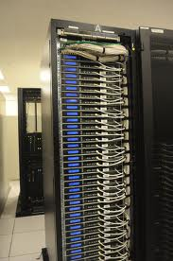
What goes into a datacenter (network)?
Servers organized in racks

Slide 6
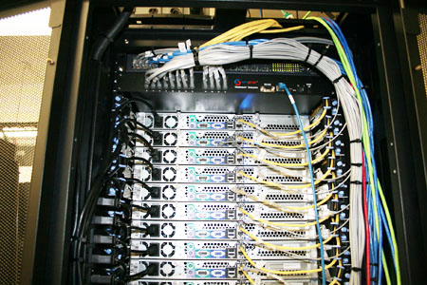
What goes into a datacenter (network)?
Servers organized in racks
Each rack has a `Top of Rack’ (ToR) switch

Slide 7
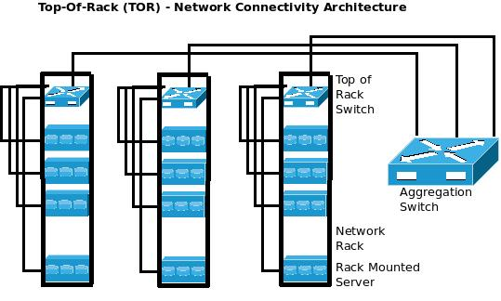
What goes into a datacenter (network)?
Servers organized in racks
Each rack has a `Top of Rack’ (ToR) switch
`Aggregation switches interconnect ToR switches

Slide 8
What goes into a datacenter (network)?
Servers organized in racks
Each rack has a `Top of Rack’ (ToR) switch
`Aggregation switches interconnect ToR switches
Connected to the outside via `core’ switches
  note: blurry line between aggregation and core
With 2x redundancy for fault-tolerance

Slide 9
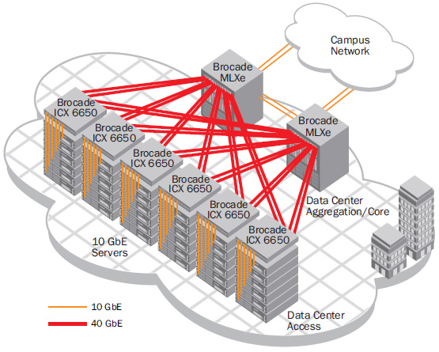
E.g., Brocade Reference Design

Slide 10
E.g., Cisco Reference Design
Internet
CR
CR
. . .
AR
AR
AR
AR
S
S
S
S
S
S
. . .
A
A
…
A
A
A
…
A
~ 40-80 servers/rack

Slide 11

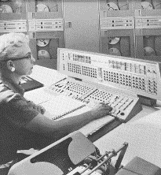
Datacenters have been around for a while
1961, Information Processing Center at the National Bank of Arizona

Slide 12
What’s new?

Slide 13
What’s new?
Scale
Applications
  Large-scale computations (“big data”)
  Customer-facing, revenue generating services
Service model
  Clouds (jargon: SaaS, PaaS, DaaS, IaaS, …)
  Multi-tenancy

Slide 14
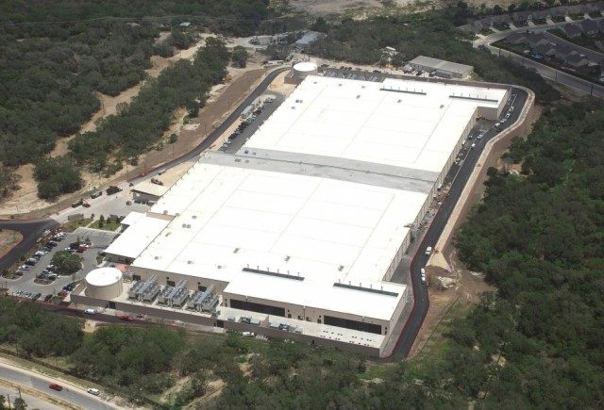
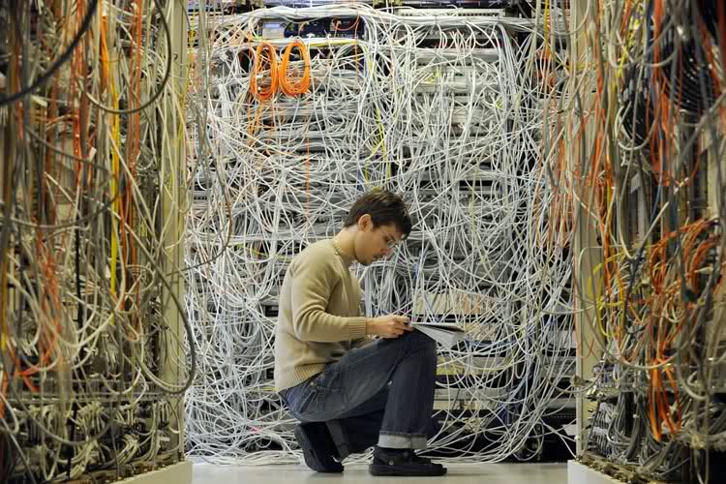
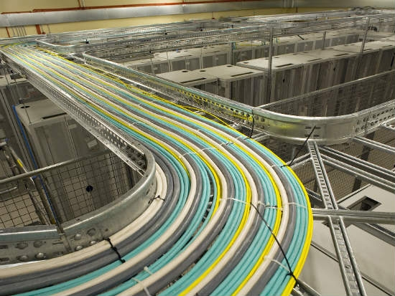
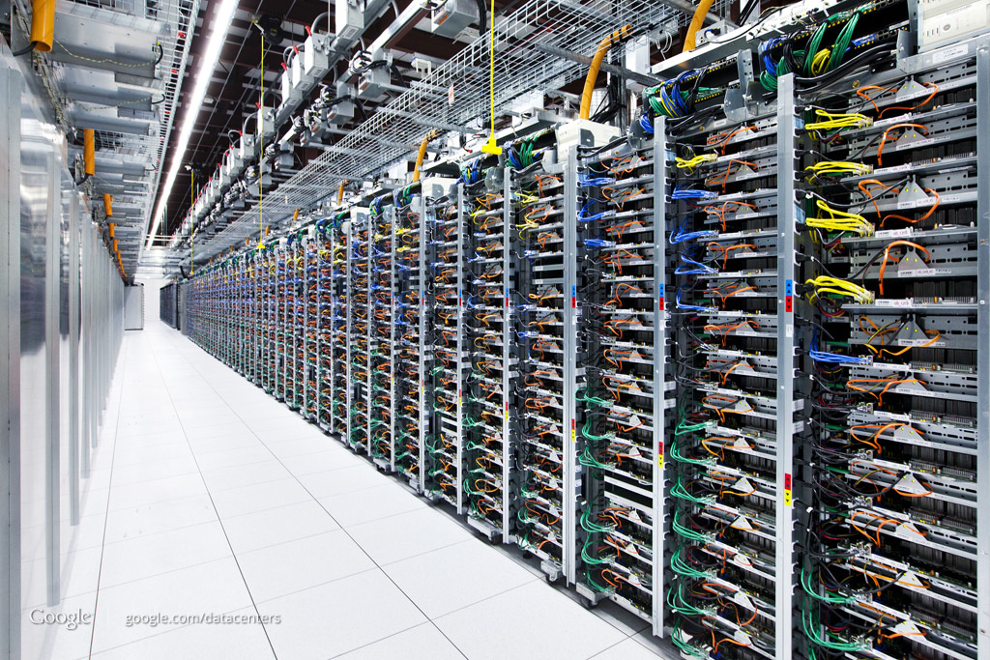
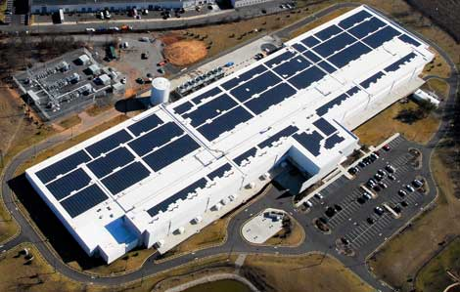
SCALE!

Slide 15
How big exactly?
1M servers/site [Microsoft/Amazon/Google]
> $1B to build one site [Facebook]
>$20M/month/site operational costs [Microsoft ’09]
But only O(10-100) sites

Slide 16
Implications (1)
Scale
  Need scalable designs (duh): e.g., avoid flooding
  Low cost designs: e.g., use commodity technology
  High utilization (efficiency): e.g., >80% avg. utilization
    Contrast: avg. utilization on Internet links often ~30%
  Tolerate frequent failure
    Large number of (low cost) components
  Automate

Slide 17
Implications (2)
Service model: clouds / multi-tenancy
  performance guarantees
  isolation guarantees
  portability
How?
  “network virtualization” (lecture on SDN)

Slide 18
Applications
Common theme: parallelism
  Applications decomposed into tasks
  Running in parallel on different machines
Two common paradigms
  “Partition Aggregate”
  Map Reduce

Slide 19
Partition-Aggregate
user requests from the Internet
Router /
Load Balancer
Front-End
Proxy
Front-End
Proxy
Web Server
Web Server
Web Server
Data
Cache
Data
Cache
Database
Database

Slide 20
“North – South” Traffic
Interactive / query-response exchange between external clients and datacenter
Handled by front-end (web) servers, mid-tier application servers, and back-end databases

Slide 21
Map-Reduce
Distributed
Storage
Map
Tasks
Reduce
Tasks
Distributed
Storage

Slide 22
Map-Reduce
Often doesn’t cross the network
Some fraction (typically 2/3) crosses the network
Distributed
Storage
Map
Tasks
Reduce
Tasks
Distributed
Storage
Always goes over the network

Slide 23
“East-West” Traffic
CR
CR
AR
AR
AR
AR
S
S
S
S
S
S
S
S
. . .
S
S
S
S
A
A
…
A
A
A
…
A
A
A
…
A
A
A
…
A

Slide 24
“East-West” Traffic
Traffic between servers in the datacenter
Communication within “big data” computations
Traffic may shift on small timescales (< minutes)

Slide 25
  Common traffic pattern:
  “Elephants” and “Mice”
  Web search, data mining (Microsoft) [Alizadeh 2010]
<100KB
>10MB
55% of flows
3% of bytes
5% of flows
35% of bytes

Slide 26
Implications (3)
Applications
  High bandwidth any-to-any communication
  (“bisection bandwidth”)
  Low latency is critical
  Worst-case (“tail”) latency is critical

Slide 27
High Bandwidth
Ideal: Each server can talk to any other server at its full access link rate
Conceptually: DC network as one giant switch

Slide 28

DC Network: Just a Giant Switch!
H1
H2
H3
H4
H5
H6
H7
H8
H9

Slide 29
DC Network: Just a Giant Switch!
H1
H2
H3
H4
H5
H6
H7
H8
H9

Slide 30
DC Network: Just a Giant Switch!
H1
H1
H1
H2
H2
H2
H3
H3
H3
H4
H4
H4
H5
H5
H5
H6
H6
H6
H7
H7
H7
H8
H8
H8
H9
TX
H9
H9
RX

Slide 31
DC Network: Just a Giant Switch!
H1
H1
H2
H2
H3
H3
H4
H4
H5
H5
H6
H6
H7
H7
H8
H8
TX
H9
H9
RX

Slide 32
High Bandwidth
Ideal: Each server can talk to any other server at its full access link rate
Conceptually: DC network as one giant switch
  Would require a 10 Pbits/sec switch!
    1M ports (one port/server)
    10Gbps per port
Practical approach: build a network of switches (“fabric”) with high “bisection bandwidth”
  Each switch has practical #ports and link speeds

Slide 33
Bisection Bandwidth
Partition a network into two equal parts
Minimum bandwidth between the partitions is the bisection bandwidth
Full bisection bandwidth: bisection bandwidth in an N node network is N/2 times the bandwidth of a single link
  →nodes of any two halves can communicate at full speed with each other.

Slide 34
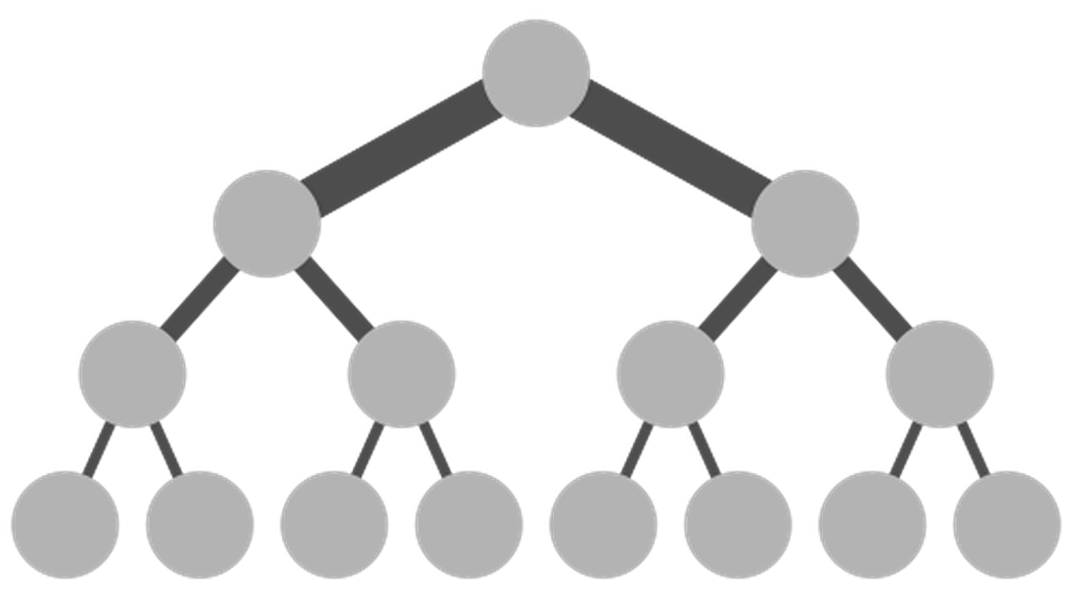
Achieving Full Bisection Bandwidth
O(40x10x100)Gbps
Internet
CR
CR
O(40x10) Gbps
. . .
AR
AR
AR
AR
10Gbps links
S
S
S
S
S
S
. . .
A
A
…
A
A
A
…
A
~ 40 servers/rack
“scale up” approach

Slide 35
Achieving Full Bisection Bandwidth
Problem: “Scaling up” a traditional tree topology is expensive!
  requires non-commodity / impractical / link and switch components
Solutions?
  Over-subscribe (i.e., provision less than full BBW)
  Better topologies

Slide 36
Oversubscription
40G
20G
20G
10G
10G
10G
Need techniques to avoid congesting oversubscribed links!

Slide 37
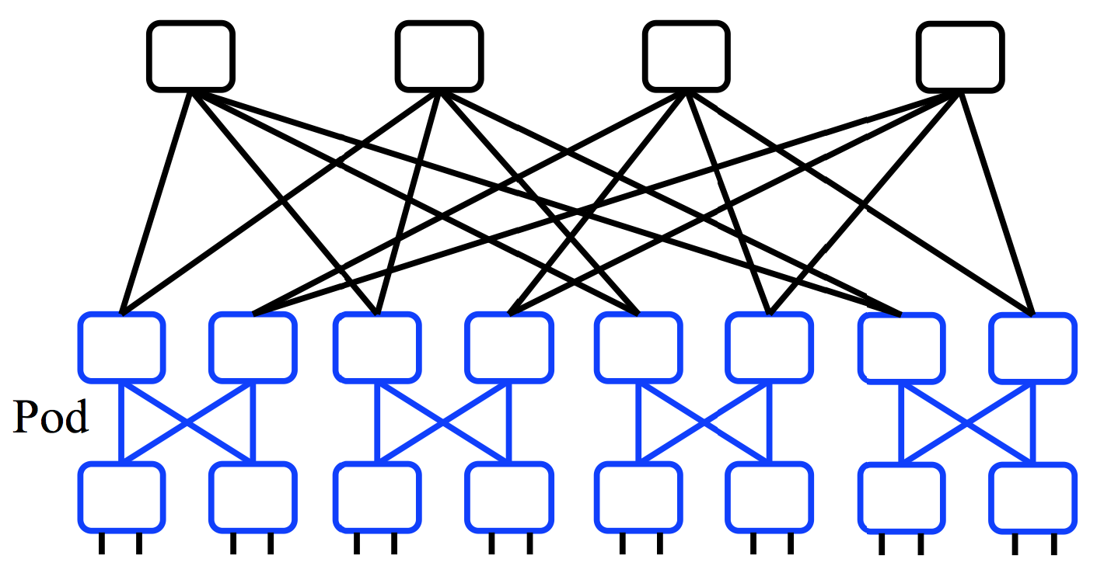
Better topologies?
40G
20G
10G
“scale up” approach
“scale out” approach

Slide 38
Better topologies?
E.g., `Clos’ topology
  Multi-stage network
  All switches have k ports
  k/2 ports up, k/2 down
E.g., with 3 stages, k=48
  k³/4 hosts = 27,648 servers
All links have same speed
“scale out” approach

Slide 39
Challenges in scale-out designs?
Topology offers high bisection bandwidth
All other system components must be able to exploit this available capacity
  Routing must use all paths
  Transport protocol must
  fill all pipes (fast)

Slide 40
Low Latency
Two (related) issues:
1) Very low RTTs within the DC (approaching 1μsec)
  Implications?
  BW x delay: 10Gbps x 1μsec = 10000 bits = 2.5 packets
  Consider TX 500B @ 10Gbps = 0.4μs per hop = 2μs if a packet traverses 5 hops and waits behind one packet at every hop
  What does this mean for buffering and switch design?
  What does this mean for congestion control?

Slide 41
Low Latency
Two (related) issues:
Very low RTTs within the DC (approaching 1μsec)
Applications want low latency
  predictable / guaranteed bounds on flow completion time, including the worst-case!
  (recall: `best effort’ vs. `guaranteed service’ debates)
  How is still an open question

Slide 42
What’s different about DC networks?
Characteristics
Huge scale
  ~20,000 switches/routers
  contrast: AT&T ~500 routers

Slide 43
What’s different about DC networks?
Characteristics
Huge scale
Limited geographic scope
  High bandwidth: 10/40/100G (Contrast: DSL/WiFi)
  Very low RTT: 1-10s μsecs. (Contrast: 100s msecs)

Slide 44
What’s different about DC networks?
Characteristics
Huge scale
Limited geographic scope
Limited heterogeneity
  link speeds, technologies, latencies, …

Slide 45
What’s different about DC networks?
Characteristics
Huge scale
Limited geographic scope
Limited heterogeneity
Regular/planned topologies (e.g., trees)
  Contrast: ad-hoc evolution of wide-area topologies

Slide 46
What’s different about DC networks?
Goals
Extreme bisection bandwidth requirements
  recall: all that east-west traffic
  target: any server can communicate at its full link speed
  How: next lecture

Slide 47
What’s different about DC networks?
Goals
Extreme bisection bandwidth requirements
Extreme latency requirements
  real money on the line
  current target: 1μs RTTs
  how? Next lecture

Slide 48
What’s different about DC networks?
Goals
Extreme bisection bandwidth requirements
Extreme latency requirements
Predictable, deterministic performance
  “your packet will reach in Xms, or not at all”
  “your VM will always see at least YGbps throughput”
  How is still an open question

Slide 49
What’s different about DC networks?
Goals
Extreme bisection bandwidth requirements
Extreme latency requirements
Predictable, deterministic performance
Differentiating between tenants is key
  e.g., “No traffic between VMs of tenant A and tenant B”
  “Tenant X cannot consume more than XGbps”
  “Tenant Y’s traffic is low priority”
  How: lecture on SDN (Nov 24)

Slide 50
What’s different about DC networks?
Goals
Extreme bisection bandwidth requirements
Extreme latency requirements
Predictable, deterministic performance
Differentiating between tenants is key
Scalability (of course)

Slide 51
What’s different about DC networks?
Goals
Extreme bisection bandwidth requirements
Extreme latency requirements
Predictable, deterministic performance
Differentiating between tenants is key
Scalability (of course)
Cost/efficiency
  focus on commodity solutions, ease of management

Slide 52
What’s different about DC networks?
New degrees of (design) freedom
Single administrative domain
  Can deviate from standards, invent your own, etc.
  “Green field” deployment is still feasible

Slide 53
What’s different about DC networks?
New degrees of (design) freedom
Single administrative domain
Control over network and endpoint(s)
  can change (say) addressing, congestion control, etc.
  can add mechanisms for security/policy/etc. at the endpoints (typically in the hypervisor)

Slide 54
What’s different about DC networks?
New degrees of (design) freedom
Single administrative domain
Control over network and endpoint(s)
Control over the placement of traffic source/sink
  e.g., map-reduce scheduler chooses where tasks run
  Can control what traffic crosses which links

Slide 55
Summary
Recap: datacenters
  new characteristics and goals
  some liberating, some constraining
  scalability is the baseline requirement
  more emphasis on performance
  less emphasis on heterogeneity
  less emphasis on interoperability
Notes:
-- incast?
-- one big switch abstraction…

