Slide 1
Foundations of Computer Graphics (Fall 2012)
CS 184, Lecture 24: Radiometry
http://inst.eecs.berkeley.edu/~cs184
Many slides courtesy Pat Hanrahan

Slide 2
Overview
Lighting and shading key in computer graphics
HW 2 etc. ad-hoc shading models, no units
Really, want to match physical light reflection
Next 3 lectures look at this formally
Today: physical measurement of light: radiometry
Formal reflection equation, reflectance models
Global Illumination (later)

Slide 4
Radiometry and Photometry
Physical measurement of electromagnetic energy
Measure spatial (and angular) properties of light
Radiant Power
Radiant Intensity
Irradiance
Inverse square and cosine law
Radiance
Radiant Exitance (Radiosity)
Reflection functions: Bi-Directional Reflectance Distribution Function or BRDF
Reflection Equation

Slide 13
Radiometry and Photometry
Physical measurement of electromagnetic energy
Measure spatial (and angular) properties of light
Radiant Power
Radiant Intensity
Irradiance
Inverse square and cosine law
Radiance
Radiant Exitance (Radiosity)
Reflection functions: Bi-Directional Reflectance Distribution Function or BRDF
Reflection Equation

Slide 20
Radiometry and Photometry
Physical measurement of electromagnetic energy
Measure spatial (and angular) properties of light
Radiant Power
Radiant Intensity
Irradiance
Inverse square and cosine law
Radiance
Radiant Exitance (Radiosity)
Reflection functions: Bi-Directional Reflectance Distribution Function or BRDF
Reflection Equation

Slide 21
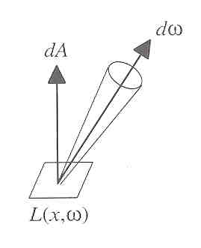
Radiance
Power per unit projected area perpendicular to the ray per unit solid angle in the direction of the ray
Symbol: L(x,ω) (W/m² sr)
Flux given by dΦ = L(x,ω) cos θ dω dA

Slide 24
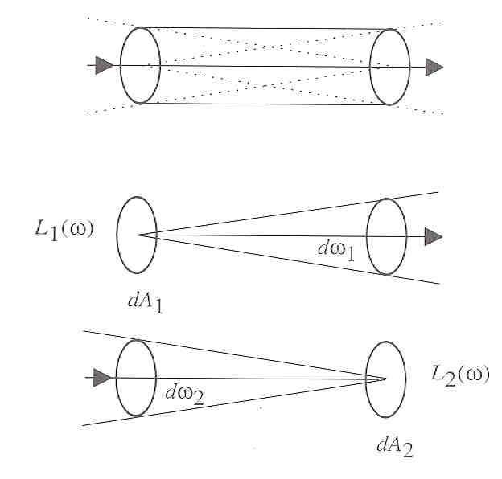
Radiance properties
Radiance constant as propagates along ray
Derived from conservation of flux
Fundamental in Light Transport.

Slide 27
Radiance properties
Sensor response proportional to radiance (constant of proportionality is throughput)
Far surface: See more, but subtend smaller angle
Wall equally bright across viewing distances
Consequences
Radiance associated with rays in a ray tracer
Other radiometric quants derived from radiance

Slide 28
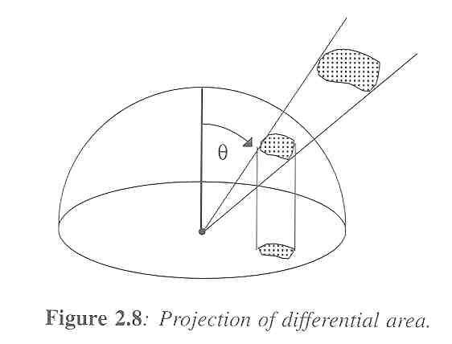
Irradiance, Radiosity
Irradiance E is radiant power per unit area
Integrate incoming radiance over hemisphere
Projected solid angle (cos θ dω)
Uniform illumination: Irradiance = π [CW 24,25]
Units: W/m²
Radiant Exitance (radiosity)
Power per unit area leaving surface (like irradiance)

Slide 32
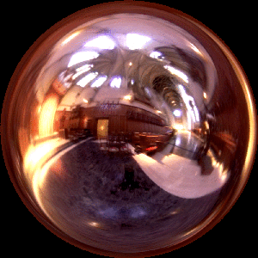
Irradiance Environment Maps
R
N
Incident Radiance
(Illumination Environment Map)
Irradiance Environment Map

Slide 35
Radiometry and Photometry
Physical measurement of electromagnetic energy
Measure spatial (and angular) properties of light
Radiant Power
Radiant Intensity
Irradiance
Inverse square and cosine law
Radiance
Radiant Exitance (Radiosity)
Reflection functions: Bi-Directional Reflectance Distribution Function or BRDF
Reflection Equation

Slide 39
Building up the BRDF
Bi-Directional Reflectance Distribution Function [Nicodemus 77]
Function based on incident, view direction
Relates incoming light energy to outgoing
Unifying framework for many materials

Slide 41
BRDF
Reflected Radiance proportional Irradiance
Constant proportionality: BRDF
Ratio of outgoing light (radiance) to incoming light (irradiance)
Bidirectional Reflection Distribution Function
(4 Vars) units 1/sr

Slide 44
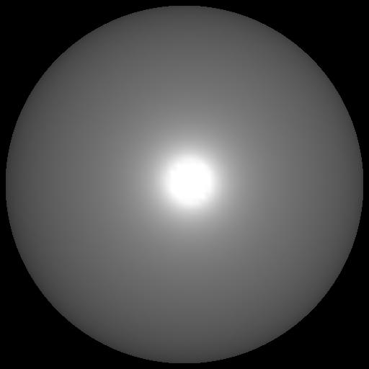
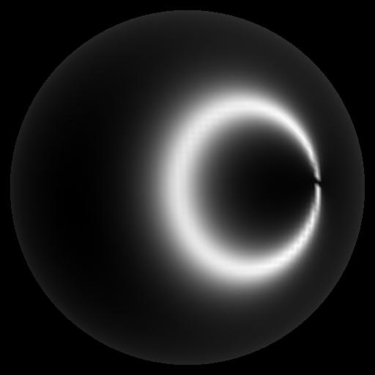
Isotropic vs Anisotropic
Isotropic: Most materials (you can rotate about normal without changing reflections)
Anisotropic: brushed metal etc. preferred tangential direction
Isotropic
Anisotropic

Slide 45
Radiometry and Photometry
Physical measurement of electromagnetic energy
Measure spatial (and angular) properties of light
Radiant Power
Radiant Intensity
Irradiance
Inverse square and cosine law
Radiance
Radiant Exitance (Radiosity)
Reflection functions: Bi-Directional Reflectance Distribution Function or BRDF
Reflection Equation (and simple BRDF models)

Slide 46
Reflection Equation
Reflected Light
(Output Image)
Emission
Incident
Light (from
light source)
BRDF
Cosine of
Incident angle

Slide 47
Reflection Equation
Sum over all light sources
Reflected Light
(Output Image)
Emission
Incident
Light (from
light source)
BRDF
Cosine of
Incident angle

Slide 48
Reflection Equation
Replace sum with integral
Reflected Light
(Output Image)
Emission
Incident
Light (from
light source)
BRDF
Cosine of
Incident angle

Slide 50
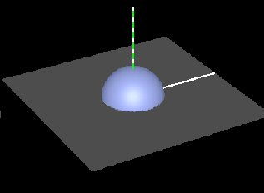
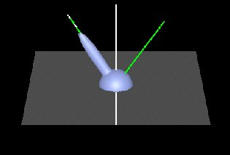
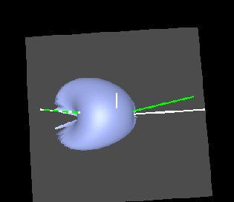
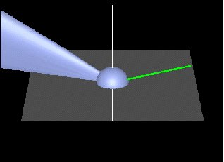
BRDF Viewer plots
Diffuse
Torrance-Sparrow
Anisotropic
bv written by Szymon Rusinkiewicz

Slide 55
Analytical BRDF: TS example
One famous analytically derived BRDF is the Torrance-Sparrow model
T-S is used to model specular surface, like Phong
more accurate than Phong
has more parameters that can be set to match different materials
derived based on assumptions of underlying geometry. (instead of ‘because it works well’)

Slide 56
Torrance-Sparrow
Assume the surface is made up grooves at microscopic level.
Assume the faces of these grooves (called microfacets) are perfect reflectors.
Take into account 3 phenomena
Shadowing
Masking
Interreflection

Slide 57
Torrance-Sparrow Result
Fresnel term:
allows for wavelength dependency
Geometric Attenuation:
reduces the output based on the amount of shadowing or masking that occurs.
Distribution:
distribution function determines what percentage of microfacets are oriented to reflect in the viewer direction.
How much of the macroscopic surface is visible to the light source
How much of the macroscopic surface is visible to the viewer

Slide 58
Other BRDF models
Empirical: Measure and build a 4D table
Anisotropic models for hair, brushed steel
Cartoon shaders, funky BRDFs
Capturing spatial variation
Very active area of research

Slide 59
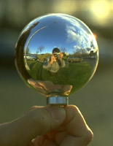
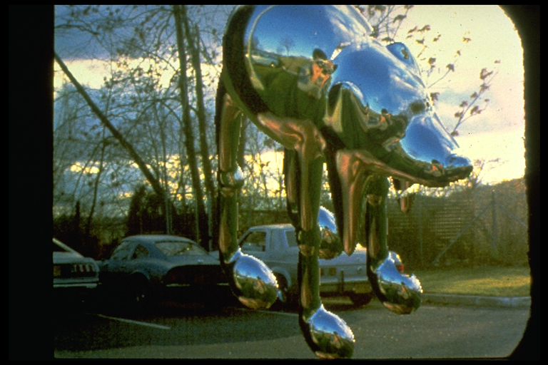
Environment Maps
Light as a function of direction, from entire environment
Captured by photographing a chrome steel or mirror sphere
Accurate only for one point, but distant lighting same at other scene locations (typically use only one env. map)
Blinn and Newell 1976, Miller and Hoffman, 1984
Later, Greene 86, Cabral et al. 87

Slide 60
Reflection Equation
Replace sum with integral
Reflected Light
(Output Image)
Emission
BRDF
Cosine of
Incident angle
Environment
Map (continuous)

Slide 61
Environment Maps
Environment maps widely used as lighting representation
Many modern methods deal with offline and real-time rendering with environment maps
Image-based complex lighting + complex BRDFs

Slide 62
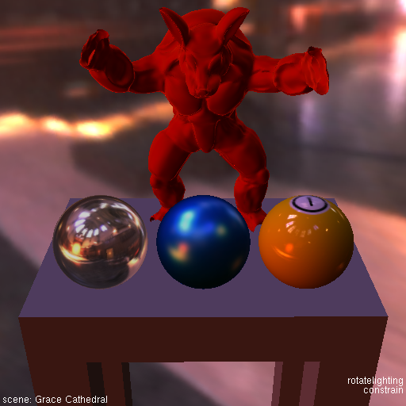
Demo

