Slide 1
Foundations of Computer Graphics (Fall 2012)
CS 184, Lecture 3: Transformations 1
http://inst.eecs.berkeley.edu/~cs184

Slide 2
To Do
Submit HW 0b
Start looking at HW 1 (simple, but need to think)
Axis-angle rotation and gluLookAt most useful
Probably only need final results, but try understanding derivations.
Problems in text help understanding material. Usually, we have review sessions per unit, but this one before midterm

Slide 3
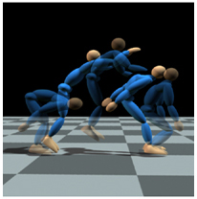
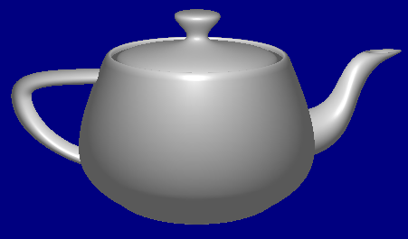
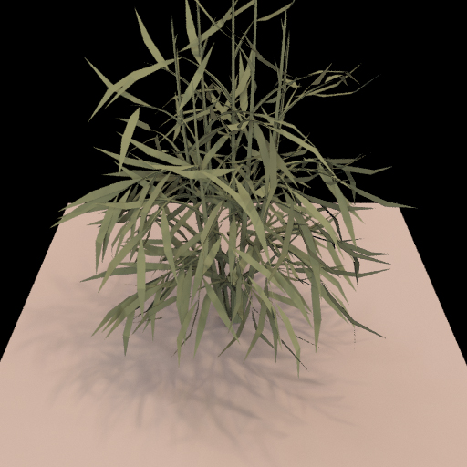
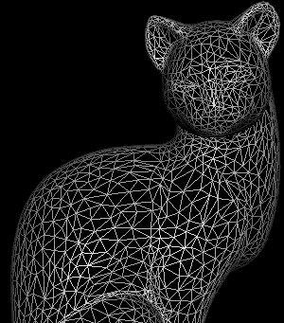
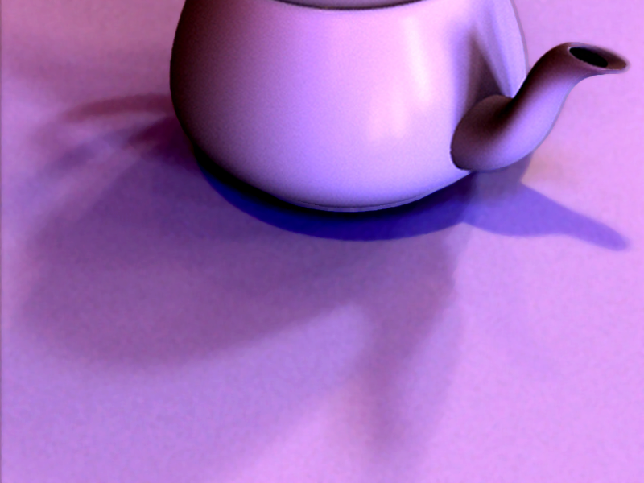
Course Outline
3D Graphics Pipeline
Modeling
Animation
Rendering

Slide 4
Course Outline
3D Graphics Pipeline
Modeling
Animation
Rendering
Unit 1: Transformations
Resizing and placing objects in the
world. Creating perspective images.
Weeks 1 and 2
Ass 1 due Sep 12 (DEMO)

Slide 5
Motivation
Many different coordinate systems in graphics
World, model, body, arms, …
To relate them, we must transform between them
Also, for modeling objects. I have a teapot, but
Want to place it at correct location in the world
Want to view it from different angles (HW 1)
Want to scale it to make it bigger or smaller
Demo of HW 1

Slide 6
Goals
This unit is about the math for these transformations
Represent transformations using matrices and matrix-vector multiplications.
Demos throughout lecture: HW 1 and Applet
Transformations Game Applet
Brown University Exploratories of Software
http://www.cs.brown.edu/exploratories/home.html
Credit: Andries Van Dam and Jean Laleuf

Slide 7
General Idea
Object in model coordinates
Transform into world coordinates
Represent points on object as vectors
Multiply by matrices
Demos with applet

Slide 8
Outline
2D transformations: rotation, scale, shear
Composing transforms
3D rotations
Translation: Homogeneous Coordinates (next time)
Transforming Normals (next time)

Slide 9
(Nonuniform) Scale
transformation_game.jar

Slide 10
Shear

Slide 11
Rotations
2D simple, 3D complicated. [Derivation? Examples?]
2D?
Linear
Commutative
R(X+Y)=R(X)+R(Y)
transformation_game.jar

Slide 12
Outline
2D transformations: rotation, scale, shear
Composing transforms
3D rotations
Translation: Homogeneous Coordinates
Transforming Normals

Slide 13
Composing Transforms
Often want to combine transforms
E.g. first scale by 2, then rotate by 45 degrees
Advantage of matrix formulation: All still a matrix
Not commutative!! Order matters

Slide 14
E.g. Composing rotations, scales
transformation_game.jar

Slide 15
Inverting Composite Transforms
Say I want to invert a combination of 3 transforms
Option 1: Find composite matrix, invert
Option 2: Invert each transform and swap order
Obvious from properties of matrices
transformation_game.jar

Slide 16
Outline
2D transformations: rotation, scale, shear
Composing transforms
3D rotations
Translation: Homogeneous Coordinates
Transforming Normals

Slide 17
Rotations
Review of 2D case
Orthogonal?,

Slide 18
Rotations in 3D
Rotations about coordinate axes simple
Always linear, orthogonal
Rows/cols orthonormal
R(X+Y)=R(X)+R(Y)

Slide 19
Geometric Interpretation 3D Rotations
Rows of matrix are 3 unit vectors of new coord frame
Can construct rotation matrix from 3 orthonormal vectors

Slide 20
Geometric Interpretation 3D Rotations
Rows of matrix are 3 unit vectors of new coord frame
Can construct rotation matrix from 3 orthonormal vectors
Effectively, projections of point into new coord frame
New coord frame uvw taken to cartesian components xyz
Inverse or transpose takes xyz cartesian to uvw

Slide 21
Non-Commutativity
Not Commutative (unlike in 2D)!!
Rotate by x, then y is not same as y then x
Order of applying rotations does matter
Follows from matrix multiplication not commutative
R1 * R2 is not the same as R2 * R1
Demo: HW1, order of right or up will matter

Slide 22
Arbitrary rotation formula
Rotate by an angle θ about arbitrary axis a
Homework 1: must rotate eye, up direction
Somewhat mathematical derivation but useful formula
Problem setup: Rotate vector b by θ about a
Helpful to relate b to X, a to Z, verify does right thing
For HW1, you probably just need final formula

Slide 23
Axis-Angle formula
Step 1: b has components parallel to a, perpendicular
Parallel component unchanged (rotating about an axis leaves that axis unchanged after rotation, e.g. rot about z)
Step 2: Define c orthogonal to both a and b
Analogous to defining Y axis
Use cross products and matrix formula for that
Step 3: With respect to the perpendicular comp of b
Cos θ of it remains unchanged
Sin θ of it projects onto vector c
Verify this is correct for rotating X about Z
Verify this is correct for θ as 0, 90 degrees

Slide 24
Axis-Angle: Putting it together
Unchanged
(cosine)
Component
along a
(hence unchanged)
Perpendicular
(rotated comp)

Slide 25
Axis-Angle: Putting it together
(x y z) are cartesian components of a

