Slide 1
Foundations of Computer Graphics (Fall 2012)
CS 184, Lecture 7: OpenGL Shading
http://inst.eecs.berkeley.edu/~cs184

Slide 2
To Do
This week’s lectures have all info for HW 2
Start thinking about HW 4

Slide 3
Methodology for Lecture
Lecture deals with lighting (DEMO for HW 2)
Briefly explain shaders used for mytest3
Do this before explaining code fully so you can start HW 2
Primarily explain with reference to source code
More formal look at lighting and shading later in class
Based on physical units and radiometry

Slide 4
Demo for mytest3
Lighting on teapot
Blue, red highlights
Diffuse shading
Texture on floor
Update as we move

Slide 5
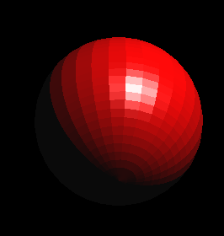
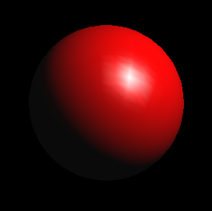
Importance of Lighting
Important to bring out 3D appearance (compare teapot now to in previous demo)
Important for correct shading under lights
The way shading is done also important
Flat: Entire face has single color (normal) from one vertex
Gouraud or smooth: Colors at each vertex, interpolate
glShadeModel(GL_FLAT)
glShadeModel(GL_SMOOTH)

Slide 6
Brief primer on Color
Red, Green, Blue primary colors
Can be thought of as vertices of a color cube
R+G = Yellow, B+G = Cyan, B+R = Magenta, R+G+B = White
Each color channel (R,G,B) treated separately
RGBA 32 bit mode (8 bits per channel) often used
A is for alpha for transparency if you need it
Colors normalized to 0 to 1 range in OpenGL
Often represented as 0 to 255 in terms of pixel intensities
Also, color index mode (not so important)
More next week

Slide 7
Outline
Gouraud and Phong shading (vertex vs fragment)
Types of lighting, materials and shading
Lights: Point and Directional
Shading: Ambient, Diffuse, Emissive, Specular
Fragment shader for mytest3
HW 2 requires a more general version of this
Source code in display routine

Slide 8
Vertex vs Fragment Shaders
Can use vertex or fragment shaders for lighting
Vertex computations interpolated by rasterizing
Gouraud (smooth) shading, as in mytest1
Flat shading: no interpolation (single color of polygon)
Either compute colors at vertices, interpolate
This is standard in old-style OpenGL
Can be implemented with vertex shaders
Or interpolate normals etc. at vertices
And then shade at each pixel in fragment shader
Phong shading (different from Phong illumination)
More accurate
Wireframe: glPolygonMode (GL_FRONT, GL_LINE)
Also, polygon offsets to superimpose wireframe
Hidden line elimination? (polygons in black…)

Slide 9
Gouraud Shading – Details
Scan line
Actual implementation efficient: difference
equations while scan converting

Slide 10
Gouraud and Errors
I₁ = 0 because (N dot E) is negative.
I₂ = 0 because (N dot L) is negative.
Any interpolation of I₁ and I₂ will be 0.
I₁ = 0
I₂ = 0
area of desired highlight

Slide 11
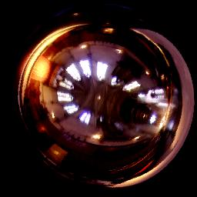
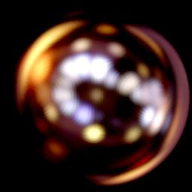
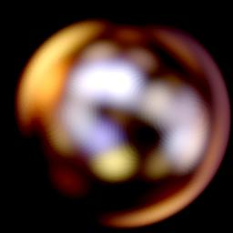
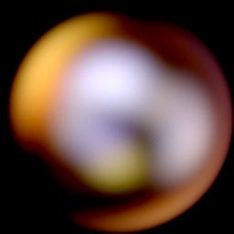
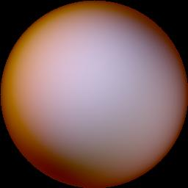
Phong Illumination Model
Specular or glossy materials: highlights
Polished floors, glossy paint, whiteboards
For plastics highlight is color of light source (not object)
For metals, highlight depends on surface color
Really, (blurred) reflections of light source
Roughness

Slide 12
2 Phongs make a Highlight
Besides the Phong Illumination or Reflectance model, there is a Phong Shading model.
Phong Shading: Instead of interpolating the intensities between vertices, interpolate the normals.
The entire lighting calculation is performed for each pixel, based on the interpolated normal. (Old OpenGL doesn’t do this, but you can and will with current fragment shaders)
I₁ = 0
I₂ = 0

Slide 13
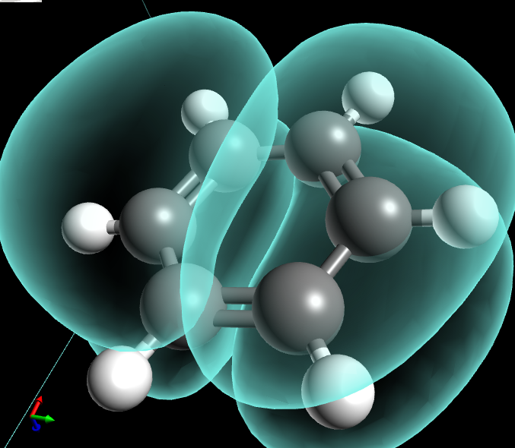
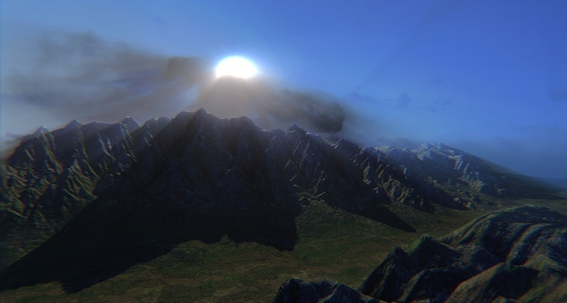
Examples and Color Plates
See OpenGL color plates 1-8 and glsl book
http://blog.cryos.net/categories/15-Avogadro/P3.html
http://blenderartists.org/forum/showthread.php?11430-Games-amp-Tutorials-(updated-Jan-5-2011)

Slide 14
Simple Vertex Shader in mytest3
# version 120
// Mine is an old machine. For version 130 or higher, do
// out vec4 color ;
// out vec4 mynormal ;
// out vec4 myvertex ;
// That is certainly more modern
varying vec4 color ;
varying vec3 mynormal ;
varying vec4 myvertex ;
void main() {
gl_TexCoord[0] = gl_MultiTexCoord0 ;
gl_Position = gl_ProjectionMatrix * gl_ModelViewMatrix * gl_Vertex ;
color = gl_Color ;
mynormal = gl_Normal ;
myvertex = gl_Vertex ; }

Slide 15
Outline
Gouraud and Phong shading (vertex vs fragment)
Types of lighting, materials and shading
Lights: Point and Directional
Shading: Ambient, Diffuse, Emissive, Specular
Fragment shader for mytest3
HW 2 requires a more general version of this
Source code in display routine

Slide 16
Lighting and Shading
Rest of this lecture considers lighting
In real world, complex lighting, materials interact
We study this more formally later in class
For now some basic approximations to capture key effects in lighting and shading
Inspired by old OpenGL fixed function pipeline
But remember that’s not physically based

Slide 17
Types of Light Sources
Point
Position, Color
Attenuation (quadratic model)
Attenuation
Usually assume no attenuation (not physically correct)
Quadratic inverse square falloff for point sources
Linear falloff for line sources (tube lights). Why?
No falloff for distant (directional) sources. Why?
Directional (w=0, infinite far away, no attenuation)
Spotlights (not considered in homework)
Spot exponent
Spot cutoff

Slide 18
Material Properties
Need normals (to calculate how much diffuse, specular, find reflected direction and so on)
Usually specify at each vertex, interpolate
GLUT does it automatically for teapots etc
Can do manually for parametric surfaces
Average face normals for more complex shapes
Four terms: Ambient, Diffuse, Specular, Emissive

Slide 19
Emissive Term
Only relevant for light sources when looking directly at them
Gotcha: must create geometry to actually see light
Emission does not in itself affect other lighting calculations

Slide 20
Ambient Term
Hack to simulate multiple bounces, scattering of light
Assume light equally from all directions
Global constant
Never have black pixels

Slide 21
Diffuse Term
Rough matte (technically Lambertian) surfaces
Light reflects equally in all directions
N
-L

Slide 22
Diffuse Term
Rough matte (technically Lambertian) surfaces
Light reflects equally in all directions
N
-L

Slide 23
Specular Term
Glossy objects, specular reflections
Light reflects close to mirror direction

Slide 24
Phong Illumination Model
Specular or glossy materials: highlights
Polished floors, glossy paint, whiteboards
For plastics highlight is color of light source (not object)
For metals, highlight depends on surface color
Really, (blurred) reflections of light source
Roughness

Slide 25
Idea of Phong Illumination
Find a simple way to create highlights that are view-dependent and happen at about the right place
Not physically based
Use dot product (cosine) of eye and reflection of light direction about surface normal
Alternatively, dot product of half angle and normal
Has greater physical backing. We use this form
Raise cosine lobe to some power to control sharpness or roughness

Slide 26
Phong Formula
R
-L
E

Slide 27
Alternative: Half-Angle (Blinn-Phong)
Diffuse and specular components for most materials
N
H

Slide 28
Demo in mytest3
What happens when we make surface less shiny?

Slide 29
Outline
Gouraud and Phong shading (vertex vs fragment)
Types of lighting, materials and shading
Lights: Point and Directional
Shading: Ambient, Diffuse, Emissive, Specular
Fragment shader for mytest3
HW 2 requires a more general version of this
Source code in display routine

Slide 30
Fragment Shader Setup
# version 120
// Mine is an old machine. For version 130 or higher, do
// in vec4 color ;
// in vec4 mynormal ;
// in vec4 myvertex ;
// That is certainly more modern
attribute vec4 color ;
attribute vec3 mynormal ;
attribute vec4 myvertex ;
uniform sampler2D tex ;
uniform int istex ;
uniform int islight ; // are we lighting.

Slide 31
Fragment Shader Variables
// Assume light 0 is directional, light 1 is a point light.
// Actual light values are passed from the main OpenGL program.
// This could of course be fancier. Illustrates a simple idea.
uniform vec3 light0dirn ;
uniform vec4 light0color ;
uniform vec4 light1posn ;
uniform vec4 light1color ;
// Now, set the material parameters. These could be varying or
// bound to a buffer. But for now, I'll just make them uniform.
// I use ambient, diffuse, specular, shininess as in OpenGL.
// But, ambient is just additive and doesn't multiply the lights.
uniform vec4 ambient ;
uniform vec4 diffuse ;
uniform vec4 specular ;
uniform float shininess ;

Slide 32
Fragment Shader Compute Lighting
vec4 ComputeLight (const in vec3 direction, const in vec4 lightcolor, const in vec3 normal, const in vec3 halfvec, const in vec4 mydiffuse, const in vec4 myspecular, const in float myshininess) {
float nDotL = dot(normal, direction) ;
vec4 lambert = mydiffuse * lightcolor * max (nDotL, 0.0) ;
float nDotH = dot(normal, halfvec) ;
vec4 phong = myspecular * lightcolor * pow (max(nDotH, 0.0), myshininess) ;
vec4 retval = lambert + phong ;
return retval ;
}

Slide 33
Fragment Shader Main Transforms
void main (void) {
if (istex > 0) gl_FragColor = texture2D(tex, gl_TexCoord[0].st) ;
else if (islight == 0) gl_FragColor = color ;
else {
// They eye is always at (0,0,0) looking down -z axis
// Also compute current fragment posn, direction to eye
const vec3 eyepos = vec3(0,0,0) ;
vec4 _mypos = gl_ModelViewMatrix * myvertex ;
vec3 mypos = _mypos.xyz / _mypos.w ; // Dehomogenize
vec3 eyedirn = normalize(eyepos - mypos) ;
// Compute normal, needed for shading.
// Simpler is vec3 normal = normalize(gl_NormalMatrix * mynormal)
vec3 _normal = (gl_ModelViewMatrixInverseTranspose*vec4(mynormal,0.0)).xyz ;
vec3 normal = normalize(_normal) ;

Slide 34
Fragment Shader Main Routine
// Light 0, directional
vec3 direction0 = normalize (light0dirn) ;
vec3 half0 = normalize (direction0 + eyedirn) ;
vec4 col0 = ComputeLight(direction0, light0color, normal, half0, diffuse, specular, shininess) ;
// Light 1, point
vec3 position = light1posn.xyz / light1posn.w ;
vec3 direction1 = normalize (position - mypos) ; // no atten.
vec3 half1 = normalize (direction1 + eyedirn) ;
vec4 col1 = ComputeLight(direction1, light1color, normal, half1, diffuse, specular, shininess) ;
gl_FragColor = ambient + col0 + col1 ;
}
}

Slide 35
Outline
Gouraud and Phong shading (vertex vs fragment)
Types of lighting, materials and shading
Lights: Point and Directional
Shading: Ambient, Diffuse, Emissive, Specular
Fragment shader for mytest3
HW 2 requires a more general version of this
Source code in display routine

Slide 36
Light Set Up (in display)
/* New for Demo 3; add lighting effects */
{
const GLfloat one[] = {1,1,1,1} ;
const GLfloat medium[] = {0.5, 0.5, 0.5, 1};
const GLfloat small[] = {0.2, 0.2, 0.2, 1};
const GLfloat high[] = {100} ;
const GLfloat zero[] = {0.0, 0.0, 0.0, 1.0} ;
const GLfloat light_specular[] = {1, 0.5, 0, 1};
const GLfloat light_specular1[] = {0, 0.5, 1, 1};
const GLfloat light_direction[] = {0.5, 0, 0, 0}; // Dir lt
const GLfloat light_position1[] = {0, -0.5, 0, 1};
GLfloat light0[4], light1[4] ;
// Set Light and Material properties for the teapot
// Lights are transformed by current modelview matrix.
// The shader can't do this globally. So we do so manually.
transformvec(light_direction, light0) ;
transformvec(light_position1, light1) ;

Slide 37
Moving a Light Source
Lights transform like other geometry
Only modelview matrix (not projection). The only real application where the distinction is important
Types of light motion
Stationary: set the transforms to identity before specifying it
Moving light: Push Matrix, move light, Pop Matrix
Moving light source with viewpoint (attached to camera). Can simply set light to 0 0 0 so origin wrt eye coords (make modelview matrix identity before doing this)

Slide 38
Modelview Light Transform
Could also use GLM (but careful of conventions)
/* New helper transformation function to transform vector by modelview */
void transformvec (const GLfloat input[4], GLfloat output[4]) {
GLfloat modelview[16] ; // in column major order
glGetFloatv(GL_MODELVIEW_MATRIX, modelview) ;
for (int i = 0 ; i < 4 ; i++) {
output[i] = 0 ;
for (int j = 0 ; j < 4 ; j++)
output[i] += modelview[4*j+i] * input[j] ;
}
}

Slide 39
Set up Lighting for Teapot
glUniform3fv(light0dirn, 1, light0) ;
glUniform4fv(light0color, 1, light_specular) ;
glUniform4fv(light1posn, 1, light1) ;
glUniform4fv(light1color, 1, light_specular1) ;
// glUniform4fv(light1color, 1, zero) ;
glUniform4fv(ambient,1,small) ;
glUniform4fv(diffuse,1,medium) ;
glUniform4fv(specular,1,one) ;
glUniform1fv(shininess,1,high) ;
// Enable and Disable everything around the teapot
// Generally, we would also need to define normals etc.
// But glut already does this for us
if (DEMO > 4)
glUniform1i(islight,lighting) ; // lighting only teapot.

Slide 40
Shader Mappings in init
vertexshader = initshaders(GL_VERTEX_SHADER, "shaders/light.vert") ;
fragmentshader = initshaders(GL_FRAGMENT_SHADER, "shaders/light.frag") ;
shaderprogram = initprogram(vertexshader, fragmentshader) ;
// * NEW * Set up the shader parameter mappings properly for lighting.
islight = glGetUniformLocation(shaderprogram,"islight") ;
light0dirn = glGetUniformLocation(shaderprogram,"light0dirn") ;
light0color = glGetUniformLocation(shaderprogram,"light0color") ;
light1posn = glGetUniformLocation(shaderprogram,"light1posn") ;
light1color = glGetUniformLocation(shaderprogram,"light1color") ;
ambient = glGetUniformLocation(shaderprogram,"ambient") ;
diffuse = glGetUniformLocation(shaderprogram,"diffuse") ;
specular = glGetUniformLocation(shaderprogram,"specular") ;
shininess = glGetUniformLocation(shaderprogram,"shininess") ;

