Slide 1
Foundations of Computer Graphics (Fall 2012)
CS 184, Lecture 8: OpenGL 2
http://inst.eecs.berkeley.edu/~cs184

Slide 2
To Do
Continue working on HW 2. Can be difficult
Class lectures, programs primary source
Can leverage many sources (GL(SL) book, excellent online documentation, see links class website)
It is a good idea to copy (and modify) relevant segments
(Very) tough to get started, but lots of fun afterwards

Slide 3
Methodology for Lecture
Make mytest1 more ambitious
Sequence of steps
Demo

Slide 4
Review of Last Demo
Changed floor to all white, added global for teapot and teapotloc, moved geometry to new header file
Demo 0 [set DEMO to 4 all features]
#include <GL/glut.h>
#include “shaders.h”
#include “geometry.h”
int mouseoldx, mouseoldy ; // For mouse motion
GLdouble eyeloc = 2.0 ; // Where to look from; initially 0 -2, 2
GLfloat teapotloc = -0.5 ; // ** NEW ** where the teapot is located
GLint animate = 0 ; // ** NEW ** whether to animate or not
GLuint vertexshader, fragmentshader, shaderprogram ; // shaders
const int DEMO = 0 ; // ** NEW ** To turn on and off features

Slide 5
Outline
Review of demo from last lecture
Basic geometry setup for cubes (pillars), colors
Single geometric object, but multiple colors for pillars
Matrix Stacks and Transforms (draw 4 pillars)
Depth testing (Z-buffering)
Animation (moving teapot)
Texture Mapping (wooden floor)
Best source for OpenGL is the red book and GLSL book. Of course, this is more a reference manual than a textbook, and you are better off implementing rather reading end to end.

Slide 6
Geometry Basic Setup
const int numobjects = 2 ; // number of objects for buffer
const int numperobj = 3 ;
const int ncolors = 4 ;
GLuint buffers[numperobj*numobjects+ncolors] ; // ** NEW ** List of buffers for geometric data
GLuint objects[numobjects] ; // For each object
GLenum PrimType[numobjects] ;
GLsizei NumElems[numobjects] ;
// Floor Geometry is specified with a vertex array
// Same for other Geometry (Cube)
// The Buffer Offset Macro is from Red Book, page 103, 106
#define BUFFER_OFFSET(bytes) ((GLubyte *) NULL + (bytes))
#define NumberOf(array) (sizeof(array)/sizeof(array[0]))
enum {Vertices, Colors, Elements} ; // For arrays for object
enum {FLOOR, CUBE} ; // For objects, for the floor

Slide 7
Cube geometry (for pillars)
const GLfloat wd = 0.1 ;
const GLfloat ht = 0.5 ;
const GLfloat _cubecol[4][3] = {
{1.0, 0.0, 0.0}, {0.0, 1.0, 0.0}, {0.0, 0.0, 1.0}, {1.0, 1.0, 0.0} } ;
const GLfloat cubeverts[8][3] = {
{-wd, -wd, 0.0}, {-wd, wd, 0.0}, {wd, wd, 0.0}, {wd, -wd, 0.0},
{-wd, -wd, ht}, {wd, -wd, ht}, {wd, wd, ht}, {-wd, wd, ht}
} ;
GLfloat cubecol[8][3] ;
const GLubyte cubeinds[6][4] = {
{0, 1, 2, 3}, // BOTTOM
{4, 5, 6, 7}, // TOP
{0, 4, 7, 1}, // LEFT
{0, 3, 5, 4}, // FRONT
{3, 2, 6, 5}, // RIGHT
{1, 7, 6, 2} // BACK
} ;

Slide 8
Cube Geometry (separate Color)
// Simple function to set the color separately. Takes out colors
void initobjectnocol(GLuint object, GLfloat * vert, GLint sizevert, GLubyte * inds, GLint sizeind, GLenum type) {
int offset = object * numperobj ;
glBindBuffer(GL_ARRAY_BUFFER, buffers[Vertices+offset]) ;
glBufferData(GL_ARRAY_BUFFER, sizevert, vert,GL_STATIC_DRAW);
glVertexPointer(3, GL_FLOAT, 0, BUFFER_OFFSET(0)) ;
glEnableClientState(GL_VERTEX_ARRAY) ;
glBindBuffer(GL_ELEMENT_ARRAY_BUFFER,buffers[Elements+offset]) ;
glBufferData(GL_ELEMENT_ARRAY_BUFFER, sizeind, inds,GL_STATIC_DRAW);
PrimType[object] = type ;
NumElems[object] = sizeind ;
}

Slide 9
Cube Colors
// Simple function to init a bunch of color buffers for the cube
void initcolorscube (void) {
int base = numobjects * numperobj ;
for (int i = 0 ; i < ncolors ; i++) {
for (int j = 0 ; j < 8 ; j++)
for (int k = 0 ; k < 3 ; k++)
cubecol[j][k] = _cubecol[i][k] ;
glBindBuffer(GL_ARRAY_BUFFER, buffers[base+i]) ;
glBufferData(GL_ARRAY_BUFFER, sizeof(cubecol), cubecol ,GL_STATIC_DRAW);
glColorPointer(3, GL_FLOAT, 0, BUFFER_OFFSET(0)) ;
glEnableClientState(GL_COLOR_ARRAY) ;
}
}
//in init
initobjectnocol(CUBE, (GLfloat *) cubeverts, sizeof(cubeverts), (GLubyte *) cubeinds, sizeof (cubeinds), GL_QUADS) ;

Slide 10
Drawing with Cube Colors
// And a function to draw with them, similar to drawobject but with color
void drawcolor(GLuint object, GLuint color) {
int offset = object * numperobj ;
int base = numobjects * numperobj ;
glBindBuffer(GL_ARRAY_BUFFER, buffers[Vertices+offset]) ;
glVertexPointer(3, GL_FLOAT, 0, BUFFER_OFFSET(0)) ;
glEnableClientState(GL_VERTEX_ARRAY) ;
glBindBuffer(GL_ARRAY_BUFFER, buffers[base+color]) ; // Set color
glColorPointer(3, GL_FLOAT, 0, BUFFER_OFFSET(0)) ;
glEnableClientState(GL_COLOR_ARRAY) ;
glBindBuffer(GL_ELEMENT_ARRAY_BUFFER, buffers[Elements+offset]) ;
glDrawElements(PrimType[object], NumElems[object], GL_UNSIGNED_BYTE, BUFFER_OFFSET(0)) ;
}

Slide 11
Outline
Review of demo from last lecture
Basic geometry setup for cubes (pillars), colors
Single geometric object, but multiple colors for pillars
Matrix Stacks and Transforms (draw 4 pillars)
Depth testing (Z-buffering)
Animation (moving teapot)
Texture Mapping (wooden floor)
Best source for OpenGL is the red book and GLSL book. Of course, this is more a reference manual than a textbook, and you are better off implementing rather reading end to end.

Slide 12
Summary OpenGL Vertex Transforms
Object coords
(x y z w)^{t} vertex
Clip coordinates
Perspective Divide
(Dehomogenization)
Normalized Device
Coordinates
Modelview matrix
[Object Transforms
and glm::lookAt]
Viewport Transform
(glViewport)
Eye coordinates
(used for lighting)
Projection matrix
[3D to 2D, usually
glm::perspective]
Window Coords

Slide 13
Transformations
Matrix Stacks
glPushMatrix, glPopMatrix, glLoad, glMultMatrixf
Useful for hierarchically defined figures, placing pillars
Mytest2 uses old-style stacks. Current recommendation is STL stacks managed yourself. (You must manage the stack yourself for HW 2).
Transforms
Write your own translate, scale, rotate for HW 1 and HW 2
Careful of OpenGL convetion: In old-style, Right-multiply current matrix (last is first applied). glm operators follow this sometimes.
Also gluLookAt (glm::lookAt), gluPerspective (glm::perspective)
Remember gluLookAt just matrix like any other transform, affecting modelview
Must come before in code, after in action to other transforms
Why not usually an issue for gluPerspective?

Slide 14
Drawing Pillars 1 (in display)
glMatrixMode(GL_MODELVIEW) ;
// 1st pillar
glPushMatrix() ;
glTranslatef(-0.4,-0.4,0.0) ;
drawcolor(CUBE, 0) ;
glPopMatrix() ;
// 2nd pillar
glPushMatrix() ;
glTranslatef(0.4,-0.4,0.0) ;
drawcolor(CUBE, 1) ;
glPopMatrix() ;

Slide 15
Drawing Pillars 2
// 3rd pillar
glPushMatrix() ;
glTranslatef(0.4,0.4,0.0) ;
drawcolor(CUBE, 2) ;
glPopMatrix() ;
// 4th pillar
glPushMatrix() ;
glTranslatef(-0.4,0.4,0.0) ;
drawcolor(CUBE, 3) ;
glPopMatrix() ;

Slide 16
Demo
Demo 1
Does order of drawing matter?
What if I move floor after pillars in code?
Is this desirable? If not, what can I do about it?

Slide 17
Outline
Review of demo from last lecture
Basic geometry setup for cubes (pillars), colors
Single geometric object, but multiple colors for pillars
Matrix Stacks and Transforms (draw 4 pillars)
Depth testing (Z-buffering)
Animation (moving teapot)
Texture Mapping (wooden floor)
Best source for OpenGL is the red book and GLSL book. Of course, this is more a reference manual than a textbook, and you are better off implementing rather reading end to end.

Slide 18
Double Buffering
New primitives draw over (replace) old objects
Can lead to jerky sensation
Solution: double buffer. Render into back (offscreen) buffer. When finished, swap buffers to display entire image at once.
Changes in main and display
glutInitDisplayMode (GLUT_DOUBLE | GLUT_RGB | GLUT_DEPTH);
glutSwapBuffers() ;
glFlush ();

Slide 19
Turning on Depth test (Z-buffer)
OpenGL uses a Z-buffer for depth tests
For each pixel, store nearest Z value (to camera) so far
If new fragment is closer, it replaces old z, color [“less than” can be over-ridden in fragment program]
Simple technique to get accurate visibility
(Be sure you know what fragments and pixels are)
Changes in main fn, display to Z-buffer
glutInitDisplayMode (GLUT_SINGLE | GLUT_RGB | GLUT_DEPTH);
glClear (GL_COLOR_BUFFER_BIT | GL_DEPTH_BUFFER_BIT);
In init function
glEnable(GL_DEPTH_TEST) ;
glDepthFunc(GL_LESS) ; // The default option

Slide 20
Demo
Demo 2
Does order of drawing matter any more?
What if I change near plane to 0?
Is this desirable? If not, what can I do about it?

Slide 21
Outline
Review of demo from last lecture
Basic geometry setup for cubes (pillars), colors
Single geometric object, but multiple colors for pillars
Matrix Stacks and Transforms (draw 4 pillars)
Depth testing (Z-buffering)
Animation (moving teapot)
Texture Mapping (wooden floor)
Best source for OpenGL is the red book and GLSL book. Of course, this is more a reference manual than a textbook, and you are better off implementing rather reading end to end.

Slide 22
Demo
Demo 3
Notice how teapot cycles around
And that I can pause and restart animation
And do everything else (zoom etc.) while teapot moves in background

Slide 23
Drawing Teapot (in display)
// ** NEW ** Put a teapot in the middle that animates
glColor3f(0.0,1.0,1.0) ; // Deprecated command to set the color
glPushMatrix() ;
// I now transform by the teapot translation for animation */
glTranslatef(teapotloc, 0.0, 0.0) ;
// The following two transforms set up and center the teapot
// Remember that transforms right-multiply the stack
glTranslatef(0.0,0.0,0.1) ;
glRotatef(90.0,1.0,0.0,0.0) ;
glutSolidTeapot(0.15) ;
glPopMatrix() ;

Slide 24
Simple Animation routine
// ** NEW ** in this assignment, is an animation of a teapot
// Hitting p will pause this animation; see keyboard callback
void animation(void) {
teapotloc = teapotloc + 0.005 ;
if (teapotloc > 0.5) teapotloc = -0.5 ;
glutPostRedisplay() ;
}

Slide 25
Keyboard callback (p to pause)
GLint animate = 0 ; // ** NEW ** whether to animate or not
void keyboard (unsigned char key, int x, int y)
{
switch (key) {
case 27: // Escape to quit
exit(0) ;
break ;
case 'p': // ** NEW ** to pause/restart animation
animate = !animate ;
if (animate) glutIdleFunc(animation) ;
else glutIdleFunc(NULL) ;
break ;
default:
break ;
}
}

Slide 26
Outline
Review of demo from last lecture
Display lists (extend init for pillars)
Matrix stacks and transforms (draw 4 pillars)
Depth testing or z-buffering
Animation (moving teapot)
Texture mapping (wooden floor) [mytest3]

Slide 27
New globals and basic setup
GLubyte woodtexture[256][256][3] ; // texture (from grsites.com)
GLuint texNames[1] ; // texture buffer
GLuint istex ; // blend parameter for texturing
GLuint islight ; // for lighting
GLint texturing = 1 ; // to turn on/off texturing
GLint lighting = 1 ; // to turn on/off lighting
// In Display
glUniform1i(islight,0) ; // Turn off lighting (except on teapot, later)
glUniform1i(istex,texturing) ;
drawtexture(FLOOR,texNames[0]) ; // Texturing floor
// drawobject(FLOOR) ;
glUniform1i(istex,0) ; // Other items aren't textured

Slide 28
Simple Toggles for Keyboard
case 't': // ** NEW ** to turn on/off texturing ;
texturing = !texturing ;
glutPostRedisplay() ;
break ;
case 's': // ** NEW ** to turn on/off shading (always smooth) ;
lighting = !lighting ;
glutPostRedisplay() ;
break ;

Slide 29
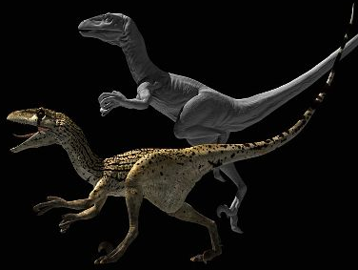
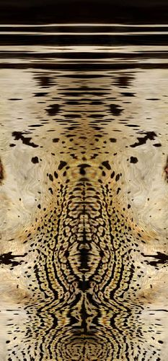
Adding Visual Detail
Basic idea: use images instead of more polygons to represent fine scale color variation

Slide 30
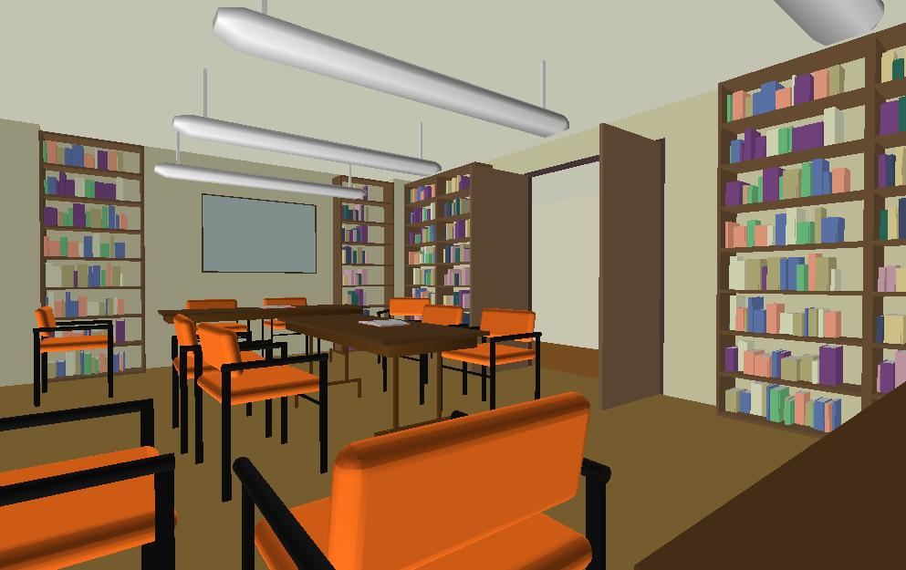
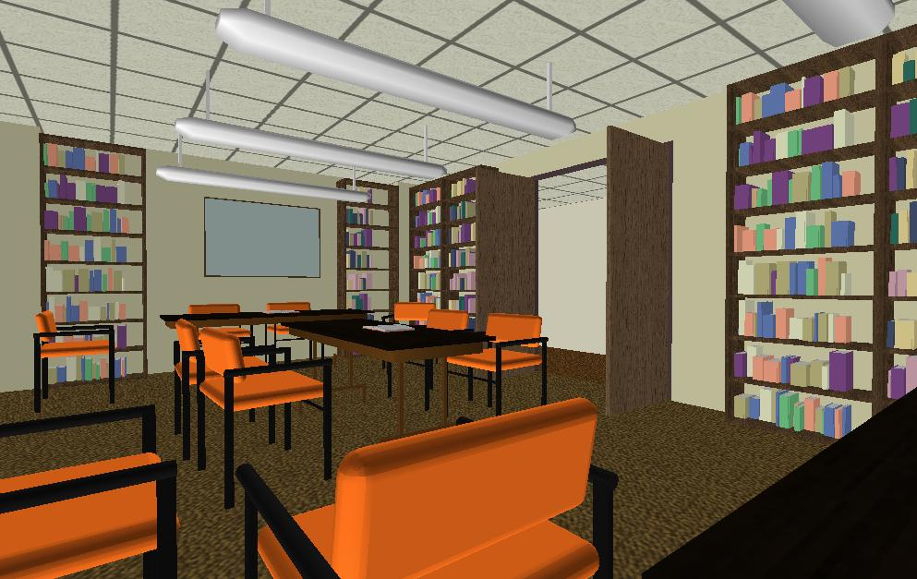
Texture Mapping
Important topic: nearly all objects textured
Wood grain, faces, bricks and so on
Adds visual detail to scenes
Can be added in a fragment shader
Polygonal model
With surface texture

Slide 31
Setting up texture
inittexture("wood.ppm", shaderprogram) ; // in init()
// Very basic code to read a ppm file
// And then set up buffers for texture coordinates
void inittexture (const char * filename, GLuint program) {
int i,j,k ;
FILE * fp ;
GLint err ;
assert(fp = fopen(filename,"rb")) ;
fscanf(fp,"%*s %*d %*d %*d%*c") ;
for (i = 0 ; i < 256 ; i++)
for (j = 0 ; j < 256 ; j++)
for (k = 0 ; k < 3 ; k++)
fscanf(fp,"%c",&(woodtexture[i][j][k])) ;
fclose(fp) ;

Slide 32
Texture Coordinates
Each vertex must have a texture coordinate: pointer to texture. Interpolate for pixels (each fragment has st)
// Set up Texture Coordinates
glGenTextures(1, texNames) ;
glBindBuffer(GL_ARRAY_BUFFER, buffers[numobjects*numperobj+ncolors]) ;
glBufferData(GL_ARRAY_BUFFER, sizeof (floortex), floortex,GL_STATIC_DRAW);
glActiveTexture(GL_TEXTURE0) ;
glEnable(GL_TEXTURE_2D) ;
glTexCoordPointer(2,GL_FLOAT,0,BUFFER_OFFSET(0)) ;
glEnableClientState(GL_TEXTURE_COORD_ARRAY) ;
glBindTexture (GL_TEXTURE_2D, texNames[0]) ;

Slide 33
Specifying the Texture Image
glTexImage2D( target, level, components, width height, border, format, type, data )
target is GL_TEXTURE_2D
level is (almost always) 0
components = 3 or 4 (RGB/RGBA)
width/height MUST be a power of 2
border = 0 (usually)
format = GL_RGB or GL_RGBA (usually)
type = GL_UNSIGNED_BYTE, GL_FLOAT, etc…

Slide 34
Texture Image and Bind to Shader
glTexImage2D(GL_TEXTURE_2D,0,GL_RGB, 256, 256, 0, GL_RGB, GL_UNSIGNED_BYTE, woodtexture) ;
glTexParameterf(GL_TEXTURE_2D, GL_TEXTURE_MAG_FILTER, GL_LINEAR) ;
glTexParameterf(GL_TEXTURE_2D, GL_TEXTURE_MIN_FILTER, GL_LINEAR) ;
glTexParameteri(GL_TEXTURE_2D, GL_TEXTURE_WRAP_S, GL_REPEAT) ;
glTexParameteri(GL_TEXTURE_2D, GL_TEXTURE_WRAP_T, GL_REPEAT) ;
// Define a sampler. See page 709 in red book, 7th ed.
GLint texsampler ;
texsampler = glGetUniformLocation(program, "tex") ;
glUniform1i(texsampler,0) ; // Could also be GL_TEXTURE0
istex = glGetUniformLocation(program,"istex") ;

Slide 35
Drawing with Texture
void drawtexture(GLuint object, GLuint texture) {
int offset = object * numperobj ;
int base = numobjects * numperobj + ncolors ;
glBindBuffer(GL_ARRAY_BUFFER, buffers[Vertices+offset]) ;
glVertexPointer(3, GL_FLOAT, 0, BUFFER_OFFSET(0)) ;
glEnableClientState(GL_VERTEX_ARRAY) ;
glBindBuffer(GL_ARRAY_BUFFER, buffers[Colors+offset]) ;
glColorPointer(3, GL_FLOAT, 0, BUFFER_OFFSET(0)) ;
glEnableClientState(GL_COLOR_ARRAY) ;
// Textures
glActiveTexture(GL_TEXTURE0) ;
glEnable(GL_TEXTURE_2D) ;
glBindTexture(GL_TEXTURE_2D, texture) ;
glEnableClientState(GL_TEXTURE_COORD_ARRAY) ;
glBindBuffer(GL_ARRAY_BUFFER, buffers[base]) ; // Texcoords
glTexCoordPointer(2, GL_FLOAT, 0, BUFFER_OFFSET(0)) ;

Slide 36
Final Steps for Drawing (+Demo)
glBindBuffer(GL_ELEMENT_ARRAY_BUFFER, buffers[Elements+offset]) ;
glDrawElements(PrimType[object], NumElems[object], GL_UNSIGNED_BYTE, BUFFER_OFFSET(0)) ;
}
Vertex shader (just pass on texture coords)
gl_TexCoord[0] = gl_MultiTexCoord0 ;
Fragment shader (can be more complex blend)
uniform sampler2D tex ;
uniform int istex ;
void main (void)
{
if (istex > 0) gl_FragColor = texture2D(tex, gl_TexCoord[0].st) ;

Slide 37
More on Texture (very briefly)
Full lecture later in course
Optimizations for efficiency
Mipmapping
Filtering
Texture Coordinate generation
Texture Matrix
Environment Mapping
If very ambitious, read all of chapter 9

Slide 38
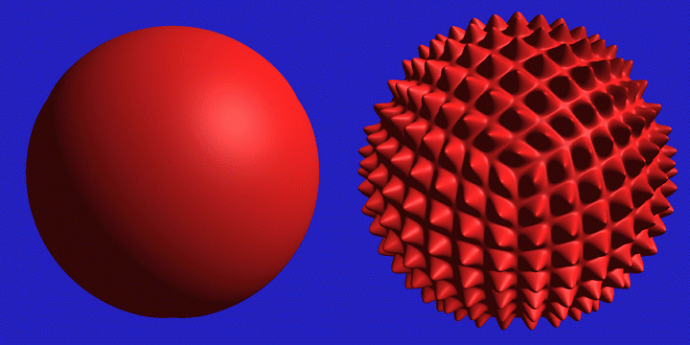
Displacement Mapping

Slide 39
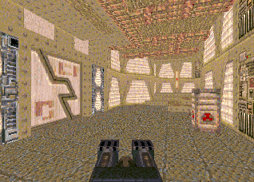
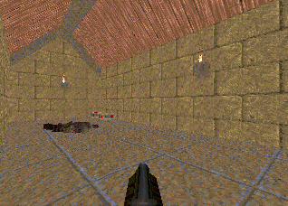
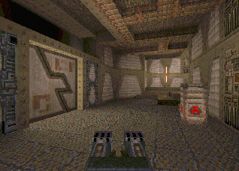
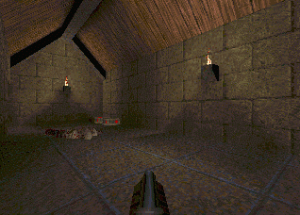
Illumination Maps
Quake introduced illumination maps or light maps to capture lighting effects in video games
Texture map:
Light map
Texture map + light map:

Slide 40
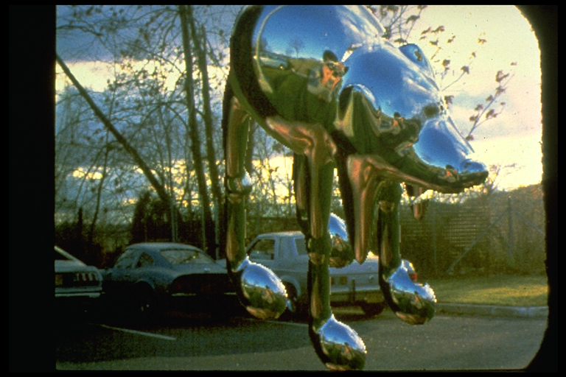
Environment Maps
Images from Illumination and Reflection Maps:
Simulated Objects in Simulated and Real Environments
Gene Miller and C. Robert Hoffman
SIGGRAPH 1984 “Advanced Computer Graphics Animation” Course Notes

Slide 41
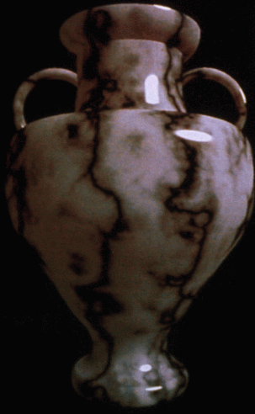
Solid textures
Texture values indexed by 3D location (x,y,z)
Expensive storage, or
Compute on the fly, e.g. Perlin noise →

