Slide 1



CS 188: Artificial Intelligence
Propositional Logic: Semantics, Inference, Agents
Instructor: Sergey Levine and Stuart Russell
University of California, Berkeley
Notes:
Please retain proper attribution and the reference to ai.berkeley.edu. Thanks!

Slide 2
You can think about deep learning as equivalent to ... our visual cortex or auditory cortex. But, of course, true intelligence is a lot more than just that, you have to recombine it into higher-level thinking and symbolic reasoning, a lot of the things classical AI tried to deal with in the 80s. … We would like to build up to this symbolic level of reasoning — maths, language, and logic. So that’s a big part of our work.
Demis Hassabis, CEO of Google Deepmind

Slide 3
Knowledge
Knowledge base = set of sentences in a formal language
Declarative approach to building an agent (or other system):
  Tell it what it needs to know (or have it Learn the knowledge)
  Then it can Ask itself what to do—answers should follow from the KB
Agents can be viewed at the knowledge level
i.e., what they know, regardless of how implemented
A single inference algorithm can answer any answerable question
  Cf. a search algorithm answers only “how to get from A to B” questions
Knowledge base
Domain-specific facts
Inference engine
Generic code

Slide 4

Logic
Syntax: What sentences are allowed?
Semantics:
  What are the possible worlds?
  Which sentences are true in which worlds? (i.e., definition of truth)
α₁
α₂
α₃
Syntaxland
Semanticsland

Slide 5
Examples
Propositional logic
  Syntax: P ∨ (¬Q ∧ R); X₁ ⇔ (Raining ⇒ Sunny)
  Possible world: {P=true,Q=true,R=false,S=true} or 1101
  Semantics: α ∧ β is true in a world iff α is true and β is true (etc.)
First-order logic
  Syntax: ∀x ∃y P(x,y) ∧ ¬Q(Joe,f(x)) ⇒ f(x)=f(y)
  Possible world: Objects o₁, o₂, o₃; P holds for <o₁,o₂>; Q holds for < o₁, o₃>; f(o₁)=o₁; Joe=o₃; etc.
  Semantics: φ(σ) is true in a world if σ=o_{j} and φ holds for o_{j}; etc.

Slide 6
Inference: entailment
Entailment: α |= β (“α entails β” or “β follows from α”) iff in every world where α is true, β is also true
  I.e., the α-worlds are a subset of the β-worlds [models(α) ⊆ models(β)]
In the example, α₂ |= α₁
(Say α₂ is ¬Q ∧ R ∧ S ∧ W
α₁ is ¬Q )
α₁
α₂

Slide 7
Inference: proofs
A proof is a demonstration of entailment between α and β
Method 1: model-checking
  For every possible world, if α is true make sure that is β true too
  OK for propositional logic (finitely many worlds); not easy for first-order logic
Method 2: theorem-proving
  Search for a sequence of proof steps (applications of inference rules) leading from α to β
  E.g., from P ∧ (P ⇒ Q), infer Q by Modus Ponens
Sound algorithm: everything it claims to prove is in fact entailed
Complete algorithm: every that is entailed can be proved

Slide 8
Quiz
What’s the connection between complete inference algorithms and complete search algorithms?
Answer 1: they both have the words “complete…algorithm”
Answer 2: they both solve any solvable problem
Answer 3: Formulate inference as a search problem
  Initial state: KB contains α
  Actions: apply any inference rule that matches KB, add conclusion
  Goal test: KB contains β
Hence any complete search algorithm (BFS, IDS, …) yields a complete inference algorithm…
provided the inference rules themselves are strong enough

Slide 9
Propositional logic syntax: The gruesome details
Given: a set of proposition symbols {X₁,X₂,…, X_{n}}
  (we often add True and False for convenience)
X_{i} is a sentence
If α is a sentence then ¬α is a sentence
If α and β are sentences then α ∧ β is a sentence
If α and β are sentences then α ∨ β is a sentence
If α and β are sentences then α ⇒ β is a sentence
If α and β are sentences then α ⇔ β is a sentence
And p.s. there are no other sentences!

Slide 10
Propositional logic semantics: The unvarnished truth
function PL-TRUE?(α,model) returns true or false
if α is a symbol then return Lookup(α, model)
if Op(α) = ¬ then return not(PL-TRUE?(Arg1(α),model))
if Op(α) = ∧ then return and(PL-TRUE?(Arg1(α),model),
PL-TRUE?(Arg2(α),model))
if Op(α) = ⇒ then return or(PL-TRUE?(Arg1(α),model),
not(PL-TRUE?(Arg2(α),model)))
etc. (Sometimes called “recursion over syntax”)

Slide 11
PacMan facts
If Pacman is at 3,3 at time 16 and goes North and there is no wall at 3,4 then Pacman is at 3,4 at time 17:
  At_3,3_16 ∧ N_16 ∧ ¬Wall_3,4 ⇒ At_3,3_17
At time 0 Pacman does one of four actions:
  (W_0 v E_0 v N_0 v S_0)
  ¬(W_0 ∧ E_0) ∧ ¬(W_0 ∧ S_0) ∧ …

Slide 12
Simple theorem proving: Forward chaining
Forward chaining applies Modus Ponens to generate new facts:
  Given X₁ ∧ X₂ ∧ … X_{n} ⇒ Y and X₁, X₂, …, X_{n}
  Infer Y
Forward chaining keeps applying this rule, adding new facts, until nothing more can be added
Requires KB to contain only definite clauses:
  (Conjunction of symbols) ⇒ symbol; or
  A single symbol (note that X is equivalent to True ⇒ X)

Slide 13
Forward chaining algorithm
function PL-FC-ENTAILS?(KB, q) returns true or false
count ← a table, where count[c] is the number of symbols in c’s premise
inferred ← a table, where inferred[s] is initially false for all s
agenda ← a queue of symbols, initially symbols known to be true in KB
while agenda is not empty do
p ← Pop(agenda)
if p = q then return true
if inferred[p] = false then
inferred[p]←true
for each clause c in KB where p is in c.premise do
decrement count[c]
if count[c] = 0 then add c.conclusion to agenda
return false

Slide 14
Forward chaining example: Proving Q
Clauses
Count
Inferred
P ⇒ Q
L ∧ M ⇒ P
B ∧ L ⇒ M
A ∧ P ⇒ L
A ∧ B ⇒ L
A
B
1
2
2
2
2
0
0
A false
B false
L false
M false
P false
Q false
// 0
xxxx true
// 1
xxxx true
// 0
// 0
xxxx true
// 1
// 0
xxxx true
// 1
xxxx true
// 0
// 1
xxxx true
Agenda
x
x
Q
x
L
x
x
x
M
P
A B
x
L

Slide 15
Properties of forward chaining
Theorem: FC is sound and complete for definite-clause KBs
Soundness: follows from soundness of Modus Ponens (easy to check)
Completeness proof:
1. FC reaches a fixed point where no new atomic sentences are derived
2. Consider the final inferred table as a model m, assigning true/false to symbols
3. Every clause in the original KB is true in m
Proof: Suppose a clause a₁∧... ∧a_{k} ⇒ b is false in m
Then a₁∧... ∧a_{k} is true in m and b is false in m
Therefore the algorithm has not reached a fixed point!
4. Hence m is a model of KB
5. If KB |= q, q is true in every model of KB, including m
A false
B false
L false
M false
P false
Q false
xxxx true
xxxx true
xxxx true
xxxx true
xxxx true
xxxx true

Slide 16
Simple model checking
function TT-ENTAILS?(KB, α) returns true or false
return TT-CHECK-ALL(KB,α,symbols(KB) U symbols(α),{})
function TT-CHECK-ALL(KB,α,symbols,model) returns true or false
if empty?(symbols) then
if PL-TRUE?(KB,model) then return PL-TRUE?(α,model)
else return true
else
P ← first(symbols)
rest ← rest(symbols)
return and (TT-CHECK-ALL(KB,α,rest,model ∪ {P = true})
TT-CHECK-ALL(KB,α,rest,model ∪ {P = false }))

Slide 17
Simple model checking, contd.
Same recursion as backtracking
O(2^{n}) time, linear space
We can do much better!
P₁=true
P₁=false
P₂=true
P₂=false
P_{n}=true
P_{n}=false
KB?
α?
11111…1
0000…0

Slide 18
Satisfiability and entailment
A sentence is satisfiable if it is true in at least one world (cf CSPs!)
Suppose we have a hyper-efficient SAT solver; how can we use it to test entailment?
  Suppose α |= β
  Then α ⇒ β is true in all worlds
  Hence ¬(α ⇒ β) is false in all worlds
  Hence α ∧ ¬β is false in all worlds, i.e., unsatisfiable
So, add the negated conclusion to what you know, test for (un)satisfiability; also known as reductio ad absurdum
Efficient SAT solvers operate on conjunctive normal form

Slide 19
Conjunctive normal form (CNF)
Replace biconditional by two implications
Every sentence can be expressed as a conjunction of clauses
Each clause is a disjunction of literals
Each literal is a symbol or a negated symbol
Conversion to CNF by a sequence of standard transformations:
  At_1,1_0 ⇒ (Wall_0,1 ⇔ Blocked_W_0)
  At_1,1_0 ⇒ ((Wall_0,1 ⇒ Blocked_W_0) ∧ (Blocked_W_0 ⇒Wall_0,1))
  ¬At_1,1_0 v ((¬Wall_0,1 v Blocked_W_0) ∧ (¬Blocked_W_0 v Wall_0,1))
  (¬At_1,1_0 v ¬Wall_0,1 v Blocked_W_0) ∧
  (¬At_1,1_0 v ¬Blocked_W_0 v Wall_0,1)
Replace α ⇒ β by ¬α v β
Distribute v over ∧

Slide 20
Efficient SAT solvers
DPLL (Davis-Putnam-Logemann-Loveland) is the core of modern solvers
Essentially a backtracking search over models with some extras:
  Early termination: stop if
    all clauses are satisfied; e.g., (A ∨ B) ∧ (A ∨ ¬C) is satisfied by {A=true}
    any clause is falsified; e.g., (A ∨ B) ∧ (A ∨ ¬C) is satisfied by {A=false,B=false}
  Pure literals: if all occurrences of a symbol in as-yet-unsatisfied clauses have the same sign, then give the symbol that value
    E.g., A is pure and positive in (A ∨ B) ∧ (A ∨ ¬C) ∧ (C ∨ ¬B) so set it to true
  Unit clauses: if a clause is left with a single literal, set symbol to satisfy clause
    E.g., if A=false, (A ∨ B) ∧ (A ∨ ¬C) becomes (false ∨ B) ∧ (false ∨ ¬C), i.e. (B) ∧ (¬C)
    Satisfying the unit clauses often leads to further propagation, new unit clauses, etc.

Slide 21
DPLL algorithm
function DPLL(clauses,symbols,model) returns true or false
if every clause in clauses is true in model then return true
if some clause in clauses is false in model then return false
P,value ←FIND-PURE-SYMBOL(symbols,clauses,model)
if P is non-null then return DPLL(clauses, symbols–P, model∪{P=value})
P,value ←FIND-UNIT-CLAUSE(clauses,model)
if P is non-null then return DPLL(clauses, symbols–P, model∪{P=value})
P ← First(symbols); rest ← Rest(symbols)
return or(DPLL(clauses,rest,model∪{P=true}),
DPLL(clauses,rest,model∪{P=false}))

Slide 22
Efficiency
Naïve implementation of DPLL: solve ~100 variables
Extras:
  Variable and value ordering (from CSPs)
  Divide and conquer
  Caching unsolvable subcases as extra clauses to avoid redoing them
  Cool indexing and incremental recomputation tricks so that every step of the DPLL algorithm is efficient (typially O(1))
    Index of clauses in which each variable appears +ve/-ve
    Keep track number of satisfied clauses, update when variables assigned
    Keep track of number of remaining literals in each clause
Real implementation of DPLL: solve ~10000000 variables

Slide 23
SAT solvers in practice
Circuit verification: does this VLSI circuit compute the right answer?
Software verification: does this program compute the right answer?
Software synthesis: what program computes the right answer?
Protocol verification: can this security protocol be broken?
Protocol synthesis: what protocol is secure for this task?
Planning: how can I eat all the dots???

Slide 24
A knowledge-based agent
function KB-AGENT(percept) returns an action
persistent: KB, a knowledge base
t, an integer, initially 0
TELL(KB, MAKE-PERCEPT-SENTENCE(percept, t))
action ← ASK(KB, MAKE-ACTION-QUERY(t))
TELL(KB, MAKE-ACTION-SENTENCE(action, t))
t←t+1
return action

Slide 25
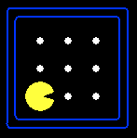
Example: Partially observable Pacman
Pacman has to act given only local perception
  Four Boolean percept variables for wall in each direction
What knowledge does he need to begin with?
  Sensor model: sentences stating how the current percept variables are determined by the current state variables
  Transition model: sentences stating how the next-state variables are determined by the current state variables and Pacman’s action
  Initial conditions: what Pacman knows about the initial state
  Domain constraints: what is generally true, e.g., Pacman can do one thing at a time and be in one place at a time

Slide 26
Pacman variables
Pacman’s location
    At_1,1_0 (Pacman is at [1,1] at time 0) At_3,3_4 etc
Wall locations (these do not change with time)
    Wall_0,0 Wall_0,1 etc
Percepts
    Blocked_W_0 (blocked by wall to my West at time 0) etc.
Actions
    W_0 (Pacman moves West at time 0), E_0 etc.
NxN world for T time steps => N²T + N² + 4T + 4T = O(N²T) variables
2^{N2T} possible worlds! N=10, T=100 => 10³⁰¹⁰ worlds (each a “history”)

Slide 27
Sensor model
State facts about how Pacman’s percepts arise…
Pacman perceives a wall to the West at time t if and only if he is in x,y and there is a wall at x-1,y ….
  Blocked_W_0 ⇔
    ((At_1,1_0 ∧ Wall_0,1) v
    (At_1,2_0 ∧ Wall_0,2) v
    (At_1,3_0 ∧ Wall_0,3) v …. )
How many of these sentences?
How big are they?

Slide 28
Quiz
What is wrong with sentences like
  At_1,1_0 ∧ Wall_0,1 ⇒ Blocked_W_0
    If you are at [1,1] at time 0 and there is a wall in [0,1], the west percept is blocked
True but incomplete!
  They say “under these conditions the percept variable is true”
  They don’t say when it is false
  In particular, they allow for worlds where the percept is always true!!
    Unintended or non-standard models

Slide 29
Transition model
How does each state variable or fluent at each time gets its value?
State variables for POPacman are At_x,y_t , e.g., At_3,3_17
A state variable gets its value according to a successor-state axiom
  X_{t} ⇔ [X_{t-1} ∧ ¬(some action_{t-1} made it false)] v
  [¬X_{t-1} ∧ (some action_{t-1} made it true)]
For Pacman location:
  At_3,3_17 ⇔ [At_3,3_16 ∧ ¬((¬Wall_3,4 ∧ N_16) v (¬Wall_4,3 ∧ E_16) v …)]
  v [¬At_3,3_16 ∧ ((At_3,2_16 ∧ ¬Wall_3,3 ∧ N_16) v
  (At_2,3_16 ∧ ¬Wall_3,3 ∧ N_16) v …)]

Slide 30
Initial state
Pacman may know its initial location:
  At_1,1_0
Or, it may not:
  At_1,1_0 v At_1,2_0 v At_1,3_0 v … v At_3,3_0
We also need a domain constraint – exactly one thing at a time
  ¬(W_0 ∧ E_0) ∧ ¬(W_0 ∧ S_0) ∧ …
  ¬(W_1 ∧ E_1) ∧ ¬(W_1 ∧ S_1) ∧ …
  … ∧ (W_0 v E_0 v N_0 v S_0) ∧ …
∧ ¬At_1,2_0 ∧ ¬At_1,3_0 ….

Slide 31
State estimation
State estimation means keeping track of what’s true now
A logical agent can just ask itself!
  E.g., ask whether KB ∧ <actions> ∧ <percepts> |= Wall_2,2
  This is “lazy”: it involves reasoning about one’s whole life history at each step!
A more “eager” form of state estimation:
  After each action and percept
    For each state variable X_{t}
      If X_{t} is entailed, add to KB
      If ¬X_{t} is entailed, add to KB

Slide 32
Planning as satisfiability
Given a hyper-efficient SAT solver, can we use it to make plans?
Yes, for fully observable, deterministic case:
  planning problem is solvable iff there is some satisfying assignment
  solution obtained from truth values of action variables
For T = 1 to infinity, set up the KB as follows and run SAT solver:
  Initial state, domain constraints
  Transition model sentences up to time T
  Goal is true at time T
Read off action variables from solution

Slide 33
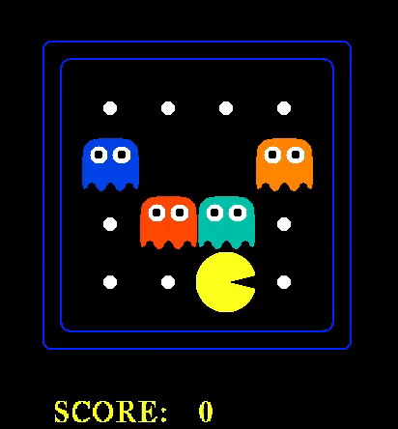

Slide 34
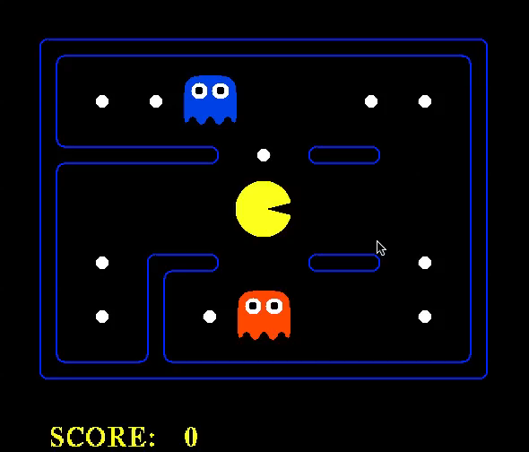

Slide 35
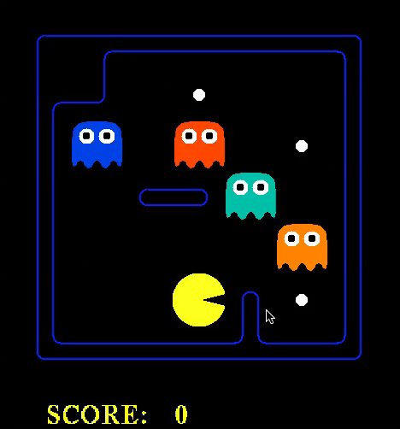

Slide 36
Summary
One possible agent architecture: knowledge + inference
Logics provide a formal way to encode knowledge
  A logic is defined by: syntax, set of possible worlds, truth condition
Logical inference computes entailment relations among sentences
SAT solvers based on DPLL provide incredibly efficient inference
Logical agents can construct plans by asking whether there is a future in which the goal is achieved

