Slide 1
Announcements
Midterm is Wednesday March 20, 7pm-9pm ☺
Details on midterm prep page (follow link on piazza)
  Format: directly on the exam sheet (no blue books); closed book, no notes
  Location: multiple rooms, go to the right one
  Past exams: on prep page
  Review sessions in section next week and the week after

Slide 2
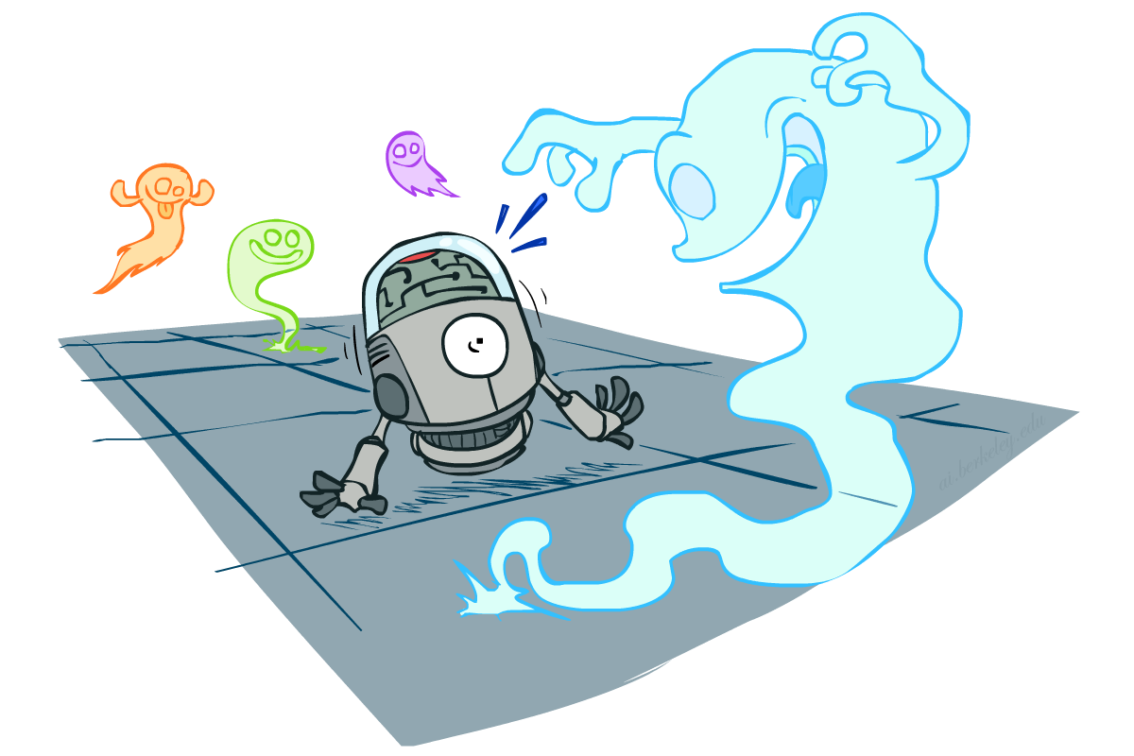
CS 188: Artificial Intelligence
Probability
Instructors: Sergey Levine and Stuart Russell --- University of California, Berkeley
[These slides were created by Dan Klein and Pieter Abbeel for CS188 Intro to AI at UC Berkeley. All CS188 materials are available at http://ai.berkeley.edu.]
Notes:
Please retain proper attribution, including the reference to ai.berkeley.edu. Thanks!

Slide 3

Today
Probability
  Random Variables
  Joint and Marginal Distributions
  Conditional Distribution
  Product Rule, Chain Rule, Bayes’ Rule
  Inference
  Independence
You’ll need all this stuff A LOT for the next few weeks, so make sure you go over it now!
Notes:
Like “sort this list” or “add these two numbers”

Slide 4
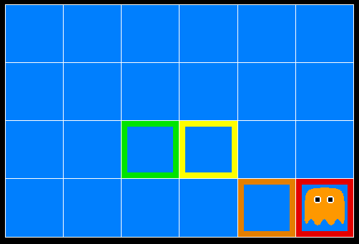
Inference in Ghostbusters
A ghost is in the grid somewhere
Sensor readings tell how close a square is to the ghost
  On the ghost: red
  1 or 2 away: orange
  3 or 4 away: yellow
  5+ away: green
Sensors are noisy, but we know P(Color | Distance)
P(red | 3) | P(orange | 3) | P(yellow | 3) | P(green | 3)
0.05 | 0.15 | 0.5 | 0.3
[Demo: Ghostbuster – no probability (L12D1) ]

Slide 5

Video of Demo Ghostbuster – No probability

Slide 6
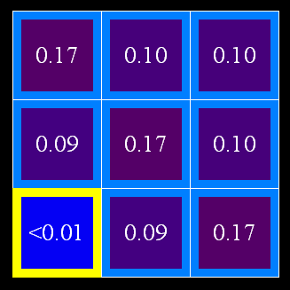
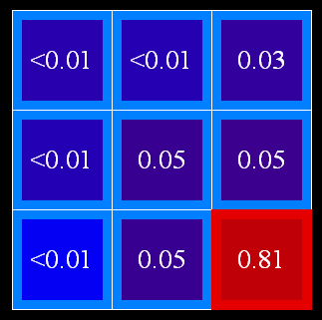
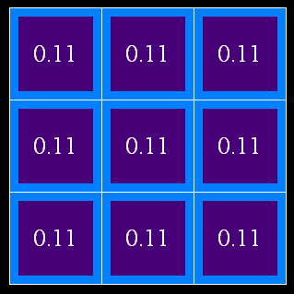
Uncertainty
General situation:
  Observed variables (evidence): Agent knows certain things about the state of the world (e.g., sensor readings or symptoms)
  Unobserved variables: Agent needs to reason about other aspects (e.g. where an object is or what disease is present)
  Model: Agent knows something about how the known variables relate to the unknown variables
Probabilistic reasoning gives us a framework for managing uncertain beliefs and knowledge

Slide 7
Random Variables
A random variable is some aspect of the world about which we (may) have uncertainty
  R = Is it raining?
  T = Is it hot or cold?
  D = How long will it take to drive to work?
  L = Where is the ghost?
(Technically, a random variable is a deterministic function from a possible world to some range of values.)
Like variables in a CSP, random variables have domains
  R in {true, false} (often write as {+r, -r})
  T in {hot, cold}
  D in [0, ∞)
  L in possible locations, maybe {(0,0), (0,1), …}

Slide 8
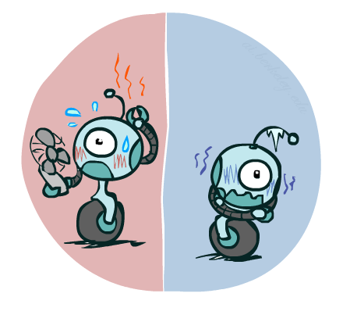

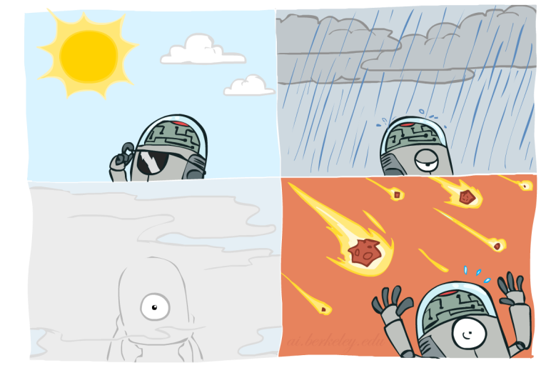

Probability Distributions
Associate a probability with each value
  Temperature:
  Weather:
W | P
sun | 0.6
rain | 0.1
fog | 0.3
meteor | 0.0
T | P
hot | 0.5
cold | 0.5

Slide 9


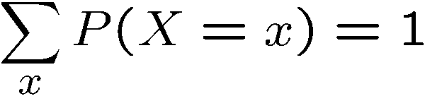
Probability Distributions
Unobserved random variables have distributions
A distribution for a discrete variable is a TABLE of probabilities of values
A probability (lower case value) is a single number
Must have: and
Shorthand notation:
OK if all domain entries are unique
T | P
hot | 0.5
cold | 0.5
W | P
sun | 0.6
rain | 0.1
fog | 0.3
meteor | 0.0

Slide 10




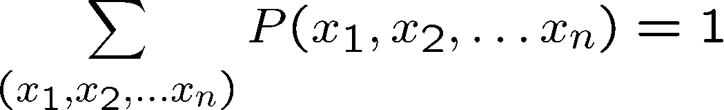
Joint Distributions
A joint distribution over a set of random variables:
specifies a real number for each assignment (or outcome):
  Must obey:
Size of distribution if n variables with domain sizes d?
  For all but the smallest distributions, impractical to write out!
T | W | P
hot | sun | 0.4
hot | rain | 0.1
cold | sun | 0.2
cold | rain | 0.3

Slide 11
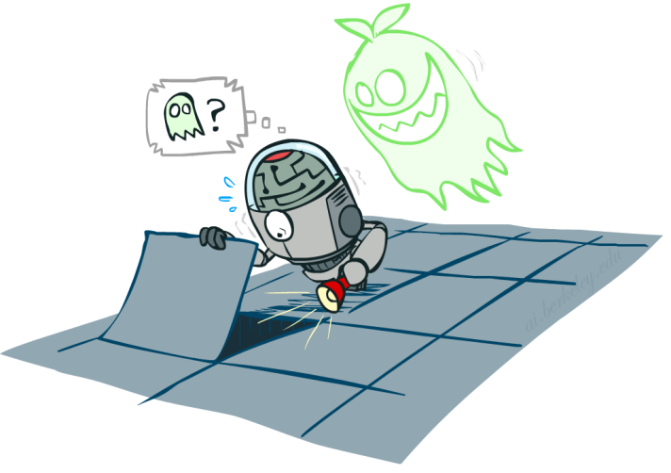

Probability Models
Distribution over T,W
A probability model is a joint distribution over a set of random variables
Probability models:
  (Random) variables with domains
  Assignments are called outcomes
  Joint distributions: say whether assignments (outcomes) are likely
  Normalized: sum to 1.0
  Ideally: only certain variables directly interact
Constraint satisfaction problems:
  Variables with domains
  Constraints: state whether assignments are possible
  Ideally: only certain variables directly interact
T | W | P
hot | sun | 0.4
hot | rain | 0.1
cold | sun | 0.2
cold | rain | 0.3
Constraint over T,W
T | W | P
hot | sun | T
hot | rain | F
cold | sun | F
cold | rain | T

Slide 12
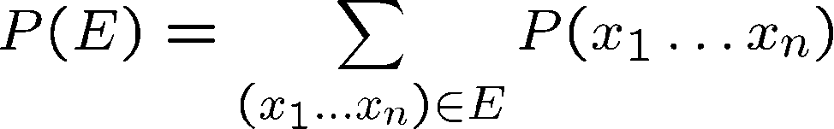
Events
An event E is a set of outcomes
From a joint distribution, we can calculate the probability of any event
  Probability that it’s hot AND sunny?
  Probability that it’s hot?
  Probability that it’s hot OR sunny?
Typically, the events we care about are partial assignments, like P(T=hot)
T | W | P
hot | sun | 0.4
hot | rain | 0.1
cold | sun | 0.2
cold | rain | 0.3

Slide 13

Quiz: Events
P(+x, +y) ?
P(+x) ?
P(-y OR +x) ?
X | Y | P
+x | +y | 0.2
+x | -y | 0.3
-x | +y | 0.4
-x | -y | 0.1

Slide 14
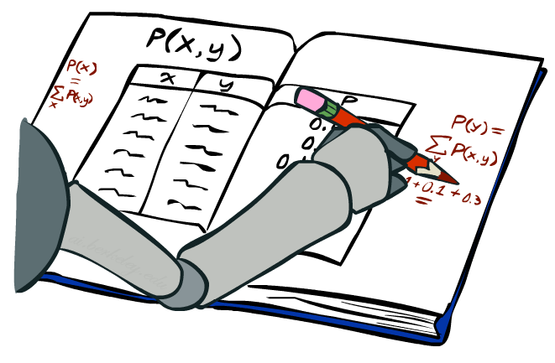
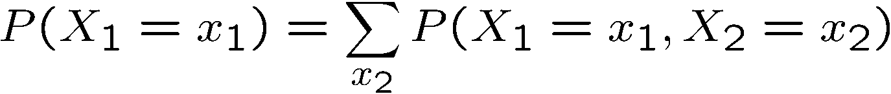
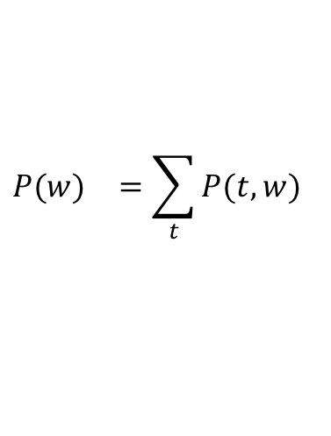
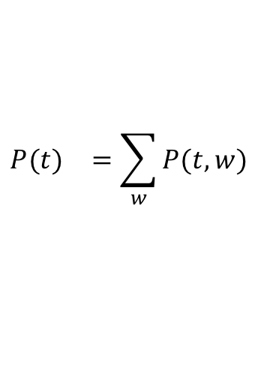
Marginal Distributions
Marginal distributions are sub-tables which eliminate variables
Marginalization (summing out): Combine collapsed rows by adding
T | P
hot | 0.5
cold | 0.5
T | W | P
hot | sun | 0.4
hot | rain | 0.1
cold | sun | 0.2
cold | rain | 0.3
$${P(t)}^{}=\sum_{w}{{P(t,w)}^{}}$$
W | P
sun | 0.6
rain | 0.4
$${P(w)}^{}=\sum_{t}{{P(t,w)}^{}}$$

Slide 15


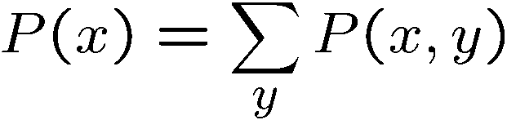

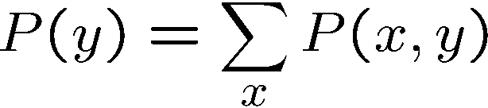
Quiz: Marginal Distributions
X | P
+x
-x
X | Y | P
+x | +y | 0.2
+x | -y | 0.3
-x | +y | 0.4
-x | -y | 0.1
Y | P
+y
-y

Slide 16
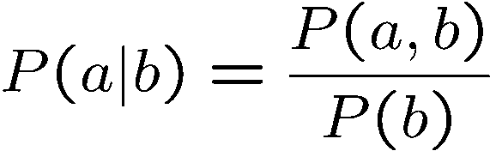
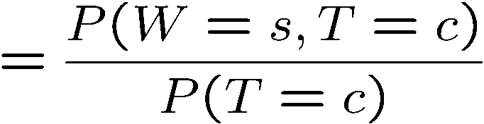
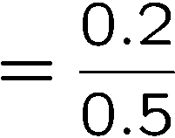



Conditional Probabilities
A simple relation between joint and conditional probabilities
  In fact, this is taken as the definition of a conditional probability
P(a,b)
P(a)
P(b)
T | W | P
hot | sun | 0.4
hot | rain | 0.1
cold | sun | 0.2
cold | rain | 0.3

Slide 17
Quiz: Conditional Probabilities
P(+x | +y) ?
P(-x | +y) ?
P(-y | +x) ?
X | Y | P
+x | +y | 0.2
+x | -y | 0.3
-x | +y | 0.4
-x | -y | 0.1

Slide 18



Conditional Distributions
Conditional distributions are probability distributions over some variables given fixed values of others
Conditional Distributions
Joint Distribution
W | P
sun | 0.8
rain | 0.2
T | W | P
hot | sun | 0.4
hot | rain | 0.1
cold | sun | 0.2
cold | rain | 0.3
W | P
sun | 0.4
rain | 0.6

Slide 19
To Normalize
(Dictionary) To bring or restore to a normal condition
Procedure:
  Step 1: Compute Z = sum over all entries
  Step 2: Divide every entry by Z
Example 1
All entries sum to ONE
Example 2
W | P
sun | 0.2
rain | 0.3
Normalize
W | P
sun | 0.4
rain | 0.6
T | W | P
hot | sun | 20
hot | rain | 5
cold | sun | 10
cold | rain | 15
T | W | P
hot | sun | 0.4
hot | rain | 0.1
cold | sun | 0.2
cold | rain | 0.3
Normalize
Z = 0.5
Z = 50

Slide 20


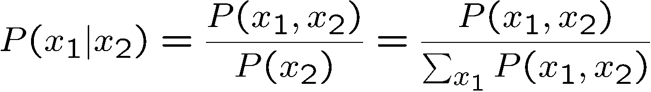
Normalization Trick
A trick to get a whole conditional distribution at once:
  Select the joint probabilities matching the evidence
  Normalize the selection (make it sum to one)
  Why does this work? Sum of selection is P(evidence)! (P(r), here)
T | W | P
hot | sun | 0.4
hot | rain | 0.1
cold | sun | 0.2
cold | rain | 0.3
T | R | P
hot | rain | 0.1
cold | rain | 0.3
T | P
hot | 0.25
cold | 0.75
Select
Normalize

Slide 21

Probabilistic Inference
Probabilistic inference: compute a desired probability from other known probabilities (e.g. conditional from joint)
We generally compute conditional probabilities
  P(on time | no reported accidents) = 0.90
  These represent the agent’s beliefs given the evidence
Probabilities change with new evidence:
  P(on time | no accidents, 5 a.m.) = 0.95
  P(on time | no accidents, 5 a.m., raining) = 0.80
  Observing new evidence causes beliefs to be updated

Slide 22





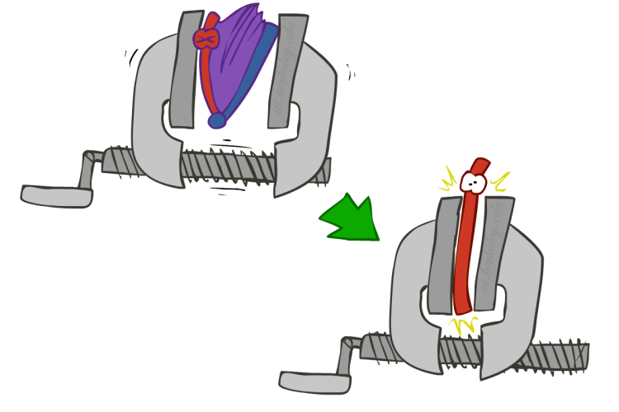
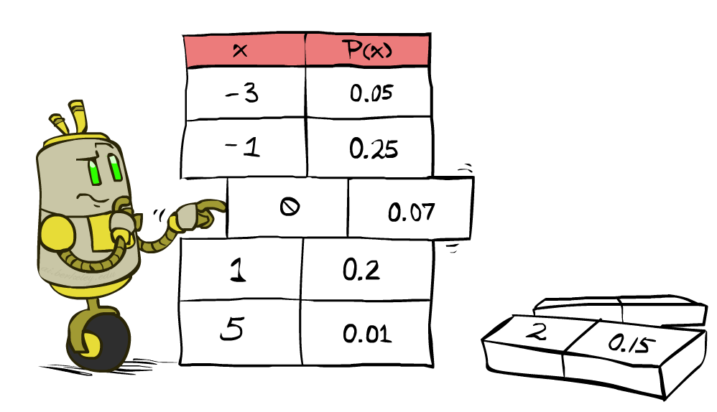


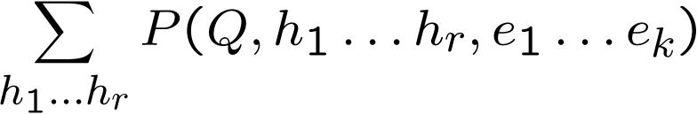
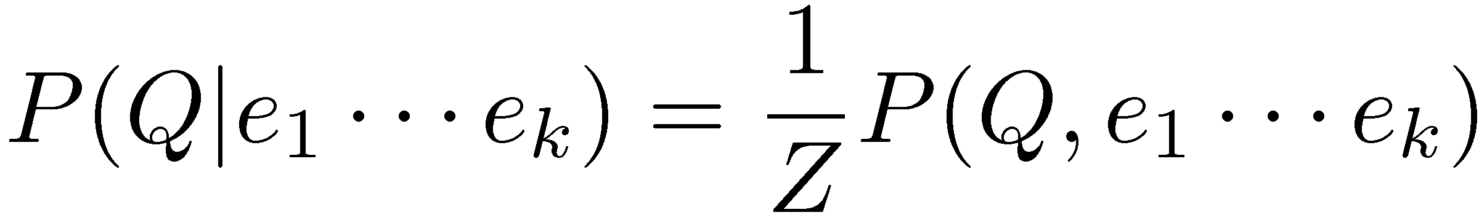
Inference by Enumeration
* Works fine with multiple query variables, too
General case:
  Evidence variables:
  Query* variable:
  Hidden variables:
We want:
All variables
Step 1: Select the entries consistent with the evidence
Step 2: Sum out H to get joint of Query and evidence
Step 3: Normalize

Slide 23
Inference by Enumeration
P(W)?
P(W | winter)?
P(W | winter, hot)?
S | T | W | P
summer | hot | sun | 0.30
summer | hot | rain | 0.05
summer | cold | sun | 0.10
summer | cold | rain | 0.05
winter | hot | sun | 0.10
winter | hot | rain | 0.05
winter | cold | sun | 0.15
winter | cold | rain | 0.20

Slide 24
Inference by Enumeration
Obvious problems:
  Worst-case time complexity O(d^{n})
  Space complexity O(d^{n}) to store the joint distribution

Slide 25
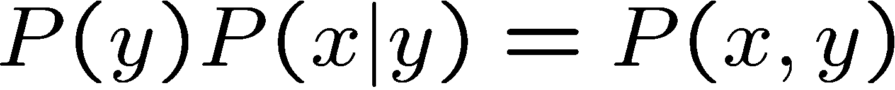

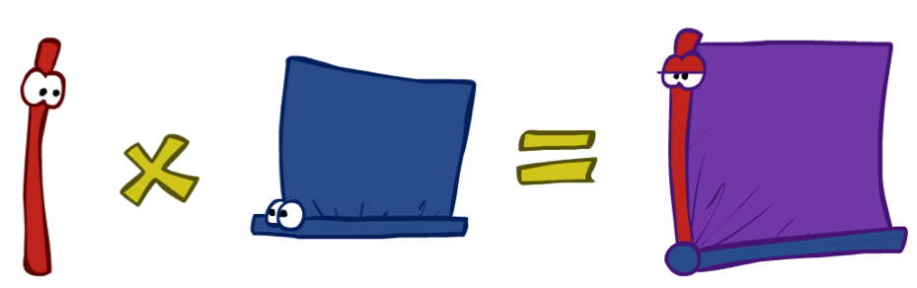
The Product Rule
Sometimes have conditional distributions but want the joint

Slide 26


The Product Rule
Example:
D | W | P
wet | sun | 0.1
dry | sun | 0.9
wet | rain | 0.7
dry | rain | 0.3
D | W | P
wet | sun | 0.08
dry | sun | 0.72
wet | rain | 0.14
dry | rain | 0.06
R | P
sun | 0.8
rain | 0.2

Slide 27
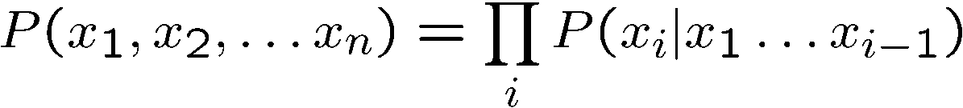
The Chain Rule
More generally, can always write any joint distribution as an incremental product of conditional distributions
Why is this always true?

Slide 28
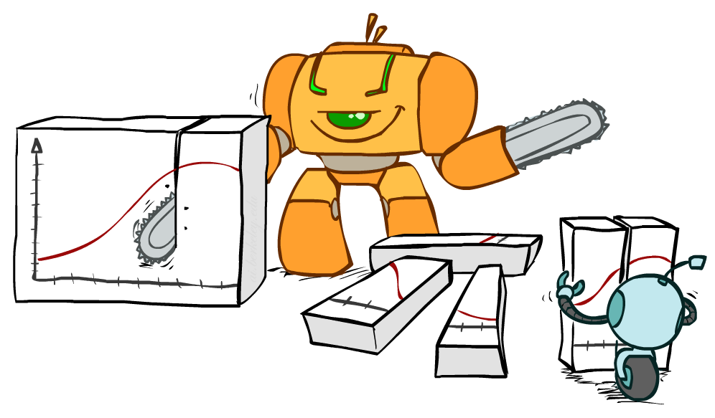
Bayes Rule

Slide 29



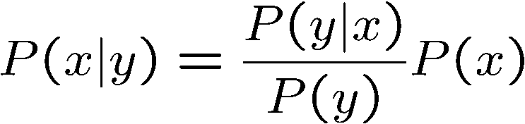
Bayes’ Rule
Two ways to factor a joint distribution over two variables:
Dividing, we get:
Why is this at all helpful?
  Lets us build one conditional from its reverse
  Often one conditional is tricky but the other one is simple
  Foundation of many systems we’ll see later (e.g. ASR, MT)
In the running for most important AI equation!
That’s my rule!

Slide 30
Inference with Bayes’ Rule
Example: Diagnostic probability from causal probability:
Example:
  M: meningitis, S: stiff neck
  Note: posterior probability of meningitis still very small
  Note: you should still get stiff necks checked out! Why?
Example
givens

Slide 31
Quiz: Bayes’ Rule
Given:
What is P(W | dry) ?
D | W | P
wet | sun | 0.1
dry | sun | 0.9
wet | rain | 0.7
dry | rain | 0.3
W | P
sun | 0.8
rain | 0.2

Slide 32

Ghostbusters, Revisited
Let’s say we have two distributions:
  Prior distribution over ghost location: P(G)
    Let’s say this is uniform
  Sensor reading model: P(R | G)
    Given: we know what our sensors do
    R = reading color measured at (1,1)
    E.g. P(R = yellow | G=(1,1)) = 0.1
We can calculate the posterior distribution P(G|r) over ghost locations given a reading using Bayes’ rule:
What about two readings? What is P(r₁,r₂ | g) ?

Slide 33
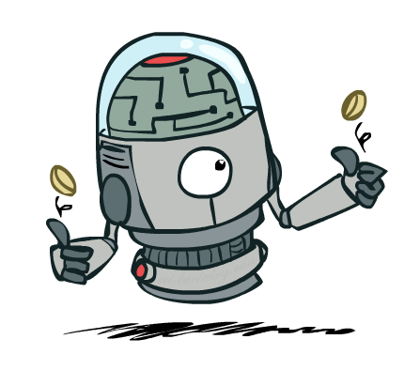
Independence

Slide 34

Independence
Two variables are independent if:
  This says that their joint distribution factors into a product two simpler distributions
  Another form:
Independence is a simplifying modeling assumption
  Empirical joint distributions: at best “close” to independent
  What could we assume for {Weather, Traffic, Cavity, Toothache}?

Slide 35
Example: Independence?
T | P
hot | 0.5
cold | 0.5
T | W | P
hot | sun | 0.4
hot | rain | 0.1
cold | sun | 0.2
cold | rain | 0.3
T | W | P
hot | sun | 0.3
hot | rain | 0.2
cold | sun | 0.3
cold | rain | 0.2
W | P
sun | 0.6
rain | 0.4

Slide 36


Example: Independence
N fair, independent coin flips:
H | 0.5
T | 0.5
H | 0.5
T | 0.5
H | 0.5
T | 0.5

Slide 37
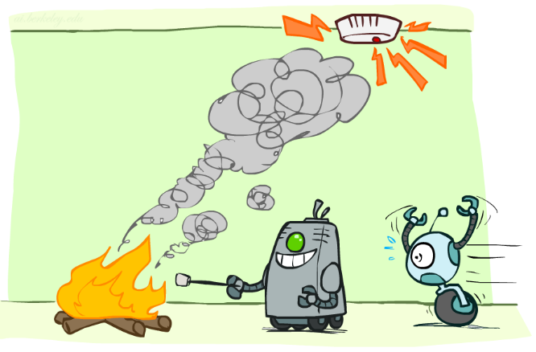
Conditional Independence

Slide 38
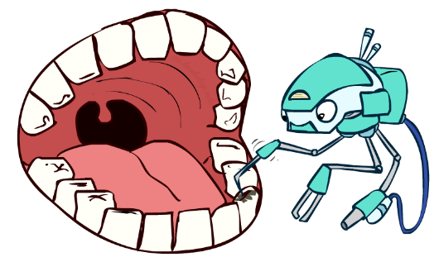
Conditional Independence
P(Toothache, Cavity, Catch)
If I have a cavity, the probability that the probe catches in it doesn't depend on whether I have a toothache:
  P(+catch | +toothache, +cavity) = P(+catch | +cavity)
The same independence holds if I don’t have a cavity:
  P(+catch | +toothache, -cavity) = P(+catch| -cavity)
Catch is conditionally independent of Toothache given Cavity:
  P(Catch | Toothache, Cavity) = P(Catch | Cavity)
Equivalent statements:
  P(Toothache | Catch , Cavity) = P(Toothache | Cavity)
  P(Toothache, Catch | Cavity) = P(Toothache | Cavity) P(Catch | Cavity)
  One can be derived from the other easily

Slide 39
Conditional Independence
Unconditional (absolute) independence very rare (why?)
Conditional independence is our most basic and robust form of knowledge about uncertain environments.
X is conditionally independent of Y given Z
if and only if:
or, equivalently, if and only if

Slide 40
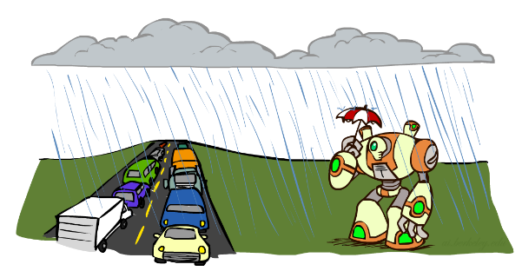
Conditional Independence
What about this domain:
  Traffic
  Umbrella
  Raining

Slide 41

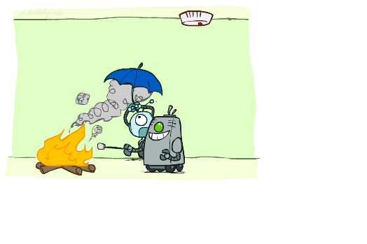
Conditional Independence
What about this domain:
  Fire
  Smoke
  Alarm

Slide 42
Ghostbusters, Revisited
What about two readings? What is P(r₁,r₂ | g) ?
Readings are conditionally independent given the ghost location!
P(r₁,r₂ | g) = P(r₁ | g) P(r₂ | g)
Applying Bayes’ rule in full:
P(g | r₁,r₂ ) α P(r₁,r₂ | g) P(g)
= P(g) P(r₁ | g) P(r₂ | g)
Bayesian updating
?
?
?
?
?
?
?
?
?
0.24
0.07
<.01
0.07
0.24
0.07
<.01
0.07
0.24
[Demo: Ghostbuster – with probability (L12D2) ]

Slide 43
Video of Demo Ghostbusters with Probability

Slide 44
Summary
Uncertainty is ubiquitous in the real world
Probability theory is designed to handle uncertain information
  “The theory of probabilities is just common sense reduced to calculus”
    Laplace, 1814
A probability model assigns a probability to each possible world
  Typically a Cartesian product of random variable assignments
Any question can be answered by summing entries in the model
Bayes’ rule operates directly with conditional probabilities
Independence and conditional independence simplify the model

Slide 45
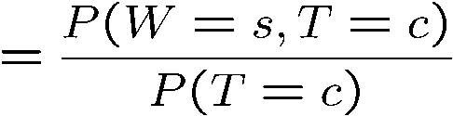

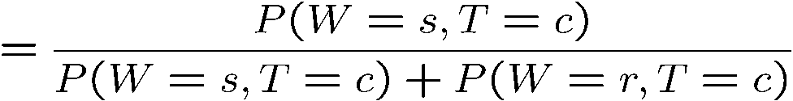
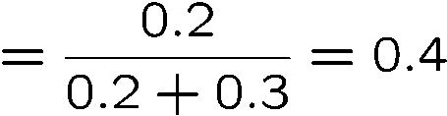

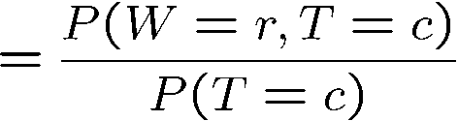

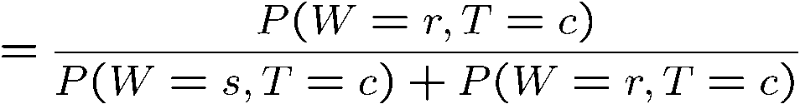
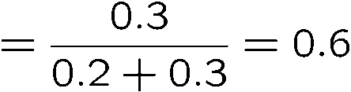
Normalization Trick
T | W | P
hot | sun | 0.4
hot | rain | 0.1
cold | sun | 0.2
cold | rain | 0.3
W | P
sun | 0.4
rain | 0.6

Slide 46








Normalization Trick
  SELECT the joint probabilities matching the evidence
  NORMALIZE the selection
  (make it sum to one)
T | W | P
hot | sun | 0.4
hot | rain | 0.1
cold | sun | 0.2
cold | rain | 0.3
T | W | P
cold | sun | 0.2
cold | rain | 0.3
W | P
sun | 0.4
rain | 0.6

Slide 47
Normalization Trick
  SELECT the joint probabilities matching the evidence
  NORMALIZE the selection
  (make it sum to one)
T | W | P
hot | sun | 0.4
hot | rain | 0.1
cold | sun | 0.2
cold | rain | 0.3
T | W | P
cold | sun | 0.2
cold | rain | 0.3
W | P
sun | 0.4
rain | 0.6
Why does this work? Sum of selection is P(evidence)! (P(T=c), here)

Slide 48

Quiz: Normalization Trick
P(X | Y=-y) ?
  SELECT the joint probabilities matching the evidence
  NORMALIZE the selection
  (make it sum to one)
X | Y | P
+x | +y | 0.2
+x | -y | 0.3
-x | +y | 0.4
-x | -y | 0.1

