Slide 1
Quick Warm-Up
Suppose we have a biased coin that comes up heads with some unknown probability p; how can we use it to produce random bits with probabilities of exactly 0.5 for 0 and 1?

Slide 2
Quick Warm-Up
Suppose we have a biased coin that comes up heads with some unknown probability p; how can we use it to produce random bits with probabilities of exactly 0.5 for 0 and 1?
Answer (von Neumann):
  Flip coin twice, repeat until the outcomes are different
  HT = 0, TH = 1, each has probability p(1-p)

Slide 3

Bayes Nets
Part I: Representation
Part II: Exact inference
  Enumeration (always exponential complexity)
  Variable elimination (worst-case exponential complexity, often better)
  Inference is NP-hard in general
Part III: Approximate Inference
Later: Learning Bayes nets from data

Slide 4
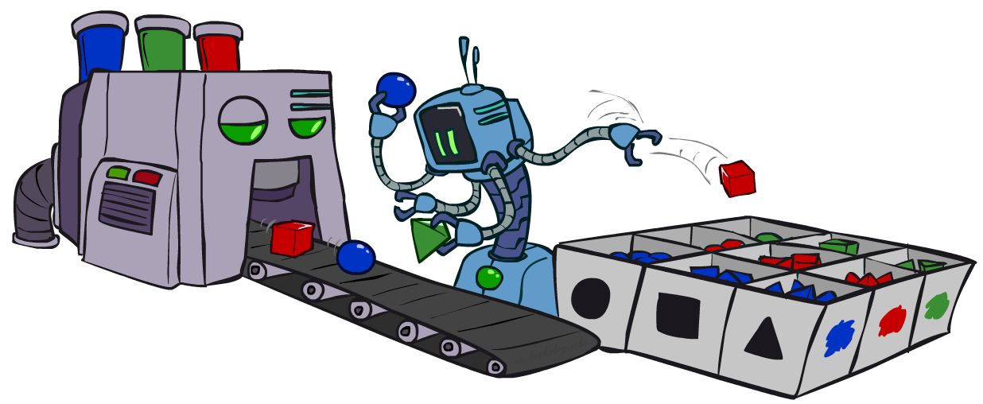
CS 188: Artificial Intelligence
Bayes Nets: Approximate Inference
Instructors: Sergey Levine and Stuart Russell
University of California, Berkeley
Notes:
Please retain proper attribution, including the reference to ai.berkeley.edu. Thanks!

Slide 5

Sampling
Basic idea
  Draw N samples from a sampling distribution S
  Compute an approximate posterior probability
  Show this converges to the true probability P
Why sample?
  Often very fast to get a decent approximate answer
  The algorithms are very simple and general (easy to apply to fancy models)
  They require very little memory (O(n))
  They can be applied to large models, whereas exact algorithms blow up

Slide 6
Example
Suppose you have two agent programs A and B for Monopoly
What is the probability that A wins?
  Method 1:
    Let s be a sequence of dice rolls and Chance and Community Chest cards
    Given s, the outcome V(s) is determined (1 for a win, 0 for a loss)
    Probability that A wins is
    Problem: infinitely many sequences s !
  Method 2:
    Sample N sequences from P(s) , play N games (maybe 100)
    Probability that A wins is roughly 1/N ∑_{i} V(s_{i}) i.e., fraction of wins in the sample
∑_{s} P(s) V(s)

Slide 7

Sampling basics: discrete (categorical) distribution
To simulate a biased d-sided coin:
  Step 1: Get sample u from uniform distribution over [0, 1)
    E.g. random() in python
  Step 2: Convert this sample u into an outcome for the given distribution by associating each outcome x with a P(x)-sized sub-interval of [0,1)
Example
  If random() returns u = 0.83, then the sample is C = blue
  E.g, after sampling 8 times:
C | P(C)
red | 0.6
green | 0.1
blue | 0.3
0.0 ≤ u < 0.6, → C=red
0.6 ≤ u < 0.7, → C=green
0.7 ≤ u < 1.0, → C=blue

Slide 8
Sampling in Bayes Nets
Prior Sampling
Rejection Sampling
Likelihood Weighting
Gibbs Sampling

Slide 9
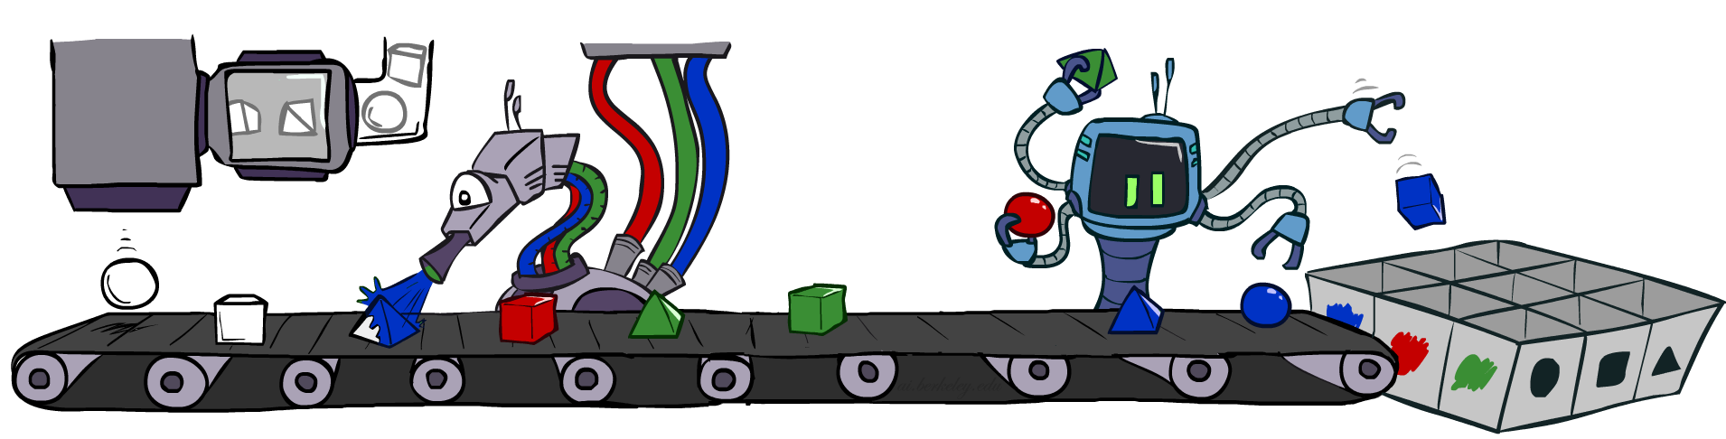
Prior Sampling

Slide 10
Prior Sampling
P(C)
c | 0.5
¬c | 0.5
Cloudy
P(S | C)
Cloudy
P(R | C)
c | s | 0.1
 | ¬s | 0.9
¬c | s | 0.5
 | ¬s | 0.5
c | r | 0.8
 | ¬r | 0.2
¬c | r | 0.2
 | ¬r | 0.8
Sprinkler
Sprinkler
Rain
Rain
P(W | S,R)
WetGrass
WetGrass
Samples:
s | r | w | 0.99
 |  | ¬w | 0.01
 | ¬r | w | 0.90
 |  | ¬w | 0.10
¬s | r | w | 0.90
 |  | ¬w | 0.10
 | ¬r | w | 0.01
 |  | ¬w | 0.99
c, ¬s, r, w
¬c, s, ¬r, w
…

Slide 11
Prior Sampling
For i=1, 2, …, n (in topological order)
  Sample X_{i} from P(X_{i} | parents(X_{i}))
Return (x₁, x₂, …, x_{n})

Slide 12
Prior Sampling
This process generates samples with probability:
  S_{PS}(x₁,…,x_{n}) =
…i.e. the BN’s joint probability
Let the number of samples of an event be N_{PS}(x₁,…,x_{n})
Estimate from N samples is Q_{N}(x₁,…,x_{n}) = N_{PS}(x₁,…,x_{n})/N
Then lim_{N→∞} Q_{N}(x₁,…,x_{n}) = lim_{N→∞} N_{PS}(x₁,…,x_{n})/N
= S_{PS}(x₁,…,x_{n})
= P(x₁,…,x_{n})
I.e., the sampling procedure is consistent
∏_{i} P(x_{i} | parents(X_{i})) = P(x₁,…,x_{n})

Slide 13
Example
We’ll get a bunch of samples from the BN:
  c, ¬s, r, w
  c, s, r, w
  ¬c, s, r, ¬w
  c, ¬s, r, w
  ¬c, ¬s, ¬r, w
If we want to know P(W)
  We have counts <w:4, ¬w:1>
  Normalize to get P(W) = <w:0.8, ¬w:0.2>
  This will get closer to the true distribution with more samples
  Can estimate anything else, too
    E.g., for query P(C| r, w) use P(C| r, w) = α P(C, r, w)
C
S
R
W

Slide 14
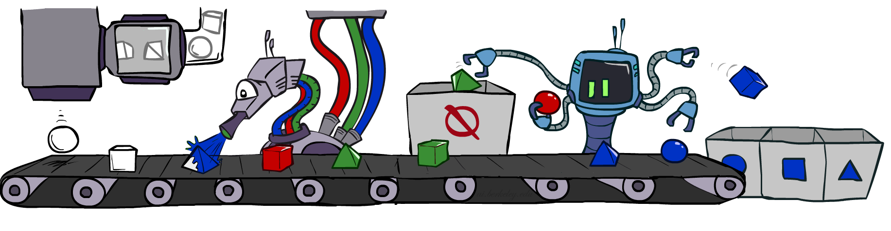
Rejection Sampling

Slide 15
Rejection Sampling
A simple modification of prior sampling for conditional probabilities
Let’s say we want P(C| r, w)
Count the C outcomes, but ignore (reject) samples that don’t have R=true, W=true
  This is called rejection sampling
  It is also consistent for conditional probabilities (i.e., correct in the limit)
C
S
R
W
  c, ¬s, r, w
  c, s, ¬r
  ¬c, s, r, ¬w
  c, ¬s, ¬r
  ¬c, ¬s, r, w

Slide 16
Rejection Sampling
Input: evidence e₁,..,e_{k}
For i=1, 2, …, n
  Sample X_{i} from P(X_{i} | parents(X_{i}))
  If x_{i} not consistent with evidence
    Reject: Return, and no sample is generated in this cycle
Return (x₁, x₂, …, x_{n})

Slide 17
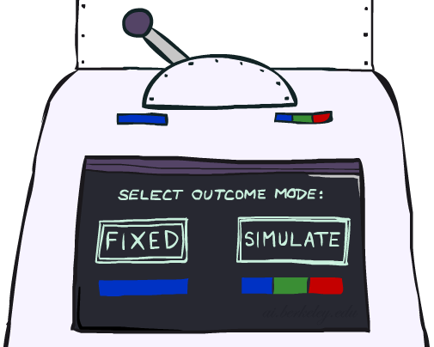
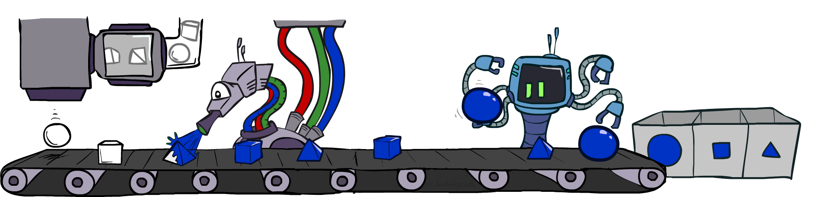
Likelihood Weighting

Slide 18
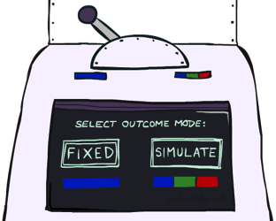


Likelihood Weighting
Problem with rejection sampling:
  If evidence is unlikely, rejects lots of samples
  Evidence not exploited as you sample
  Consider P(Shape|Color=blue)
Idea: fix evidence variables, sample the rest
  Problem: sample distribution not consistent!
  Solution: weight each sample by probability of evidence variables given parents
  pyramid, green
  pyramid, red
  sphere, blue
  cube, red
  sphere, green
  pyramid, blue
  pyramid, blue
  sphere, blue
  cube, blue
  sphere, blue
Shape
Color
Shape
Color

Slide 19
Likelihood Weighting
P(C)
c | 0.5
¬c | 0.5
P(S | C)
Cloudy
P(R | C)
Cloudy
c | s | 0.1
 | ¬s | 0.9
¬c | s | 0.5
 | ¬s | 0.5
c | r | 0.8
 | ¬r | 0.2
¬c | r | 0.2
 | ¬r | 0.8
Sprinkler
Sprinkler
Rain
Rain
P(W | S,R)
WetGrass
Samples:
WetGrass
s | r | w | 0.99
 |  | ¬w | 0.01
 | ¬r | w | 0.90
 |  | ¬w | 0.10
¬s | r | w | 0.90
 |  | ¬w | 0.10
 | ¬r | w | 0.01
 |  | ¬w | 0.99
c
, s, , w
r
w = 1.0
x 0.1
x 0.99

Slide 20
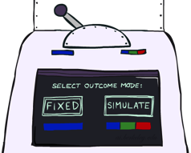
Likelihood Weighting
Input: evidence e₁,..,e_{k}
w = 1.0
for i=1, 2, …, n
  if X_{i} is an evidence variable
    x_{i} = observed value_{i} for X_{i}
    Set w = w * P(x_{i} | Parents(X_{i}))
  else
    Sample x_{i} from P(X_{i} | Parents(X_{i}))
return (x₁, x₂, …, x_{n}), w

Slide 21
Likelihood Weighting
Sampling distribution if Z sampled and e fixed evidence
S_{WS}(z,e) = ∏_{i} P(z_{i} | parents(Z_{i}))
Now, samples have weights
w(z,e) = ∏_{j} P(e_{j} | parents(E_{j}))
Together, weighted sampling distribution is consistent
S_{WS}(z,e) ⋅ w(z,e) = ∏_{i} P(z_{i} | parents(Z_{i})) ∏_{j} P(e_{j} | parents(E_{j}))
= P(z,e)
Cloudy
C
S
R
W

Slide 22
Likelihood Weighting
Likelihood weighting is good
  All samples are used
  The values of downstream variables are influenced by upstream evidence
Likelihood weighting still has weaknesses
  The values of upstream variables are unaffected by downstream evidence
    E.g., suppose evidence is a video of a traffic accident
  With evidence in k leaf nodes, weights will be O(2^{-k})
  With high probability, one lucky sample will have much larger weight than the others, dominating the result
We would like each variable to “see” all the evidence!

Slide 23
Break Quiz
Suppose I perform a random walk on a graph, following the arcs out of a node uniformly at random. In the infinite limit, what fraction of time do I spend at each node?
  Consider these two examples:
a
a
b
c
b
c

Slide 24
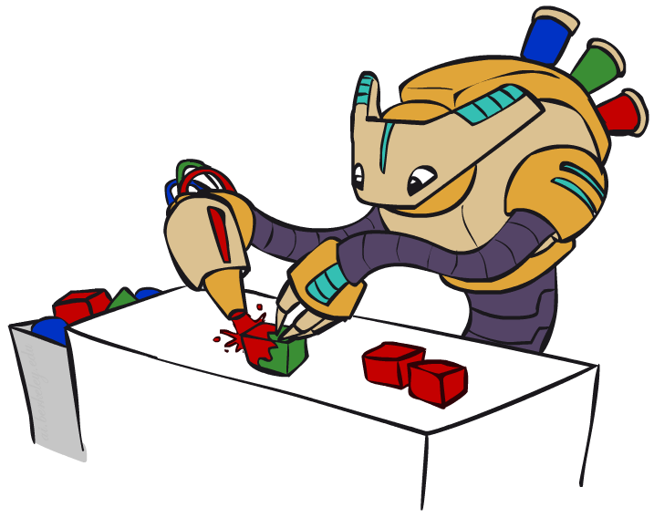
Gibbs Sampling

Slide 25
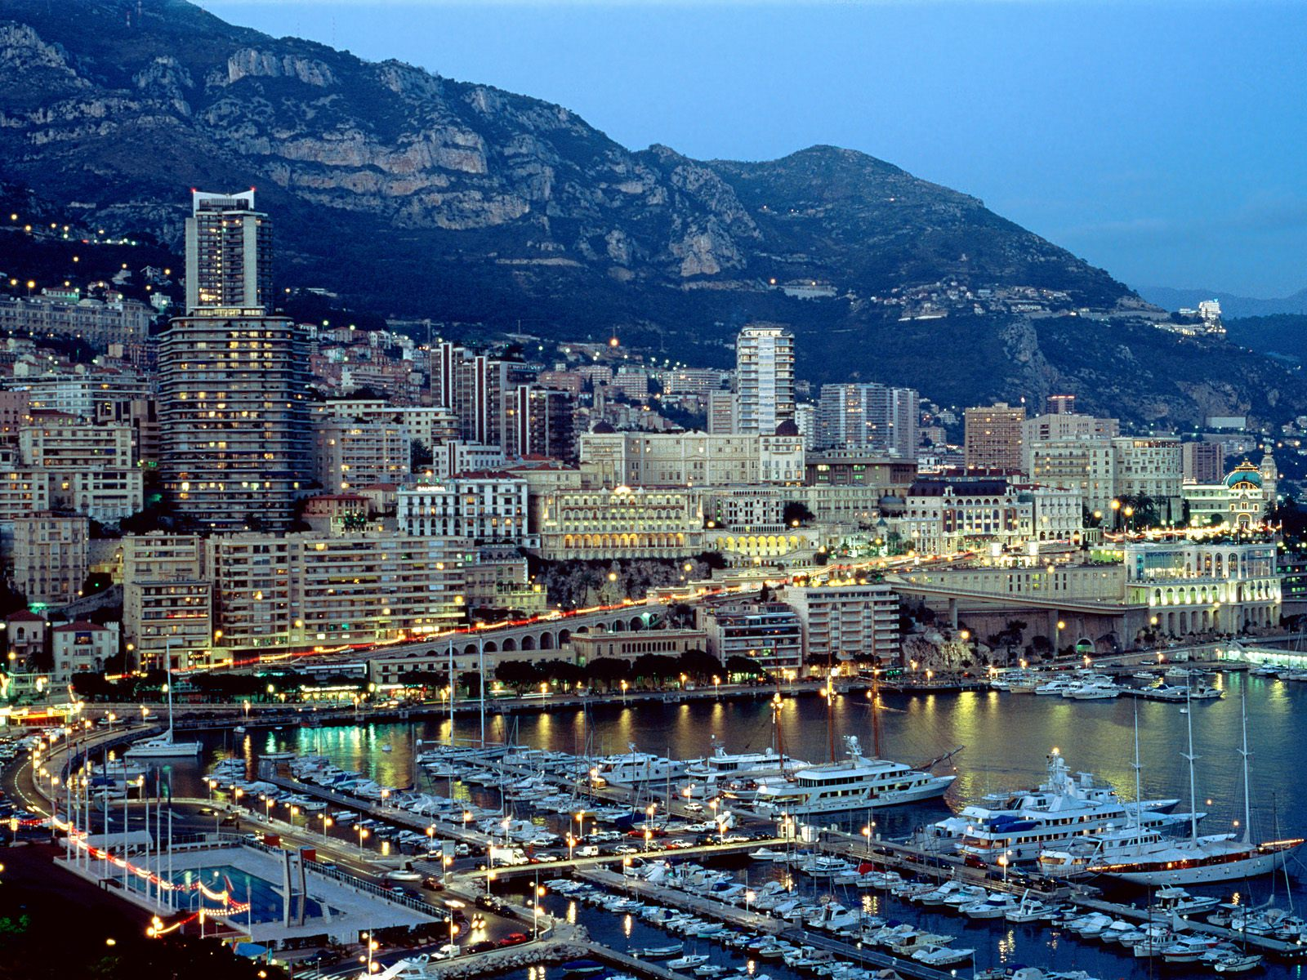
Markov Chain Monte Carlo
MCMC (Markov chain Monte Carlo) is a family of randomized algorithms for approximating some quantity of interest over a very large state space
  Markov chain = a sequence of randomly chosen states (“random walk”), where each state is chosen conditioned on the previous state
  Monte Carlo = a very expensive city in Monaco with a famous casino
  Monte Carlo = an algorithm (usually based on sampling) that has some probability of producing an incorrect answer
MCMC = wander around for a bit, average what you see

Slide 26
Gibbs sampling
A particular kind of MCMC
  States are complete assignments to all variables
    (Cf local search: closely related to min-conflicts, simulated annealing!)
  Evidence variables remain fixed, other variables change
  To generate the next state, pick a variable and sample a value for it conditioned on all the other variables (Cf min-conflicts!)
    X_{i}’ ~ P(X_{i} | x₁,..,x_{i-1},x_{i+1},..,x_{n})
    Will tend to move towards states of higher probability, but can go down too
    In a Bayes net, P(X_{i} | x₁,..,x_{i-1},x_{i+1},..,x_{n}) = P(X_{i} | markov_blanket(X_{i}))
Theorem: Gibbs sampling is consistent*
Provided all Gibbs distributions are bounded away from 0 and 1 and variable selection is fair

Slide 27
Why would anyone do this?
Samples soon begin to reflect all the evidence in the network
Eventually they are being drawn from the true posterior!

Slide 28
How would anyone do this?
  Repeat many times
    Sample a non-evidence variable X_{i} from
    P(X_{i} | x₁,..,x_{i-1},x_{i+1},..,x_{n}) = P(X_{i} | markov_blanket(X_{i}))
    = α P(X_{i} | parents (X_{i})) ∏_{j} P(y_{j} | parents(Y_{j}))

Slide 29
Gibbs Sampling Example: P( S | r)
Step 1: Fix evidence
  R = true
Step 3: Repeat
  Choose a non-evidence variable X
  Resample X from P(X | markov_blanket(X))
Step 2: Initialize other variables
  Randomly
C
C
S
r
S
r
W
W
C
C
C
C
C
C
S
r
S
r
S
r
S
r
S
r
S
r
W
W
W
W
W
W
Sample S ~ P(S | c, r, ¬w)
Sample C ~ P(C | s, r)
Sample W ~ P(W | s, r)
Notes:
Better animation

Slide 30
Why does it work? (see AIMA 14.5.2 for details)
Suppose we run it for a long time and predict the probability of reaching any given state at time t: π_{t}(x₁,...,x_{n}) or π_{t}(x)
    Each Gibbs sampling step (pick a variable, resample its value) applied to a state x has a probability q(x’ | x) of reaching a next state x’
    So π_{t+1}(x’) = ∑_{x} q(x’ | x) π_{t}(x) or, in matrix/vector form π_{t+1} = Qπ_{t}
When the process is in equilibrium π_{t+1} = π_{t} so Qπ_{t} = π_{t}
This has a unique* solution π_{t} = P(x₁,...,x_{n} | e₁,...,e_{k})
So for large enough t the next sample will be drawn from the true posterior
  “Large enough” depends on CPTs in the Bayes net; takes longer if nearly deterministic

Slide 31
Gibbs sampling and MCMC in practice
The most commonly used method for large Bayes nets
  See, e.g., BUGS, JAGS, STAN, infer.net, BLOG, etc.
Can be compiled to run very fast
  Eliminate all data structure references, just multiply and sample
  ~100 million samples per second on a laptop
Can run asynchronously in parallel (one processor per variable)
Many cognitive scientists suggest the brain runs on MCMC

Slide 32


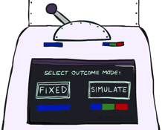
Bayes Net Sampling Summary
Prior Sampling P
Likelihood Weighting P( Q | e)
Rejection Sampling P( Q | e )
Gibbs Sampling P( Q | e )

