Slide 1
Announcements
HW 8 is out, due tonight at 11:59 pm
Project 4 due 4/12, this Friday

Slide 2
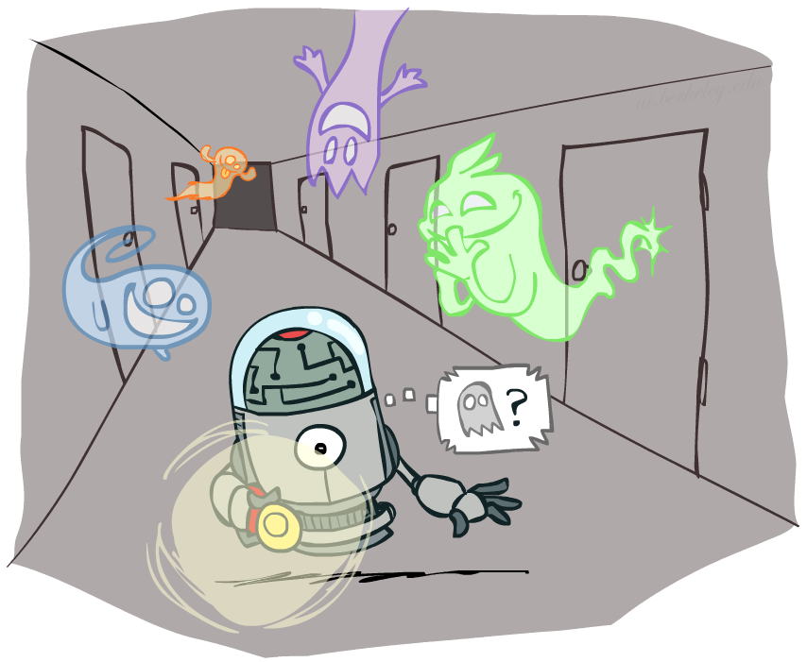
CS 188: Artificial Intelligence
Hidden Markov Models
Instructor: Sergey Levine and Stuart Russell --- University of California, Berkeley
[These slides were created by Dan Klein, Pieter Abbeel, and Sergey Levine. http://ai.berkeley.edu.]
Notes:
Please retain proper attribution, including the reference to ai.berkeley.edu. Thanks!

Slide 3

Markov Models
Basic conditional independence:
  Past and future independent given the present
  Each time step only depends on the previous
  This is called the (first order) Markov property

Slide 4
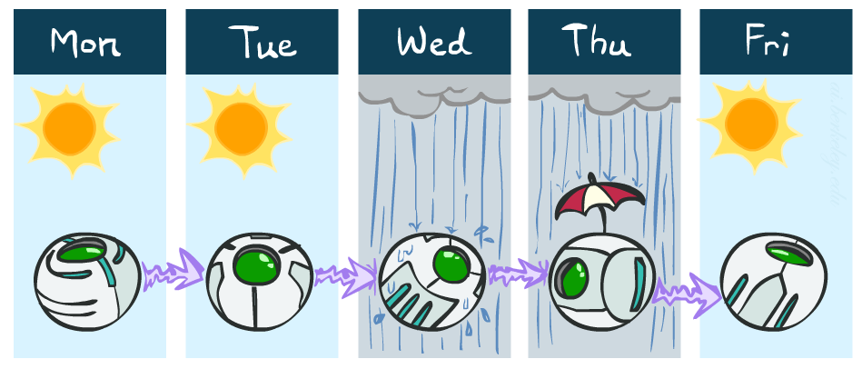
Example Markov Chain: Weather
States: X = {rain, sun}
Initial distribution: 0.5 sun
CPT P(X_{t} | X_{t-1}):
Two new ways of representing the same CPT
X_{t-1} | X_{t} | P(X_{t}|X_{t-1})
sun | sun | 0.9
sun | rain | 0.1
rain | sun | 0.3
rain | rain | 0.7
0.9
0.3
0.9
rain
sun
sun
sun
0.1
0.3
rain
rain
0.7
0.7
0.1

Slide 5
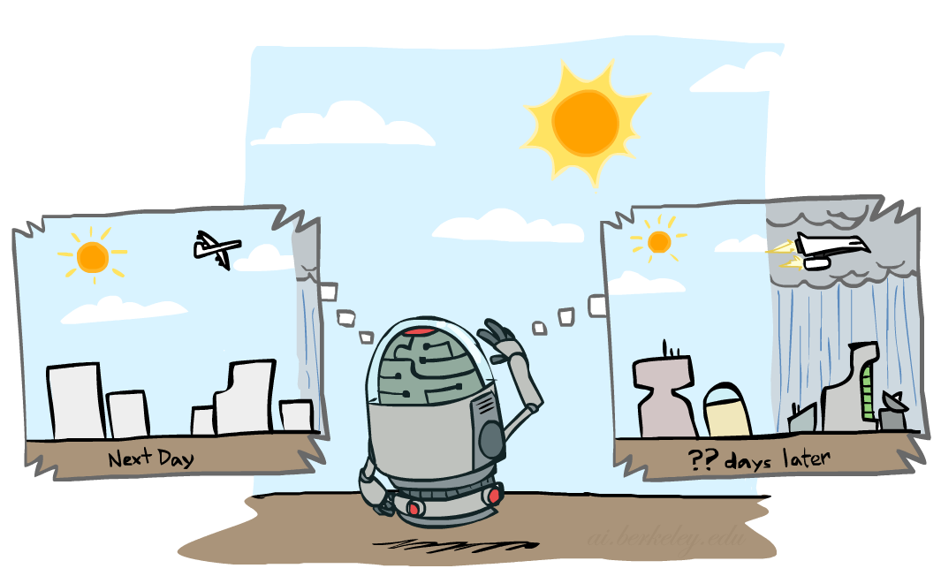

Forward Algorithm
Question: What’s P(X) on some day t?
X₁
X₂
X₃
X₄
Forward simulation

Slide 6
Stationary Distributions
Question: What’s P(X) at time t = infinity?
X₁
X₂
X₃
X₄
X_{t-1} | X_{t} | P(X_{t}|X_{t-1})
sun | sun | 0.9
sun | rain | 0.1
rain | sun | 0.3
rain | rain | 0.7
Also:

Slide 7

Hidden Markov Models
Markov chains not so useful for most agents
  Need observations to update your beliefs
Hidden Markov models (HMMs)
  Underlying Markov chain over states X
  You observe outputs (effects) at each time step
X₁
X₂
X₃
X₄
X₅
E₁
E₂
E₃
E₄
E₅

Slide 8


Example: Weather HMM
Rain_{t-1}
Rain_{t}
Rain_{t+1}
Umbrella_{t-1}
Umbrella_{t}
Umbrella_{t+1}
An HMM is defined by:
  Initial distribution:
  Transitions:
  Emissions:
R_{t} | R_{t+1} | P(R_{t+1}|R_{t})
+r | +r | 0.7
+r | -r | 0.3
-r | +r | 0.3
-r | -r | 0.7
R_{t} | U_{t} | P(U_{t}|R_{t})
+r | +u | 0.9
+r | -u | 0.1
-r | +u | 0.2
-r | -u | 0.8
Notes:
demo

Slide 9
Inference tasks
Filtering: P(X_{t}|e_{1:t})
  belief state—input to the decision process of a rational agent
Prediction: P(X_{t+k}|e_{1:t}) for k > 0
  evaluation of possible action sequences; like filtering without the evidence
Smoothing: P(X_{k}|e_{1:t}) for 0 ≤ k < t
  better estimate of past states, essential for learning
Most likely explanation: arg max_{x1:t} P(x_{1:t} | e_{1:t})
  speech recognition, decoding with a noisy channel

Slide 10
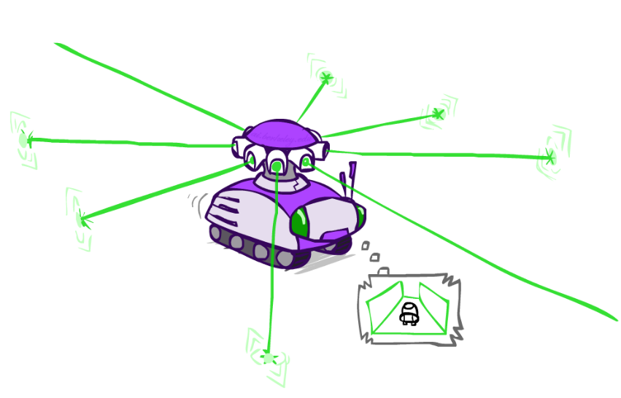
Example: Robot Localization
Example from Michael Pfeiffer
Prob
0
1
t=0
Sensor model: four bits for wall/no-wall in each direction, never more than 1 mistake
Transition model: action may fail with small prob.

Slide 11
Example: Robot Localization
Prob
0
1
t=1
Lighter grey: was possible to get the reading,
but less likely (required 1 mistake)

Slide 12
Example: Robot Localization
Prob
0
1
t=2

Slide 13
Example: Robot Localization
Prob
0
1
t=3

Slide 14
Example: Robot Localization
Prob
0
1
t=4

Slide 15
Example: Robot Localization
Prob
0
1
t=5

Slide 16
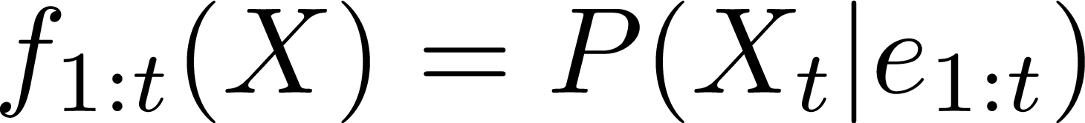

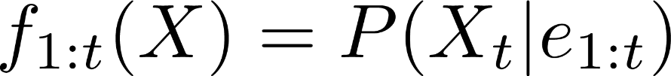
Filtering: Find State Given Past Evidence
We are given evidence at each time and want to know
Idea: start with P(X₁) and derive f_{1:t} in terms of f_{1:t-1}
  equivalently, derive f_{1:t+1} in terms of f_{1:t}

Slide 17


Two Steps: Passage of Time + Observation
X₁
X₂
X₃
X₄
X₅
E₁
E₂
E₃
E₄
E₅

Slide 18

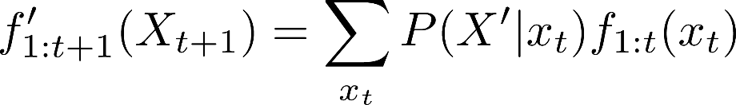
Passage of Time
Assume we have current belief
Then, after one time step passes:
Basic idea: beliefs get “pushed” through the transitions
X₁
X₂
Or compactly:
Notes:
TODO: intermediate step in derivation!

Slide 19


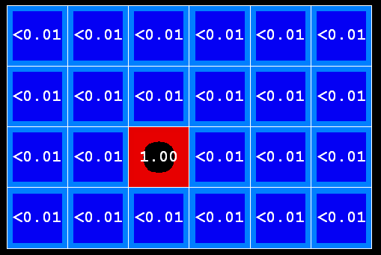
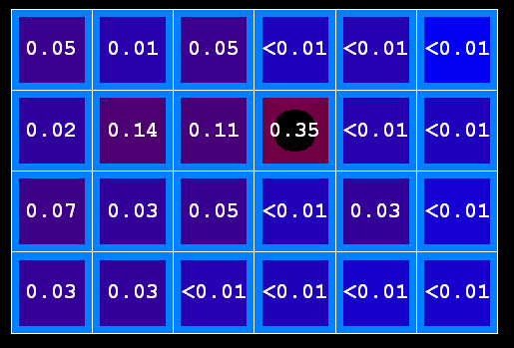
Example: Passage of Time
As time passes, uncertainty “accumulates”
(Transition model: ghosts usually go clockwise)
T = 1
T = 2
T = 5

Slide 20

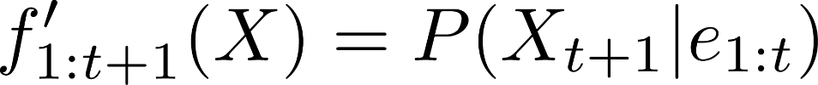
Observation
X₁
Assume we have current belief P(X | previous evidence):
Then, after evidence comes in:
Or, compactly:
E₁
Basic idea: beliefs “reweighted” by likelihood of evidence
Unlike passage of time, we have to renormalize
Notes:
Basic idea: beliefs “reweighted” by likelihood of evidence
Unlike passage of time, we have to renormalize

Slide 21


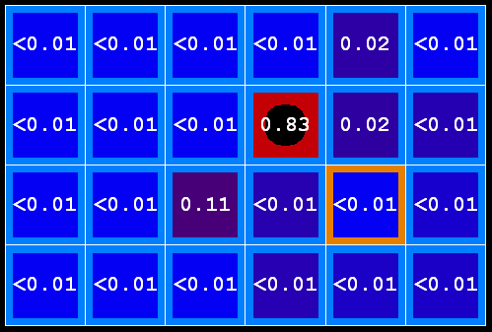
Example: Observation
As we get observations, beliefs get reweighted, uncertainty “decreases”
Before observation
After observation

Slide 22
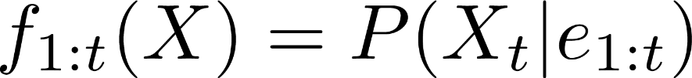
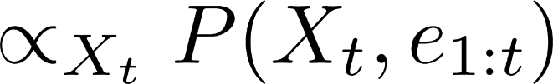
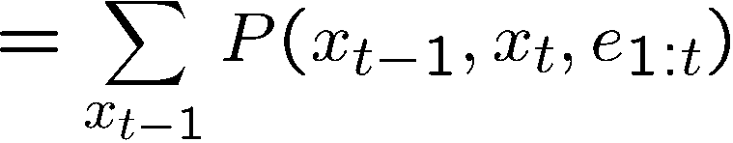
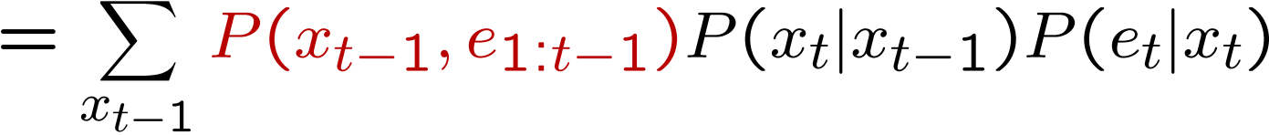
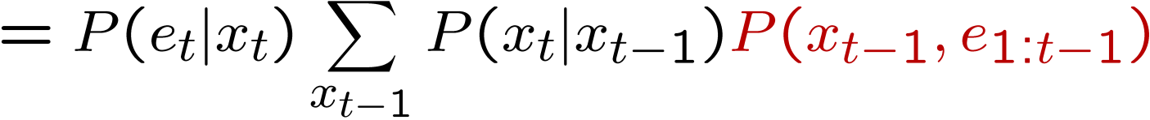
HMM Filtering Algorithm
We are given evidence at each time and want to know
We can derive the following updates
We can normalize as we go if we want to have P(x|e) at each time step, or just once at the end…
Notes:
TODO: explain propto and it’s X_t, not X

Slide 23
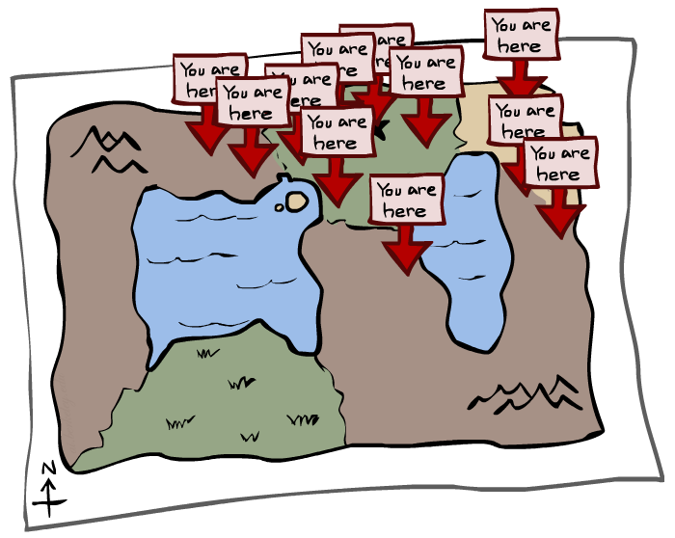
Particle Filtering

Slide 24
Particle Filtering
Filtering: approximate solution
Sometimes |X| is too big to use exact inference
  |X| may be too big to even store f(X)
  E.g. X is continuous
Solution: approximate inference
  Track samples of X, not all values
  Samples are called particles
  Time per step is linear in the number of samples
  But: number needed may be large
  In memory: list of particles, not states
This is how robot localization works in practice
Particle is just new name for sample
0.0
0.1
0.0
0.0
0.0
0.2
0.0
0.2
0.5

Slide 25
Representation: Particles
Our representation of P(X) is now a list of N particles (samples)
  Generally, N << |X|
  Storing map from X to counts would defeat the point
P(x) approximated by number of particles with value x
  So, many x may have P(x) = 0!
  More particles, more accuracy
For now, all particles have a weight of 1
Particles:
(3,3)
(2,3)
(3,3)
(3,2)
(3,3)
(3,2)
(1,2)
(3,3)
(3,3)
(2,3)

Slide 26

Particle Filtering: Elapse Time
Each particle is moved by sampling its next position from the transition model
  This is like prior sampling – samples’ frequencies reflect the transition probabilities
  Here, most samples move clockwise, but some move in another direction or stay in place
This captures the passage of time
  If enough samples, close to exact values before and after (consistent)
Particles:
(3,3)
(2,3)
(3,3)
(3,2)
(3,3)
(3,2)
(1,2)
(3,3)
(3,3)
(2,3)
Particles:
(3,2)
(2,3)
(3,2)
(3,1)
(3,3)
(3,2)
(1,3)
(2,3)
(3,2)
(2,2)

Slide 27


Particle Filtering: Observe
Particles:
(3,2)
(2,3)
(3,2)
(3,1)
(3,3)
(3,2)
(1,3)
(2,3)
(3,2)
(2,2)
Slightly trickier:
  Don’t sample observation, fix it
  Similar to likelihood weighting, downweight samples based on the evidence
  As before, the probabilities don’t sum to one, since all have been downweighted (in fact they now sum to (N times) an approximation of P(e))
Particles:
(3,2) w=.9
(2,3) w=.2
(3,2) w=.9
(3,1) w=.4
(3,3) w=.4
(3,2) w=.9
(1,3) w=.1
(2,3) w=.2
(3,2) w=.9
(2,2) w=.4

Slide 28
Particle Filtering: Resample
Rather than tracking weighted samples, we resample
N times, we choose from our weighted sample distribution (i.e. draw with replacement)
This is equivalent to renormalizing the distribution
Now the update is complete for this time step, continue with the next one
Particles:
(3,2) w=.9
(2,3) w=.2
(3,2) w=.9
(3,1) w=.4
(3,3) w=.4
(3,2) w=.9
(1,3) w=.1
(2,3) w=.2
(3,2) w=.9
(2,2) w=.4
(New) Particles:
(3,2)
(2,2)
(3,2)
(2,3)
(3,3)
(3,2)
(1,3)
(2,3)
(3,2)
(3,2)

Slide 29
Recap: Particle Filtering
Particles: track samples of states rather than an explicit distribution
Elapse
Weight
Resample
Particles:
(3,3)
(2,3)
(3,3)
(3,2)
(3,3)
(3,2)
(1,2)
(3,3)
(3,3)
(2,3)
Particles:
(3,2)
(2,3)
(3,2)
(3,1)
(3,3)
(3,2)
(1,3)
(2,3)
(3,2)
(2,2)
Particles:
(3,2) w=.9
(2,3) w=.2
(3,2) w=.9
(3,1) w=.4
(3,3) w=.4
(3,2) w=.9
(1,3) w=.1
(2,3) w=.2
(3,2) w=.9
(2,2) w=.4
(New) Particles:
(3,2)
(2,2)
(3,2)
(2,3)
(3,3)
(3,2)
(1,3)
(2,3)
(3,2)
(3,2)
[Demos: ghostbusters particle filtering (L15D3,4,5)]

Slide 30

Video of Demo – Moderate Number of Particles

Slide 31
Video of Demo – One Particle

Slide 32
Video of Demo – Huge Number of Particles

Slide 33
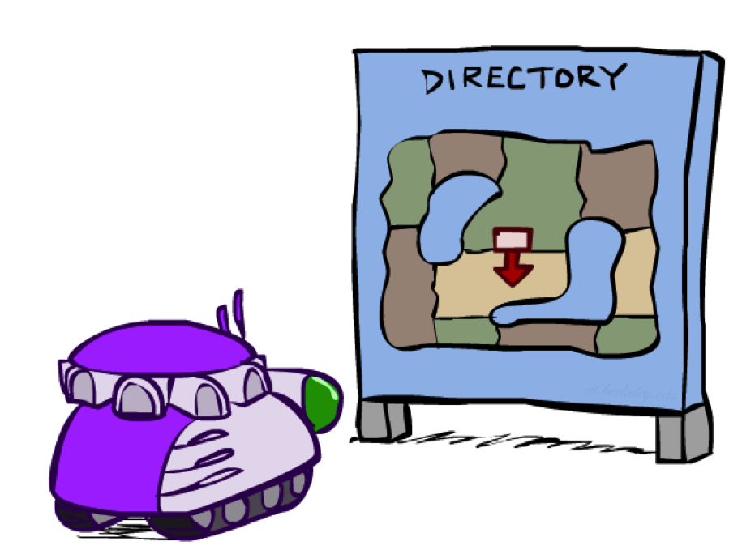
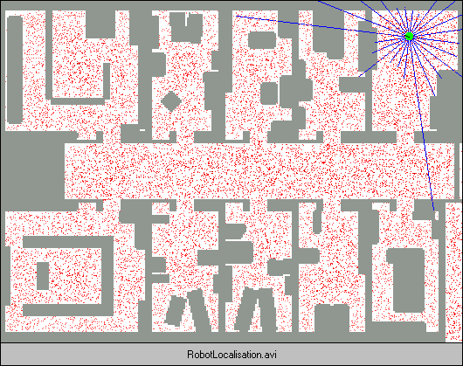
Robot Localization
In robot localization:
  We know the map, but not the robot’s position
  Observations may be vectors of range finder readings
  State space and readings are typically continuous (works basically like a very fine grid) and so we cannot store B(X)
  Particle filtering is a main technique

Slide 34
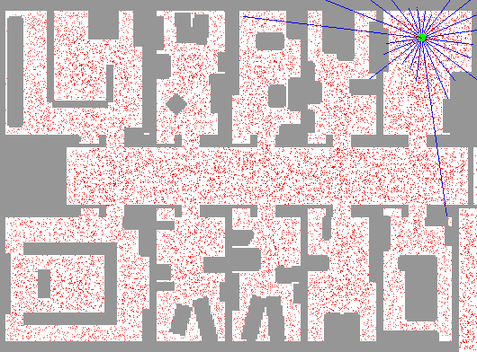
Example: Robot Localization

Slide 35

Particle Filter Localization (Sonar)
[Video: global-sonar-uw-annotated.avi]

Slide 36
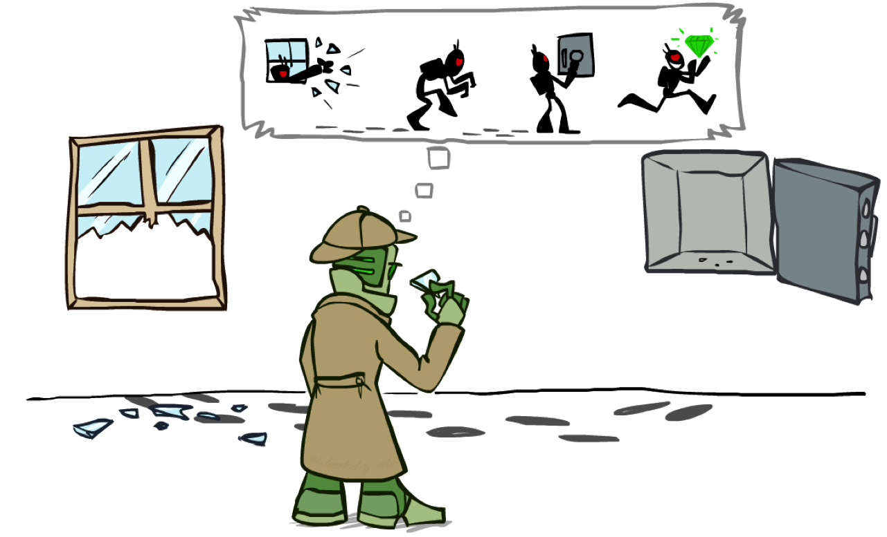
Most Likely Explanation

Slide 37

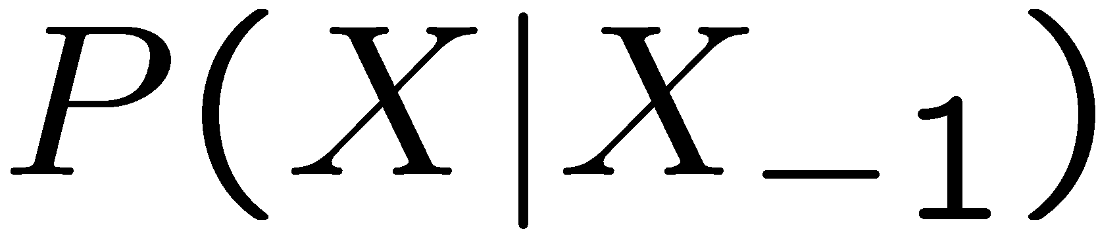
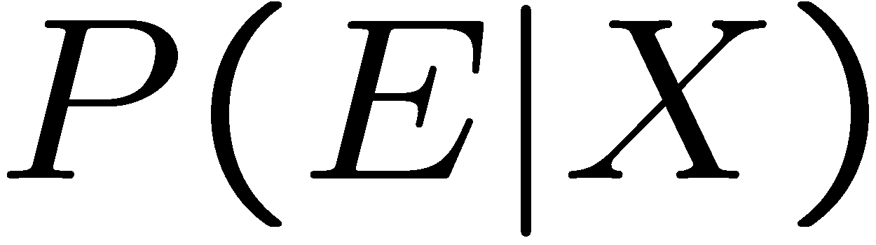
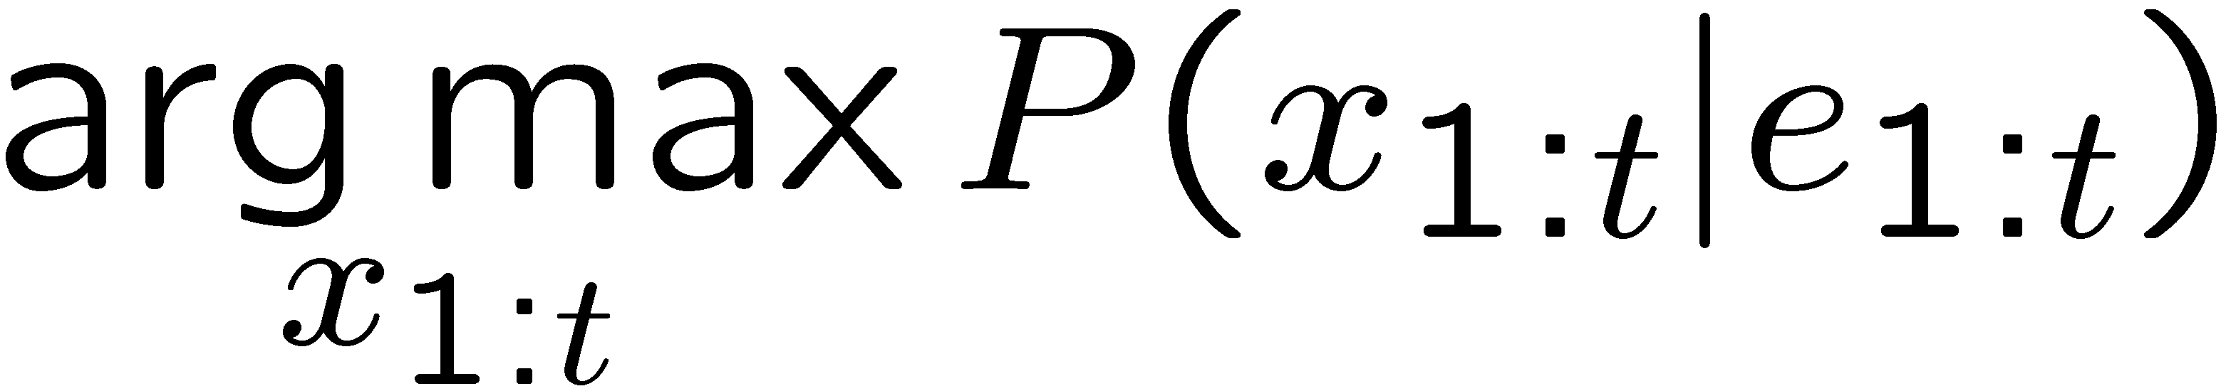
HMMs: MLE Queries
HMMs defined by
  States X
  Observations E
  Initial distribution:
  Transitions:
  Emissions:
New query: most likely explanation:
New method: the Viterbi algorithm
X₁
X₂
X₃
X₄
X₅
E₁
E₂
E₃
E₄
E₅

Slide 38
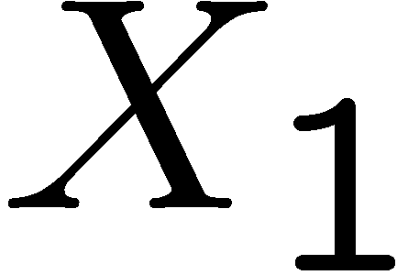
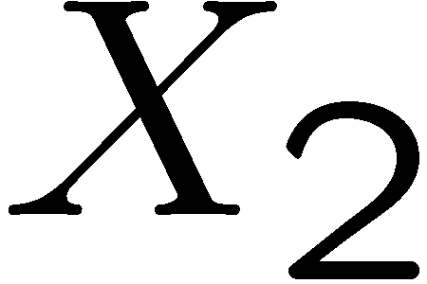

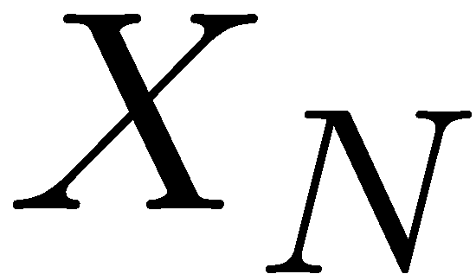

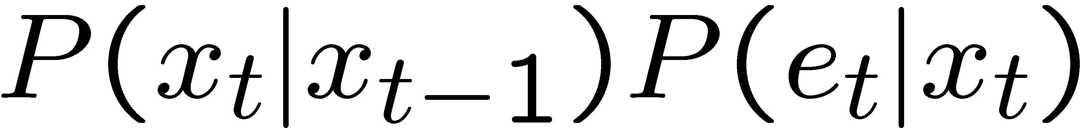
State Trellis
State trellis: graph of states and transitions over time
Each arc represents some transition
Each arc has weight
Each path is a sequence of states
The product of weights on a path is that sequence’s probability along with the evidence
Forward algorithm computes sums of paths, Viterbi computes best paths
sun
sun
sun
sun
rain
rain
rain
rain

Slide 39


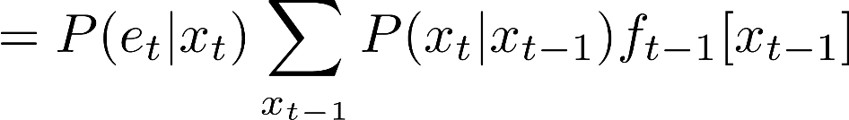
Finding the Most Likely Path
sun
sun
sun
sun
rain
rain
rain
rain
Forward Algorithm (Sum)
Viterbi Forward Phase (Max)

Slide 40




Why is This True?
sun
sun
sun
sun
rain
rain
rain
rain

Slide 41


Now What?
sun
sun
sun
sun
rain
rain
rain
rain

Slide 42












A Tricky Counter-Example
sun
sun
rain
rain

Slide 43
What do We Do?
sun
sun
rain
rain

Slide 44



Follow the Breadcrumbs…
sun
sun
sun
sun
rain
rain
rain
rain

Slide 45


Follow the Breadcrumbs…
sun
sun
sun
sun
rain
rain
rain
rain

Slide 46
Most Likely Explanation

Slide 47
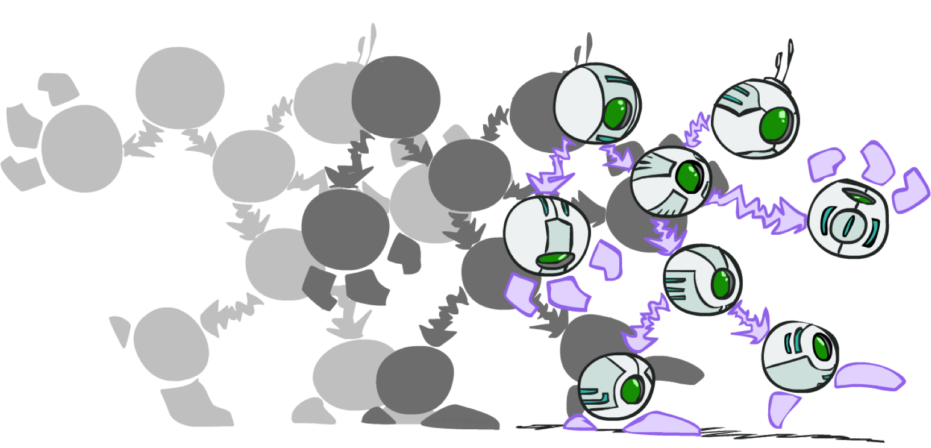
Dynamic Bayes Nets

Slide 48

Dynamic Bayes Nets (DBNs)
We want to track multiple variables over time, using multiple sources of evidence
Idea: Repeat a fixed Bayes net structure at each time
Variables from time t can condition on those from t-1
Dynamic Bayes nets are a generalization of HMMs
t =1
t =2
t =3
G₁ª
G₂ª
G₃ª
G₁^{b}
G₂^{b}
G₃^{b}
E₁ª
E₁^{b}
E₂ª
E₂^{b}
E₃ª
E₃^{b}

Slide 49
DBN Particle Filters
A particle is a complete sample for a time step
Initialize: Generate prior samples for the t=1 Bayes net
  Example particle: G₁ª = (3,3) G₁^{b} = (5,3)
Elapse time: Sample a successor for each particle
  Example successor: G₂ª = (2,3) G₂^{b} = (6,3)
Observe: Weight each entire sample by the likelihood of the evidence conditioned on the sample
  Likelihood: P(E₁ª |G₁ª ) * P(E₁^{b} |G₁^{b} )
Resample: Select prior samples (tuples of values) in proportion to their likelihood
Notes:
Dan has a demo here.

Slide 50
Exact Inference in DBNs
Variable elimination applies to dynamic Bayes nets
Procedure: “unroll” the network for T time steps, then eliminate variables until P(X_{T}|e_{1:T}) is computed
Online belief updates: Eliminate all variables from the previous time step; store factors for current time only
t =1
t =2
t =3
G₁ª
G₂ª
G₃ª
G₃^{b}
G₁^{b}
G₂^{b}
G₃^{b}
E₁ª
E₁^{b}
E₂ª
E₂^{b}
E₃ª
E₃^{b}

