Slide 1
Announcements
Project 4 due Friday
HW9 due next Monday

Slide 2
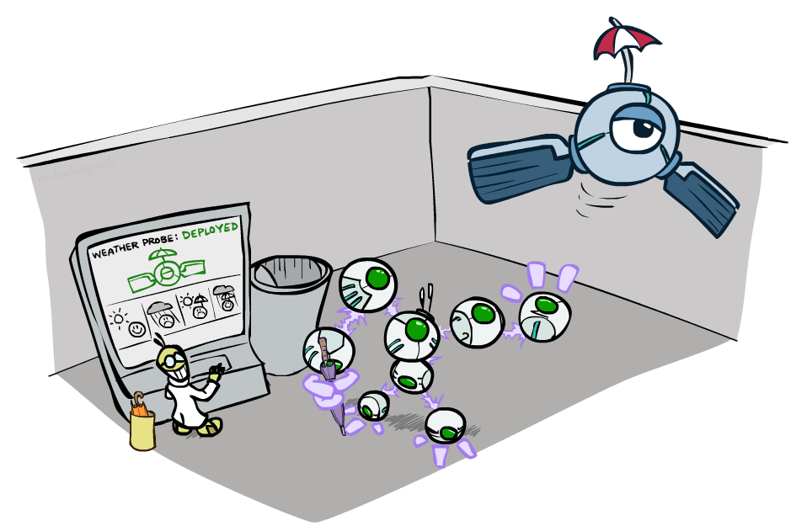
CS 188: Artificial Intelligence
Decision Networks and Value of Perfect Information
Instructors: Sergey Levine and Stuart Russell
University of California, Berkeley
[These slides were created by Dan Klein, Pieter Abbeel, Sergey Levine for CS188 Intro to AI at UC Berkeley. All CS188 materials are available at http://ai.berkeley.edu.]
Notes:
Please retain proper attribution, including the reference to ai.berkeley.edu. Thanks!

Slide 3
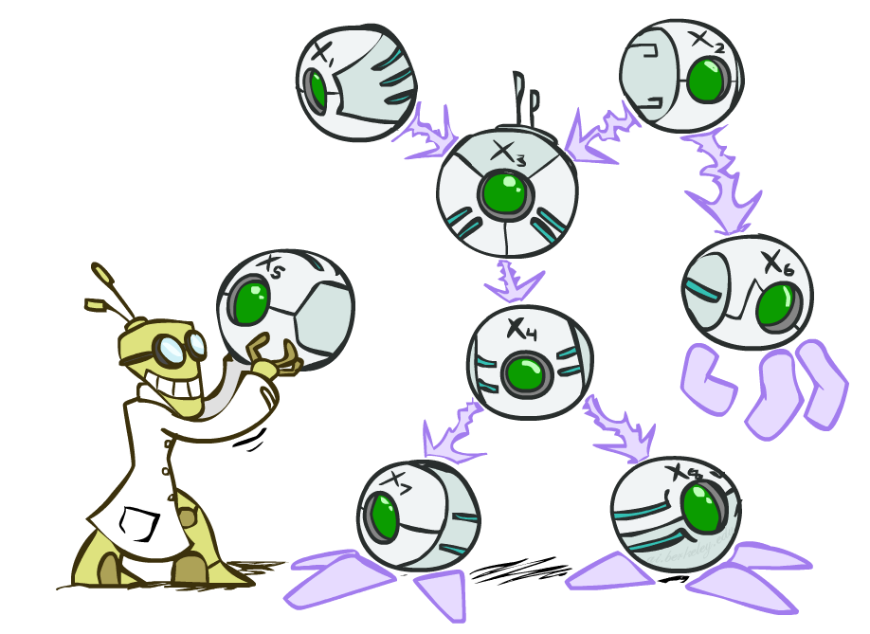
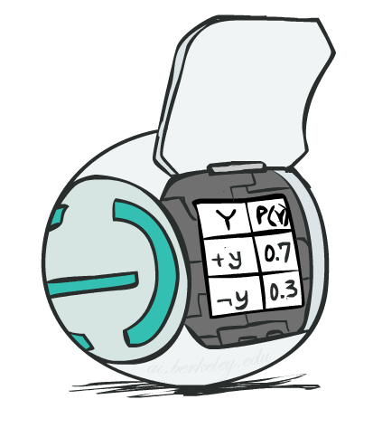
Bayes’ Net
A directed, acyclic graph, one node per random variable
A conditional probability table (CPT) for each node
A collection of distributions over X, one for each combination of parents’ values
Bayes’ nets implicitly encode joint distributions
As a product of local conditional distributions
To see what probability a BN gives to a full assignment, multiply all the relevant conditionals together:

Slide 4
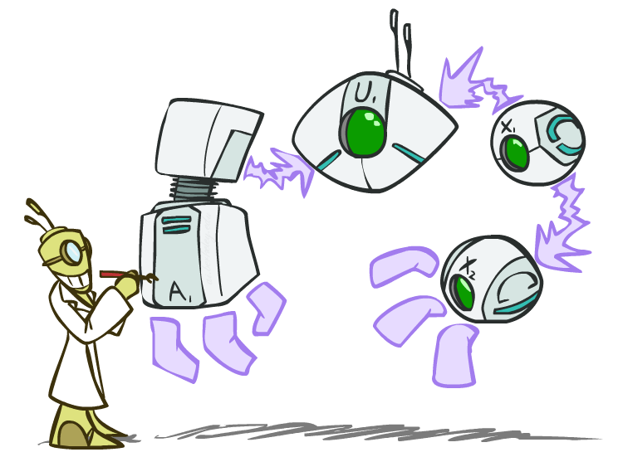
Decision Networks

Slide 5
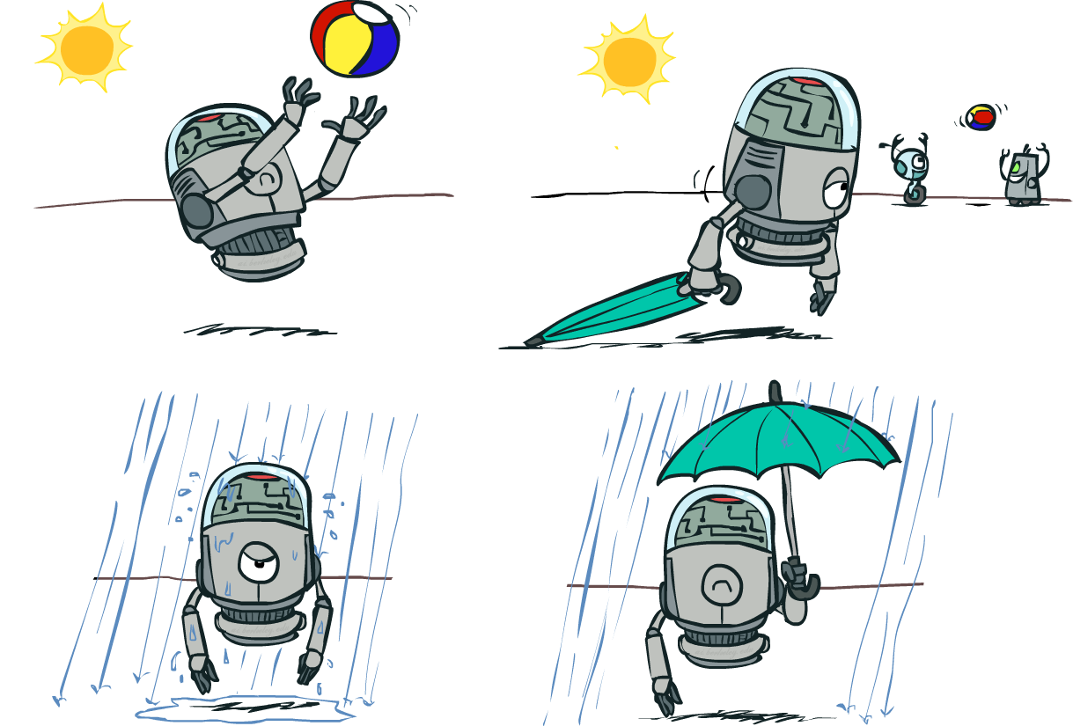
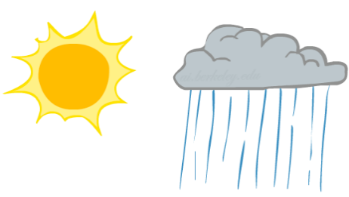
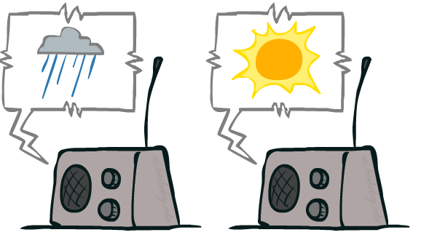
Decision Networks
Umbrella
U
Weather
Forecast
Notes:
There exists a ghostbusters demo

Slide 6
Decision Networks
MEU: choose the action which maximizes the expected utility given the evidence
Can directly operationalize this with decision networks
Bayes nets with nodes for utility and actions
Lets us calculate the expected utility for each action
New node types:
Chance nodes (just like BNs)
Actions (rectangles, cannot have parents, act as observed evidence)
Utility node (diamond, depends on action and chance nodes)
Umbrella
U
Weather
Forecast
Notes:
There exists a ghostbusters demo

Slide 7
Decision Networks
Action selection
Instantiate all evidence
Set action node(s) each possible way
Calculate posterior for all parents of utility node, given the evidence
Calculate expected utility for each action
Choose maximizing action
Umbrella
U
Weather
Forecast
Notes:
There exists a ghostbusters demo

Slide 8
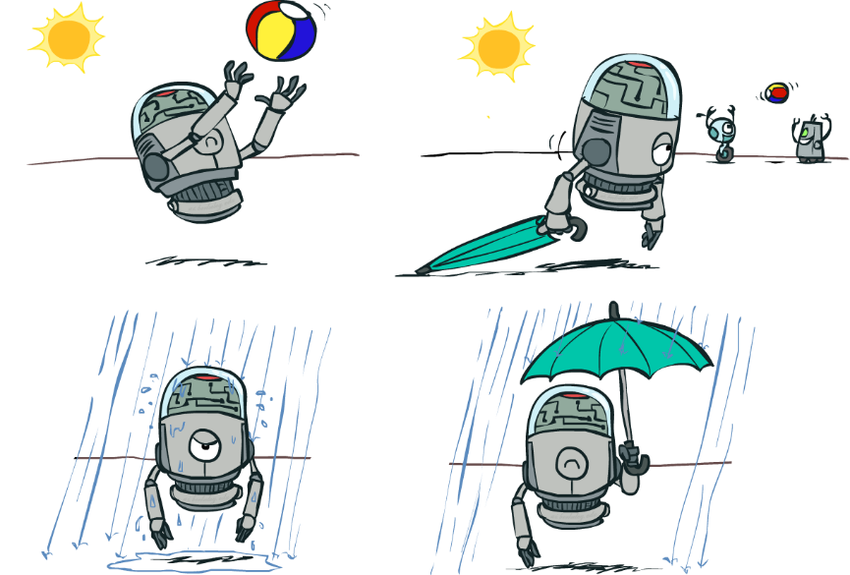
Decision Networks
Umbrella = leave
Umbrella
U
Umbrella = take
Weather
A | W | U(A,W)
leave | sun | 100
leave | rain | 0
take | sun | 20
take | rain | 70
W | P(W)
sun | 0.7
rain | 0.3
Optimal decision = leave
Notes:
There exists a ghostbusters demo

Slide 9
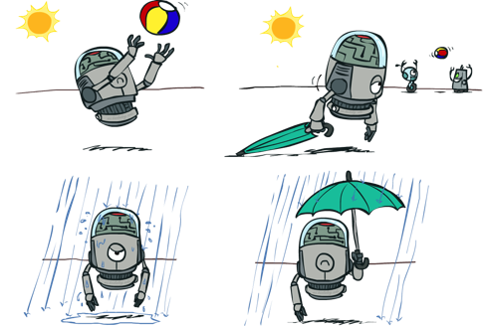
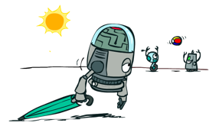
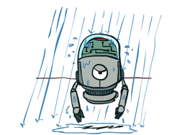
Decisions as Outcome Trees
{}
take
leave
Umbrella
Weather | {}
Weather | {}
U
sun
sun
Weather
rain
rain
U(t,s)
U(t,r)
U(l,s)
U(l,r)
Almost exactly like expectimax / MDPs

Slide 10
Example: Decision Networks
Umbrella = leave
A | W | U(A,W)
leave | sun | 100
leave | rain | 0
take | sun | 20
take | rain | 70
Umbrella
U
Umbrella = take
Weather
W | P(W|F=bad)
sun | 0.34
rain | 0.66
Optimal decision = take
Forecast
=bad

Slide 11
Decisions as Outcome Trees
Umbrella
{b}
take
leave
U
W | {b}
W | {b}
Weather
sun
sun
rain
rain
U(t,s)
U(t,r)
U(l,s)
U(l,r)
Forecast
=bad

Slide 12
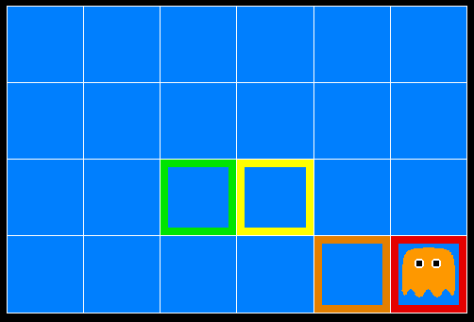
Inference in Ghostbusters
A ghost is in the grid somewhere
Sensor readings tell how close a square is to the ghost
On the ghost: red
1 or 2 away: orange
3 or 4 away: yellow
5+ away: green
Sensors are noisy, but we know P(Color | Distance)
P(red | 3) | P(orange | 3) | P(yellow | 3) | P(green | 3)
0.05 | 0.15 | 0.5 | 0.3

Slide 13
Video of Demo Ghostbusters with Probability

Slide 14
Ghostbusters Decision Network
Bust
U
Ghost Location
…
Sensor (1,1)
Sensor (1,2)
Sensor (1,3)
Sensor (1,n)
Sensor (2,1)
…
…
…
Sensor (m,1)
Sensor (m,n)

Slide 15
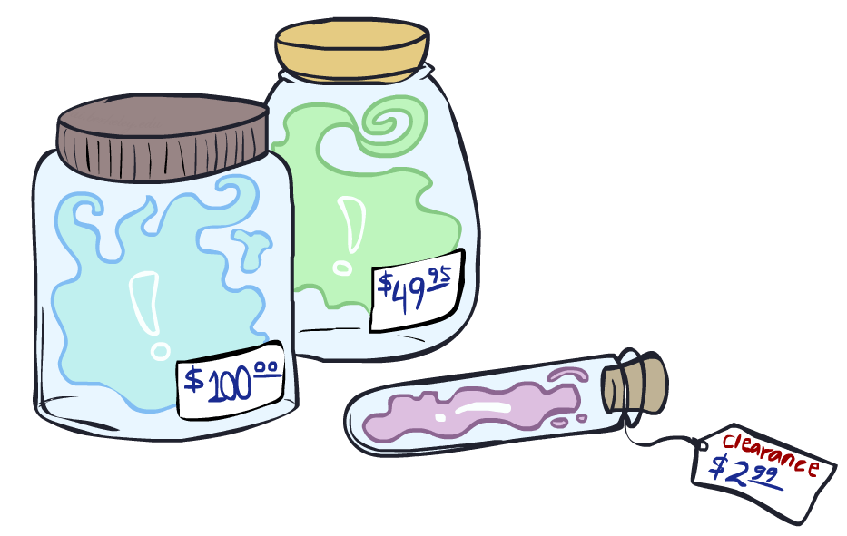
Value of Information

Slide 16
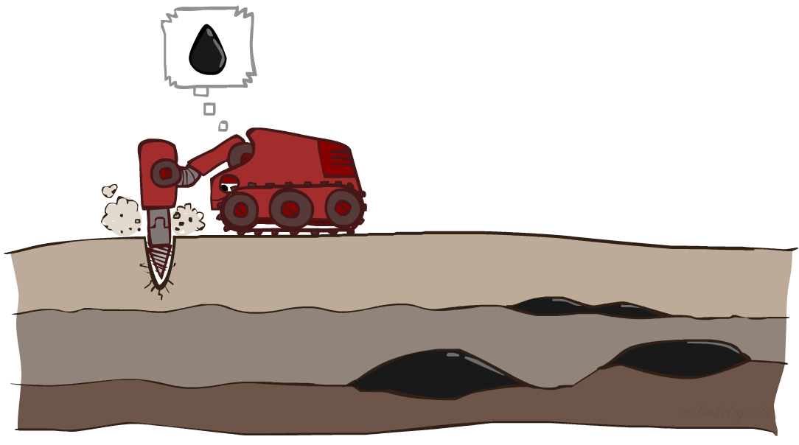
Value of Information
Idea: compute value of acquiring evidence
Can be done directly from decision network
Example: buying oil drilling rights
Two blocks A and B, exactly one has oil, worth k
You can drill in one location
Prior probabilities 0.5 each, & mutually exclusive
Drilling in either A or B has EU = k/2, MEU = k/2
Question: what’s the value of information of O?
Value of knowing which of A or B has oil
Value is expected gain in MEU from new info
Survey may say “oil in a” or “oil in b,” prob 0.5 each
If we know OilLoc, MEU is k (either way)
Gain in MEU from knowing OilLoc?
VPI(OilLoc) = k/2
Fair price of information: k/2
D | O | U
a | a | k
a | b | 0
b | a | 0
b | b | k
DrillLoc
U
O | P
a | 1/2
b | 1/2
OilLoc

Slide 17
VPI Example: Weather
MEU with no evidence
Umbrella
A | W | U
leave | sun | 100
leave | rain | 0
take | sun | 20
take | rain | 70
U
MEU if forecast is bad
Weather
MEU if forecast is good
Forecast
Forecast distribution
F | P(F)
good | 0.59
bad | 0.41

Slide 18
Value of Information
{+e}
Assume we have evidence E=e. Value if we act now:
Assume we see that E’ = e’. Value if we act then:
BUT E’ is a random variable whose value is
unknown, so we don’t know what e’ will be
Expected value if E’ is revealed and then we act:
Value of information: how much MEU goes up
by revealing E’ first then acting, over acting now:
a
P(s | +e)
U
{+e, +e’}
a
P(s | +e, +e’)
U
{+e}
P(+e’ | +e)
P(-e’ | +e)
{+e, +e’}
{+e, -e’}
a

Slide 19
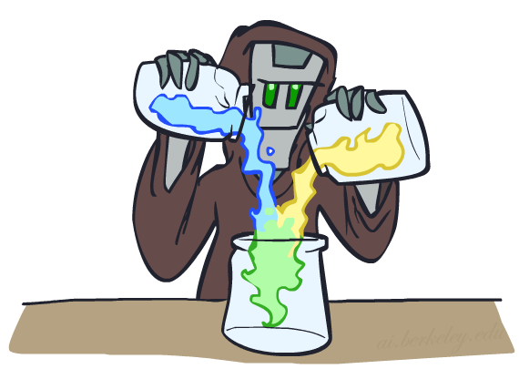
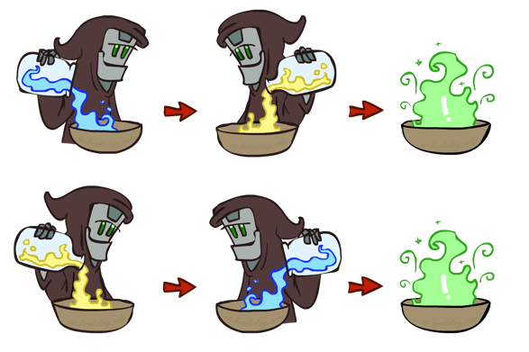
VPI Properties
Can it be negative?
Is it additive?
(think of observing E_{j} twice)
Is it order-dependent?

Slide 20
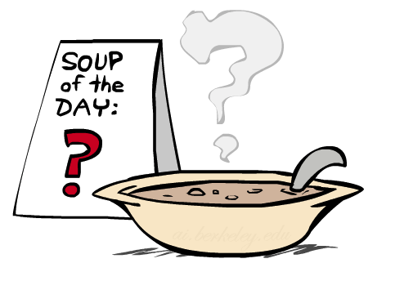
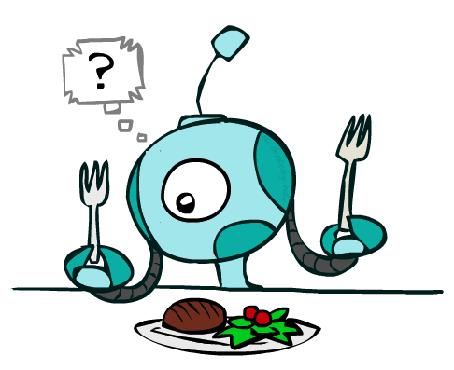
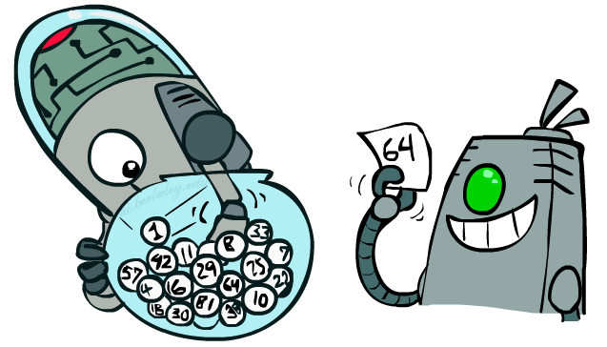
Quick VPI Questions
The soup of the day is either clam chowder or split pea, but you wouldn’t order either one. What’s the value of knowing which it is?
There are two kinds of plastic forks at a picnic. One kind is slightly sturdier. What’s the value of knowing which?
You’re playing the lottery. The prize will be $0 or $100. You can play any number between 1 and 100 (chance of winning is 1%). What is the value of knowing the winning number?

Slide 21
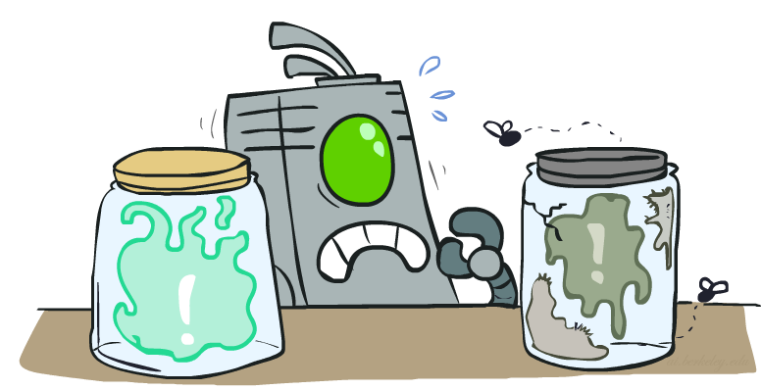
Value of Imperfect Information?
No such thing
Information corresponds to the observation of a node in the decision network
If data is “noisy” that just means we don’t observe the original variable, but another variable which is a noisy version of the original one

Slide 22
VPI Question
VPI(OilLoc) ?
VPI(ScoutingReport) ?
VPI(Scout) ?
VPI(Scout | ScoutingReport) ?
Generally:
If Parents(U) Z | CurrentEvidence
Then VPI( Z | CurrentEvidence) = 0
DrillLoc
U
Scout
OilLoc
Scouting
Report

Slide 23
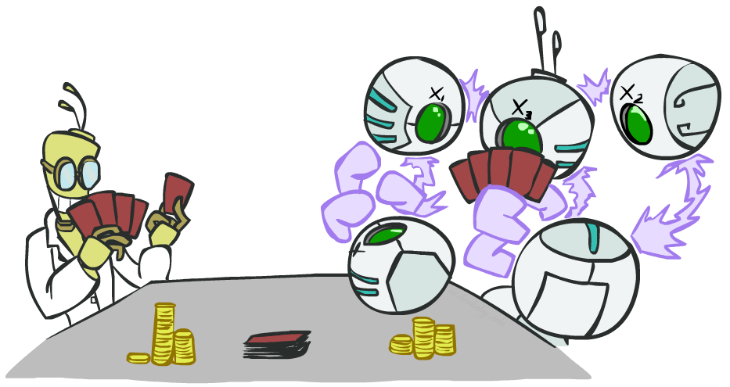
POMDPs

Slide 24
POMDPs
MDPs have:
States S
Actions A
Transition function P(s’|s,a) (or T(s,a,s’))
Rewards R(s,a,s’)
POMDPs add:
Observations O
Observation function P(o|s) (or O(s,o))
POMDPs are MDPs over belief
states b (distributions over S)
s
a
s, a
s,a,s’
s’
b
a
b, a
o
b’

Slide 25
Example: Ghostbusters
In Ghostbusters:
Belief state determined by evidence to date {e}
Tree really over evidence sets
Probabilistic reasoning needed to predict new evidence given past evidence
Solving POMDPs
One way: use truncated expectimax to compute approximate value of actions
What if you only considered busting or one sense followed by a bust?
You get a VPI-based agent!
b
{e}
a
a
b, a
e, a
e’
e’
b’
{e, e’}
{e}
a_{bust}
a_{sense}
{e}, a_{sense}
U(a_{bust}, {e})
e’
{e, e’}
a_{bust}
U(a_{bust}, {e, e’})

Slide 26
Video of Demo Ghostbusters with VPI

Slide 27
POMDPs as Decision Networks
MDPs have:
States S
Actions A
Transition function P(s’|s,a) (or T(s,a,s’))
Rewards R(s,a,s’)
POMDPs add:
Observations O
Observation function P(o|s) (or O(s,o))

Slide 28
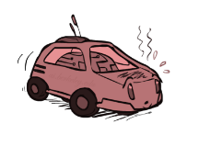
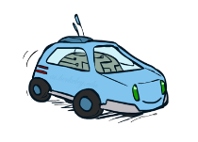
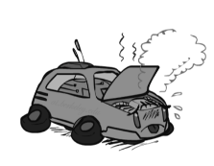
POMDPs More Generally*
0.5
+1
1.0
How can we solve POMDPs?
Fast
s
+1
Slow
-10
0.5
a
Slow
Warm
Fast
0.5
+2
s, a
Cool
0.5
Overheated
1.0
+1
+2
s,a,s’
s’
vector of three continuous numbers!
b
a
b, a
o
b’

Slide 29
POMDPs More Generally*
General solutions map belief functions to actions
Can divide regions of belief space (set of belief functions) into policy regions (gets complex quickly)
Can build approximate policies
Can factor belief functions in various ways
Overall, POMDPs are very (actually PSPACE-) hard
Most real problems are POMDPs, but we can rarely solve then in general!

Slide 30
Up Next: Learning
So far, we’ve seen…
Search and decision making problems:
Search
Games
CSPs
MDPs
Reasoning with uncertainty:
Bayes nets
HMMs, decision networks
Next week: learning!

