Slide 1

CS 188: Artificial Intelligence
Discriminative Learning
Instructors: Sergey Levine and Stuart Russell --- University of California, Berkeley
[These slides were created by Dan Klein, Pieter Abbeel, Sergey Levine. All CS188 materials are at http://ai.berkeley.edu.]
Notes:
Please retain proper attribution, including the reference to ai.berkeley.edu. Thanks!

Slide 2
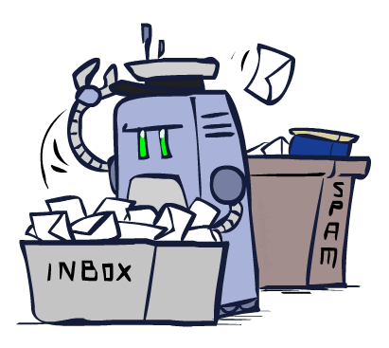
Classification

Slide 3
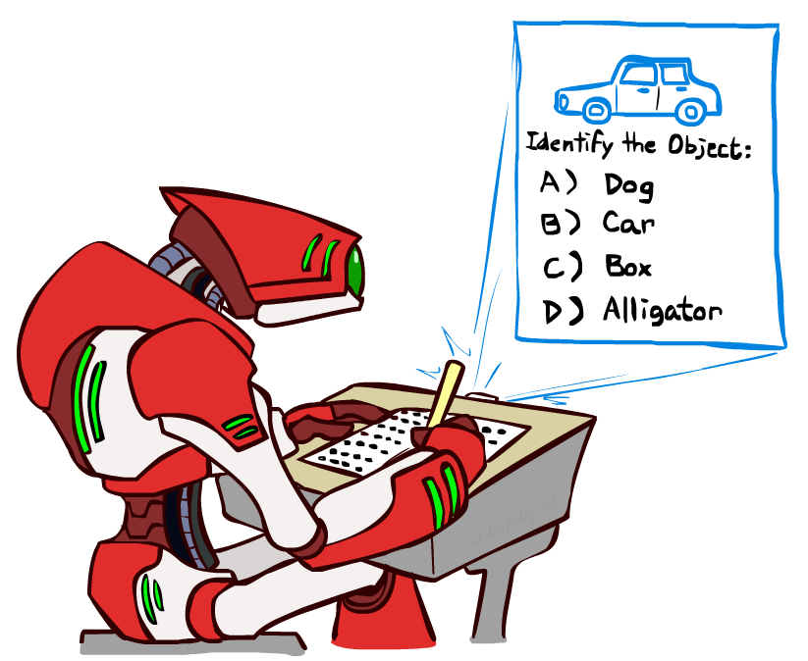


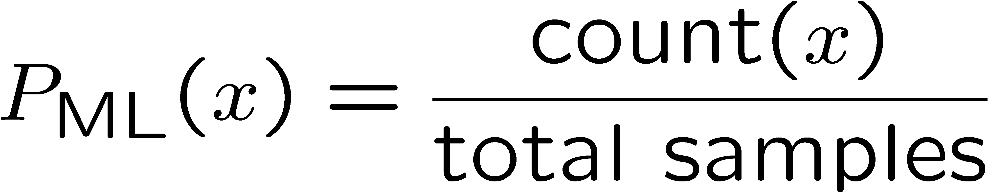
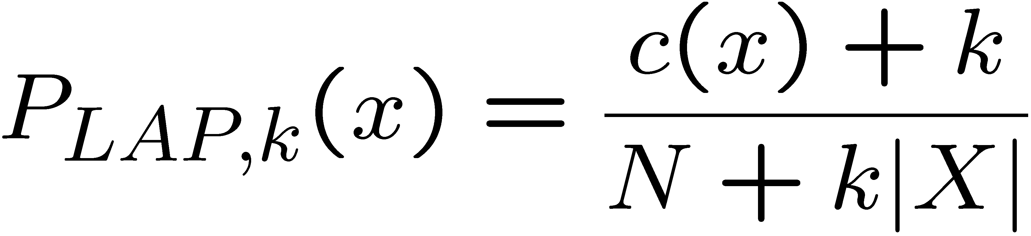
Last Time
Classification: given inputs x, predict labels (classes) y
Naïve Bayes
Parameter estimation:
  MLE, MAP, priors
Laplace smoothing
Training set, held-out set, test set
Y
F₁
F₂
F_{n}

Slide 4
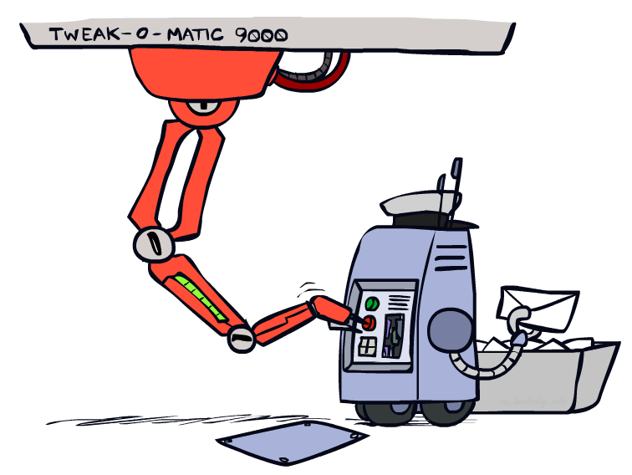
Tuning

Slide 5








Tuning on Held-Out Data
Now we’ve got two kinds of unknowns
  Parameters: the probabilities P(X|Y), P(Y)
  Hyperparameters: e.g. the amount / type of smoothing to do, k, α
What should we learn where?
  Learn parameters from training data
  Tune hyperparameters on different data
    Why?
  For each value of the hyperparameters, train and test on the held-out data
  Choose the best value and do a final test on the test data

Slide 6
Baselines
First step: get a baseline
  Baselines are very simple “straw man” procedures
  Help determine how hard the task is
  Help know what a “good” accuracy is
Weak baseline: most frequent label classifier
  Gives all test instances whatever label was most common in the training set
  E.g. for spam filtering, might label everything as ham
  Accuracy might be very high if the problem is skewed
  E.g. calling everything “ham” gets 66%, so a classifier that gets 70% isn’t very good…
For real research, usually use previous work as a (strong) baseline

Slide 7
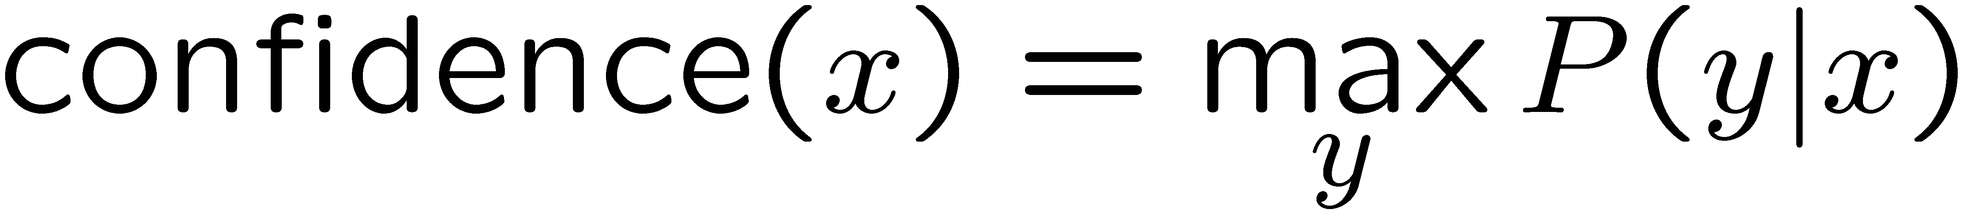

Confidences from a Classifier
The confidence of a probabilistic classifier:
  Posterior over the top label
  Represents how sure the classifier is of the classification
  Any probabilistic model will have confidences
  No guarantee confidence is correct
Calibration
  Weak calibration: higher confidences mean higher accuracy
  Strong calibration: confidence predicts accuracy rate
  What’s the value of calibration?

Slide 8
Errors, and What to Do
Examples of errors
Dear GlobalSCAPE Customer,
GlobalSCAPE has partnered with ScanSoft to offer you the latest version of OmniPage Pro, for just $99.99* - the regular list price is $499! The most common question we've received about this offer is - Is this genuine? We would like to assure you that this offer is authorized by ScanSoft, is genuine and valid. You can get the . . .
. . . To receive your $30 Amazon.com promotional certificate, click through to
http://www.amazon.com/apparel
and see the prominent link for the $30 offer. All details are there. We hope you enjoyed receiving this message. However, if you'd rather not receive future e-mails announcing new store launches, please click . . .

Slide 9
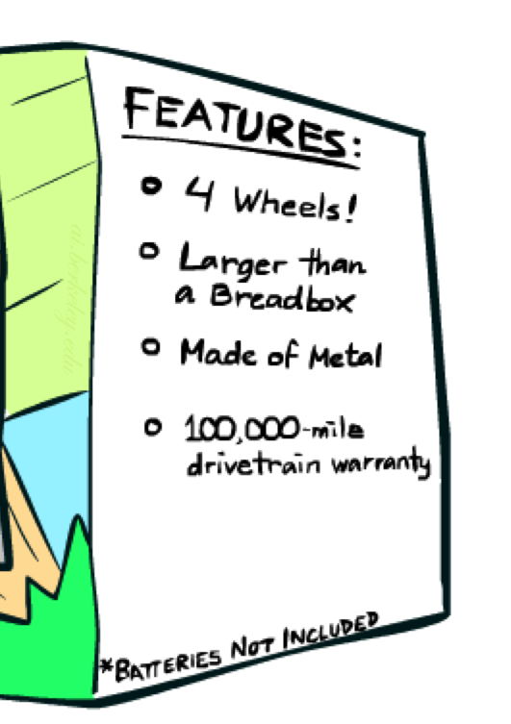
What to Do About Errors?
Need more features– words aren’t enough!
  Have you emailed the sender before?
  Have 1K other people just gotten the same email?
  Is the sending information consistent?
  Is the email in ALL CAPS?
  Do inline URLs point where they say they point?
  Does the email address you by (your) name?
Can add these information sources as new variables in the NB model
…but NB must model all of the features
Features often not independent, NB is not a good model in this case

Slide 10
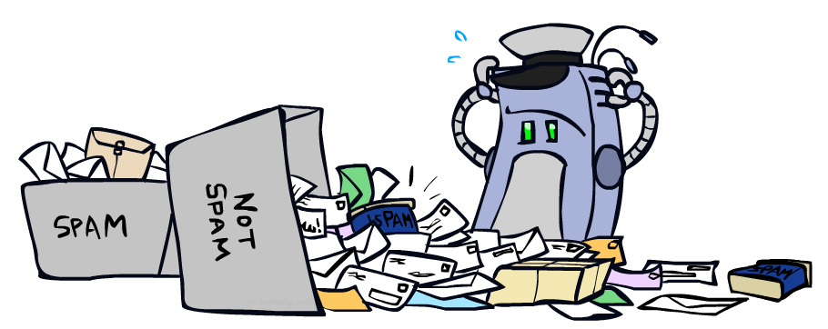
Error-Driven Classification

Slide 11
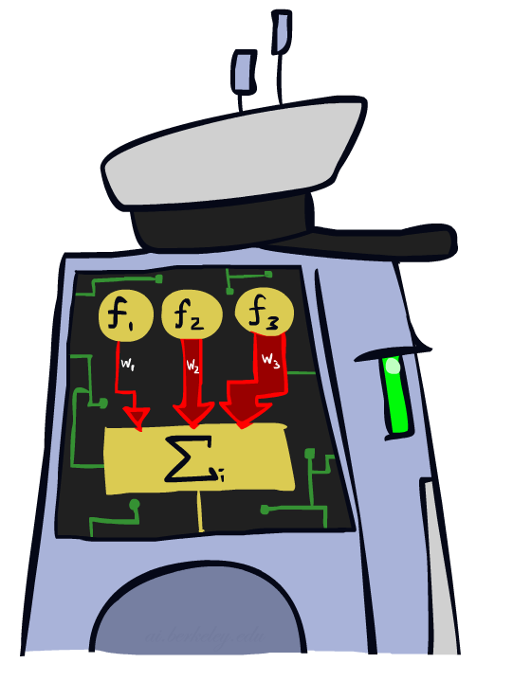
Linear Classifiers

Slide 12
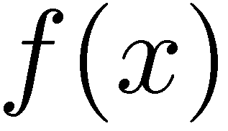



Feature Vectors
Hello,
Do you want free printr cartriges? Why pay more when you can get them ABSOLUTELY FREE! Just
# free : 2
YOUR_NAME : 0
MISSPELLED : 2
FROM_FRIEND : 0
...
SPAM
or
+
PIXEL-7,12 : 1
PIXEL-7,13 : 0
...
NUM_LOOPS : 1
...
“2”

Slide 13

Some (Simplified) Biology
Very loose inspiration: human neurons

Slide 14
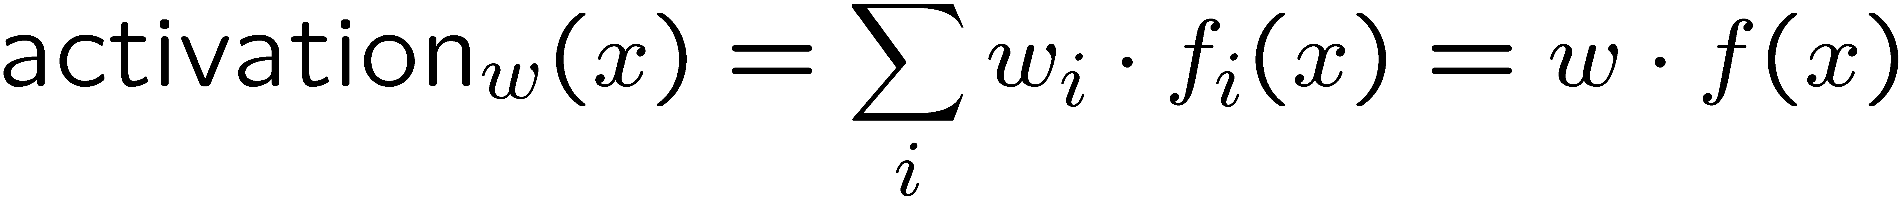
Linear Classifiers
Inputs are feature values
Each feature has a weight
Sum is the activation
If the activation is:
  Positive, output +1
  Negative, output -1
w₁
f₁
Σ
w₂
>0?
f₂
w₃
f₃

Slide 15


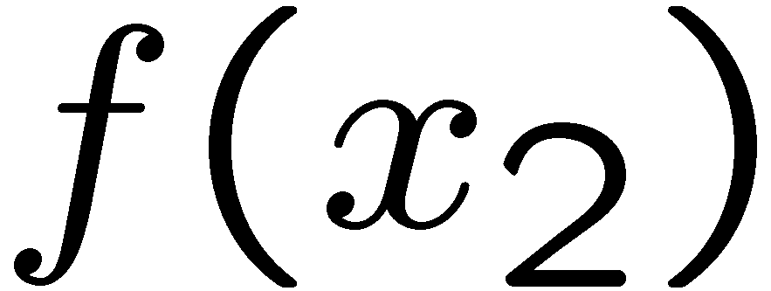
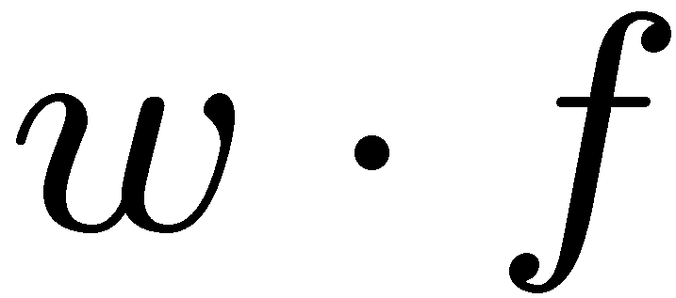
Weights
Binary case: compare features to a weight vector
Learning: figure out the weight vector from examples
# free : 4
YOUR_NAME :-1
MISSPELLED : 1
FROM_FRIEND :-3
...
# free : 2
YOUR_NAME : 0
MISSPELLED : 2
FROM_FRIEND : 0
...
# free : 0
YOUR_NAME : 1
MISSPELLED : 1
FROM_FRIEND : 1
...
Dot product positive means the positive class

Slide 16
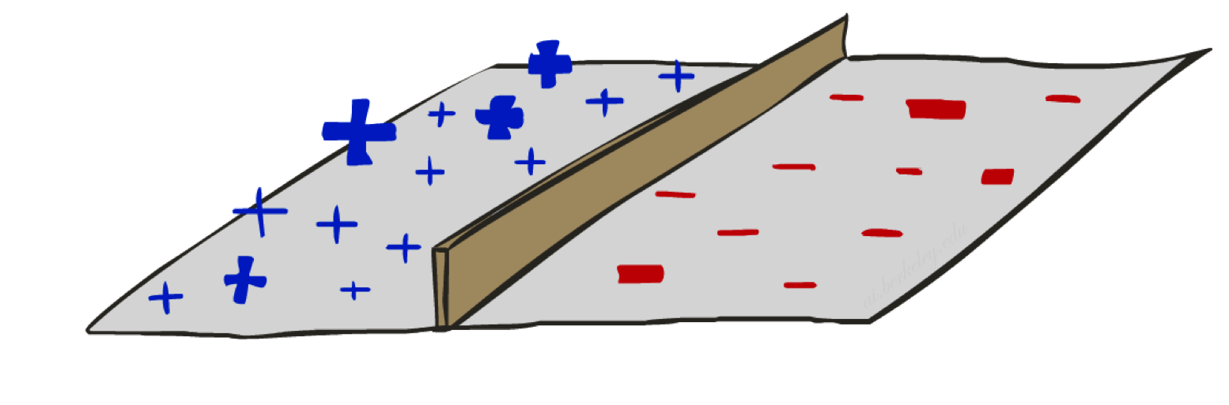
Decision Rules

Slide 17
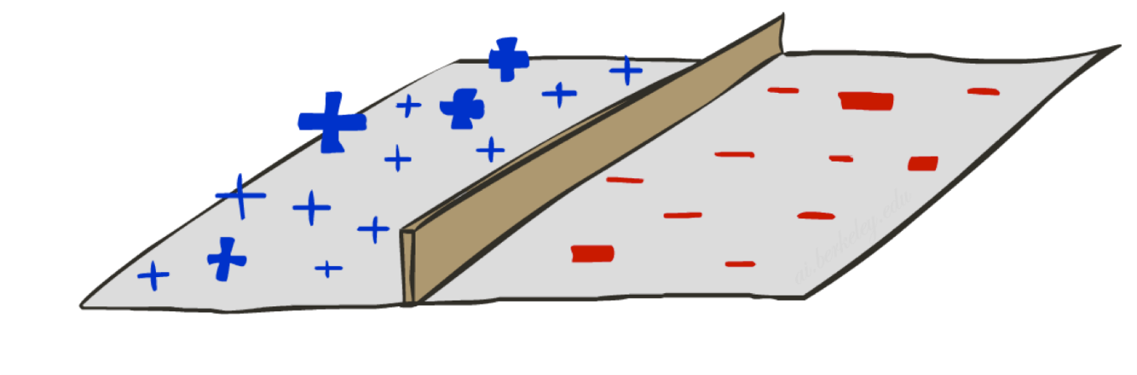

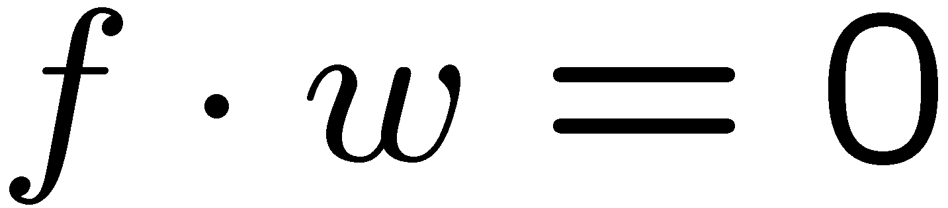
Binary Decision Rule
In the space of feature vectors
  Examples are points
  Any weight vector is a hyperplane
  One side corresponds to Y=+1
  Other corresponds to Y=-1
money
2
+1 = SPAM
1
BIAS : -3
free : 4
money : 2
...
0
-1 = HAM
0
1
free

Slide 18
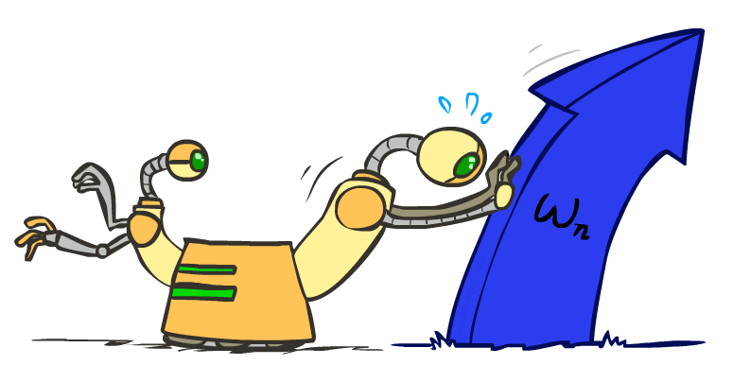
Weight Updates

Slide 19
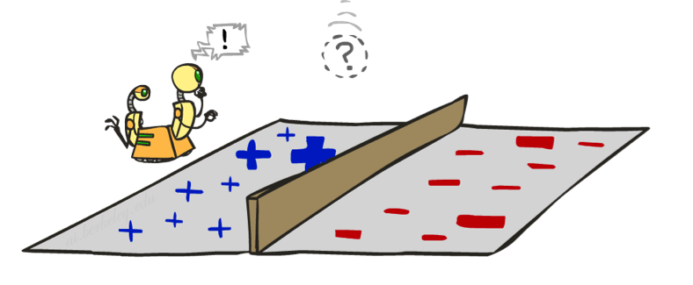
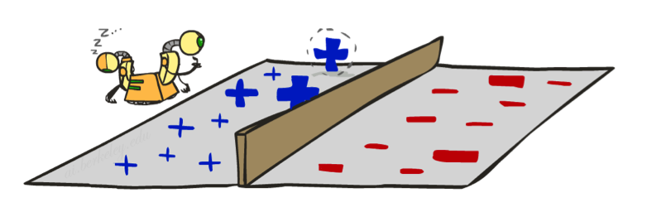
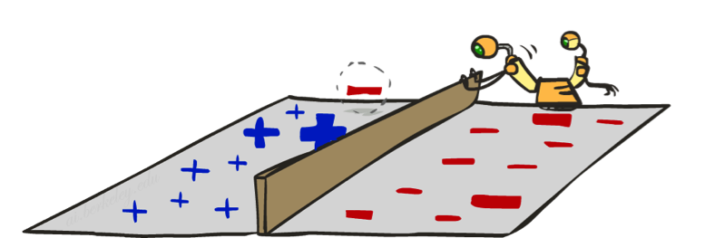
Learning: Binary Perceptron
Start with weights = 0
For each training instance:
  Classify with current weights
  If correct (i.e., y=y*), no change!
  If wrong: adjust the weight vector
Notes:
http://isl.ira.uka.de/neuralNetCourse/2004/VL_11_5/Perceptron.html

Slide 20

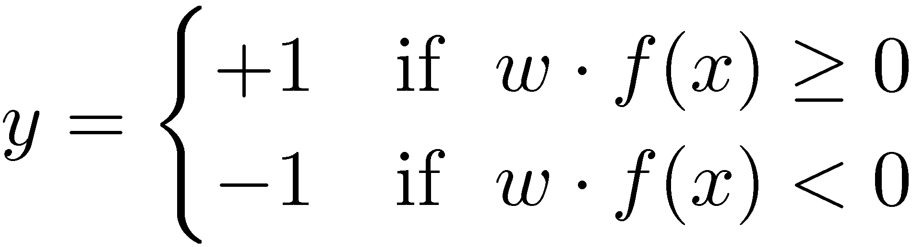

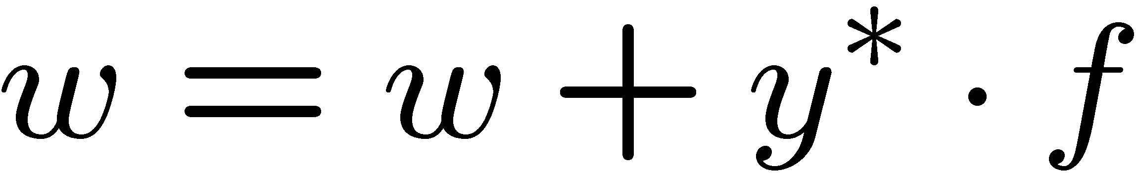
Learning: Binary Perceptron
Start with weights = 0
For each training instance:
  Classify with current weights
  If correct (i.e., y=y*), no change!
  If wrong: adjust the weight vector by adding or subtracting the feature vector. Subtract if y* is -1.
Notes:
http://isl.ira.uka.de/neuralNetCourse/2004/VL_11_5/Perceptron.html

Slide 21
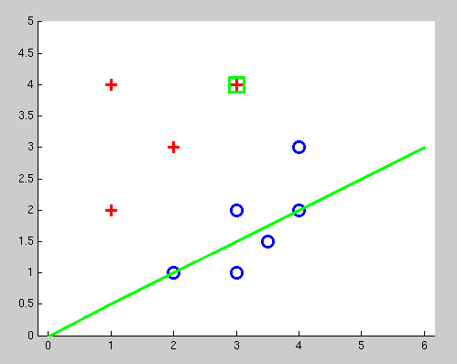
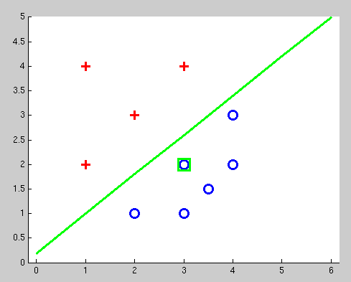
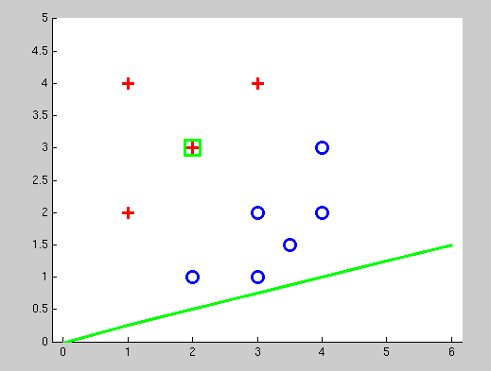
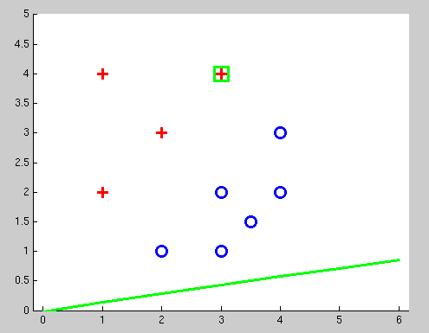
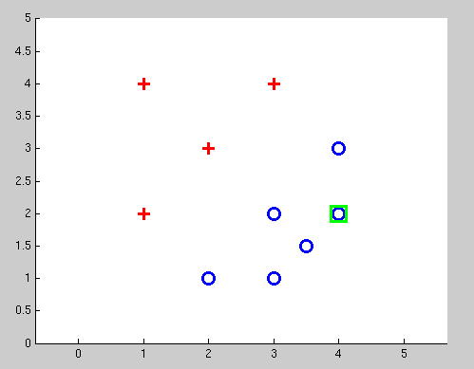
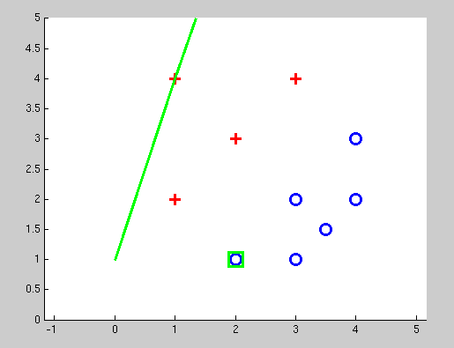
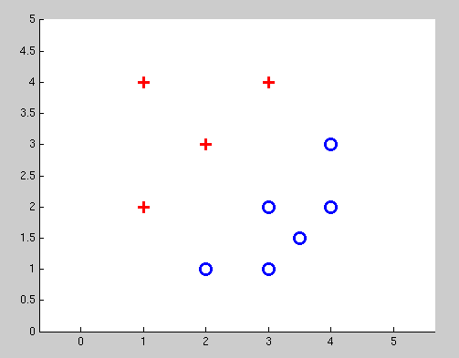
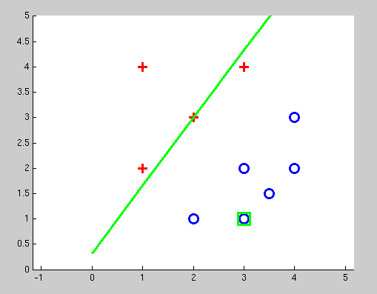
Examples: Perceptron
Separable Case

Slide 22
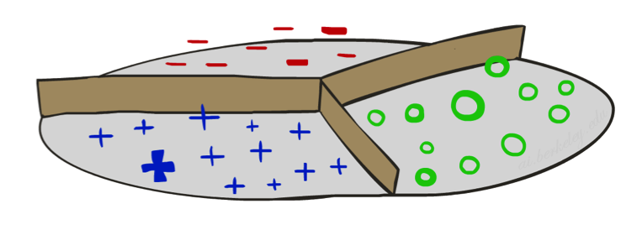


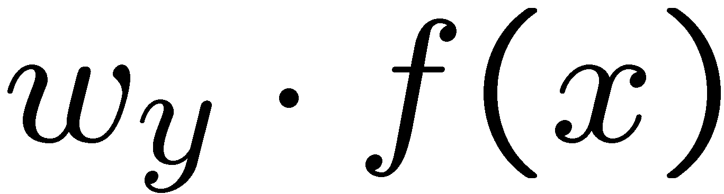



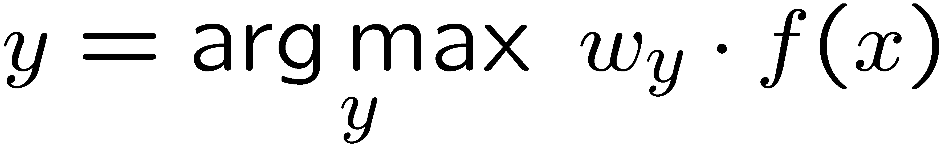
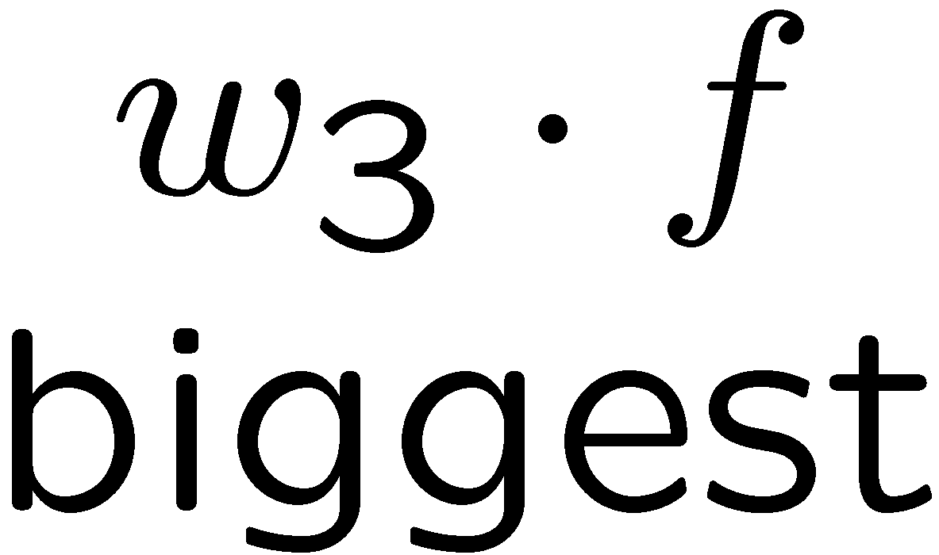
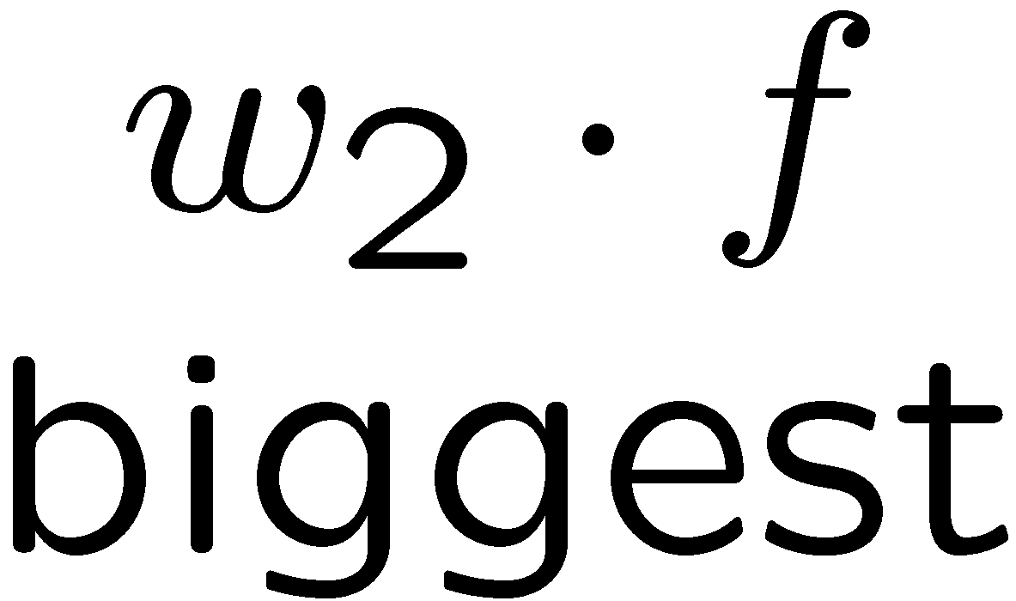
Multiclass Decision Rule
If we have multiple classes:
  A weight vector for each class:
  Score (activation) of a class y:
  Prediction highest score wins
Binary = multiclass where the negative class has weight zero

Slide 23



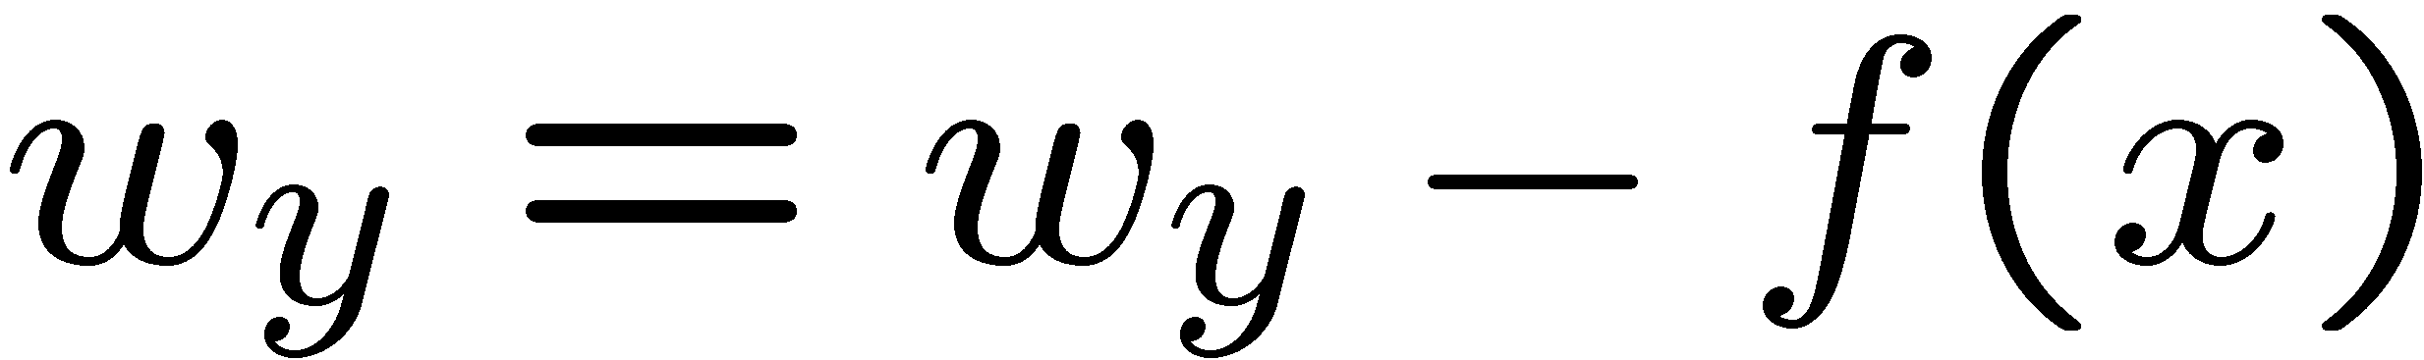
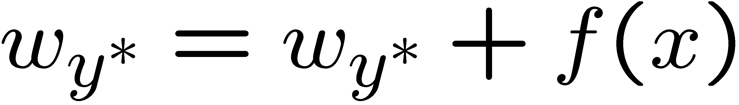
Learning: Multiclass Perceptron
Start with all weights = 0
Pick up training examples one by one
Predict with current weights
If correct, no change!
If wrong: lower score of wrong answer, raise score of right answer

Slide 24



Example: Multiclass Perceptron
“win the vote”
“win the election”
“win the game”
BIAS : 1
win : 0
game : 0
vote : 0
the : 0
...
BIAS : 0
win : 0
game : 0
vote : 0
the : 0
...
BIAS : 0
win : 0
game : 0
vote : 0
the : 0
...

Slide 25
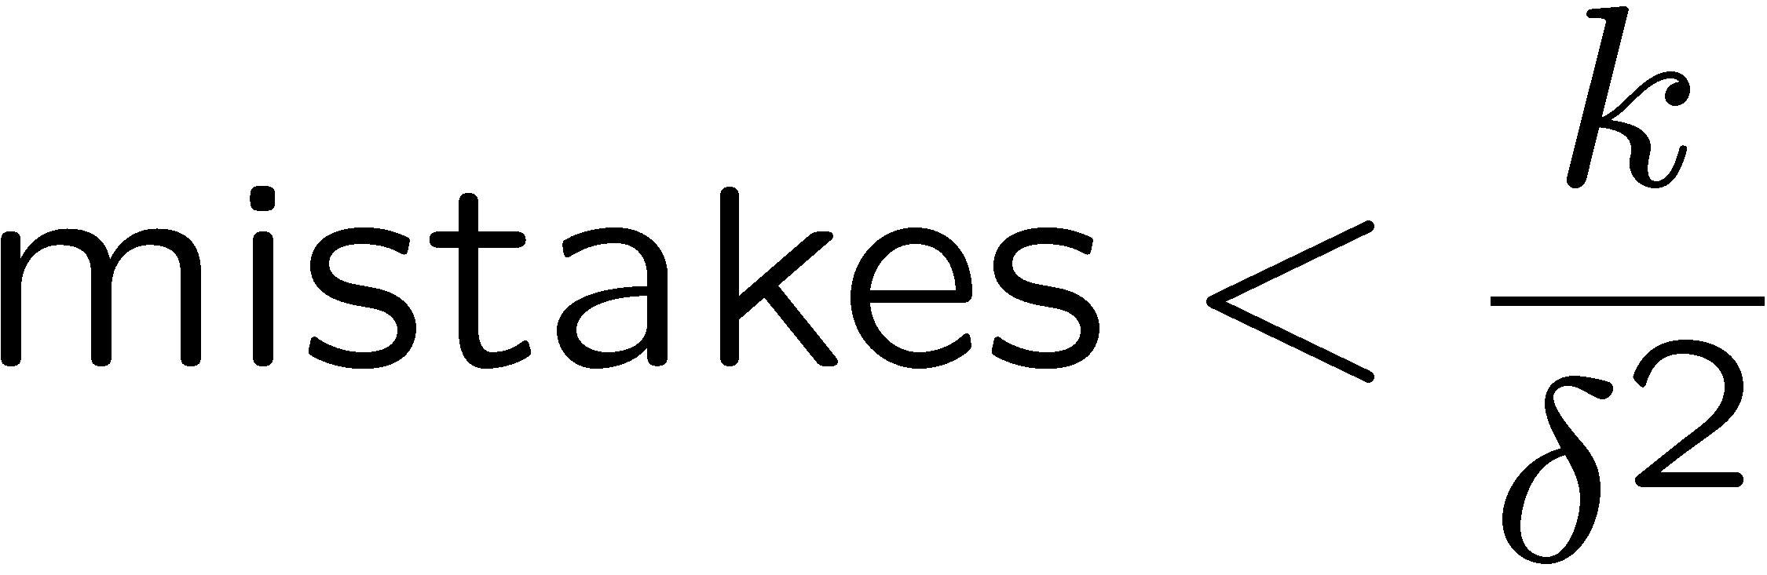
Properties of Perceptrons
Separable
Separability: true if some parameters get the training set perfectly correct
Convergence: if the training is separable, perceptron will eventually converge (binary case)
Mistake Bound: the maximum number of mistakes (binary case) related to the margin or degree of separability
Non-Separable

Slide 26
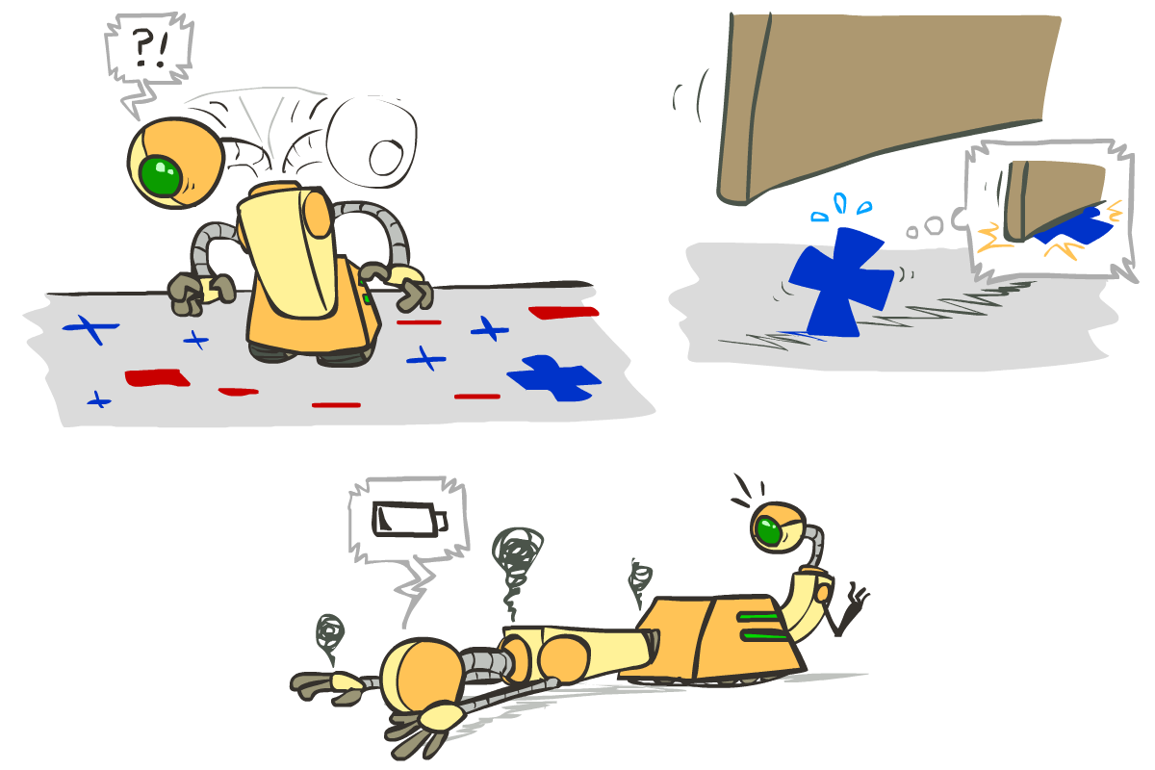




Problems with the Perceptron
Noise: if the data isn’t separable, weights might thrash
  Averaging weight vectors over time can help (averaged perceptron)
Mediocre generalization: finds a “barely” separating solution
Overtraining: test / held-out accuracy usually rises, then falls
  Overtraining is a kind of overfitting

Slide 27
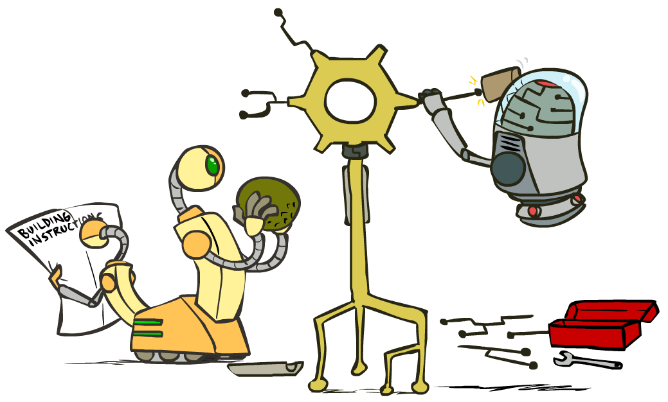
Improving the Perceptron

Slide 28
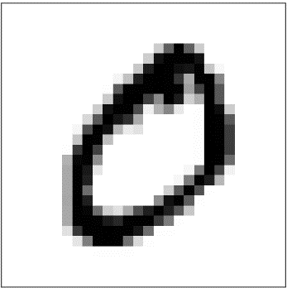

Probabilistic Classification
Naïve Bayes provides probabilistic classification
Perceptron just gives us a class prediction
  Can we get it to give us probabilities?
  Turns out it also makes it easier to train!
1: 0.001
2: 0.703
…
6: 0.264
…
0: 0.001
1: 0.001
2: 0.001
…
0: 0.991
Note: I’m going to be lazy and use “x” in place of “f(x)” here – this is just for notational convenience!

Slide 29


A Probabilistic Perceptron

Slide 30



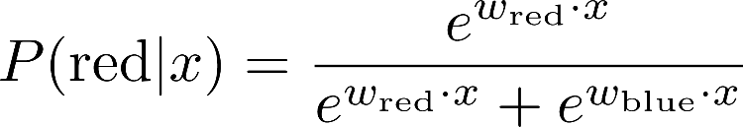
A 1D Example
definitely blue
not sure
definitely red
probability increases exponentially as we move away from boundary
normalizer

Slide 31
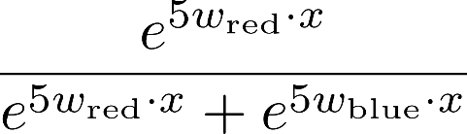
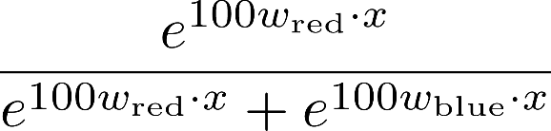

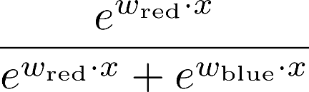
The Soft Max

Slide 32
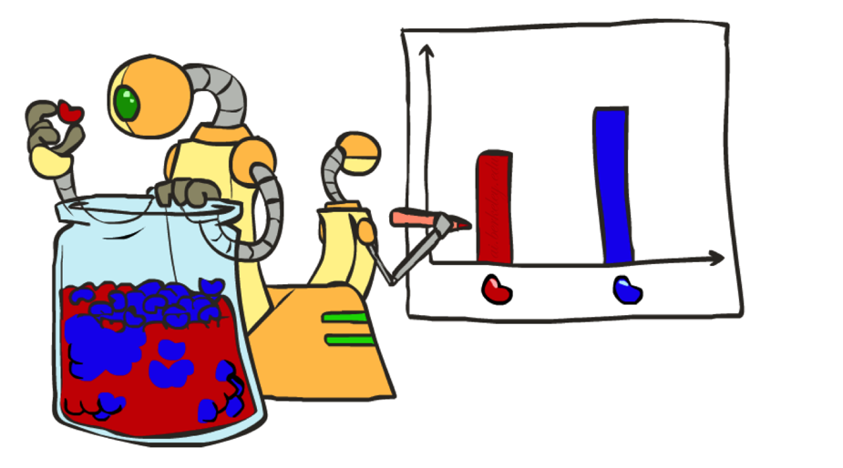
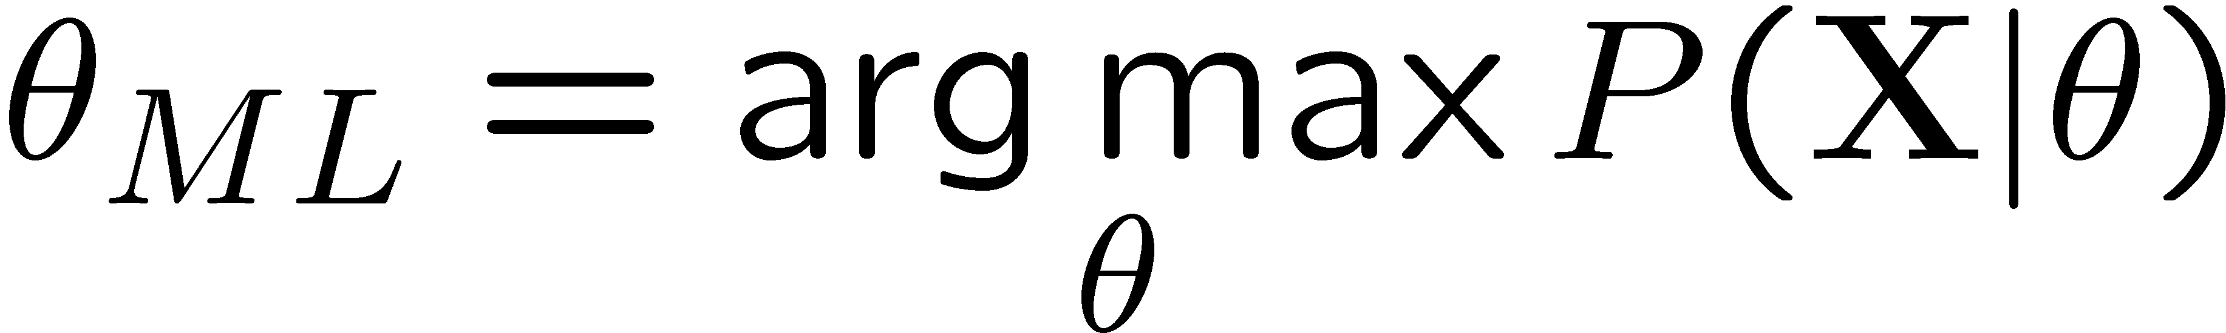
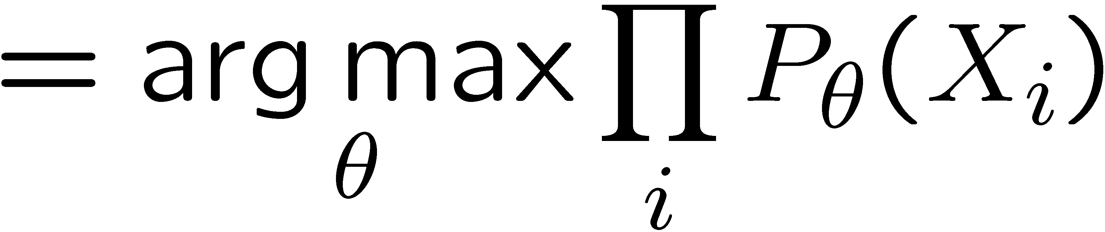
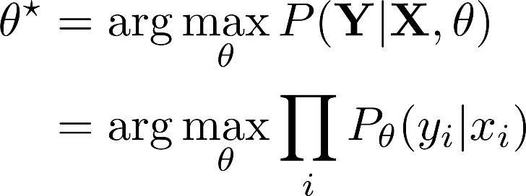
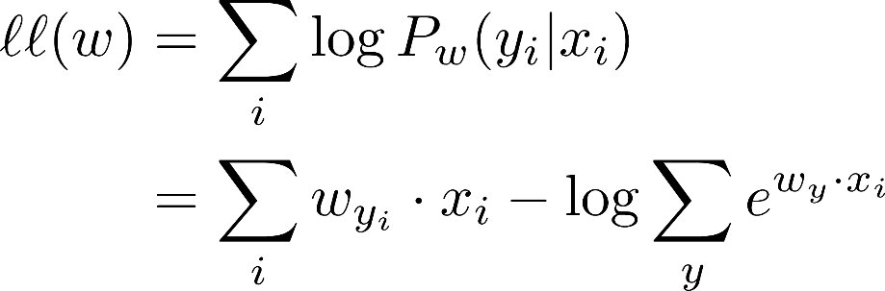

How to Learn?
Maximum likelihood estimation
Maximum conditional likelihood estimation

Slide 33

Local Search
Simple, general idea:
  Start wherever
  Repeat: move to the best neighboring state
  If no neighbors better than current, quit
  Neighbors = small perturbations of w
Notes:
33

Slide 34
Our Status
Our objective
Challenge: how to find a good w ?
Equivalently:

Slide 35
1D optimization
Could evaluate and
  Then step in best direction
Or, evaluate derivative:
  Which tells which direction to step into

Slide 36

2-D Optimization
Source: Thomas Jungblut’s Blog

Slide 37

Steepest Descent
Idea:
  Start somewhere
  Repeat: Take a step in the steepest descent direction
Figure source: Mathworks

Slide 38
Steepest Direction
Steepest Direction = direction of the gradient

Slide 39

How to Learn?

Slide 40



Optimization Procedure: Gradient Descent

Slide 41


Stochastic Gradient Descent
compare this to the multiclass perceptron: probabilistic weighting!
probability of incorrect answer
probability of incorrect answer

Slide 42
Logistic Regression Demo!
https://playground.tensorflow.org/

