Slide 1
Announcements
HW10
  Due tonight!
That is all.

Slide 2
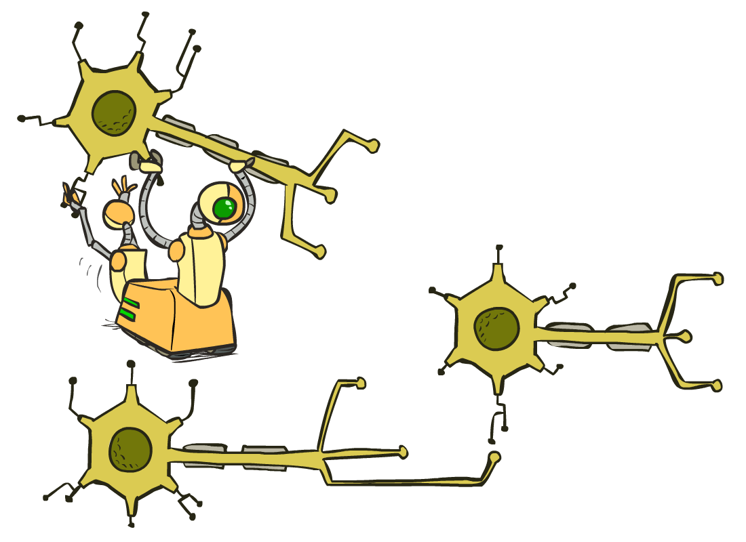
CS 188: Artificial Intelligence
Optimization and Neural Nets
Instructors: Sergey Levine and Stuart Russell --- University of California, Berkeley
[These slides were created by Dan Klein, Pieter Abbeel, Sergey Levine. All CS188 materials are at http://ai.berkeley.edu.]
Notes:
Please retain proper attribution, including the reference to ai.berkeley.edu. Thanks!

Slide 3
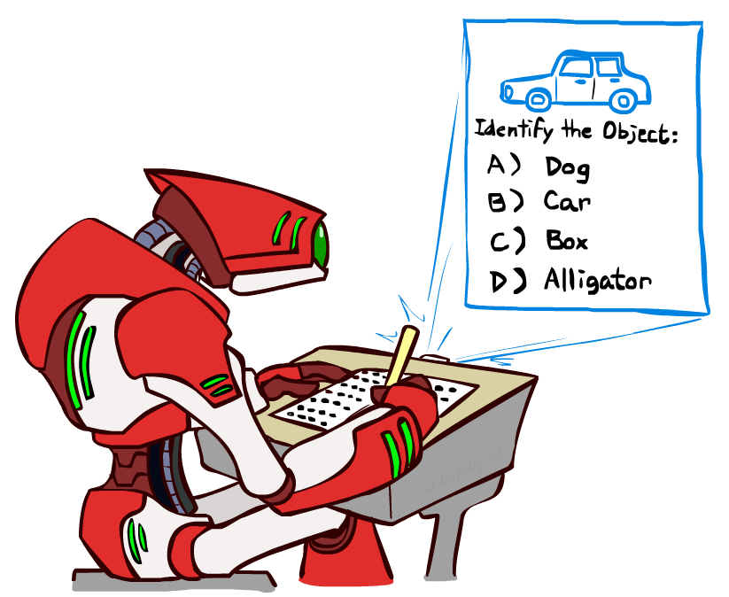

Last Time

Slide 4
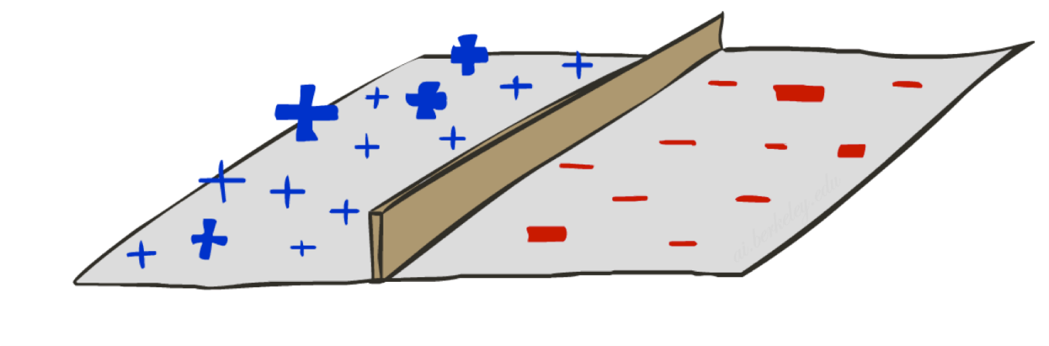
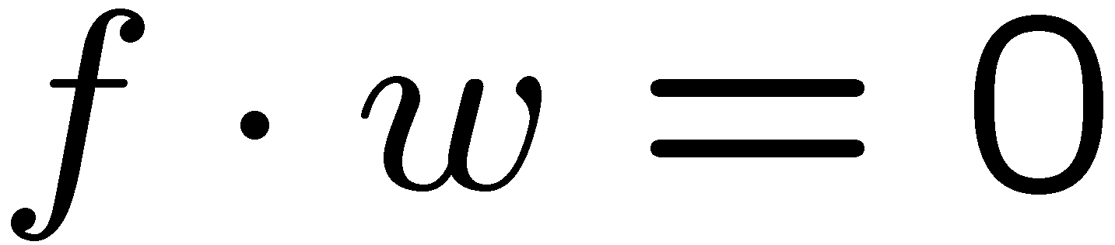
Last Time
Linear classifier
  Examples are points
  Any weight vector is a hyperplane
  One side corresponds to Y=+1
  Other corresponds to Y=-1
Perceptron
  Algorithm for learning decision boundary for linearly separable data
2
+1 = SPAM
1
0
-1 = HAM
0
1
free

Slide 5


Quick Aside: Bias Terms
2
BIAS : 1
free : 0
money : 1
...
BIAS : -3.6
free : 4.2
money : 2.1
...
+1 = SPAM
1
0
-1 = HAM
0
1
free
Why???

Slide 6

Quick Aside: Bias Terms
Imagine 1D features, without bias term:
grade: 1
grade: 3.7
With bias term:
BIAS : 1
grade : 1
BIAS : -1.5
grade : 1.0

Slide 7


A Probabilistic Perceptron

Slide 8
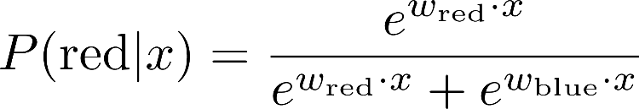



A 1D Example
probability increases exponentially as we move away from boundary
normalizer
definitely blue
not sure
definitely red

Slide 9
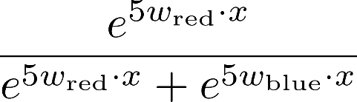
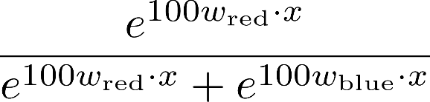

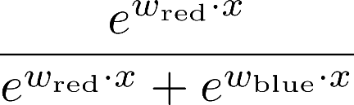
The Soft Max

Slide 10
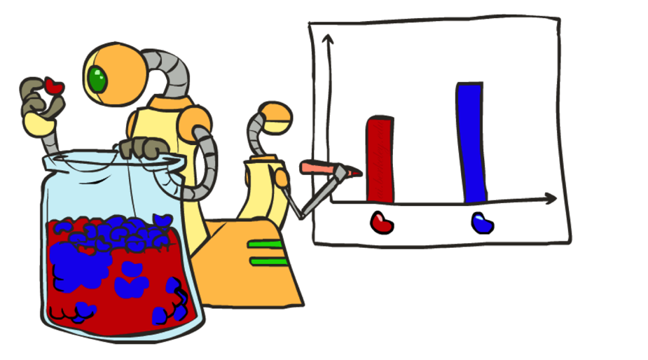
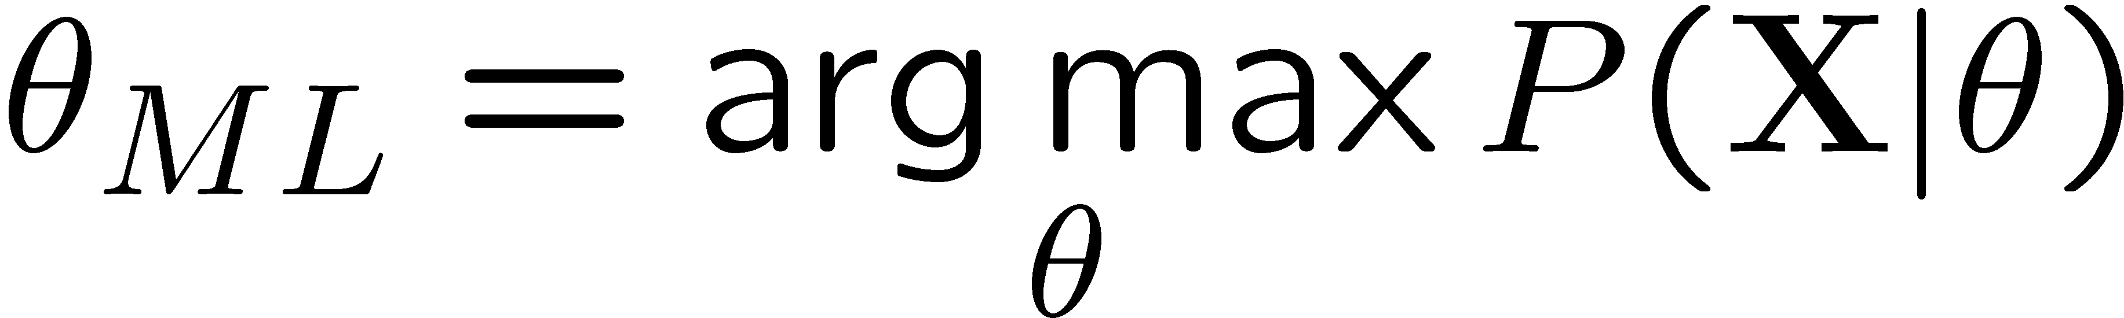
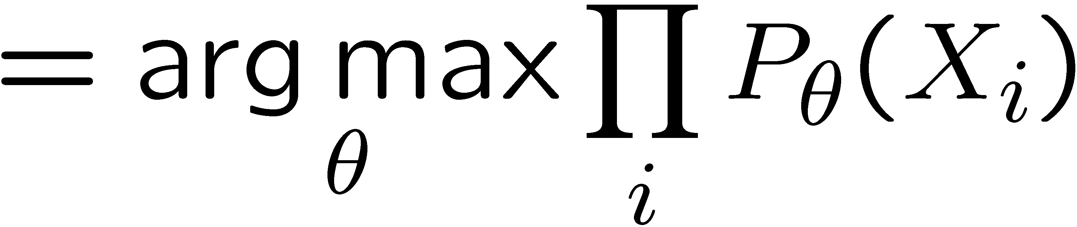
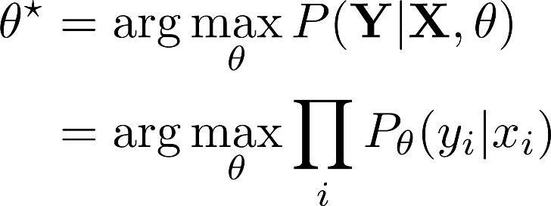
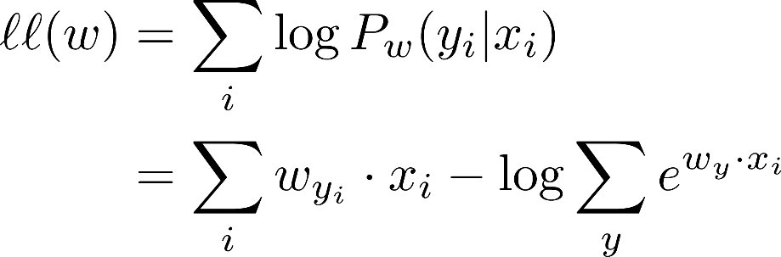
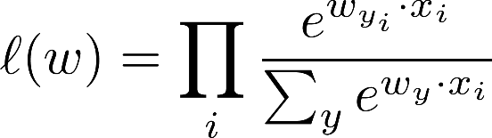
How to Learn?
Maximum likelihood estimation
Maximum conditional likelihood estimation

Slide 11
Best w?
Maximum likelihood estimation:
with:
= Multi-Class Logistic Regression

Slide 12
Logistic Regression Demo!
https://playground.tensorflow.org/

Slide 13

Hill Climbing
Recall from CSPs lecture: simple, general idea
  Start wherever
  Repeat: move to the best neighboring state
  If no neighbors better than current, quit
What’s particularly tricky when hill-climbing for multiclass logistic regression?
  Optimization over a continuous space
    Infinitely many neighbors!
    How to do this efficiently?

Slide 14

1-D Optimization
Could evaluate and
  Then step in best direction
Or, evaluate derivative:
  Tells which direction to step into

Slide 15
2-D Optimization
Source: offconvex.org

Slide 16
Gradient Ascent
Perform update in uphill direction for each coordinate
The steeper the slope (i.e. the higher the derivative) the bigger the step for that coordinate
E.g., consider:
    Updates:
  Updates in vector notation:
  with:
= gradient

Slide 17
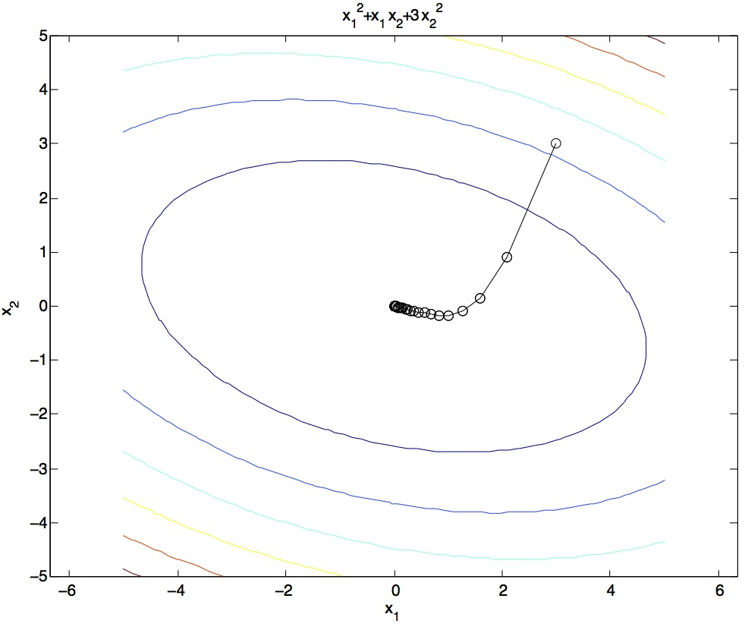
Gradient Ascent
Idea:
  Start somewhere
  Repeat: Take a step in the gradient direction
Figure source: Mathworks

Slide 18
What is the Steepest Direction?
First-Order Taylor Expansion:
Steepest Descent Direction:
Recall: →
Hence, solution:
Gradient direction = steepest direction!

Slide 19
Gradient in n dimensions

Slide 20
Optimization Procedure: Gradient Ascent
init
for iter = 1, 2, …
: learning rate --- tweaking parameter that needs to be chosen carefully
How? Try multiple choices
  Crude rule of thumb: update changes about 0.1 – 1 %

Slide 21
Batch Gradient Ascent on the Log Likelihood Objective
init
for iter = 1, 2, …

Slide 22
Stochastic Gradient Ascent on the Log Likelihood Objective
Observation: once gradient on one training example has been computed, might as well incorporate before computing next one
init
for iter = 1, 2, …
  pick random j

Slide 23
Mini-Batch Gradient Ascent on the Log Likelihood Objective
Observation: gradient over small set of training examples (=mini-batch) can be computed in parallel, might as well do that instead of a single one
init
for iter = 1, 2, …
  pick random subset of training examples J

Slide 24
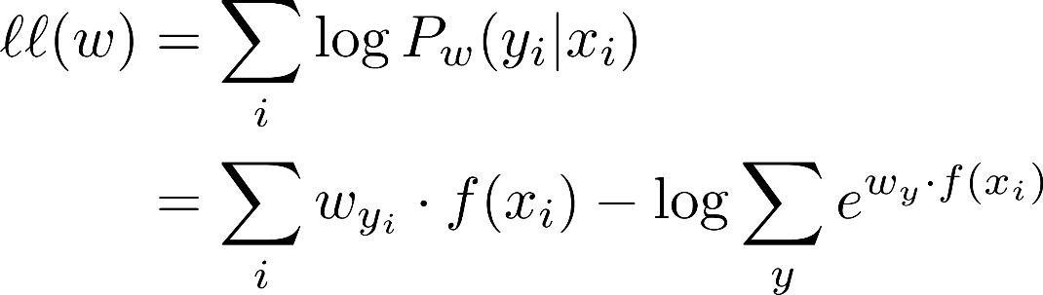
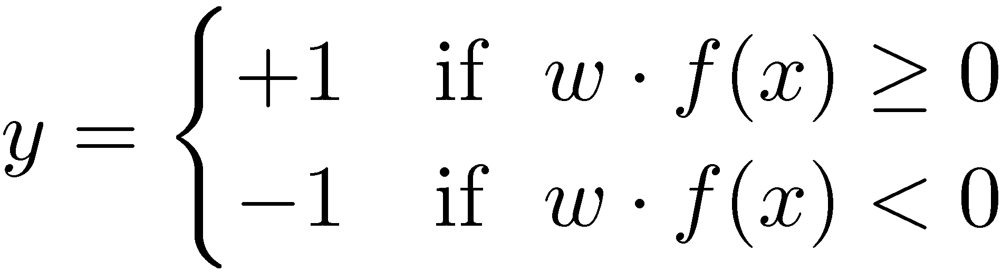
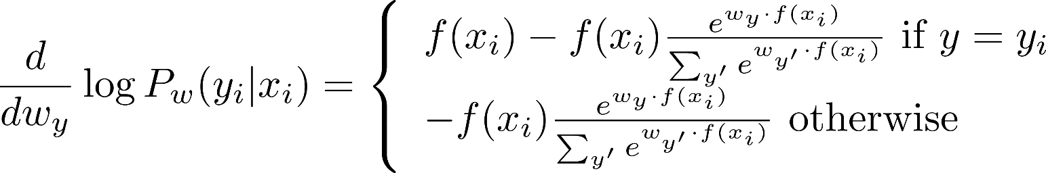
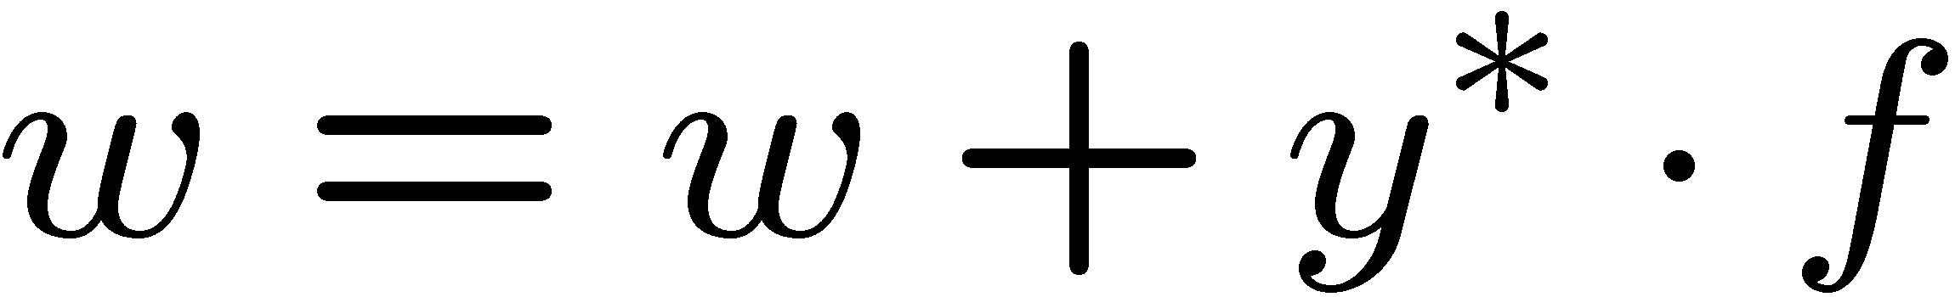
Gradient for Logistic Regression
Recall perceptron:
  Classify with current weights
  If correct (i.e., y=y*), no change!
  If wrong: adjust the weight vector by adding or subtracting the feature vector. Subtract if y* is -1.

Slide 25
How about computing all the derivatives?
We’ll talk about that once we covered neural networks, which are a generalization of logistic regression

Slide 26
Neural Networks

Slide 27
Multi-class Logistic Regression
= special case of neural network
f₁(x)
z₁
softmax
f₂(x)
z₂
f₃(x)
…
z₃
f_{K}(x)

Slide 28
Deep Neural Network = Also learn the features!
f₁(x)
z₁
softmax
f₂(x)
z₂
f₃(x)
…
z₃
f_{K}(x)

Slide 29
Deep Neural Network = Also learn the features!
x₁
f₁(x)
softmax
x₂
f₂(x)
…
x₃
f₃(x)
…
…
…
…
…
x_{L}
f_{K}(x)
g = nonlinear activation function

Slide 30
Deep Neural Network = Also learn the features!
x₁
softmax
x₂
…
x₃
…
…
…
…
…
x_{L}
g = nonlinear activation function

Slide 31
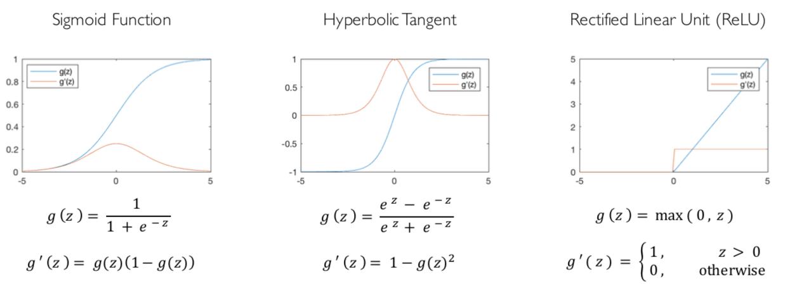
Common Activation Functions
[source: MIT 6.S191 introtodeeplearning.com]

Slide 32
Deep Neural Network: Also Learn the Features!
Training the deep neural network is just like logistic regression:
  just w tends to be a much, much larger vector ☺
  just run gradient ascent
  + stop when log likelihood of hold-out data starts to decrease

Slide 33
Neural Networks Properties
Theorem (Universal Function Approximators). A two-layer neural network with a sufficient number of neurons can approximate any continuous function to any desired accuracy.
Practical considerations
  Can be seen as learning the features
  Large number of neurons
    Danger for overfitting
    (hence early stopping!)

Slide 34
Neural Net Demo!
https://playground.tensorflow.org/

Slide 35
How about computing all the derivatives?
Derivatives tables:
[source: http://hyperphysics.phy-astr.gsu.edu/hbase/Math/derfunc.html

Slide 36
How about computing all the derivatives?
But neural net f is never one of those?
  No problem: CHAIN RULE:
    If
    Then
    → Derivatives can be computed by following well-defined procedures

Slide 37
Automatic Differentiation
Automatic differentiation software
  e.g. Theano, TensorFlow, PyTorch, Chainer
  Only need to program the function g(x,y,w)
  Can automatically compute all derivatives w.r.t. all entries in w
  This is typically done by caching info during forward computation pass of f, and then doing a backward pass = “backpropagation”
  Autodiff / Backpropagation can often be done at computational cost comparable to the forward pass
Need to know this exists
How this is done? -- outside of scope of CS188

Slide 38
Summary of Key Ideas
Optimize probability of label given input
Continuous optimization
  Gradient ascent:
    Compute steepest uphill direction = gradient (= just vector of partial derivatives)
    Take step in the gradient direction
    Repeat (until held-out data accuracy starts to drop = “early stopping”)
Deep neural nets
  Last layer = still logistic regression
  Now also many more layers before this last layer
    = computing the features
    → the features are learned rather than hand-designed
  Universal function approximation theorem
    If neural net is large enough
    Then neural net can represent any continuous mapping from input to output with arbitrary accuracy
    But remember: need to avoid overfitting / memorizing the training data → early stopping!
  Automatic differentiation gives the derivatives efficiently (how? = outside of scope of 188)

Slide 39

Computer Vision
Notes:
39

Slide 40

Object Detection
Notes:
40

Slide 41



Manual Feature Design
Notes:
41

Slide 42
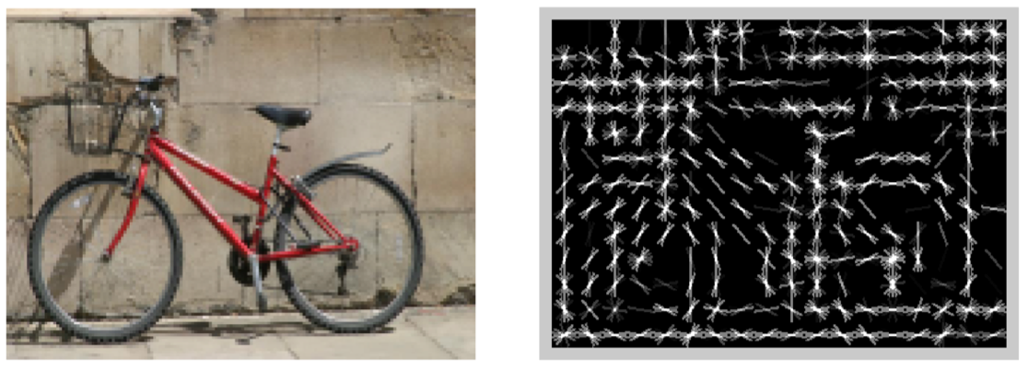
Features and Generalization
[HoG: Dalal and Triggs, 2005]
Notes:
42

Slide 43
Features and Generalization
Image
HoG
Notes:
HoG, SIFT, Daisy
Deformable part models
43

Slide 44
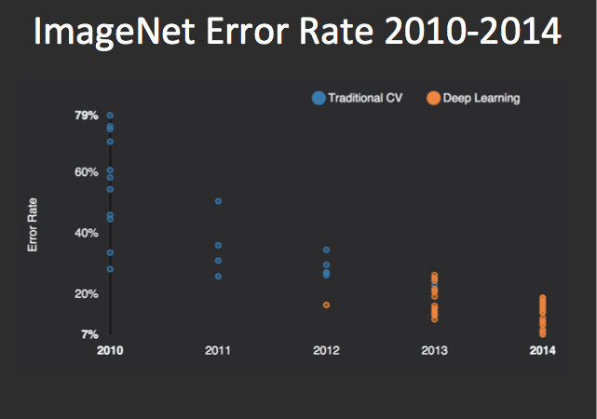
Performance
graph credit Matt Zeiler, Clarifai

Slide 45
Performance
graph credit Matt Zeiler, Clarifai

Slide 46
Performance
AlexNet
graph credit Matt Zeiler, Clarifai

Slide 47
Performance
AlexNet
graph credit Matt Zeiler, Clarifai

Slide 48
Performance
AlexNet
graph credit Matt Zeiler, Clarifai

Slide 49
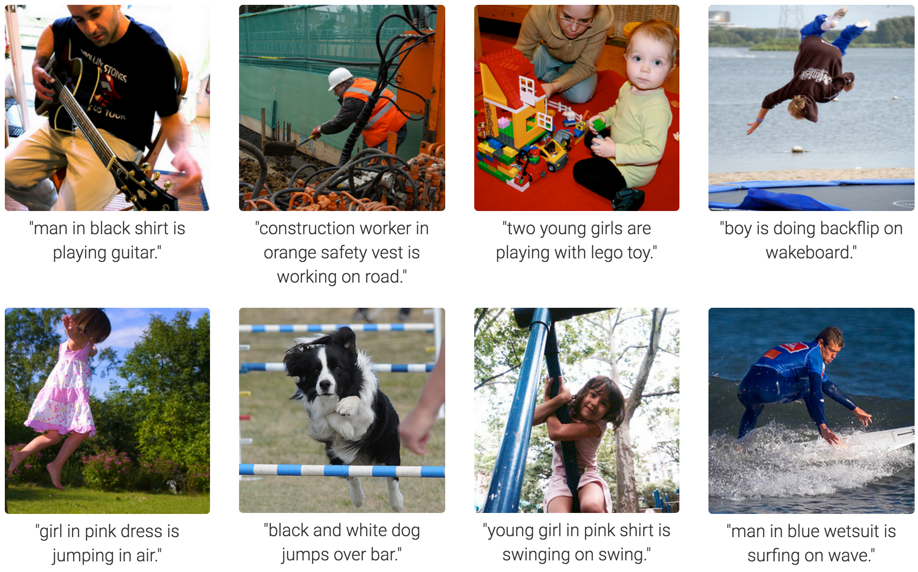
MS COCO Image Captioning Challenge
Karpathy & Fei-Fei, 2015; Donahue et al., 2015; Xu et al, 2015; many more

Slide 50
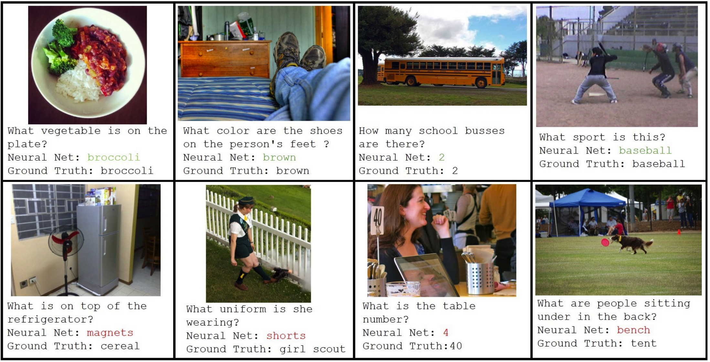
Visual QA Challenge
Stanislaw Antol, Aishwarya Agrawal, Jiasen Lu, Margaret Mitchell, Dhruv Batra, C. Lawrence Zitnick, Devi Parikh

Slide 51
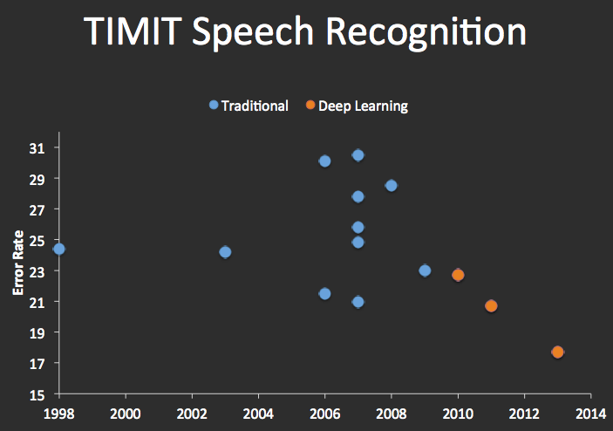


Speech Recognition
graph credit Matt Zeiler, Clarifai

Slide 52
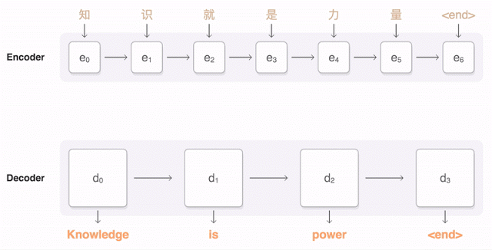
Machine Translation
Google Neural Machine Translation (in production)
Notes:
https://research.googleblog.com/2016/09/a-neural-network-for-machine.html

