Slide 1
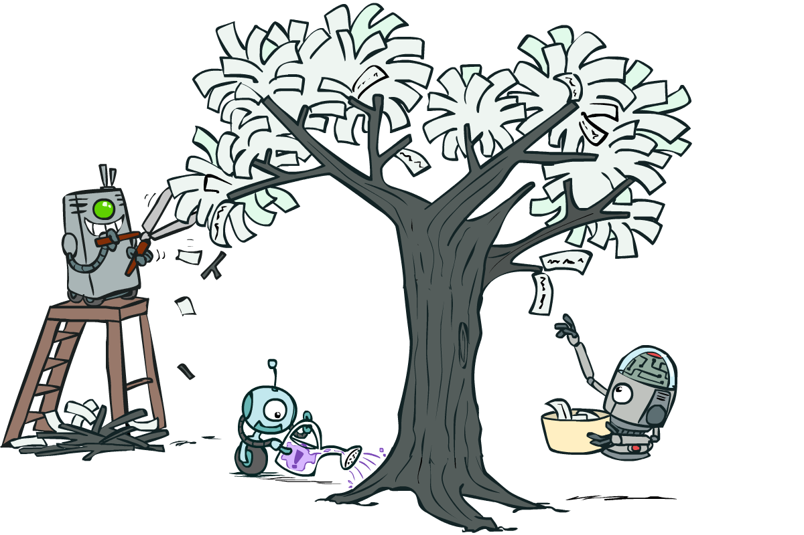
CS 188: Artificial Intelligence
Neural Nets and Decision Trees
Instructors: Sergey Levine and Stuart Russell --- University of California, Berkeley
[These slides were created by Dan Klein, Pieter Abbeel, Sergey Levine. All CS188 materials are at http://ai.berkeley.edu.]
Notes:
Please retain proper attribution, including the reference to ai.berkeley.edu. Thanks!

Slide 2
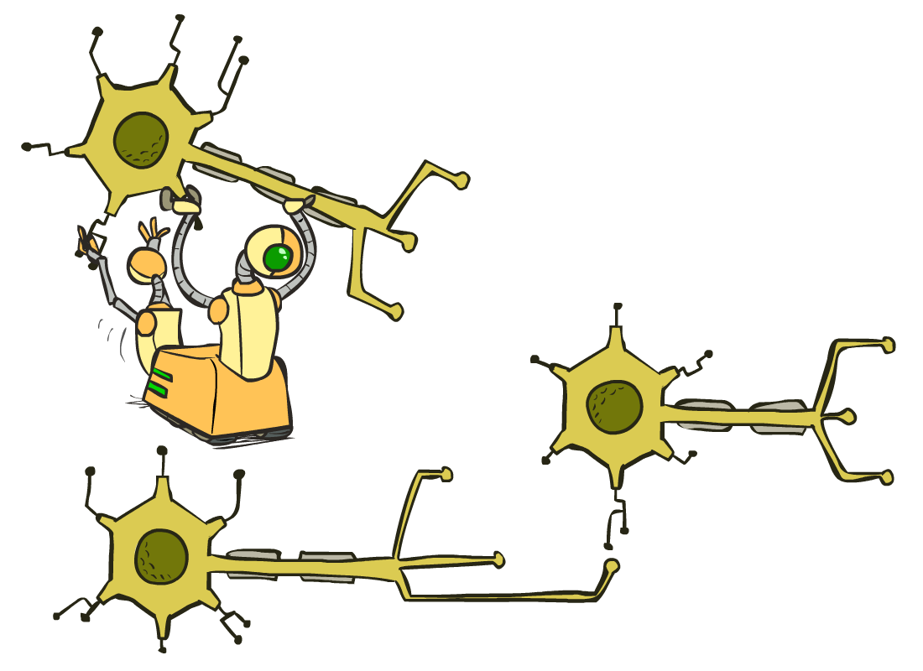
Neural Networks

Slide 3
Multi-class Logistic Regression
= special case of neural network
f₁(x)
z₁
softmax
f₂(x)
z₂
f₃(x)
…
z₃
f_{K}(x)

Slide 4
Deep Neural Network = Also learn the features!
f₁(x)
z₁
softmax
f₂(x)
z₂
f₃(x)
…
z₃
f_{K}(x)

Slide 5
Deep Neural Network = Also learn the features!
x₁
f₁(x)
softmax
x₂
f₂(x)
…
x₃
f₃(x)
…
…
…
…
…
x_{L}
f_{K}(x)
g = nonlinear activation function

Slide 6
Deep Neural Network = Also learn the features!
x₁
softmax
x₂
…
x₃
…
…
…
…
…
x_{L}
g = nonlinear activation function

Slide 7
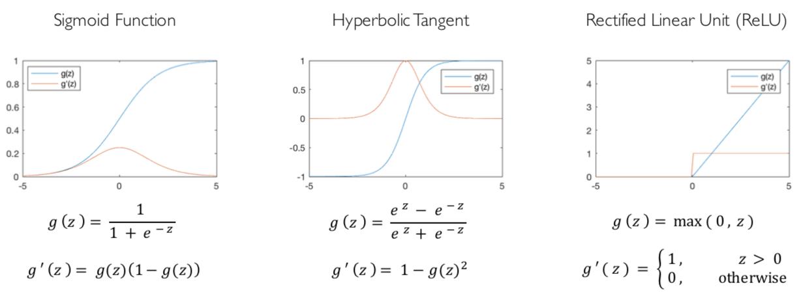
Common Activation Functions
[source: MIT 6.S191 introtodeeplearning.com]

Slide 8
Deep Neural Network: Also Learn the Features!
Training the deep neural network is just like logistic regression:
  just w tends to be a much, much larger vector ☺
  just run gradient ascent
  + stop when log likelihood of hold-out data starts to decrease

Slide 9
Neural Networks Properties
Theorem (Universal Function Approximators). A two-layer neural network with a sufficient number of neurons can approximate any continuous function to any desired accuracy.
Practical considerations
  Can be seen as learning the features
  Large number of neurons
    Danger for overfitting
    (hence early stopping!)

Slide 10
Neural Net Demo!
https://playground.tensorflow.org/

Slide 11
How about computing all the derivatives?
Derivatives tables:
[source: http://hyperphysics.phy-astr.gsu.edu/hbase/Math/derfunc.html

Slide 12
How about computing all the derivatives?
But neural net f is never one of those?
  No problem: CHAIN RULE:
    If
    Then
    → Derivatives can be computed by following well-defined procedures

Slide 13
Automatic Differentiation
Automatic differentiation software
  e.g. Theano, TensorFlow, PyTorch, Chainer
  Only need to program the function g(x,y,w)
  Can automatically compute all derivatives w.r.t. all entries in w
  This is typically done by caching info during forward computation pass of f, and then doing a backward pass = “backpropagation”
  Autodiff / Backpropagation can often be done at computational cost comparable to the forward pass
Need to know this exists
How this is done? -- outside of scope of CS188

Slide 14
Summary of Key Ideas
Optimize probability of label given input
Continuous optimization
  Gradient ascent:
    Compute steepest uphill direction = gradient (= just vector of partial derivatives)
    Take step in the gradient direction
    Repeat (until held-out data accuracy starts to drop = “early stopping”)
Deep neural nets
  Last layer = still logistic regression
  Now also many more layers before this last layer
    = computing the features
    → the features are learned rather than hand-designed
  Universal function approximation theorem
    If neural net is large enough
    Then neural net can represent any continuous mapping from input to output with arbitrary accuracy
    But remember: need to avoid overfitting / memorizing the training data → early stopping!
  Automatic differentiation gives the derivatives efficiently (how? = outside of scope of 188)

Slide 15

Computer Vision
Notes:
15

Slide 16
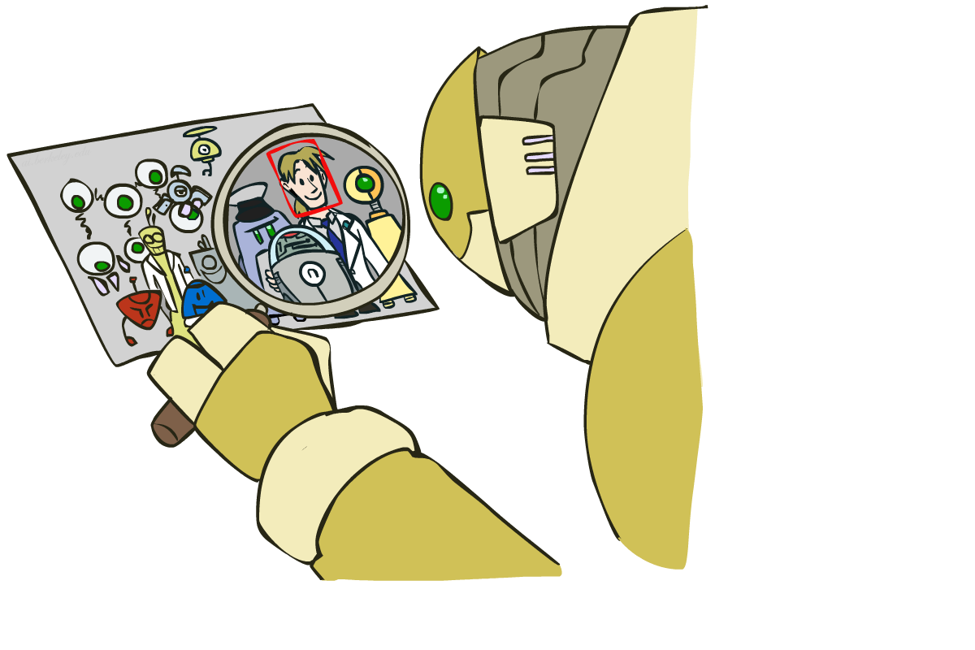
Object Detection
Notes:
16

Slide 17

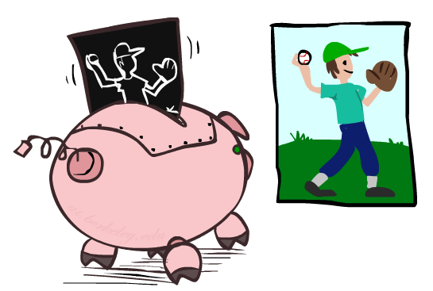

Manual Feature Design
Notes:
17

Slide 18
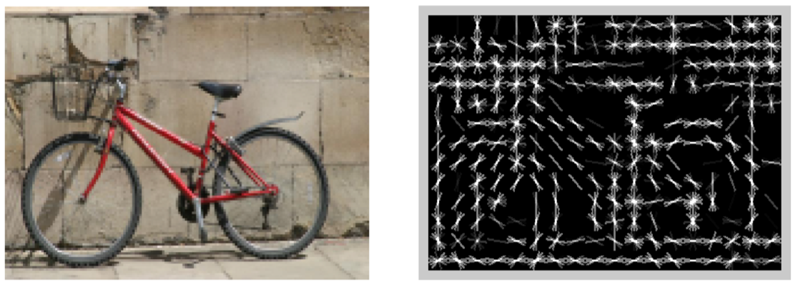
Features and Generalization
[HoG: Dalal and Triggs, 2005]
Notes:
18

Slide 19
Features and Generalization
Image
HoG
Notes:
HoG, SIFT, Daisy
Deformable part models
19

Slide 20
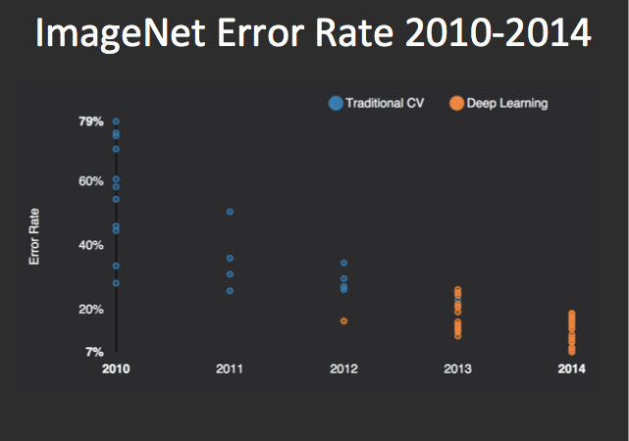
Performance
graph credit Matt Zeiler, Clarifai

Slide 21
Performance
graph credit Matt Zeiler, Clarifai

Slide 22
Performance
AlexNet
graph credit Matt Zeiler, Clarifai

Slide 23
Performance
AlexNet
graph credit Matt Zeiler, Clarifai

Slide 24
Performance
AlexNet
graph credit Matt Zeiler, Clarifai

Slide 25
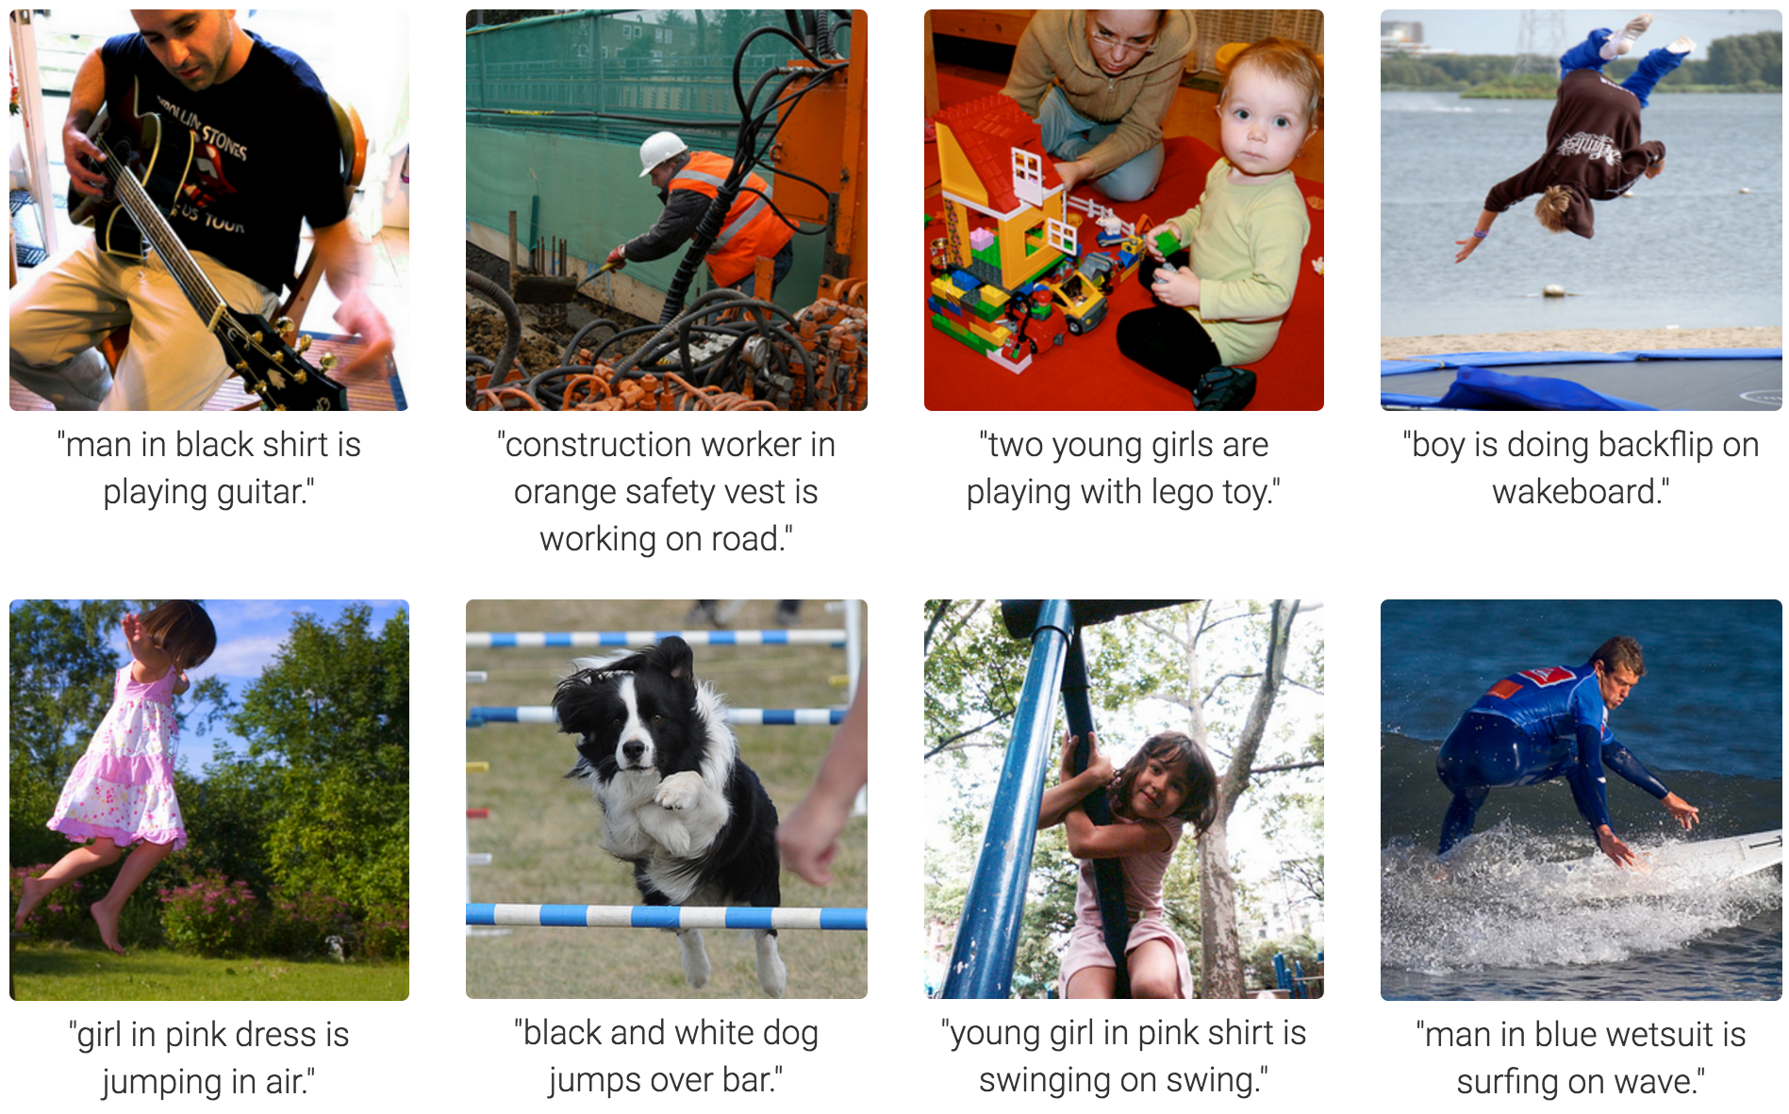
MS COCO Image Captioning Challenge
Karpathy & Fei-Fei, 2015; Donahue et al., 2015; Xu et al, 2015; many more

Slide 26
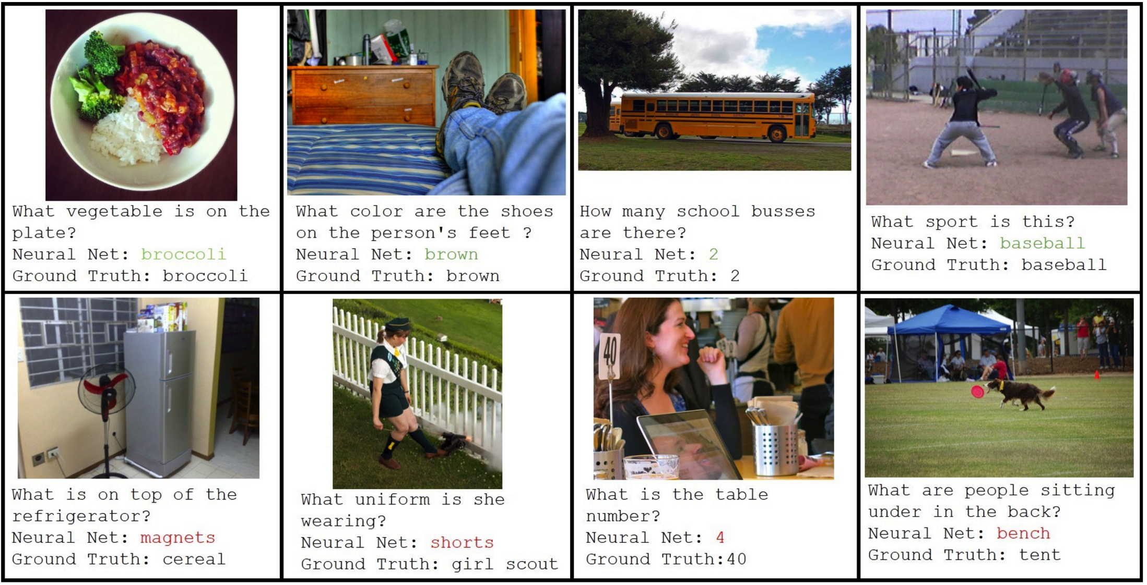
Visual QA Challenge
Stanislaw Antol, Aishwarya Agrawal, Jiasen Lu, Margaret Mitchell, Dhruv Batra, C. Lawrence Zitnick, Devi Parikh

Slide 27
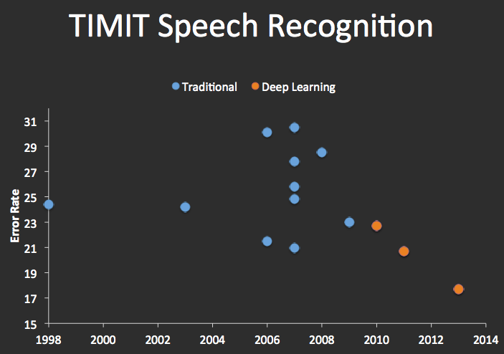


Speech Recognition
graph credit Matt Zeiler, Clarifai

Slide 28
Decision Trees

Slide 29
Reminder: Features
Features, aka attributes
  Sometimes: TYPE=French
  Sometimes: f_{TYPE=French}(x) = 1

Slide 30
Reminder: Features
Features, aka attributes
  Sometimes: TYPE=French
  Sometimes: f_{TYPE=French}(x) = 1

Slide 31
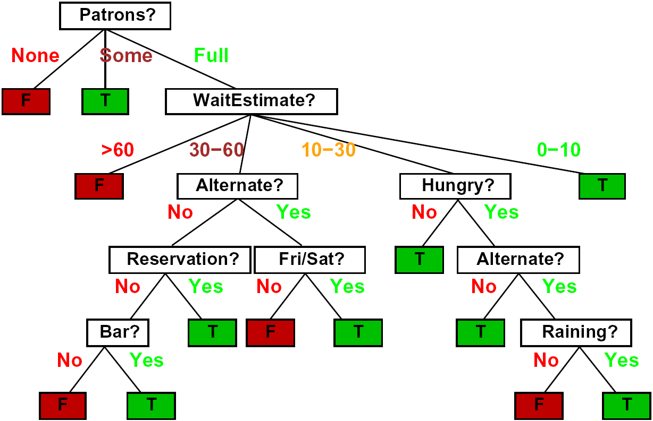
Decision Trees
Compact representation of a function:
  Truth table
  Conditional probability table
  Regression values
True function
  Realizable: in H

Slide 32

Expressiveness of DTs
Can express any function of the features
However, we hope for compact trees

Slide 33
Comparison: Perceptrons
What is the expressiveness of a perceptron over these features?
For a perceptron, a feature’s contribution is either positive or negative
  If you want one feature’s effect to depend on another, you have to add a new conjunction feature
  E.g. adding “PATRONS=full ∧ WAIT = 60” allows a perceptron to model the interaction between the two atomic features
DTs automatically conjoin features / attributes
  Features can have different effects in different branches of the tree!
Difference between modeling relative evidence weighting (NB) and complex evidence interaction (DTs)
  Though if the interactions are too complex, may not find the DT greedily

Slide 34
Decision Tree Learning
Aim: find a small tree consistent with the training examples
Idea: (recursively) choose “most significant” attribute as root of (sub)tree

Slide 35
Choosing an Attribute
Idea: a good attribute splits the examples into subsets that are (ideally) “all positive” or “all negative”
So: we need a measure of how “good” a split is, even if the results aren’t perfectly separated out

Slide 36
Entropy and Information
Information answers questions
  The more uncertain about the answer initially, the more information in the answer
  Scale: bits
    Answer to Boolean question with prior <1/2, 1/2>?
    Answer to 4-way question with prior <1/4, 1/4, 1/4, 1/4>?
    Answer to 4-way question with prior <0, 0, 0, 1>?
    Answer to 3-way question with prior <1/2, 1/4, 1/4>?
A probability p is typical of:
  A uniform distribution of size 1/p
  A code of length log 1/p

Slide 37
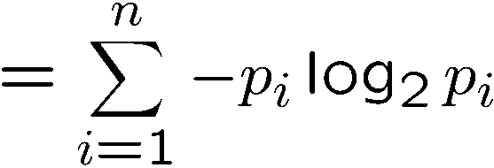
Entropy
General answer: if prior is <p₁,…,p_{n}>:
  Information is the expected code length
Also called the entropy of the distribution
  More uniform = higher entropy
  More values = higher entropy
  More peaked = lower entropy
1 bit
0 bits
0.5 bit

Slide 38

Information Gain
Back to decision trees!
For each split, compare entropy before and after
  Difference is the information gain
  Problem: there’s more than one distribution after split!
  Solution: use expected entropy, weighted by the number of examples

Slide 39
Next Step: Recurse
Now we need to keep growing the tree!
Two branches are done (why?)
What to do under “full”?
  See what examples are there…

Slide 40
Example: Learned Tree
Decision tree learned from these 12 examples:
Substantially simpler than “true” tree
  A more complex hypothesis isn't justified by data
Also: it’s reasonable, but wrong

Slide 41
Example: Miles Per Gallon
40 Examples

Slide 42
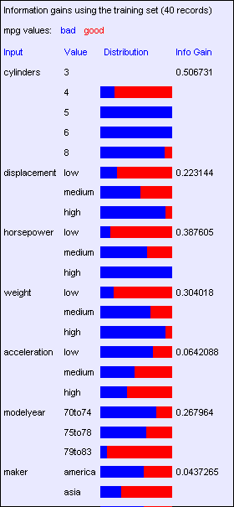
Find the First Split
Look at information gain for each attribute
Note that each attribute is correlated with the target!
What do we split on?

Slide 43
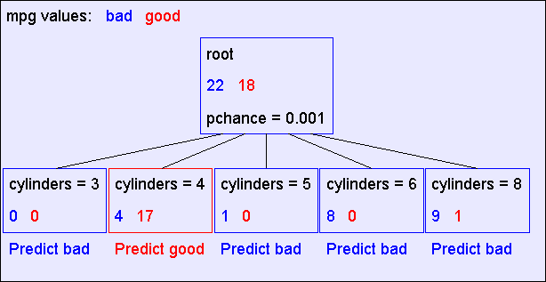
Result: Decision Stump

Slide 44
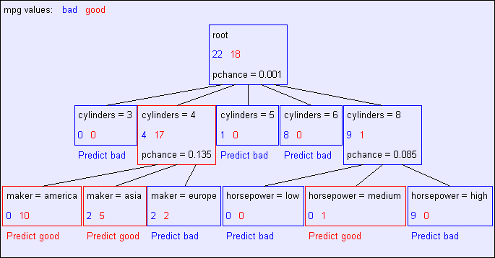
Second Level

Slide 45
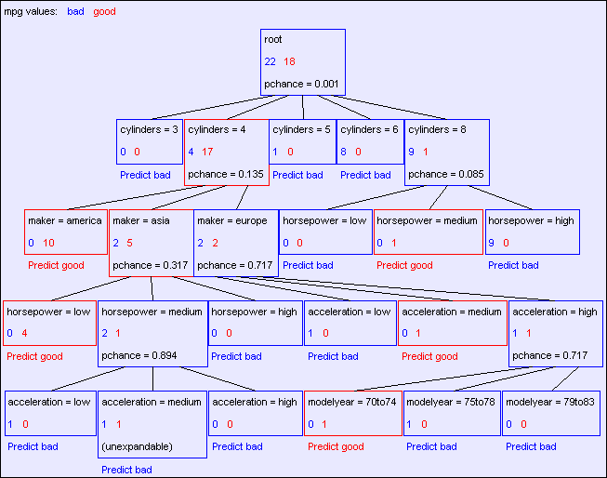
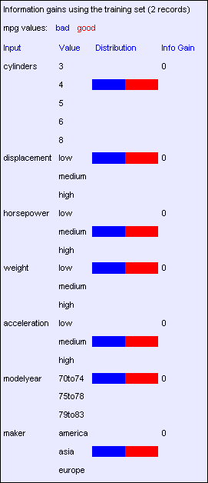
Final Tree

Slide 46
Reminder: Overfitting
Overfitting:
  When you stop modeling the patterns in the training data (which generalize)
  And start modeling the noise (which doesn’t)
We had this before:
  Naïve Bayes: needed to smooth
  Perceptron: early stopping

Slide 47

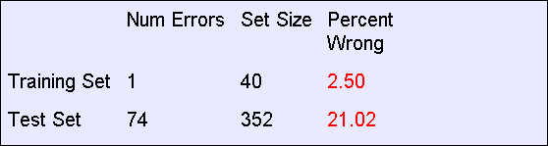
MPG Training Error
The test set error is much worse than the training set error…
…why?

Slide 48
Significance of a Split
Starting with:
  Three cars with 4 cylinders, from Asia, with medium HP
  2 bad MPG
  1 good MPG
What do we expect from a three-way split?
  Maybe each example in its own subset?
  Maybe just what we saw in the last slide?
Probably shouldn’t split if the counts are so small they could be due to chance
A chi-squared test can tell us how likely it is that deviations from a perfect split are due to chance*
Each split will have a significance value, p_{CHANCE}

Slide 49

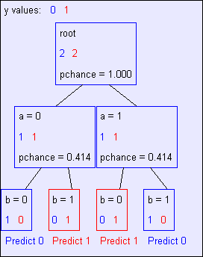
Keeping it General
Pruning:
  Build the full decision tree
  Begin at the bottom of the tree
  Delete splits in which
  p_{CHANCE} > MaxP_{CHANCE}
  Continue working upward until there are no more prunable nodes
y = a XOR b

Slide 50
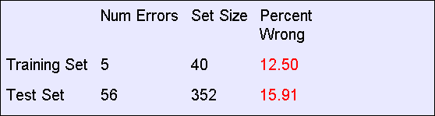
Pruning example
With MaxP_{CHANCE} = 0.1:
Note the improved test set accuracy compared with the unpruned tree

Slide 51
Regularization
MaxP_{CHANCE} is a regularization parameter
Generally, set it using held-out data (as usual)
Training
Held-out / Test
Accuracy
Decreasing
Increasing
MaxP_{CHANCE}
Small Trees
Large Trees
High Bias
High Variance

Slide 52
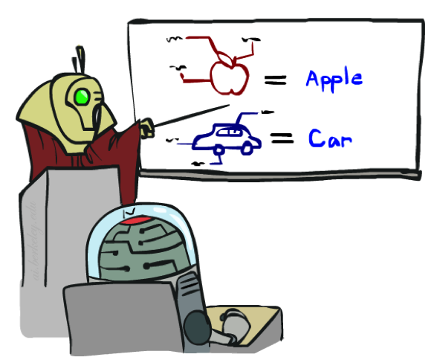


A few important points about learning
Data: labeled instances, e.g. emails marked spam/ham
  Training set
  Held out set
  Test set
Features: attribute-value pairs which characterize each x
Experimentation cycle
  Learn parameters (e.g. model probabilities) on training set
  (Tune hyperparameters on held-out set)
  Compute accuracy of test set
  Very important: never “peek” at the test set!
Evaluation
  Accuracy: fraction of instances predicted correctly
Overfitting and generalization
  Want a classifier which does well on test data
  Overfitting: fitting the training data very closely, but not generalizing well
  Underfitting: fits the training set poorly
Training
Data
Held-Out
Data
Test
Data

Slide 53








A few important points about learning
What should we learn where?
  Learn parameters from training data
  Tune hyperparameters on different data
    Why?
  For each value of the hyperparameters, train and test on the held-out data
  Choose the best value and do a final test on the test data
What are examples of hyperparameters?

Slide 54
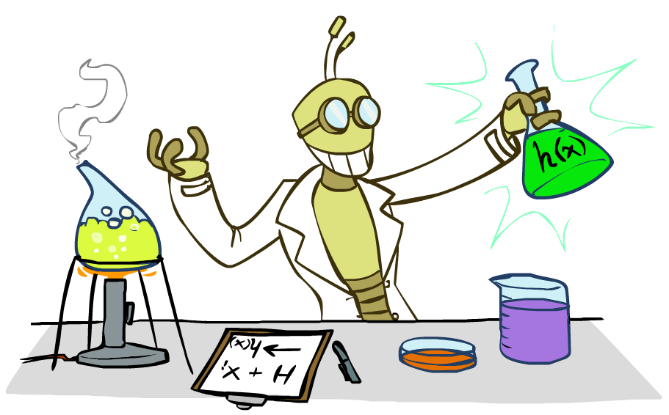
Inductive Learning

Slide 55



Inductive Learning (Science)
Simplest form: learn a function from examples
  A target function: g
  Examples: input-output pairs (x, g(x))
  E.g. x is an email and g(x) is spam / ham
  E.g. x is a house and g(x) is its selling price
Problem:
  Given a hypothesis space H
  Given a training set of examples x_{i}
  Find a hypothesis h(x) such that h ~ g
Includes:
  Classification (outputs = class labels)
  Regression (outputs = real numbers)
How do perceptron and naïve Bayes fit in? (H, h, g, etc.)

Slide 56
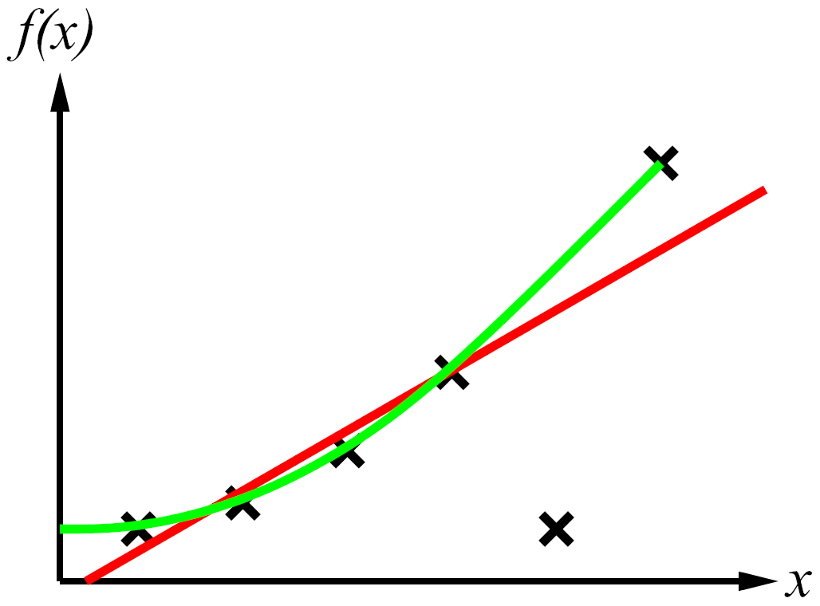
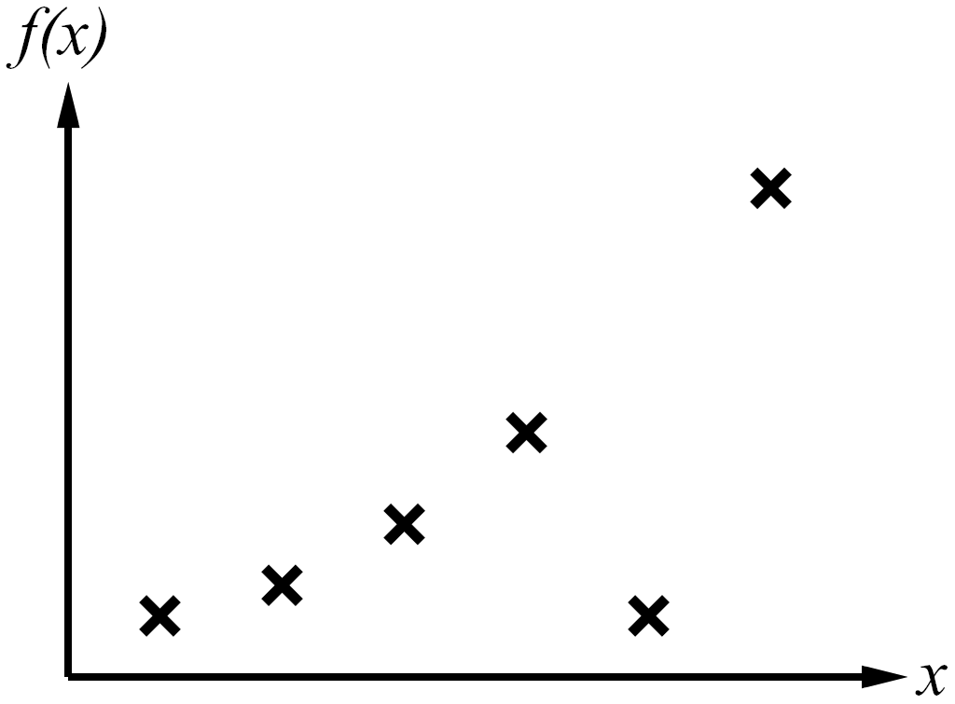
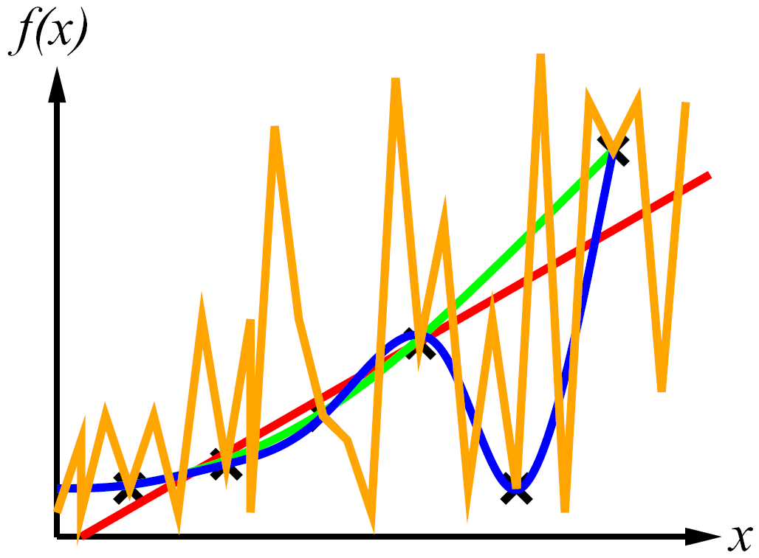
Inductive Learning
Curve fitting (regression, function approximation):
Consistency vs. simplicity
Ockham’s razor

Slide 57
Consistency vs. Simplicity
Fundamental tradeoff: bias vs. variance
Usually algorithms prefer consistency by default (why?)
Several ways to operationalize “simplicity”
  Reduce the hypothesis space
    Assume more: e.g. independence assumptions, as in naïve Bayes
    Have fewer, better features / attributes: feature selection
    Other structural limitations (decision lists vs trees)
  Regularization
    Smoothing: cautious use of small counts
    Many other generalization parameters (pruning cutoffs today)
    Hypothesis space stays big, but harder to get to the outskirts

