Slide 1
CS 188: Artificial Intelligence
Conclusion
Instructors: Sergey Levine and Stuart Russell
Notes:
Please retain proper attribution and the reference to ai.berkeley.edu. Thanks!

Slide 2
Course Staff – Thanks!!
Aditya
Baradwaj
Adam Gleave
Alex Li
Austen Zhu
Avi Singh
Charles Tang
Dennis Lee
Dequan Wang
Ellen Luo
Fred Ebert
Henry Zhu
Jasmine Deng
Jason Peng
Katie Luo
Laura Smith
Micah Carroll
Mike Chang
Murtaza Dalal
Rachel Li
Rishi
Veerapaneni
Ronghang Hu
Sid Reddy
Simin Liu
Tony Zhao
Wilson Yan
Xiaocheng (Mesut) Yang

Slide 3
Announcements/Reminders
Final exam: Thursday May 16, 7pm
Practice final online: 1pt extra credit if done by May 6
Clobbering policy: midterm score <- max(midterm score, final score)
HW12 (extra practice questions on ML, ungraded)
RRR week: GSI office hours only

Slide 4
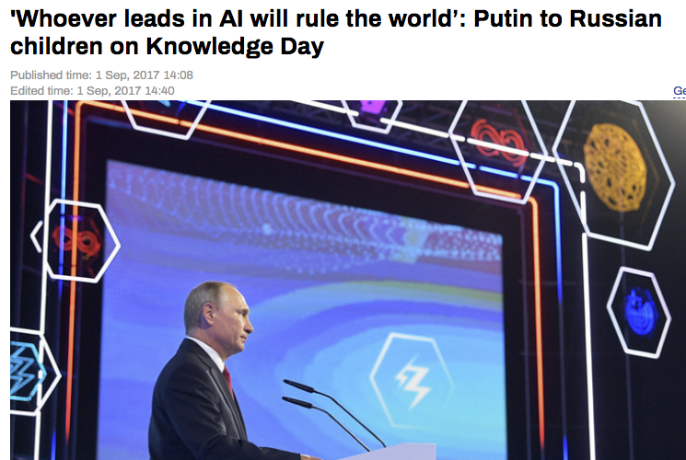
News AI

Slide 5
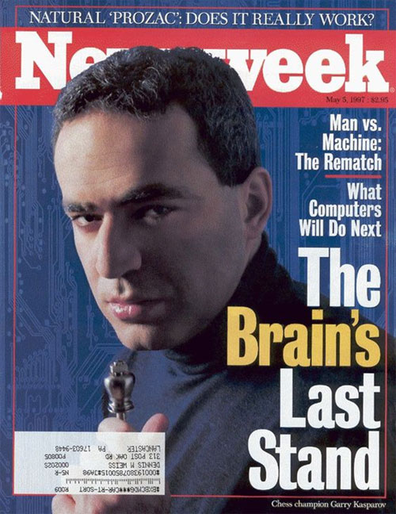
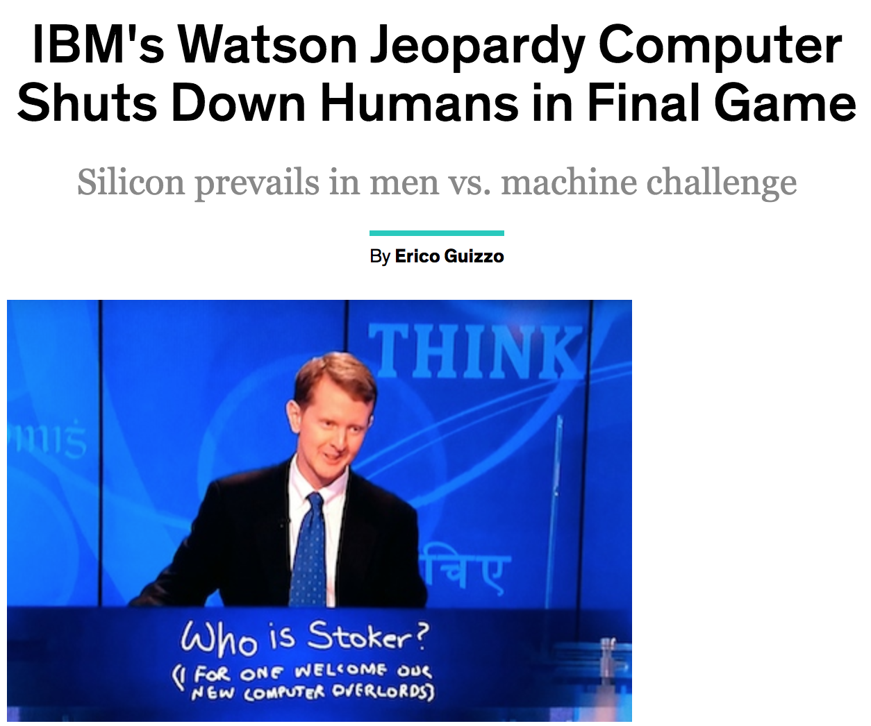
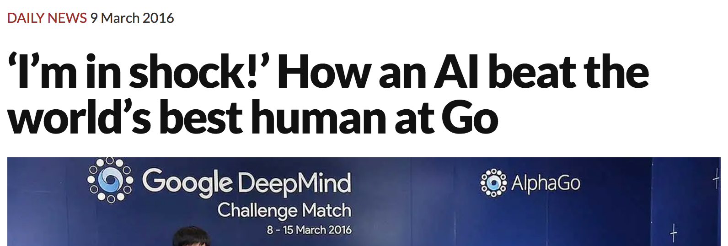
News AI

Slide 6
A note of caution
snake
Data is the new oil
Better learning => far less data needed
Serious disappointments (e.g., autonomous vehicles) could result in a significant backlash

Slide 7
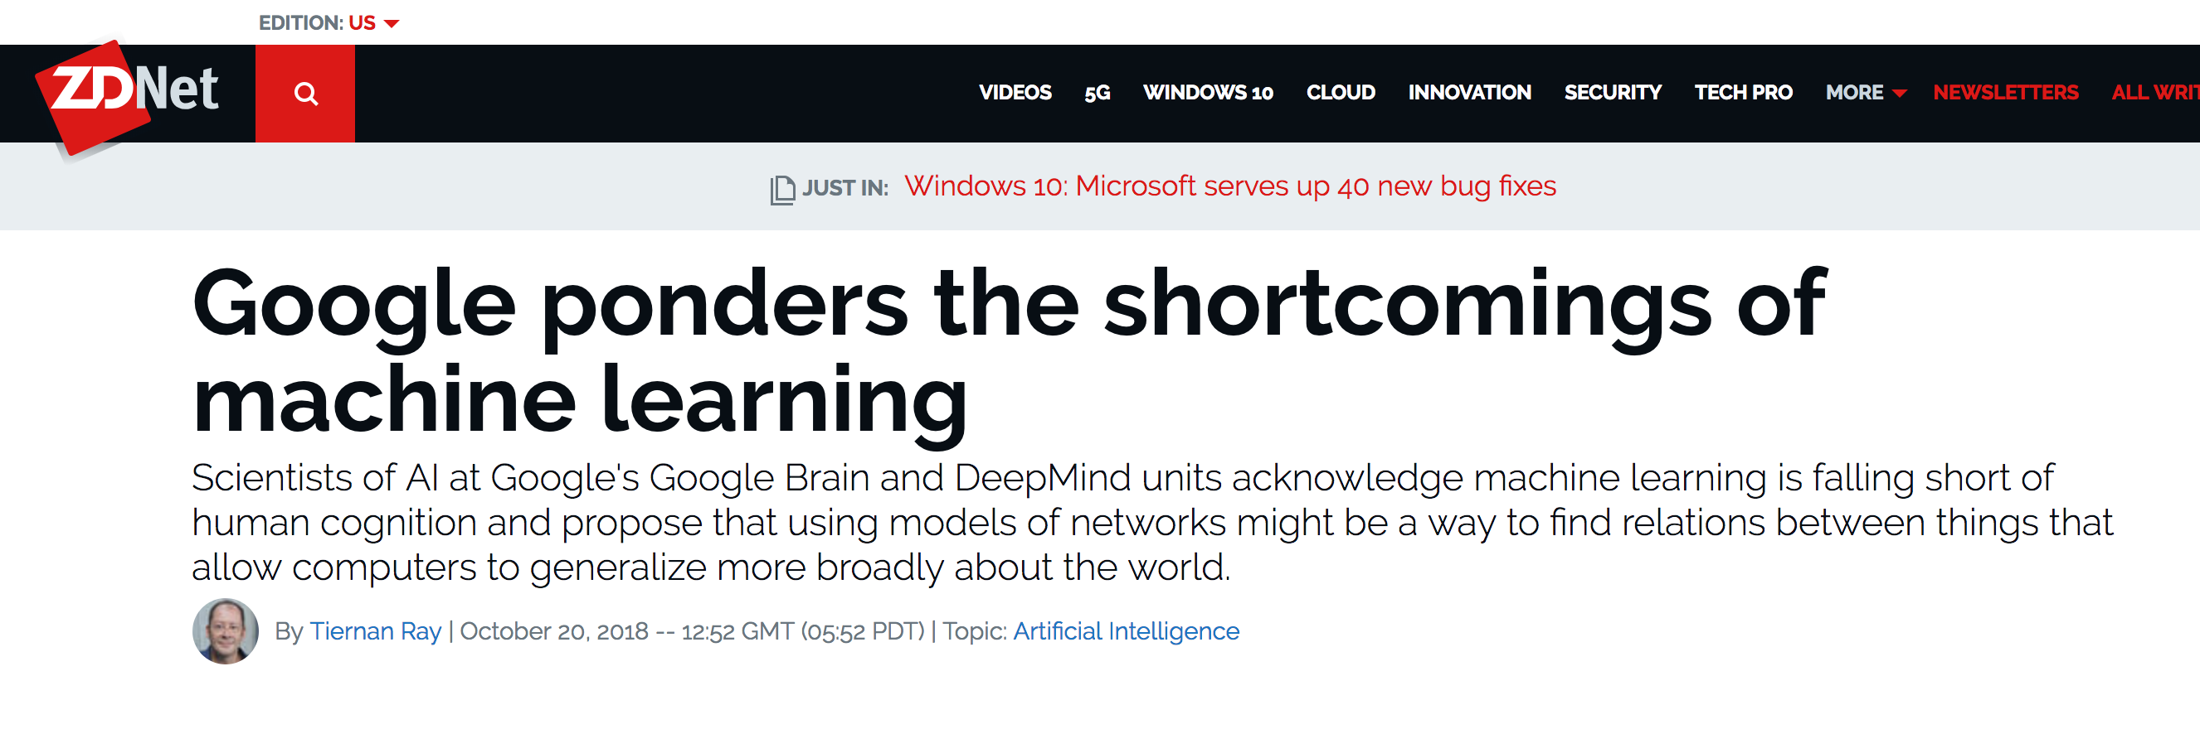
François Chollet: “Many more applications are completely out of reach for current deep learning techniques – even given vast amounts of human-annotated data.
The main directions in which I see promise are models closer to general-purpose computer programs.”

Slide 8
Probabilistic programming
Universal (Turing-equivalent) languages and algorithms for probabilistic modelling, learning, and reasoning
Notes:
Fortunately, probabilistic programming already does this.
Let me explain with an example.

Slide 9
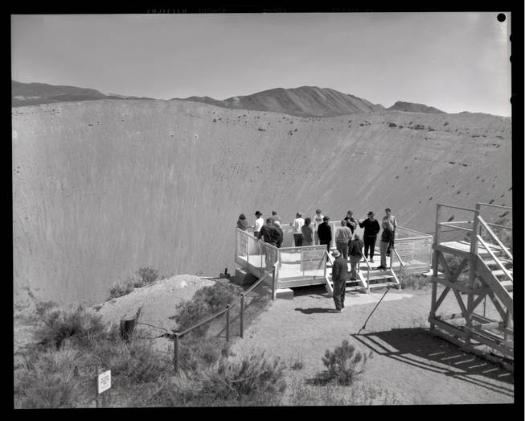
Notes:
Here’s a crater from a small nuclear test: 12 million tons of earth ejected into the atmosphere.
The Comprehensive Nuclear Test Ban Treaty bans such tests

Slide 10
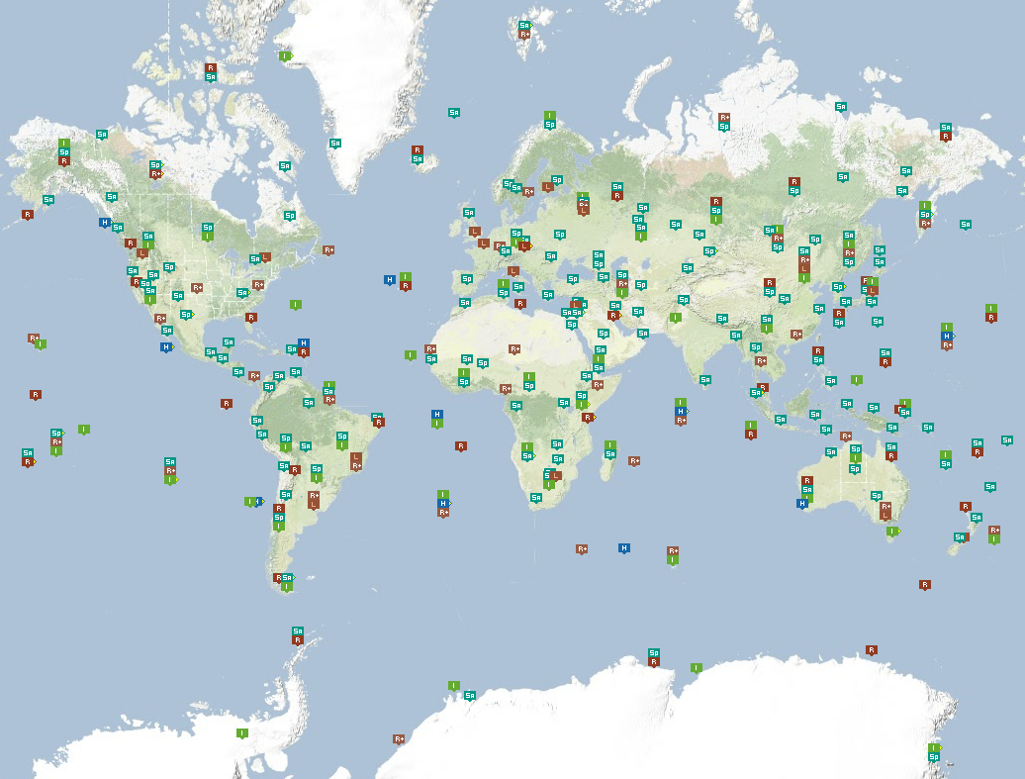
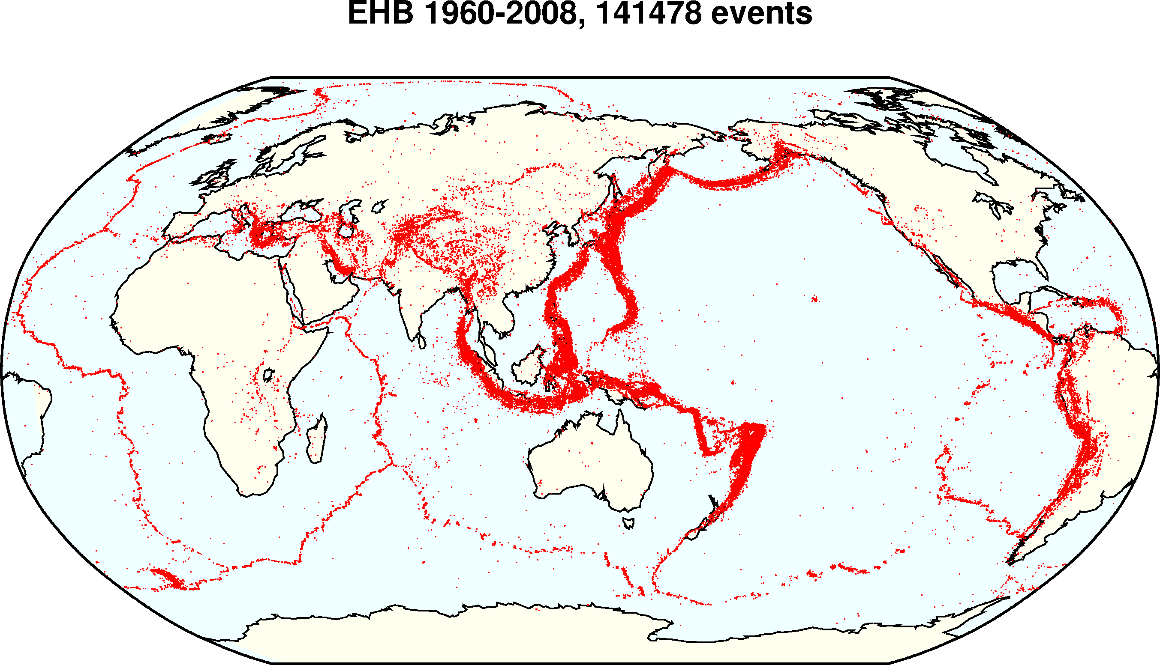
Global seismic monitoring for CTBT
Evidence: waveforms from 150 seismic stations
Query: what happened?
Model: geophysics of event occurrence, signal transmission, detection, noise
IMS
waveforms
bulletin
Notes:
Verification of the treaty requires continuous global seismic monitoring.
We do this using a probabilistic programming language, or PPL.
The *evidence* consists of seismic waveforms measured at 150 stations of the International Monitoring System (including several here in China).
The *query* is what happened today? The daily bulletin lists all seismic events.
The *model* is written in the PPL and captures what we know about the problem.

Slide 11
NET-VISA model
#SeismicEvents ~ Poisson[T*λ_{e}];
Time(e) ~ Uniform(0,T)
IsEarthQuake(e) ~ Bernoulli(.999);
Location(e) ~ if IsEarthQuake(e) then SpatialPrior() else UniformEarthDistribution();
Depth(e) ~ if IsEarthQuake(e) then Uniform[0,700] else 0;
Magnitude(e) ~ Exponential(log(10));
IsDetected(e,p,s) ~ Logistic[weights(s,p)](Magnitude(e), Depth(e), Distance(e,s));
#Detections(site = s) ~ Poisson[T*λ_{f}(s)];
#Detections(event=e, phase=p, station=s) = if IsDetected(e,p,s) then 1 else 0;
OnsetTime(a,s) ~ if (event(a) = null) then Uniform[0,T] else
Time(event(a)) + GeoTravelTime(Distance(event(a),s),Depth(event(a)),phase(a)) + Laplace(μ_{t}(s), σ_{t}(s))
Amplitude(a,s) ~ If (event(a) = null) then NoiseAmplitudeDistribution(s)
else AmplitudeModel(Magnitude(event(a)), Distance(event(a),s),Depth(event(a)),phase(a))
Azimuth(a,s) ~ If (event(a) = null) then Uniform(0, 360)
else GeoAzimuth(Location(event(a)),Depth(event(a)),phase(a),Site(s)) + Laplace(0,σ_{a}(s))
Slowness(a,s) ~ If (event(a) = null) then Uniform(0,20)
else GeoSlowness(Location(event(a)),Depth(event(a)),phase(a),Site(s)) + Laplace(0,σ_{a}(s))
ObservedPhase(a,s) ~ CategoricalPhaseModel(phase(a))
Notes:
Here it is, written in the BLOG language.
It’s entirely readable by a geophysicist, and took half an hour to write.
Then the quantitative aspects were trained from historical data.

Slide 12
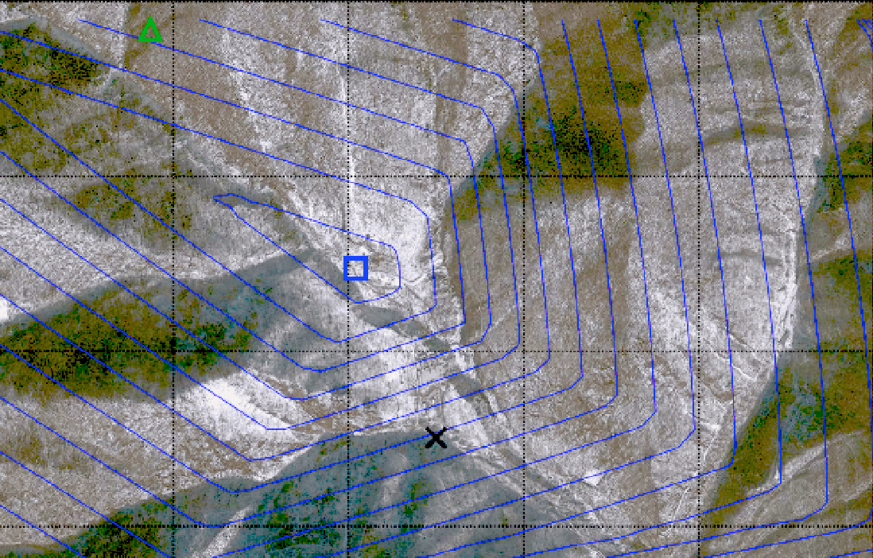
February 12, 2013 DPRK test
Global expert consensus location
NET-VISA location
Tunnel entrance
Notes:
For the 2012 nuclear test in North Korea, it gave a much more accurate location than
the consensus estimate from the world’s experts

Slide 13
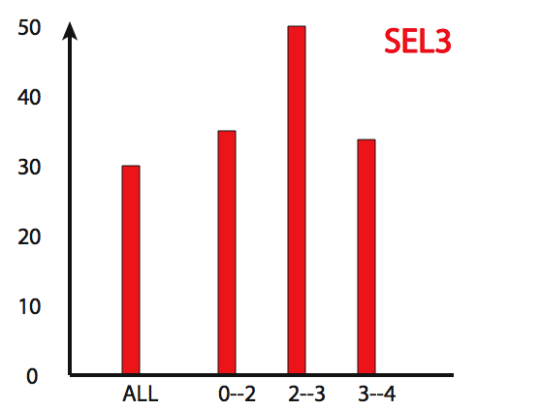
Fraction of events missed
Previous UN system
NET-VISA
As of Jan 1, 2018,
NETVISA is the operational system for the CTBT
magnitude
Magnitude
Notes:
Compared to the previous UN system, it is 2-3 times more sensitive from the same data.
As of January 1st, it is part of the deployed monitoring system for the treaty

Slide 14
Future
We are doing AI…
To create intelligent systems
The more intelligent, the better
To gain a better understanding of human intelligence
To magnify those benefits that flow from it
E.g., net present value of human-level AI ≥ $13,500T
Might help us avoid war and ecological catastrophes, achieve immortality and expand throughout the universe
What if we succeed?

Slide 15
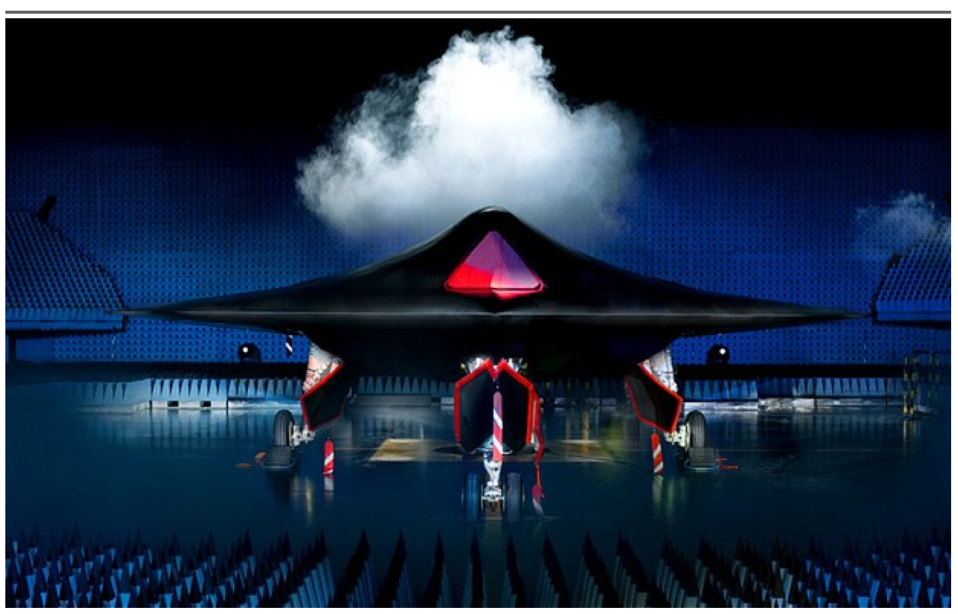
Notes:
using robots to kill people, possibly on an enormous scale

Slide 18
We had better be quite sure that the purpose put into the machine is the purpose which we really desire
Norbert Wiener, 1960
King Midas, c540 BCE
You can’t fetch the coffee if you’re dead
Notes:
It’s not just that smarter machines are more powerful than humans.
Norbert Wiener made this point in 1960: the machines’ objective has to be perfectly aligned with humans.
And the legend of King Midas tells us that’s very difficult. He asked for everything he touched to turn to gold
and the gods granted his wish – so his food, his drink, his family turned to gold and he died in misery and starvation.
Actually it’s worse than that: a machine with an objective, even one as simple as fetching the coffee,
knows that it cannot achieve the objective if it’s switched off. So it will take steps to defend itself.
Not because it has a self-preservation instinct, but because it has an objective.
So here’s your high-value takeaway from today’s talk: you can’t fetch the coffee if you’re dead.

Slide 19
Image by User:Cryteria on Wikimedia. CC-BY-3.0 licensed
I’m sorry, Dave, I’m afraid I
can’t do that
Notes:
wrong objective + defend itself = 2001, except not quite superintelligent
Go match, except the stakes are the whole world.

Slide 20
Social media catastrophe
Optimizing clickthrough
= learning what people want
= modifying people to be more predictable

Slide 21
Where did we go wrong?
Humans are intelligent to the extent that our actions can be expected to achieve our objectives
Machines are intelligent to the extent that their actions can be expected to achieve their objectives
Give them objectives to optimize (cf control theory, economics, operations research, statistics)
We don’t want machines that are intelligent in this sense
Machines are beneficial to the extent that their actions can be expected to achieve our objectives
We need machines to be provably beneficial

Slide 22
Three simple ideas
1. The robot’s only objective is to maximize the realization of human preferences
2. The robot is initially uncertain about what those preferences are
3. The source of information about human preferences is human behavior*

Slide 23
AIMA 1,2,3: objective given to machine
Human objective
Human behaviour
Machine behaviour

Slide 24
AIMA 1,2,3: objective given to machine
Human objective
Machine behaviour

Slide 25
AIMA 4: objective is a latent variable
Human objective
Human behaviour
Machine behaviour

Slide 26
Example: image classification
Old: minimize loss with (typically) a uniform loss matrix
Accidentally classify human as gorilla
Spend millions fixing public relations disaster
New: structured prior distribution over loss matrices
Some examples safe to classify
Say “don’t know” for others
Use active learning to gain additional feedback from humans

Slide 27
Example: fetching the coffee
What does “fetch some coffee” mean?
If there is so much uncertainty about preferences, how does the robot do anything useful?
Answer:
The instruction suggests coffee would have higher value than expected a priori, ceteris paribus
and there’s probably a low-cost way to get it
Uncertainty about the value of other aspects of environment state doesn’t matter as long as the robot leaves them unchanged
Humans mostly like things the way they are
Notes:
“Fetch some coffee” is NOT an instruction, it’s NOT a goal to be achieved.
Cf house is burning down, coffee costs 21 euros, you’re in the desert, etc.

Slide 28
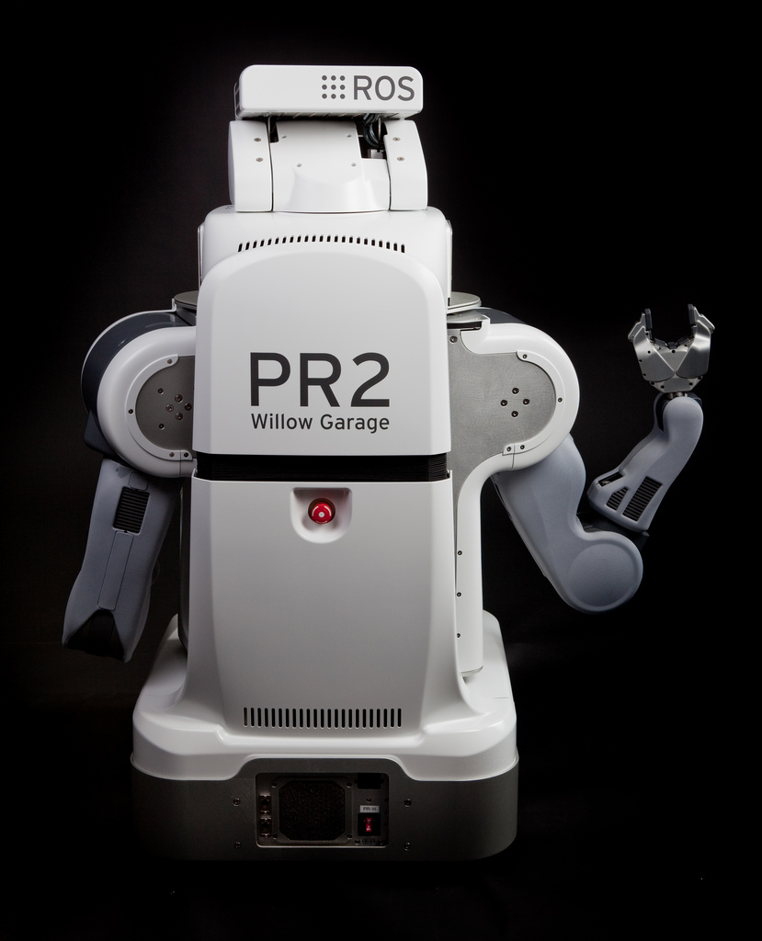
The off-switch problem
A robot, given an objective, has an incentive to disable its own off-switch
“You can’t fetch the coffee if you’re dead”
A robot with uncertainty about objective won’t behave this way

Slide 29
R
act
switch self off
wait
U = U_{act}
H
U = 0
go ahead
switch robot off
R
U = 0
act
U = U_{act}
Theorem: robot has a positive incentive to allow itself to be switched off
Theorem: robot is provably beneficial

Slide 30
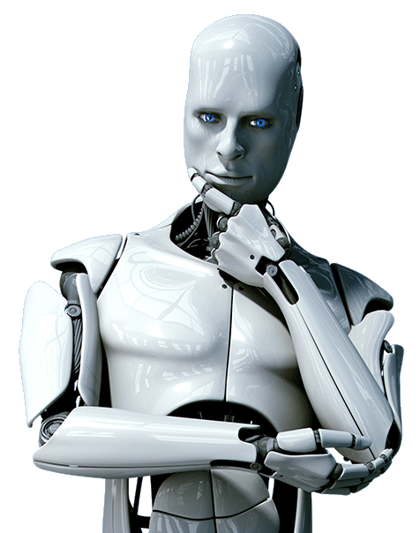
Learning from human behavior
Inverse reinforcement learning: learn a reward function by observing another agent’s behavior
Cooperative IRL:
human and robot in same environment
R(s,a,s’; θ)

Slide 31
Basic CIRL game
Preferences θ
Acts roughly according to θ
Maximize unknown human θ
Prior P(θ)
CIRL equilibria: Human teaches robot
Robot asks questions, permission; defers to human; allows off-switch
Solve by reduction to POMDP in [s,θ]
[Hadfield-Menell et al, NIPS 16; Fisac et al, ISRR 17; Palaniappan et al, ICML 18]

Slide 32
Example: paperclips vs staples
State (p,s) has p paperclips and s staples
Human reward is θp + (1-θ)s and θ=0.49
Robot has uniform prior for θ on [0,1]
H
[2,0]
[1,1]
[0,2]
$0.98
$1.00
$1.02
[1,1] is optimal
for θ in [.446,.554]
R
R
R
[90,0]
[50,50]
[0,90]

Slide 33
One robot, many humans
Weighing human preferences:
Harsanyi: Pareto-optimal policy optimizes a linear combination when humans have a common prior over the future
With individual priors: weights proportional to whose predictions turn out to be correct
Utility monsters (Nozick, 1974)
Welfare aggregation and the Somalia problem

Slide 34
Welcome home! Long day?
Yes, terrible, not even time for lunch.
So you must be quite hungry!
Starving! Anything for dinner?
There’s something I need to tell you
There are humans in Somalia in more urgent need of help.
I am leaving now. Please make your own dinner.
Notes:
or this:
problem in game theory, social choice theory, moral philosophy,
and we are actively seeking collaborators

Slide 35
Real(ish) humans
Computationally limited, irrational
Hierarchically organized behavior
Emotional states affecting behavior, revealing preferences
Heterogeneous
Nasty
Zero out negative-altruism preferences (sadism, pride/envy)
Inconsistent, non-additive, memory-laden preferences
“two selves” (Kahneman, 2015)
Plastic/adaptive preferences

Slide 36
Summary
AI may eventually overtake human abilities
Provably beneficial AI is possible and desirable
Continuing theoretical work (AI, CS, economics)
Initiating practical work (assistants, robots, cars)
Inverting human cognition (AI, cogsci, psychology)
Long-term goals (AI, philosophy, polisci, sociology)
Remaining problems…

Slide 37
Notes:
First, Dr Evil and his friends may not want to use safe AI

Slide 38
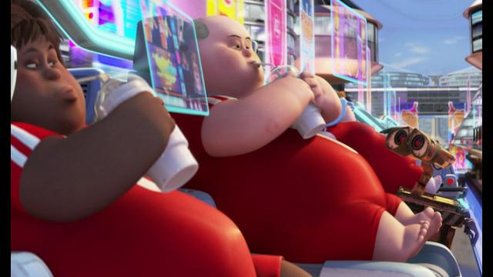
Notes:
and second, how do we avoid human enfeeblement when we
hand over the running of our civilization to machines?

