Slide 1
Announcements
Homework 1
  Due tonight at 11:59pm
    Electronic HW1
    Written HW1
Project 1
  Due Friday 2/8 at 4:00pm

Slide 2
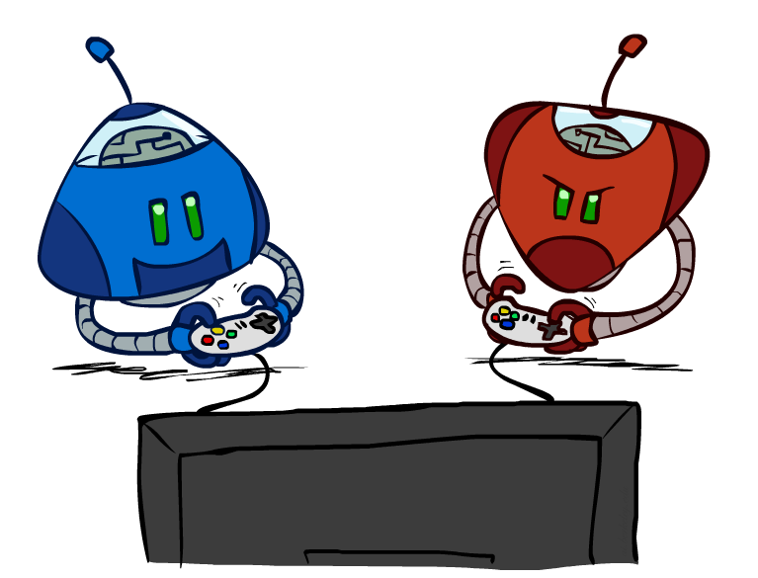
CS 188: Artificial Intelligence
Adversarial Search and Game Trees
Instructors: Sergey Levine & Stuart Russell
University of California, Berkeley
[Slides adapted from Dan Klein and Pieter Abbeel (ai.berkeley.edu).]
Notes:
Please retain proper attribution, including the reference to ai.berkeley.edu. Thanks!

Slide 3
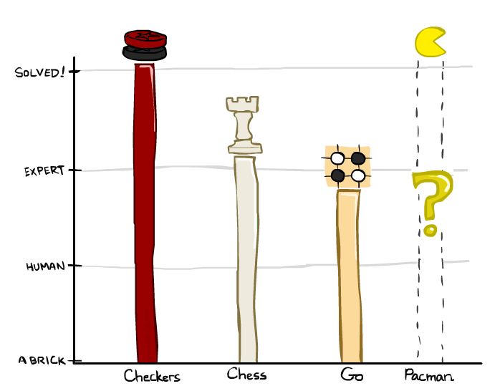
Game Playing State-of-the-Art
Checkers: 1950: First computer player. 1994: First computer champion: Chinook ended 40-year-reign of human champion Marion Tinsley using complete 8-piece endgame. 2007: Checkers solved!
Chess: 1997: Deep Blue defeats human champion Gary Kasparov in a six-game match. Deep Blue examined 200M positions per second, used very sophisticated evaluation and undisclosed methods for extending some lines of search up to 40 ply. Current programs are even better, if less historic.
Go: Human champions are now starting to be challenged by machines. In go, b > 300! Classic programs use pattern knowledge bases, but big recent advances use Monte Carlo (randomized) expansion methods.

Slide 4

Game Playing State-of-the-Art
Checkers: 1950: First computer player. 1994: First computer champion: Chinook ended 40-year-reign of human champion Marion Tinsley using complete 8-piece endgame. 2007: Checkers solved!
Chess: 1997: Deep Blue defeats human champion Gary Kasparov in a six-game match. Deep Blue examined 200M positions per second, used very sophisticated evaluation and undisclosed methods for extending some lines of search up to 40 ply. Current programs are even better, if less historic.
Go: 2016: Alpha GO defeats human champion. Uses Monte Carlo Tree Search, learned evaluation function.
Pacman

Slide 5

Behavior from Computation
[Demo: mystery pacman (L6D1)]

Slide 6

Video of Demo Mystery Pacman

Slide 7
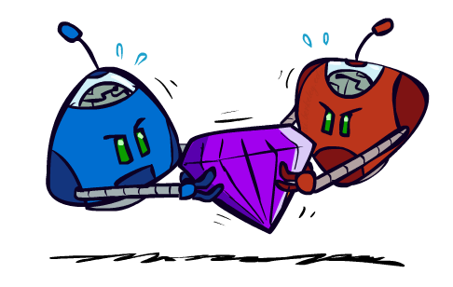
Adversarial Games

Slide 8
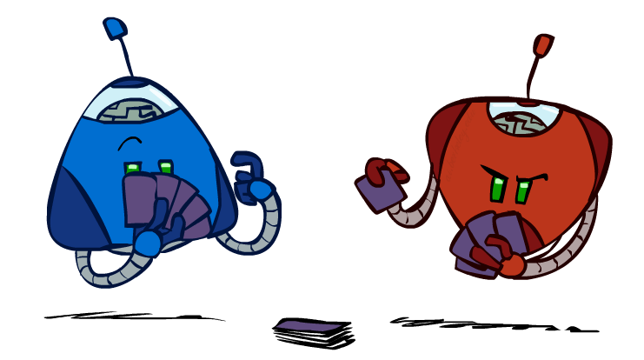
Types of Games
Many different kinds of games!
Axes:
  Deterministic or stochastic?
  One, two, or more players?
  Zero sum?
  Perfect information (can you see the state)?
Want algorithms for calculating a strategy (policy) which recommends a move from each state

Slide 9
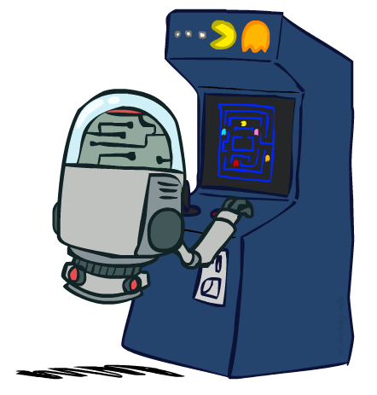
Deterministic Games
Many possible formalizations, one is:
  States: S (start at s₀)
  Players: P={1...N} (usually take turns)
  Actions: A (may depend on player / state)
  Transition Function: SxA → S
  Terminal Test: S → {t,f}
  Terminal Utilities: SxP → R
Solution for a player is a policy: S → A

Slide 10
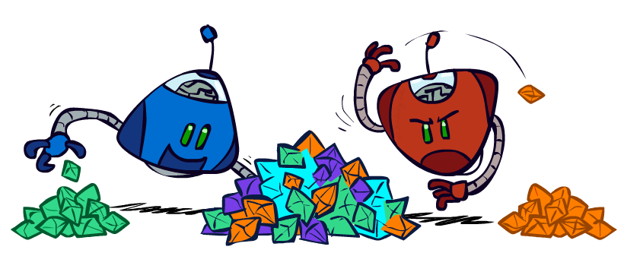
Zero-Sum Games
Zero-Sum Games
  Agents have opposite utilities (values on outcomes)
  Lets us think of a single value that one maximizes and the other minimizes
  Adversarial, pure competition
General Games
  Agents have independent utilities (values on outcomes)
  Cooperation, indifference, competition, and more are all possible
  More later on non-zero-sum games

Slide 11
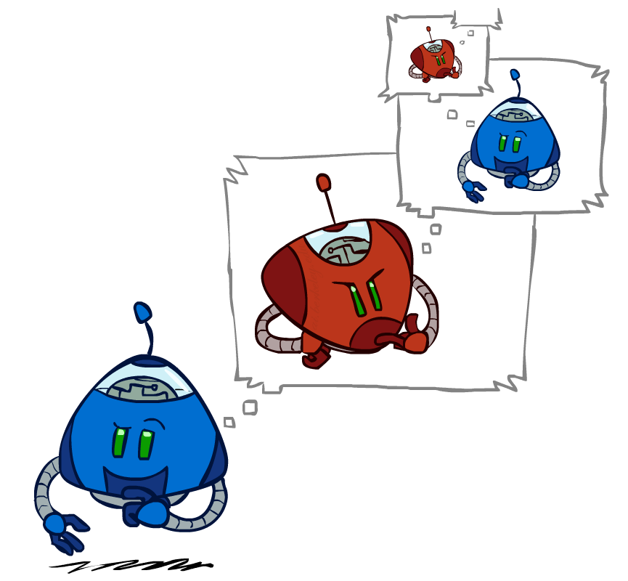
Adversarial Search

Slide 12
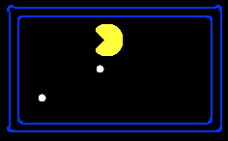
Single-Agent Trees
8
2
0
…
2
6
…
4
6

Slide 13
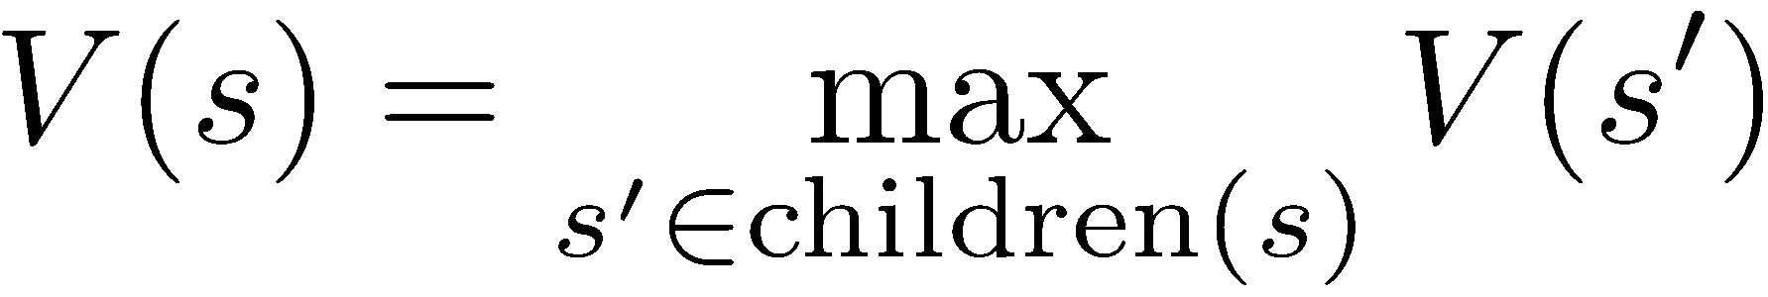

Value of a State
Value of a state: The best achievable outcome (utility) from that state
Non-Terminal States:
8
2
0
…
2
6
…
4
6
Terminal States:

Slide 14

Adversarial Game Trees
-20
-8
…
-18
-5
…
-10
+4
-20
+8

Slide 15
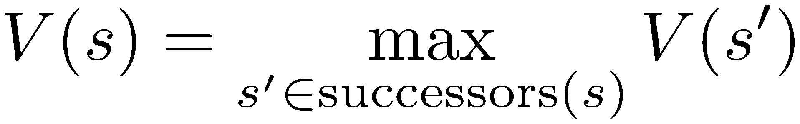
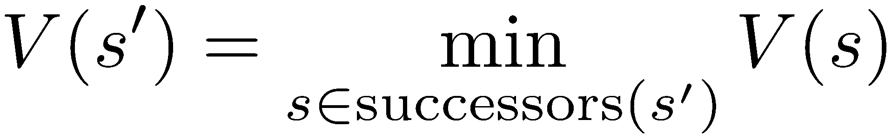
Minimax Values
States Under Agent’s Control:
States Under Opponent’s Control:
-8
-5
-10
+8
Terminal States:

Slide 16

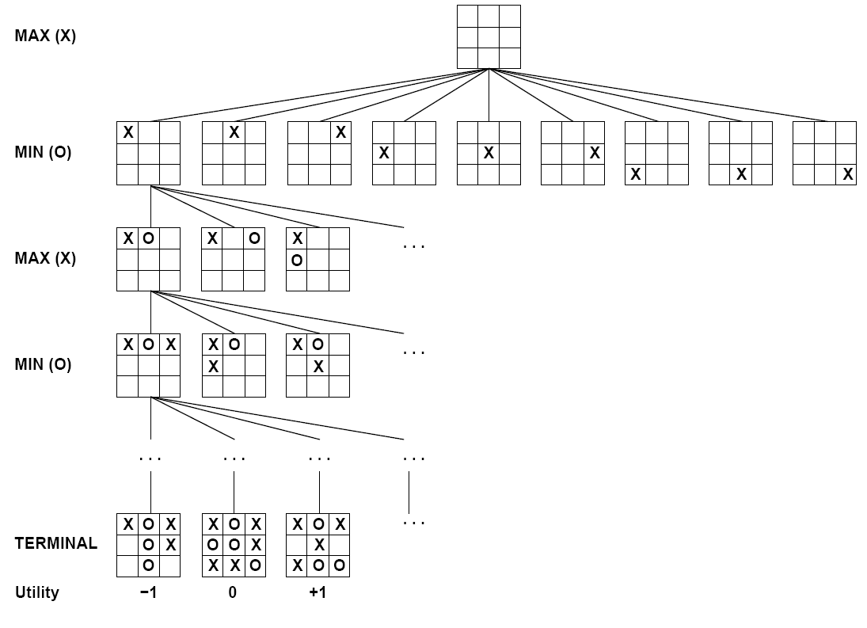

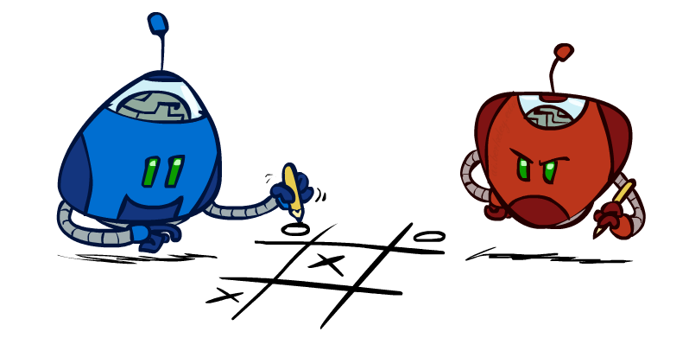
Tic-Tac-Toe Game Tree

Slide 17
Adversarial Search (Minimax)
Deterministic, zero-sum games:
  Tic-tac-toe, chess, checkers
  One player maximizes result
  The other minimizes result
Minimax search:
  A state-space search tree
  Players alternate turns
  Compute each node’s minimax value: the best achievable utility against a rational (optimal) adversary
Minimax values:
computed recursively
5
max
2
5
min
8
2
5
6
Terminal values:
part of the game

Slide 18
Minimax Implementation
def max-value(state):
  initialize v = -∞
  for each successor of state:
    v = max(v, min-value(successor))
  return v
def min-value(state):
  initialize v = +∞
  for each successor of state:
    v = min(v, max-value(successor))
  return v

Slide 19
Minimax Implementation (Dispatch)
def value(state):
  if the state is a terminal state: return the state’s utility
  if the next agent is MAX: return max-value(state)
  if the next agent is MIN: return min-value(state)
def max-value(state):
  initialize v = -∞
  for each successor of state:
    v = max(v, value(successor))
  return v
def min-value(state):
  initialize v = +∞
  for each successor of state:
    v = min(v, value(successor))
  return v
Notes:
Pick an order for two reasons: sequential processor and pruning

Slide 20
Minimax Example
3
12
8
2
4
6
14
5
2

Slide 21
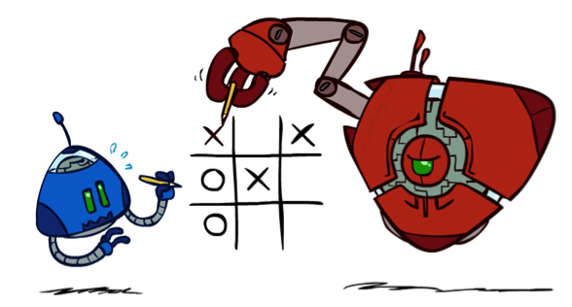
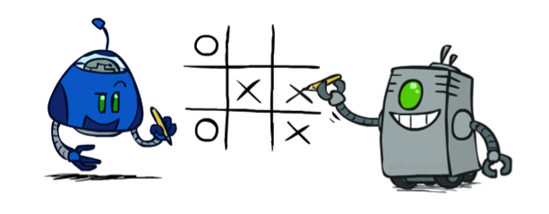
Minimax Properties
max
min
10
10
9
100
Optimal against a perfect player. Otherwise?
[Demo: min vs exp (L6D2, L6D3)]

Slide 22
Video of Demo Min vs. Exp (Min)

Slide 23
Video of Demo Min vs. Exp (Exp)

Slide 24
Minimax Efficiency
How efficient is minimax?
  Just like (exhaustive) DFS
  Time: O(b^{m})
  Space: O(bm)
Example: For chess, b ≈ 35, m ≈ 100
  Exact solution is completely infeasible
  But, do we need to explore the whole tree?

Slide 25
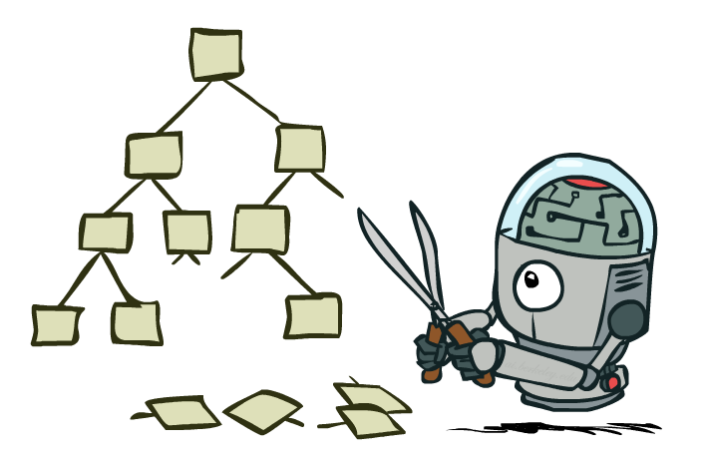
Game Tree Pruning

Slide 26
Minimax Example
3
12
8
2
4
6
14
5
2

Slide 27
Minimax Pruning
3
12
8
2
14
5
2

Slide 28
Alpha-Beta Pruning
General configuration (MIN version)
  We’re computing the MIN-VALUE at some node n
  We’re looping over n’s children
  n’s estimate of the childrens’ min is dropping
  Who cares about n’s value? MAX
  Let a be the best value that MAX can get at any choice point along the current path from the root
  If n becomes worse than a, MAX will avoid it, so we can stop considering n’s other children (it’s already bad enough that it won’t be played)
MAX version is symmetric
MAX
MIN
a
MAX
MIN
n

Slide 29
Alpha-Beta Implementation
  α: MAX’s best option on path to root
  β: MIN’s best option on path to root
def max-value(state, α, β):
  initialize v = -∞
  for each successor of state:
    v = max(v, value(successor, α, β))
    if v ≥ β return v
    α = max(α, v)
  return v
def min-value(state , α, β):
  initialize v = +∞
  for each successor of state:
    v = min(v, value(successor, α, β))
    if v ≤ α return v
    β = min(β, v)
  return v
Notes:
Pick an order for two reasons: sequential processor and pruning

Slide 30
Alpha-Beta Pruning Properties
This pruning has no effect on minimax value computed for the root!
Values of intermediate nodes might be wrong
  Important: children of the root may have the wrong value
  So the most naïve version won’t let you do action selection
Good child ordering improves effectiveness of pruning
With “perfect ordering”:
  Time complexity drops to O(b^{m/2})
  Doubles solvable depth!
  Full search of, e.g. chess, is still hopeless…
max
min
10
10
0

Slide 31
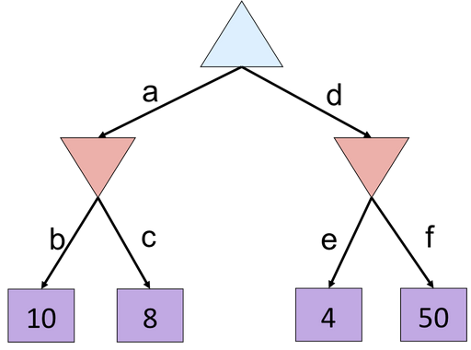
Alpha-Beta Quiz

Slide 32
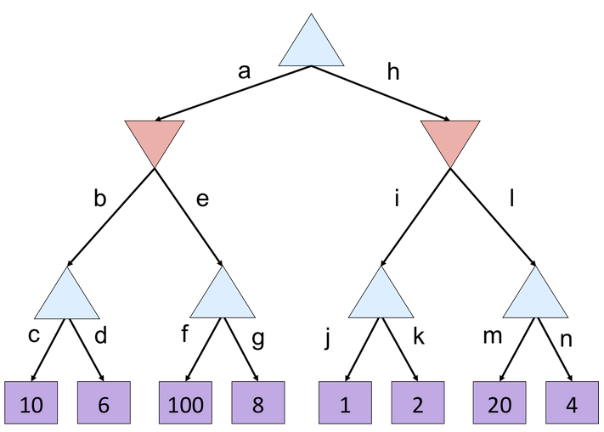
Alpha-Beta Quiz 2

Slide 33

Resource Limits

Slide 34
Resource Limits
Problem: In realistic games, cannot search to leaves!
Solution: Depth-limited search
  Instead, search only to a limited depth in the tree
  Replace terminal utilities with an evaluation function for non-terminal positions
Example:
  Suppose we have 100 seconds, can explore 10K nodes / sec
  So can check 1M nodes per move
  α-β reaches about depth 8 – decent chess program
Guarantee of optimal play is gone
Use iterative deepening for an anytime algorithm
max
4
-2
4
min
-1
-2
4
9
?
?
?
?

Slide 35
Video of Demo Thrashing (d=2)
[Demo: thrashing d=2, thrashing d=2 (fixed evaluation function) (L6D6)]

Slide 36
Why Pacman Starves
A danger of replanning agents!
  He knows his score will go up by eating the dot now (west, east)
  He knows his score will go up just as much by eating the dot later (east, west)
  There are no point-scoring opportunities after eating the dot (within the horizon, two here)
  Therefore, waiting seems just as good as eating: he may go east, then back west in the next round of replanning!

Slide 37
Video of Demo Thrashing -- Fixed (d=2)
[Demo: thrashing d=2, thrashing d=2 (fixed evaluation function) (L6D7)]

Slide 38
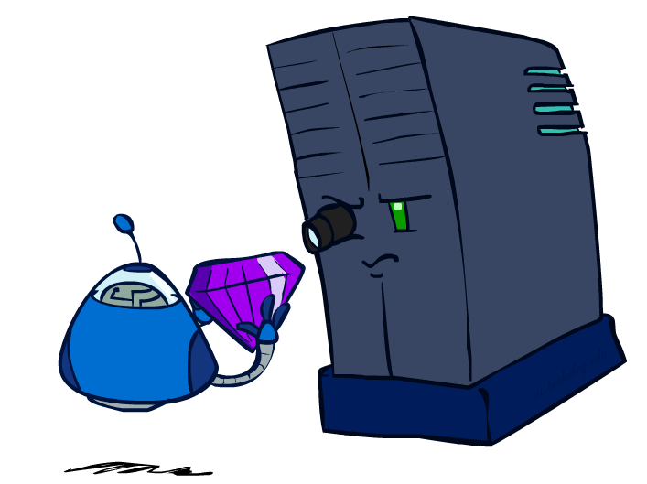
Evaluation Functions

Slide 39
Evaluation Functions
Evaluation functions score non-terminals in depth-limited search
Ideal function: returns the actual minimax value of the position
In practice: typically weighted linear sum of features:
e.g. f₁(s) = (num white queens – num black queens), etc.

Slide 40




Evaluation for Pacman
[Demo: thrashing d=2, thrashing d=2 (fixed evaluation function), smart ghosts coordinate (L6D6,7,8,10)]

Slide 41
Video of Demo Smart Ghosts (Coordination)

Slide 42
Video of Demo Smart Ghosts (Coordination) – Zoomed In

Slide 43


Depth Matters
Evaluation functions are always imperfect
The deeper in the tree the evaluation function is buried, the less the quality of the evaluation function matters
An important example of the tradeoff between complexity of features and complexity of computation
[Demo: depth limited (L6D4, L6D5)]

Slide 44
Video of Demo Limited Depth (2)

Slide 45
Video of Demo Limited Depth (10)

Slide 46
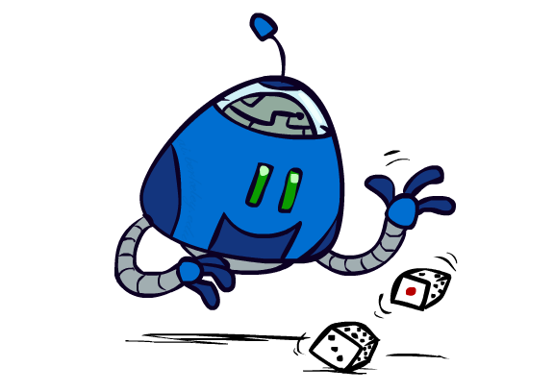
Uncertain Outcomes

Slide 47


Worst-Case vs. Average Case
max
min
10
10
9
100
Idea: Uncertain outcomes controlled by chance, not an adversary!
Notes:
At least 10, or otherwise just rather dead; or just 100, or otherwise rather dead; that’s yet something different than minimax or expectimax

Slide 48
Expectimax Search
Why wouldn’t we know what the result of an action will be?
  Explicit randomness: rolling dice
  Unpredictable opponents: the ghosts respond randomly
  Actions can fail: when moving a robot, wheels might slip
Values should now reflect average-case (expectimax) outcomes, not worst-case (minimax) outcomes
Expectimax search: compute the average score under optimal play
  Max nodes as in minimax search
  Chance nodes are like min nodes but the outcome is uncertain
  Calculate their expected utilities
  I.e. take weighted average (expectation) of children
Later, we’ll learn how to formalize the underlying uncertain-result problems as Markov Decision Processes
max
chance
10
10
4
10
5
9
7
100

Slide 49
Expectimax Pseudocode
def value(state):
  if the state is a terminal state: return the state’s utility
  if the next agent is MAX: return max-value(state)
  if the next agent is EXP: return exp-value(state)
def max-value(state):
  initialize v = -∞
  for each successor of state:
    v = max(v, value(successor))
  return v
def exp-value(state):
  initialize v = 0
  for each successor of state:
  p = probability(successor)
    v += p * value(successor)
  return v
Notes:
Pick an order for two reasons: sequential processor and pruning

Slide 50
Expectimax Pseudocode
def exp-value(state):
  initialize v = 0
  for each successor of state:
  p = probability(successor)
    v += p * value(successor)
  return v
1/2
1/6
1/3
5
8
7
24
-12
v = (1/2) (8) + (1/3) (24) + (1/6) (-12) = 10

Slide 51
Expectimax Example
3
12
9
2
4
6
15
6
0

Slide 52
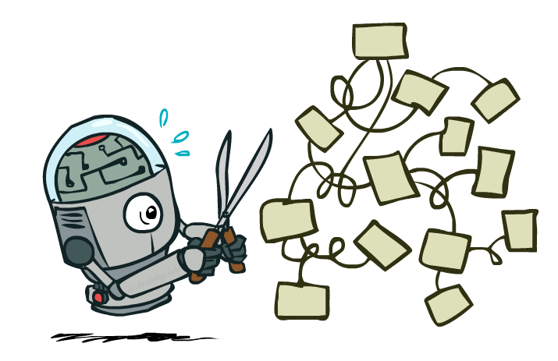
Expectimax Pruning?
3
12
9
2

Slide 53
Depth-Limited Expectimax
Estimate of true expectimax value (which would require a lot of work to compute)
400
300
…
…
492
362
…

Slide 54
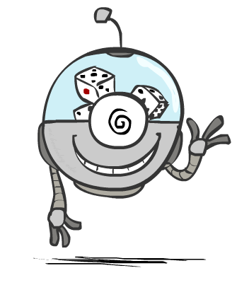
Probabilities

Slide 55
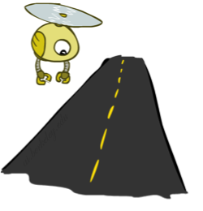
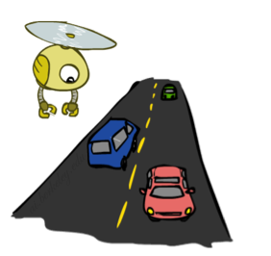
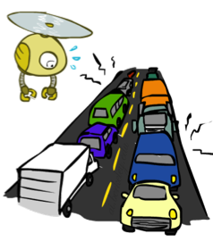
Reminder: Probabilities
A random variable represents an event whose outcome is unknown
A probability distribution is an assignment of weights to outcomes
Example: Traffic on freeway
  Random variable: T = whether there’s traffic
  Outcomes: T in {none, light, heavy}
  Distribution: P(T=none) = 0.25, P(T=light) = 0.50, P(T=heavy) = 0.25
Some laws of probability:
  Probabilities are always non-negative
  Probabilities over all possible outcomes sum to one
0.25
0.50
0.25

Slide 56
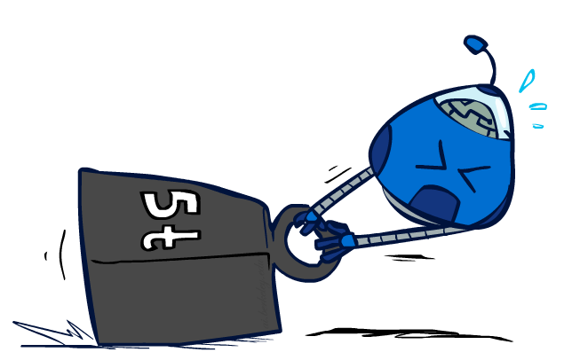
Reminder: Expectations
The expected value of a function of a random variable is the average, weighted by the probability distribution over outcomes
Example: How long to get to the airport?
Time:
20 min
30 min
60 min
+
+
35 min
x
x
x
Probability:
0.25
0.50
0.25

Slide 57

What Probabilities to Use?
In expectimax search, we have a probabilistic model of how the opponent (or environment) will behave in any state
  Model could be a simple uniform distribution (roll a die)
  Model could be sophisticated and require a great deal of computation
  We have a chance node for any outcome out of our control: opponent or environment
  The model might say that adversarial actions are likely!
For now, assume each chance node magically comes along with probabilities that specify the distribution over its outcomes
Having a probabilistic belief about another agent’s action does not mean that the agent is flipping any coins!

Slide 58
Quiz: Informed Probabilities
Let’s say you know that your opponent is actually running a depth 2 minimax, using the result 80% of the time, and moving randomly otherwise
Question: What tree search should you use?
Answer: Expectimax!
  To figure out EACH chance node’s probabilities, you have to run a simulation of your opponent
  This kind of thing gets very slow very quickly
  Even worse if you have to simulate your opponent simulating you…
  … except for minimax, which has the nice property that it all collapses into one game tree
0.1 0.9

Slide 59

Modeling Assumptions

Slide 60
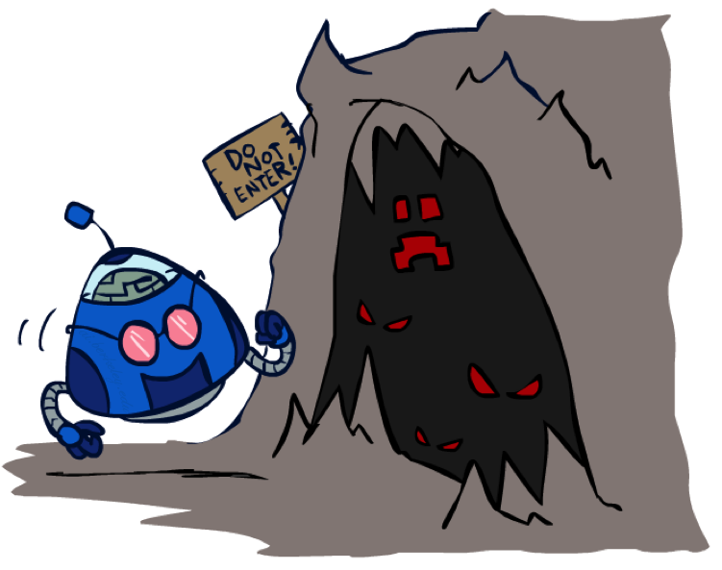
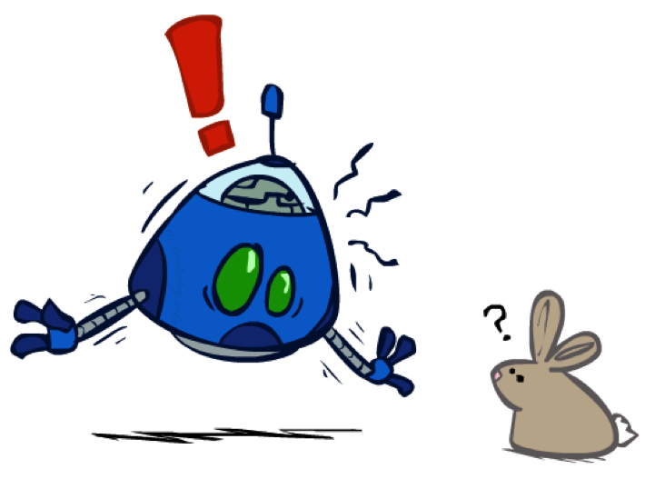
The Dangers of Optimism and Pessimism
Dangerous Optimism
Assuming chance when the world is adversarial
Dangerous Pessimism
Assuming the worst case when it’s not likely

Slide 61
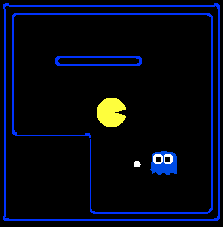
Assumptions vs. Reality
 | Adversarial Ghost | Random Ghost
Minimax Pacman | Won 5/5 Avg. Score: 483 | Won 5/5 Avg. Score: 493
Expectimax Pacman | Won 1/5 Avg. Score: -303 | Won 5/5 Avg. Score: 503
Results from playing 5 games
Pacman used depth 4 search with an eval function that avoids trouble
Ghost used depth 2 search with an eval function that seeks Pacman
[Demos: world assumptions (L7D3,4,5,6)]
Notes:
python pacman.py -g SmartGhost -l trapped2 -p ExpectimaxAgent -a depth=4,evalFn=better

Slide 62
Assumptions vs. Reality
 | Adversarial Ghost | Random Ghost
Minimax Pacman | Won 5/5 Avg. Score: 483 | Won 5/5 Avg. Score: 493
Expectimax Pacman | Won 1/5 Avg. Score: -303 | Won 5/5 Avg. Score: 503
Results from playing 5 games
Pacman used depth 4 search with an eval function that avoids trouble
Ghost used depth 2 search with an eval function that seeks Pacman
[Demos: world assumptions (L7D3,4,5,6)]
Notes:
python pacman.py -g SmartGhost -l trapped2 -p ExpectimaxAgent -a depth=4,evalFn=better

Slide 63
Video of Demo World Assumptions
Random Ghost – Expectimax Pacman

Slide 64
Video of Demo World Assumptions
Adversarial Ghost – Minimax Pacman

Slide 65
Video of Demo World Assumptions
Adversarial Ghost – Expectimax Pacman

Slide 66
Video of Demo World Assumptions
Random Ghost – Minimax Pacman

Slide 67

Other Game Types

Slide 68

Mixed Layer Types
E.g. Backgammon
Expectiminimax
  Environment is an extra “random agent” player that moves after each min/max agent
  Each node computes the appropriate combination of its children
Notes:
If it’s terminal or we reached our depth limit, return utility

Slide 69
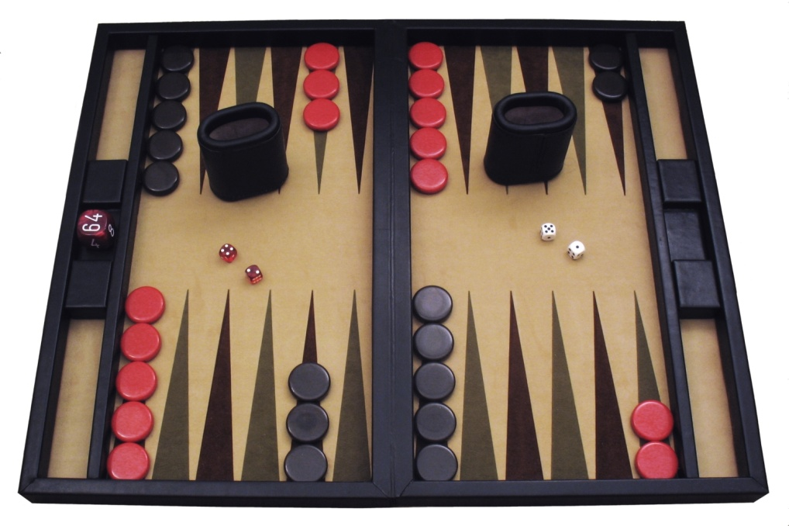
Example: Backgammon
Dice rolls increase b: 21 possible rolls with 2 dice
  Backgammon ≈ 20 legal moves
  Depth 2 = 20 x (21 x 20)³ = 1.2 x 10⁹
As depth increases, probability of reaching a given search node shrinks
  So usefulness of search is diminished
  So limiting depth is less damaging
  But pruning is trickier…
Historic AI: TDGammon uses depth-2 search + very good evaluation function + reinforcement learning:
world-champion level play
1st AI world champion in any game!
Image: Wikipedia

Slide 70
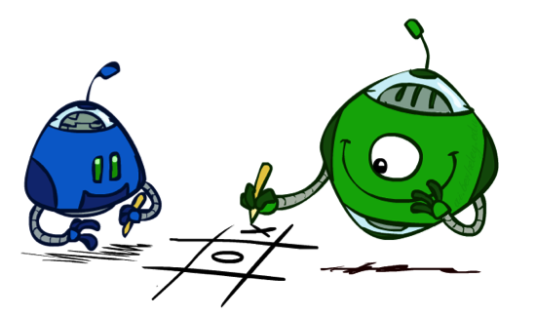
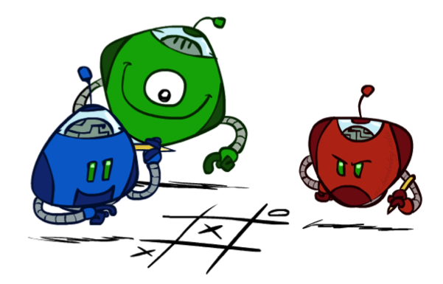
Multi-Agent Utilities
What if the game is not zero-sum, or has multiple players?
Generalization of minimax:
  Terminals have utility tuples
  Node values are also utility tuples
  Each player maximizes its own component
  Can give rise to cooperation and
  competition dynamically…
1,6,6
7,1,2
6,1,2
7,2,1
5,1,7
1,5,2
7,7,1
5,2,5

