Slide 1
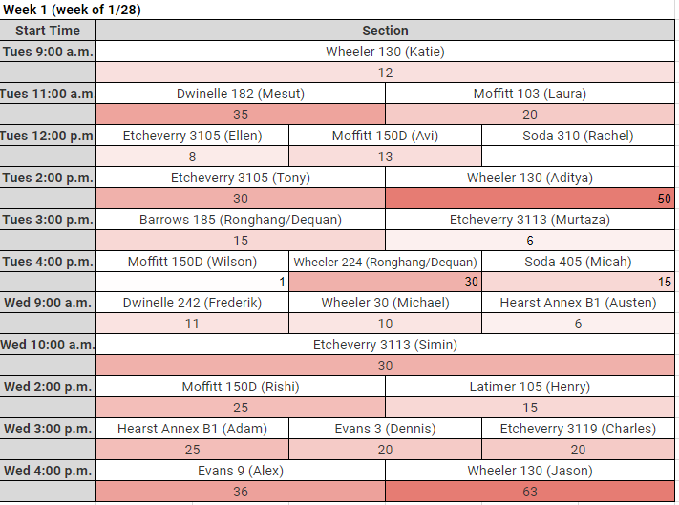
Announcements
Homework 2
  Due 2/11 at 11:59pm
    Electronic HW2
    Written HW2
Project 1
  Due Friday 2/8 at 4:00pm
Mini-contest 1 (optional)
  Due 2/11 at 11:59pm

Slide 2

CS 188: Artificial Intelligence
Expectimax & Markov Decision Processes
Instructors: Sergey Levine and Stuart Russell
University of California, Berkeley
[slides adapted from Dan Klein and Pieter Abbeel http://ai.berkeley.edu.]
Notes:
Please retain proper attribution, including the reference to ai.berkeley.edu. Thanks!

Slide 3
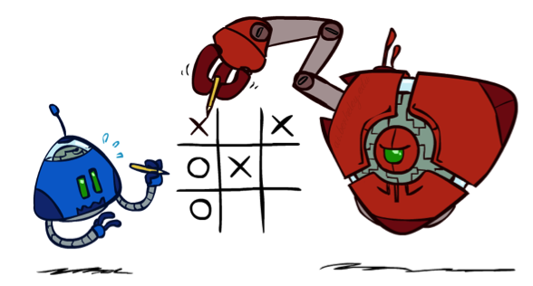
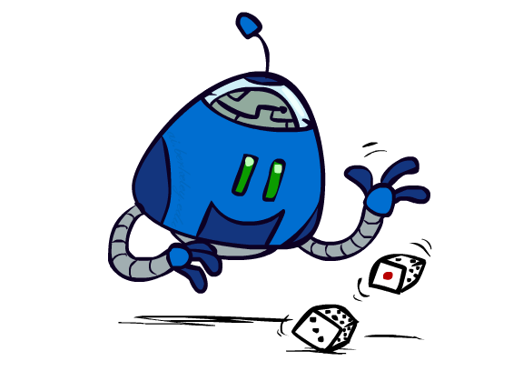

Worst-Case vs. Average Case
max
min
10
10
9
100
Notes:
At least 10, or otherwise just rather dead; or just 100, or otherwise rather dead; that’s yet something different than minimax or expectimax

Slide 4
Expectimax Search
Why wouldn’t we know what the result of an action will be?
  Explicit randomness: rolling dice
  Unpredictable opponents: the ghosts respond randomly
  Actions can fail: when moving a robot, wheels might slip
Values should now reflect average-case (expectimax) outcomes, not worst-case (minimax) outcomes
Expectimax search: compute the average score under optimal play
  Max nodes as in minimax search
  Chance nodes are like min nodes but the outcome is uncertain
  Calculate their expected utilities
  I.e. take weighted average (expectation) of children
Later, we’ll learn how to formalize the underlying uncertain-result problems as Markov Decision Processes
max
chance
10
10
4
10
5
9
7
100

Slide 5
Expectimax Pseudocode
def value(state):
  if the state is a terminal state: return the state’s utility
  if the next agent is MAX: return max-value(state)
  if the next agent is EXP: return exp-value(state)
def max-value(state):
  initialize v = -∞
  for each successor of state:
    v = max(v, value(successor))
  return v
def exp-value(state):
  initialize v = 0
  for each successor of state:
  p = probability(successor)
    v += p * value(successor)
  return v
Notes:
Pick an order for two reasons: sequential processor and pruning

Slide 6
Expectimax Pseudocode
def exp-value(state):
  initialize v = 0
  for each successor of state:
  p = probability(successor)
    v += p * value(successor)
  return v
1/2
1/6
1/3
5
8
7
24
-12
v = (1/2) (8) + (1/3) (24) + (1/6) (-12) = 10

Slide 7
Expectimax Example
3
12
9
2
4
6
15
6
0

Slide 8
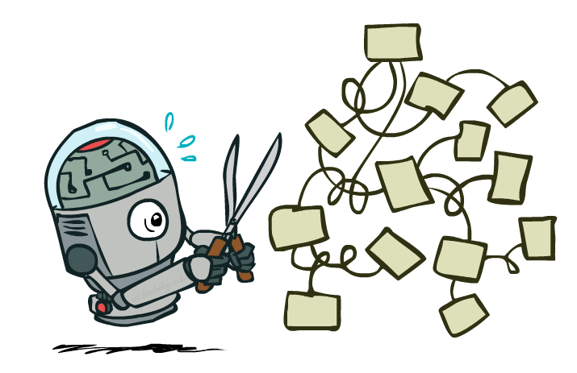
Expectimax Pruning?
3
12
9
2

Slide 9



Depth-Limited Expectimax
Estimate of true expectimax value (which would require a lot of work to compute)
400
300
…
…
492
362
…

Slide 10

Probabilities

Slide 11

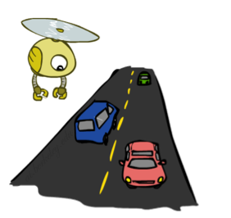
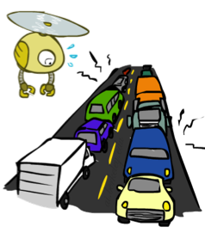
Reminder: Probabilities
A random variable represents an event whose outcome is unknown
A probability distribution is an assignment of weights to outcomes
Example: Traffic on freeway
  Random variable: T = whether there’s traffic
  Outcomes: T in {none, light, heavy}
  Distribution: P(T=none) = 0.25, P(T=light) = 0.50, P(T=heavy) = 0.25
Some laws of probability:
  Probabilities are always non-negative
  Probabilities over all possible outcomes sum to one
0.25
0.50
0.25

Slide 12

Reminder: Expectations
The expected value of a function of a random variable is the average, weighted by the probability distribution over outcomes
Example: How long to get to the airport?
Time:
20 min
30 min
60 min
+
+
35 min
x
x
x
Probability:
0.25
0.50
0.25

Slide 13

What Probabilities to Use?
In expectimax search, we have a probabilistic model of how the opponent (or environment) will behave in any state
  Model could be a simple uniform distribution (roll a die)
  Model could be sophisticated and require a great deal of computation
  We have a chance node for any outcome out of our control: opponent or environment
  The model might say that adversarial actions are likely!
For now, assume each chance node magically comes along with probabilities that specify the distribution over its outcomes
Having a probabilistic belief about another agent’s action does not mean that the agent is flipping any coins!

Slide 14
Quiz: Informed Probabilities
Let’s say you know that your opponent is actually running a depth 2 minimax, using the result 80% of the time, and moving randomly otherwise
Question: What tree search should you use?
Answer: Expectimax!
  To figure out EACH chance node’s probabilities, you have to run a simulation of your opponent
  This kind of thing gets very slow very quickly
  Even worse if you have to simulate your opponent simulating you…
  … except for minimax, which has the nice property that it all collapses into one game tree
0.1 0.9

Slide 15

Other Game Types

Slide 16



Mixed Layer Types
E.g. Backgammon
Expectiminimax
  Environment is an extra “random agent” player that moves after each min/max agent
  Each node computes the appropriate combination of its children
Notes:
If it’s terminal or we reached our depth limit, return utility

Slide 17
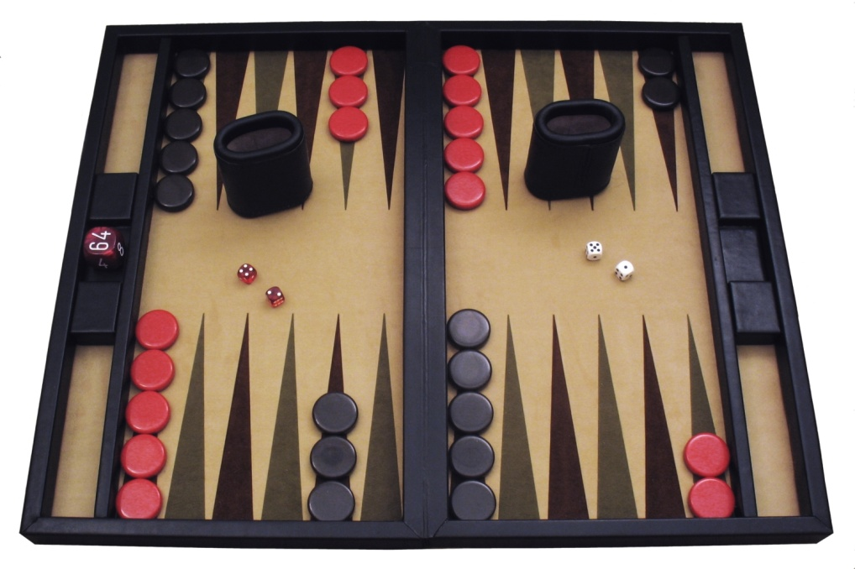
Example: Backgammon
Dice rolls increase b: 21 possible rolls with 2 dice
  Backgammon ≈ 20 legal moves
  Depth 2 = 20 x (21 x 20)³ = 1.2 x 10⁹
As depth increases, probability of reaching a given search node shrinks
  So usefulness of search is diminished
  So limiting depth is less damaging
  But pruning is trickier…
Historic AI: TDGammon uses depth-2 search + very good evaluation function + reinforcement learning:
world-champion level play
1st AI world champion in any game!
Image: Wikipedia

Slide 18
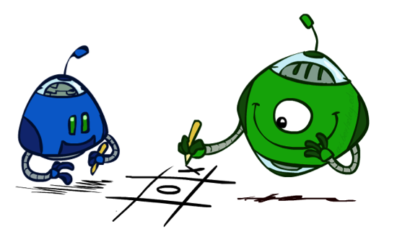
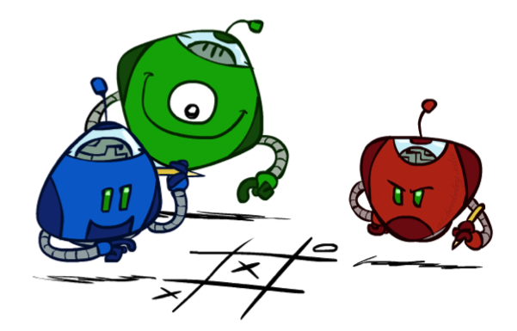
Multi-Agent Utilities
What if the game is not zero-sum, or has multiple players?
Generalization of minimax:
  Terminals have utility tuples
  Node values are also utility tuples
  Each player maximizes its own component
  Can give rise to cooperation and
  competition dynamically…
1,6,6
7,1,2
6,1,2
7,2,1
5,1,7
1,5,2
7,7,1
5,2,5

Slide 19

Non-Deterministic Search
max
chance
10
10
4
10
5
9
7
100

Slide 20





Example: Grid World
A maze-like problem
  The agent lives in a grid
  Walls block the agent’s path
Noisy movement: actions do not always go as planned
  80% of the time, the action North takes the agent North
  (if there is no wall there)
  10% of the time, North takes the agent West; 10% East
  If there is a wall in the direction the agent would have been taken, the agent stays put
The agent receives rewards each time step
  Small “living” reward each step (can be negative)
  Big rewards come at the end (good or bad)
Goal: maximize sum of rewards
Notes:
[cut demo of moving around in grid world program]

Slide 21



Grid World Actions
Deterministic Grid World
Stochastic Grid World

Slide 22
Markov Decision Processes
An MDP is defined by:
  A set of states s ∈ S
  A set of actions a ∈ A
  A transition function T(s, a, s’)
    Probability that a from s leads to s’, i.e., P(s’| s, a)
    Also called the model or the dynamics
  A reward function R(s, a, s’)
    Sometimes just R(s) or R(s’)
  A start state
  Maybe a terminal state
MDPs are non-deterministic search problems
  One way to solve them is with expectimax search
  We’ll have a new tool soon
[Demo – gridworld manual intro (L8D1)]
Notes:
In search problems: did not talk about actions, but about successor functions --- now the information inside the successor function is unpacked into actions, transitions and reward
Write out S, A, example entry in T, entry in R
Reward function different from the book : R(s,a,s’)
In book simpler for equations, but not useful for the projects.
Need to modify expectimax a tiny little bit to account for rewards along the way, but that’s something you should be able to do, and so you can already solve MDP’s (not in most efficient way)

Slide 23

Video of Demo Gridworld Manual Intro

Slide 24


What is Markov about MDPs?
“Markov” generally means that given the present state, the future and the past are independent
For Markov decision processes, “Markov” means action outcomes depend only on the current state
This is just like search, where the successor function could only depend on the current state (not the history)
Andrey Markov (1856-1922)
Notes:
Like search: successor function only depended on current state
Can make this happen by stuffing more into the state;
Very similar to search problems: when solving a maze with food pellets, we stored which food pellets were eaten

Slide 25

Policies
In deterministic single-agent search problems, we wanted an optimal plan, or sequence of actions, from start to a goal
For MDPs, we want an optimal policy π*: S → A
  A policy π gives an action for each state
  An optimal policy is one that maximizes expected utility if followed
  An explicit policy defines a reflex agent
Expectimax didn’t compute entire policies
  It computed the action for a single state only
Notes:
Dan has a DEMO for this.

Slide 26
Optimal Policies
R(s) = -0.01
R(s) = -0.03
R(s) = -0.4
R(s) = -2.0
Notes:
R(s) = the “living reward”

Slide 27
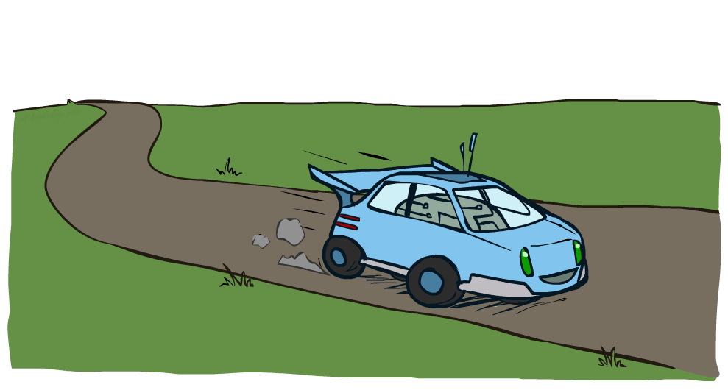
Example: Racing

Slide 28


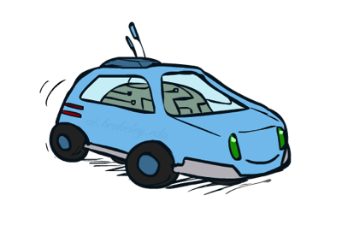
Example: Racing
A robot car wants to travel far, quickly
Three states: Cool, Warm, Overheated
Two actions: Slow, Fast
Going faster gets double reward
0.5
+1
1.0
Fast
Slow
-10
+1
0.5
Warm
Slow
Fast
0.5
+2
Cool
0.5
Overheated
+1
1.0
+2

Slide 29


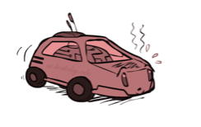
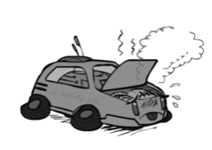
Racing Search Tree

Slide 30
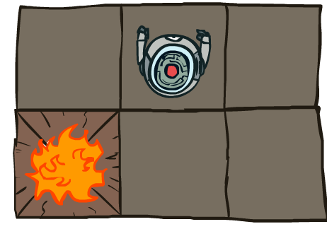


MDP Search Trees
Each MDP state projects an expectimax-like search tree
s
s is a state
a
(s, a) is a q-state
s, a
(s,a,s’) called a transition
T(s,a,s’) = P(s’|s,a)
R(s,a,s’)
s,a,s’
s’
Notes:
In MDP chance node represents uncertainty about what might happen based on (s,a) [as opposed to being a random adversary]
Q-state (s,a) is when you were in a state and took an action

Slide 31

Utilities of Sequences

Slide 32
Utilities of Sequences
What preferences should an agent have over reward sequences?
More or less?
Now or later?
[1, 2, 2]
or
[2, 3, 4]
[0, 0, 1]
or
[1, 0, 0]

Slide 33




Discounting
It’s reasonable to maximize the sum of rewards
It’s also reasonable to prefer rewards now to rewards later
One solution: values of rewards decay exponentially
Worth Now
Worth Next Step
Worth In Two Steps

Slide 34

Discounting
How to discount?
  Each time we descend a level, we multiply in the discount once
Why discount?
  Sooner rewards probably do have higher utility than later rewards
  Also helps our algorithms converge
Example: discount of 0.5
  U([1,2,3]) = 1*1 + 0.5*2 + 0.25*3
  U([1,2,3]) < U([3,2,1])
Notes:
Rewards in the future (deeper in the tree) matter less
Interesting: running expectimax, if having to truncate the search, then not losing much; e.g., less then \gamma^d / (1-\gamma)

Slide 35

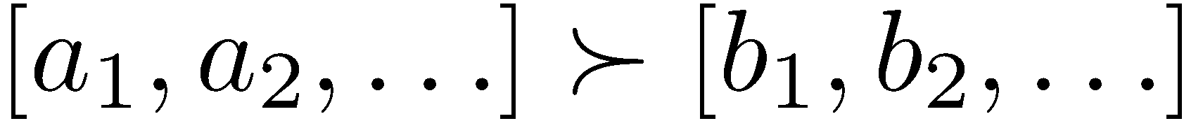
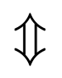
Stationary Preferences
Theorem: if we assume stationary preferences:
Then: there are only two ways to define utilities
  Additive utility:
  Discounted utility:

Slide 36


Quiz: Discounting
Given:
  Actions: East, West, and Exit (only available in exit states a, e)
  Transitions: deterministic
Quiz 1: For γ = 1, what is the optimal policy?
Quiz 2: For γ = 0.1, what is the optimal policy?
Quiz 3: For which γ are West and East equally good when in state d?

Slide 37

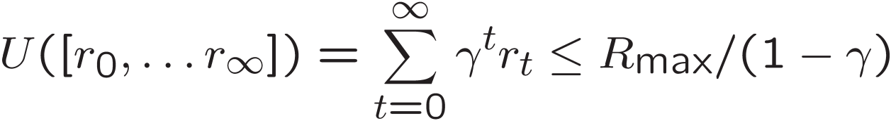
Infinite Utilities?!
Problem: What if the game lasts forever? Do we get infinite rewards?
Solutions:
  Finite horizon: (similar to depth-limited search)
    Terminate episodes after a fixed T steps (e.g. life)
    Gives nonstationary policies (π depends on time left)
  Discounting: use 0 < γ < 1
    Smaller γ means smaller “horizon” – shorter term focus
  Absorbing state: guarantee that for every policy, a terminal state will eventually be reached (like “overheated” for racing)

Slide 38
Recap: Defining MDPs
Markov decision processes:
  Set of states S
  Start state s₀
  Set of actions A
  Transitions P(s’|s,a) (or T(s,a,s’))
  Rewards R(s,a,s’) (and discount γ)
MDP quantities so far:
  Policy = Choice of action for each state
  Utility = sum of (discounted) rewards
s
a
s, a
s,a,s’
s’

Slide 39
Solving MDPs

Slide 40
Optimal Quantities
The value (utility) of a state s:
  V*(s) = expected utility starting in s and acting optimally
The value (utility) of a q-state (s,a):
  Q*(s,a) = expected utility starting out having taken action a from state s and (thereafter) acting optimally
The optimal policy:
  π*(s) = optimal action from state s
s
s is a state
a
(s, a) is a q-state
s, a
s,a,s’
(s,a,s’) is a
transition
s’
[Demo – gridworld values (L8D4)]
Notes:
[Note: this demo doesn’t show anything in action, just pops up V and Q values.]

Slide 41
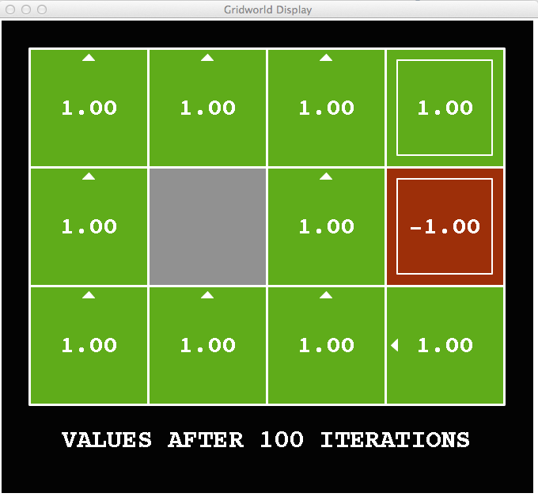
Snapshot of Demo – Gridworld V Values
Noise = 0
Discount = 1
Living reward = 0
Notes:
This demo doesn’t show anything in action, it just shows the V and Q values.

Slide 42
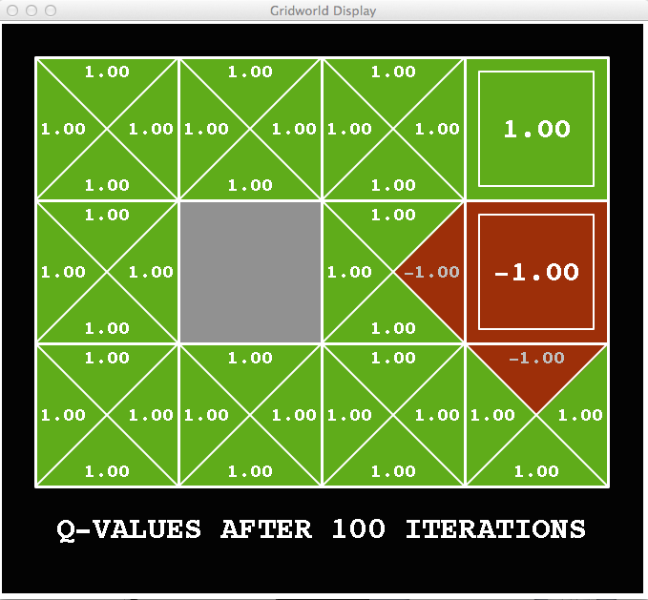
Snapshot of Demo – Gridworld Q Values
Noise = 0
Discount = 1
Living reward = 0
Notes:
This demo doesn’t show anything in action, it just shows the V and Q values.

Slide 43

Snapshot of Demo – Gridworld V Values
Noise = 0.2
Discount = 1
Living reward = 0
Notes:
This demo doesn’t show anything in action, it just shows the V and Q values.

Slide 44
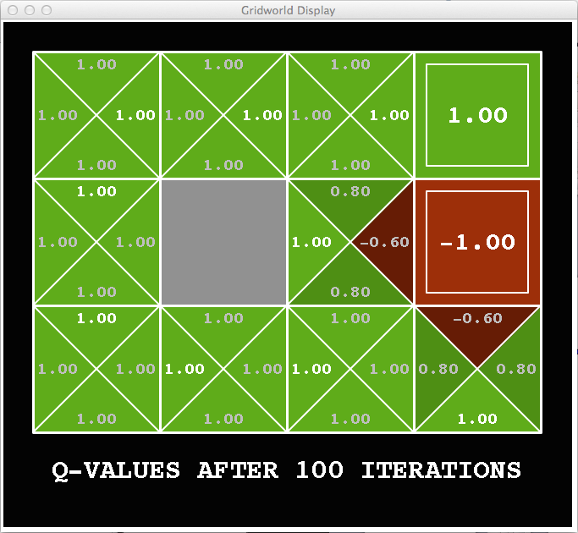
Snapshot of Demo – Gridworld Q Values
Noise = 0.2
Discount = 1
Living reward = 0
Notes:
This demo doesn’t show anything in action, it just shows the V and Q values.

Slide 45

Snapshot of Demo – Gridworld V Values
Noise = 0.2
Discount = 0.9
Living reward = 0
Notes:
This demo doesn’t show anything in action, it just shows the V and Q values.

Slide 46

Snapshot of Demo – Gridworld Q Values
Noise = 0.2
Discount = 0.9
Living reward = 0
Notes:
This demo doesn’t show anything in action, it just shows the V and Q values.

Slide 47
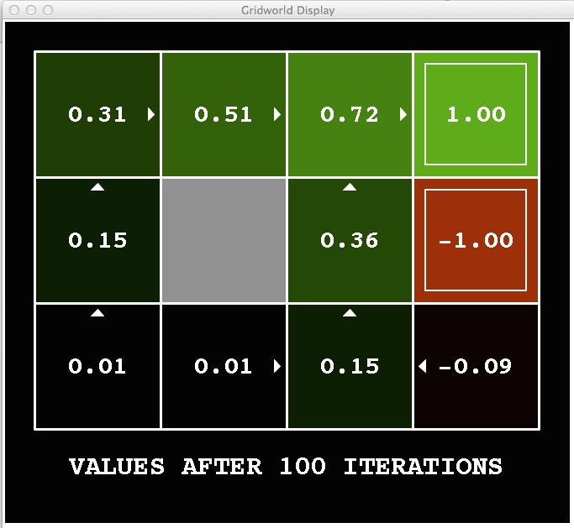
Snapshot of Demo – Gridworld V Values
Noise = 0.2
Discount = 0.9
Living reward = -0.1
Notes:
This demo doesn’t show anything in action, it just shows the V and Q values.

Slide 48
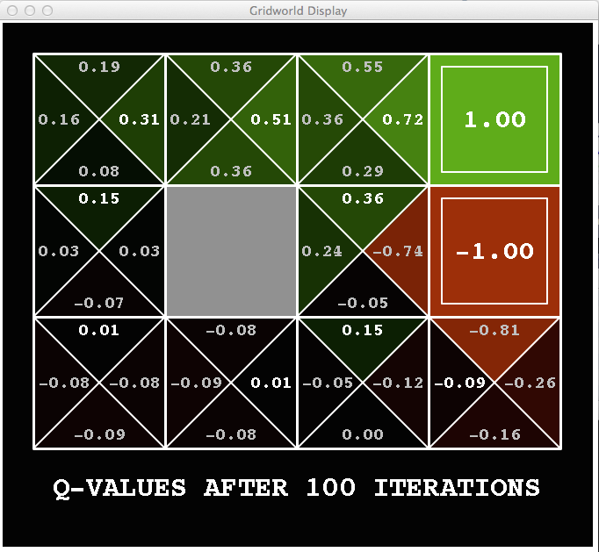
Snapshot of Demo – Gridworld Q Values
Noise = 0.2
Discount = 0.9
Living reward = -0.1
Notes:
This demo doesn’t show anything in action, it just shows the V and Q values.

Slide 49


Values of States
Fundamental operation: compute the (expectimax) value of a state
  Expected utility under optimal action
  Average sum of (discounted) rewards
  This is just what expectimax computed!
Recursive definition of value:
s
a
s, a
s,a,s’
s’

Slide 50
Racing Search Tree

Slide 51




Racing Search Tree

Slide 52
Racing Search Tree
We’re doing way too much work with expectimax!
Problem: States are repeated
  Idea: Only compute needed quantities once
Problem: Tree goes on forever
  Idea: Do a depth-limited computation, but with increasing depths until change is small
  Note: deep parts of the tree eventually don’t matter if γ < 1

Slide 53





Time-Limited Values
Key idea: time-limited values
Define V_{k}(s) to be the optimal value of s if the game ends in k more time steps
  Equivalently, it’s what a depth-k expectimax would give from s
[Demo – time-limited values (L8D6)]
Notes:
This demo generates the time-limited values for gridworld as snapshotted onto the next slides.

Slide 54

k=0
Noise = 0.2
Discount = 0.9
Living reward = 0
Notes:
Assuming zero living reward

Slide 55

k=1
Noise = 0.2
Discount = 0.9
Living reward = 0
Notes:
Assuming zero living reward

Slide 56

k=2
Noise = 0.2
Discount = 0.9
Living reward = 0
Notes:
Assuming zero living reward

Slide 57

k=3
Noise = 0.2
Discount = 0.9
Living reward = 0
Notes:
Assuming zero living reward

Slide 58

k=4
Noise = 0.2
Discount = 0.9
Living reward = 0
Notes:
Assuming zero living reward

Slide 59

k=5
Noise = 0.2
Discount = 0.9
Living reward = 0
Notes:
Assuming zero living reward

Slide 60

k=6
Noise = 0.2
Discount = 0.9
Living reward = 0
Notes:
Assuming zero living reward

Slide 61

k=7
Noise = 0.2
Discount = 0.9
Living reward = 0
Notes:
Assuming zero living reward

Slide 62

k=8
Noise = 0.2
Discount = 0.9
Living reward = 0
Notes:
Assuming zero living reward

Slide 63

k=9
Noise = 0.2
Discount = 0.9
Living reward = 0
Notes:
Assuming zero living reward

Slide 64

k=10
Noise = 0.2
Discount = 0.9
Living reward = 0
Notes:
Assuming zero living reward

Slide 65

k=11
Noise = 0.2
Discount = 0.9
Living reward = 0
Notes:
Assuming zero living reward

Slide 66

k=12
Noise = 0.2
Discount = 0.9
Living reward = 0
Notes:
Assuming zero living reward

Slide 67

k=100
Noise = 0.2
Discount = 0.9
Living reward = 0
Notes:
Assuming zero living reward

Slide 68





Computing Time-Limited Values

Slide 69

Value Iteration

Slide 70
Value Iteration
Start with V₀(s) = 0: no time steps left means an expected reward sum of zero
Given vector of V_{k}(s) values, do one step of expectimax from each state:
Repeat until convergence
Complexity of each iteration: O(S²A)
Theorem: will converge to unique optimal values
  Basic idea: approximations get refined towards optimal values
  Policy may converge long before values do
V_{k+1}(s)
a
s, a
s,a,s’
V_{k}(s’)
Notes:
Discuss computational complexity: S * A * S times number of iterations
Note: updates not in place [if in place, it means something else and not even clear what it means]

Slide 71

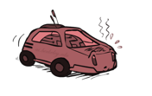

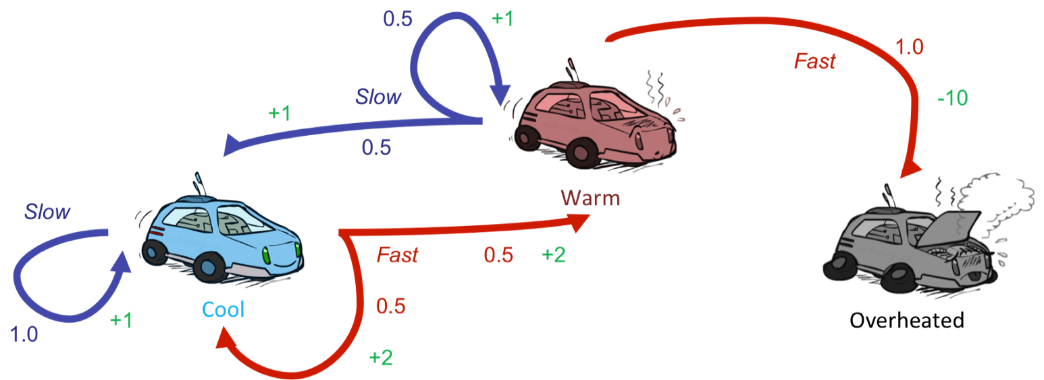



Example: Value Iteration
3.5 2.5 0
2 1 0
Assume no discount!
0 0 0

Slide 72


Convergence*
How do we know the V_{k} vectors are going to converge?
Case 1: If the tree has maximum depth M, then V_{M} holds the actual untruncated values
Case 2: If the discount is less than 1
  Sketch: For any state V_{k} and V_{k+1} can be viewed as depth k+1 expectimax results in nearly identical search trees
  The difference is that on the bottom layer, V_{k+1} has actual rewards while V_{k} has zeros
  That last layer is at best all R_{MAX}
  It is at worst R_{MIN}
  But everything is discounted by γ^{k} that far out
  So V_{k} and V_{k+1} are at most γ^{k} max|R| different
  So as k increases, the values converge

Slide 73
Next Time: Policy-Based Methods

