Slide 1
Announcements
Homework 2
  Due 2/11 (today) at 11:59pm
    Electronic HW2
    Written HW2
Project 2
  Releases today
  Due 2/22 at 4:00pm
Mini-contest 1 (optional)
  Due 2/11 (today) at 11:59pm

Slide 2
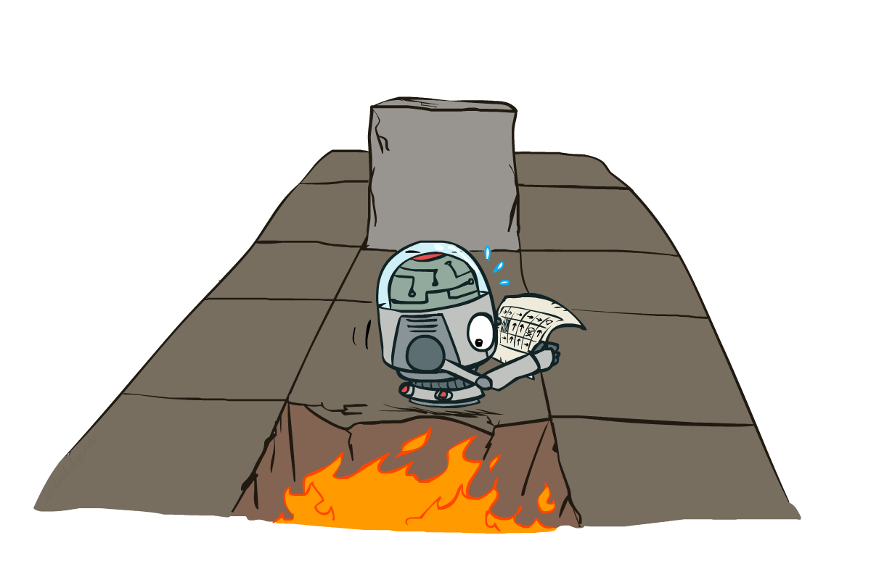
CS 188: Artificial Intelligence
How to Solve Markov Decision Processes
Instructors: Sergey Levine and Stuart Russell
University of California, Berkeley
[slides adapted from Dan Klein and Pieter Abbeel http://ai.berkeley.edu.]
Notes:
Please retain proper attribution, including the reference to ai.berkeley.edu. Thanks!

Slide 3





Example: Grid World
A maze-like problem
  The agent lives in a grid
  Walls block the agent’s path
Noisy movement: actions do not always go as planned
  80% of the time, the action North takes the agent North
  10% of the time, North takes the agent West; 10% East
  If there is a wall in the direction the agent would have been taken, the agent stays put
The agent receives rewards each time step
  Small “living” reward each step (can be negative)
  Big rewards come at the end (good or bad)
Goal: maximize sum of (discounted) rewards
Notes:
[cut demo of moving around in grid world program]

Slide 4
Recap: MDPs
Markov decision processes:
  States S
  Actions A
  Transitions P(s’|s,a) (or T(s,a,s’))
  Rewards R(s,a,s’) (and discount γ)
  Start state s₀
Quantities:
  Policy = map of states to actions
  Utility = sum of discounted rewards
  Values = expected future utility from a state (max node)
  Q-Values = expected future utility from a q-state (chance node)
s
a
s, a
s,a,s’
s’

Slide 5


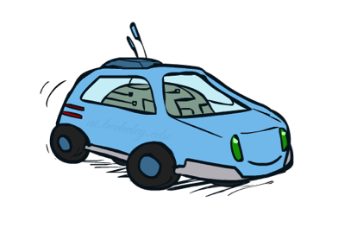
Example: Racing
A robot car wants to travel far, quickly
Three states: Cool, Warm, Overheated
Two actions: Slow, Fast
Going faster gets double reward
0.5
+1
1.0
Fast
Slow
-10
+1
0.5
Warm
Slow
Fast
0.5
+2
Cool
0.5
Overheated
+1
1.0
+2

Slide 6


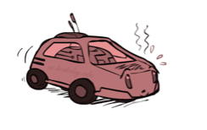
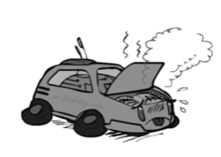
Racing Search Tree

Slide 7





Discounting
How to discount?
  Each time we descend a level, we multiply in the discount once
Why discount?
  Sooner rewards probably do have higher utility than later rewards
  Also helps our algorithms converge
Example: discount of 0.5
  U([1,2,3]) = 1*1 + 0.5*2 + 0.25*3
  U([1,2,3]) < U([3,2,1])
Notes:
Rewards in the future (deeper in the tree) matter less
Interesting: running expectimax, if having to truncate the search, then not losing much; e.g., less then \gamma^d / (1-\gamma)

Slide 8
Optimal Quantities
The value (utility) of a state s:
  V*(s) = expected utility starting in s and acting optimally
The value (utility) of a q-state (s,a):
  Q*(s,a) = expected utility starting out having taken action a from state s and (thereafter) acting optimally
The optimal policy:
  π*(s) = optimal action from state s
s
s is a state
a
(s, a) is a q-state
s, a
s,a,s’
(s,a,s’) is a
transition
s’
[Demo: gridworld values (L9D1)]
Notes:
Demo just shows V and Q values, snapshots on next slides.

Slide 9

Solving MDPs

Slide 10

Snapshot of Demo – Gridworld V Values
Noise = 0.2
Discount = 0.9
Living reward = 0
Notes:
This demo doesn’t show anything in action, it just shows the V and Q values.

Slide 11

Snapshot of Demo – Gridworld Q Values
Noise = 0.2
Discount = 0.9
Living reward = 0
Notes:
This demo doesn’t show anything in action, it just shows the V and Q values.

Slide 12
Racing Search Tree

Slide 13




Racing Search Tree

Slide 14
Racing Search Tree
We’re doing way too much work with expectimax!
Problem: States are repeated
  Idea: Only compute needed quantities once
Problem: Tree goes on forever
  Idea: Do a depth-limited computation, but with increasing depths until change is small
  Note: deep parts of the tree eventually don’t matter if γ < 1

Slide 15





Time-Limited Values
Key idea: time-limited values
Define V_{k}(s) to be the optimal value of s if the game ends in k more time steps
  Equivalently, it’s what a depth-k expectimax would give from s
[Demo – time-limited values (L8D6)]
Notes:
This demo generates the time-limited values for gridworld as snapshotted onto the next slides.

Slide 16

k=0
Noise = 0.2
Discount = 0.9
Living reward = 0
Notes:
Assuming zero living reward

Slide 17

k=1
Noise = 0.2
Discount = 0.9
Living reward = 0
Notes:
Assuming zero living reward

Slide 18

k=2
Noise = 0.2
Discount = 0.9
Living reward = 0
Notes:
Assuming zero living reward

Slide 19

k=3
Noise = 0.2
Discount = 0.9
Living reward = 0
Notes:
Assuming zero living reward

Slide 20

k=4
Noise = 0.2
Discount = 0.9
Living reward = 0
Notes:
Assuming zero living reward

Slide 21

k=5
Noise = 0.2
Discount = 0.9
Living reward = 0
Notes:
Assuming zero living reward

Slide 22

k=6
Noise = 0.2
Discount = 0.9
Living reward = 0
Notes:
Assuming zero living reward

Slide 23

k=7
Noise = 0.2
Discount = 0.9
Living reward = 0
Notes:
Assuming zero living reward

Slide 24

k=8
Noise = 0.2
Discount = 0.9
Living reward = 0
Notes:
Assuming zero living reward

Slide 25

k=9
Noise = 0.2
Discount = 0.9
Living reward = 0
Notes:
Assuming zero living reward

Slide 26

k=10
Noise = 0.2
Discount = 0.9
Living reward = 0
Notes:
Assuming zero living reward

Slide 27

k=11
Noise = 0.2
Discount = 0.9
Living reward = 0
Notes:
Assuming zero living reward

Slide 28

k=12
Noise = 0.2
Discount = 0.9
Living reward = 0
Notes:
Assuming zero living reward

Slide 29

k=100
Noise = 0.2
Discount = 0.9
Living reward = 0
Notes:
Assuming zero living reward

Slide 30





Computing Time-Limited Values

Slide 31

Value Iteration

Slide 32
Value Iteration
Start with V₀(s) = 0: no time steps left means an expected reward sum of zero
Given vector of V_{k}(s) values, do one step of expectimax from each state:
Repeat until convergence
Complexity of each iteration: O(S²A)
Theorem: will converge to unique optimal values
  Basic idea: approximations get refined towards optimal values
  Policy may converge long before values do
V_{k+1}(s)
a
s, a
s,a,s’
V_{k}(s’)
Notes:
Discuss computational complexity: S * A * S times number of iterations
Note: updates not in place [if in place, it means something else and not even clear what it means]

Slide 33

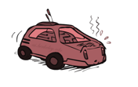

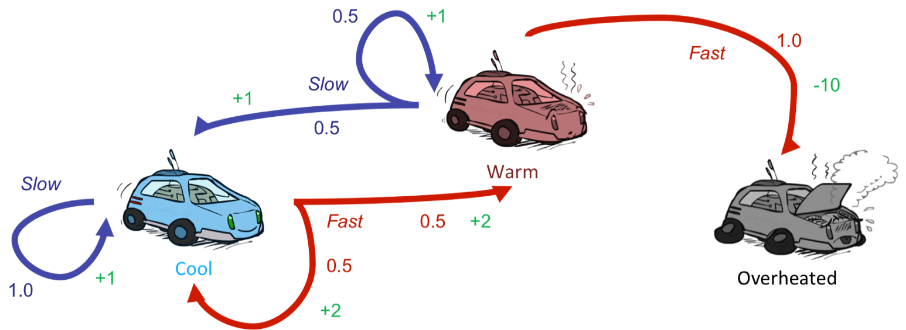



Example: Value Iteration
3.5 2.5 0
2 1 0
Assume no discount!
0 0 0

Slide 34


Convergence*
How do we know the V_{k} vectors are going to converge?
Case 1: If the tree has maximum depth M, then V_{M} holds the actual untruncated values
Case 2: If the discount is less than 1
  Sketch: For any state V_{k} and V_{k+1} can be viewed as depth k+1 expectimax results in nearly identical search trees
  The difference is that on the bottom layer, V_{k+1} has actual rewards while V_{k} has zeros
  That last layer is at best all R_{MAX}
  It is at worst R_{MIN}
  But everything is discounted by γ^{k} that far out
  So V_{k} and V_{k+1} are at most γ^{k} max|R| different
  So as k increases, the values converge

Slide 35

The Bellman Equations
How to be optimal:
Step 1: Take correct first action
Step 2: Keep being optimal

Slide 36


The Bellman Equations
Definition of “optimal utility” via expectimax recurrence gives a simple one-step lookahead relationship amongst optimal utility values
These are the Bellman equations, and they characterize optimal values in a way we’ll use over and over
s
a
s, a
s,a,s’
s’
Notes:
Let’s start by equations that characterize these quantities through mutual recursions. [step through this by writing on slide, one step at a time]
Recursive characterization of V* in terms of V*; not necessarily helpful; but it is a characterization.
Note: this is a set of equations that needs to be satisfied; but it could have multiple solutions (it does not, but at this stage of our knowledge it could).

Slide 37
Value Iteration
Bellman equations characterize the optimal values:
Value iteration computes them:
Value iteration is just a fixed point solution method
  … though the V_{k} vectors are also interpretable as time-limited values
V(s)
a
s, a
s,a,s’
V(s’)
Notes:
Discuss computational complexity: S * A * S times number of iterations
Note: updates not in place [if in place, it means something else and not even clear what it means]

Slide 38
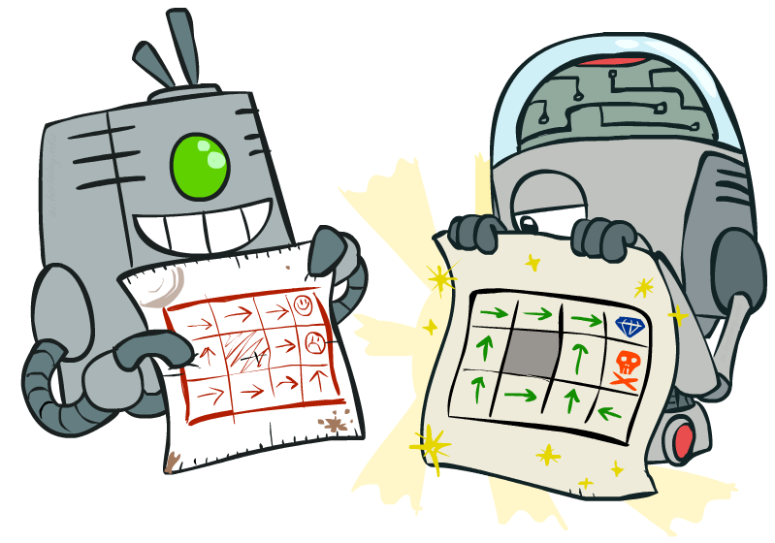
Policy Methods

Slide 39

Policy Evaluation

Slide 40
Fixed Policies
Do the optimal action
Do what π says to do
s
s
a
π(s)
s, a
s, π(s)
s,a,s’
s, π(s),s’
s’
s’
Expectimax trees max over all actions to compute the optimal values
If we fixed some policy π(s), then the tree would be simpler – only one action per state
  … though the tree’s value would depend on which policy we fixed

Slide 41
Utilities for a Fixed Policy
Another basic operation: compute the utility of a state s under a fixed (generally non-optimal) policy
Define the utility of a state s, under a fixed policy π:
  V^{π}(s) = expected total discounted rewards starting in s and following π
Recursive relation (one-step look-ahead / Bellman equation):
s
π(s)
s, π(s)
s, π(s),s’
s’

Slide 42
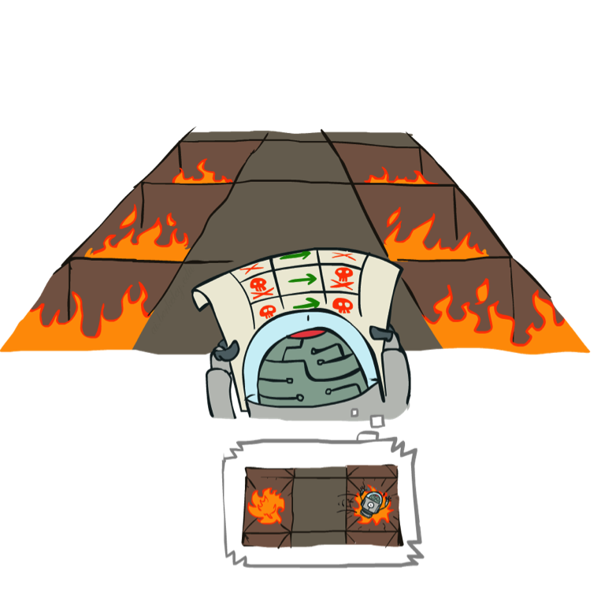
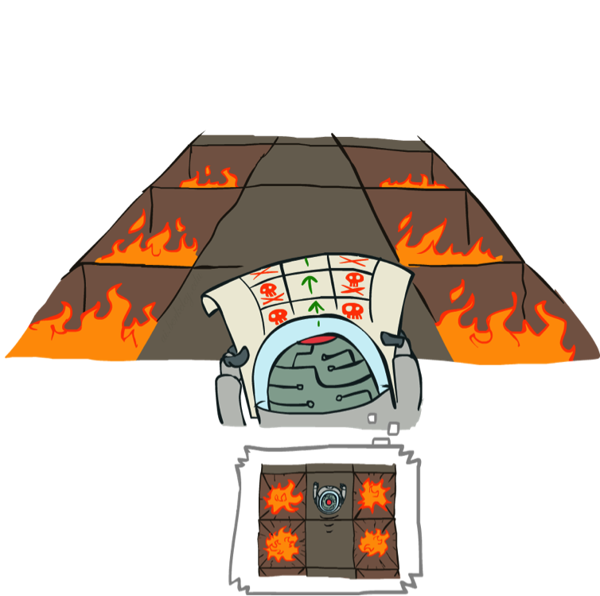
Example: Policy Evaluation
Always Go Right
Always Go Forward

Slide 43
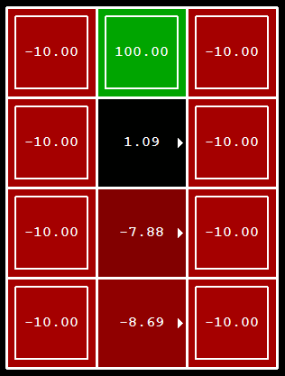
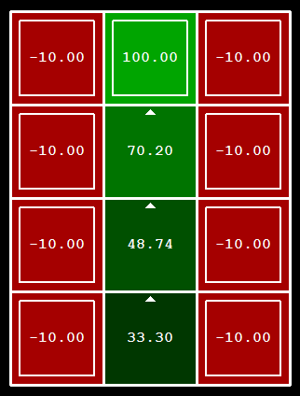
Example: Policy Evaluation
Always Go Right
Always Go Forward

Slide 44

Policy Evaluation
s
How do we calculate the V’s for a fixed policy π?
Idea 1: Turn recursive Bellman equations into updates
(like value iteration)
Efficiency: O(S²) per iteration
Idea 2: Without the maxes, the Bellman equations are just a linear system
  Solve with Matlab (or your favorite linear system solver)
π(s)
s, π(s)
s, π(s),s’
s’
Challenge question: how else can we solve this?

Slide 45
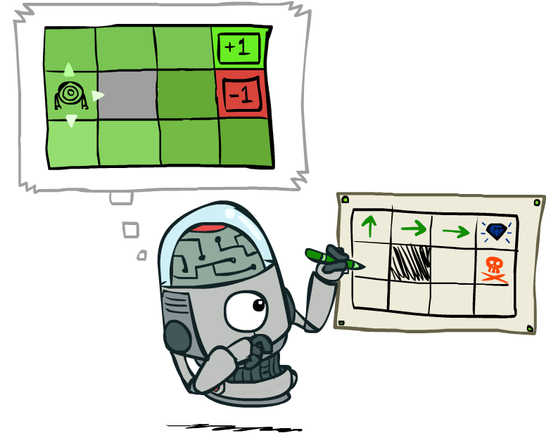
Policy Extraction

Slide 46
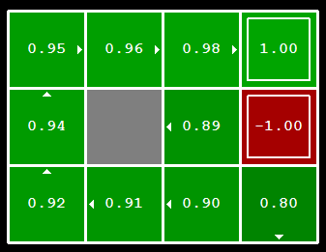


Computing Actions from Values
Let’s imagine we have the optimal values V*(s)
How should we act?
  It’s not obvious!
We need to do a mini-expectimax (one step)
This is called policy extraction, since it gets the policy implied by the values

Slide 47
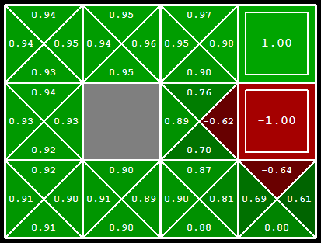
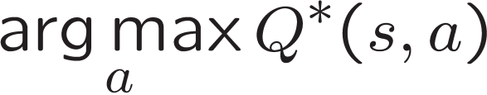
Computing Actions from Q-Values
Let’s imagine we have the optimal q-values:
How should we act?
  Completely trivial to decide!
Important lesson: actions are easier to select from q-values than values!

Slide 48

Policy Iteration

Slide 49
Problems with Value Iteration
Value iteration repeats the Bellman updates:
Problem 1: It’s slow – O(S²A) per iteration
Problem 2: The “max” at each state rarely changes
Problem 3: The policy often converges long before the values
s
a
s, a
s,a,s’
s’
Notes:
Demo steps through value iteration; snapshots of values shown on next slides.

Slide 50
k=0
Noise = 0.2
Discount = 0.9
Living reward = 0
Notes:
Assuming zero living reward

Slide 51
k=1
Noise = 0.2
Discount = 0.9
Living reward = 0
Notes:
Assuming zero living reward

Slide 52
k=2
Noise = 0.2
Discount = 0.9
Living reward = 0
Notes:
Assuming zero living reward

Slide 53
k=3
Noise = 0.2
Discount = 0.9
Living reward = 0
Notes:
Assuming zero living reward

Slide 54
k=4
Noise = 0.2
Discount = 0.9
Living reward = 0
Notes:
Assuming zero living reward

Slide 55
k=5
Noise = 0.2
Discount = 0.9
Living reward = 0
Notes:
Assuming zero living reward

Slide 56
k=6
Noise = 0.2
Discount = 0.9
Living reward = 0
Notes:
Assuming zero living reward

Slide 57
k=7
Noise = 0.2
Discount = 0.9
Living reward = 0
Notes:
Assuming zero living reward

Slide 58
k=8
Noise = 0.2
Discount = 0.9
Living reward = 0
Notes:
Assuming zero living reward

Slide 59
k=9
Noise = 0.2
Discount = 0.9
Living reward = 0
Notes:
Assuming zero living reward

Slide 60
k=10
Noise = 0.2
Discount = 0.9
Living reward = 0
Notes:
Assuming zero living reward

Slide 61
k=11
Noise = 0.2
Discount = 0.9
Living reward = 0
Notes:
Assuming zero living reward

Slide 62
k=12
Noise = 0.2
Discount = 0.9
Living reward = 0
Notes:
Assuming zero living reward

Slide 63
k=100
Noise = 0.2
Discount = 0.9
Living reward = 0
Notes:
Assuming zero living reward

Slide 64
Policy Iteration
Alternative approach for optimal values:
  Step 1: Policy evaluation: calculate utilities for some fixed policy (not optimal utilities!) until convergence
  Step 2: Policy improvement: update policy using one-step look-ahead with resulting converged (but not optimal!) utilities as future values
  Repeat steps until policy converges
This is policy iteration
  It’s still optimal!
  Can converge (much) faster under some conditions

Slide 65
Policy Iteration
Evaluation: For fixed current policy π, find values with policy evaluation:
  Iterate until values converge:
Improvement: For fixed values, get a better policy using policy extraction
  One-step look-ahead:

Slide 66
Comparison
Both value iteration and policy iteration compute the same thing (all optimal values)
In value iteration:
  Every iteration updates both the values and (implicitly) the policy
  We don’t track the policy, but taking the max over actions implicitly recomputes it
In policy iteration:
  We do several passes that update utilities with fixed policy (each pass is fast because we consider only one action, not all of them)
  After the policy is evaluated, a new policy is chosen (slow like a value iteration pass)
  The new policy will be better (or we’re done)
Both are dynamic programs for solving MDPs

Slide 67
Summary: MDP Algorithms
So you want to….
  Compute optimal values: use value iteration or policy iteration
  Compute values for a particular policy: use policy evaluation
  Turn your values into a policy: use policy extraction (one-step lookahead)
These all look the same!
  They basically are – they are all variations of Bellman updates
  They all use one-step lookahead expectimax fragments
  They differ only in whether we plug in a fixed policy or max over actions

Slide 68
Next Time: Reinforcement Learning!

