Slide 1
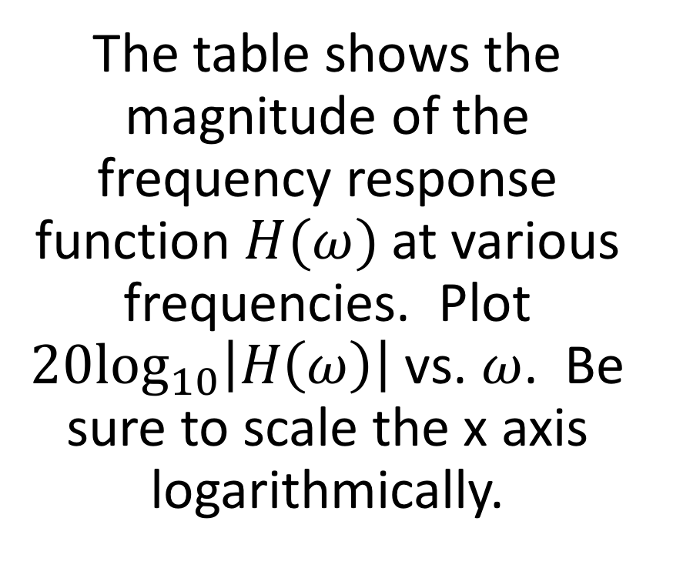
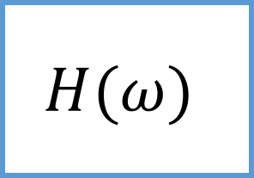


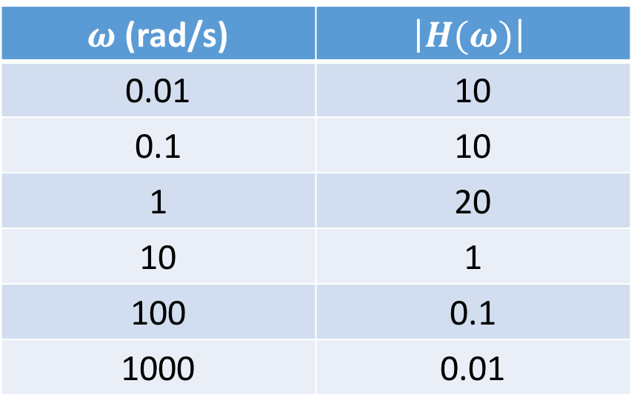
Warmup
$$H(ω)$$
The table shows the magnitude of the frequency response function $H(ω)$ at various frequencies. Plot $20\log_{10}\left|H\left(ω\right)\right|$ vs. $ω$. Be sure to scale the x axis logarithmically.
$$V_{in}$$
$$V_{out}$$
$ω$ (rad/s) | $$\left|H(ω)\right|$$
0.01 | 10
0.1 | 10
1 | 20
10 | 1
100 | 0.1
1000 | 0.01

Slide 3
Complex Impedance!

