Slide 1
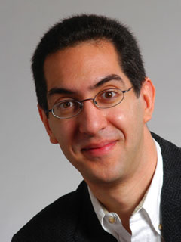
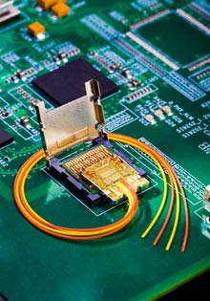
Intel to replace copper wires
CS39N
The Beauty and Joy of Computing
Lecture #7
Applications That Changed The World
2009-10-05
UC Berkeley
Computer Science
Lecturer SOE
Dan Garcia
We’ve all heard of “Fiber Optic” cables, using photons instead of electrons to transport data. That’s great for long distances, but copper wiring is still used for short distances. Intel hopes to change that with its prototype “Light Peak” cables, which will be lighter & cheaper with higher bandwidth.
technologyreview.com/computing/23523/

Slide 2
Lecture Overview
What counts?
For each application
  Historical context
    What world was like before
    On what shoulders does it stand?
  Key players
    Sometimes origins fuzzy
  How it changed world
Summary

Slide 3
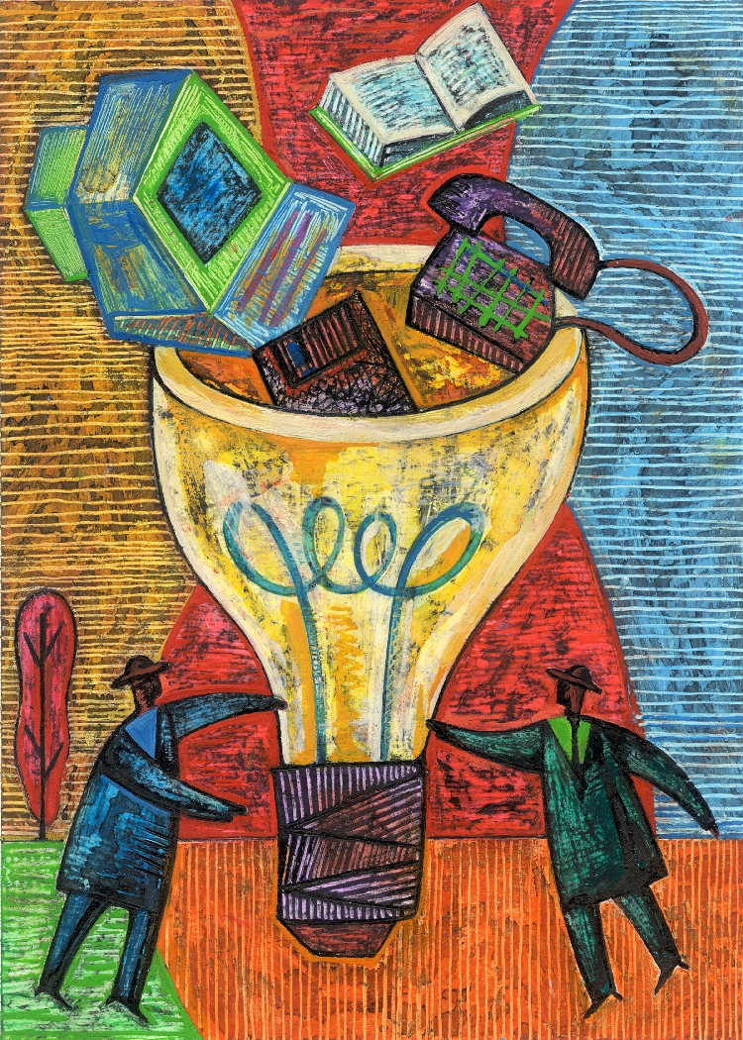
Applications that Changed the World
www.greatachievements.org
Lots of applications changed the world
  Electricity, Radio, TV, Cars, Planes, AC, ...
We’ll focus on those utilizing Computing
Important to consider historical apps
  Too easy to focus on recent N years!

Slide 4
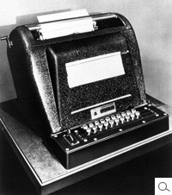
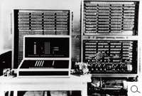
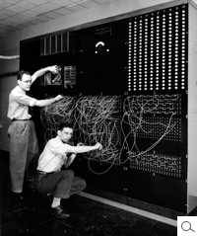
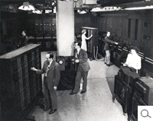
The Computer (1940s)
www.computerhistory.org/timeline
Early Inventions
  Bell Labs’ CNC ‘39
  Konrad Zuse’s Z3 ‘41
  Harvard’s Mark-1 ‘44
  Eckert & Mauchly’s ENIAC ’46
Early Theoreticians
  Shannon’s theories
  Turing’s computability, AI
History : entire museum
  Lots of incremental progress
  Early ones size of house
Everything today owes its success to this
CNC
Z3
Mark-1
ENIAC

Slide 5
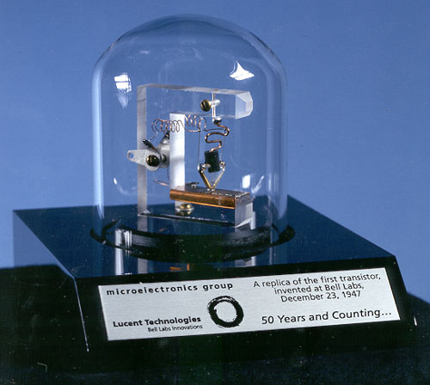
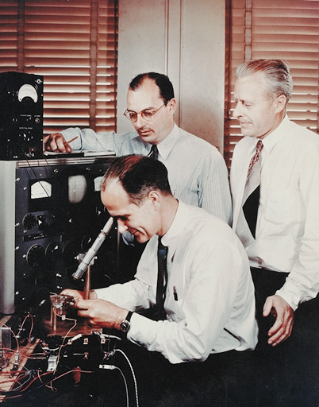
The Transistor (“born” 1947-12-23)
en.wikipedia.org/wiki/History_of_the_transistor
Semiconductor device to amplify or switch signals
  Key component in ALL modern electronics
Who?
  John Bardeen, William Shockley, Walter Brattain
Before that?
  Vacuum Tubes
After that?
  Integrated circuit, microprocessor
"The Transistor was probably THE most
important invention of the 20th Century”
- Ira Flatow, Transistorized! (PBS Special)
www.pbs.org/transistor
www.youtube.com/watch?v=-td7YT-Pums
www.youtube.com/watch?v=ZaBLiciesOU

Slide 6
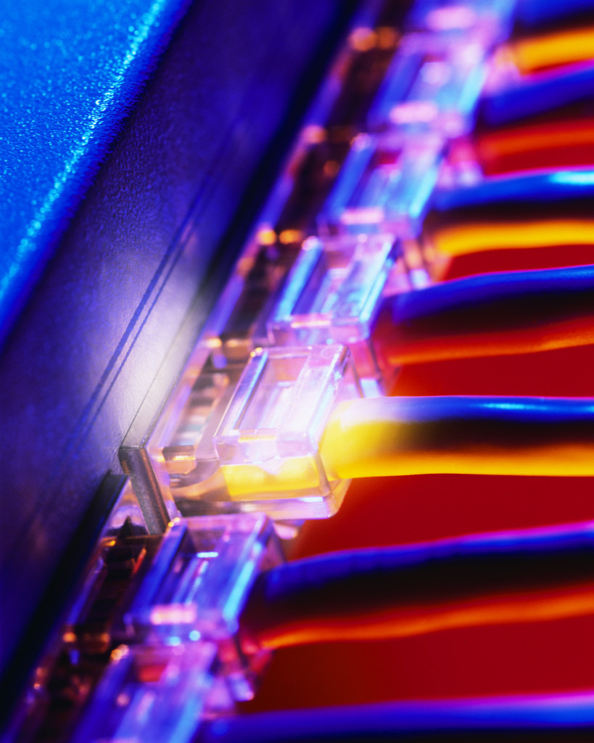
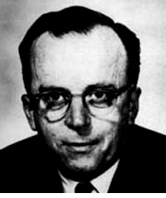
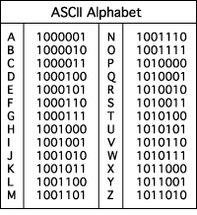
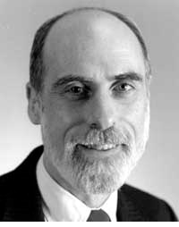
The Internet (1962)
www.computerhistory.org/internet_history
Founders
  JCR Licklider, as head of ARPA, writes on “intergalactic network”
  1963 : ASCII becomes first universal computer standard
  1969 : Defense Advanced Research Projects Agency (DARPA) deploys 4 “nodes” @ UCLA, SRI, Utah, & UCSB
  1973 Robert Kahn & Vint Cerf invent TCP, now part of the Internet Protocol Suite
Internet growth rates
  Exponential since start!
“Lick”
Revolutions like this don't come along very often
Vint Cerf
www.greatachievements.org/?id=3736
en.wikipedia.org/wiki/Internet_Protocol_Suite

Slide 7
Email (1965)
en.wikipedia.org/wiki/Email
Fundamentally changed the way people interact!
1965: MIT’s CTSS
  Compatible Time-Sharing Sys
Exchange of digital info
  Model: “Store and Forward”
  “Push” technology
Pros
  Solves logistics (where) & synchronization (when)
Cons
  “Email Fatigue”
  Information Overload
  Loss of Context
How
  Alice composes email to bob@b.org
  Domain Name System looks up where b.org is
  DNS server with the mail exchange server for b.org
  Mail is sent to mx.b.org
  Bob reads email from there

Slide 8
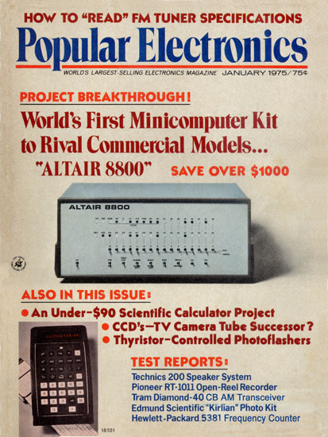
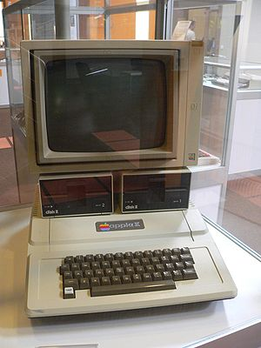
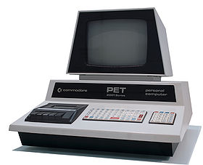
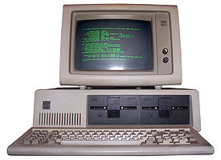
The Personal Computer (1970s)
www.greatachievements.org/?id=3989 www.blinkenlights.com/pc.shtml
First PCs sold as kits to hobbyists
  Altair 8800 (1975)
Early mass-prod PCs
  Apple I, II (Jobs & Woz)
  Commodore PET
  IBM ran away w/market
Microprocessor key
Laptops → portability
Created industry, wealth
  Silicon Valley!
  Bill Gates worth $50 Billion
Altair 8800
Apple II
Commodore PET
IBM PC
en.wikipedia.org/wiki/Personal_computer

Slide 9
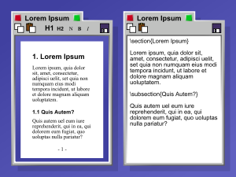
WIMP, WYSIWYG Interface (1973)
en.wikipedia.org/wiki/{Wysiwyg, WIMP_(computing)}
WIMP: Window, Icon, Menu/Mouse, Pointer
  Dominant style of Human-Somputer Interaction (HCI)
  Contrast with a command-line interface it replaced
  Both developed at Xerox PARC 1973, popularized by Apple’s Mac computers 1984
WYSIWYG: What You See Is What You Get
  Display shows printed result
  Before this, commands →
  Even today, both WYSIWYG and non- available
“The program on the left uses a WYSIWYG editor to produce a document. The program on the right contains LaTeX code, which when compiled will produce a document that will look very similar to the document on the left.”

Slide 10
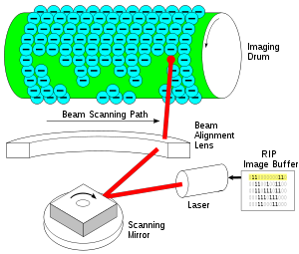
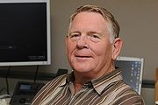
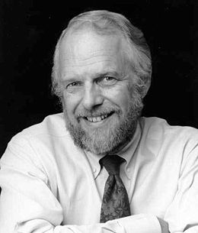
The Laser Printer (‘69), Postscript (‘82)
en.wikipedia.org/wiki/Laser_printer
Gary Starkweather @ Xerox invented it
  Modified an existing Xerox
  Laser beam projects image onto electrically charged rotating drum
Picture is commands!
  John Warnock, founder of Adobe, invented Postscript
  Turing-complete language!
  The processor on the printer rasterized the image
    Commands → Image bits on/off
Professional-quality output in hands of people
Gary Starkweather
How it works
%!PS
/Courier findfont
20 scalefont
setfont
72 500 moveto
(Hello world!) show
showpage
John Warnock

Slide 11
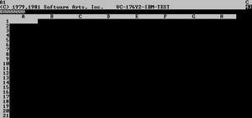
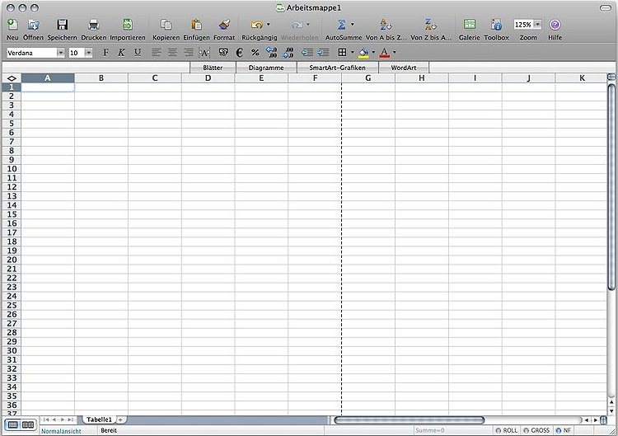
The Spreadsheet (1961, 1980)
en.wikipedia.org/wiki/Spreadsheet
Grid of rows and columns, with each cell a formula or data
  Simulates a paper worksheet
  Commonly used for financial information (& grades!)
History
  Richard Mattessich 1961 paper
    “Budgeting Models & System Simulation”
  VisiCalc (by Dan Bricklin) helped drive the sales of Apple II ~1980
  Lotus 1-2-3 with DOS in 1981
  Excel the current market leader
Now online (Google Docs)
VisiCalc, the first PC spreadsheet (1970s)
Microsoft Excel (2008)

Slide 12
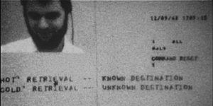

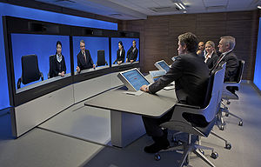
Audio/Videoconferencing (1980s)
en.wikipedia.org/wiki/Videoconferencing
History
  1936 : closed-circuit TV
  1968 : Englebart’s “Mother of All Demos”
  1980s : Digital Telephony (via ISDN)
  1990s : Internet Protocol (IP) based videoconferencing
Impact
  For some businesses, essential (e.g., Dreamworks)
  Big with grandparents, sign language communication
  Telemedicine
  Education impact huge
First demo of videoconferencing in 1968
T3 ultra-high resolution telepresence

Slide 13
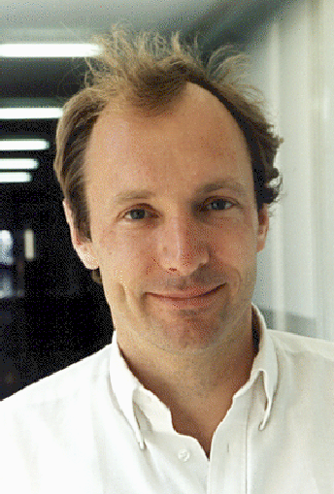
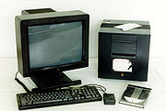

The World Wide Web (1989)
en.wikipedia.org/wiki/History_of_the_World_Wide_Web
“System of interlinked hypertext documents on the Internet”
History
  1945: Vannevar Bush describes hypertext system called “memex” in article
  1989: Tim Berners-Lee proposes, gets system up ’90
  ~2000 Dot-com entrepreneurs rushed in, 2001 bubble burst
Wayback Machine
  Snapshots of web over time
Today : Access anywhere!
World’s First web server in 1990
Tim Berners-Lee
www.archive.org

Slide 14
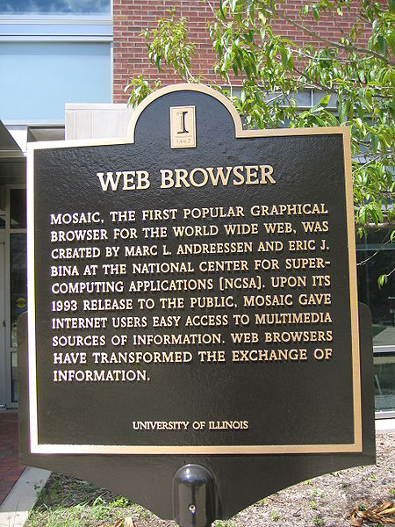
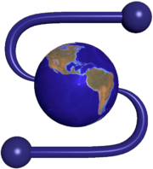

WWW Search & Browser (1993)
en.wikipedia.org/wiki/History_of_the_web_browser
Browser
  Marc L. Andreesen and Eric J. Bina @ NCSA create Mosaic, 1st popular WWW browser
    First Internet “Killer App”
    Later: Netscape Navigator
  Now IE (68%), Firefox (22%)
Search
  Before engines, there was a complete list of all servers!
  1993 Martijn Koster Aliweb is 1st web search engine
  1997 Stanford Sergey Brin and Larry Page develop Google’s search, based on PageRank (each: $12 Billion)

Slide 15
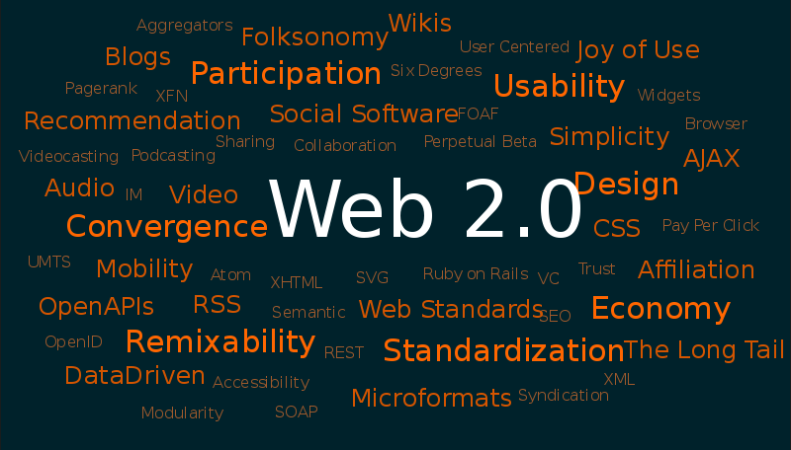
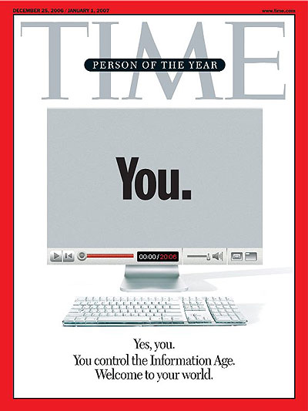
Web 2.0 : The Social Network (2004)
en.wikipedia.org/wiki/Web_2.0
“…web development & design that facilitates interactive information sharing, interoperability, user-centered design and collaboration on WWW”
  Users change content via “architecture of partipation”
Examples
  Web communities, apps, social networks, video & photo sharing, wikis, blogs, tweets, …
“Take back the web!”
“You” – Time’s 2006 Person of the Year

Slide 16

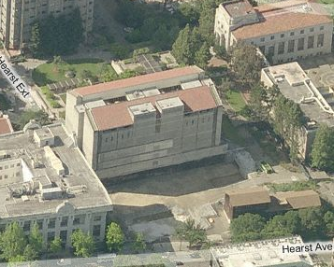
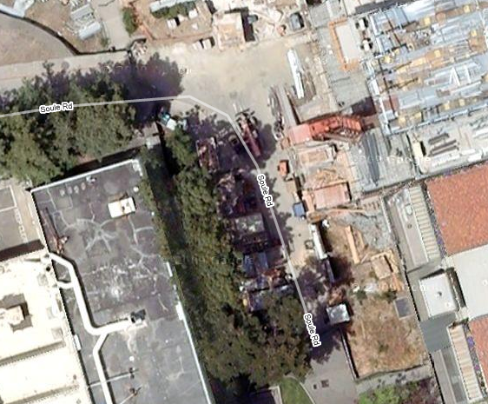
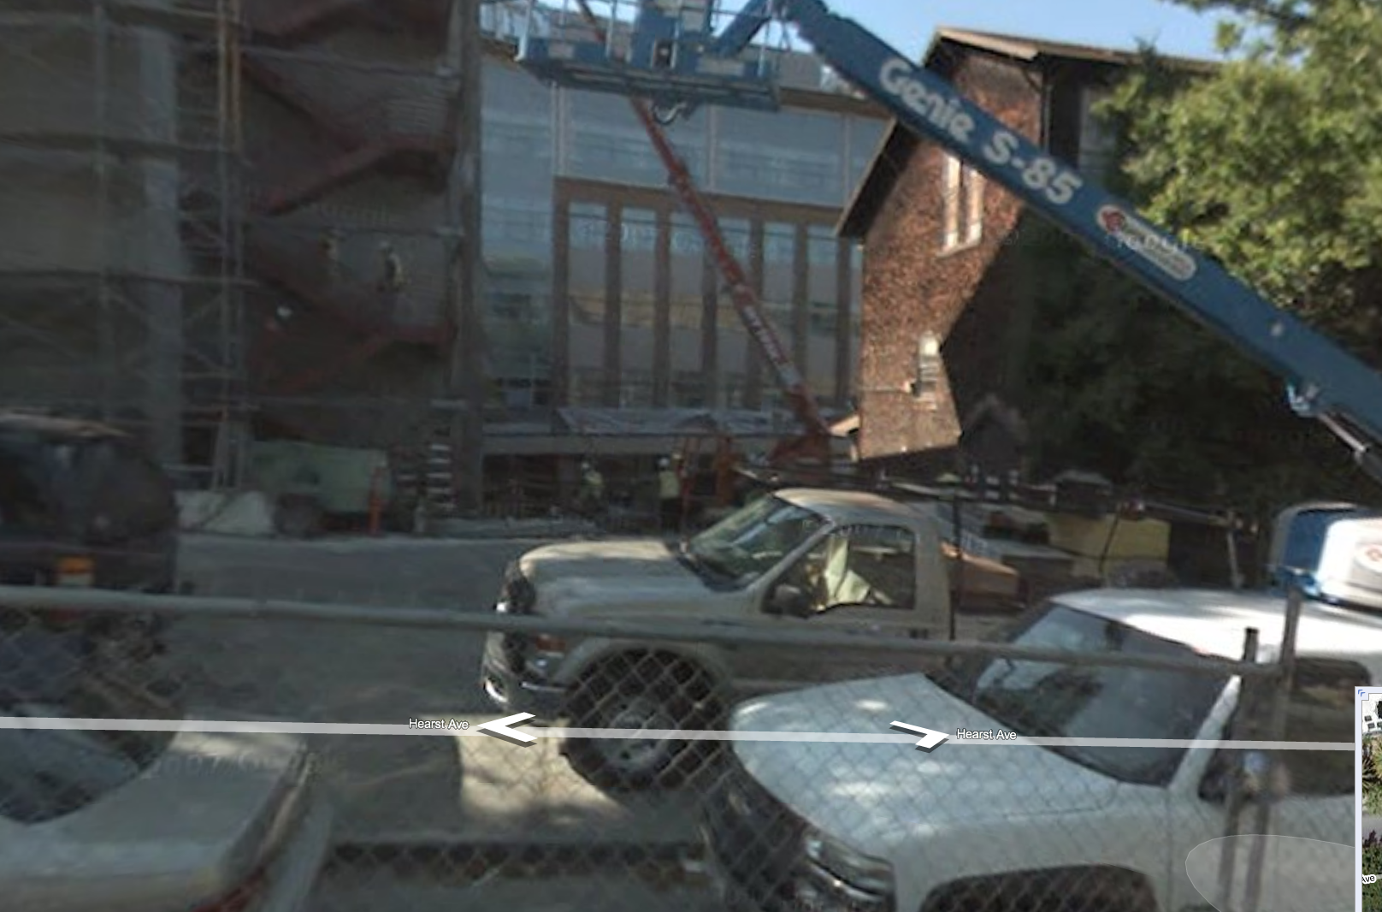
Web Mapping (1993)
en.wikipedia.org/wiki/{Web_mapping, Gps}
“Designing, implementing, generating and delivering maps on the WWW”
Advantages
  Mobile computing + GPS means you’re never lost again!
  Real-time traffic!!
  Collaborative maps have lots of potential (E.g., WikiMapia)
  Street view can allow you to see what it looks like on the ground
  Can have hyperlinking, yet another way to connect to web
  Can layer content, many uses!
Different views of this classroom

Slide 17

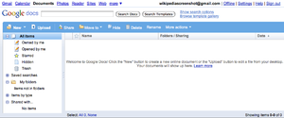
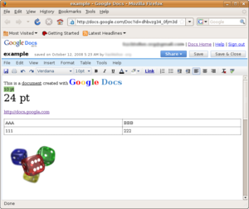
Google Docs, SW as a Service (2006)
en.wikipedia.org/wiki/Google_Docs
Free, web-based word processor, spreadsheet, presentation and form application
Single source of truth!
Fundamentally changing the way people collaboratively author documents
  No more attachments and versions!!
  Much better than Wikis, which are not WYSIWYG, so folks grabs local temp copy

Slide 18
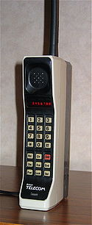
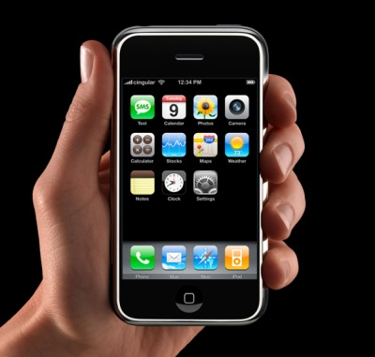
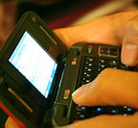
The Mobile Phone, PDA & Texting
en.wikipedia.org/wiki/{Personal_digital_assistant, Mobile_phone, Texting}
History of Cell Phones
  1908: Nathan Stubblefield patents wireless telephone
  1945: 0G introduced
  1983: Motorola DynaTAC 1st FCC-approved phone
PDA: handheld computer
  1983: First PDA (Casio)
  Phones became “smart”
Texting (short messages)
  Most popular mobile service
  Has affected language...gr8!

Slide 19
Summary
How many of the 21st cent engineering achievements are happening today?
What’s the next big thing?
  Natural language processing?
  3D displays?
  Robotics? Self-driving cars?
  Optical or quantum computing?
  Personal air vehicle?
  Space travel?
  Computer displays in glasses?
  Flexible displays?
  Brain machine interfaces?
  Energy!

