Slide 1
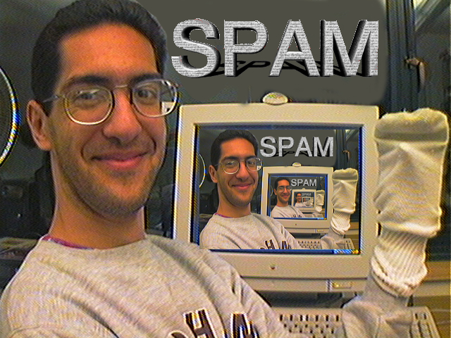
Muscle-bound computer interface
CS39N The Beauty and Joy of Computing Lecture #11 Recursion II
2009-11-02
UC Berkeley Computer Science Lecturer SOE Dan Garcia
Researchers at Microsoft, UW and U Toronto have come up with a technique to interact with a computer by flexing muscles (sensor electrodes on forearm)
www.technologyreview.com/computing/23813/

Slide 2
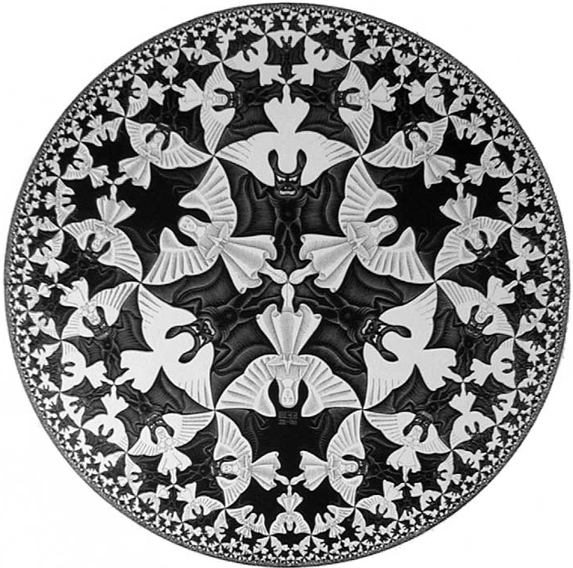
You already know it!
doi.acm.org/10.1145/330908.331877

Slide 3
Definition
www.catb.org/~esr/jargon/html/R/recursion.html www.nist.gov/dads/HTML/recursion.html
Recursion: (noun) See recursion. ☺
An algorithmic technique where a function, in order to accomplish a task, calls itself with some part of the task
Recursive solutions involve two major parts:
Base case(s), the problem is simple enough to be solved directly
Recursive case(s). A recursive case has three components:
Divide the problem into one or more simpler or smaller parts
Invoke the function (recursively) on each part, and
Combine the solutions of the parts into a solution for the problem.
Depending on the problem, any of these may be trivial or complex.

Slide 4
Linear Functional Pattern
Base case(s)
Recursive case(s)
Divide
Invoke
Combine
Functional programming
It’s all about the reporter return value
There are no side-effects
Recursion(arg) { if(base_case_test) { return(base_case_answer) } else { return(Combiner(SomePart(arg), Recursion(Rest(arg)))) } }

Slide 5
Linear Functional Example: n!
en.wikipedia.org/wiki/Factorial
n | n!
0 | 1
1 | 1
2 | 2
3 | 6
4 | 24
5 | 120
Recursion(arg) { if(base_case_test) { return(base_case_answer) } else { return(Combiner(SomePart(arg), Recursion(Rest(arg)))) } }
Factorial(n) = n! Inductive definition:
n! = 1 , n = 0
n! = n * (n-1)!, n > 0
What are…
base_case_test
n == 0
base_case_answer
1
SomePart(arg)
n
Rest(arg)
n-1
Combiner: *
Factorial(n) { if(n == 0) { return(1) } else { return(n * Factorial(n-1)) } }
Let’s now trace…

Slide 6
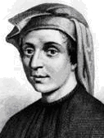
Non-linear Functional Example: Fib
en.wikipedia.org/wiki/Fibonacci_number www.ics.uci.edu/~eppstein/161/960109.html
n | F(n)
0 | 0
1 | 1
2 | 1
3 | 2
4 | 3
5 | 5
Inductive definition:
What are…
base_case_test
n <= 1
base_case_answer
n
SomePart(arg)
0
Rest(arg)
n-1 and n-2
Combiner
+
Recursion(arg) { if(base_case_test) { return(base_case_answer) } else { return(Combiner(SomePart(arg), Recursion(Rest(arg)))) } }
Recursion(arg) { if(base_case_test) { return(base_case_answer); } else { return(Combiner(SomePart(arg), Recursion(Rest1(arg)), Recursion(Rest2(arg)), … Recursion(Restn(arg)) )) } }
Fib(n) { if(n <= 1) { return(n) } else { return(Fib(n-1)+Fib(n-2)) } }
Leonardo de Pisa aka, Fibonacci
Let’s now: trace… (gif from Ybungalobill@wikimedia)

Slide 7
Authoring: Trust the Recursion!
When authoring recursive code:
The base is usually easy: “when to stop?”
In the recursive step
How can we break the problem down into two:
A piece I can handle right now
The answer from a smaller piece of the problem
Assume your self-call does the right thing on a smaller piece of the problem
How to combine parts to get the overall answer?
Practice will make it easier to see idea

Slide 8
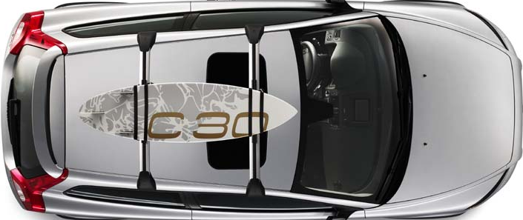
Now you try one…
http://doi.acm.org/10.1145/1473195.1473219 mathworld.wolfram.com/RenyisParkingConstants.html
Want to park unit-length cars on a block 10 units wide.
In the ideal case, you can get 10 cars in.
Assume no wiggling needed, they just drop in
Assuming cars arrive & park randomly on the open spaces, how many cars can park on avg?
With a partner, write park(room) ➔ # of cars
Answer will be park(10)
Given: place(room) randomly places rear bumper on a place from 0 to room-1 and returns location. Assumes room > 1!
E.g., place(10)
➔ 2
2
7

Slide 9
10⁷ trials; avg = 7.2235337
park(room) { if(room < 1) { return(0) } else {
rear = place(room) return(park(rear) + 1 +
park(room-(rear+1))) } }

Slide 10
Fractal Beauty in Nature
en.wikipedia.org/wiki/Fractal
Fractals are self-similar objects
They appear in nature: rivers, coastlines, mountains, snow
They are perfect for describing with recursion
Same ideas apply: base case + recursive case
Tip: look at n=0 and n=1 case; n=∞ is often hard to decrypt
How to write (pseudo)code for the Sierpinski Square:
SierpinskiSquare(L,R,U,D,n) given DrawRectangle(L,R,U,D) and OneThird(from,to)
n = 0
n = 1
…
n = 4
U
D
L
R

Slide 11
Sierpinski Square
SierpinskiSquare(L,R,U,D,n) { if(n == 0) { DrawRectangle(L,R,U,D)
} else { // We shorten OneThird to OT here… SierpinskiSquare(L,OT(L,R),U,OT(U,D),n-1) // NW SierpinskiSquare(OT(R,L),R,U,OT(U,D),n-1) // NE SierpinskiSquare(OT(L,R),OT(R,L),OT(U,D),OT(D,U),n-1) SierpinskiSquare(L,OT(L,R),OT(D,U),D,n-1) // SW SierpinskiSquare(OT(R,L),R,OT(D,U),D,n-1) // SE } }
This is procedural recursion -- purpose is side-effect, not return value
Sometimes we want a side-effect AND a return value…

Slide 12
Conclusion
Many flavors, patterns
Functional
Procedural
Inductive definitions lead naturally to recursion
Recursion simpler code
Fractals scream for it
Thinking recursively
Breaking problem down by trusting recursion, building off of that

