Slide 1

Above the Clouds:
A Berkeley View of Cloud Computing
Armando Fox, UC Berkeley
Reliable Adaptive Distributed Systems Lab
© 2009
Image: John Curley http://www.flickr.com/photos/jay_que/1834540/

Slide 2
What is distributed computing?
What is warehouse-scale computing?
What is cloud computing?
Why should you care?

Slide 3
What is distributed computing?

Slide 4
The first demonstration of how to build really large Internet sites out of clusters of computers was done by:
(a) Stanford
(b) Berkeley
(c) Yahoo!
(d) Google
(e) IBM

Slide 5
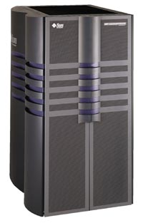
Big Computers c. 1996
Sun E-10000 “supermini”
Up to 64 processors @250MHz
Up to 64 GB RAM
Up to 20 TB Disk
Used by eBay, among others
PC
200 MHz CPU, 32MB RAM, 4 GB disk

Slide 6
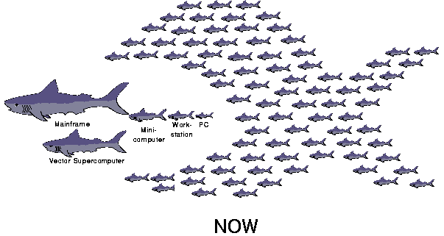
UC Berkeley Networks Of Workstations (1994-1999)

Slide 7
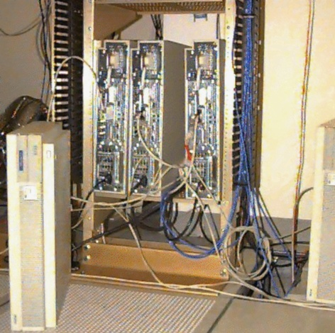
NOW-0 (4 HP-735’s)
NOW-0
1994
Four
HP-735’s

Slide 8
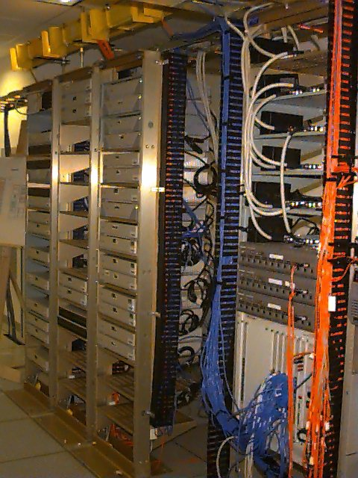
NOW-1
1995
32 Sun SPARC-
stations

Slide 9
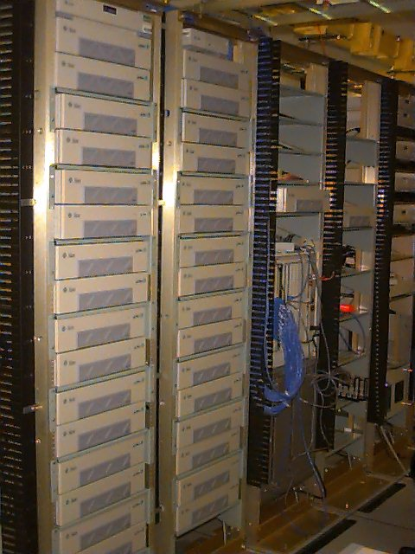
NOW-2
1997
60 Sun SPARC-2

Slide 10
A Google datacenter built c.2005 would be designed to house approximately _______ computers.
(a) 1,000
(b) 5,000
(c) 10,000
(d) 50,000
(e) 100,000

Slide 11
Challenge: how do you program a NOW? (or: what is it good for?)
Notes:
What's hard about programming NOW?
Handling partial failures
As gets bigger, hard to manage so many machines

Slide 12
The Killer App for NOWs
Prof. Eric Brewer, Armando Fox, Steve Gribble, Paul Gauthier, Yatin Chawathe: Cluster-Based Scalable Network Servers
in Symposium on Operating Systems Principles, 1997
Non-goal: build best/fastest search engine
  But led to Inktomi, first truly scalable search engine that took advantage of NOW ideas
Goal: show general techniques for programming NOW’s for Internet services

Slide 13
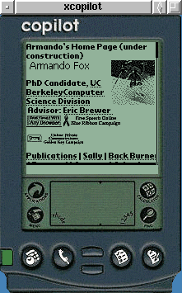
Access Is the Killer App!
UC Berkeley, 1994-1999
Project Daedalus: Profs. Katz & Brewer
Data, services in infrastructure cloud
  search, email, personal comms, productivity...
Mobile access anywhere, anytime
Many “firsts”:
  server architecture with auto-scaling
  cluster-based Internet service: Inktomi
  mobile Web: TopGun Wingman on Palm
Challenge: deploying the service!

Slide 14


Slide 15
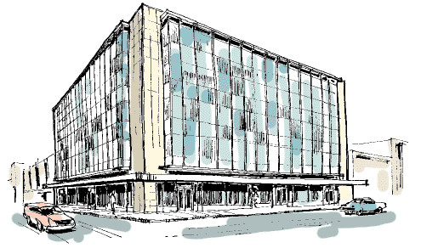
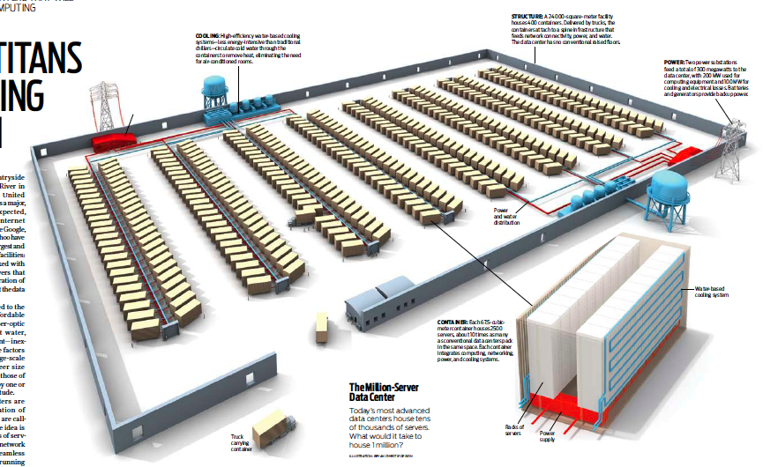
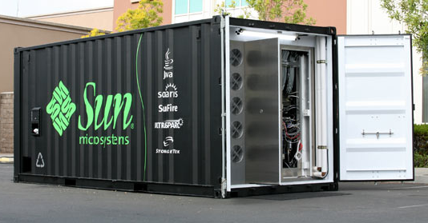
2005: Datacenter is new “server”
“Program” => Web search, email, map/GIS, …
“Computer” => 1000’s computers, storage, network
Warehouse-sized facilities and workloads
15
photos: Sun Microsystems, CNET, & datacenterknowledge.com
Notes:
15
200KW racked HW, 7TB RAM, 1.5TB disk, 250 servers
“In tents” Computing

Slide 16















RAD Lab 5-year Mission
Enable 1 person to develop, deploy, operate
next -generation Internet application
Key enabling technology: Statistical machine learning
Highly interdisciplinary faculty & students
  7 faculty across CS, from theory to systems
  2 postdocs, ~30 PhD students, ~5 undergrads

Slide 17
Utility Computing Arrives
Amazon Elastic Compute Cloud (EC2)
“Compute unit” rental: $0.08-0.80/hr.
  1 CU ≈ 1.0-1.2 GHz 2007 AMD Opteron/Xeon core
N
No up-front cost, no contract, no minimum
Billing rounded to nearest hour; pay-as-you-go storage also available
A new paradigm for deploying services?
“Instances” | Platform | Cores | Memory | Disk
Small - $0.10 / hr | 32-bit | 1 | 1.7 GB | 160 GB
Large - $0.40 / hr | 64-bit | 4 | 7.5 GB | 850 GB – 2 spindles
XLarge - $0.80 / hr | 64-bit | 8 | 15.0 GB | 1690 GB – 3 spindles
17

Slide 18
But...
What is cloud computing, exactly?

Slide 19
“It’s nothing (new)”
“...we’ve redefined Cloud Computing to include everything that we already do...
I don’t understand what we would do differently ... other than change the wording of some of our ads.”
– Larry Ellison, CEO, Oracle
(Wall Street Journal, Sept. 26, 2008)

Slide 20
Above the Clouds:
A Berkeley View of Cloud Computing
abovetheclouds.cs.berkeley.edu
2/09 White paper by RAD Lab PI’s and students
Goal: stimulate discussion on what’s really new
  Clarify terminology
  Comparison with conventional computing
  Identify challenges & opportunities
Why can we offer new perspective?
  Strong engagement with industry
  Users of cloud computing in our own research and teaching
Over 60,000 downloads

Slide 21
Above The Clouds Impact
Research collaborations/hires: Amazon, Google, Microsoft, Twitter, Facebook, Cloudera, Yahoo!...
Invited presentations/advice
  Google, Fujitsu, IBM, HP, Microsoft, SAP, Juniper, ...
  World Economic Forum
  Nat’l Academy of Engineering
  OpenCirrus Summit
  UCB Office of the CIO
  UC Systemwide Cloud Computing Task Force
UCB is academic leader in cloud computing in both research & education
Notes:
Subtext: come to our retreats!

Slide 22
What is it? What’s new?
Old idea: Software as a Service (SaaS)
  Software hosted in the infrastructure vs. installed on local servers or desktops; dumb (but brawny) terminals
New: pay-as-you-go utility computing
  Illusion of infinite resources on demand
  Fine-grained billing: release == don’t pay
  Earlier examples: Sun, Intel Computing Services—longer commitment, more $$$/hour, no storage
  Public (utility) vs. private clouds

Slide 23
How much data per month, approximately, is processed through Google’s BigTable storage system?
(a) 1 TB (1,000 GB)
(b) 100 TB
(c) 1 PB (1,000 TB)
(d) 100 PB
(e) 1 EB (exabyte = 1,000 PB)

Slide 24
Why Now (not then)?
The Web “Space Race”: Build-out of extremely large datacenters (10,000’s of commodity PCs)
Driven by growth in demand (more users)
  Infrastructure software: e.g., Google File System
  Operational expertise
  Discovered economy of scale: 5-7x cheaper than provisioning a medium-sized (100’s machines) facility
More pervasive broadband Internet
Free & open source software

Slide 25
Cloud Economics 101
Static provisioning for peak - wasteful, but necessary for SLA
Capacity
Machines
$
Demand
Capacity
Demand
Time
Time
“Statically provisioned”
data center
“Virtual” data center
in the cloud
Unused resources

Slide 26
Risk of Under Utilization
Underutilization results if “peak” predictions are too optimistic
Capacity
Unused resources
Resources
Demand
Time
Static data center

Slide 27




Risks of Under Provisioning
Resources
Capacity
Demand
Resources
Capacity
1
2
3
Time (days)
Demand
Lost revenue
1
2
3
Time (days)
Resources
Capacity
Demand
1
2
3
Time (days)
Lost users

Slide 28
What can you do with this?

Slide 29
Cost Associativity
1,000 CPUs for 1 hour same price as
1 CPU for 1,000 hours
Washington Post converted Hillary Clinton’s travel documents to post on WWW
  Conversion time: <1 day after released
  Cost: less than $200
RAD Lab graduate students demonstrate improved MapReduce scheduling—on 1,000 servers

Slide 30
Risk transfer
2001: CNN home page meltdown on 9/11
  ~10x traffic increase in ~15 minutes
  result: site had to go offline
2008: Animoto
  traffic doubled every 12 hours for 3 days when released as Facebook plug-in
  Scaled from 50 to >3500 servers
  ...then scaled back down

Slide 31
Indexing the Web
To be or not to be...
...or a better fool ...
...better to love a fool...
Map &
Combine
better | C
to | C
love | C
a | C
fool | C
to | A
be | A
or | A
not | A
or | B
a | B
better | B
fool | B
to
A,C
be
A
or
A,B
not
A
better
B,C
love
C
a
B,C
fool
B,C

Slide 32
MapReduce in Practice
Example: spam classification
  training: 10⁷ URLs x 64KB data each = 640GB data
  One heavy-duty server: ~270 hours
  100 servers in cloud: ~3 hours (= ~$255)
Rapid uptake in other scientific research
  Large-population genetic risk analysis & simulation (Harvard Medical School)
  Genome sequencing (UNC Chapel Hill Cancer Ctr)
  many others... so what’s the downside?
Notes:
Spam classification parallelizes well since batches of training instances can be handled separately

Slide 33
Challenges & Opportunities
Challenges to adoption, growth, & business/policy models
Both technical and nontechnical
Most translate to 1 or more opportunities
Complete list in paper; I’ll discuss subset

Slide 34
Challenge: Cloud Programming
Challenge: exposing parallelism
  MapReduce relies on “embarrassing parallelism”
Programmers must (re)write problems to expose this parallelism, if it’s there to be found
Tools still primitive, though progressing rapidly
Notes:
I said M/R was elegant, not necessarily intuitive
Open-source tools could still integrate much better than they do
Bottom line, though, is you have to find & expose //ism; also makes multicore prog hard.

Slide 35
Challenge: Big Data
Application | Data generated per day
DNA Sequencing (Illumina HiSeq machine) | 1 TB
Large Synoptic Survey Telescope | 30 TB; 400 Mbps sustained data rate between Chile and NCSA
Large Hadron Collider | 60 TB
Challenge: Long-haul networking is most expensive cloud resource, and improving most slowly
Copy 8 TB to Amazon over ~20 Mbps network
=> ~35 days, ~$800 in transfer fees
How about shipping 8TB drive to Amazon instead?
=> 1 day, ~$150 (shipping + transfer fees)
Source: Ed Lazowska, eScience 2010, Microsoft Cloud Futures Workshop, lazowska.cs.washington.edu/cloud2010.pdf
Notes:
partitioning computation to minimize bulk data movement
((if time)) "gravity well" effect of data, importance of open standards

Slide 36
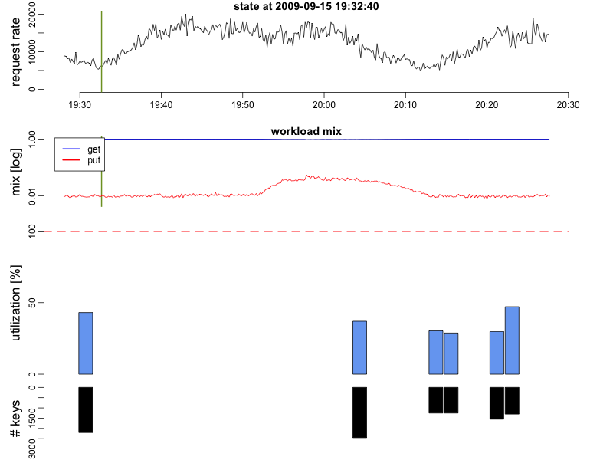
Web services in the cloud
Notes:
Potentially 32 servers, just 6 used here
Top is request rage
Middle is mix of puts (writes so lots more work) vs. gets (reads so easier)
Bottom is Utilization based on workload in blue, number of keys per sever in black, replicas show up in green
Changes every 5 minutes

Slide 37
Cloud in Education
Berkeley research culture: integrate leading research into teaching at all levels
RAD Lab need for “killer apps” to show off infrastructure
Current efforts (student counts approximate):
Great Ideas in Computer Architecture (reinvented Fall 2010): 190 students
Software Engineering for SaaS (in its 4th iteration): 50+50+50+70 students
Operating Systems: 70 students
Intro. Data Science (Spring 2010): 30
Adv. topics in HCI: 20 students
Natural language processing: 20 students

Slide 38
AWS is a great fit for courses...
New undergraduate teaching opportunities
  SaaS: make a database fall over—would need 200 servers for ~20 project teams
  deploy projects publicly, many continue after course
Better use of resources
  Heavy usage right before lab deadlines

Slide 39
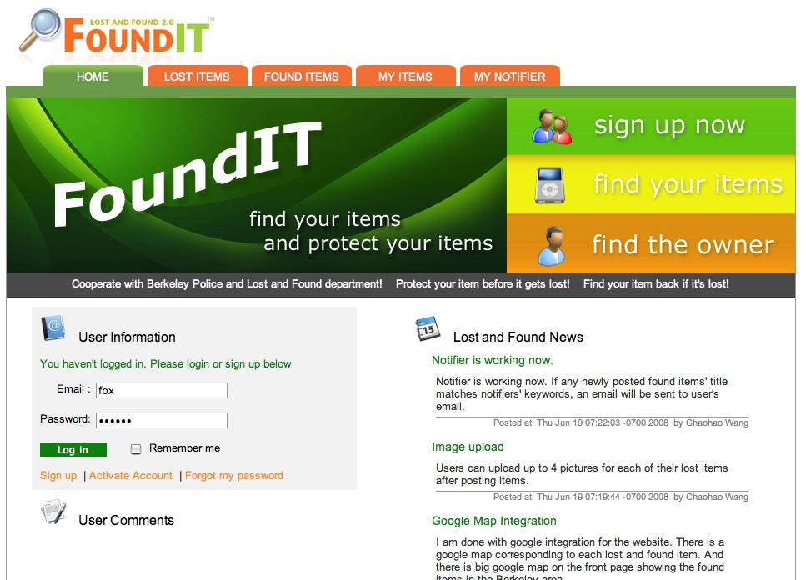
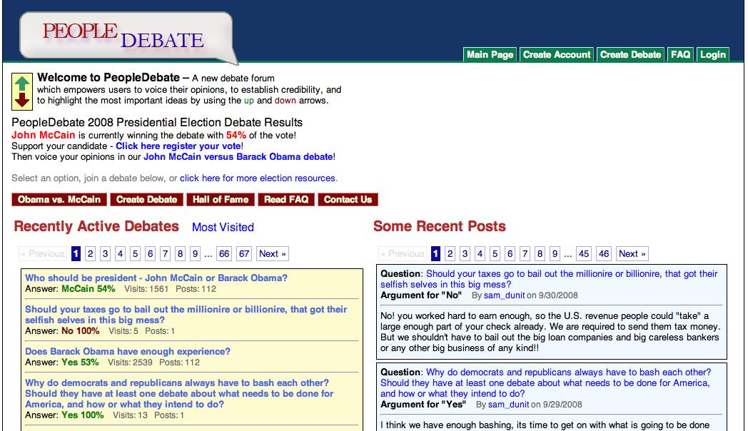

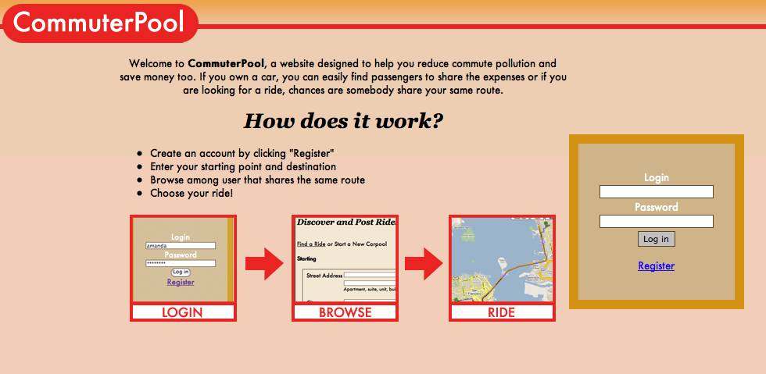
Success stories

Slide 40
Summary
Cloud computing democratizes access to “supercomputer-class” capability
  All you need is a credit card
Puts students, academia on more level playing field to have high impact in industry
The next Google, eBay, Amazon, etc. can come from a small team of entrepreneurs even without heavy dose of $$ up front

Slide 41
Going back to NOW...
2000: using medium-
sized clusters for
Internet services
=> several PhD’s
2010: CS169 students do it in 6-8 weeks and deploy on cloud computing
2020: ?

Slide 42
Thank you!

