Slide 1
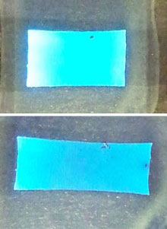
The first stretchable Oled
CS10 The Beauty and Joy of Computing Lecture #2 HowItWorks : 3D Graphics
2011-09-31
UC Berkeley EECS Lecturer SOE Dan Garcia
This is still in the early research stage, but engineers at sister campus UCLA have developed an organic light-emitting diode that streches, which could lead to electronics that can be rolled up like cloth.
www.technologyreview.com/computing/38439

Slide 2
3D Computer Graphics, 10 Miles Up
http://en.wikipedia.org/wiki/3D_computer_graphics
Computer Graphics one of the sub-fields of research in Computer Science
UC Berkeley’s Graphics group is ranked in the top 10
I graduated from this group in 2000
2D Graphics often called “graphic design”; very different
“The Last Guardian” by Johnny Yip (POV-Ray)

Slide 3
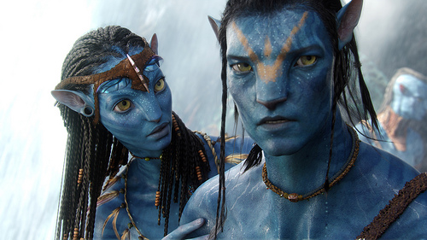
3D Graphics Used In…
Film, Television, Print
Either pure CG (e.g., Pixar) or CG elements added to film plates
hours / frame
Video Games
Both “in-engine” graphics + pre-rendered cinematics
30 frames / second
“Avatar” (wikipedia)
“Gran Turismo” (us.gran-turismo.com)

Slide 4
…although that line is often blurred
events.game-artist.net/scene_from_a_movie/

Slide 5
Aside: Scenes from a Movie winner
events.game-artist.net/scene_from_a_movie/winners.php
“Blade Runner” by The Replicants

Slide 6
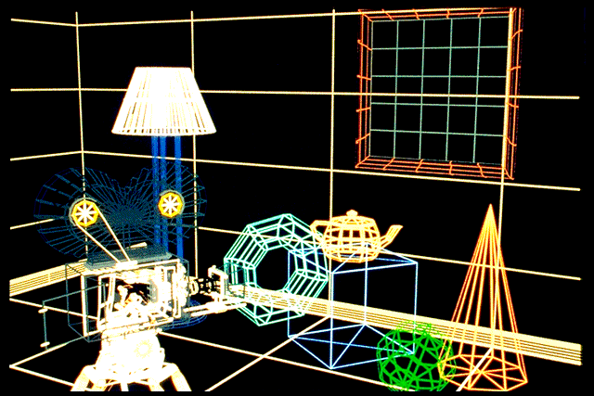
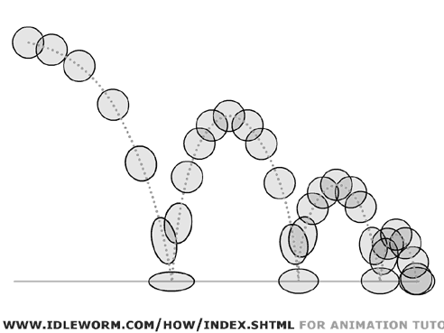
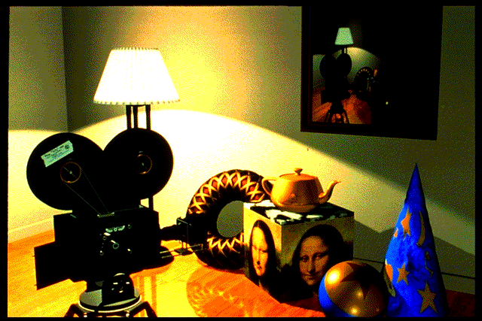
3D Graphics : How it’s done (simplified)
web.engr.oregonstate.edu/~mjb/intro2009/
“Shutterbug Rendering Progression” by Pixar
“Squash & Stretch” by idleworm.com
“Procedural Wood” by Pixar
“Shutterbug Rendering Progression” by Pixar

Slide 7
Modeling
www.youtube.com/watch?v=FOOynE1F4P4 www.cyberware.com
Could come from
3D Scanners
Interactive modeling
Model libraries
Procedural techniques
This also involves
Attaching animation variables to model, allowing animator to control a very complex model w/a few controls
Representation: Lots of options, math
“Menger Cube” by UCB Alum David Wallace (now at LucasFilm)

Slide 8
Animation
web.engr.oregonstate.edu/~mjb/intro2009/ en.wikipedia.org/wiki/Motion_capture www.youtube.com/watch?v=1wK1Ixr-UmM
Could come from
Interactive keyframing
Procedural motion
Motion capture
This has put some animators out of a job
Used in Avatar, LotR, …
Physics
Evolution, Rule systems
Emotions conveyed!
Humans are very good at reading bad motion

Slide 9
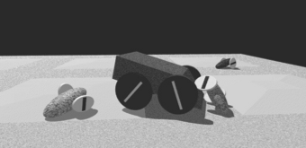
Creature War … Animation automatic!
www.kuffner.org/james/software/dynamics/mirtich/
Brian Mirtich, 1996 UCB Ph.D.
Thesis: “Impulse -based Dynamic Simulation of Rigid Body Systems”
Very cool work!
“Creature War” demo
His purpose: show off his simulator
Great example of rule-drive motion!
Creature “rules”

Slide 10
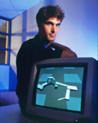
Genetic Algorithms
web.genarts.com/karl/
Karl Sims blew away his colleagues with his 1994 seminal work on evolved creatures
evolved virtual creatures

Slide 11
Lighting and Shading (and Camera…)
hof.povray.org/2b.html
Just like in a movie…
Artist sets up lights in the shot for mood
Teams of artists apply hand-drawn and procedural textures, called “shaders”
There are layers of them
The virtual 3D camera (and its movement) set
But “render!” instead of “action!”…
“Harvest Time” by Gilles Tran (POV-RAY)

Slide 12
3D Projection Basics (in Rendering)
http://en.wikipedia.org/wiki/3D_projection
For each frame…
Take 3D geometry (and lights and surface shaders) and figure out what color each 2D pixel should be
The math is simply similar triangles
There are lots of algorithms to do this
“Expensive” = slower, but quality usu higher
B_{x}/B_{z} = A_{x}/A_{z}
B_{x} = B_{z} * A_{x}/A_{z}

Slide 13
Rendering : Global Illumination
en.wikipedia.org/wiki/Global_illumination
What’s our goal?
Find rendering algorithms that simulate what real light does in real world
“Photo-realism”
Limitations
There are way too many photons to simulate all of them at once!
Every technique is a different way to simulate the real world
Each has costs & benefits
Direct vs Global Illumination
“The Lovers” by Gilles Tran. (POV-Ray)

Slide 14
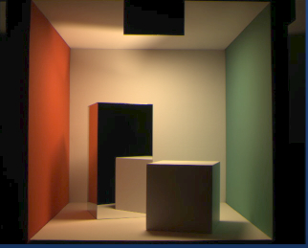
Cornell Box
www.graphics.cornell.edu/online/box/compare.html
“The Cornell Box experiments have come to symbolize our approach to physically based rendering. The Cornell box is a simple physical environment for which we have measured the lighting, geometry, and material reflectance properties. Synthetic images of this environment are then created, and compared to images captured with a calibrated CCD camera. In this way, we can confirm the accuracy of our simulations.”
Photograph
Rendering

Slide 15
Direct Illumination Image
Image courtesy Henrik Jensen @ UCSD

Slide 16
Global Illumination Image
Image courtesy Henrik Jensen @ UCSD

Slide 17
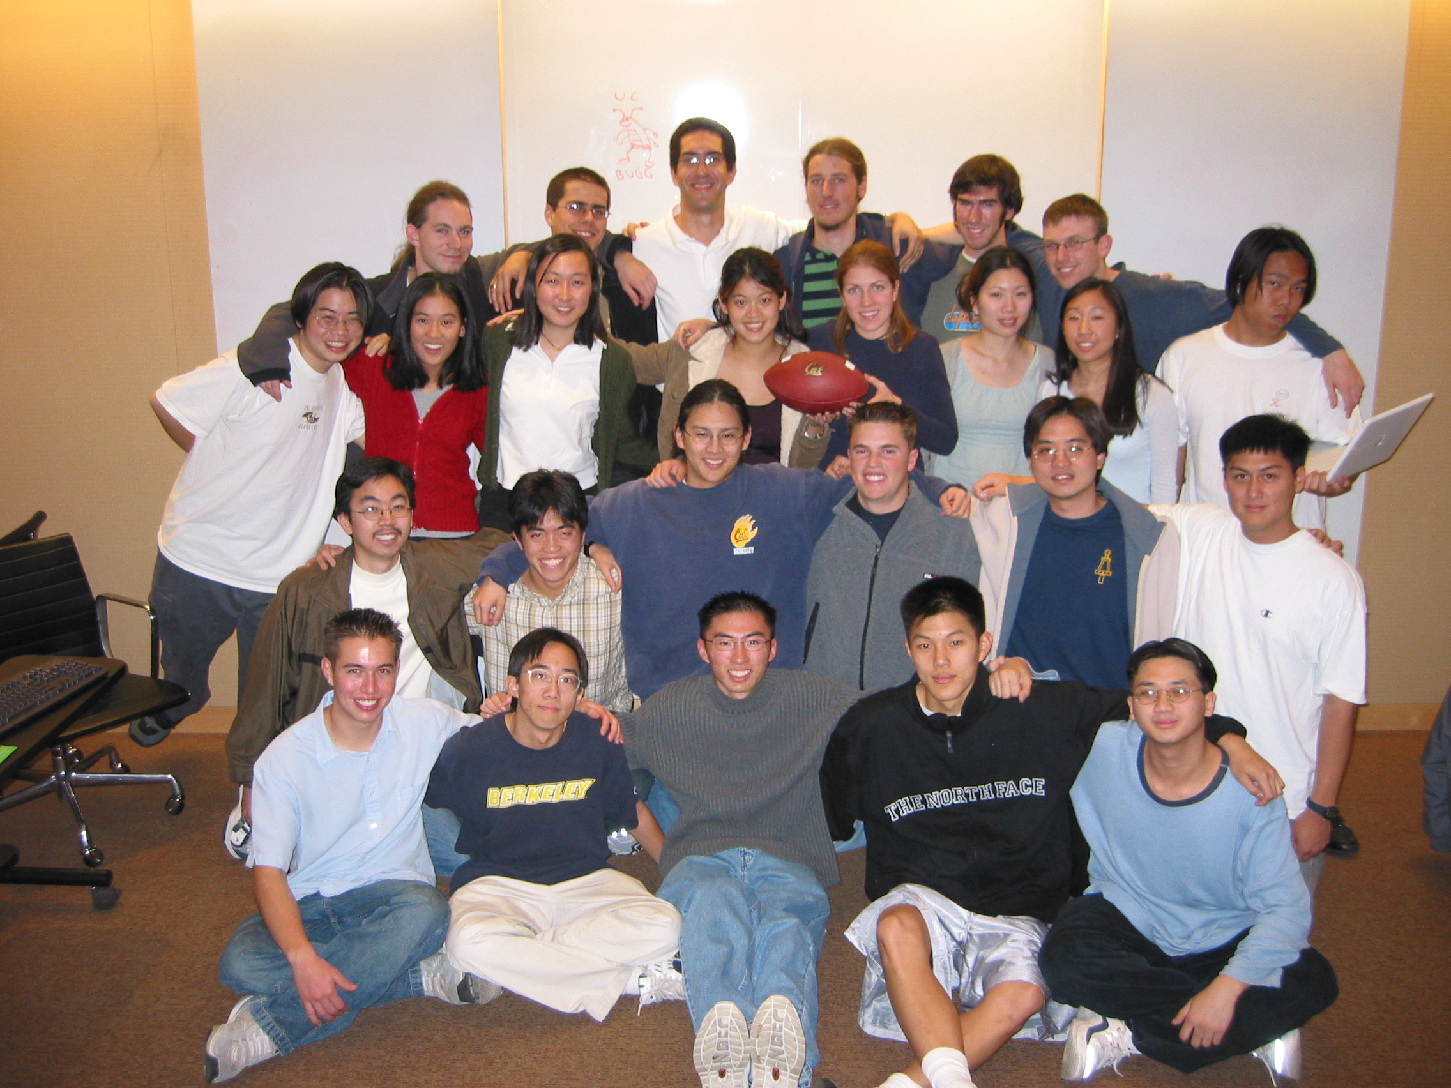
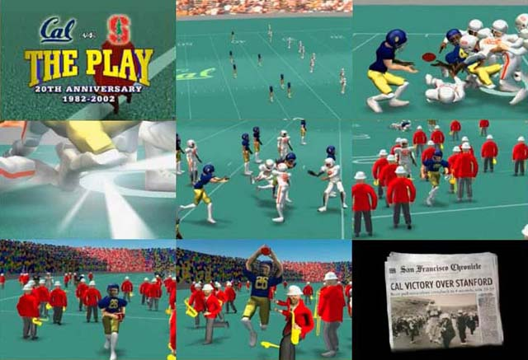
How to learn more? … UCBUGG!
www.graphics.cornell.edu/online/box/compare.html
UCB Undergrad Graphics Group
No prereqs!!!
Student-led DeCal
Students make animated short film
Example : The Play3D
In 2002, made 3D recreation of famous Cal football play
CS184 : Intro to Computer Graphics

Slide 18
Summary
kevinbeason.com/smallpt/
Beauty and Joy of Computing? You bet!
The field of 3D Graphics has transformed film, television & video games
How does it work?
Modeling
Animation
Lighting & Shading & Camera
Rendering (film,games different)
It allows people to exercise right and left sides of brain
Opportunities @ Cal!

