Slide 1
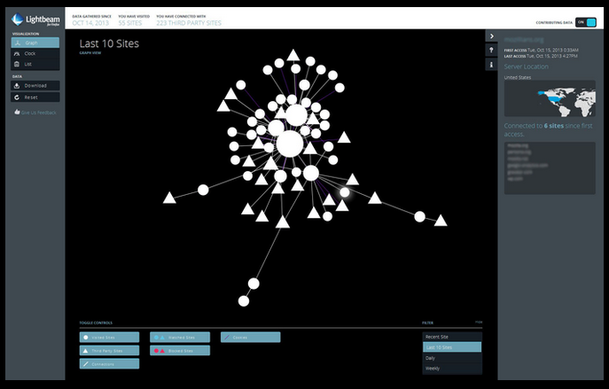
The Beauty and Joy of Computing Lecture #15
Internet I
UC Berkeley EECS Lecturer Gerald Friedland
Lightbeam: Visualizing third-party web trackers.
Good: Nice insight
Bad: Doesn’t prevent tracking
http://www.fastcompany.com/3020704/fast-feed/want-to-see-who-watches-you-online-this-browser-add-on-in-lets-you?partner

Slide 2
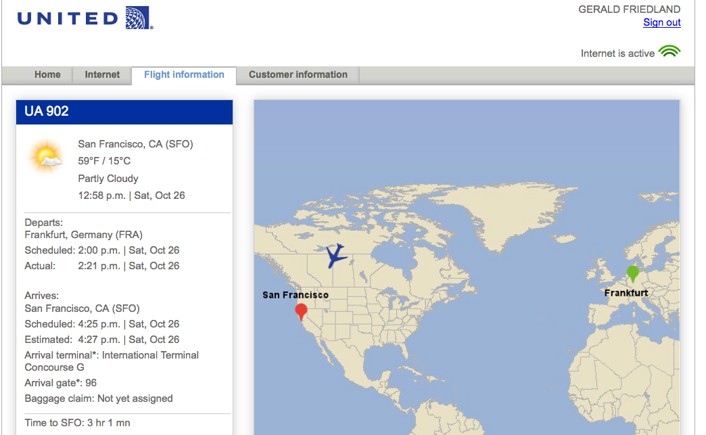
Internet is pretty much everywhere!
Notes:
Data and information is hard to define. There are philosophical and meta-physical issues. So let’s all watch the Matrix…

Slide 3
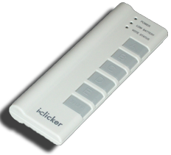
Quick Question I
In the last 3 years, what was the longest time stretch you have ever been without Internet?
Several hours
1-2 days
More than 2 days
Several weeks
More than several weeks
Notes:
Data and information is hard to define. There are philosophical and meta-physical issues. So let’s all watch the Matrix…

Slide 4
Quick Question II
What was the reasons for not having access to the Internet?
Technical interruption
In an area with no Internet
Voluntary break
Didn’t bother having access
Other
Notes:
Data and information is hard to define. There are philosophical and meta-physical issues. So let’s all watch the Matrix…

Slide 5
The basics of the basics
http://youtu.be/7_LPdttKXPc
Notes:
40% of the Internet traffic is YouTube alone!

Slide 6
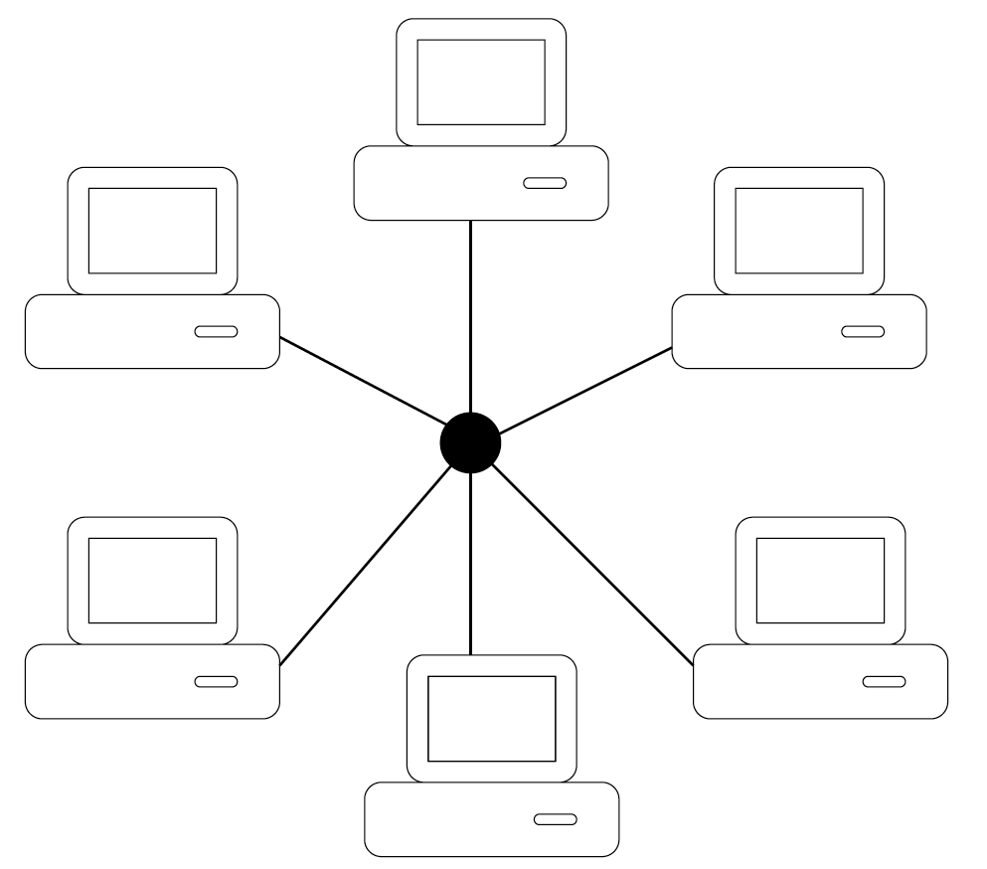
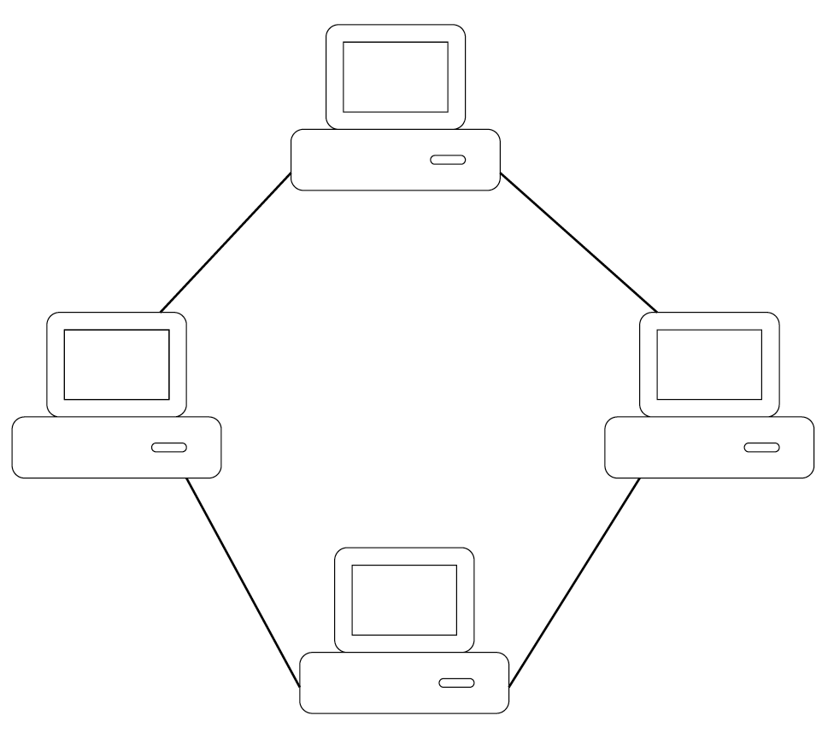
Network Topologies
Point-to-Point (Peer-to-Peer)
Starnet/Arcnet
Token Ring

Slide 7
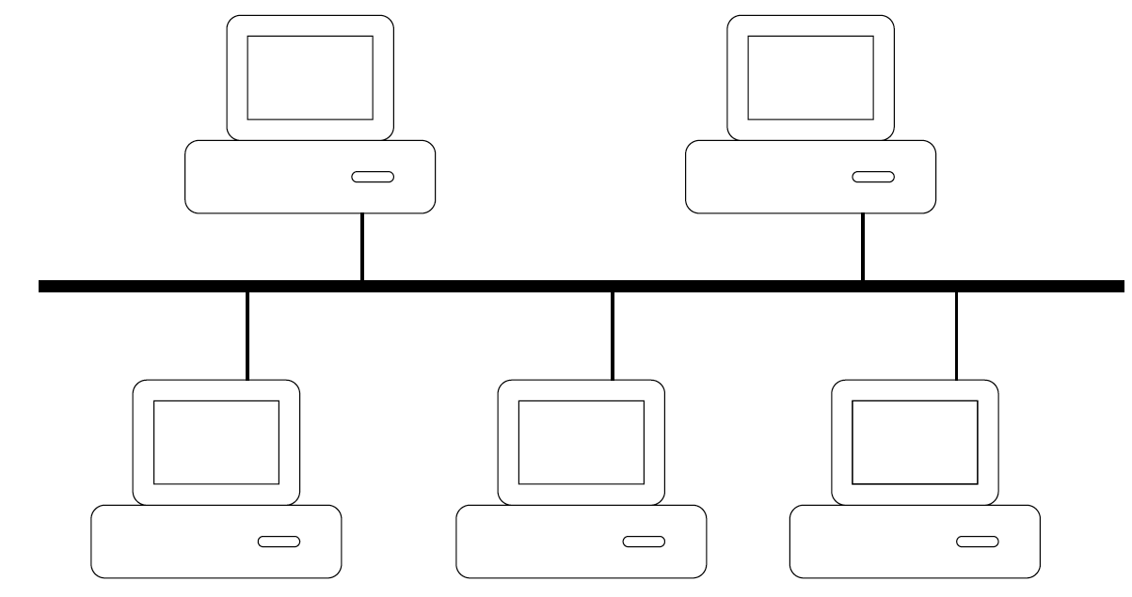
Network Topologies II
Ethernet (Bus)
Most prevalent network today
Wireless networks = Ethernet topology!

Slide 8
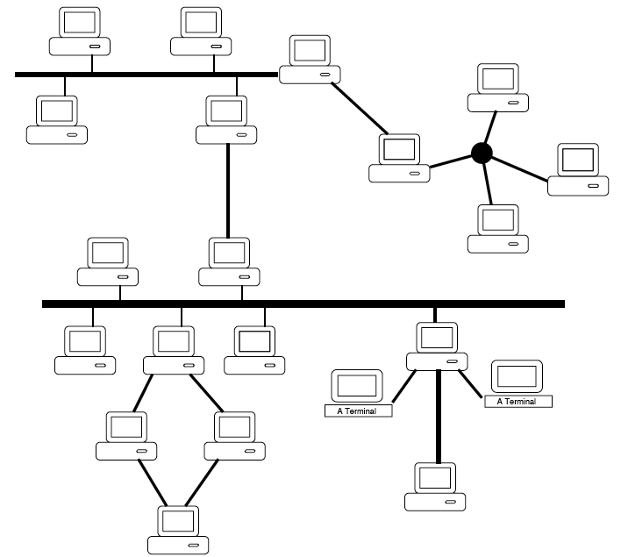
Network Topologies III
An internet

Slide 9
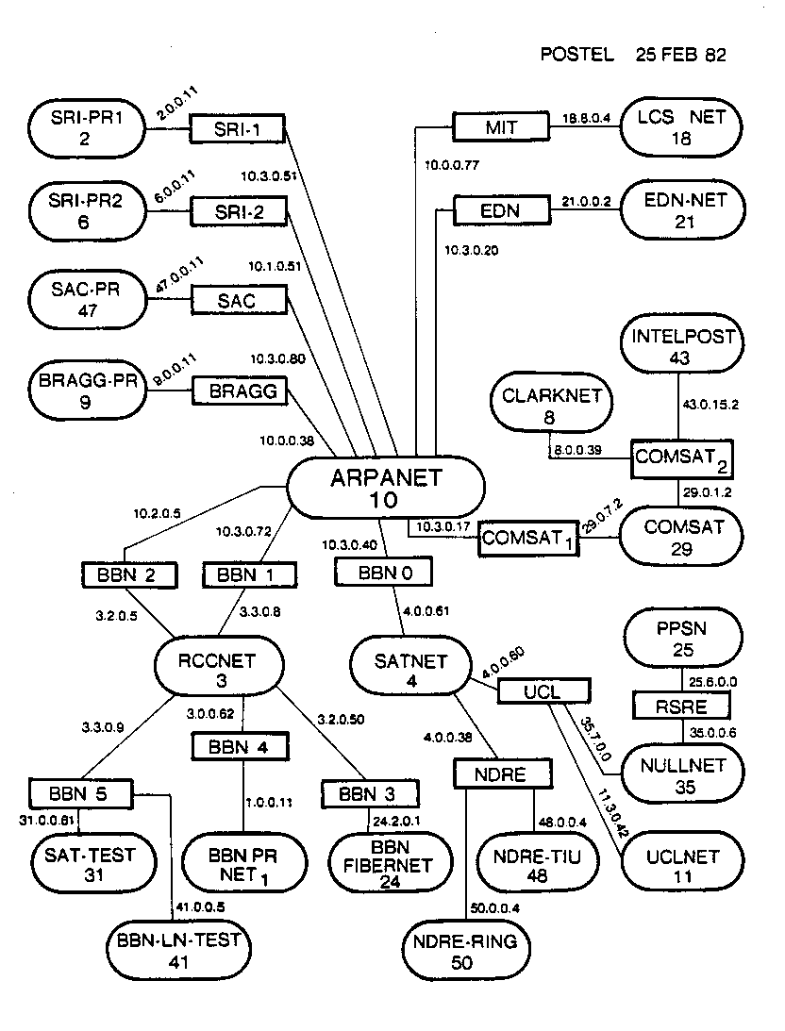
The Internet 1982

Slide 10
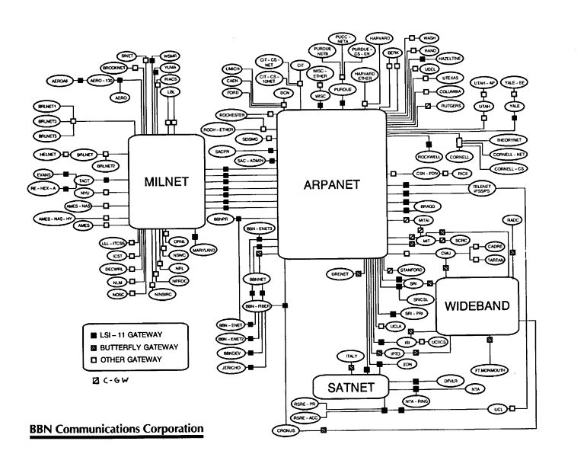
The Internet 1986

Slide 11
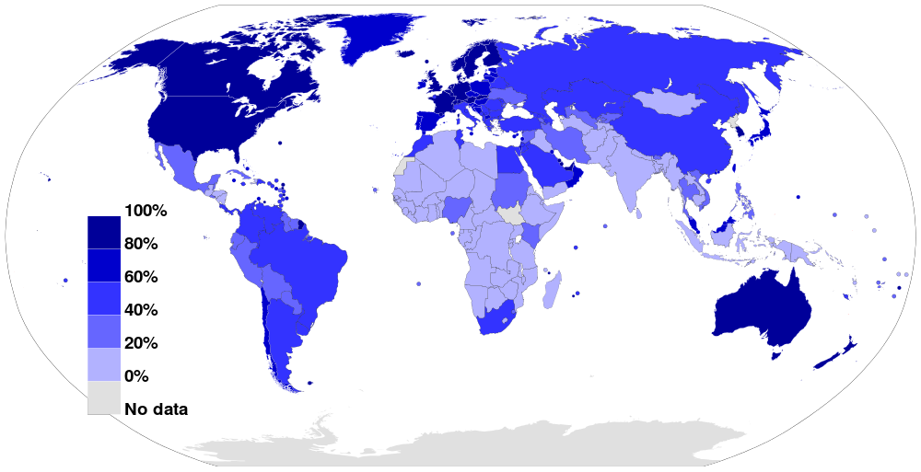
The Internet Today
Internet Usage as a Percentage of Population (2012)
Source: Wikimedia Commons

Slide 12
Question
Why is there only ONE Internet?
Picture credit: Chelsea Ganske

Slide 13
Growth of the Internet
The major point in building networks is agreement.
The Internet was build
using a decentralized architecture
using open protocols

Slide 14
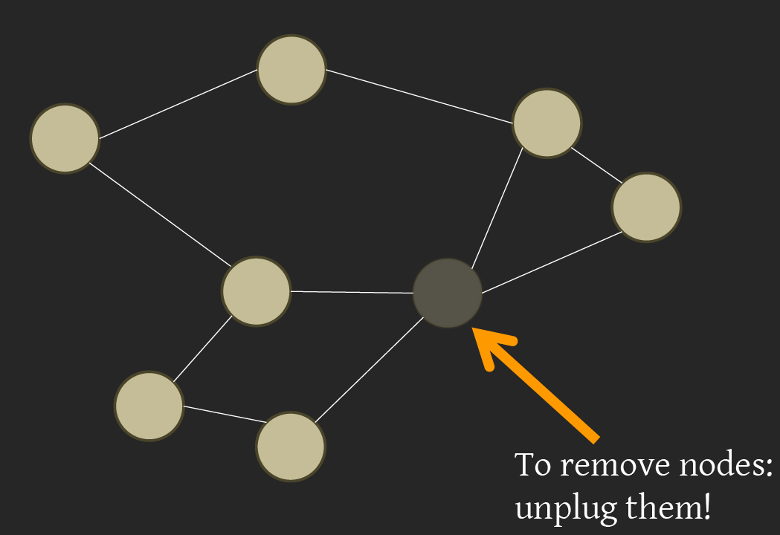
Properties of the Internet: Decentralization
Source: BJC Spring 12, Lecture 17

Slide 15
Properties of the Internet: Open Standards
Internet Engineering Task Force (IETF):
Request for Comments (RFC)
World Wide Web Consortium (W3C)
HTML
International Standards Organization (ISO)
JPEG, MPEG
Institute of Electrical and Electronics Engineers (IEEE)
WiFi

Slide 16
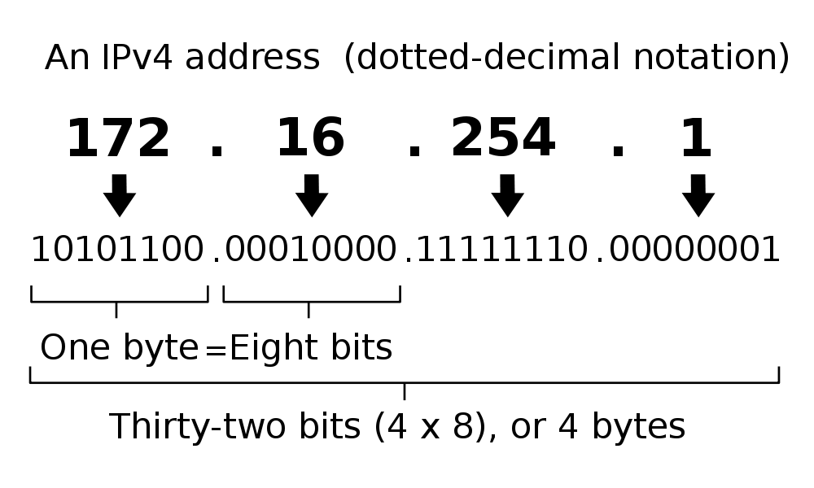
IP Addresses
Split: First part network, second part computer indicated by /bits: e.g. 192.168.1.103/16
2³² = 4 billion unique numbers (world population 7 billion)

Slide 17
IP Address Allocation
IANA (Internet Assigned Numbers Authority) allocates network addresses to entities by delegating to RIRs (Regional Internet Registries).

Slide 18
Count
Take a moment and count: How many Internet-connected devices do you own?
0
1
2-5
5-10
More than 10
Notes:
Data and information is hard to define. There are philosophical and meta-physical issues. So let’s all watch the Matrix…

Slide 19
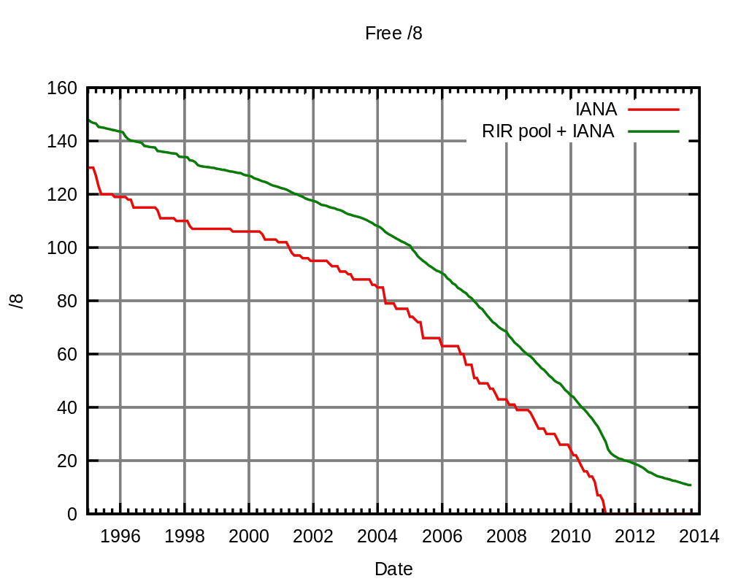
Problem: No more IP addresses left…
Source: Wikimedia Commons

Slide 20
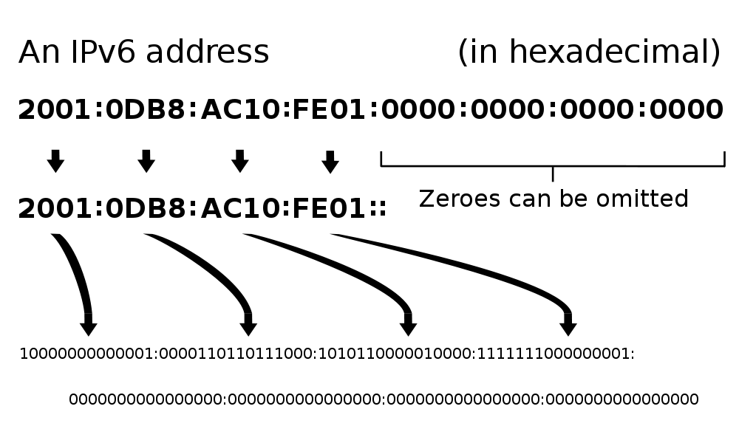
Solution: IPv6
2¹²⁸ = 3.403 x 10³⁸ unique addresses
Issue: Adoption still in progress
Workaround exists: NAT (Network Address Translation)

Slide 21
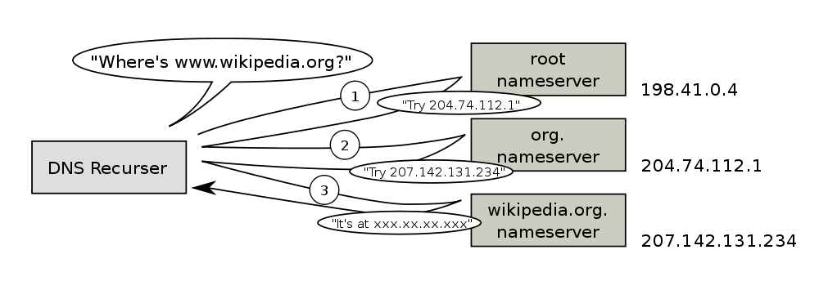
Domain Name Service
DNS is used to resolve names to IP addresses in a decentralized manner

Slide 22
Summary and Outlook
The Internet is setup for growth using open standards
It is highly failure tolerant due to decentralization
However, issues arise with trying to improve it.
Internet II (Wednesday):
Routers
Internet Protocols
Vulnerabilities of the Internet
More on Social Implications

