Slide 1

1 Gbps wi-fi coming to a billion devices
CS10
The Beauty and Joy of Computing
Lecture #7
Algorithmic Complexity
2011-02-09
UC Berkeley EECS
Lecturer SOE
Dan Garcia
One million Wi-Fi devices isn’t cool.
You know what’s cool? A Billion Wi-Fi devices.
…all running the new 802.11ac 1G Wi-Fi standard, which hasn’t yet been ratified by the IEEE, but we’ll see draft by 2011 and products out there by 2012. It’ll use radio spectrum below 6GHz & bond 4- or 8-channels together.
hothardware.com/News/1Gbps-WiFi-Soon-Coming-To-a-Billion-Devices

Slide 2
Functional Abstraction (review)
A block, or function has inputs & outputs
  Possibly no inputs
  Possibly no outputs (if block is a command)
    In this case, it would have a “side effect”, i.e., what it does (e.g., move a robot)
The contract describing what that block does is called a specification or spec
x
F
F(x)

Slide 3
What is IN a spec? (review)
Typically they all have
  NAME
  INPUT(s)
    (and types, if appropriate)
    Requirements
  OUTPUT
    Can write “none”
  (SIDE-EFFECTS)
  EXAMPLE CALLS
Example
  NAME : Double
  INPUT : n (a number)
  OUTPUT: n + n
n
Double
Double(n)

Slide 4

What is NOT in a spec?
How!
  That’s the beauty of a functional abstraction; it doesn’t say how it will do its job.
Example: Double
  Could be n * 2
  Could be n + n
  Could be n+1 (n times)
    if n is a positive integer
This gives great freedom to author!
  You choose Algorithm(s)!

Slide 5
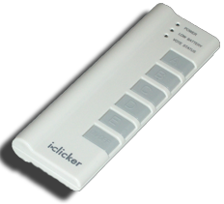
What do YOU think?
Which factor below is the most important in choosing the algorithm to use?
  Simplest?
  Easiest to implement?
  Takes less time?
  Uses up less space (memory)?
  Gives a more precise answer?
Notes:
Answer: All of the above! Depending on the situation, certainly

Slide 6
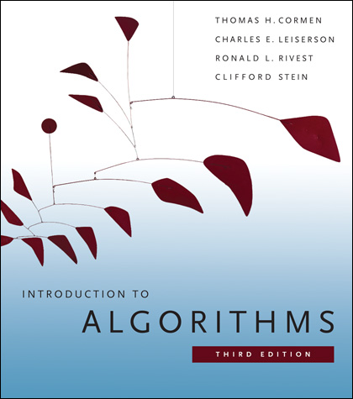
Reference text
This book launched a generation of CS students into Algorithm Analysis
  It’s on everyone’s shelf
  It might be hard to grok at this point, but if you go on in CS, remember it & own it!
    …but get the most recent vers

Slide 7
Algorithm analysis : the basics
An algorithm is correct if, for every input, it reports the correct output and doesn’t run forever or cause an error.
  Incorrect algorithms may run forever, or may crash, or may not return the correct answer.
    They could still be useful!
    Consider an approximation…
  For now, we’ll only consider correct algorithms
Algorithm for managing Vitamin D sterols based on serum calcium levels.
www.kidney.org/professionals/kdoqi/guidelines_bone/guide8b.htm

Slide 8

Algorithm analysis : running time
One commonly used criterion in making a decision is running time
  how long does the algorithm take to run and finish its task?
How do we measure it?
08:23:12

Slide 9
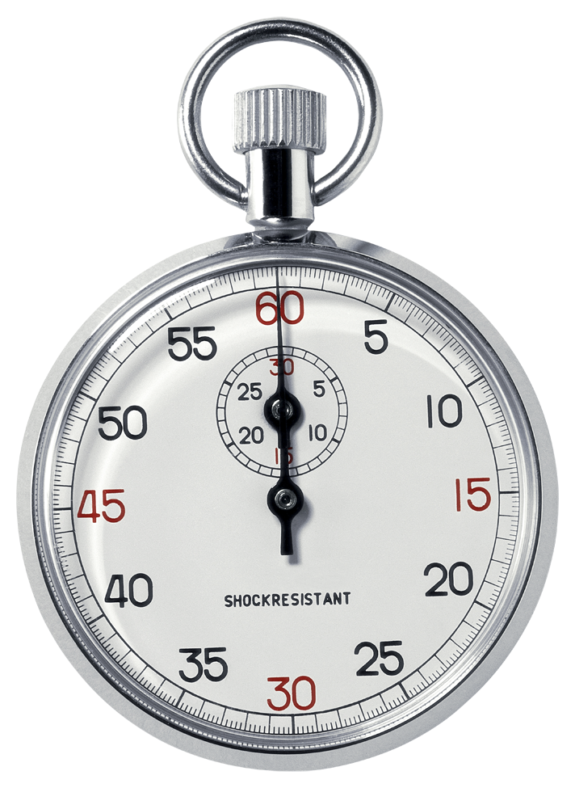
Runtime analysis problem & solution
Time w/stopwatch, but…
  Different computers may have different runtimes. ☹
  Same computer may have different runtime on the same input. ☹
  Need to implement the algorithm first to run it. ☹
Solution: Count the number of “steps” involved, not time!
  Each operation = 1 step
  If we say “running time”, we’ll mean # of steps, not time!

Slide 10
Runtime analysis : input size & efficiency
Definition
  Input size: the # of things in the input.
  E.g., # of things in a list
  Running time as a function of input size
  Measures efficiency
Important!
  In CS10 we won’t care about the efficiency of your solutions!
  …in CS61B we will
CS10
CS61A
CS61B
CS61C

Slide 11

Runtime analysis : worst or avg case?
Could use avg case
  Average running time over a vast # of inputs
Instead: use worst case
  Consider running time as input grows
Why?
  Nice to know most time we’d ever spend
  Worst case happens often
  Avg is often ~ worst

Slide 12
Runtime analysis: Final abstraction
Instead of an exact number of operations we’ll use abstraction
  Want order of growth, or dominant term
In CS10 we’ll consider
  Constant
  Logarithmic
  Linear
  Quadratic
  Cubic
  Exponential
E.g. 10 n² + 4 log n + n
  …is quadratic
Exponential
Cubic
Quadratic
Linear
Logarithmic
Constant
Graph of order of growth curves on log-log plot

Slide 13
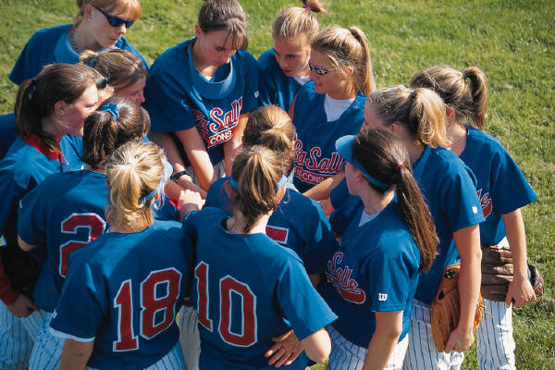
Example: Finding a student (by ID)
Input
  Unsorted list of students L
  Particular student S
Output
  True if S is in L, else False
Pseudocode Algorithm
  Start one by one, checking for match.
  If match, true
  If exhausted L and didn’t find S, false
Worst-case running time as function of the size of L?
  Constant
  Logarithmic
  Linear
  Quadratic
  Exponential

Slide 14
Example: Finding a student (by ID)
Input
  Sorted list of students L
  Particular student S
Output : same
Pseudocode Algorithm
  Start in middle
  If match, report true
  If exhausted, throw away half of L and check again in the middle of remaining part of L
  If nobody left, report false
Worst-case running time as function of the size of L?
  Constant
  Logarithmic
  Linear
  Quadratic
  Exponential

Slide 15
Example: Finding a student (by ID)
What if L were given to you in advance and you had infinite storage?
  Could you do any better than logarithmic?
Worst-case running time as function of the size of L?
  Constant
  Logarithmic
  Linear
  Quadratic
  Exponential

Slide 16
Example: Finding a shared birthday
Input
  Unsorted list L (of size n) of birthdays of team
Output
  True if any two people shared birthday, else False
What’s the worst-case running time?
Worst-case running time as function of the size of L?
  Constant
  Logarithmic
  Linear
  Quadratic
  Exponential

Slide 17
Example: Finding subsets
Input:
  Unsorted list L (of size n) of people
Output
  All the subsets
Worst-case running time?
E.g., for 3 people (a,b,c):
  1 empty: { }
  3 1-person: {a, b, c}
  3 2-person: {ab, bc, ac}
  1 3-person: {abc}
Worst-case running time as function of the size of L?
  Constant
  Logarithmic
  Linear
  Quadratic
  Exponential

Slide 18
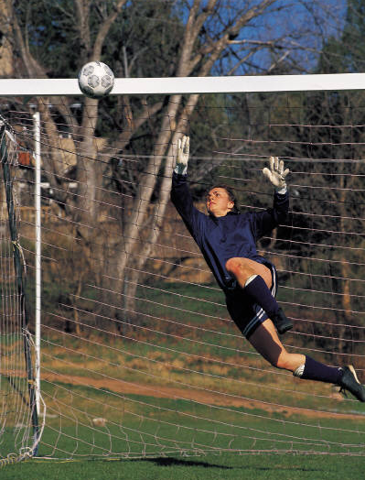
Summary
When choosing algorithm, could optimize for
  Simplest
  Easiest to implement?
  Most efficient
  Uses up least resources
  Gives most precision
  …
In CS10 we’ll consider
  Constant
  Logarithmic
  Linear
  Quadratic
  Cubic
  Exponential
How does the goalie choose how to block ball?

