Slide 1
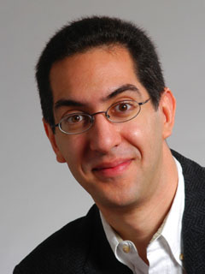
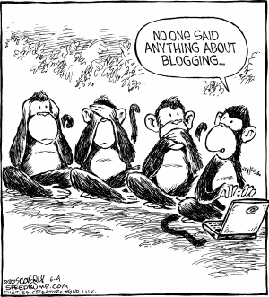
Twitter, facebook : no free speech pact
CS10 The Beauty and Joy of Computing Lecture #12 Social Implications of Computing II
2011-03-07
UC Berkeley EECS Lecturer SOE Dan Garcia
Hello to Aw Jia-Yu in Singapore!
The Global Network Initiative (founders of a “code of conduct” online free speech initiative) “has failed to attract any corporate members aside from the original (American) three: Google, MS, Yahoo”. No Twitter, no Facebook, nobody else. It was founded 3 yrs ago just after the big China censorship debate with Google. Yahoo had turned over data that helped imprison Chinese activists, MS shut down a blog, Google introduced a censored search engine to comply with China’s laws.
Image Credit: Speedbump.com
www.nytimes.com/2011/03/07/technology/07rights.html

Slide 2
Overview
Privacy
Examples of media stories and lessons learned
Intellectual Property
E-Voting

Slide 3
Peer Instruction
How much of your personal life do you reveal online?
Nothing. I have no online footprint. Google’d find nada.
You might find a photo or two of me, not much else.
You would find photos & blogs & videos of me if you were my friends or family, not much else.
You’d find photos & blogs & videos & tweets, but nothing embarrassing. I filter what I put up.
My entire life is visible to the world. I hold nothing back. Location, videos, etc. JennyCam has nothing on me.
Notes:
Answer: D (includes everything in which the computer poses a question and you have to answer in a computer-readable form, which so far means multiple choice)

Slide 4
Tyler Clementi, RIP
en.wikipedia.org/wiki/Suicide_of_Tyler_Clementi
Student at Rutgers who was cyber-bullied in Sep
Filmed by roommate in a sexual encounter (twice)
After he found out and complained, and found out it had happened again, he committed suicide
The same month, four other teens committed suicide after “bullying”
Internet amplification of invasion of privacy

Slide 5
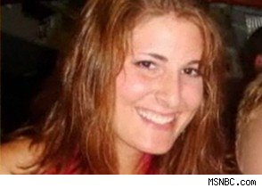
Karen Owen’s Powerpoint
www.msnbc.msn.com/id/21134540/vp/39552594#39552594
Student at Duke who documented sexual encounters in PPT
41 pages, photos and tables and graphs
Men are ranked, physical details shared
Shared with 3 others
Went Viral
If Karen were a man?
Lesson
Anything can go viral

Slide 6
Robbins v Lower Merion School District
en.wikipedia.org/wiki/Robbins_v._Lower_Merion_School_District
Details
In 2009-2010 Lower Merion (near Philly) issued MacBooks to each of 2,306 HS kids
The schools elected to use TheftTrack to allow school district employees to remotely activate webcam
Classic case of spyware
$610k settlement
Image Credit: wired.com

Slide 7
Peer Instruction (thanks to BH)
www.riaa.com/physicalpiracy.php?content_selector=piracy_online_the_law
Music on your portable player: Where do you get it?
I paid to download everything on my iPod
I bought everything, either as a download or ripped from CD/DVD
I bought most of my music but there are few exceptions
I bought a little of my music, but most of it I didn’t buy
It’s all from Limewire / BitTorrent / friends / etc
Notes:
Answer: D (includes everything in which the computer poses a question and you have to answer in a computer-readable form, which so far means multiple choice)

Slide 8
Intellectual Property
en.wikipedia.org/wiki/Copyright_Term_Extension_Act
copyright.gov
BH:
“We’re going to make a bargain with creators. We’re going to give you a limited time monopoly to profit from your idea in return for sharing your idea with us. … Congress keeps extending the duration of copyright”
US Constitution, Article I, Section 8:
“The Congress shall have power… to promote the Progress of Science and useful Arts, by securing for limited Times to Authors and Inventions the exclusive Right to their respective Writings and Discoveries.”
Logo for opposition to CTEA

Slide 9
Creative Commons
creativecommons.org
A GREAT way to share / remix / reuse content
Legal!
Infrastructure that makes it possible
UC Online
This issue has come up; they have to find the right one…
BY = Attribution | Share Alike | No Derivs | Non Commercial
CC BY
CC BY SA | x
CC BY ND |  | x
CC BY NC |  |  | x
CC BY NC SA | x |  | x
CC BY NC ND |  | x | x

Slide 10
Peer Instruction
“I trust electronic voting machines & infrastructure.”
I strongly disagree
I disagree
Neutral
I agree
I strongly agree
Notes:
Answer: D (includes everything in which the computer poses a question and you have to answer in a computer-readable form, which so far means multiple choice)

Slide 11
E-Voting
seattletimes.nwsource.com/html/localnews/2014398575_apwaxgrlegislature.html video.google.com/videoplay?docid=7926958774822130737# en.wikipedia.org/wiki/Hacking_Democracy
“Hacking Democracy” is an Emmy-nominated documentary
Harri Hursti demonstrates “Hursti Hack” on Diebold machines thought safe
Senate Ok’s online vote only for military in Washington state
Bill goes to House
It’s really scary, folks

Slide 12
Summary
Be cautious about your online exposure
Fight for your privacy
Use Creative Commons to share / remix / reuse content
Pay for your music
or use Pandora, which does it for you
Fight online voting
CS195 to learn more
(Credit: Geekologie)

