Slide 1
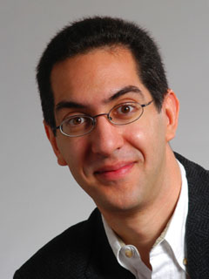
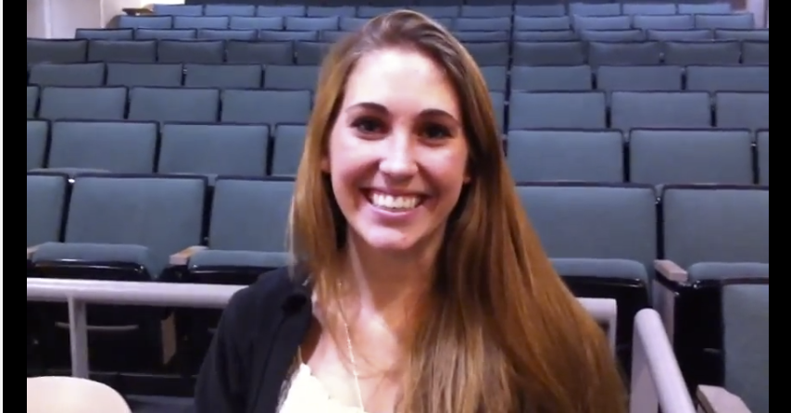
Cs10 : you’ll love it!
CS10 The Beauty and Joy of Computing Lecture #1 Welcome; Abstraction
2012-01-18
UC Berkeley Computer Science Lecturer SOE Dan Garcia
Watch the student testimonials about CS10, what it means to them, and how it has changed their lives. Inspiring!
inst.eecs.berkeley.edu/~cs10/

Slide 2
CS10 in one slide
Big Ideas of Programming
Abstraction
Algorithms (2)
Recursion (2)
Functions-as-data, λ (2)
Programming Paradigms
Concurrency
Distributed Computing
Beauty and Joy
“CS Unplugged” activities
All lab work in pairs
Two 3-week projects in pairs
Of their own choice!!
One blog
Of students’ own choice!!
Big Ideas of Computing
HowStuffWorks
3D Graphics
Video Games
Computational Game Theory
Research Summaries
AI
HCI
Apps that Changed the World
Social Implications of Computing
Saving the World with Computing
How Twitter Works (guest lecture)
Cloud Computing
Limits of Computing
Future of Computing

Slide 3
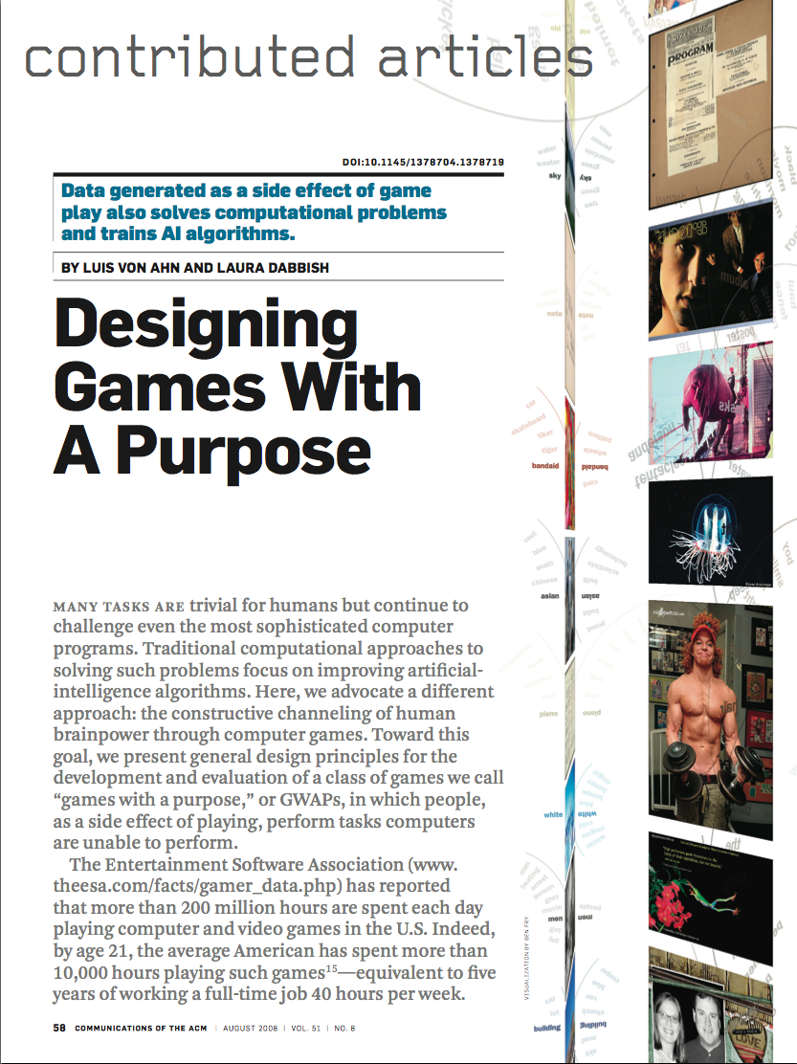
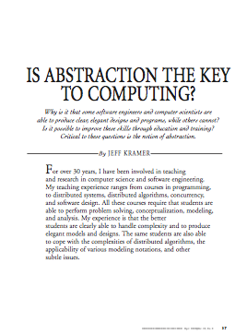
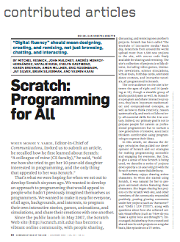
Format & Textbooks
Format (7 hrs/wk * 14 wks)
Selected Reading
Taken from great book (“Blown to Bits” by Abelson, Ledeen & Lewis) + articles + videos
Current events EVERY DAY (e.g., IBM’s Watson vs Jeopardy)
All resources FREE
Even clickers!
Mon | Wed | Fri
Lecture | Lecture | Discussion
Lab | Lab
Lab | Lab
…

Slide 4
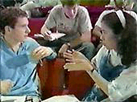
Peer Instruction
Increase real-time learning in lecture, test understanding of concepts vs. details
As complete a “segment” ask multiple choice question
1-2 minutes to decide yourself
2 minutes in pairs/triples to reach consensus. Teach others!
2 minute discussion of answers, questions, clarifications

Slide 5
Piazza for {ask,answer}ing questions

Slide 6
Abstraction
Detail removal
“The act or process of leaving out of consideration one or more properties of a complex object so as to attend to others.”
Generalization
“The process of formulating general concepts by abstracting common properties of instances”
Henri Matisse “Naked Blue IV”

Slide 7
Detail Removal
Automatic Generation of Detail Maps Maneesh Agrawala (UCB EECS), among others

Slide 8
Detail Removal (in CS10)
You’ll want to write a project to simulate a real-world situation, or play a game, or …
Abstraction is the idea that you focus on the essence, the cleanest way to map the messy real world to one you can build
The London Underground 1928 Map & the 1933 map by Harry Beck.

Slide 9
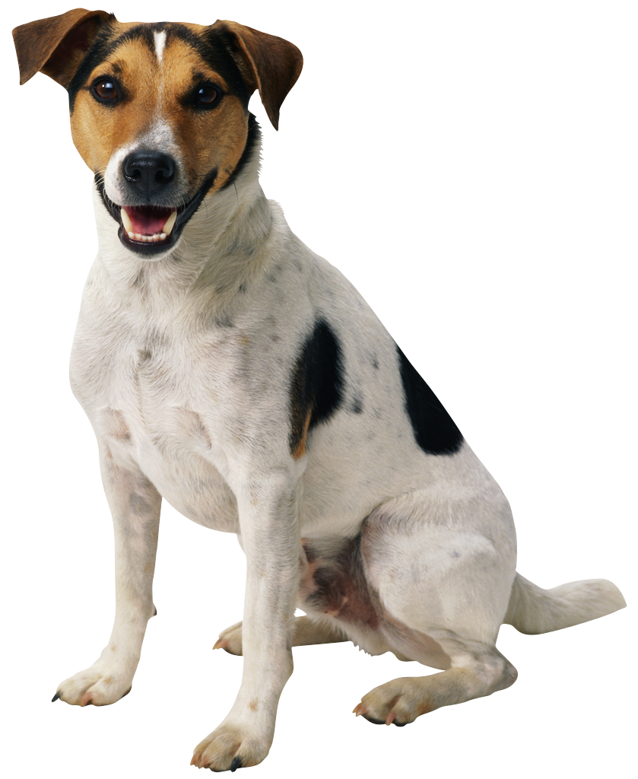
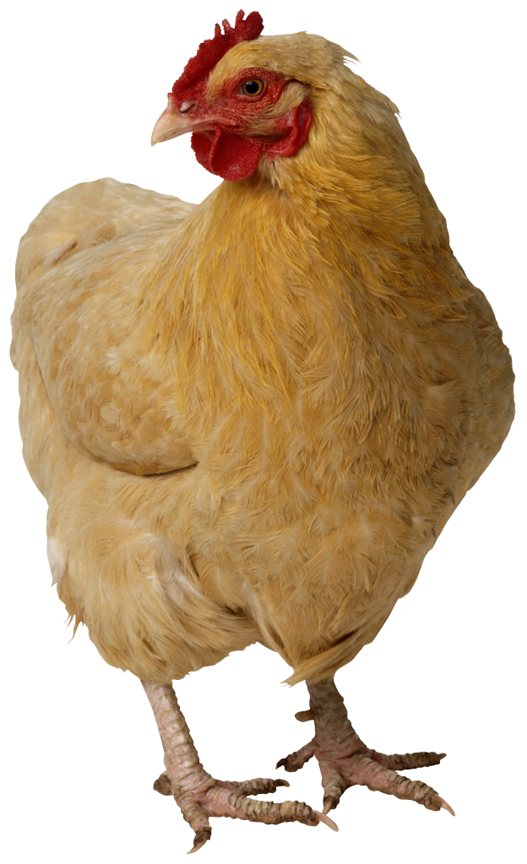
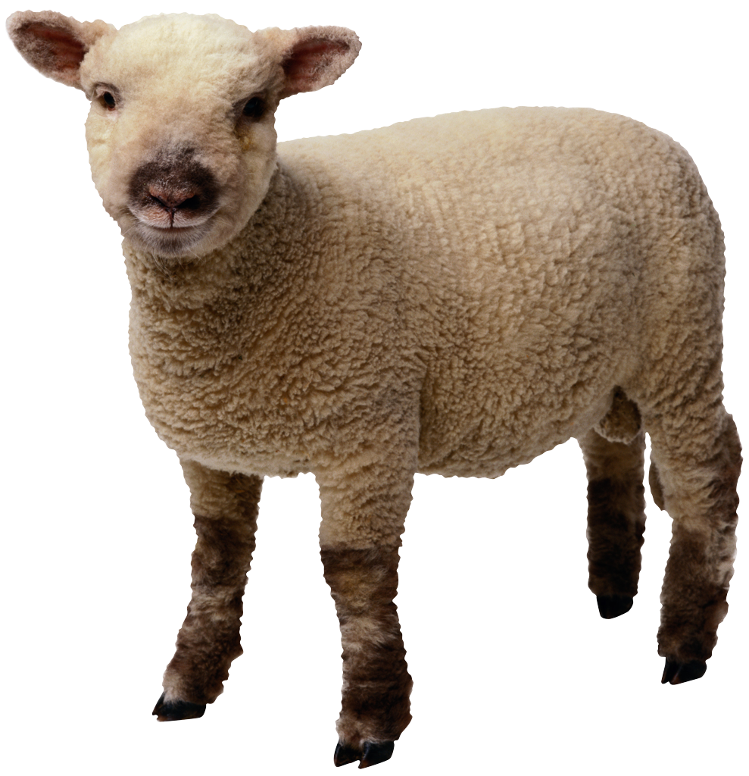
Generalization Example
You have a farm with many animal kinds.
Different food for each
You have directions that say
To feed dog, put dog food in dog dish
To feed chicken, put chicken food in chicken dish
To feed rabbit, put rabbit food in rabbit dish
Etc…
How could you do better?
To feed <animal>, put <animal> food in <animal> dish

Slide 10
Generalization (in CS10)
You are going to learn to write functions, like in math class:
y = sin(x)
You should think about what inputs make sense to use so you don’t have to duplicate code
“Function machine” from Simply Scheme (Harvey)

Slide 11
Summary
Abstraction is one of the big ideas of computing and computational thinking
Think about driving. How many of you know how a car works? How many can drive a car? Abstraction!
Someone who died in 1930 could still drive a car today because they’ve kept the same Abstraction!
(right pedal faster, left pedal slow)

