Slide 1
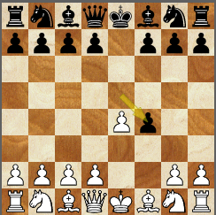
Busting the king’s gambit
CS10 : The Beauty and Joy of Computing Lecture #19 Higher Order Functions II
2012-04-04
UC Berkeley EECS Lecturer SOE Dan Garcia
(Image Credit: chessbase.com)
The popular opening 1. e4 e5 2. f4 exf4 refutes the “formerly popular opening”. He “strongly solved” it using ~3,000 cores powered by the IBM Watson team, and finds out that there’s only ONE move that draws for white 3. Be2; every other move “loses by force”. (they consider a game in which a person is down by 5.12 points to be a loss)
http://www.chessbase.com/newsdetail.asp?newsid=8047

Slide 2
Peer Instruction
I understand higher-order functions.
Strongly disagree
Disagree
Neutral
Agree
Strongly agree
Notes:
Answer: D (includes everything in which the computer poses a question and you have to answer in a computer-readable form, which so far means multiple choice)

Slide 3
Today
Review useful HOFs
map Reporter over List
Report a new list, every element E of List becoming Reporter(E)
keep items such that Predicate from List
Report a new list, keeping only elements E of List if Predicate(E)
combine with Reporter over List
Combine all the elements of List with Reporter(E)
This is also known as “reduce”
Acronym example
keep ➔ map ➔ combine
The script, run and launch
For each
Compose example

