Slide 1
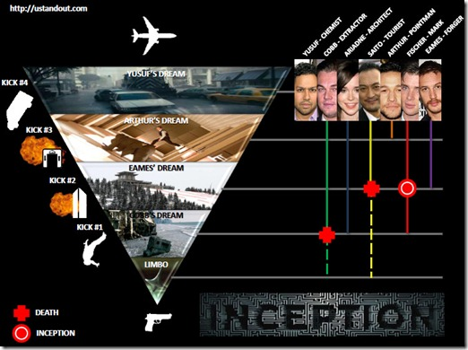
Go see Inception!
The Beauty & Joy of Computing Lecture #8
Recursion
UC Berkeley EECS Sr Lecturer SOE Dan Garcia
The coolest movie last year highlights recursion, and it was up for best picture. If you haven’t seen it yet, you should, because it will help you understand recursion!!
New Rule: Use scratch paper in lab! The problems there are hard enough that you won’t be able to keep it in your head!
en.wikipedia.org/wiki/Inception_(film)

Slide 2
Overview
www.worldofescher.com/gallery/A13.html
Recursion
Demo
Vee example & analysis
Downup
You already know it
Definition
Trust the Recursion!
Conclusion
M. C. Escher : Drawing Hands

Slide 3
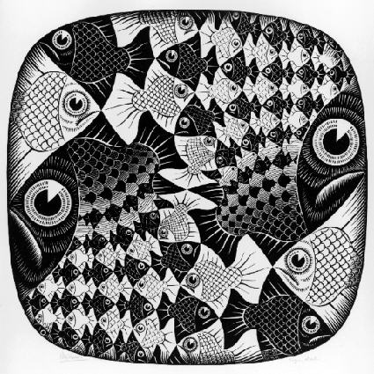
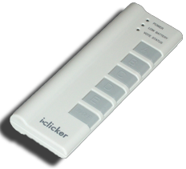
“I understood Vee & Downup”
Strongly disagree
Disagree
Neutral
Agree
Strongly agree
M. C. Escher : Fish and Scales

Slide 4
Definition
www.catb.org/~esr/jargon/html/R/recursion.html www.nist.gov/dads/HTML/recursion.html
Recursion: (noun) See recursion. ☺
An algorithmic technique where a function, in order to accomplish a task, calls itself with some part of the task
Recursive solutions involve two major parts:
Base case(s), the problem is simple enough to be solved directly
Recursive case(s). A recursive case has three components:
Divide the problem into one or more simpler or smaller parts
Invoke the function (recursively) on each part, and
Combine the solutions of the parts into a solution for the problem.
Depending on the problem, any of these may be trivial or complex.

Slide 5
You already know it!

Slide 6
Trust the Recursion
When authoring recursive code:
The base is usually easy: “when to stop?”
In the recursive step
How can we break the problem down into two:
A piece I can handle right now
The answer from a smaller piece of the problem
Assume your self-call does the right thing on a smaller piece of the problem
How to combine parts to get the overall answer?
Practice will make it easier to see idea

Slide 7
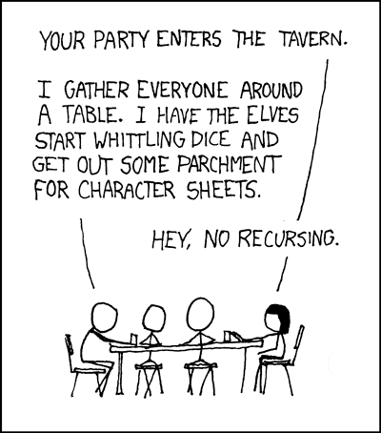
Sanity Check…
Recursion is  Iteration (i.e., loops)
Almost always, writing a recursive solution is  than an iterative one
more powerful than, easier
just as powerful as, easier
more powerful than, harder
just as powerful as, harder
http://xkcd.com/244/

Slide 8
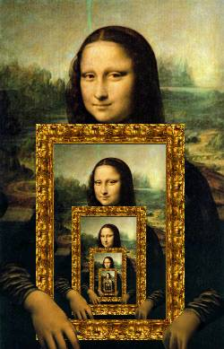
Summary
Behind Abstraction, Recursion is probably the 2nd biggest idea about programming in this course
It’s tremendously useful when the problem is self-similar
It’s no more powerful than iteration, but often leads to more concise & better code
http://www.dominiek.eu/blog/?m=200711

