Slide 1
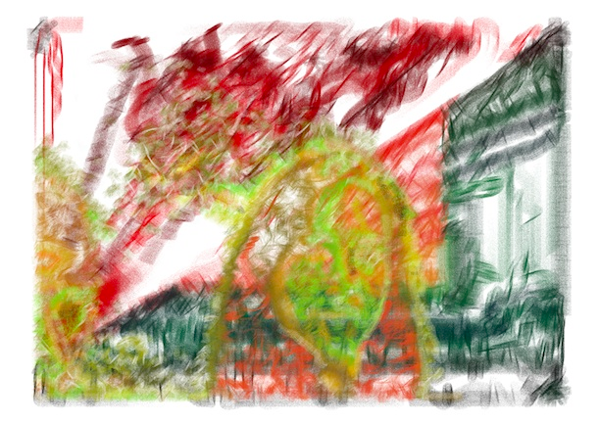
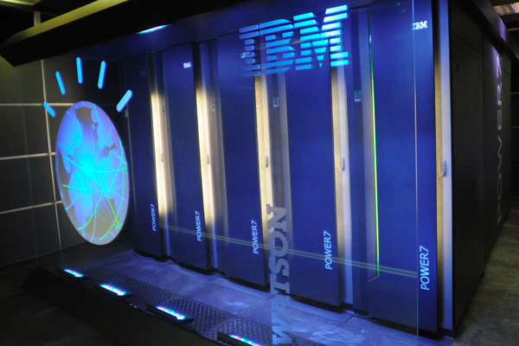
CS10: The Beauty and Joy of Computing
Artificial Intelligence
Anna Rafferty
(Slides adapted from Dan Garcia)
Notes:
http://www.youtube.com/watch?v=SqBw7XapJKk – bicycle robot
In september, driverless cars legalized in CA
http://www.youtube.com/watch?v=glT26E_fZ0I – 59s
Herb:
https://www.youtube.com/watch?v=gBgfpl0lcIo – 2:28

Slide 2
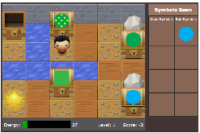
What I Do…
Model human learning using machine learning
Adaptive instruction and feedback in computer-based educational environments
E.g., diagnose a student’s knowledge by watching her play a game

Slide 3
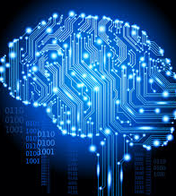
Lecture Overview
What is AI?
Some AI history: AI winter and the resurgence!
Tour of areas of AI
Philosophy: What would it mean for a program to be intelligent?

Slide 4
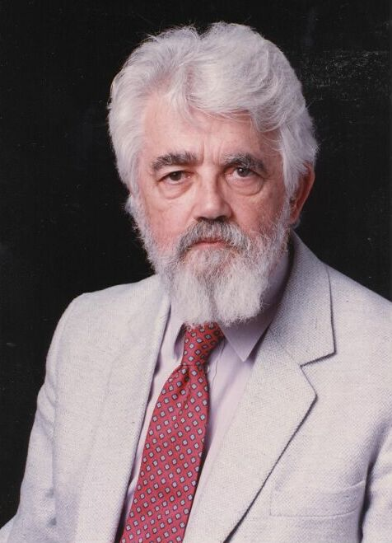
AI Definition by John McCarthy
“Getting a computer to do things which, when done by people, are said to involve intelligence”
Finesses the idea of whether a computer has consciousness, whether they have rights, etc.

Slide 5
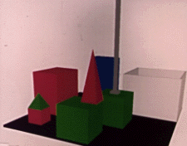
A little history…
Early AI (1956-early 1970s): symbolic reasoning and lots of optimism
Neural nets (but very simple)
Person: PICK UP A BIG RED BLOCK.
Computer: OK. (does it)
Person: GRASP THE PYRAMID.
Computer: I DON'T UNDERSTAND WHICH PYRAMID YOU MEAN.
Person: FIND A BLOCK WHICH IS TALLER THAN THE ONE YOU ARE HOLDING AND PUT IT INTO THE BOX.
Computer: BY "IT", I ASSUME YOU MEAN THE BLOCK WHICH IS TALLER THAN THE ONE I AM HOLDING.
Computer: OK. (does it)
http://hci.stanford.edu/winograd/shrdlu/
Notes:
Talk about theorem prover; also

Slide 6
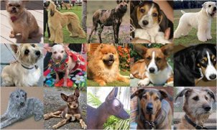
Clicker Question
Which of these rules is true for all dogs?
  (A) Has four legs
  (B) Has fur
  (C) Barks
  (D) None of the above
(Image from: http://vision.stanford.edu/resources_links.html)
Notes:
Peer instruction: Can you think of a rule that always works for identifying dogs? What problems does this pose for making an intelligent system?
- If everyone gets it right: talk to your partner about how you might surmount this issue with rules and symbols)

Slide 7
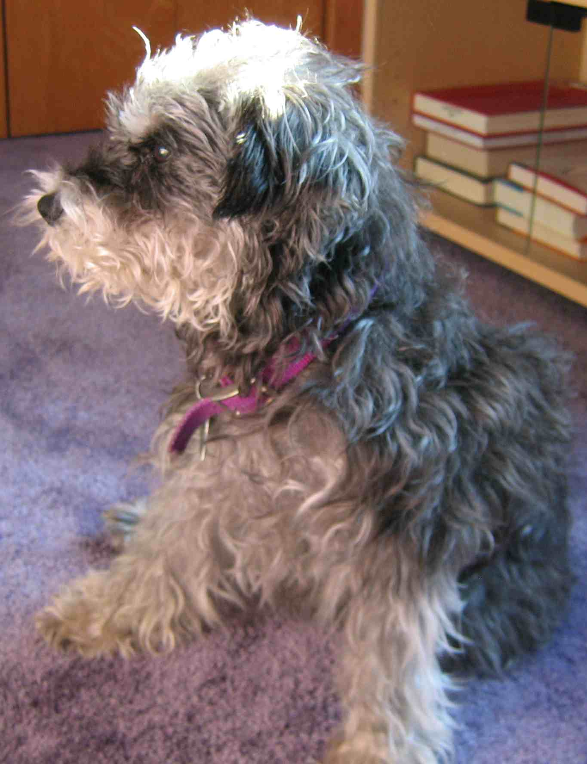
Revival of AI: Big Ideas
Brittle rules break down in the real world
Probability and uncertainty
No “dog rule” – instead: what is the probability that the thing we’re seeing is a dog?
Increased computational power and larger datasets
Notes:
Mention better math for existing algorithms

Slide 8


Revival of AI
Early neural nets theoretically less brittle than rules, but unable to learn some simple functions

Slide 9
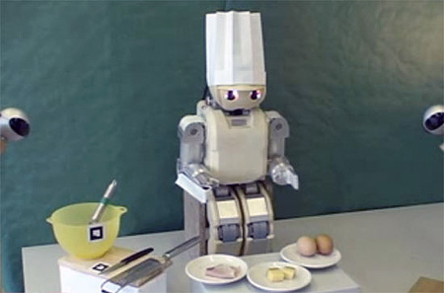
What intelligent things do people do?
Imagine cooking a meal with your roommates…
Planning
(Machine) Learning
Natural Language Processing
Motion and manipulation
Perception
Creativity
en.wikipedia.org/wiki/Artificial_intelligence

Slide 10
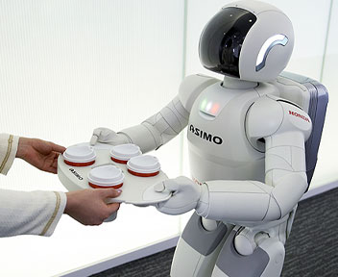
Tour of AI Applications
Questions to keep in mind:
  How would you evaluate how well a machine performed on the tasks we talk about?
  How can blending artificial and human intelligence make tasks simpler, even if the AI isn’t perfect?

Slide 11
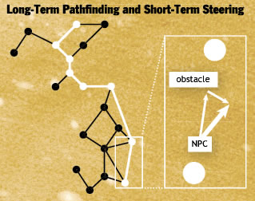
Planning
Range of intelligence
  Low: simple heuristics
  Medium: pathfinding
  High: Learns from player
Dynamic difficulty - adjust to player’s skill
Allocation of resources
  E.g., choose what land resources to give to which conservation projects
www.businessweek.com/innovate/content/aug2008/id20080820_123140.htm
en.wikipedia.org/wiki/Dynamic_game_difficulty_balancing
en.wikipedia.org/wiki/Game_artificial_intelligence
queue.acm.org/detail.cfm?id=971593

Slide 12
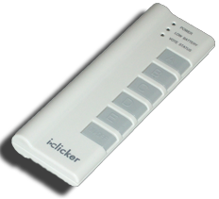
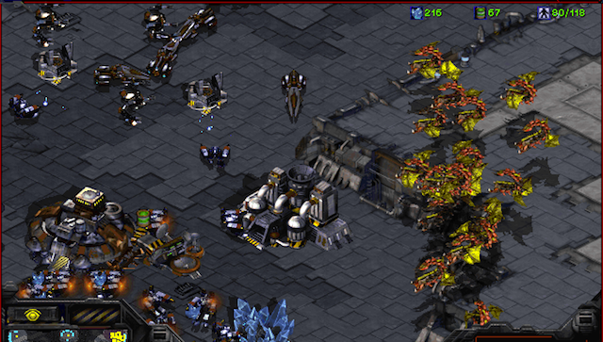
Clicker Question
The WORLD’S BEST AI StarCraft player is from:
Google
IBM (folks who did Watson)
Stanford
Berkeley
MIT

Slide 13
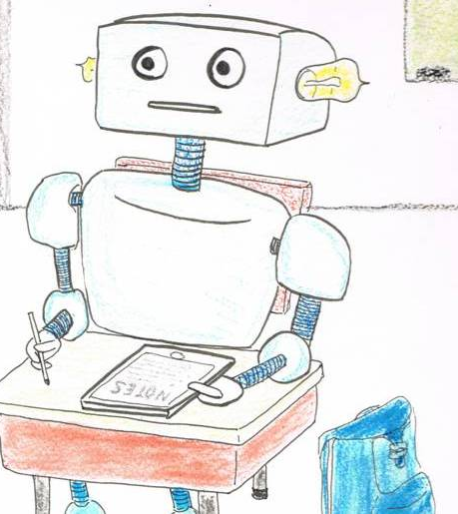
Machine Learning
“A program learns if, after an experience, it performs better”
Machine learning enables a program to act without behavior being explicitly programmed.
Need to discover the right generalizations
en.wikipedia.org/wiki/Machine_learning
Notes:
Examples:
supervised can learn to distinguish different classes of things (E.g., what part of speech are words in a sentence?), application to Kahn academy: predict if person will get next problem right
Unsupervised: learn representations (how do these objects differ from one another?)
Reinforcement learning: playing a game, learning to walk (http://www.youtube.com/watch?v=SJS22jQTdSU)

Slide 14

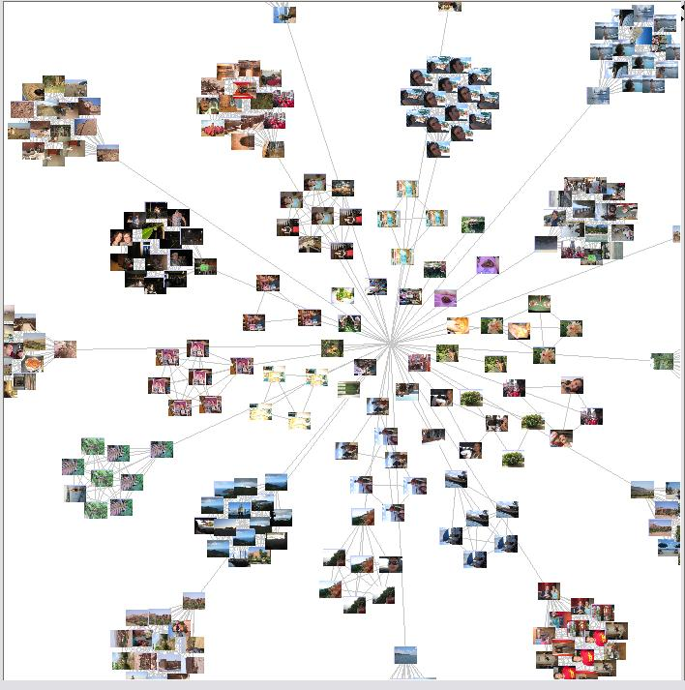
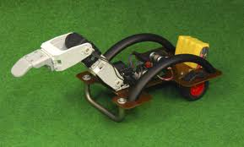
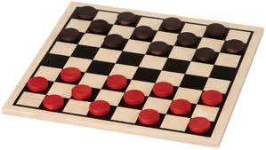
Machine Learning
Algorithm Types
  Supervised learning
    Give a system input & output training data, and it produces a classifier
  Unsupervised learning
    Determine how data is organized or clustered
  Reinforcement learning
    No training data, real-time corrections adjust behavior
SPAM
SPAM
HAM
HAM
HAM
?
en.wikipedia.org/wiki/Machine_learning
Notes:
Examples:
supervised can learn to distinguish different classes of things (E.g., what part of speech are words in a sentence?), application to Kahn academy: predict if person will get next problem right
Unsupervised: learn representations (how do these objects differ from one another?)
Reinforcement learning: playing a game, learning to walk (http://www.youtube.com/watch?v=SJS22jQTdSU)
Emphasize that multiple algorithms can be applied – what you choose depends both on the setup of the task and your goals

Slide 15
Clicker question
You want to make a spam filter that can tell you if an email is spam or not. What might be some good features for your algorithm?
The full text of each email you’ve marked as spam
Individual sentences from emails marked as spam or not spam
Character counts (e.g., $ seen 54 times in spam emails, A seen 85 times in spam email)
Words from emails marked as spam or not spam

Slide 16
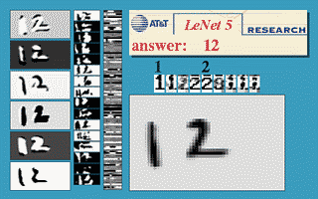

Example: Deep Learning
Combines supervised and unsupervised learning: Learn the right representations for input -> output
Notes:
http://yann.lecun.com/exdb/lenet/a12.html

Slide 17
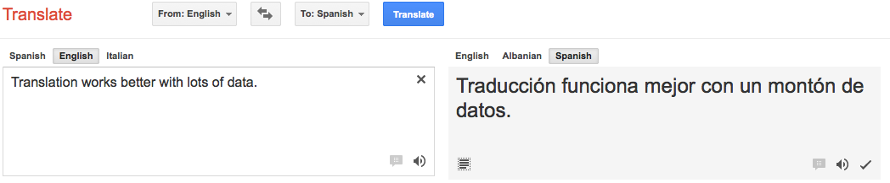
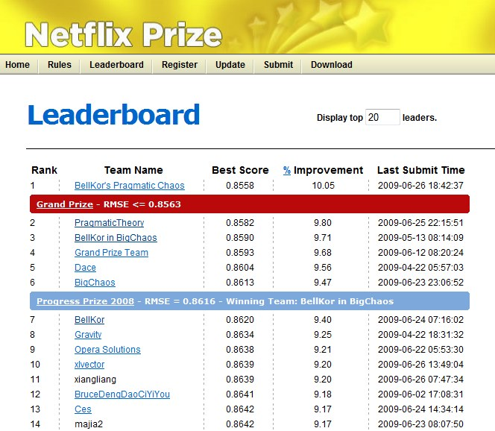
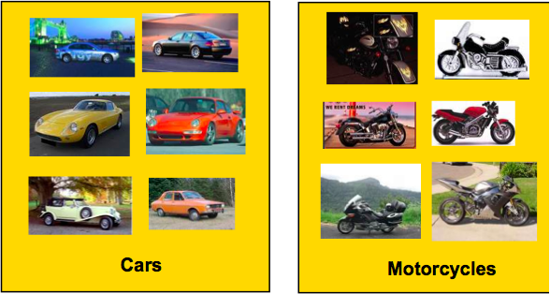
Benefiting from Big Data
Translation
Computer vision
Recommendation
More examples help algorithms recognize trends and similarities across instances.
Notes:
Examples:
supervised can learn to distinguish different classes of things (E.g., what part of speech are words in a sentence?), application to Kahn academy: predict if person will get next problem right
Unsupervised: learn representations (how do these objects differ from one another?)
Reinforcement learning: playing a game, learning to walk (http://www.youtube.com/watch?v=SJS22jQTdSU)

Slide 18
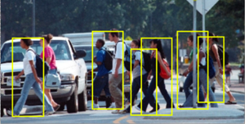
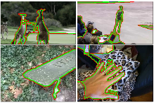

Vision
Tasks related to understanding images/camera input
Pedestrian detection
Action recognition
Figure/ground segmentation
(Some images from Berkeley vision group)

Slide 19
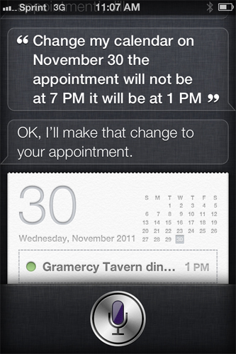
Natural Language Processing
Known as “AI-complete” problem
  (Often) requires extensive knowledge of world
Statistical NLP
  Correcting/guessing text
  Suggesting news stories
  Finding articles that are similar to one another
  Translate or paraphrase texts
en.wikipedia.org/wiki/Natural_language_processing

Slide 20
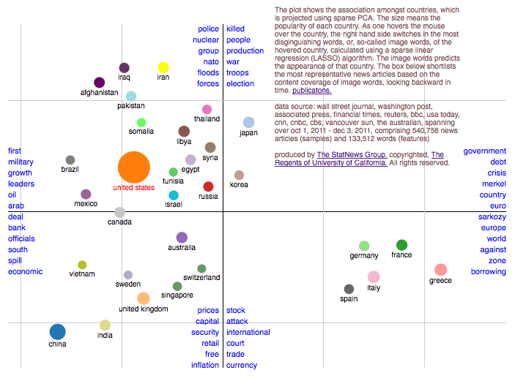
Unsupervised Learning Example
statnews.org

Slide 21
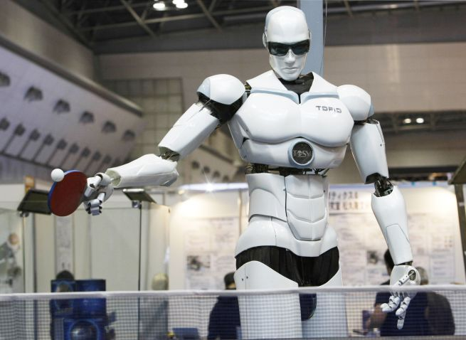
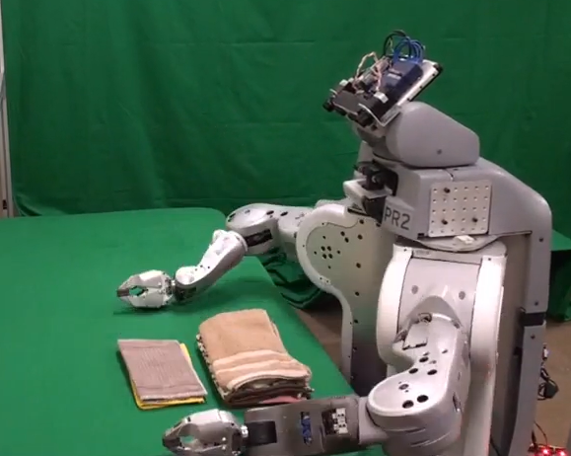
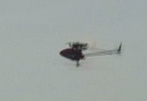
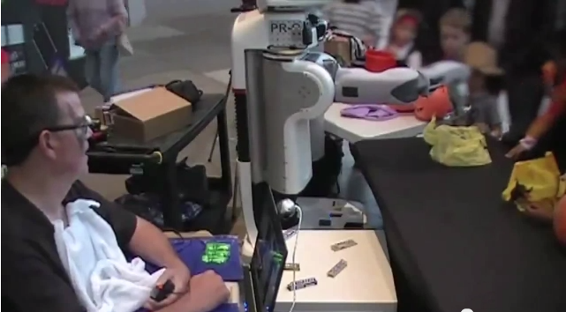
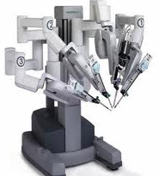
Robotics
For many, the coolest and scariest part of AI
Combines fields of AI/CS
  Speech recognition
  Synthetic voice
  Machine vision
  Planning
  HCI
TOPIO, the ping-pong playing robot
Surgical robots
Autonomous helicopter
UC Berkeley’s towel-folder
Assistive robots
en.wikipedia.org/wiki/Robotics
Notes:
http://www.youtube.com/watch?v=gy5g33S0Gzo – towel folding
http://www.youtube.com/watch?v=SqBw7XapJKk – bicycle robot
FINISH
Bio mimicry: http://www.youtube.com/watch?v=4V1631-Vcm4&feature=plcp
Herb:
https://www.youtube.com/watch?v=gBgfpl0lcIo – 2:28
Assistive robotics:
http://www.youtube.com/watch?v=aRA6VyhXDJ8 – 1:49

Slide 22
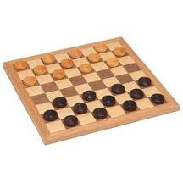
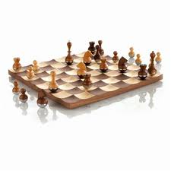
Recap
All of these applications are tough because they require:
  Knowing about context
  Uncertainty about input
  Intensive computations
But AI has been relatively successful at making progress (and in some cases, better than people!)

Slide 23
Clicker Question
What would a “truly intelligent” AI system look like?
  (A) Behaves in an optimal or rational manner
  (B) Behaves similarly to people – when it makes errors, those errors are similar to people’s errors
  (C) Carries out the same type of processing (mental representations) people do – i.e., thinks like people
Notes:
Peer instruction: talk to a neighbor about why you answered as you did – and whether the right answer might depend on circumstance

Slide 24

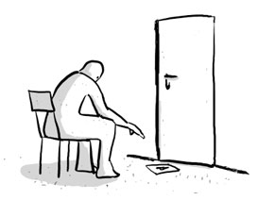
Turing Test for Intelligence
In 1950, Turing defined a test of whether a machine could “think”
“A human judge engages in a natural language conversation with one human and one machine, each of which tries to appear human. If judge can’t tell, machine passes the Turing test”
John Searle argued against the test via the Chinese room experiment, in which someone carries on a conversation by looking up phrases in a book. Does that person understand Chinese?
en.wikipedia.org/wiki/Turing_test

Slide 25
Clicker Question
How would you respond to Searle’s Chinese room experiment?
  (A) The system as a whole understands Chinese
  (B) The man doesn’t understand Chinese, but if he had a way to connect with the outside world (rather than just receiving strings of symbols), he could understand Chinese
  (C) We must be missing something about “understanding” since the argument implies that brains, which are collections of neurons, cannot understand
Notes:
Peer instruction: talk to a neighbor about why you answered as you did – and whether the right answer might depend on circumstance

Slide 26
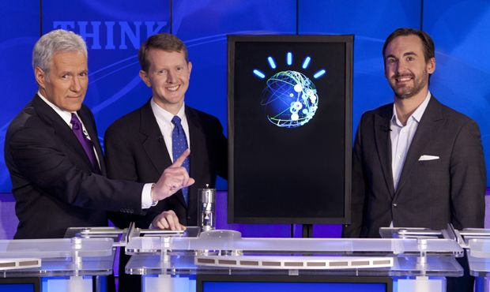
Summary
AI systems excel in things computers are good at
  Big data (using web to parse language)
  Constrained worlds (chess, math)
It’s getting better at…
  Language understanding
  Real-time robotics
Lots more applications that I didn’t have time to talk about!
CS188: Artificial Intelligence
  One of the most popular courses on campus!
CogSci131: Computational Models of Cognition
Thanks! Feel free to email me with questions at rafferty@cs.berkeley.edu

