Slide 1
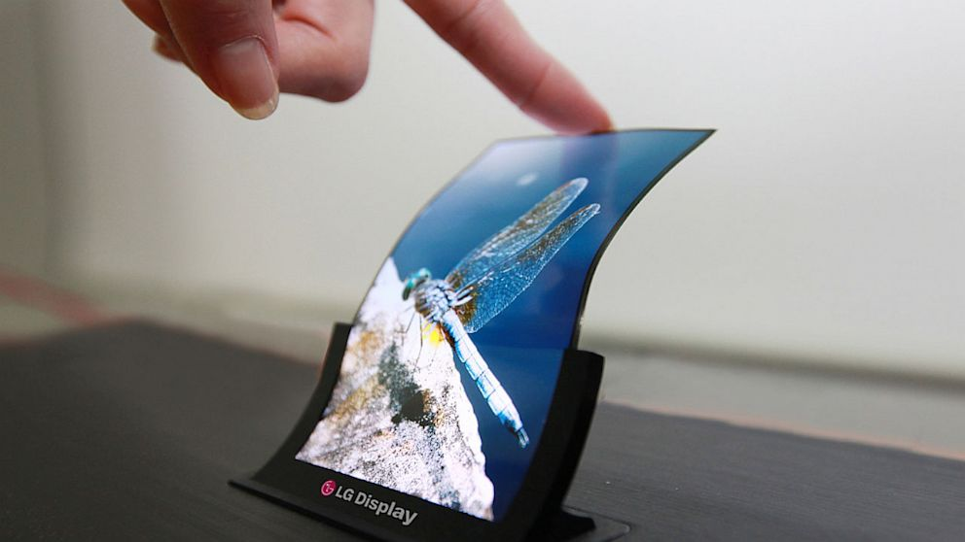
The Beauty and Joy of Computing Data
UC Berkeley EECS Sr Lecturer SOE Dan Garcia
Bendable Displays!!!
http://abcnews.go.com/Technology/lgs-flexible-screens-rolling-off-factory-lines/story?id=20498107

Slide 2
Data and Information facilitate knowledge
Computing enables and empowers new methods of information processing that have led to monumental change across disciplines, from art to business to science.
Managing & interpreting an overwhelming amount of raw data is part of the foundation of our information society and economy.
People use computers and computation to translate, process, and visualize raw data, and create information.
Computation and computer science facilitate and enable a new understanding of data and information that contributes knowledge to the world.
You will work with data using a variety of computational tools and techniques to better understand the many ways in which data is transformed into information and knowledge.
Notes:
Data and information is hard to define. There are philosophical and meta-physical issues. So let’s all watch the Matrix…

Slide 3
Ubiquitous data
…we work with it all the time:
Data is collected any moment of your life
Data is stored, copied, transmitted, deleted, edited.
Computers perform operations on data
Data enters and exits through sensors
We can measure it!
1 bit = ‘0’|’1’
1 Byte = 8 bit
1 KB = 1024 Bytes, 1MB = 1024kB, 1GB = 1024MB, 1TB=1024GB, 1PB=1024TB, 1EB=1024PB, …

Slide 4
How much is?
1 KB?
Paragraph of text
1 MB?
4 Mega pixel JPEG (compressed) image
1 GB?
One hour of SD TV or 7 minutes of HDTV
1 TB?
2,000 hours of audio (uncompressed), 17,000 hours of MP3s
1 PB?
Enough data to store the DNA of the entire population of the US – three times!

Slide 5
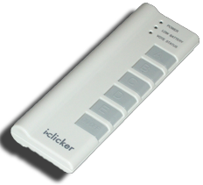
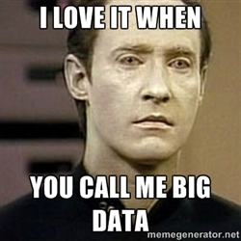
The “biggest” data?
What do you think is the biggest data overall?
Text
Images
DNA
Videos
Census Data
Notes:
40% of the Internet traffic is YouTube alone!

Slide 6
Big Data
Netflix is said to use 1 PB to store the videos for streaming.
World of Warcraft is stored on 1.3PB to maintain the game.
Internet Archive: About 10PB
AT&T transfers about 30PB of data through its networks each day.
YouTube processes about 40PB of videos a day.
Multimedia data biggest data!

Slide 7
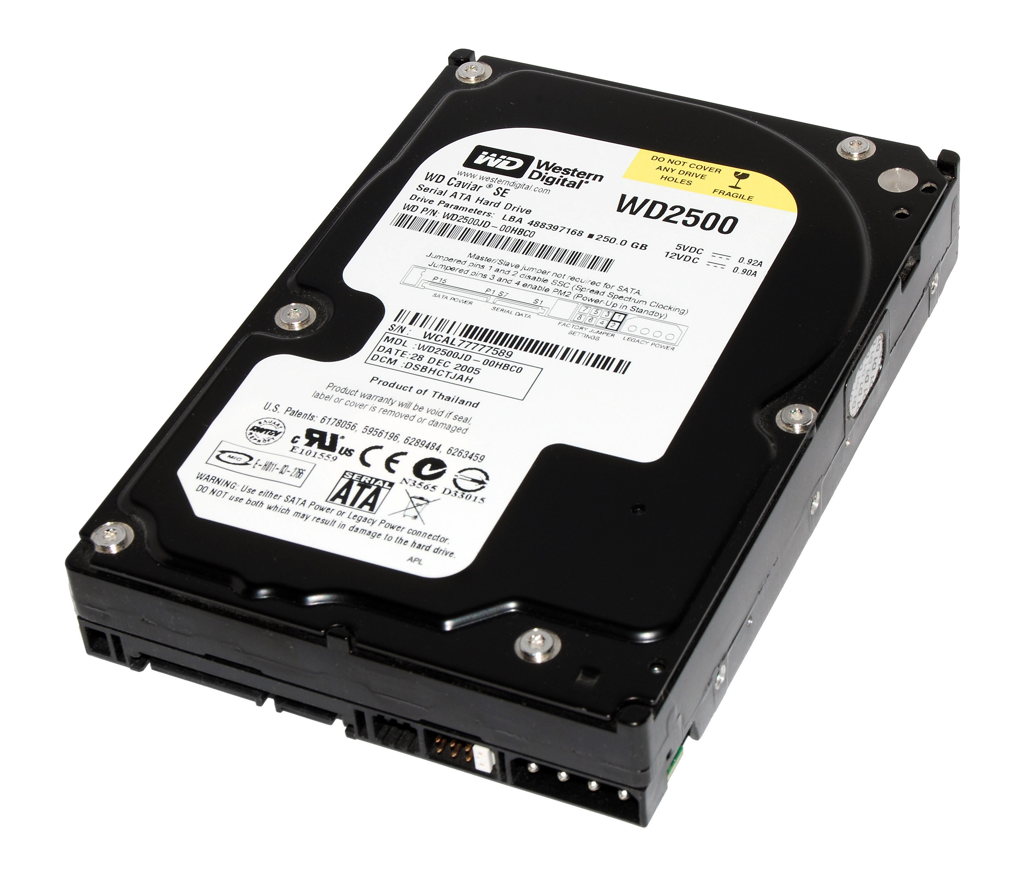
Challenges
Storage
No single hard disk/memory
unit can store the data
Need to parallelize harddisks
All the problems of concurrent programming!
How to access the data?
What if a disk fails?
How fast is the access (read, write, delete)?
Physical limits: Energy cooling
Notes:
Storage systems from solid-state drives to cloud storage affect how Big Data is used.
Use of Big Data requires innovation in software solutions.
Analytical techniques change as the size of data sets scale.

Slide 8
Techniques that Help: Lossless Compression
Entropy compression reduces data volume by removing redundant information
This compression is reversible but has mathematically proven limits.
Example:
AAAAAABBBBBCCC -> 6A5B3C

Slide 9
Techniques that Help: Lossy Compression
Lossy compression reduces data volume by removing irrelevant information
This compression is not fully reversible but only has perceptual limits.
Compression needs an agreement on decompression = “format”

Slide 10
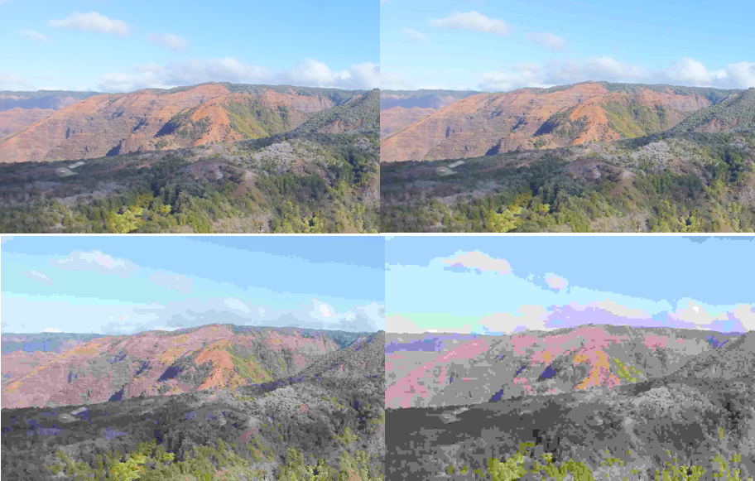
Lossy Compression: JPEG

Slide 11
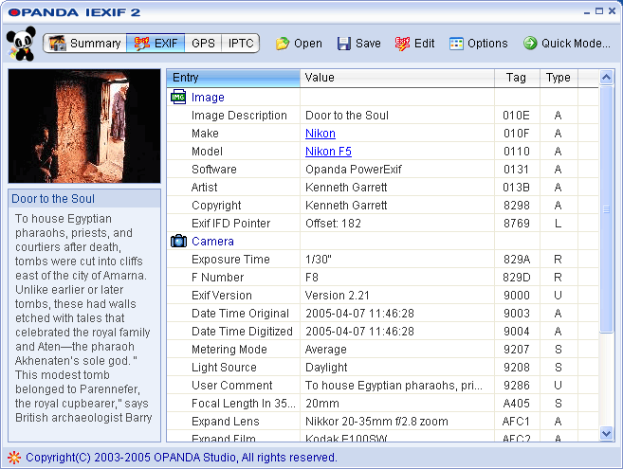
Techniques that help: Metadata
Metadata: Data about data. Helps processing of data, e.g. search
Example:
Notes:
Metadata can increase the effective use of data or a data set by providing additional information about various aspects of that data.
Image metadata can include time and geolocation, as well as information about the image such as size and color table.
Standards for metadata facilitate effective use of data depending on the type of data.

Slide 12
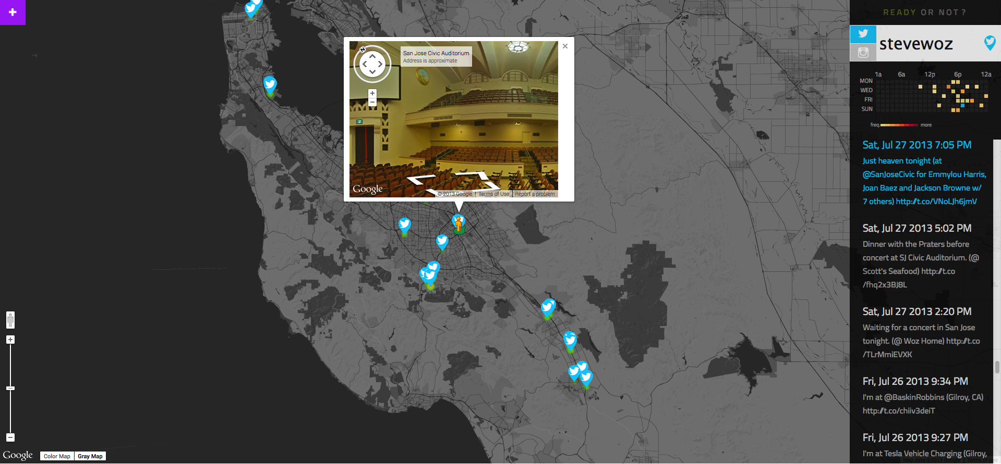
Two Main Reason for Digital Data
Digital data can be copied without loss.
Digital data can be processed by a computer, e.g. for search
Problems:
Privacy
Security
Notes:
Security concerns engender trade-offs in storing and transmitting information.
Privacy concerns arise with some data (e.g., with health and financial information).

Slide 13
One Main Reason for Big Data
Analyzing data at Internet-scale helps understand the world on never before seen scale.
Useful for empirical sciences:
What are the economic trends based on Google searches?
Are there animals that dance to music without human training?
How is the flu progressing?
`www.google.org/flutrends/us/
Notes:
Big Data offers opportunities for identifying trends, making connections in data, and solving problems.
Big Data includes data such as transactions, measurements, text, sound, images, and video.
Storing, processing, and curating large data sets is a challenge.
Structuring large data sets for analysis is a challenge.
Maintaining privacy of large data sets containing personal information is a challenge.

Slide 14
Correlation does not Imply Causality!
en.wikipedia.org/wiki/Correlation_does_not_imply_causation!
cum hoc ergo propter hoc logical fallacy:
A occurs in correlation with B.
Therefore, A causes B.
Just because A and B are correlated does not necessarily imply one causes the other! It could be that…
A may be the cause of B
B may be the cause of A
some unknown third factor C may actually be the cause of A and B.
A caused B AND B caused A. This is a self-reinforcing system.
E.g., “preditor-prey” relationships
the "relationship" is a coincidence or so complex or indirect that it is more effectively called a coincidence (i.e. two events occurring at the same time that have no direct relationship to each other besides the fact that they are occurring at the same time).

Slide 15
Is Data the Solution to Everything?
“Even” Internet data is biased
It’s easy to draw conclusions too quickly
Sometimes finding the questions to ask is the hard part…
E.g., NetFlix Prize
“Predict whether someone will enjoy a movie based on how much they liked or disliked other movies”
Dataset: users and movie ratings
What questions can we ask of this data set?

Slide 16
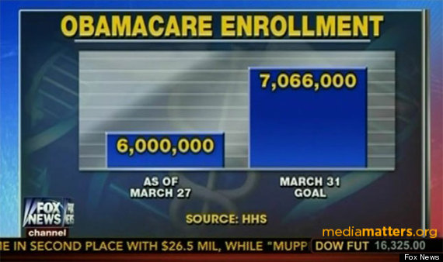
Visualization … Epic FAIL
www.huffingtonpost.com/2014/03/31/fox-news-obamacare-graphic_n_5063582.html
Fox News Graphic on the “Obamacare” Enrollment as of 2014-03-27

Slide 17
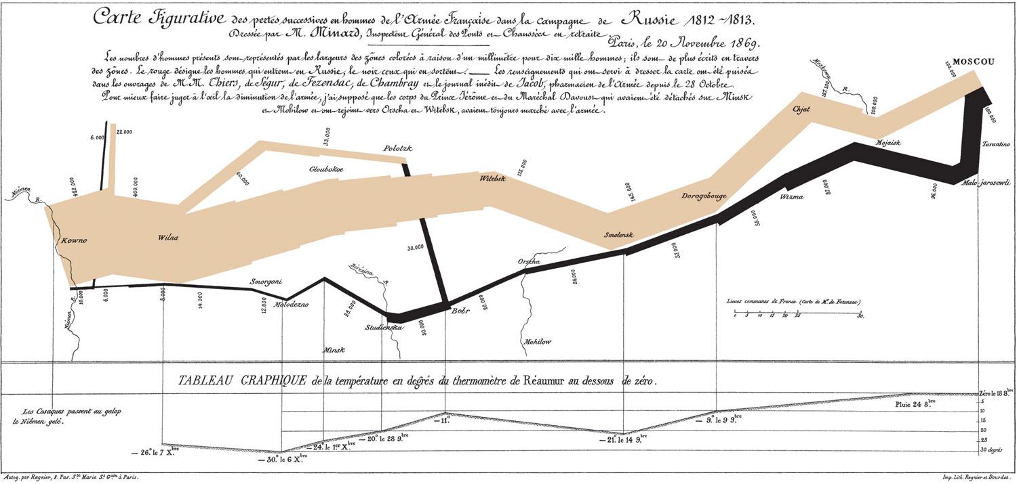
Visualization … Epic WIN
www.edwardtufte.com/tufte/posters
Charles Joseph Minard, Napoleon’s 1812 Russian Campaign

Slide 18
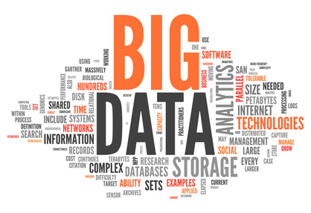
Summary
The right questions need to be answered by the proper data.
The rewards are high but handling data is an ongoing challenge to computer scientists as well as security specialists and privacy preservers.

