Slide 1
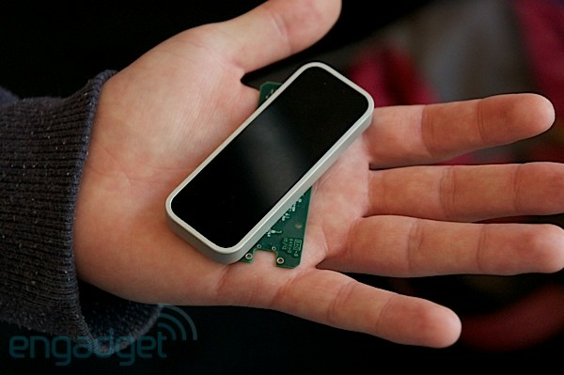
Leap Motion: $70?
CS10 The Beauty and Joy of Computing Lecture #3 : Video Games
2012-06-20
UC Berkeley Computer Science Summer Instructor Ben Chun
200x more accurate than Kinect; tracks 10 fingers to 1/100 of a millimeter… by the end of this year
http://engt.co/MAf8fR

Slide 2
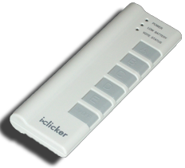
Size of the US video game market?
www.theesa.com/facts
$250,000,000
$2,500,000,000
$25,000,000,000
$250,000,000,000
$2,500,000,000,000
Notes:
(c) Consumers spent $24.75 billion on video games, hardware and accessories in 2011.
http://www.theesa.com/facts/index.asp

Slide 3
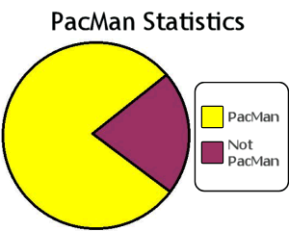
Video Games : Overview
History
Inventors & Games
How
Design
2D & 3D graphics
Motion Capture
Artificial Intelligence (AI)
Good, Bad, Ugly
GWAP, RSI, Violence
Future

Slide 4
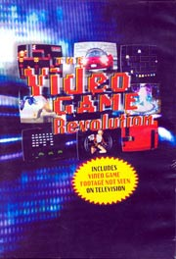
Documentaries on Video Games
History: Video Games: Behind the Fun (2000)
Available on Netflix
PBS: The Video Game Revolution (2004)
video.google.com/videoplay?docid=-4729348985218842392
Discovery: History of Video Games (2006)
video.google.com/videoplay?docid=3637639460474263178
ON Networks : Play Value (2009)
www.onnetworks.com/videos/play-value
History of Video Games (WWW)
en.wikipedia.org/wiki/History_of_video_games
en.wikipedia.org/wiki/ List_of_films_based_on_video_games# Documentaries_on_video_games

Slide 5
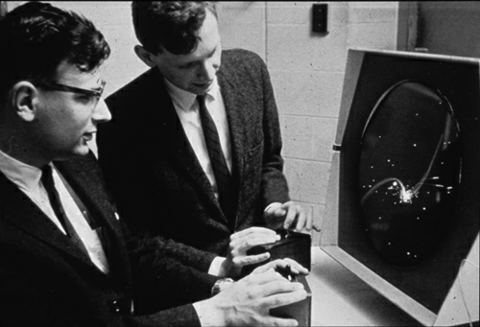
The Beginning : Spacewar!
First to gain recognition
Others had games before
“Conceived in 1961 by Martin Graetz, Steve Russell, & Wayne Wiitanen”
Written for PDP-1 @ MIT
Inspired lots, widely ported
Can still play this!
1 Working PDP-1 … in CHM
Java version available
www3.sympatico.ca/maury/games/space/spacewar.html en.wikipedia.org/wiki/Spacewar! www.computerhistory.org
spacewar.oversigma.com

Slide 6
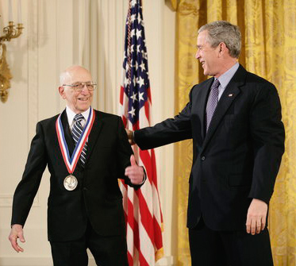
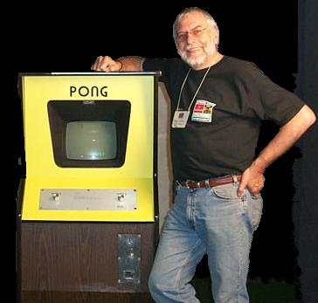
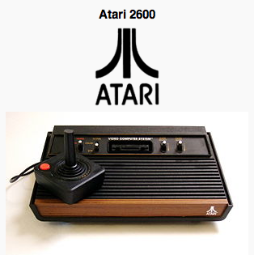
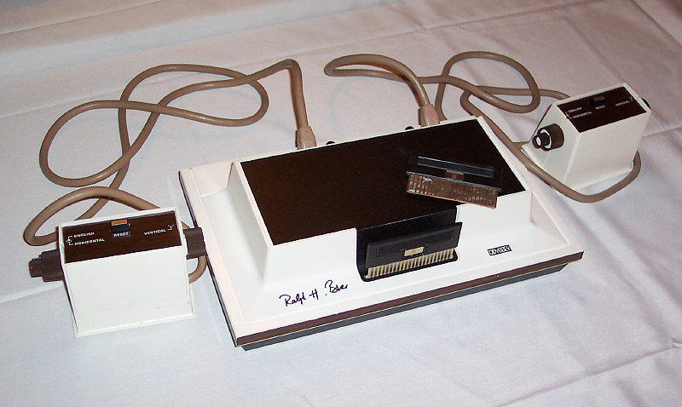
The Founding Fathers
Ralph Baer
Nolan Bushnell
www.onnetworks.com/videos/play-value/the-founding-fathers (also on iTunes in HD 720p)

Slide 7
Shigeru Miyamoto
The “Walt Disney” of video games
Chief Game designer at Nintendo
1st elected to Hall of Fame
Designed (among others):
Donkey Kong
Super Mario Bros
The Legend of Zelda
Super Mario 64
Nintendo DS, Wii
www.onnetworks.com/videos/play-value/shigeru-miyamoto www.newyorker.com/reporting/2010/12/20/101220fa_fact_paumgarten
www.nytimes.com/2008/05/25/arts/television/25schi.html

Slide 8
Design of a Casual Video Game
Staff requirements
Can be done by one person, like days of old
Bigger teams also (< 10)
Lots of new developers
Phones great platforms
iPhone dominates field
Students are signing up!
Time to completion
Often only a few months!
www.apple.com/iphone/apps-for-everything/fun-and-games.html blog.entertonement.com/2009/07/7-addicting-casual-games en.wikipedia.org/wiki/Casual_game

Slide 9
Design of a Core Video Game
Staff requirements
Cross-disciplinary
Producer, programmers, game, graphic & sound designers, musicians, testers, …
100+ person teams
Similar to film
Often, games->film, and film->games
Lucasfilm, etc. want to tie assets together
en.wikipedia.org/wiki/Video_games

Slide 10
% of Parents : “Video games are a positive part of my child’s life”
www.theesa.com/facts/gameplayer.asp
22%
32%
42%
52%
62%
Notes:
(d) 52% say video games are a positive part of my child’s life
http://www.theesa.com/facts/gameplayer.asp

Slide 11
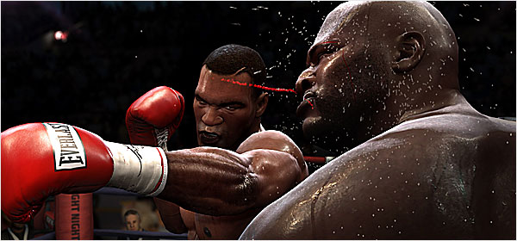
How : 3D Computer Graphics
Similar to making a 3D animated film…
Model characters, environment in 3D
Add shading + lights + effects + behavior
Let 3D rendering engine (on graphics card) do the work of figuring out 2D scene from 3D
Limitations
Many things are too “expensive” to do in 30 frames per second
Research breakthroughs!
www.nytimes.com/2009/07/08/arts/television/08fight.html en.wikipedia.org/wiki/Portal:Computer_graphics www.siggraph.org

Slide 12
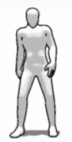
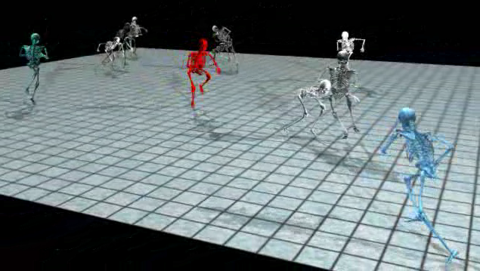
How : Motion Capture
Actors in MoCap suits
Motions recorded, put in “motion libraries”
E.g., running, throwing, passing, tackling
Can be edited/cleaned
Motion synthesis also
Challenges
Motion “blending”
Non-”sliding” feet
UC Berkeley Research!
en.wikipedia.org/wiki/Motion_capture
www.phasespace.com

Slide 13
How : Artificial Intelligence
Range of intelligence
Low: simple heuristics
High: Learns from player
Dynamic difficulty
Must hold interest
“Simple to learn, difficult to master is the holy grail of game design.”
Cheating AI (e.g.,racing)
www.businessweek.com/innovate/content/aug2008/id20080820_123140.htm
en.wikipedia.org/wiki/Dynamic_game_difficulty_balancing
en.wikipedia.org/wiki/Game_artificial_intelligence
queue.acm.org/detail.cfm?id=971593

Slide 14
Video Games : Good (Serious Games)
Simulations for training
Flight simulations, combat, medical training
Games w/a Purpose
A game to do useful stuff, hard for computers
Luis von Ahn: GWAP
ESP : Label images fastest
Gender Guesser
Popvideo : label video
Matchin : Pick best images
en.wikipedia.org/wiki/Serious_games
en.wikipedia.org/wiki/Game_based_learning
gwap.com

Slide 15
Video Games : Bad (RSI, addiction)
Gamers Thumb
Caused with too much use of gamepad
Solutions?
Break timers, rest
Video game addiction
Impulse control disorder
Stanford: yes, addictive!
“Gamers Wife”
Online gamers anon
en.wikipedia.org/wiki/Video_game_addiction
en.wikipedia.org/wiki/Repetitive_strain_injury

Slide 16
Video Games : Ugly (Violence)
Violent video games
Increase aggression, decrease “helping”
Others found no link
High-profile incidents
Columbine kids loved the Doom video game
Ratings help
Games “folk devil”
Billions $, kids at stake
en.wikipedia.org/wiki/Video_game_controversy
www.apa.org/science/psa/sb-anderson.html

Slide 17
Conclusion : Future of Video Games
Media producers connecting assets
Disney, Lucas big players
Controllers and sensors expand
Games on Demand
Steam, OnLive
Brain-Computer Interface (BCI)
Invasive and Non-
www.pbs.org/kcts/videogamerevolution/impact/future.html en.wikipedia.org/wiki/Brain–computer_interface

Slide 18
History of Video Games : 1970s
Golden age of video arcades
Pong, Space Invaders, Asteroids, Pac Man
1st gen consoles (1972–1976)
Magnavox Odyssey
Mainframe computers
Hunt the Wumpus, Rogue
Home computers
Type the program in!
Floppies, Tapes. Zork, others.
2nd gen consoles (1977–1984)
Atari 2600, Intellivision, Colecovision, Activision
en.wikipedia.org/wiki/History_of_video_games
www.thegameconsole.com

Slide 19
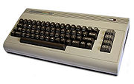
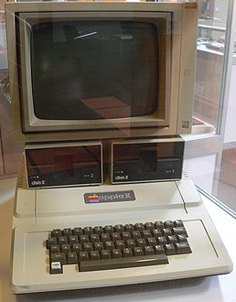
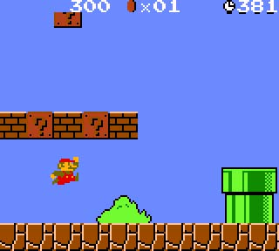
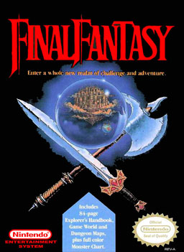
History of Video Games : 1980s
Genre innovation
Gaming computers
Apple II, Commodore 64, Atari 800
Early online gaming
Mostly text only, MUDs
Handheld LCD games
Video game crash of 1983
Atari buried millions of ETs in dump
3rd gen consoles (1985–1989)
Nintendo Ent. System (NES)
Super Mario Bros, Zelda, FF I
Gamepad introduced

Slide 20
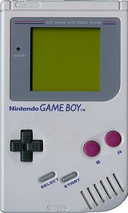
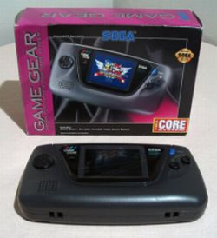
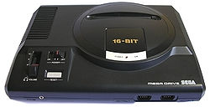
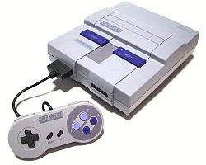
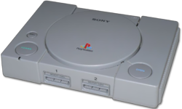
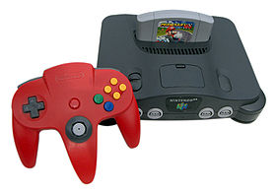
History of Video Games : 1990s
Decline of arcades
Handhelds come of age
GameBoy, Sega Game Gear
Mobile phone gaming
Fourth generation consoles (1990–1994)
Sega Genesis, Super NES
Fifth generation consoles (1995–2000)
Playstation, Nintendo 64 (with Super Mario 64)
Transition to 3D, CDs
Crash Bandicoot, Tomb Raider

Slide 21
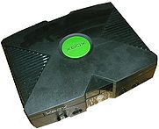
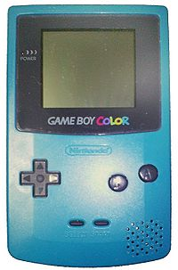
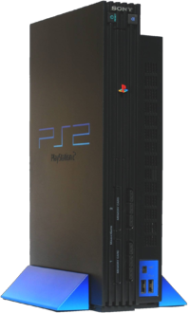
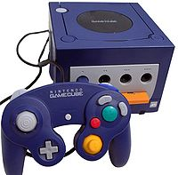
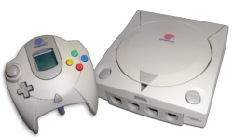
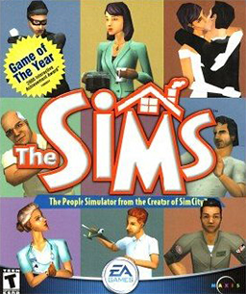
History of Video Games : 2000s
Mobile games
iPhone (games ½ apps)
Sixth generation consoles (since 2001)
PS2, Xbox, GameCube
Return of alternate controllers (DDR, guitars)
Online gaming rises to prominence
WoW, Ultima Online
Rise of casual PC games
Bejeweled, The Sims

Slide 22
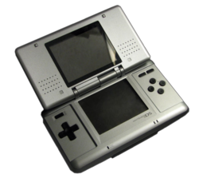
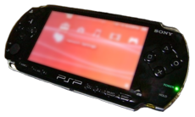
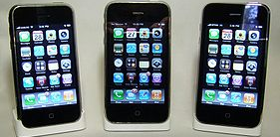
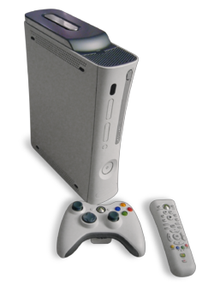
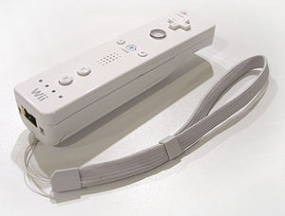
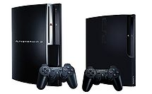
History of Video Games : 2005+
Seventh generation consoles (since 2005)
Portables
Nintendo DS, PSP, iPhone
Consoles
PS3, Xbox 360, Wii
Increases in development budgets
Motion control revolutionizes play
Wii controller, iPhone

Slide 23
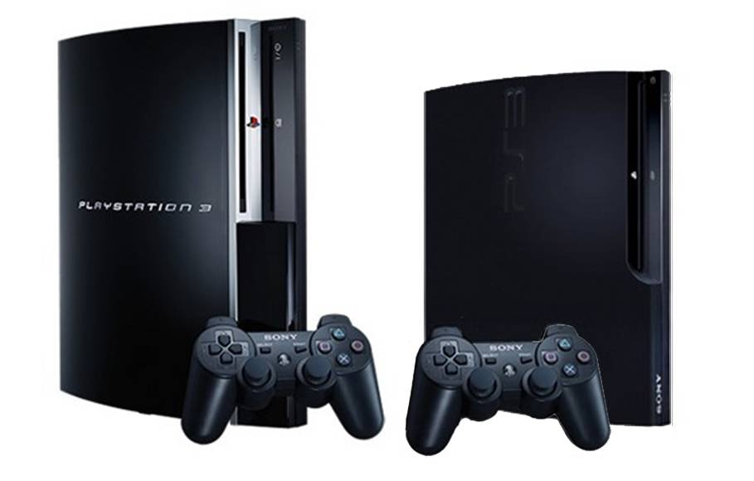
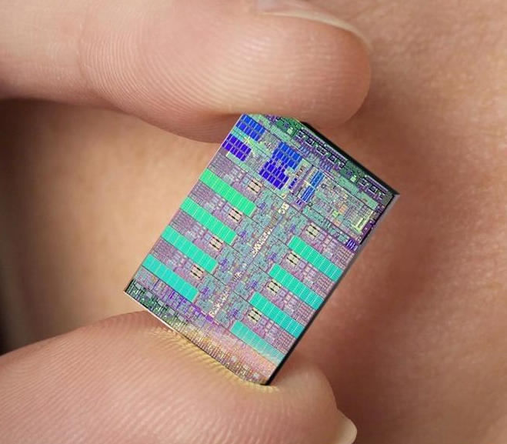
Example: Playstation 3 Hardware
State-of-the-art system
But SW determines success!
(also, cool controllers helps)
9 3.2GHz Cores (1PPE, 8SPE)
Power Processing Element (PPE)
Supervises activities, allocates work
Synergystic Processing Elt (SPE)
Where work gets done
During testing, one “locked out”
I.e., it didn’t work; shut down
…even if everything DID work!
en.wikipedia.org/wiki/PlayStation_3
www.us.playstation.com

