Slide 1
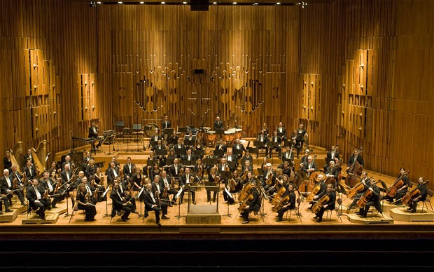
LSO plays iamus
CS10 : The Beauty & Joy of Computing Lecture #9 : Recursion
2012-07-03
UC Berkeley EECS Summer Instructor Ben Chun
Program written at University of Malaga (Study Group on Biomimicry) generated the entire piece – CD coming out in September.
http://bit.ly/OT9Alx

Slide 2
Overview
www.worldofescher.com/gallery/A13.html
Recursion
Demo
Vee example & analysis
Downup
You already know it
Definition
Trust the Recursion!
Conclusion
M. C. Escher : Drawing Hands

Slide 3
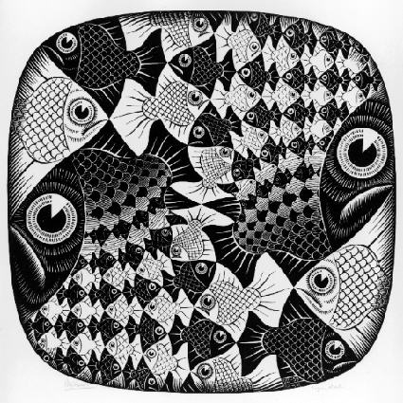
“I understood Vee & Downup”
Strongly disagree
Disagree
Neutral
Agree
Strongly agree
M. C. Escher : Fish and Scales

Slide 4
Definition
www.catb.org/~esr/jargon/html/R/recursion.html www.nist.gov/dads/HTML/recursion.html
Recursion: (noun) See recursion. ☺
An algorithmic technique where a function, in order to accomplish a task, calls itself with some part of the task
Recursive solutions involve two major parts:
Base case(s), the problem is simple enough to be solved directly
Recursive case(s). A recursive case has three components:
Divide the problem into one or more simpler or smaller parts
Invoke the function (recursively) on each part, and
Combine the solutions of the parts into a solution for the problem.
Depending on the problem, any of these may be trivial or complex.

Slide 5
You already know it!

Slide 6
Trust the Recursion
When authoring recursive code:
The base is usually easy: “when to stop?”
In the recursive step
How can we break the problem down into two:
A piece I can handle right now
The answer from a smaller piece of the problem
Assume your self-call does the right thing on a smaller piece of the problem
How to combine parts to get the overall answer?
Practice will make it easier to see idea

Slide 7
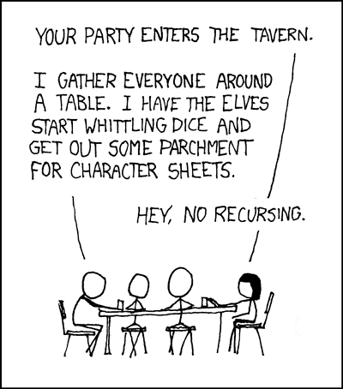
Sanity Check…
Recursion is Iteration (i.e., loops)
Almost always, writing a recursive solution is than an iterative one
more powerful than, easier
just as powerful as, easier
more powerful than, harder
just as powerful as, harder
http://xkcd.com/244/

Slide 8
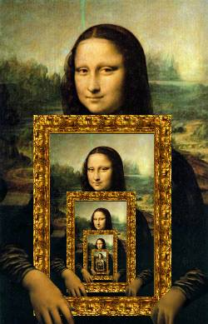
Summary
Behind Abstraction, Recursion is probably the 2nd biggest idea about programming in this course
It’s tremendously useful when the problem is self-similar
It’s no more powerful than iteration, but often leads to more concise & better code
http://www.dominiek.eu/blog/?m=200711

