Slide 1
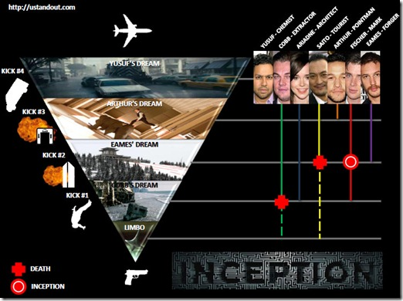
Go see Inception!
The Beauty & Joy of Computing Lecture #8
Recursion
Instructor:
Sean Morris
This movie(2010) highlights recursion, and was up for best picture. If you haven’t seen it yet, you should, because it will help you understand recursion!!
en.wikipedia.org/wiki/Inception_(film)

Slide 2
Overview
www.worldofescher.com/gallery/A13.html
Recursion
Demo
Vee example & analysis
Downup
You already know it
Definition
Trust the Recursion!
Conclusion
M. C. Escher : Drawing Hands

Slide 3
OurDownup: 2 parts to solve
Base Case
When do we stop our recursive calls?
Smallest part of the problem
Consider a two letter word:
➔ OurDownup(It) => It I It
What is an even smaller part of the problem?

Slide 4
OurDownup: 2 parts to solve
Click it out …
Base Case: OurDownup
A) When we have an “I”
B) When the length of word is 2
C) No Base Case is needed
D) When the length of word is 1
E) Who knows

Slide 5
OurDownUp: 2 parts to solve
Recursive Case: OurDownUp
(Divide, Invoke, Combine(process))
Go back to a 2-letter word:
OurDownUp(It) → It I It
➔ What has to happen to process a 2-letter word?

Slide 6
OurDownUp: 2 parts to solve
Click it out …
Recursive Case: OurDownUp(It)
A) Write It, Strip off last, Write It
B) Strip off last, Write It, Write It
C) Write It, Write It, Strip off last
D) Who knows

Slide 7
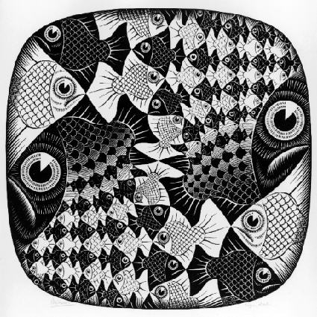
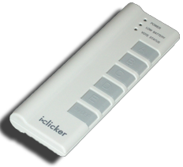
“I understood Vee & Downup”
Strongly disagree
Disagree
Neutral
Agree
Strongly agree
M. C. Escher : Fish and Scales

Slide 8
Paradigms: Functional or Imperative?
Recursive DownUp:

Slide 9
Paradigms: Functional or Imperative?
Iterative DownUp:

Slide 10
Reverse a word : Try It
Base Case?
Recursive Case?
Draw it on you notes
Pair it out…

Slide 11
Definition
www.catb.org/~esr/jargon/html/R/recursion.html www.nist.gov/dads/HTML/recursion.html
Recursion: (noun) See recursion. ☺
An algorithmic technique where a function, in order to accomplish a task, calls itself with some part of the task
Recursive solutions involve two major parts:
Base case(s), the problem is simple enough to be solved directly
Recursive case(s). A recursive case has three components:
Divide the problem into one or more simpler or smaller parts
Invoke the function (recursively) on each part, and
Combine the solutions of the parts into a solution for the problem.
Depending on the problem, any of these may be trivial or complex.

Slide 12
You already know it!

Slide 13
Trust the Recursion
When authoring recursive code:
The base is usually easy: “when to stop?”
In the recursive step
How can we break the problem down into two:
A piece I can handle right now
The answer from a smaller piece of the problem
Assume your self-call does the right thing on a smaller piece of the problem
How to combine parts to get the overall answer?
Practice will make it easier to see idea

Slide 14
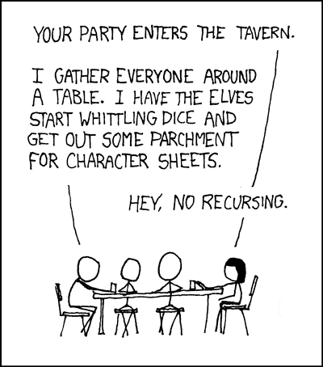
Sanity Check…
Recursion is  Iteration (i.e., loops)
Almost always, writing a recursive solution is  than an iterative one
more powerful than, easier
just as powerful as, easier
more powerful than, harder
just as powerful as, harder
http://xkcd.com/244/

Slide 15
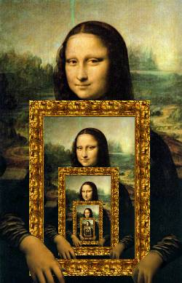
Summary
Behind Abstraction, Recursion is probably the 2nd biggest idea about programming in this course
It’s tremendously useful when the problem is self-similar
It’s no more powerful than iteration, but often leads to more concise & better code
http://www.dominiek.eu/blog/?m=200711

