Slide 1

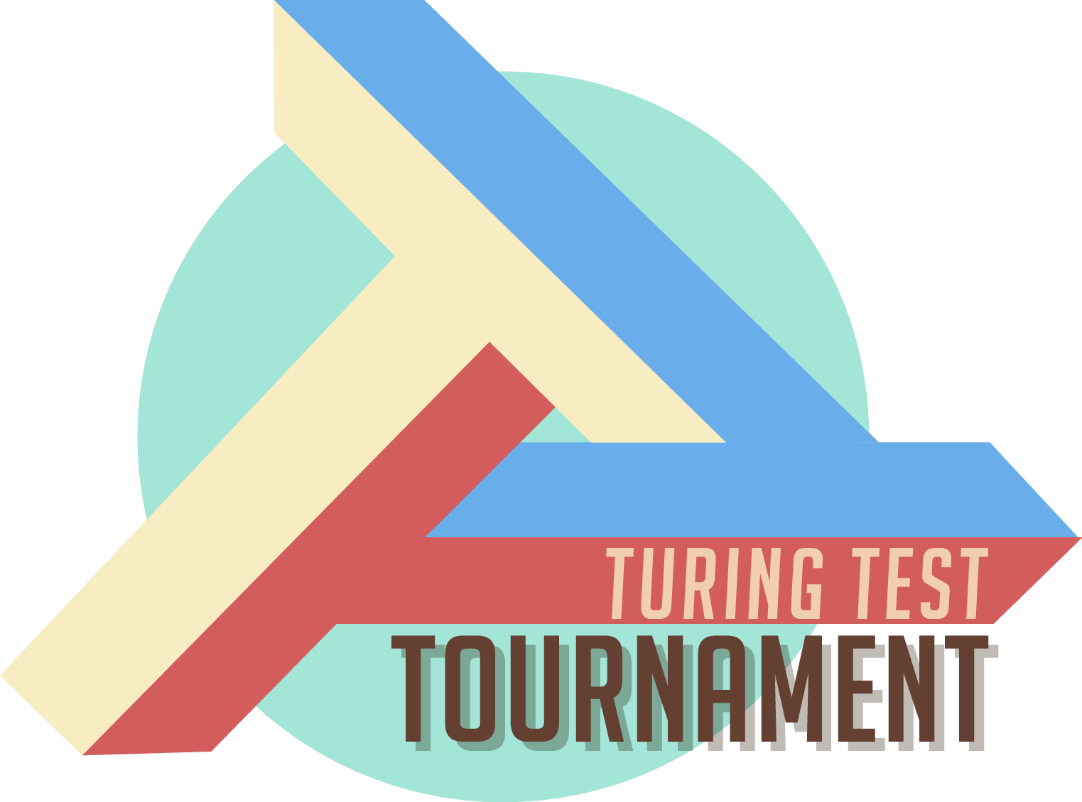
CS10: The Beauty and Joy of Computing
Lecture #21
Limits of Computing
Instructor:
Sean Morris
Bot or Not?
UCB announces The Turing Test Tournament. An experimental chat-based game that will connect you with thousands of other Berkeley students in a contest of identity. Compete against other students in trying to tell human from machine, then join a chat yourself and see if you can convincingly perform a given role.
http://ttt.berkeley.edu/

Slide 2
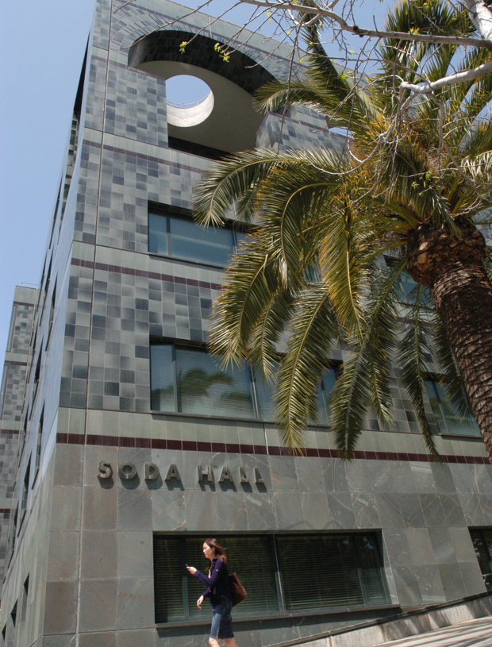
Computer Science … A UCB view
www.eecs.berkeley.edu/Research/Areas/
CS research areas:
  Artificial Intelligence
  Biosystems & Computational Biology
  Database Management Systems
  Graphics
  Human-Computer Interaction
  Networking
  Programming Systems
  Scientific Computing
  Security
  Systems
  Theory
    Complexity theory
  …

Slide 3
Let’s revisit algorithm complexity
Problems that…
  are tractable with efficient solutions in reasonable time
  are intractable
  are solvable approximately, not optimally
  have no known efficient solution
  are not solvable

Slide 4
Tractable with efficient sols in reas time
en.wikipedia.org/wiki/P_(complexity)
Recall our algorithm complexity lecture, we’ve got several common orders of growth
  Constant
  Logarithmic
  Linear
  Quadratic
  Cubic
  Exponential
Order of growth is polynomial in the size of the problem
E.g.,
  Searching for an item in a collection
  Sorting a collection
  Finding if two numbers in a collection are same
These problems are called being “in P”
(for polynomial)

Slide 5
Intractable problems
en.wikipedia.org/wiki/Intractability_(complexity)#Intractability
Problems that can be solved, but not solved fast enough
This includes exponential problems
  E.g., f(n) = 2^{n}
    as in the image to the right
This also includes poly-time algorithm with a huge exponent
  E.g, f(n) = n¹⁰
Only solve for small n
Imagine a program that calculated something important at each of the
bottom circles. This tree has height n,
but there are 2^{n} bottom circles!

Slide 6
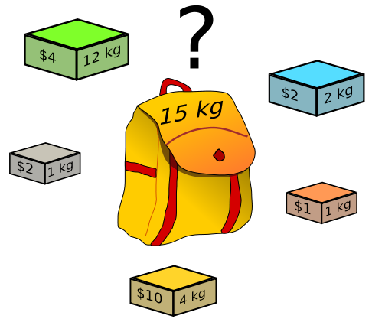
Solvable approximately, not optimally in reas time
en.wikipedia.org/wiki/Knapsack_problem
A problem might have an optimal solution that cannot be solved in reasonable time
BUT if you don’t need to know the perfect solution, there might exist algorithms which could give pretty good answers in reasonable time
Knapsack Problem
You have a backpack with a weight limit (here 15kg), which boxes (with weights and values) should be taken to maximize value?

Slide 7
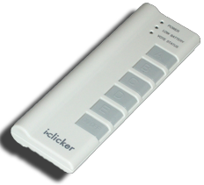
Peer Instruction
What’s the most you
can put in your
knapsack?
$10
$15
$33
$36
$40
Knapsack Problem
You have a backpack with a weight limit (here 15kg), which boxes (with weights and values) should be taken to maximize value?
(any # of each box is available)
Notes:
Taking a greedy approach of max $/kg the gold $10/4 = 2.5 is the most. Max out on that yields $30, with 3 kb left (15-12). The next most valuable box is the silver $2/1 = 2 box. Conveniently we fit exactly 3 boxes, for an additional $6, so $36.

Slide 8
Subset Sum Problem …
en.wikipedia.org/wiki/P_%3D_NP_problem
-2
-3
15
Are there a handful of these numbers (at least 1) that add together to get 0?
14
7
-10
“in NP(Non-Deterministic Polynomial)” ➔
Verify a solution in Polynomial time
But as n grows, there is no efficient solution
Examples: Integer Factorization, Graph comparison (Chemical Compound Comparison)

Slide 9
NP-Complete:
en.wikipedia.org/wiki/P_%3D_NP_problem
➔ in NP
If you guess an answer, can I verify it in polynomial time?
  Non-deterministic Polynomial
➔ NP-Hard : Solving one of them would solve an entire class of them!
  We can transform one to another, i.e., reduce
  A problem, P₁, is “hard” for a class of problems, C, if every element in C can be “reduced” to P₁
NP-Complete:
If you’re “in NP” and “NP-hard”

Slide 10
Classes of NP-complete problems
en.wikipedia.org/wiki/List_of_NP-complete_problems
Data Storage and Compression
Scheduling and Sequencing(logistics)
Sets and Partitions
Logic problems
Computational Geometry
Biology: Protein Structure Prediction

Slide 11
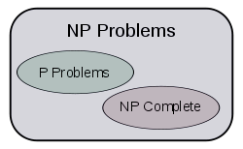
The fundamental question. Is P = NP?
en.wikipedia.org/wiki/P_%3D_NP_problem
This is THE major unsolved problem in CS!
One of 7 “millennium prizes” w/a $1M reward
If P=NP, then solving ONE problem in the NP-complete set in polynomial time!!
  Huge ramifications for cryptography, economics
If P ≠NP, then

Slide 12
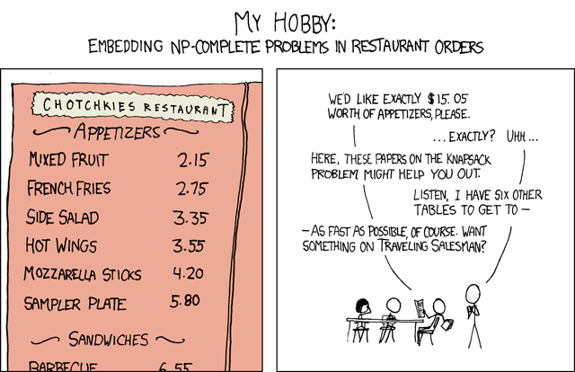
xkcd.com/287

Slide 13
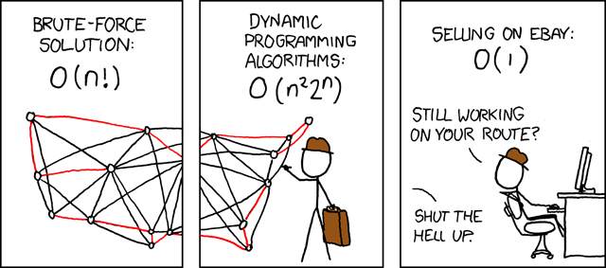
xkcd.com/399

Slide 14

Problems NOT solvable
www.cgl.uwaterloo.ca/~csk/halt/
Decision problems answer YES or NO for an infinite # of inputs
  E.g., is N prime?
  E.g., is sentence S grammatically correct?
An algorithm is a solution if it correctly answers YES/NO in a finite amount of time
A problem is decidable if it has a solution
Alan Turing
asked, “Are all problems decidable?”
(People believed yes at the time.)
Turing proved they are not!

Slide 15
The Halting Problem
en.wikipedia.org/wiki/List_of_NP-complete_problems
Given a computer program and some input to that program, will the program go into an infinite loop when fed that input?
➔ How might me write an algorithm to decide this?

Slide 16
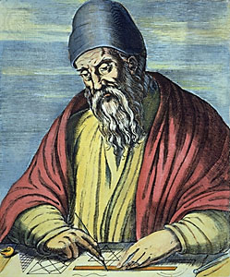
Review: Proof by Contradiction
Infinitely Many Primes?
Assume the contrary, then prove that it’s impossible
  Only a finite # of primes
  Number them p₁, p₂, …, p_{n}
  Consider the number q
    q = (p₁ * p₂ * … * p_{n}) + 1
    Dividing q by any prime(p₁, p₂,…) leaves remainder of 1
    So q isn’t composite, q is prime
    But we said p_{n} was the biggest, and q is bigger than p_{n}
  So there IS no biggest p_{n}
Euclid
www.hisschemoller.com/wp-content/uploads/2011/01/euclides.jpg

Slide 17
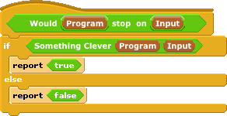



Turing’s proof : The Halting Problem
Given a program and some input, will that program eventually stop? (or will it loop)
Assume we could write it:
  1. write Stops on Self?
  2. Write Weird
  3. Call Weird on itself
Notes:
Explain proof by contradiction (infinitely many primes)

Slide 18
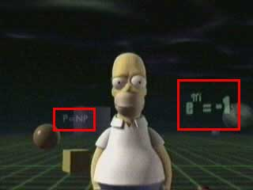
Conclusion
Complexity theory important part of CS
If given a hard problem, rather than try to solve it yourself, see if others have tried similar problems
If you don’t need an exact solution, many approximation algorithms help
Some not solvable!
P=NP question even made its way
into popular culture, here shown in
the Simpsons 3D episode!

