Slide 1
CS 152 Computer Architecture and Engineering Lecture 2 - Simple Machine Implementations
Krste Asanovic
Electrical Engineering and Computer Sciences
University of California at Berkeley
http://www.eecs.berkeley.edu/~krste
http://inst.eecs.berkeley.edu/~cs152

Slide 2
Last Time in Lecture 1
Computer Science at crossroads from sequential to parallel computing
Computer Architecture >> ISAs and RTL
CS152 is about interaction of hardware and software, and design of appropriate abstraction layers
Comp. Arch. shaped by technology and applications
History provides lessons for the future
Cost of software development a large constraint on architecture
Compatibility a key solution to software cost
IBM 360 introduces notion of “family of machines” running same ISA but very different implementations
Six different machines released on same day (April 7, 1964)
“Future-proofing” for subsequent generations of machine

Slide 3
Instruction Set Architecture (ISA)
The contract between software and hardware
Typically described by giving all the programmer-visible state (registers + memory) plus the semantics of the instructions that operate on that state
IBM 360 was first line of machines to separate ISA from implementation (aka. microarchitecture)
Many implementations possible for a given ISA
E.g., today you can buy AMD or Intel processors that run the x86-64 ISA.
E.g.2: many cellphones use the ARM ISA with implementations from many different companies including TI, Qualcomm, Samsung, Marvell, etc.
E.g.3., the Soviets build code-compatible clones of the IBM360, as did Amdhal after he left IBM.

Slide 4
Microprogramming
Today, a brief look at microprogrammed machines
To show how to build very small processors with complex ISAs
To help you understand where CISC* machines came from
Because it is still used in the most common machines (x86, PowerPC, IBM360)
As a gentle introduction into machine structures
To help understand how technology drove the move to RISC*
* CISC/RISC names came much later than the style of machines they refer to.

Slide 5
ISA to Microarchitecture Mapping
ISA often designed with particular microarchitectural style in mind, e.g.,
CISC ⇒ microcoded
RISC ⇒ hardwired, pipelined
VLIW ⇒ fixed-latency in-order parallel pipelines
JVM ⇒ software interpretation
But can be implemented with any microarchitectural style
Intel Nehalem: hardwired pipelined CISC (x86) machine (with some microcode support)
Simics: Software-interpreted SPARC RISC machine
Intel could implement a dynamically scheduled out-of-order VLIW Itanium (IA-64) processor
ARM Jazelle: A hardware JVM processor
This lecture: a microcoded RISC (MIPS) machine

Slide 6
Microarchitecture: Implementation of an ISA
Controller
control
points
status
lines
Data
path
Structure: How components are connected.
Static
Behavior: How data moves between components
Dynamic

Slide 7
Microcontrol Unit Maurice Wilkes, 1954
op conditional
code flip-flop
First used in EDSAC-2, completed 1958
Next state
μ address
Matrix A
Matrix B
Embed the control logic state table in a memory array
Decoder
Memory
Control lines to
ALU, MUXs, Registers

Slide 8
Microcoded Microarchitecture
busy?
μcontroller
(ROM)
holds fixed
microcode instructions
zero?
opcode
Datapath
Data
Addr
Memory
(RAM)
holds user program written in macrocode instructions (e.g., MIPS, x86, etc.)
enMem
MemWrt

Slide 9
The MIPS32 ISA
Processor State
32 32-bit GPRs, R0 always contains a 0
16 double-precision/32 single-precision FPRs
FP status register, used for FP compares & exceptions
PC, the program counter
some other special registers
Data types
8-bit byte, 16-bit half word
32-bit word for integers
32-bit word for single precision floating point
64-bit word for double precision floating point
Load/Store style instruction set
data addressing modes- immediate & indexed
branch addressing modes- PC relative & register indirect
Byte addressable memory- big-endian mode
All instructions are 32 bits
See H&P Appendix B for full description

Slide 10
MIPS Instruction Formats
6 5 5 5 5 6
0 rs rt rd 0 func rd ← (rs) func (rt)
ALU
ALUi
opcode rs rt immediate rt ← (rs) op immediate
6 5 5 16
opcode rs rt displacement M[(rs) + displacement]
Mem
6 5 5 16
opcode rs offset BEQZ, BNEZ
6 5 5 16
opcode rs JR, JALR
6 26
opcode offset J, JAL

Slide 11
Data Formats and Memory Addresses
Data formats:
Bytes, Half words, words and double words
Some issues
Byte addressing
Big Endian 0 1 2 3
vs. Little Endian 3 2 1 0
Word alignment
Suppose the memory is organized in 32-bit words.
Can a word address begin only at 0, 4, 8, .... ?
Most Significant Byte
Least Significant Byte
Byte Addresses
0 1 2 3 4 5 6 7

Slide 12
A Bus-based Datapath for MIPS
Opcode
zero?
busy
ldIR
OpSel
ldA
ldB
32(PC)
ldMA
31(Link)
rd
2
rt
rs
RegSel
MA
rd
3
IR
rt
A
B
addr
addr
rs
32 GPRs
+ PC ...
32-bit Reg
ExtSel
Memory
MemWrt
Imm
Ext
ALU
control
RegWrt
2
ALU
enReg
enImm
enALU
data
data
enMem
Bus
32
Microinstruction: register to register transfer (17 control signals)
MA ← PC means RegSel = PC; enReg=yes; ldMA= yes
B ← Reg[rt] means
RegSel = rt; enReg=yes; ldB = yes

Slide 13
Memory Module
addr
busy
RAM
Write(1)/Read(0)
we
Enable
din
dout
bus
Assumption: Memory operates independently
and is slow as compared to Reg-to-Reg transfers (multiple CPU clock cycles per access)

Slide 14
Instruction Execution
Execution of a MIPS instruction involves
1. instruction fetch
2. decode and register fetch
3. ALU operation
4. memory operation (optional)
5. write back to register file (optional)
+ the computation of the
next instruction address

Slide 15
Microprogram Fragments
instr fetch: MA ← PC
A ← PC
IR ← Memory
PC ← A + 4
dispatch on OPcode
can be
treated as
a macro
ALU: A ← Reg[rs]
B ← Reg[rt]
Reg[rd] ← func(A,B)
do instruction fetch
ALUi: A ← Reg[rs]
B ← Imm sign extension ...
Reg[rt] ← Opcode(A,B)
do instruction fetch

Slide 16
Microprogram Fragments (cont.)
LW: A ← Reg[rs]
B ← Imm
MA ← A + B
Reg[rt] ← Memory
do instruction fetch
J: A ← PC
B ← IR
PC ← JumpTarg(A,B)
do instruction fetch
beqz: A ← Reg[rs]
If zero?(A) then go to bz-taken
do instruction fetch
bz-taken: A ← PC
B ← Imm << 2
PC ← A + B
do instruction fetch
JumpTarg(A,B) =
{A[31:28],B[25:0],00}

Slide 17
MIPS Microcontroller: first attempt
Opcode
zero?
Busy (memory)
6
μPC (state)
s
How big is “s”?
addr
s
ROM size ?
μProgram ROM
= 2^{(opcode+status+s)} words
Word size ?
data
= control+s bits
next state
Control Signals (17)

Slide 18
Microprogram in the ROM worksheet
State Op zero? busy Control points next-state
fetch₀ * * * MA ← PC fetch₁
fetch₁ * * yes .... fetch₁
fetch₁ * * no IR ← Memory fetch₂
fetch₂ * * * A ← PC fetch₃
fetch₃ * * * PC ← A + 4 ?
ALU₀ * * * A ← Reg[rs] ALU₁
ALU₁ * * * B ← Reg[rt] ALU₂
ALU₂ * * * Reg[rd] ← func(A,B) fetch₀
fetch₃ ALU * * PC ← A + 4 ALU₀

Slide 19
Microprogram in the ROM
State Op zero? busy Control points next-state
fetch₀ * * * MA ← PC fetch₁
fetch₁ * * yes .... fetch₁
fetch₁ * * no IR ← Memory fetch₂
fetch₂ * * * A ← PC fetch₃
fetch₃ ALU * * PC ← A + 4 ALU₀
fetch₃ ALUi * * PC ← A + 4 ALUi₀
fetch₃ LW * * PC ← A + 4 LW₀
fetch₃ SW * * PC ← A + 4 SW₀
fetch₃ J * * PC ← A + 4 J₀
fetch₃ JAL * * PC ← A + 4 JAL₀
fetch₃ JR * * PC ← A + 4 JR₀
fetch₃ JALR * * PC ← A + 4 JALR₀
fetch₃ beqz * * PC ← A + 4 beqz₀
...
ALU₀ * * * A ← Reg[rs] ALU₁
ALU₁ * * * B ← Reg[rt] ALU₂
ALU₂ * * * Reg[rd] ← func(A,B) fetch₀

Slide 20
Microprogram in the ROM Cont.
State Op zero? busy Control points next-state
ALUi₀ * * * A ← Reg[rs] ALUi₁
ALUi₁ sExt * * B ← sExt₁₆(Imm) ALUi₂
ALUi₁ uExt * * B ← uExt₁₆(Imm) ALUi₂
ALUi₂ * * * Reg[rd]← Op(A,B) fetch₀
...
J₀ * * * A ← PC J₁
J₁ * * * B ← IR J₂
J₂ * * * PC ← JumpTarg(A,B) fetch₀
...
beqz₀ * * * A ← Reg[rs] beqz₁
beqz₁ * yes * A ← PC beqz₂
beqz₁ * no * .... fetch₀
beqz₂ * * * B ← sExt₁₆(Imm) beqz₃
beqz₃ * * * PC ← A+B fetch₀
...
JumpTarg(A,B) = {A[31:28],B[25:0],00}

Slide 21
Size of Control Store
status & opcode
/
w
μPC
addr
/ s
size = 2^{(w+s)} x (c + s)
Control ROM
next μPC
data
Control signals
/ c
MIPS: w = 6+2 c = 17 s = ?
no. of steps per opcode = 4 to 6 + fetch-sequence
no. of states ≈ (4 steps per op-group ) x op-groups
+ common sequences
= 4 x 8 + 10 states = 42 states ⇒ s = 6
Control ROM = 2⁽⁸⁺⁶⁾ x 23 bits ≈ 48 Kbytes

Slide 22
Reducing Control Store Size
Control store has to be fast ⇒ expensive
Reduce the ROM height (= address bits)
reduce inputs by extra external logic
each input bit doubles the size of the
control store
reduce states by grouping opcodes
find common sequences of actions
condense input status bits
combine all exceptions into one, i.e.,
exception/no-exception
Reduce the ROM width
restrict the next-state encoding
Next, Dispatch on opcode, Wait for memory, ...
encode control signals (vertical microcode)

Slide 23
CS152 Administrivia
Lab 1 coming out on Tuesday, together with PS1
Lab 1 overview in Section, next Thursday, 2pm, 320 Soda
Lab 1 and PS 1 due start of class Thursday Feb. 11
No extensions for Problem set. Zero credit afterwards.
Problem sets graded on 0,1,2 scale
Up to two free lab extensions per student, up till next class (Tuesday). Zero credit afterwards.
Solutions to PS 1 released at end of same class
Section reviewing PS 1, same Thursday at 2pm
First Quiz, in class, Tue Feb 16, 9:30-11AM
Closed book, no calculators, no computers, no cellphones
PS 2 and Lab 2 handed out day of Quiz 1

Slide 24
Collaboration Policy
Can collaborate to understand problem sets, but must turn in own solution. Some problems repeated from earlier years - do not copy solutions. (Quiz problems will not be repeated…)
Each student must complete directed portion of the lab by themselves. OK to collaborate to understand how to run labs
Class news group info on web site.
Lab reports must be readable English summaries. Zero credit for handing in output log files from experiments.
Can work in group of up to 3 students for open-ended portion of each lab
OK to be in different group for each lab -just make sure to label participants’ names clearly on each turned-in lab section

Slide 25
MIPS Controller V2
absolute
Opcode
ext
op-group
μPC
μPC+1
input encoding reduces ROM height
μPC (state)
+1
μPCSrc
zero
address
jump
logic
busy
μJumpType =
next | spin
| fetch | dispatch
| feqz | fnez
Control ROM
data
Control Signals (17)
next-state encoding reduces ROM width

Slide 26
Jump Logic
μPCSrc = Case μJumpTypes
next ⇒ μPC+1
spin ⇒ if (busy) then μPC else μPC+1
fetch ⇒ absolute
dispatch ⇒ op-group
feqz ⇒ if (zero) then absolute else μPC+1
fnez ⇒ if (zero) then μPC+1 else absolute

Slide 27
Instruction Fetch & ALU:MIPS-Controller-2
State Control points next-state
fetch₀ MA ← PC
fetch₁ IR ← Memory
fetch₂ A ← PC
fetch₃ PC ← A + 4
...
ALU₀ A ← Reg[rs]
ALU₁ B ← Reg[rt]
ALU₂ Reg[rd]←func(A,B)
ALUi₀ A ← Reg[rs]
ALUi₁ B ← sExt₁₆(Imm)
ALUi₂ Reg[rd]← Op(A,B)
next
spin
next
dispatch
next
next
fetch
next
next
fetch

Slide 28
Load & Store: MIPS-Controller-2
State Control points next-state
LW₀ A ← Reg[rs] next
LW₁ B ← sExt₁₆(Imm) next
LW₂ MA ← A+B next
LW₃ Reg[rt] ← Memory spin
LW₄ fetch
SW₀ A ← Reg[rs] next
SW₁ B ← sExt₁₆(Imm) next
SW₂ MA ← A+B next
SW₃ Memory ← Reg[rt] spin
SW₄ fetch

Slide 29
Branches: MIPS-Controller-2
State Control points next-state
BEQZ₀ A ← Reg[rs] next
BEQZ₁ fnez
BEQZ₂ A ← PC next
BEQZ₃ B ← sExt₁₆(Imm<<2) next
BEQZ₄ PC ← A+B fetch
BNEZ₀ A ← Reg[rs] next
BNEZ₁ feqz
BNEZ₂ A ← PC next
BNEZ₃ B ← sExt₁₆(Imm<<2) next
BNEZ₄ PC ← A+B fetch

Slide 30
Jumps: MIPS-Controller-2
State Control points next-state
J₀ A ← PC next
J₁ B ← IR next
J₂ PC ← JumpTarg(A,B) fetch
JR₀ A ← Reg[rs] next
JR₁ PC ← A fetch
JAL₀ A ← PC next
JAL₁ Reg[31] ← A next
JAL₂ B ← IR next
JAL₃ PC ← JumpTarg(A,B) fetch
JALR₀ A ← PC next
JALR₁ B ← Reg[rs] next
JALR₂ Reg[31] ← A next
JALR₃ PC ← B fetch

Slide 31
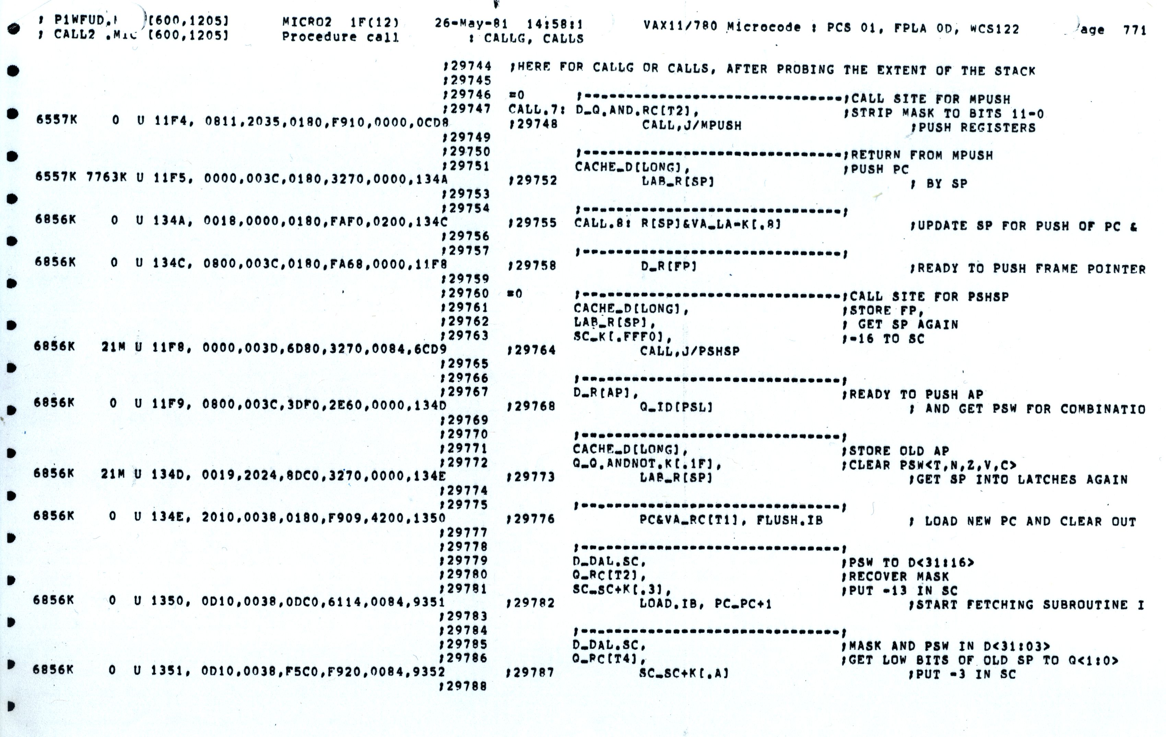
VAX 11-780 Microcode

Slide 32
Implementing Complex Instructions
Opcode
zero?
busy
ldIR
OpSel
ldA
ldB
32(PC)
ldMA
31(Link)
rd
2
rt
rs
RegSel
MA
rd
3
IR
rt
A
B
addr
addr
rs
32 GPRs
+ PC ...
32-bit Reg
ExtSel
Memory
MemWrt
Imm
Ext
ALU
control
RegWrt
2
ALU
enReg
enImm
enALU
data
data
enMem
Bus
32
rd ← M[(rs)] op (rt) Reg-Memory-src ALU op
M[(rd)] ← (rs) op (rt) Reg-Memory-dst ALU op
M[(rd)] ← M[(rs)] op M[(rt)] Mem-Mem ALU op

Slide 33
Mem-Mem ALU Instructions: MIPS-Controller-2
Mem-Mem ALU op M[(rd)] ← M[(rs)] op M[(rt)]
ALUMM₀ MA ← Reg[rs] next
ALUMM₁ A ← Memory spin
ALUMM₂ MA ← Reg[rt] next
ALUMM₃ B ← Memory spin
ALUMM₄ MA ←Reg[rd] next
ALUMM₅ Memory ← func(A,B) spin
ALUMM₆ fetch
Complex instructions usually do not require datapath modifications in a microprogrammed implementation
-- only extra space for the control program
Implementing these instructions using a hardwired controller is difficult without datapath modifications

Slide 34
Performance Issues
Microprogrammed control
⇒ multiple cycles per instruction
Cycle time ?
t_{C} > max(t_{reg-reg}, t_{ALU}, t_{μROM})
Suppose 10 * t_{μROM} < t_{RAM}
Good performance, relative to a single-cycle
hardwired implementation, can be achieved
even with a CPI of 10

Slide 35
Horizontal vs Vertical μCode
Bits per μInstruction
# μInstructions
Horizontal μcode has wider μinstructions
Multiple parallel operations per μinstruction
Fewer microcode steps per macroinstruction
Sparser encoding ⇒ more bits
Vertical μcode has narrower μinstructions
Typically a single datapath operation per μinstruction
separate μinstruction for branches
More microcode steps per macroinstruction
More compact ⇒ less bits
Nanocoding
Tries to combine best of horizontal and vertical μcode

Slide 36
Nanocoding
Exploits recurring control signal patterns in μcode, e.g.,
ALU₀ A ← Reg[rs]
...
ALUi₀ A ← Reg[rs]
...
μcode
next-state
μPC (state)
μaddress
μcode ROM
nanoaddress
nanoinstruction ROM
data
MC68000 had 17-bit μcode containing either 10-bit μjump or 9-bit nanoinstruction pointer
Nanoinstructions were 68 bits wide, decoded to give 196 control signals

Slide 37
Microprogramming in IBM 360
 | M30 | M40 | M50 | M65
Datapath width (bits) | 8 | 16 | 32 | 64
μinst width (bits) | 50 | 52 | 85 | 87
μcode size (K µinsts) | 4 | 4 | 2.75 | 2.75
μstore technology | CCROS | TCROS | BCROS | BCROS
μstore cycle (ns) | 750 | 625 | 500 | 200
memory cycle (ns) | 1500 | 2500 | 2000 | 750
Rental fee ($K/month) | 4 | 7 | 15 | 35
Only the fastest models (75 and 95) were hardwired

Slide 38
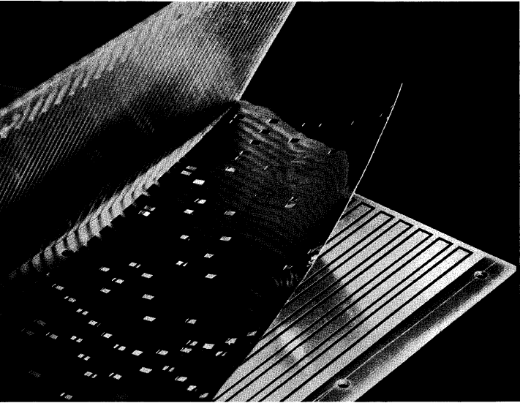
IBM Card Capacitor Read-Only Storage
Punched Card with metal film
Fixed sensing plates
[ IBM Journal, January 1961]

Slide 39
Microcode Emulation
IBM initially miscalculated the importance of software compatibility with earlier models when introducing the 360 series
Honeywell stole some IBM 1401 customers by offering translation software (“Liberator”) for Honeywell H200 series machine
IBM retaliated with optional additional microcode for 360 series that could emulate IBM 1401 ISA, later extended for IBM 7000 series
one popular program on 1401 was a 650 simulator, so some customers ran many 650 programs on emulated 1401s
(650 simulated on 1401 emulated on 360)

Slide 40
Microprogramming thrived in the Seventies
Significantly faster ROMs than DRAMs were available
For complex instruction sets, datapath and controller were cheaper and simpler
New instructions , e.g., floating point, could be supported without datapath modifications
Fixing bugs in the controller was easier
ISA compatibility across various models could be achieved easily and cheaply
Except for the cheapest and fastest machines, all computers were microprogrammed

Slide 41
Writable Control Store (WCS)
Implement control store in RAM not ROM
MOS SRAM memories now almost as fast as control store (core memories/DRAMs were 2-10x slower)
Bug-free microprograms difficult to write
User-WCS provided as option on several minicomputers
Allowed users to change microcode for each processor
User-WCS failed
Little or no programming tools support
Difficult to fit software into small space
Microcode control tailored to original ISA, less useful for others
Large WCS part of processor state - expensive context switches
Protection difficult if user can change microcode
Virtual memory required restartable microcode

Slide 42
Microprogramming: early Eighties
Evolution bred more complex micro-machines
Complex instruction sets led to need for subroutine and call stacks in µcode
Need for fixing bugs in control programs was in conflict with read-only nature of µROM
➔WCS (B1700, QMachine, Intel i432, …)
With the advent of VLSI technology assumptions about ROM & RAM speed became invalid →more complexity
Better compilers made complex instructions less important.
Use of numerous micro-architectural innovations, e.g., pipelining, caches and buffers, made multiple-cycle execution of reg-reg instructions unattractive
Looking ahead to RISC next time
Use chip area to build fast instruction cache of user-visible vertical microinstructions - use software subroutine not hardware microroutines
Use simple ISA to enable hardwired pipelined implementation

Slide 43
Modern Usage
Microprogramming is far from extinct
Played a crucial role in micros of the Eighties
DEC uVAX, Motorola 68K series, Intel 386 and 486
Microcode pays an assisting role in most modern
micros (AMD Phenom, Intel Nehalem, Intel Atom, IBM PowerPC)
Most instructions are executed directly, i.e., with hard-wired
control
Infrequently-used and/or complicated instructions invoke the
microcode engine
Patchable microcode common for post-fabrication
bug fixes, e.g. Intel processors load µcode patches
at bootup

Slide 44
Acknowledgements
These slides contain material developed and copyright by:
Arvind (MIT)
Krste Asanovic (MIT/UCB)
Joel Emer (Intel/MIT)
James Hoe (CMU)
John Kubiatowicz (UCB)
David Patterson (UCB)
MIT material derived from course 6.823
UCB material derived from course CS252

